Slide 1

PSYCO 241 Social Psychology
Chapter 1: Introduction
Takahiko Masuda, Ph.D
Department of Psychology
University of Alberta
PSYCO 241, Masuda

Slide 2
Today’s Plan
Characterizing Social Psychology
The “How” question-Explaining Underlying Processes
The “Why” question-
  Evolution
  Culture
PSYCO 241, Masuda

Slide 3

Characterizing Social Psychology
Social Psychology - The scientific study of the feelings, thoughts, and behaviors of individuals in social situations
Explaining Behavior
Comparing Social Psychology to Related Disciplines
Proximal and Distal Influences in Social
Psychology
PSYCO 241, Masuda

Slide 4
1. Explaining Behavior
Ch 3. The Social Self
Ch 4. Social Cognition
Ch 5. Social Attribution
Ch 6. Emotion
Ch 7. Attitude, Behavior, Rationalization
Ch 8. Persuasion
Ch 9. Social Judgment
Ch 10. Relationships & Attraction
Ch 11. Prejudice, Stereotypes, & Discrimination
Ch 12. Group
Ch 13 & 14. Aggression, Altruism & Cooperation
Modules. Social Psychology Applied
PSYCO 241, Masuda
Notes:
.

Slide 5
2. Comparing Social Psychology to Related Disciplines
Personality Psychology - stresses individual differences in behavior
Cognitive Psychology - study of how people think about, perceive, and remember aspects of the world
Sociology - study of behavior of people in the aggregate (population level issues)
PSYCO 241, Masuda

Slide 6
3. Proximal and Distal Influences in Social Psychology
Proximal Factors- factors that exist in the here-and-now or that immediately precede what the individual does
Distal Factors- factors that are more removed in time from a given context or episode
In recent years, two distal factors have greatly influenced the field of social psychology: Human Evolution (evolutionary psychology) & Culture (cultural psychology)
PSYCO 241, Masuda

Slide 7
How? Explaining Processes of Human Behavior
Examples:
The Power of The Situation
The Role of Construal
Automatic and Controlled Processing
PSYCO 241, Masuda

Slide 8
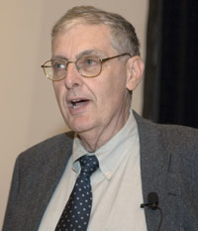
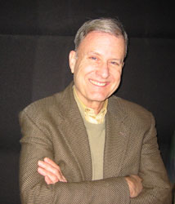
Topic 1:
The Power of The Situation
Classic issue in social psychology:
Is behavior due to individual differences
(personality) or situational influences?
e.g. Ross & Nisbett (1991) The Person and the Situation: Perspective of Social Psychology
Lee Ross
Richard Nisbett
PSYCO 241, Masuda

Slide 9
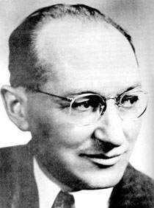
Lewin’s Field Theory
- Lewin was the founder of modern social psychology
- fled Nazi Germany, was a Gestalt
psychologist
famous equation representing his field theory:
B = f (p x s) [Behavior is a function of the person and the situation]
Kurt Lewin
PSYCO 241, Masuda

Slide 10


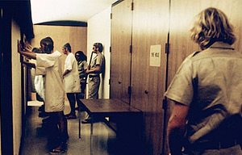
The Stanford Prison Experiment
Philip Zimbardo
PSYCO 241, Masuda

Slide 11
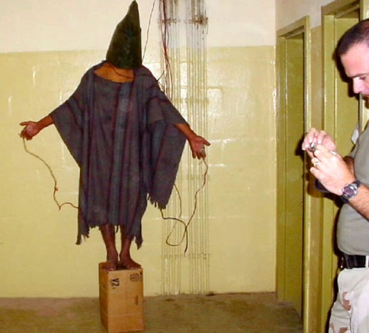
The Abu Ghreib
PSYCO 241, Masuda

Slide 12
The Fundamental Attribution Error (FAE)
Our Judgment is not always accurate!
The FAE: the failure to recognize the
importance of situational influences on
behavior, together with the tendency to
overemphasize the importance of
dispositions or traits on behavior
e.g. Ross et al. (1977) Game Show Experiment
Lee Ross
PSYCO 241, Masuda

Slide 13

Basketball Players
PSYCO 241, Masuda

Slide 14
Topic 2: The Role of Construal
People often think about, perceive, or ‘construe’ the same stimulus in different ways. If we are to predict behavior in a given situation, we need to understand how an individual construes the situation.
PSYCO 241, Masuda

Slide 15
Interpreting Reality
Gestalt Psychology - based on the German word,
Gestalt, meaning “form”, this approach stresses the
fact that objects are perceived not by means of some
automatic registering device but by active, usually
unconscious, interpretation of what the object
represents as a whole
PSYCO 241, Masuda

Slide 16
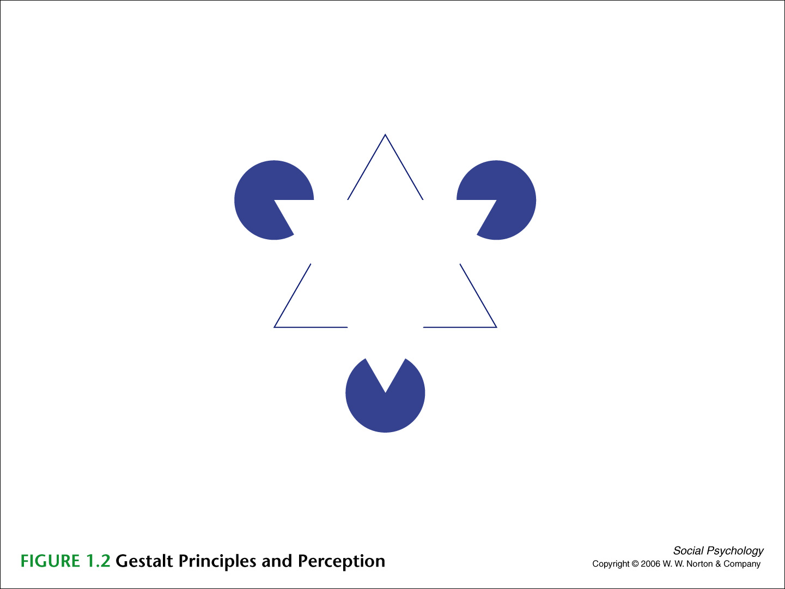
PSYCO 241, Masuda

Slide 17
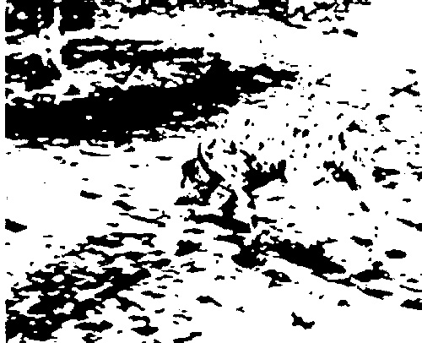
What do you see?
PSYCO 241, Masuda

Slide 18
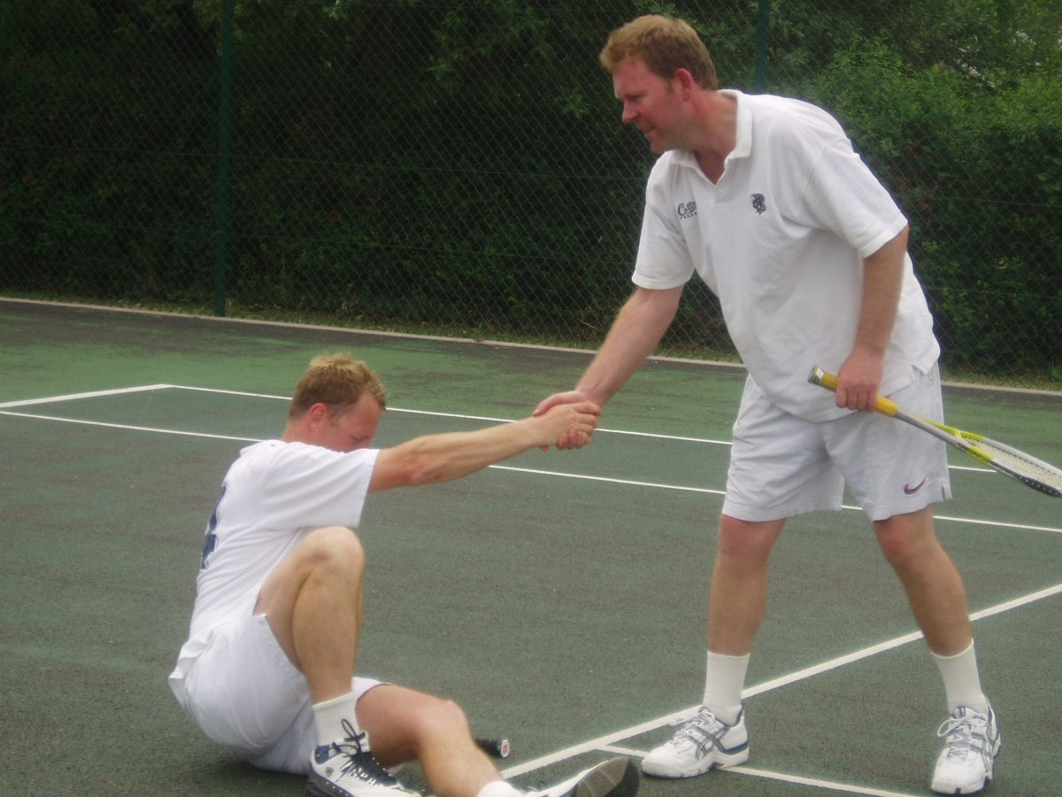
Helping Behavior
He is a gentle man!
He is a Machiavellian!
PSYCO 241, Masuda

Slide 19
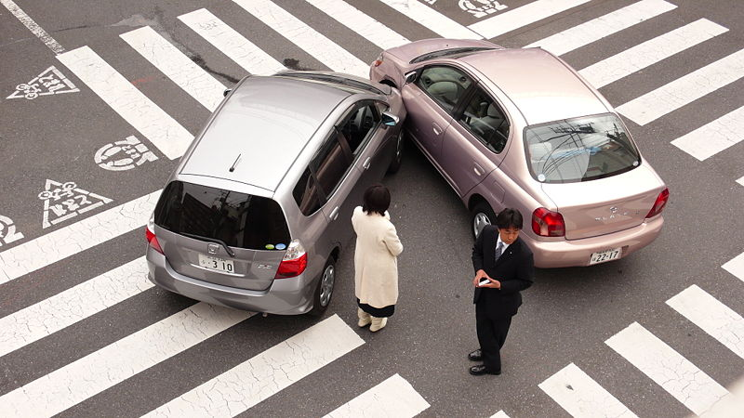
A Car Accident
This is her fault!
This is his fault!
PSYCO 241, Masuda

Slide 20
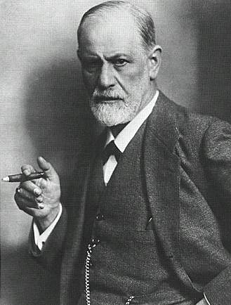
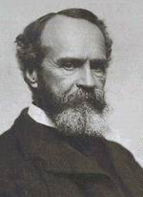
Topic 3: Automatic and Controlled Processing
Sigmund Freud
William James
Unconscious Processes
PSYCO 241, Masuda

Slide 21

The Implicit Prejudice
The mind processes information in two ways in a social situation. One is an automatic, unconscious, often emotional reaction. The other is conscious, systematic, and likely to be governed by careful thought.
e.g. Devine’s (1989a, 1989b) research
on prejudice.
Survey Data → No Prejudice
Actual Behavior → Negative towards the target
Patricia Devine
PSYCO 241, Masuda

Slide 22
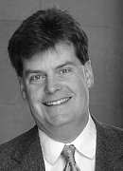
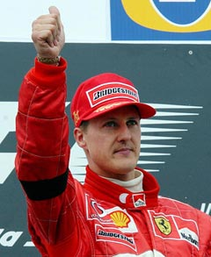
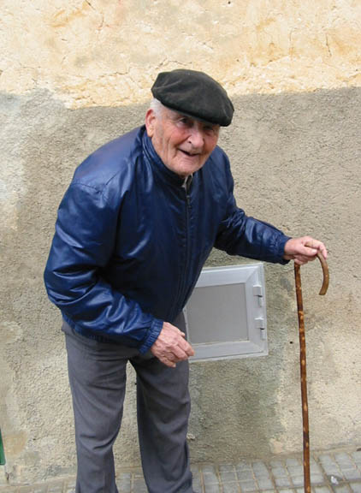
2. Functions of Unconscious Processing
Priming Study:
The priming stimulus influence the participant’s behavior.
John Bargh
Start
Goal
PSYCO 241, Masuda

Slide 23
Two Distal Factors
Evolution - explaining commonalities in human behavior as due to adaptation / natural selection
Culture - attempt to understand the deep cultural differences that exist between societies, and how those differences influence behavior
PSYCO 241, Masuda

Slide 24
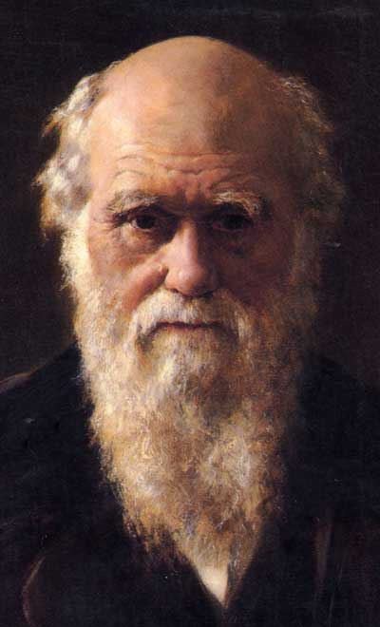
Distal Factor 1
Evolution and Human Behavior: How We Are The Same
Darwin assumed that Natural Selection is just as important for behavioral propensities as they are for biological characteristics.
Natural Selection: An evolutionary process that operates to mold animals and plants such that traits that enhance the probability of survival and reproduction are passed on to subsequent generations)
PSYCO 241, Masuda

Slide 25

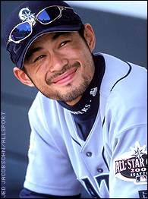
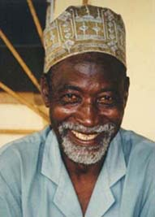

1. Human Universals
PSYCO 241, Masuda

Slide 26
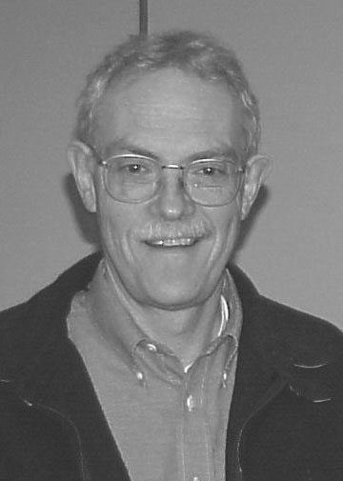
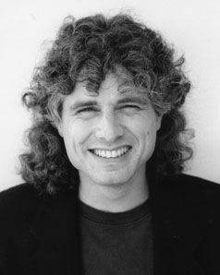
  2. Group Living, Language, and Theory of Mind
Theory of Mind (the understanding that
other people have beliefs and desires)
is the foundation of our social behavior.
e.g. studies of children with autism demonstrate the lack of theory of mind in these persons.
Human has evolved an innate ability to use languages.
Henry Wellman
Steven Pinker
PSYCO 241, Masuda

Slide 27
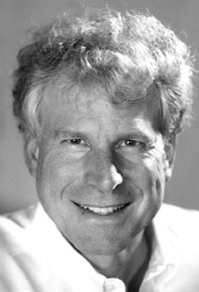
  3. Parental Investment
In virtually all mammalian species, males expend far less energy devoted to raising their offspring compared to females. This may help to understand universal tendencies related to child rearing, sex, and gender.
David Buss
PSYCO 241, Masuda

Slide 28
  4. Criticisms against the Evolutionary Perspective
Just-so-story
Political misuse
Naturalistic Fallacy: The way things are, are the way they should be.
It should be noted that some people mistake evolutionary accounts for behavior as suggesting that ‘biology is destiny.’ This is not true. We are predisposed for plenty of various behaviors, but those may often never arise.
PSYCO 241, Masuda

Slide 29
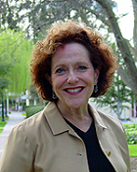

Distal Factor 2:
Culture and Human Behavior:
How We Are Different
1. Cultural Differences in Self-Definition
• Independent (individualistic) vs. Interdependent (collectivistic) cultures
Hazel Markus & Shinobu Kitayama
PSYCO 241, Masuda

Slide 30
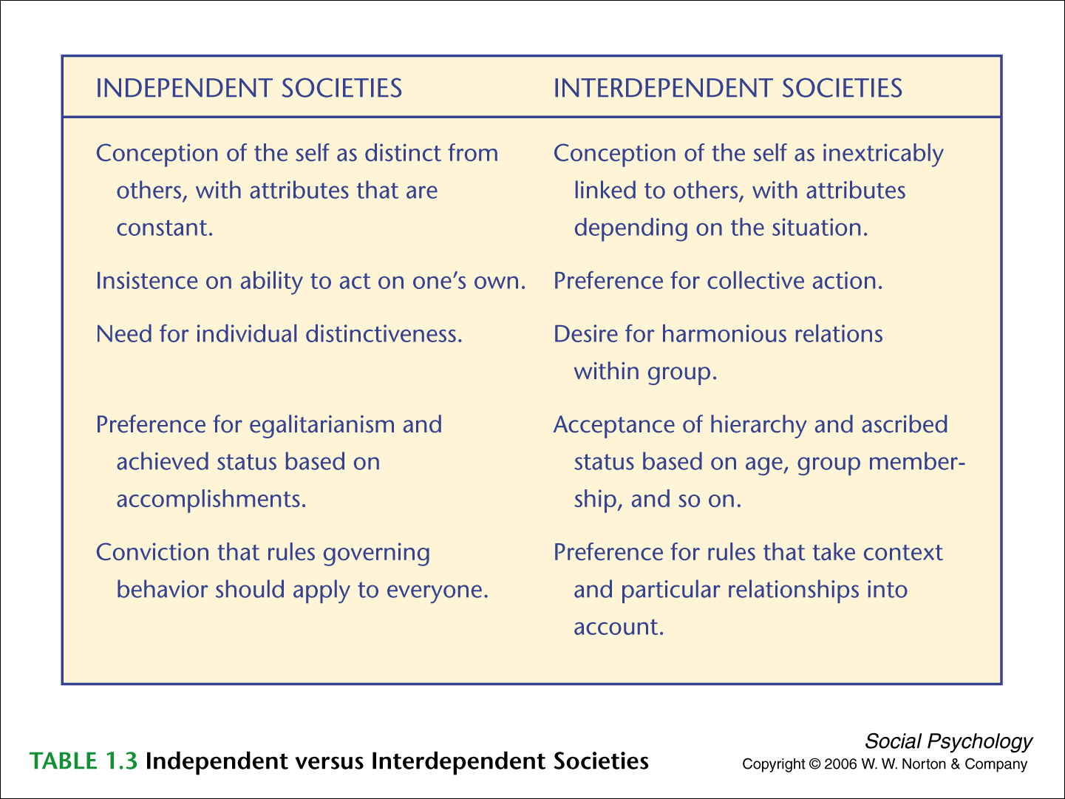
PSYCO 241, Masuda

Slide 31
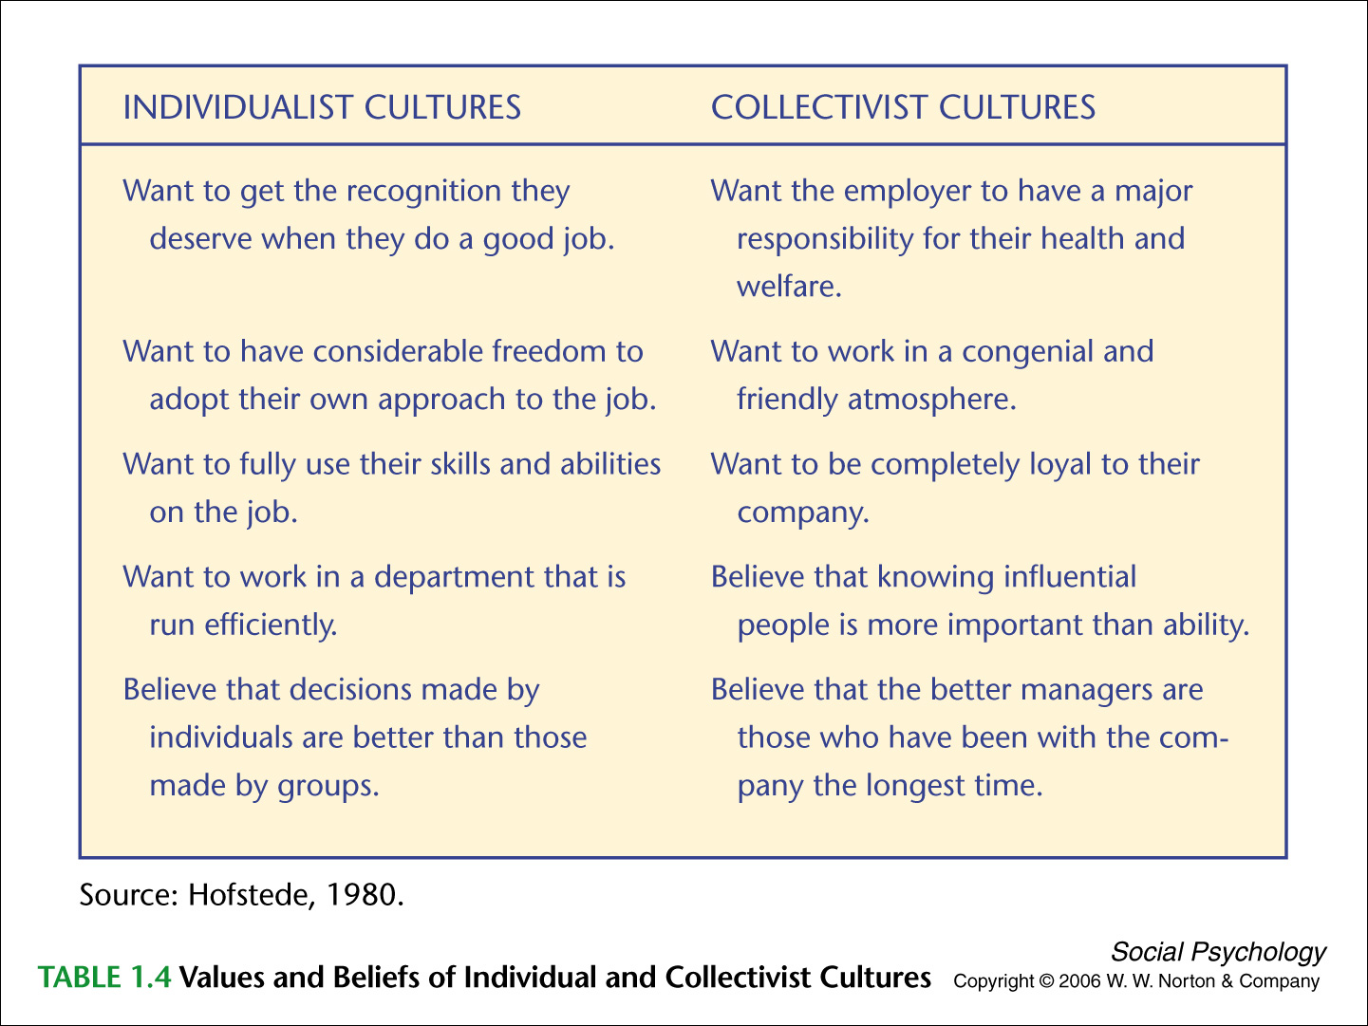
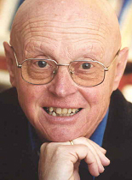
Geert Hofstede
PSYCO 241, Masuda

Slide 32

Individualism vs. Collectivism
PSYCO 241, Masuda

Slide 33
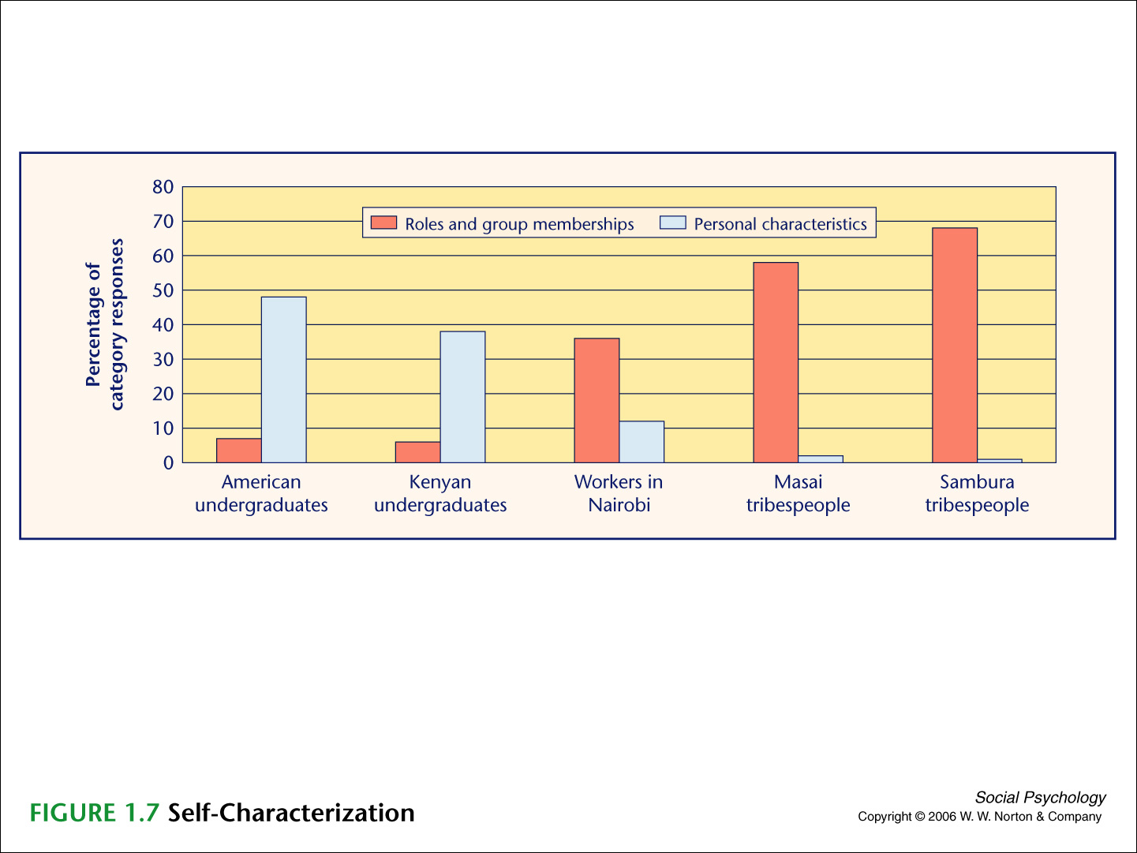
  Causes of Cultural Variation in Human Behavior: Modernism
PSYCO 241, Masuda

Slide 34
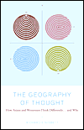
  Causes of Cultural Variation in Human Behavior: Philosophy
Western philosophers in general shared the idea that everything exists independently, and all the objects have their own characteristics inside of it.
Eastern philosophers in general shared the idea that everything is interrelated to each other, and that all the actions should be interpreted as a whole.
Richard Nisbett
PSYCO 241, Masuda

Slide 35
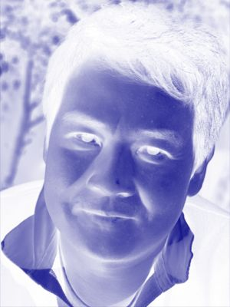

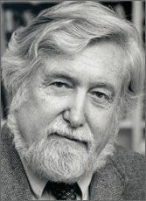
Taka’s Thoughts
The issue of Culture & Evolution is different from Nature vs. Nurture dichotomy.
As Clifford Geertz put it, Culture has helped human evolution, human evolution has been a necessary factor for cultural development.
PSYCO 241, Masuda

Slide 36
Summary of Today’s Lecture
Social Psychology is the research field that investigates human thoughts, emotions, and behaviors in a social settings
Various Researchers have attempted to explain the underlying processes of social phenomena
Two distal factors of social behavior: Evolution and Culture has been discussed by Evolutionary psychologists and Cultural Psychologists
PSYCO 241, Masuda

