Slide 1

PSYCO 241 Social Psychology
Chapter 3: The Social Self (1)
Takahiko Masuda, Ph.D
Department of Psychology
University of Alberta
PSYCO 241, Masuda

Slide 2
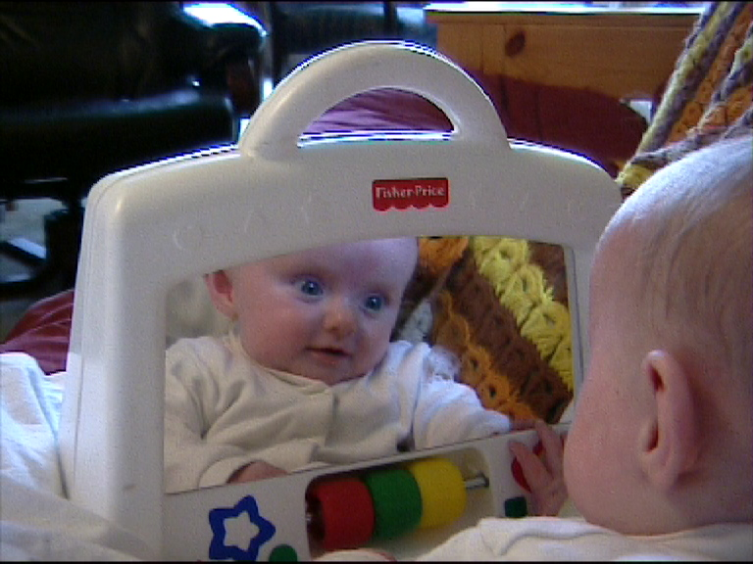
Today’s Plan
The Self and the Society
The Evolutionary Perspective
The Cultural Perspective
  Theory of Mind
  Joint Attention
PSYCO 241, Masuda

Slide 3
The Self?
“The self” has a long and controversial history in psychology. Some eras, such as our own, exalt it to a central position in personality and social psychology, whereas others relegate it to the realm of the unobservable, unknowable, and scientifically unthinkable.” Westen, 1992, p.1
PSYCO 241, Masuda

Slide 4
An Example of Self-Description
I guess I don’t really feel like I have had very many positive academic experiences…I’ve found a lot of the materials very difficult… the worse moment I can think of was my French final; I went completely blank at the start…I haven’t made many new friends since I got to the school. Mostly, I have to rely on the people that I knew before….
PSYCO 241, Masuda

Slide 5
The Self and The Society
Social surroundings affect self-awareness.
  Taka felt uncomfortable when he was at the first parental meeting.
Self-Interest colours social judgment.
  Two Canadian Nobel Prize Winners fought against each other.
Self-Concern motivated social behaviour.
  In Academia vs. with gang members
PSYCO 241, Masuda

Slide 6

The Self and The Society
Self-Concept
Who am I?
Self-Esteem
My sense of
self-worth
Social Self
My role as a student,
family member, and
friend; my group
identity
Self-Knowledge
How can I explain
and predict myself?
PSYCO 241, Masuda

Slide 7

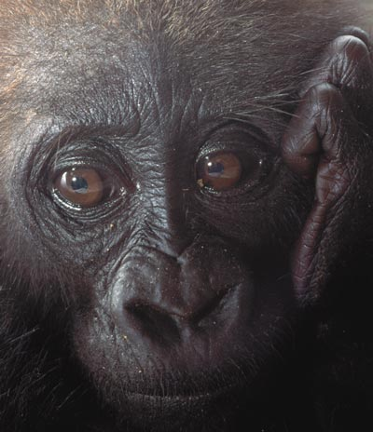
Evolutionary Aspects of the Self
The Symbolic Self in an Evolutionary Context
All species have the capacity to distinguish between the ___________ (the self) and the ___________
But, self-awareness or self-consciousness is presumably limited to the ___________
PSYCO 241, Masuda
PSYCO 241, Masuda

Slide 8
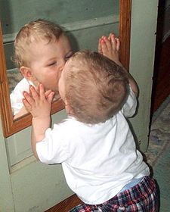
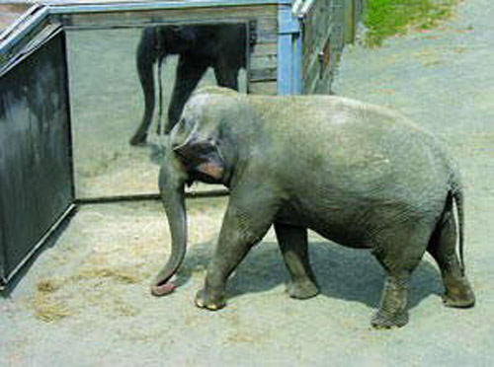
Evolutionary Aspects of the Self
The ______ test, The _____
__________ test
Two-year old toddlers and most primates, and large animals _________ a post-it on their forehead.
Experienced chimps use the mirror to ________________
Dogs and Cats typically ________ their image in a mirror.
PSYCO 241, Masuda
PSYCO 241, Masuda

Slide 9

Evolutionary Aspects of the Self
Sedikides & Skowronski
Our central thesis is that the symbolic self is a broad-based capacity that was selected and distributed in the human population because of its high ________ significance.
PSYCO 241, Masuda
PSYCO 241, Masuda

Slide 10
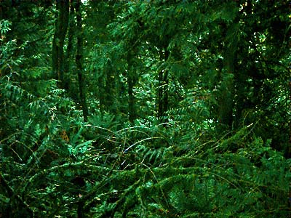
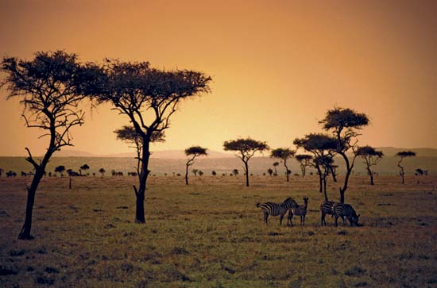
Evolutionary Aspects of the Self
Movement from forest to savanna
PSYCO 241, Masuda
PSYCO 241, Masuda

Slide 11
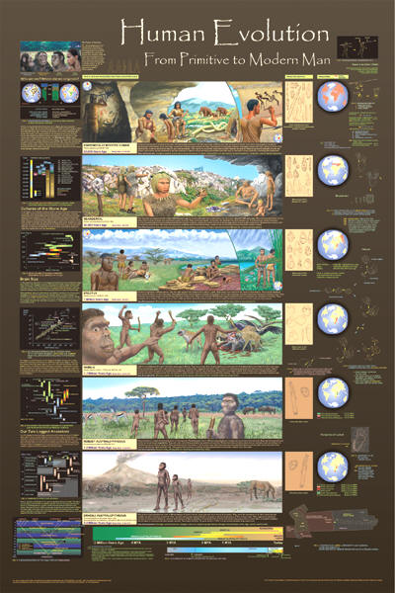
Evolutionary Aspects of the Self
Creation of a _____ culture
The development of cognitive processes (symbols and language) to acquire food and protect from predators
Adaptive values of forming a group
PSYCO 241, Masuda
PSYCO 241, Masuda

Slide 12
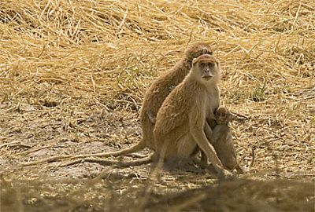
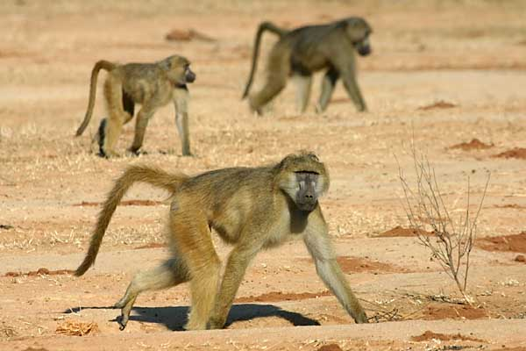
Evolutionary Aspects of the Self
Patas Monkeys
Baboons
PSYCO 241, Masuda
PSYCO 241, Masuda

Slide 13
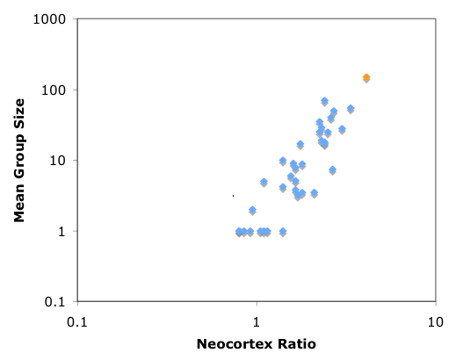
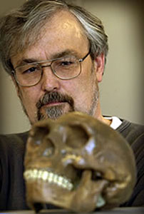
Social Brain Hypothesis
Robin Danbar
Primate brain evolution appears to be largely driven by their _______________(e.g. living with more than _____ individuals).
PSYCO 241, Masuda

Slide 14
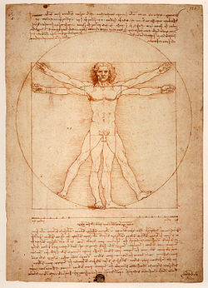
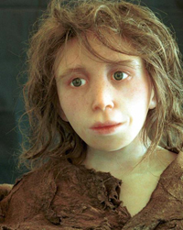
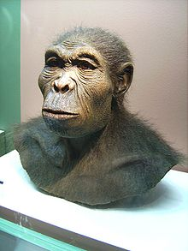
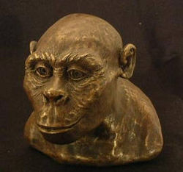
Evolutionary Aspects of the Self
The concept of symbolic self should be a universal, part of our evolutionary heritage.
PSYCO 241, Masuda
PSYCO 241, Masuda

Slide 15
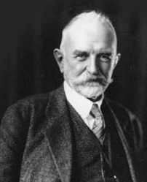
Cultural Aspects of the Self
“I and the me”
the 'me' is the ______ aspect of the person. It is what is learned in interaction with others and (more generally) with the environment. This includes both knowledge about that __________ (including society), but also about who he or she is: his or her ‘_____________'.
George H Mead
Oct 14, 2008
PSYCO 241, Masuda
PSYCO 241, Masuda

Slide 16

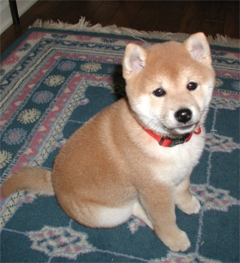

I and the me
Animal’s way
Action
Reaction
Reaction
Oct 14, 2008
PSYCO 241, Masuda
PSYCO 241, Masuda

Slide 17


I and the me
General Others
Human’s Way
The “Me” part of self
The “I” part of self
Reaction
The “I” part of self
YOU
YOUR FRIEND
I part and Me part are both symbolic
PSYCO 241, Masuda
PSYCO 241, Masuda

Slide 18
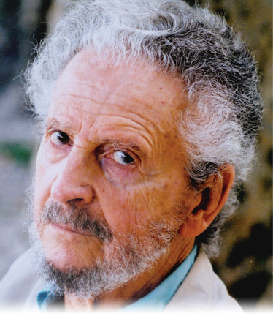
  2. Group Living, Language, and Theory of Mind
Premack & Woodruff’s article titled "Does the chimpanzee have a theory of mind?" (1978)
Theory of Mind - the ability to attribute ____________—beliefs, intents, desires, pretending, knowledge, etc.—to oneself and others and to understand that others have beliefs, desires and intentions that are different from one's own.
David Premack
PSYCO 241, Masuda
PSYCO 241, Masuda

Slide 19
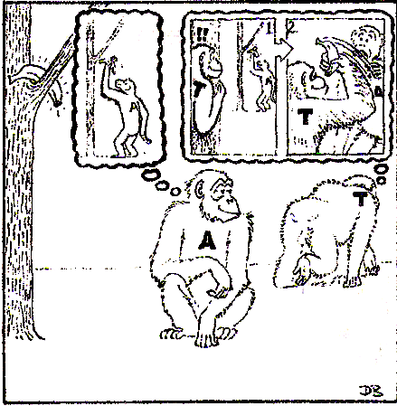
Theory of Mind
Chimpanzees are able to _______ other group members (especially those who are stronger than them).
e.g. If A does not move, T cannot know about the location of banana. So, A can take it later.
Oct 14, 2008
PSYCO 241, Masuda
PSYCO 241, Masuda

Slide 20
  The False Belief Task
Wimmer, H., & Perner, J. (1983).
The false belief -- to recognize that others can have _______ about the world that are wrong.
The false belief task - the task which measure one’s level of understanding that
people’s beliefs are based on their knowledge,
mental states can differ from reality,
people’s behavior can be predicted by their mental states.
Oct 14, 2008
PSYCO 241, Masuda
PSYCO 241, Masuda

Slide 21
The False Belief Task
Sally puts her ball under the light blue box.
Sally
You
PSYCO 241, Masuda
PSYCO 241, Masuda

Slide 22
The False Belief Task
Then, Sally leaves. Meanwhile, Ann picks up her ball under the light blue box
Sally
Ann
You
PSYCO 241, Masuda
PSYCO 241, Masuda

Slide 23
The False Belief Task
And, Ann puts the ball under the light yellow box.
Ann
You
PSYCO 241, Masuda
PSYCO 241, Masuda

Slide 24
The False Belief Task
Question: Which Box will Sally Open?
Sally
?
You
Oct 14, 2008
PSYCO 241, Masuda
PSYCO 241, Masuda

Slide 25
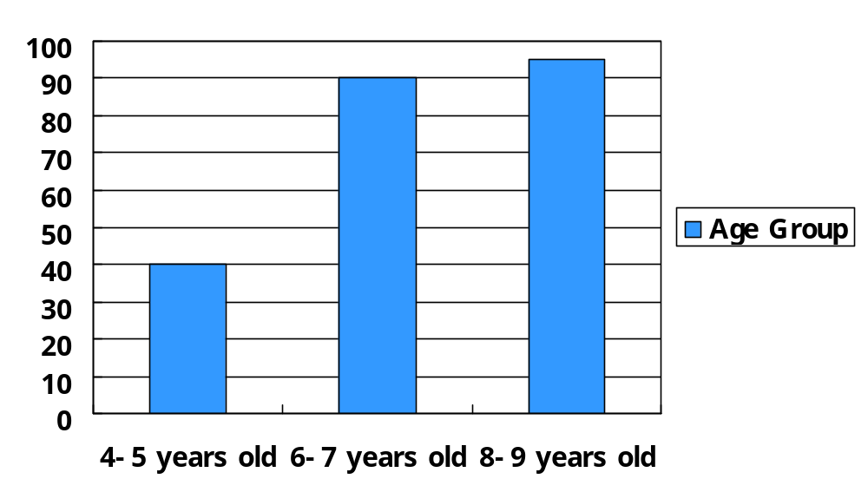
The False Belief Task
Children over 5 years old tend to say “Sally opens the light blue box”
Children under 5 years old tend to say “Sally opens the YELLOW box.”
Oct 14, 2008
PSYCO 241, Masuda
PSYCO 241, Masuda

Slide 26
Autism & T of M
Mind-Blindness: Lack of Perspective Taking
These Individuals who experience a theory of mind deficit
(1) have difficulty determining the _______ of others
(2) lack understanding of how their behavior affects ________
(3) have a difficult time with social __________.
These are some of symptoms of autistic children.
PSYCO 241, Masuda
PSYCO 241, Masuda

Slide 27
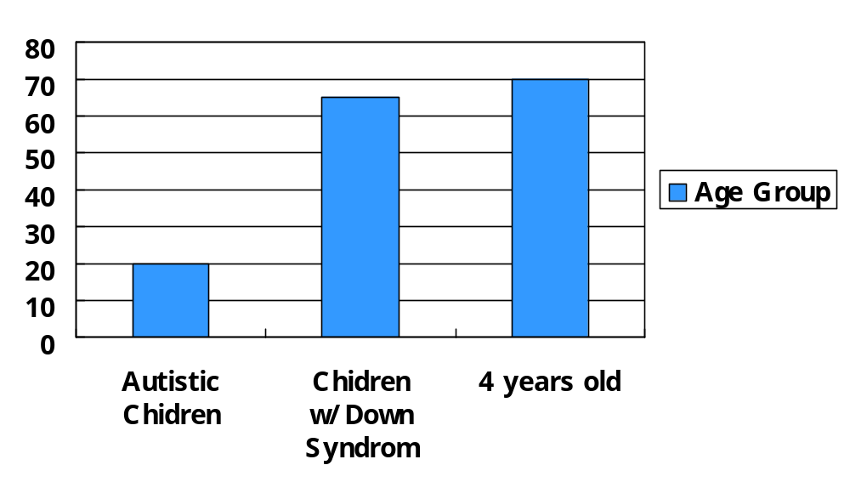
Autism & T of M
Autistic Children showed difficulty to correctly answer this task, indicating their lack the TofM (Baron-Cohen, 1985)
PSYCO 241, Masuda
PSYCO 241, Masuda

Slide 28
Autism & T of M
A Pretend Play: children with autism show extreme deficits in pretend play (Leslie).
A Social-Affective skill: a person with _______ deficits in theory of mind result from a distortion in understanding and responding to _________ (Hobson).
PSYCO 241, Masuda
PSYCO 241, Masuda

Slide 29
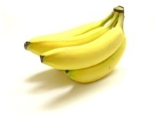
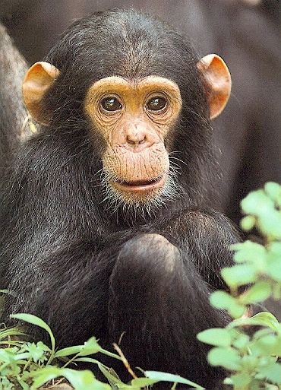

Primates & T of M
Other Primates are said to lack these abilities
They requests a hidden food to experimenters indiscriminately (Povinelli et al).
Experimenter 2
Experimenter 1
Experimenter 3
PSYCO 241, Masuda
PSYCO 241, Masuda
Experimenter 4

Slide 30
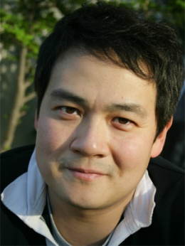

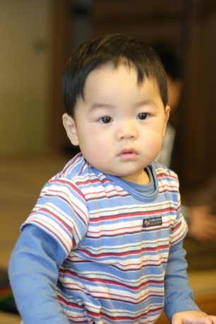

Primates & T of M
Call & Tomasello (2008)
Chimpanzees understand others in terms of _____________ psychology, as oppose to human like ___________ psychology
Intention
Desire
Reaction
PSYCO 241, Masuda
PSYCO 241, Masuda

Slide 31

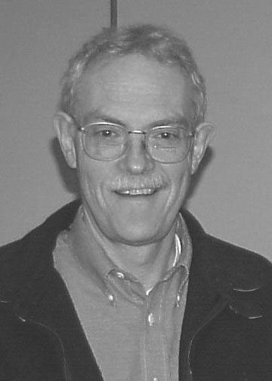
Is T of M innate?
The Innate hypothesis (Baron-Cohen)
The Leaning Hypothesis (Henry Wellman)
Baron-Cohen
Wellman
PSYCO 241, Masuda
PSYCO 241, Masuda

Slide 32

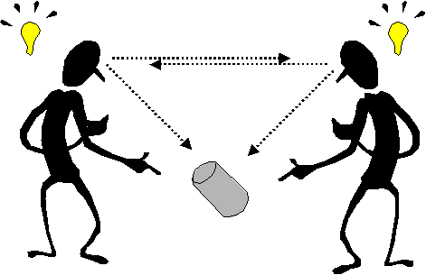
Taka’s Thoughts
Whether the self proceeds the emergence of symbols, or symbols proceed the emergence of the self is still a controversial issue.
It will be a central part of elucidating human sociality.
PSYCO 241, Masuda

Slide 33
Summary of Today’s Lecture
The issue of why human beings have developed a sense of self has been examined by both evolutionary and cultural psychologists
Evolutionary psychologists attempt to identify determinants for human beings to develop the self-concept.
Cultural psychologists maintain the theory of mind is one of key factors for us to see the world symbolically.
PSYCO 241, Masuda

