Slide 1

ADEFS-I
Nano Satellite Platforms
Eng. Marcelo dos Anjos
E12347-teachers@esp.mit.edu
marcelo@airspacedefens.org
UNA – National University of Asuncion

Slide 2
Main Problems.
• Temperature.
• Radiation.
• Radio Transmitter.
2/14

Slide 3
Steps applied in the present work
• ADEFS-I.
• IOT.
• Use Case Study.
• Implementation 1 , 2 , 3.
• Conclusion.
• The Future.
3/14

Slide 4
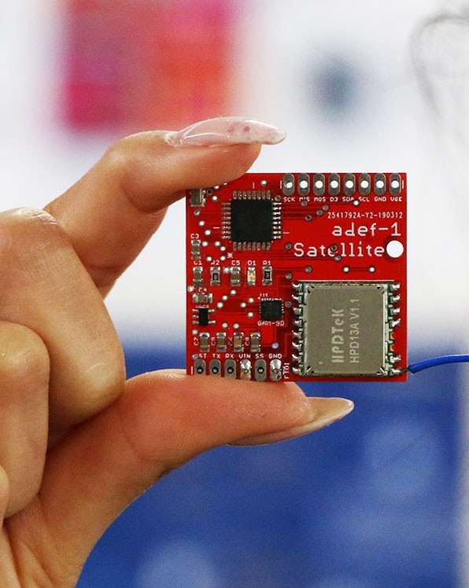
ADEFS-I
Fig. 1 ADEFS-I
4/14

Slide 5
I O T (Internet Of Things)
The spread of IoT technologies in various industries, such as agriculture and mining, reveals problematic data transfer in geographically remote locations due to lack of network infrastructure. Various technologies such as LPWAN, (Low Power Wide Area Network), offer extended communication ranges, satellite networks are the only option available to transmit IoT data to a central server point.
5/14

Slide 6
Use Case Study
CubeSat Solutions...
6/14

Slide 7
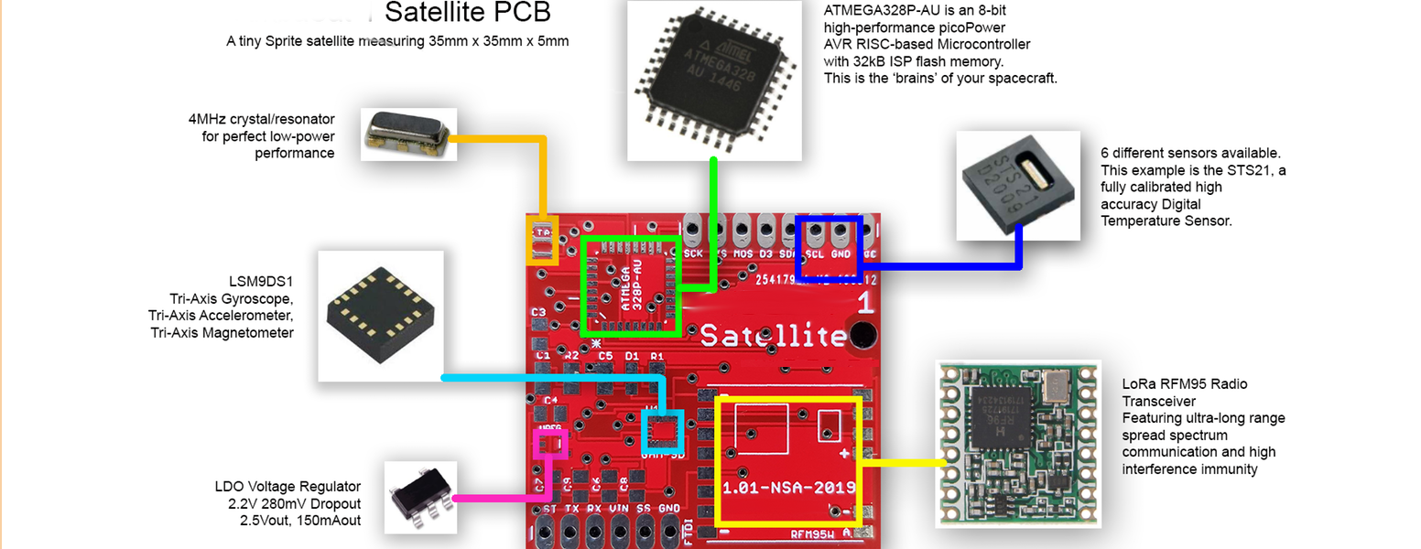
Implementation - 1
ADEFS-I is a Nano satellite project, focused on presenting the theoretical bases for development. Completely built by yourself.
Fig. 2 Main Board
7/14

Slide 8
Implementación - 2
Experimental tests by phases of technologies for the launch, and the use of Nano satellite with different modifications, will confirm the technical feasibility of the project, with given weight and dimension characteristics, such as the correction of structural and technological solutions.
Thus, as the design methods and circuits used, to ensure durability against radiation.
8/14

Slide 9
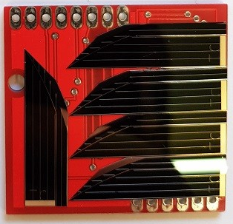
Implementation - 3
Fig. 3
Solar Panel
7/11
9/14

Slide 10
Conclusion
One possible implementation of a Nanosatellite with an ultra-low-power, battery-operated, long-life, and long-range transceiver demonstrates the feasibility of low-cost, long-life devices connected to an M2M network, based on a bi-directional satellite of low orbit, in an IOT network.
Launch with Forecast to February / March 2021.
10/14
8/11

Slide 11
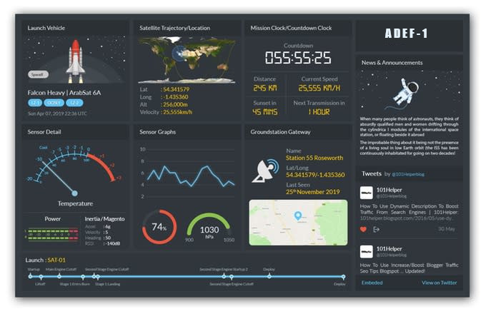
The Future
Fig. 4 Dashboard from the Base Station
11/14

Slide 12
...
Thank You !!!
Eng. Marcelo dos Anjos
marcelo@airspacedefense.org
E12347-teachers@esp.mit.edu
12/14

Slide 13
References
[1] B.F. Nesterov, V.M. Chmyrev, V. S. A. A., 2017.AVISSpace Experiment: Testing of Technologies for the Development and Use of Multifunction nano/picosatellitePlatforms. Nauka i Tekhnologicheskie Razrabotki, Ko-rolev, 141070 Russia.
[2] Ludek Dud acek Ales Voborn k Ji rMasopust, A., 2017.PilsenCUBE-II Measurement Board as interface for student’s experiments. Pilsen, Czech Republic.
[3] Ian F. Akyildiz, A. K., 2018. “The internet of space things/cubesats: A ubiquitous cyber-physical system for the connected world”. Computer Networks , S1389-1286(18)31419-1.
[4] L. Ouvry, D. Lachartre, C. B. F. L. F. D., 2018. An ultra low power 4.7ma-rx 22.4ma-tx transceiver circuit in 65nm cmos for m2m satellite communications. IEEE Transactions on Circuits and Systems II, 10.1109 TC-SII.2018.2820806.
[5] Syed Muhammad, Arsalan Bashir Ghulam Abbas, M. R.M. K. K., ed., 2017. Design and Performance Evaluation of Low Cost, Medium Resolution Imaging Payload for Nanosatellites. SUPARCO Karachi, Pakistan.
[6] Carlos L. G. Batista, Eliane Martins Maria de Fatima, M.-F., 2018.“On the use of a failure emulator mechanism at nanosatellite subsystems integration tests”. IEEE.
[7] van der Kouwe, C. M. F. N. M. M. A. P. E., and Wang, P.“, 2018.”. In Towards Affordable Fault-Tolerant Nanosatellite Computing with Commodity Hardware, IEEE. 2018 IEEE 27th Asian Test Symposium.
[8] Ivan I. Lysogor Leonid S. Voskov, S. G. E., 2018. “Survey of Data Exchange Formats for Heterogeneous LPWAN-Satellite IoT Networks”. Master’s thesis, 2018 Moscow Workshop on Electronic and Networking Technologies (MWENT), IEEE.
[9] Yaseen Zaidi, R. v. Z., 2017. A low cost testbed and test-design methodology for nanosatellite sub-/systems. IEEE Africon 2017 Proceedings.
13/14

Slide 14

Contact
== All CODES in
https://github.com/splash2018
14/14

