Slide 1
Arduino : Introduction & Programming

Slide 2
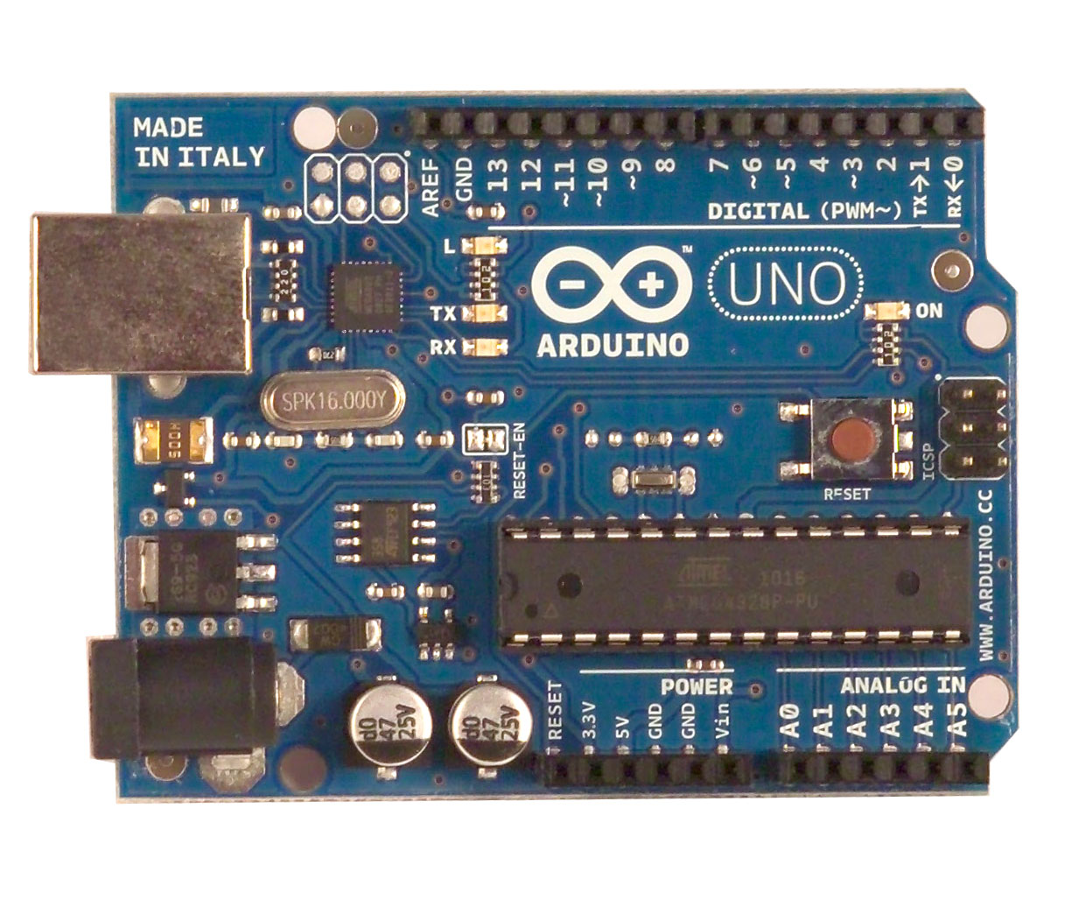
What is an Arduino ?
Open Source electronic prototyping platform based on flexible easy to use hardware and software.

Slide 3
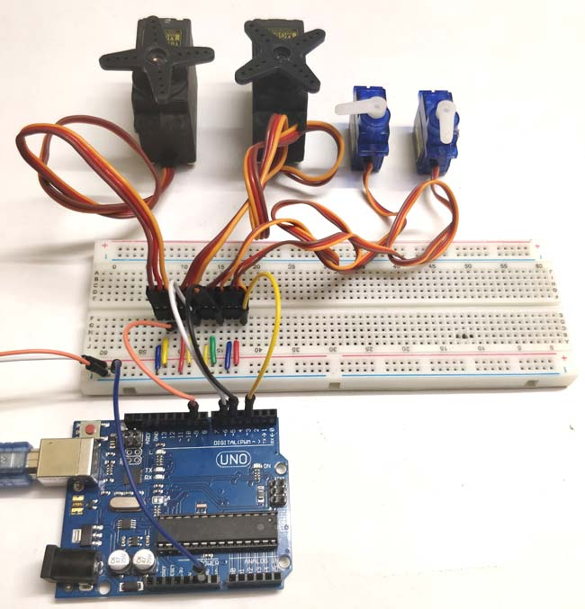
Uses of Arduino

Slide 4
Uses of Arduino
Servo motors are available at different shapes and sizes. A servo motor will have mainly there wires, one is for positive voltage another is for ground and last one is for position setting. The RED wire is connected to power, Black wire is connected to ground and YELLOW wire is connected to signal.
Simply speaking the control electronics adjust shaft position by controlling DC motor. This data regarding position of shaft is sent through the SIGNAL pin. The position data to the control should be sent in the form of PWM signal through the Signal pin of servo motor.
The frequency of PWM (Pulse Width Modulated) signal can vary based on type of servo motor. The important thing here is the DUTY RATIO of the PWM signal. Based on this DUTY RATION the control electronics adjust the shaft.

Slide 5
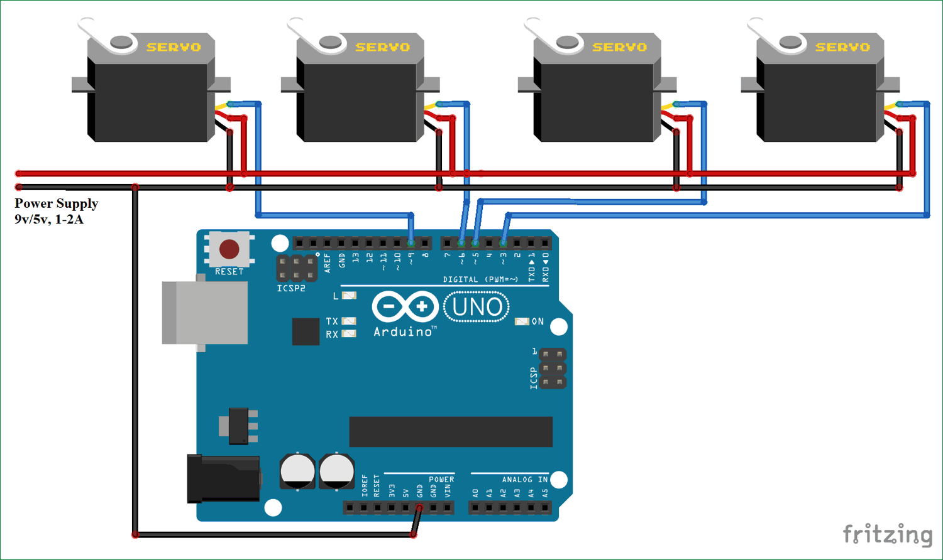
Uses of Arduino

Slide 6
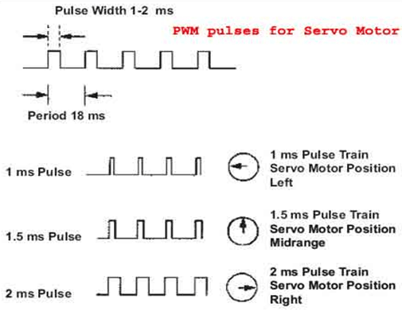
Uses of Arduino

Slide 7
Getting started with Programming

Slide 8
Bare minimum code
void setup() { // put your setup code here, to run once:
}
void loop() { // put your main code here, to run repeatedly:
}

Slide 9
Bare minimum code
setup : It is called only when the Arduino is powered on or reset. It is used to initialize variables and pin modes
loop : The loop functions runs continuously till the device is powered off. The main logic of the code goes here. Similar to while (1) for micro-controller programming.

Slide 10
PinMode
A pin on arduino can be set as input or output by using pinMode function.
pinMode(13, OUTPUT); // sets pin 13 as output pin
pinMode(13, INPUT); // sets pin 13 as input pin

Slide 11
Reading/writing digital values
digitalWrite(13, LOW); // Makes the output voltage on pin 13 , 0V
digitalWrite(13, HIGH); // Makes the output voltage on pin 13 , 5V
int buttonState = digitalRead(2); // reads the value of pin 2 in buttonState

Slide 12
Analog to Digital Coversion
What is analog ?
It is continuous range of voltage values (not just 0 or 5V)
Why convert to digital ?
Because our microcontroller only understands digital.

Slide 13
ADC in Arduino Uno

Slide 14
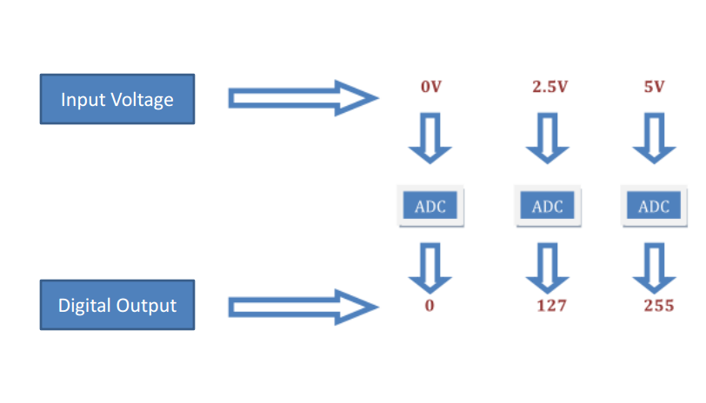
Converting Analog Value to Digital

Slide 15
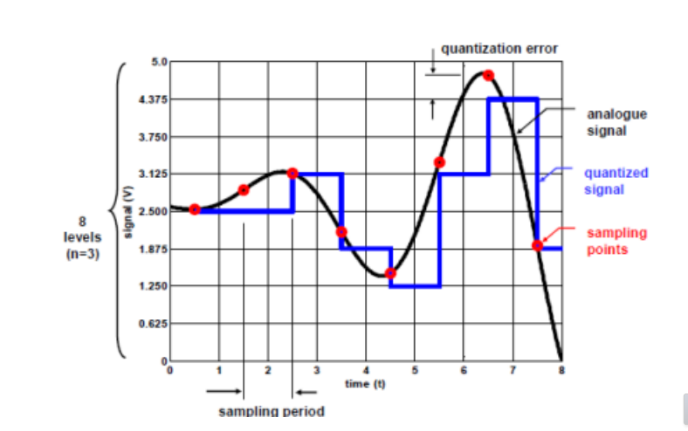
Quantanization the signal

Slide 16
ADC in Arduino
The Arduino Uno board contains 6 pins for ADC
10-bit analog to digital converter
This means that it will map input voltages between 0 and 5 volts into integer values between 0 and 1023

Slide 17
Reading/Writing Analog Values
analogRead(A0); // used to read the analog value from the pin A0
analogWrite(2,128);

Slide 18
ADC Example
// These constants won't change. They're used to give names to the pins used: const int analogInPin = A0; // Analog input pin that the potentiometer is attached to const int analogOutPin = 9; // Analog output pin that the LED is attached to int sensorValue = 0; // value read from the pot int outputValue = 0; // value output to the PWM (analog out) void setup() { // initialize serial communications at 9600 bps: Serial.begin(9600); } void loop() { // read the analog in value: sensorValue = analogRead(analogInPin); // map it to the range of the analog out: outputValue = map(sensorValue, 0, 1023, 0, 255); // change the analog out value: analogWrite(analogOutPin, outputValue); // print the results to the serial monitor: Serial.print("sensor = " ); Serial.print(sensorValue); Serial.print("\t output = "); Serial.println(outputValue); // wait 2 milliseconds before the next loop // for the analog-to-digital converter to settle // after the last reading: delay(2); }

Slide 19
Servo Example
#include <Servo.h>
Servo servo1;
Servo servo2;
Servo servo3;
Servo servo4;
int i = 0;
void setup() {
servo1.attach(3);
servo2.attach(5);
servo3.attach(6);
servo4.attach(9);
}
void loop() {
for (i = 0; i < 180; i++) {
servo1.write(i);
servo2.write(i);
servo3.write(i);
servo4.write(i);
delay(10);
}
for (i = 180; i > 0; i--) {
servo1.write(i);
servo2.write(i);
servo3.write(i);
servo4.write(i);
delay(10);
}
}

