Slide 1



CONFERENCE TALK · 45 MINUTES
Splitting Trust, Not Just Keys
Threshold recoverability by construction, not by policy
John Davis · Venue and date TBD
github.com/splashd1/shardic-crypt
Notes:
[0:00] Title. Introduce yourself in one sentence. Promise: a live demo, the math from first principles, and where it goes next — including human-AI oversight.

Slide 2



THE HOOK
It only took one
1
Insider
Trusted, authorized, acting alone.
Credential theft
compromised credential, coerced admin, or rogue insider — that's all a conventional key-custody design needs to fail.
One account, full access.
Coercion
Policy said "no one does this alone." Nothing in the cryptography agreed.
One person under pressure.
SHARDIC · Conference Talk · v4.1.1
2
Notes:
[0:00–0:04] Frame via a real incident class — insider risk, one compromised credential — not abstractly. Pick a recent public example suited to the audience. Point: every one of these had policy saying 'no one should do this alone.' Nothing in the crypto enforced it.

Slide 3
THE THESIS
Make "no single party can decrypt this alone" a mathematical fact — not a policy promise.
Encrypt once. Split the key into T shards. Any D recover it. Fewer than D hold zero information about it.
Notes:
The thesis in one slide. Pause here.

Slide 4



LIVE DEMO
Create 3-of-5. Recover with 3. Fail with 2.
One file
$ python3 vault_create.py --input demo/sample-secret \
--trustees 5 --threshold 3 --outdir ./v
[*] Split DEK into 5 shards, threshold 3
[*] Wrote vault container: pzzsrzg30y9z0pwv.krypt
$ python3 vault_recover.py v/*.krypt --outdir ./r \
--word <t1> --word <t3> --word <t5>
[+] Codeword accepted (1/3).
[+] Codeword accepted (2/3).
[+] Codeword accepted (3/3).
[*] Success.
$ diff -r demo/sample-secret r/sample-secret
Show the .krypt — no trustee map inside.
Any three, any order
Shuffle the codewords on purpose.
Wrong or too few
Rejected by the auth tag; nothing written.
SHARDIC · Conference Talk · v4.1.1
4
Notes:
[0:04–0:10] Switch to a real terminal — not slides. Create T=5, D=3 on demo/sample-secret; show the single .krypt file; recover with three codewords in shuffled order; show a mistyped codeword being rejected; show that two codewords never produce output. Finish with diff -r. Fallback: recorded run if venue AV fails.

Slide 5

FIRST PRINCIPLES · 1
The obvious answer is wrong
Chunks or XOR shares
What we want
Hide the key from anyone short of all pieces
Reconstruction needs every piece
Lose one trustee → key gone forever
Any D of T reconstruct
Fewer than D learn nothing
Lose up to T − D and still recover
That's a threshold scheme — and Adi Shamir solved it in 1979 with one fact from high-school algebra.
SHARDIC · Conference Talk · v4.1.1
5
Notes:
[0:10] Ask the room: how would you split a key among five people? Most will say chunks or XOR. Both are all-or-nothing — you can't ask for 'any 3 of 5'.

Slide 6
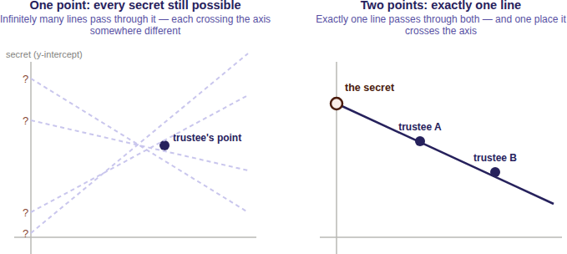
FIRST PRINCIPLES · 2
Two points fix a line
Secret = where the line crosses the axis.
One point: infinitely many lines. Every secret equally possible.
Two points: exactly one line, one crossing.
D points fix a curve of degree D − 1.
SHARDIC · Conference Talk · v4.1.1
6
Notes:
[0:11] The secret is where the line crosses the axis. One point: infinitely many lines, every secret possible. Two points: one line, one crossing. For D = 3, a parabola. For D, a degree D-1 curve.

Slide 7
FIRST PRINCIPLES · 3
Now make it precise
1
Random coefficients
f(x) = S + a₁x + … + a₍D−1₎x^(D−1)
f(0) = S # the secret
shard_i = (i, f(i)) # one per trustee
a₁ … a₍D−1₎ drawn uniformly at random
2
T distinct x-values
1 through T — never 0, that's the secret
Any D shards → Lagrange interpolation → evaluate at x = 0 → S.
3
Per byte of the DEK
32 independent polynomials over GF(256)
SHARDIC · Conference Talk · v4.1.1
7
Notes:
[0:13] Constant term is the secret; shards are points; Lagrange interpolation at x = 0 recovers it. Mirrors docs/sss_explained_for_shardic.md.

Slide 8
FIRST PRINCIPLES · 4
0 bits
is what D − 1 shards reveal about the secret. Every possible value fits them equally well.
No partial credit. No "getting warmer." No computational assumption for a quantum computer to erode — the information simply isn't there.
Notes:
[0:15] The key slide. Not 'hard to break' — nothing to break. Relevant to the post-quantum conversation: no computational assumption to erode.

Slide 9
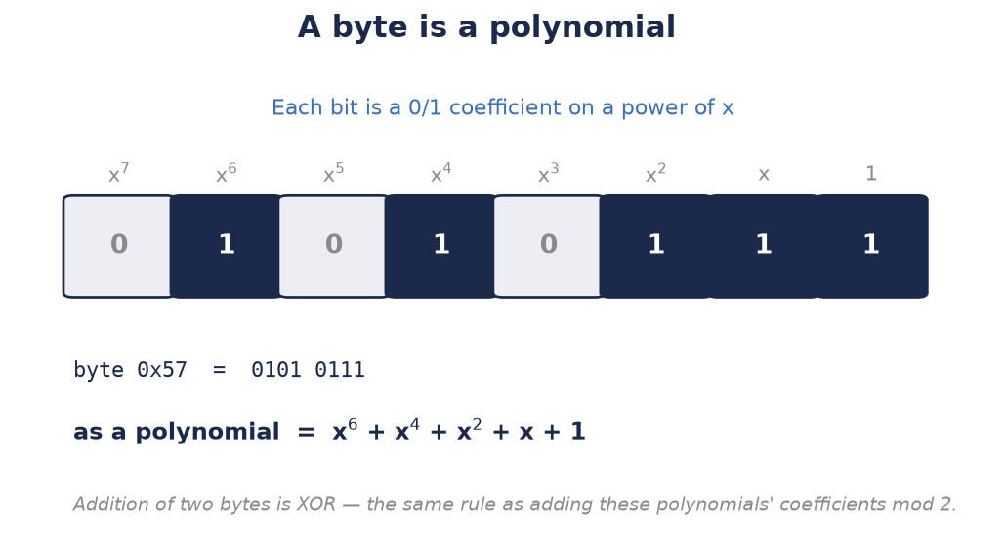
FIRST PRINCIPLES · 5
Why GF(256), in one slide
1 byte
= one field element. Exact arithmetic, no rounding.
0x11B
AES's own reduction polynomial, generator 3.
255
shards max — 0 is reserved for the secret.
SHARDIC · Conference Talk · v4.1.1
9
Notes:
[0:17] Reals bring fractions and rounding that corrupt the secret. GF(256): exact, one element per byte, AES's own field. The side effect: at most 255 shards — an operational ceiling that real deployments never approach.

Slide 10
FROM MATH TO A WORKING VAULT
Split the key, seal every shard, ship one file
1
2
3
4
5
Archive
Encrypt once
Split the key
Seal each shard
One .krypt
Pack the input into one uncompressed tar.
AES-256-GCM under a random 256-bit DEK.
Shamir splits only the 32-byte DEK into T shards.
Under its own shardic encryption key, e.g. codeword → Argon2id.
Header, metadata, ciphertext. Safe to share.
A raw shard is just data.
D raw Shamir points stored in the clear would rebuild the key with nobody's cooperation — so every shard is sealed before it's stored.
No map inside the file.
Records are opaque and shuffled. Recovery tries each codeword against every record; GCM's auth tag confirms the match.
SHARDIC · Conference Talk · v4.1.1
10
Notes:
[0:18] SSS never touches the bulk data — AES-256-GCM encrypts the archive once; Shamir splits only the 32-byte DEK. Then the step people skip: a raw Shamir point is just data, so D of them stored in the clear would rebuild the key with nobody's cooperation. Each shard is sealed under its own shardic encryption key — a codeword through Argon2id today, or a full-strength key by envelope. Finally, the .krypt file carries no trustee map: records are opaque and shuffled, and recovery tries every codeword against every record — the GCM auth tag confirms the match. With T in the tens that's instant, and the file reveals nothing about who holds what. This is what takeaway 2 means.

Slide 11
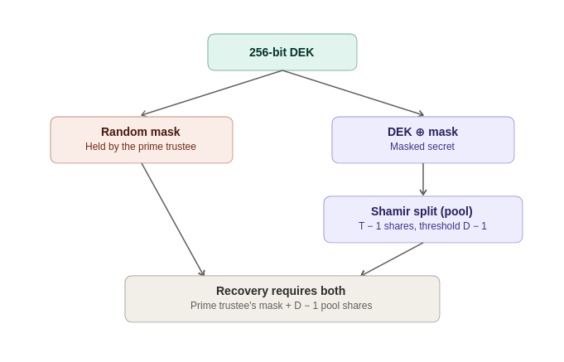
EXTENDING THE TEXTBOOK
shardic-prime: one trustee the math can't do without
mask = random bytes, len(DEK)
masked_secret = DEK XOR mask
pool_shards = split(masked_secret,
pool_threshold, pool_size)
DEK = reconstruct(pool_shards) XOR mask
Nothing new to trust
Each half keeps the information-theoretic guarantee. All pool shards without the mask rebuild only noise.
The mask is just a value — so hardware can hold it. Remember that for Level 3.
SHARDIC · Conference Talk · v4.1.1
11
Notes:
[0:20] Some roles must always sign off — an executor, a security lead. shardic-prime layers a one-time-pad mask over the ordinary split: the prime trustee holds the mask, the pool holds Shamir shards of the masked key. Every pool shard together still yields only random noise; the mask alone yields nothing. So the prime is mathematically essential, not just required by policy. Plant the payoff: the mask is just a value — nothing says a person has to hold it. Hold that thought for Level 3.

Slide 12
THE QUESTION YOU SHOULD BE ASKING
So is the real security just the codewords?
UNCONDITIONAL
COMPUTATIONAL
Key length & Shamir split
Each codeword
256-bit DEK, no known AES-256 shortcut
Below D: zero information
Raising T or D changes how many must collude
Only as strong as its guess space × KDF cost
Attacker cracks codewords one at a time
More trustees don't fix a weak codeword
Yes — the codeword is the floor. Default: 8 EFF words ≈ 103 bits, Argon2id at 256 MiB per guess. For high-assurance ceremonies, replace it with a full-strength random key delivered by shardic envelope — parity with the 256-bit DEK.
SHARDIC · Conference Talk · v4.1.1
12
Notes:
[0:22] Answer the challenge before someone asks it. The DEK and the Shamir split are effectively unconditional. Each codeword is only computationally strong — guess space times KDF cost — and a higher D doesn't compensate, because an attacker cracks codewords one at a time, never the set at once. Two knobs; neither substitutes for the other. And for high-assurance ceremonies you skip the codeword entirely. Numbers are on the backup slide if asked.

Slide 13
IMPLEMENTED VS. PROPOSED
Where the line is — stated plainly
RUNNING CODE
RUNNING CODE
DESIGN PROPOSAL
Level 1 · Personal utility
Level 2 · Shardic ceremony
Level 3 · SPAC
CLI + GUI, no server
Codewords + one .krypt file
shardic-prime mandatory trustee
Public-key-wrapped delivery
Keycloak-backed trustee selection
Automatic backfill on decline
Gate any consequential action
Bound to one Fielded Prime Element
Human-AI mutual oversight
Each level reuses the one below unchanged. Level 3 adds no new cryptography.
SHARDIC · Conference Talk · v4.1.1
13
Notes:
[0:24–0:25] Credibility: be explicit. Levels 1 and 2 are running code. Level 3 is a design proposal built on the same unmodified math.

Slide 14
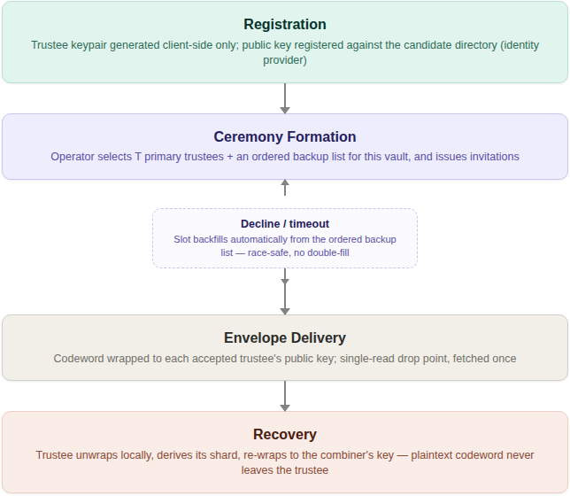
LEVEL 2 · RUNNING CODE
The ceremony: identity, custody, and math kept apart
1
Register
Trustees generate keypairs on their own devices. Keycloak handles identity — never keys.
2
Form
An operator picks T trustees plus ordered backups. Declines backfill automatically; the operator can't pick themselves.
3
Deliver
Each trustee fetches their own wrapped envelope, addressed by authenticated identity.
4
Recover
The combiner only ever sees unsealed shards — never a codeword.
A compromised identity provider can stall provisioning — it can't weaken D-of-T.
SHARDIC · Conference Talk · v4.1.1
14
Notes:
[0:25–0:27] What makes Level 2 more than a CLI. Registration: trustees come from a dedicated Keycloak group and generate their own keypairs on their own devices — the private key never touches a server shardic controls. Formation: an operator with the shardic-operator role picks T trustees plus an ordered backup list; declines and timeouts backfill automatically, race-safe; and the operator can't pick themselves. Delivery: each trustee fetches their own wrapped envelope, addressed by authenticated identity (a single-read drop point is designed but not built yet — say so if asked). Recovery: the combiner only ever receives unsealed shards, never a codeword. The organizing principle: a compromised identity provider or a stalled ceremony can block provisioning, but neither can weaken D-of-T.

Slide 15

WHERE IT GENERALIZES
From protected file to protected action
PT SPAC → CT SPAC
Fielded Prime Element
Old idea, new math
Any enabling value — a signing credential, a release-enable code — encrypted and split exactly like a file's key.
A hardware-sealed secret takes the prime trustee's slot. Copy the ciphertext elsewhere and a full quorum still fails.
Permissive Action Links and Two-Person Integrity, enforced by the math instead of procedure.
DEK = reconstruct_secret_with_prime(mask, pool_shards) # unmodified
CT_SPAC = AES-256-GCM(PT_SPAC, DEK) # unmodified
SHARDIC · Conference Talk · v4.1.1
15
Notes:
[0:27] The plaintext never had to be a file. A SPAC is any enabling value: a signing key, a release-enable code. The Fielded Prime Element reuses shardic-prime's mask so a copied CT SPAC plus a legitimate quorum still fails on the wrong hardware. Precedent: Permissive Action Links, Two-Person Integrity.

Slide 16
ONE VIGNETTE, END TO END
A high-value treasury wire, start to finish
1
2
3
4
5
Approve
Emplace
Operate
Convene
Arm
Controller validates the signing key and signs a commitment.
Wrap as CT SPAC; split across 5 officers + the HSM appliance.
Appliance holds only ciphertext — indefinitely.
3 of 5 respond; compliance authorizes; custodian turns the key.
DEK rebuilds, integrity check passes, wire signs, secrets zeroized.
As-is: two clicks in a web app. One hijacked admin can fake both.
shardic-SPAC: three genuine shards, this appliance, this key-switch — or nothing.
Why an independent approver? AES-GCM proves the value decrypts to exactly what went in — not that what went in was right.
SHARDIC · Conference Talk · v4.1.1
16
Notes:
[0:29] Walk the five stages. Contrast with the as-is: two web-app approvals that one compromised admin or two coerced officers can fake. Here, three of five officers plus the appliance's own hardware plus an on-site key-switch — and the controller's commitment is checked at arming. Point out why the approver exists: AES-GCM guarantees the CT SPAC decrypts to exactly what went in, but says nothing about whether what went in was the right value. A stale or substituted value would sail through — so an approver independent of whoever wraps it signs a commitment, checked thoroughly at emplacement and quickly at every arming.

Slide 17

THE FLAGSHIP CASE
Human-AI mutual oversight — one rule, both directions
Humans gate the AI
AI checks the humans
An AI proposes a consequential action. It can't execute on its own confidence or speed: below the human threshold, the key doesn't exist — no prompt or internal state rebuilds it.
A coerced or rogue human pushes an action. An independent AI evaluator attests only to allow-listed criteria on authenticated evidence — or fails closed.
No model in the cryptographic path. Just trustee slots, assigned by class, composed with an explicit AND.
SHARDIC · Conference Talk · v4.1.1
17
Notes:
[0:31] The same D-of-T rule, pointed either way by trustee-class assignment. AI-initiated action needs independent human sign-off — no prompt or internal state rebuilds a key that doesn't exist. Human-initiated action needs an independent AI evaluator's attestation against allow-listed criteria — no seniority or urgency talks it out of failing closed.

Slide 18
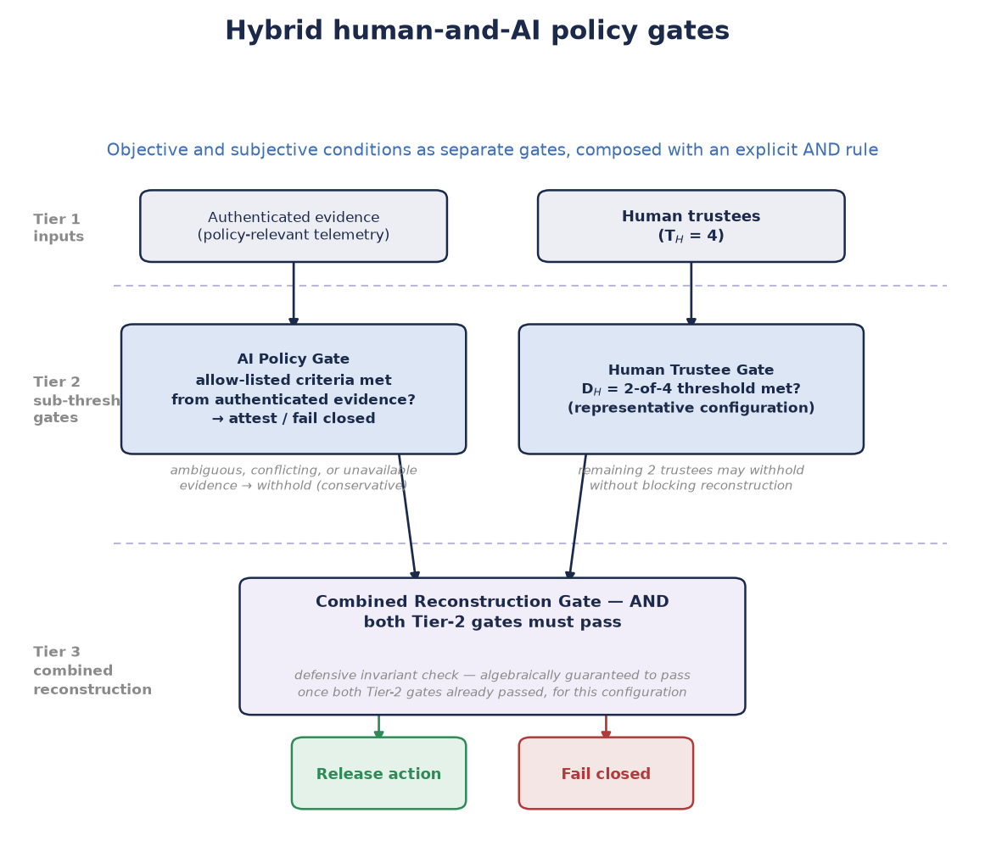
HOW IT COMPOSES
Separate gates, explicit AND
One D-of-T split treats all shards as equal peers — it can't say "all AI checks and any two humans."
So: separate gates, combined with an explicit AND, verified server-side, deny by default.
An AI trustee is a bounded evaluator
Inputs, policy version, identity, attestation key: authenticated and audited
Its attestation expires; ambiguous evidence fails closed
Never waives the human quorum — and never the sole enabler of an irreversible action
SHARDIC · Conference Talk · v4.1.1
18
Notes:
[0:33] A single Shamir split can't express 'all three AI checks AND any two humans.' Use separate gates or a vetted access-structure scheme, combined by an explicit AND, verified server-side — and treat that composition logic as security-critical: deny by default, and test missing, stale, duplicate, invalid, and wrong-role contributions. The AI is a bounded evaluator — never an autonomous authority, never able to waive the human threshold. Walk the rules box: authenticate and audit what it reads and which policy it ran; its attestation expires; ambiguous or conflicting evidence fails closed; and for irreversible actions it shouldn't be the only thing enabling them.

Slide 19
CRYPTOGRAPHIC VS. TOPOLOGICAL BYPASS
Can the ceremony simply be skipped?
The math guarantees fewer than D shards never rebuild the key. It can't guarantee the system ever calls the ceremony.
HIGHEST
HIGH
Physical interlock
MEDIUM
Secure-element sequencing
MEDIUM
Constrained state machine
Capability binding
The actuation circuit stays open until the ceremony closes it.
The hardware performs the end-state action itself; software only sees the result.
No edge in the operating sequence reaches the end state except through the ceremony.
The ceremony yields a value the end state needs as input — a key, not a yes/no.
Software-enforced: reduces risk — but whoever can edit that code can route around it.
Hardware-anchored: bypass means breaking the hardware boundary. Proof grade.
SHARDIC · Conference Talk · v4.1.1
19
Notes:
[0:35] The most important idea after the math itself. Below-threshold recovery is a cryptographic guarantee. Whether the system ever invokes the ceremony is a topological property of the surrounding design — a second code path, a config flag, or a maintenance mode can reach the end state without it. Four patterns bind the ceremony into the execution path, weakest to strongest. The software patterns reduce risk, but a privileged insider who can edit that code can route around them. Only the hardware-anchored patterns reach the same bar as the math, because bypassing them means breaking the hardware boundary or physically defeating a circuit. Real deployments layer several; the composite is only as strong as its weakest layer.

Slide 20
BEYOND THE MATH
NEAT: what a critical deployment still needs
N
E
A
T
Non-bypassable
Evaluable
Always-invoked
Tamper-proof
The ceremony is the only path to the end state.
Small and standard enough to verify independently.
No admin override, debug flag, or maintenance path.
Subverting it means breaking the hardware boundary.
A deployment bar, not a cryptographic one: it doesn't make the math stronger — it makes the system around the math trustworthy.
SHARDIC · Conference Talk · v4.1.1
20
Notes:
[0:37] NEAT names what the previous slide implies. It extends the classic reference-monitor requirements (tamperproof, always invoked, small enough to verify). It's a deployment framework, not a cryptographic one — meeting it doesn't make the math stronger, it makes the system around the math trustworthy.

Slide 21

CREDIBILITY OVER HYPE
Where shardic doesn't fit
Frequent or live authorization
Revoking one trustee
Built for rare break-glass events, not every request.
It's split-once: changing trustees means a full re-split.
Online quorum & key rotation
Hundreds of trustees
Use threshold signatures (FROST) or HSM-backed multisig.
GF(256) caps at 255 — real ceremonies run in the tens.
Rare, high-stakes, offline, small trustee set, shareable vault file — that's the sweet spot.
SHARDIC · Conference Talk · v4.1.1
21
Notes:
[0:39–0:41] Say this out loud. Frequent or live authorization, per-trustee revocation, online quorum and key rotation: use FROST or HSM-backed multisig. shardic is for rare, high-stakes, deliberate recovery.

Slide 22

CREDIBILITY OVER HYPE · 2
What the math doesn't do on its own
Practical SPAC design parameters (hardware target, grant wire format) will be driven by target operational and security constraints.
How AI trustees get trustworthy, authenticated input data is implementation specific.
The guarantee requires the creator deleted the plaintext and all copies.
Reconstruction is a functional protection. Identity or intent, or non-repudiation, if needed, need to integrate other mechanisms.
The single .krypt file is a conscious availability risk tradeoff, though not an access risk.
SHARDIC · Conference Talk · v4.1.1
22
Notes:
[0:41–0:43] The second half of the credibility section: each of these is a boundary the deployment has to own, not a flaw in the threshold guarantee. SPAC's open parameters are integration decisions, not open cryptographic questions. AI-trustee data feeds need multi-source authentication designed per deployment. The creator's deletion is an operational assumption the cryptography can't enforce. Reconstruction records contributions; it doesn't prove who or why. And the one-file design trades availability risk for simplicity — back it up durably.

Slide 23
TAKE THESE HOME
Three things to remember
1
Threshold, not chunks
Shamir turns "split a secret" into a real D-of-T threshold — and below D, zero information.
2
It runs today
A working reference implementation, down to a vault file that leaks no shard-to-trustee mapping.
3
It generalizes
Gate any consequential action — and enforce human-AI oversight in both directions.
SHARDIC · Conference Talk · v4.1.1
23
Notes:
Mirror the CFP 'attendees will learn' list.

Slide 24


THANK YOU
Math beats policies and permissions.
Run it
Read it
Build with us
github.com/splashd1/
shardic-crypt
White paper v4.1 · public-education explainer
Integration conversations welcome
Questions?
Notes:
[0:43–0:45] Repo link, README use-case catalog, and how to reach the project for integration conversations. Then Q&A.

Slide 25
BACKUP · IF ASKED ABOUT CODEWORD STRENGTH
Is ~2^100 enough when the DEK is 2^256?
~103 bits
DEK / AES-256-GCM layer
8 words from the EFF long wordlist, ~12.9 bits each.
Attacker holds only ciphertext. Full, unstructured 256-bit keyspace, nothing else in the way — so it must be unconditionally strong.
256 MiB
Argon2id memory per guess (time cost 4, parallelism 4).
Codeword layer
Attacker holds one stolen shard record. Bounded, memory-hard search — and success buys one D-of-T point, worthless below threshold.
~10^18 s
to exhaust 2^100 at an impossible 10^12 guesses/s — tens of billions of years.
10^12 guesses/s × 256 MiB ≈ 250 EB/s of memory bandwidth — not a plausible attacker.
SHARDIC · Conference Talk · v4.1.1
25
Notes:
Backup for slide 12. The 256-bit comparison measures the wrong thing: the DEK layer faces an unbounded, global keyspace search with nothing else in the way; a codeword faces someone holding one stolen record, searching a bounded, memory-hard space, and success yields one D-of-T point — worthless below threshold. Even at a deliberately impossible 10^12 Argon2id guesses per second, exhausting 2^100 takes ~1.3×10^18 seconds — tens of billions of years — and that guess rate implies ~250 exabytes per second of memory bandwidth. More words or higher Argon2id cost is still worthwhile headroom, not a fix.

Slide 26
BACKUP · IF ASKED WHETHER PEOPLE CAN REMEMBER EIGHT WORDS
Can a trustee really hold eight words?
Rehearsed, not recited once. Like a PIN or alarm code — not Miller's 7 ± 2, which is about working memory.
Inside Diceware's range. Six words standard, ten for 10+ year use.
Real words carry meaning. Eight become one short mental sentence.
BIP39 seed phrase
shardic codeword
Length
12–24 words
8 words (~103 bits)
Wrong word
Silently derives a different wallet
Auth tag rejects it; retry
Cost of a mistake
Total, often undetected loss
A failed match, nothing lost
Who must recall
One holder, alone
Any D of T trustees
BIP39's caution is right for its problem. It doesn't carry over to this one.
SHARDIC · Conference Talk · v4.1.1
26
Notes:
Backup for slide 12. The task is long-term retention through rehearsal, not one-shot recall — Miller's 'seven plus or minus two' is about working memory and doesn't describe a standing trustee. Diceware recommends six words as standard and ten for 10+ year use; eight sits inside that range, and real words become a mental sentence. BIP39's 'write it down' advice answers a harder question: three times the words, zero error tolerance, silent catastrophic failure, and one holder who must recall it alone.

Slide 27
BACKUP · WHERE IT APPLIES
Rare, high-stakes, no lone actor
Break-glass infrastructure
Estate & succession
Government
Root CA key, database master key, SCADA override — T = 7, D = 4.
A password manager's master vault split among family, lawyer, partner — T = 5, D = 3.
Generalized two-person rule, continuity-of-government credentials, election tabulation keys.
Escrow & disputes
Treasury cold storage
Separation of duties
M&A documents released only by a quorum of board, counsel, and escrow agent.
Root key material behind a multisig wallet — no single executive moves funds.
SOX, HIPAA "minimum necessary" — enforced by the math, not just policy.
SHARDIC · Conference Talk · v4.1.1
27
Notes:
Backup, for 'who would actually use this?' Every case shares the shape: policy or regulation already says no single party should decrypt this alone, and access is rare and deliberate rather than routine. Full catalog in the white paper's use-case section and the README.

Slide 28
BACKUP · IF ASKED HOW FAST A CEREMONY CAN RUN
Latency is a CONOPS choice, not a fixed cost
Convening the quorum
Shard delivery
Endgame unlock
Pre-form the ceremony before it's needed: hours of select-invite-accept become seconds to minutes. The biggest lever.
Network: near-instant. Physical carriage: minutes to days. Air-gap independence and a tight recovery time rarely coexist.
One operator, one custodian — fast. On-call backups protect availability without adding authorizers.
Speed comes from pre-positioning inputs you already need — never from needing fewer of them.
SHARDIC · Conference Talk · v4.1.1
28
Notes:
Backup for the SPAC section. Target recovery time is a per-deployment parameter. Pre-forming the ceremony is the biggest lever — it moves select/invite/accept out of the clock entirely. Network delivery is near-instant; physical carriage is minutes to days, so air-gap independence and a tight recovery time largely exclude each other. A single operator and custodian are fast, but an unreachable one is a single point of availability failure — on-call backups fix that without adding authorizers. None of this reduces how many parties the cryptography requires.

