Slide 1



CONFERENCE TALK · 45 MINUTES
Splitting Trust, Not Just Keys
Threshold recoverability by construction, not by policy
[Speaker name] · [Venue, date]
github.com/splashd1/shardic
Notes:
[0:00] Title. Introduce yourself in one sentence. Promise: a live demo, the math from first principles, and where it goes next — including human-AI oversight.

Slide 2



THE HOOK
It only took one
1
Insider
Trusted, authorized, acting alone.
Credential theft
compromised credential, coerced admin, or rogue insider — that's all a conventional key-custody design needs to fail.
One account, full access.
Coercion
Policy said "no one does this alone." Nothing in the cryptography agreed.
One person under pressure.
SHARDIC · Conference Talk · v4.1
2
Notes:
[0:00–0:04] Frame via a real incident class — insider risk, one compromised credential — not abstractly. Pick a recent public example suited to the audience. Point: every one of these had policy saying 'no one should do this alone.' Nothing in the crypto enforced it.

Slide 3
THE THESIS
Make "no single party can decrypt this alone" a mathematical fact — not a policy promise.
Encrypt once. Split the key into T shards. Any D recover it. Fewer than D hold zero information about it.
Notes:
The thesis in one slide. Pause here.

Slide 4



LIVE DEMO
Create 3-of-5. Recover with 3. Fail with 2.
One file
$ python3 vault_create.py --input demo/sample-secret \
--trustees 5 --threshold 3 --outdir ./v
[*] Split DEK into 5 shards, threshold 3
[*] Wrote vault container: pzzsrzg30y9z0pwv.krypt
$ python3 vault_recover.py v/*.krypt --outdir ./r \
--word <t1> --word <t3> --word <t5>
[+] Codeword accepted (1/3).
[+] Codeword accepted (2/3).
[+] Codeword accepted (3/3).
[*] Success.
$ diff -r demo/sample-secret r/sample-secret
Show the .krypt — no trustee map inside.
Any three, any order
Shuffle the codewords on purpose.
Wrong or too few
Rejected by the auth tag; nothing written.
SHARDIC · Conference Talk · v4.1
4
Notes:
[0:04–0:10] Switch to a real terminal — not slides. Create T=5, D=3 on demo/sample-secret; show the single .krypt file; recover with three codewords in shuffled order; show a mistyped codeword being rejected; show that two codewords never produce output. Finish with diff -r. Fallback: recorded run if venue AV fails.

Slide 5

FIRST PRINCIPLES · 1
The obvious answer is wrong
Chunks or XOR shares
What we want
Hide the key from anyone short of all pieces
Reconstruction needs every piece
Lose one trustee → key gone forever
Any D of T reconstruct
Fewer than D learn nothing
Lose up to T − D and still recover
That's a threshold scheme — and Adi Shamir solved it in 1979 with one fact from high-school algebra.
SHARDIC · Conference Talk · v4.1
5
Notes:
[0:10] Ask the room: how would you split a key among five people? Most will say chunks or XOR. Both are all-or-nothing — you can't ask for 'any 3 of 5'.

Slide 6
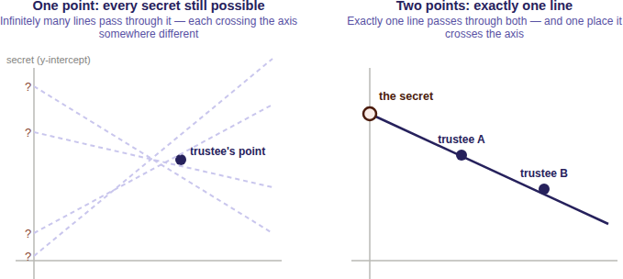
FIRST PRINCIPLES · 2
Two points fix a line
Secret = where the line crosses the axis.
One point: infinitely many lines. Every secret equally possible.
Two points: exactly one line, one crossing.
D points fix a curve of degree D − 1.
SHARDIC · Conference Talk · v4.1
6
Notes:
[0:12] The secret is where the line crosses the axis. One point: infinitely many lines, every secret possible. Two points: one line, one crossing. For D = 3, a parabola. For D, a degree D-1 curve.

Slide 7
FIRST PRINCIPLES · 3
Now make it precise
1
Random coefficients
f(x) = S + a₁x + … + a₍D−1₎x^(D−1)
f(0) = S # the secret
shard_i = (i, f(i)) # one per trustee
a₁ … a₍D−1₎ drawn uniformly at random
2
T distinct x-values
1 through T — never 0, that's the secret
Any D shards → Lagrange interpolation → evaluate at x = 0 → S.
3
Per byte of the DEK
32 independent polynomials over GF(256)
SHARDIC · Conference Talk · v4.1
7
Notes:
[0:15] Constant term is the secret; shards are points; Lagrange interpolation at x = 0 recovers it. Mirrors docs/sss_explained_for_shardic.md.

Slide 8
FIRST PRINCIPLES · 4
0 bits
is what D − 1 shards reveal about the secret. Every possible value fits them equally well.
No partial credit. No "getting warmer." No computational assumption for a quantum computer to erode — the information simply isn't there.
Notes:
[0:18] The key slide. Not 'hard to break' — nothing to break. Relevant to the post-quantum conversation: no computational assumption to erode.

Slide 9
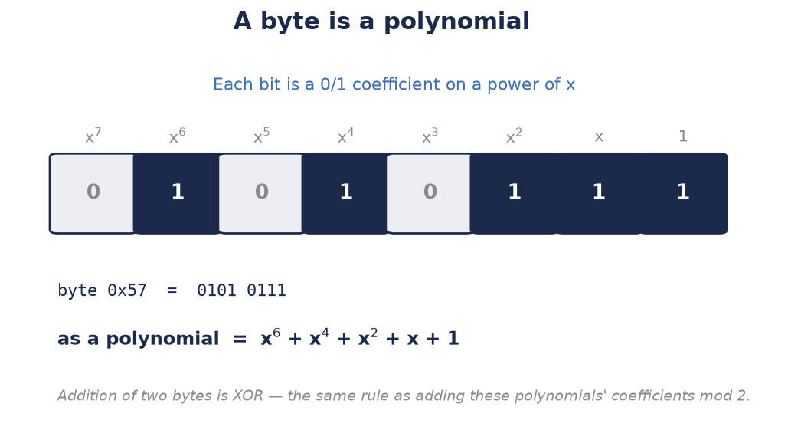
FIRST PRINCIPLES · 5
Why GF(256), in one slide
1 byte
= one field element. Exact arithmetic, no rounding.
0x11B
AES's own reduction polynomial, generator 3.
255
shards max — 0 is reserved for the secret.
SHARDIC · Conference Talk · v4.1
9
Notes:
[0:20] Reals bring fractions and rounding that corrupt the secret. GF(256): exact, one element per byte, AES's own field. The side effect: at most 255 shards — an operational ceiling that real deployments never approach.

Slide 10
IMPLEMENTED VS. PROPOSED
Where the line is — stated plainly
RUNNING CODE
RUNNING CODE
DESIGN PROPOSAL
Level 1 · Personal utility
Level 2 · Shardic ceremony
Level 3 · SPAC
CLI + GUI, no server
Codewords + one .krypt file
shardic-prime mandatory trustee
Public-key-wrapped delivery
Keycloak-backed trustee selection
Automatic backfill, single-read drop
Gate any consequential action
Bound to one Fielded Prime Element
Human-AI mutual oversight
Each level reuses the one below unchanged. Level 3 adds no new cryptography.
SHARDIC · Conference Talk · v4.1
10
Notes:
[0:22–0:28] Credibility: be explicit. Levels 1 and 2 are running code. Level 3 is a design proposal built on the same unmodified math.

Slide 11

WHERE IT GENERALIZES
From protected file to protected action
PT SPAC → CT SPAC
Fielded Prime Element
Old idea, new math
Any enabling value — a signing credential, a release-enable code — encrypted and split exactly like a file's key.
A hardware-sealed secret takes the prime trustee's slot. Copy the ciphertext elsewhere and a full quorum still fails.
Permissive Action Links and Two-Person Integrity, enforced by the math instead of procedure.
DEK = reconstruct_secret_with_prime(mask, pool_shards) # unmodified
CT_SPAC = AES-256-GCM(PT_SPAC, DEK) # unmodified
SHARDIC · Conference Talk · v4.1
11
Notes:
[0:28] The plaintext never had to be a file. A SPAC is any enabling value: a signing key, a release-enable code. The Fielded Prime Element reuses shardic-prime's mask so a copied CT SPAC plus a legitimate quorum still fails on the wrong hardware. Precedent: Permissive Action Links, Two-Person Integrity.

Slide 12
ONE VIGNETTE, END TO END
A high-value treasury wire, start to finish
1
2
3
4
5
Approve
Emplace
Operate
Convene
Arm
Controller validates the signing key and signs a commitment.
Wrap as CT SPAC; split across 5 officers + the HSM appliance.
Appliance holds only ciphertext — indefinitely.
3 of 5 respond; compliance authorizes; custodian turns the key.
DEK rebuilds, integrity check passes, wire signs, secrets zeroized.
As-is: two clicks in a web app. One hijacked admin can fake both.
shardic-SPAC: three genuine shards, this appliance, this key-switch — or nothing.
SHARDIC · Conference Talk · v4.1
12
Notes:
Walk the five stages. Contrast with the as-is: two web-app approvals that one compromised admin or two coerced officers can fake. Here, three of five officers plus the appliance's own hardware plus an on-site key-switch — and the controller's commitment is checked at arming.

Slide 13

THE FLAGSHIP CASE
Human-AI mutual oversight — one rule, both directions
Humans gate the AI
AI checks the humans
An AI proposes a consequential action. It can't execute on its own confidence or speed: below the human threshold, the key doesn't exist — no prompt or internal state rebuilds it.
A coerced or rogue human pushes an action. An independent AI evaluator attests only to allow-listed criteria on authenticated evidence — or fails closed.
No model in the cryptographic path. Just trustee slots, assigned by class, composed with an explicit AND.
SHARDIC · Conference Talk · v4.1
13
Notes:
[0:32] The same D-of-T rule, pointed either way by trustee-class assignment. AI-initiated action needs independent human sign-off — no prompt or internal state rebuilds a key that doesn't exist. Human-initiated action needs an independent AI evaluator's attestation against allow-listed criteria — no seniority or urgency talks it out of failing closed.

Slide 14
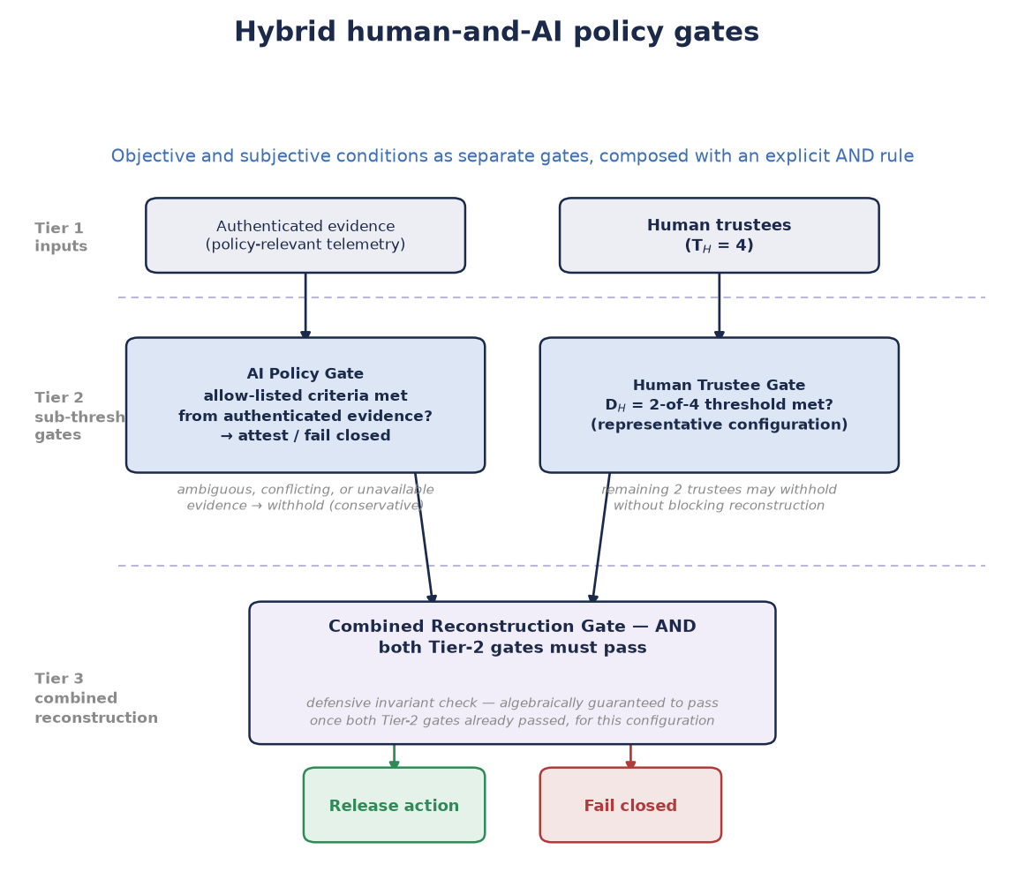
HOW IT COMPOSES
Separate gates, explicit AND
One D-of-T split treats all shards as equal peers — it can't say "all AI checks and any two humans."
So: separate gates, combined with an explicit AND, verified server-side.
The AI gate is a bounded evaluator: signed, time-limited, auditable — and it can never waive the human threshold.
SHARDIC · Conference Talk · v4.1
14
Notes:
A single Shamir split can't express 'all three AI checks AND any two humans.' Use separate gates or a vetted access-structure scheme, combined by an explicit AND, verified server-side. The AI is a bounded evaluator — never an autonomous authority, never able to waive the human threshold.

Slide 15
BEYOND THE MATH
NEAT: what a critical deployment still needs
N
E
A
T
Non-bypassable
Evaluable
Always-invoked
Tamper-proof
The ceremony is the only path to the end state.
Small and standard enough to verify independently.
No admin override, debug flag, or maintenance path.
Subverting it means breaking the hardware boundary.
Software-only enforcement reduces risk. Secure-element sequencing or a physical interlock is what reaches proof grade.
SHARDIC · Conference Talk · v4.1
15
Notes:
[0:36] The math only protects you if nothing routes around the ceremony. NEAT extends the classic reference-monitor requirements. Only hardware-anchored patterns — secure-element-internal sequencing or a physical interlock — reach proof grade.

Slide 16

CREDIBILITY OVER HYPE
Where shardic doesn't fit
Frequent or live authorization
Revoking one trustee
Built for rare break-glass events, not every request.
It's split-once: changing trustees means a full re-split.
Online quorum & key rotation
Hundreds of trustees
Use threshold signatures (FROST) or HSM-backed multisig.
GF(256) caps at 255 — real ceremonies run in the tens.
Rare, high-stakes, offline, small trustee set, shareable vault file — that's the sweet spot.
SHARDIC · Conference Talk · v4.1
16
Notes:
[0:38–0:43] Say this out loud. Frequent or live authorization, per-trustee revocation, online quorum and key rotation: use FROST or HSM-backed multisig. shardic is for rare, high-stakes, deliberate recovery.

Slide 17
TAKE THESE HOME
Three things to remember
1
Threshold, not chunks
Shamir turns "split a secret" into a real D-of-T threshold — and below D, zero information.
2
It runs today
A working reference implementation, down to a vault file that leaks no shard-to-trustee mapping.
3
It generalizes
Gate any consequential action — and enforce human-AI oversight in both directions.
SHARDIC · Conference Talk · v4.1
17
Notes:
Mirror the CFP 'attendees will learn' list.

Slide 18



THANK YOU
Math beats policies and permissions.
Run it
Read it
Build with us
github.com/splashd1/shardic
White paper v4.1 · public-education explainer
Integration conversations welcome
Questions?
Notes:
[0:43–0:45] Repo link, README use-case catalog, and how to reach the project for integration conversations. Then Q&A.

