Slide 1
PUBLIC EDUCATION · WHITE PAPER V4.1 COMPANION
The Cryptographic Foundation of Shardic
How threshold secret sharing turns "no one acts alone" into math — and how to build on it.
Open for evaluation and integration · github.com/splashd1/shardic · September 2026
Notes:
This deck is for people who may never run the CLI: architects and teams deciding whether shardic's primitive belongs in their own multi-party security design.

Slide 2



WHY WE'RE SHARING THIS
A building block, not just a tool
Reuse the primitive
Human-only or human + AI
Evaluate it openly
Standard parts — Shamir over GF(256), AES-256-GCM, Argon2id — composed so no single party holds control.
Trustees are just independent key holders. The math doesn't care whether a slot is a person or a policy-bound agent.
Small, standards-based, and published — so you can verify the claims rather than take them on faith.
The question shardic answers: how do we make sure no single party can expose this secret — or invoke this capability — alone?
SHARDIC · Cryptographic Foundations · v4.1
2
Notes:
Goal: let other teams evaluate or integrate the primitive for their own multi-entity security — human-only, or human plus AI. Everything here is standard, publicly analyzable cryptography.

Slide 3



START WITH THE WRONG ANSWER
Why "cut the key into pieces" fails
Chunk it
XOR it
Same flaw
Hand each of four trustees an 8-byte slice of the 32-byte key.
Make every piece random except the last, chosen so they all XOR back to the key.
All-or-nothing. You can't ask for "any D of T" — lose one trustee and the key is gone forever.
What we actually want: any D of T recover, and fewer than D learn nothing. That's a threshold scheme.
SHARDIC · Cryptographic Foundations · v4.1
3
Notes:
Chunking and XOR splitting can hide the key from anyone short of all pieces, but they're all-or-nothing. Lose one trustee and the key is gone forever.

Slide 4
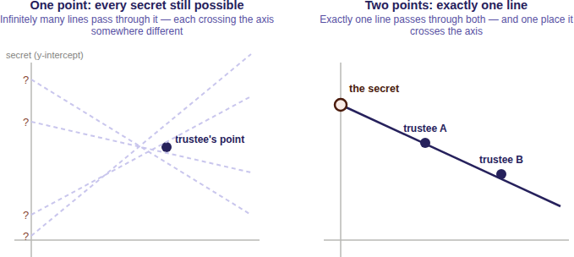
THE INTUITION
Hide the secret as a point only enough hints can locate
Picture the secret as the spot where a line crosses the vertical axis.
Give each trustee one point on that line. One point alone fits infinitely many lines — every secret stays equally possible.
Two points fix exactly one line, so exactly one crossing. That's D = 2.
Need D = 3? Use a parabola. In general: a curve that takes exactly D points to pin down.
Any D of the T points will do — not a specific D, not all T — so the scheme absorbs losing up to T − D trustees.
SHARDIC · Cryptographic Foundations · v4.1
4
Notes:
The secret is where a line crosses the vertical axis. One point on the line tells you nothing — infinitely many lines pass through it. Two points fix the line, and so the crossing.

Slide 5
THE PRECISE CONSTRUCTION
Shamir's Secret Sharing (1979)
1
Build
f(x) = S + a₁x + a₂x² + … + a₍D−1₎x^(D−1)
f(0) = S # the secret
shard_i = (i, f(i)) for i = 1 … T
Random coefficients a₁…a₍D−1₎; the constant term is the secret.
2
Evaluate
Each shard is one point (i, f(i)) at a distinct nonzero x.
D points fix a degree-(D−1) polynomial. No more, no fewer — that one algebra fact is the whole scheme.
3
Distribute
One point per trustee — T in total.
4
Reconstruct
Any D points → Lagrange interpolation → evaluate at x = 0.
SHARDIC · Cryptographic Foundations · v4.1
5
Notes:
Hide the secret as the constant term of a random degree D-1 polynomial. Shards are points on it. Lagrange interpolation at x = 0 recovers the secret from any D points.

Slide 6

THE GUARANTEE
Below threshold, the answer doesn't exist yet
0 bits
Computational security
Information-theoretic
learned about the secret from D − 1 shards — regardless of computing power, time, or future cryptanalysis.
Most crypto: breaking it is hard (factoring, discrete log). A better algorithm or bigger computer could, in principle, win.
Shamir below threshold: nothing to break. Every candidate secret fits the shards equally well.
No partial credit, no "getting warmer." The Dth point doesn't refine the answer — it's the moment the answer springs into existence.
SHARDIC · Cryptographic Foundations · v4.1
6
Notes:
With D-1 points, one polynomial fits every possible secret equally well. That's information-theoretic: no algorithm, no quantum computer, no amount of time helps, because the information isn't there.

Slide 7
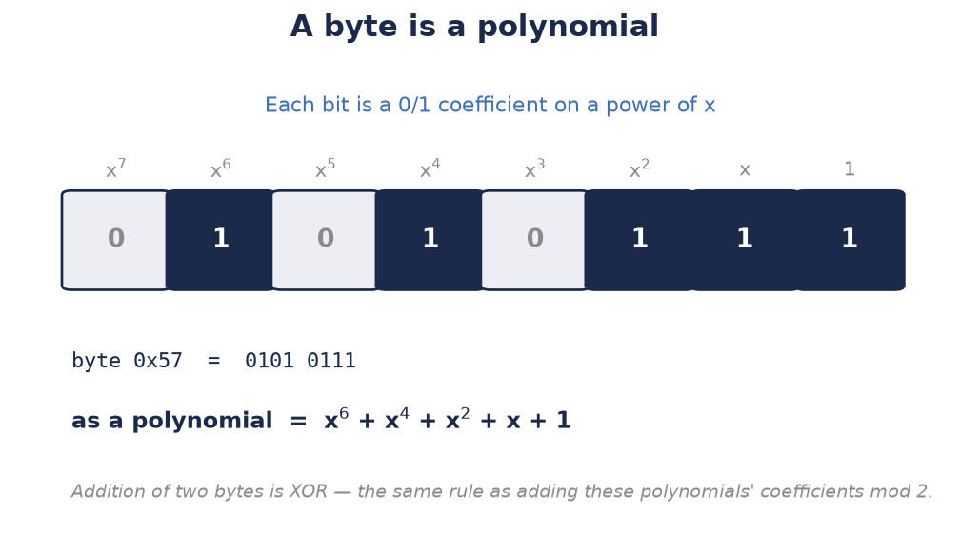


MAKING IT EXACT
Why GF(256) instead of real numbers
Reals break it
Fractions and floating-point rounding silently corrupt the secret.
One element = one byte
256 elements, closed arithmetic, no rounding — the same field AES uses.
A built-in ceiling
255 usable x-values (0 is the secret) → at most 255 shards.
shardic applies the construction independently to each of the DEK's 32 bytes.
SHARDIC · Cryptographic Foundations · v4.1
7
Notes:
Real-number interpolation brings fractions and floating-point rounding that silently corrupt the secret. GF(256) is exact, one element per byte, and the same field AES uses. It also sets the 255-shard ceiling.

Slide 8
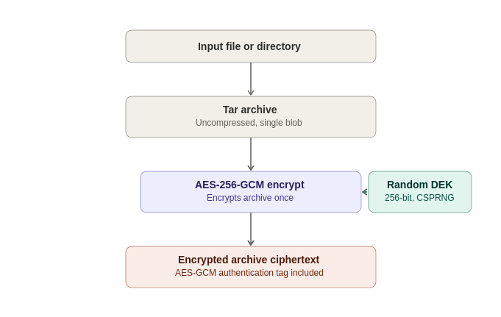
FROM TEXTBOOK TO SYSTEM
Split the key, never the file
Layer 1 — AES-256-GCM on the data
Encrypt the uncompressed tar archive once under a random DEK. Computational security, plus built-in tamper detection.
Layer 2 — Shamir on the key
Split only the 32-byte DEK into T shards at threshold D. Information-theoretic below D.
Uncompressed on purpose: ciphertext size shouldn't leak plaintext compressibility.
SHARDIC · Cryptographic Foundations · v4.1
8
Notes:
SSS never touches bulk data. AES-256-GCM encrypts the archive under a random DEK; SSS splits only the 32-byte DEK. Two independent layers: computational for data, information-theoretic for the key.

Slide 9



SEALING EACH SHARD
The shardic encryption key: four pluggable sources
KDF from a codeword
IMPLEMENTED
shardic envelope
IMPLEMENTED
Memorized words → Argon2id (or PBKDF2). The only source a human recalls.
Full-strength CSPRNG key, delivered wrapped under the trustee's public key.
External token
PLUGGABLE
Anything mainstream
PLUGGABLE
PIV/FIDO2, an HSM, or a shardware-token releases the key.
Enterprise KMS, PKI credentials — any 256-bit key held with comparable rigor.
Each shard record stores only {salt, nonce, ciphertext}. The container records the KDF and parameters once, so the vault describes itself.
SHARDIC · Cryptographic Foundations · v4.1
9
Notes:
A raw shard is just data, so each is sealed under its own 256-bit AES-GCM key. The guarantee only needs each trustee to hold one independently. Mix sources across trustees in one vault.

Slide 10
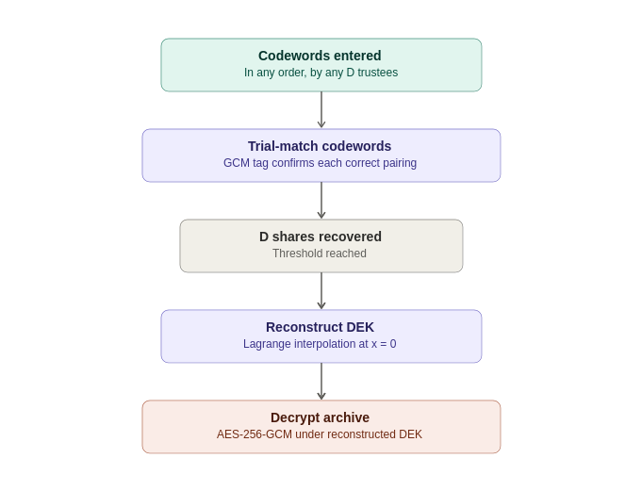
A PROPERTY WORTH COPYING
Zero-leakage indexing: no map, just trial
The shard list has no trustee mapping — just opaque, shuffled {salt, nonce, ciphertext} records.
Recovery tries each supplied key against every unmatched record. GCM's auth tag makes the right pairing decrypt and every wrong one fail fast.
With T in the tens, trial is effectively instant — so don't add a mapping "for efficiency."
The .krypt file on its own reveals nothing about who holds what.
SHARDIC · Cryptographic Foundations · v4.1
10
Notes:
The metadata never records which codeword unlocks which shard. Recovery tries each key against every unmatched record; GCM's auth tag is the oracle. With T in the tens, that's instant — and the file leaks nothing about who holds what.

Slide 11
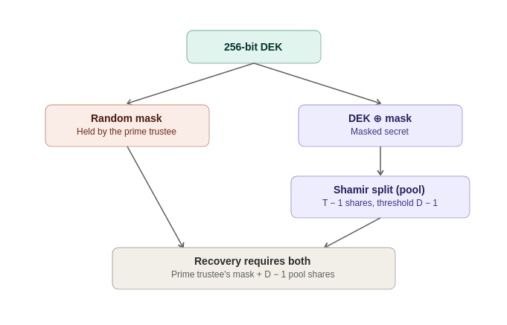
EXTENDING THE TEXTBOOK
shardic-prime: one mandatory trustee
mask = random bytes, len(DEK)
masked_secret = DEK XOR mask
pool_shards = split(masked_secret,
D − 1, pool_size)
DEK = reconstruct(pool_shards) XOR mask
Nothing new to trust
Both halves keep the information-theoretic guarantee. The layering makes the prime trustee mathematically essential, not just customary.
The mask is just a value — so hardware can hold it. That's the Fielded Prime Element.
SHARDIC · Cryptographic Foundations · v4.1
11
Notes:
A one-time-pad mask over the ordinary split. The prime trustee holds the mask; the pool holds Shamir shards of the masked secret. Neither half alone reveals anything. Because the mask is just a value, a hardware element can hold it — that's the Fielded Prime Element.

Slide 12
SIZE IT CORRECTLY
Two different strengths, two different levers
UNCONDITIONAL
COMPUTATIONAL
Key length & Shamir split
Each codeword
256-bit DEK, no known AES-256 shortcut
Below D: zero information
Raising T or D changes how many must collude
Only as strong as its guess space × KDF cost
Attacker cracks D codewords one at a time
More trustees don't fix a weak codeword
Default memorable codewords: 8 EFF words ≈ 103 bits, Argon2id at 256 MiB per guess. For high-assurance ceremonies, skip the codeword entirely — a CSPRNG key delivered by shardic envelope reaches parity with the DEK.
SHARDIC · Cryptographic Foundations · v4.1
12
Notes:
The DEK and Shamir split are effectively unconditional. Each codeword is only computationally strong, and a higher D doesn't compensate: an attacker cracks D codewords individually. Tune both knobs.

Slide 13
BUILDING ON IT
What stays fixed when you integrate
IMPLEMENTED
IMPLEMENTED
DESIGN PROPOSAL
Level 1 · Personal utility
Level 2 · Shardic ceremony
Level 3 · SPAC
Codewords + a .krypt file. The math everything else reuses.
Change how keys reach trustees and how trustees are chosen — not the math.
Change what the value gates: any consequential action, bound to one device.
Invariants to preserve
One crypto core — never fork encrypt/split logic per frontend
No shard-to-trustee mapping in metadata
KDF fixed at creation — no downgrade on recovery
Fail closed: no partial or best-guess output
SHARDIC · Cryptographic Foundations · v4.1
13
Notes:
Each level reuses the one beneath unchanged. Integrators change delivery, trustee organization, or what the value gates — never the split, the KDF path, or the container. Keep the implemented-vs-proposed line explicit.

Slide 14


LEARN THE FOUNDATION
Pick your depth
Plain language
The math, step by step
The full argument
Code-level path
docs/public-education-explainer.md
docs/sss_explained_for_shardic.md
White paper v4.1 — md / docx / html
docs/shardic-cryptographic-path.md
Evaluate it, break it, build on it — github.com/splashd1/shardic
Notes:
Point to the four reading paths, from plain-language to code-level.

