Slide 1



OVERVIEW & DEMO · WHITE PAPER V4.1 COMPANION
SHARDIC
No single party can decrypt it alone. Any D of T can.
Threshold-recoverable encryption you can run today — a working CLI and GUI, no server, no network.
github.com/splashd1/shardic · September 2026
Notes:
Opening. One line: shardic makes 'no single party can decrypt this alone' a mathematical fact, not a policy promise.

Slide 2


THE STATUS QUO
One key, one point of failure
Conventional encryption is monolithic: whoever holds the key — or controls the system holding it — controls the plaintext, alone and for good.
Wrap the key under a public key and the private key becomes the new single secret. Lock it in an HSM and one coerced admin still gets through.
Same shape every time: one secret, one holder, one point of failure.
Rogue insider
One trusted person acts alone.
Coerced admin
One person is pressured into acting.
Stolen credential
One compromised account is enough.
SHARDIC · Overview & Demo · v4.1
2
Notes:
Whoever holds the key has unilateral, permanent control. Wrapping it or locking it in an HSM moves the single point of control; it doesn't remove it.

Slide 3

THE SHARDIC IDEA
Split the key, not the file
Encrypt once
›
Split the DEK
›
Seal each shard
›
Distribute
AES-256-GCM under a random 256-bit DEK
Shamir's Secret Sharing → T shards, threshold D
Under that trustee's own shardic encryption key
One codeword per trustee, out of band
Any D of T trustees rebuild the DEK. Fewer than D hold zero information about it — not "hard to break," but simply not there.
The creator can't recover alone either — once they delete their local copies and distribute the codewords.
SHARDIC · Overview & Demo · v4.1
3
Notes:
Encrypt once under a random DEK. Split the DEK with Shamir's Secret Sharing into T shards. Each trustee unlocks their shard with their own shardic encryption key. Any D rebuild the DEK; fewer carry zero information.

Slide 4
THE GUARANTEE IN THREE NUMBERS
What the math actually promises
3 of 5
0 bits
1 file
Any three trustees recover. Which three doesn't matter — and two can be lost for good.
What D − 1 shards reveal about the key, regardless of computing power.
One .krypt container: header, metadata, ciphertext. No trustee-to-shard map inside.
Information-theoretic below threshold: the guarantee doesn't erode as quantum or classical computing improves.
SHARDIC · Overview & Demo · v4.1
4
Notes:
Three facts: any D of T recover; below D you learn zero bits; everything ships as one self-describing file.

Slide 5
LIVE DEMO · 1 OF 2
Create a 3-of-5 vault
1
Pick T and D
$ python3 vault_create.py --input demo/sample-secret \
--trustees 5 --threshold 3 --outdir ./v
[i] Shard protection KDF: argon2id
[*] Memorable mode: 7772 real words (EFF list)
[*] Estimated codeword strength: ~103 bits
[*] Archiving 'demo/sample-secret' ...
[*] Split DEK into 5 shards, threshold 3
[*] Wrote vault container: pzzsrzg30y9z0pwv.krypt
[+] Wrote 5 trustee codeword files
Distribute each to exactly one trustee,
then DELETE them from this machine.
Five trustees, any three recover.
2
Memorable codewords
Eight real words each — e.g. unruly-numbing-precision-lemon-…
3
One .krypt file
Safe to store or share: it maps no shard to any trustee.
4
Hand off, then delete
Distribution is your trust decision — the tool never automates it.
SHARDIC · Overview & Demo · v4.1
5
Notes:
Real output from vault_create.py run against demo/sample-secret. Point out: Argon2id KDF, ~103-bit memorable codewords, one .krypt file, and the instruction to distribute then delete codeword files.

Slide 6


LIVE DEMO · 2 OF 2
Recover with any three — and nothing less
Any order, any three
$ python3 vault_recover.py v/*.krypt --outdir ./r \
--word <trustee 1> --word <trustee 3> --word <trustee 5>
[i] This vault requires 3 of 5 codewords to recover.
[+] Codeword accepted (1/3).
[+] Codeword accepted (2/3).
[+] Codeword accepted (3/3).
[*] Reconstructing DEK from recovered shards ...
[*] Decrypting archive ...
[*] Success.
$ diff -r demo/sample-secret r/sample-secret # identical
# and when a trustee mistypes:
[-] That codeword doesn't match any remaining shard.
Recovery never asks who you are.
Wrong word? Rejected
GCM's auth tag fails fast — no garbage output.
Two isn't enough
Short of D, recovery stops. No partial output, ever.
SHARDIC · Overview & Demo · v4.1
6
Notes:
Real output. Codewords in any order; a wrong codeword is rejected by the AES-GCM auth tag; three good ones reconstruct and decrypt. diff -r confirms a byte-identical round trip.

Slide 7


WHERE IT FITS
Rare, high-stakes, nobody-acts-alone access
Break-glass infrastructure
Estate & succession
Root CA keys, DB master keys, SCADA overrides — say T=7, D=4.
Relatives, a lawyer, a partner (T=5, D=3), with memorizable codewords.
Government & public sector
Business & regulated industry
Any-3-of-7 officials, escrowed archives, continuity-of-government keys.
M&A escrow, treasury cold storage, SOX/HIPAA separation of duties.
SHARDIC · Overview & Demo · v4.1
7
Notes:
Break-glass keys, estate planning, public-sector two-person rules, regulated separation of duties. Common thread: rare access, high stakes, a small static trustee set.

Slide 8
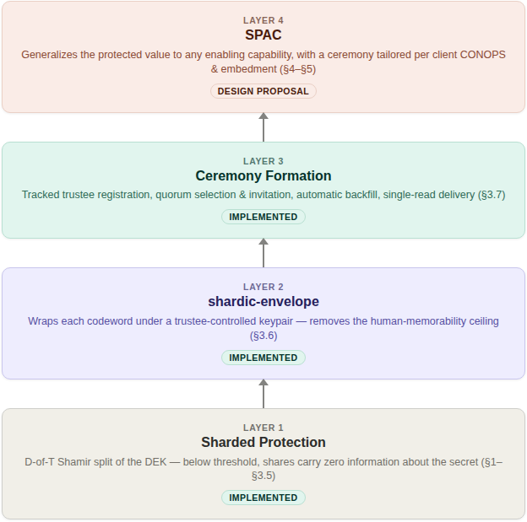
ONE PRIMITIVE, THREE LEVELS
Start small — the same math scales up
IMPLEMENTED
Level 1 — Personal & small group
CLI + GUI. Codewords, a .krypt file, no server.
IMPLEMENTED
Level 2 — Shardic ceremony
Public-key-wrapped delivery, identity-backed trustee selection, automatic backfill.
DESIGN PROPOSAL
Level 3 — SPAC product protection
Gate any consequential action, bound to one fielded device — including human-AI mutual oversight.
SHARDIC · Overview & Demo · v4.1
8
Notes:
Each level reuses the one beneath it unchanged. Levels 1 and 2 run today; Level 3 (SPAC) is a design proposal on the same unmodified math. You can stop at any level.

Slide 9
HONEST BOUNDARIES
Great fit, poor fit
Reach for shardic when…
Reach for something else when…
Access is rare and high-stakes, not routine
No single party should ever decrypt alone
The trustee set is small and fairly static (tens, not thousands)
You must store or share the vault file without leaking who holds what
You want it offline — no server in the recovery path
You need frequent or live authorization
You must revoke one trustee without a full re-split
You need online quorum and key rotation — use FROST or HSM-backed multisig
Your trustee count runs past 255 (the GF(256) ceiling)
Being clear about the boundary is part of the guarantee: shardic solves one problem — rare recovery that needs genuine multi-party agreement — and solves it completely.
SHARDIC · Overview & Demo · v4.1
9
Notes:
Credibility matters more than hype. For frequent or live authorization with key rotation, use FROST or HSM-backed multisig.

Slide 10
TRY IT IN FIVE MINUTES
Math beats policies and permissions.
Read next
White paper v4.1 — docs/
Plain-language explainer — public-education-explainer.md
Foundations deck — the cryptography, step by step
$ git clone github.com/splashd1/shardic
$ pip install cryptography argon2-cffi
$ python3 vault_create.py --input <dir> \
--trustees 5 --threshold 3 --outdir v
$ python3 vault_recover.py v/*.krypt ...
No server. No network. Just Python 3, a .krypt file, and D people who agree.
Notes:
Close: clone, run the two commands, read the white paper or the plain-language explainer.

