Slide 1
5 SHARDS · THRESHOLD 3
SHARDIC
Threshold-Recoverable Encrypted Vaults
Enforcing multi-person integrity for high-stakes data recovery and capability authorization — including human-AI mutual oversight for AI-era decisions
White Paper Companion Deck · September 2026
github.com/splashd1/shardic

Slide 2

1.1 — THE STATUS QUO
One Key, One Point of Failure
Whoever holds the key — a person, a process, a single server — has complete and unilateral power over the data it protects. Access is a binary, anonymous fact: either you hold the key, or you don't.
Wrapping a key with another key changes who the single point of control is — not that there is one.
Locking a key in an HSM or safe changes where it lives — a single compromised operator still defeats it.
ONE KEY
complete, unilateral access
Any ONE of these is sufficient to cause disclosure:
Rogue insider
Neither changes the shape of the trust model — one secret, one holder, one point of failure.
Coerced operator
Compromised credential
SHARDIC
2

Slide 3


1.2 — THE ALTERNATIVE
No Single Party Can Unilaterally Decrypt
5 shards (T)
No single trustee — including the vault's creator — can ever recover the data alone.
A rogue insider or single compromised account is insufficient; collusion of D independents is required.
DEK
recovered
3 of 5 required
to reconstruct
Tolerates loss of up to T − D trustees without losing recoverability.
Every recovery event has a natural audit trail of who participated.
Plaintext recovered
Threshold recovery reframes “access” from a binary fact about one secret into a quorum fact about independent people. That's not a policy statement enforced by a process — it's a mathematical property of the construction itself (see §3.1–§3.2).
SHARDIC
3

Slide 4




1.3 — REPRESENTATIVE USE CASES
Where Threshold Recovery Fits
Break-Glass Infrastructure
Estate & Succession Planning
Root CA keys, production database master keys, SCADA overrides. T=7, D=4 — nobody has access day-to-day.
Password-manager master vaults split among relatives, a lawyer, and a partner (T=5, D=3), with memorable codewords.
Government & Public Sector
Business & Regulated Industry
Generalized two-person rules, lawful-intercept escrow, continuity-of-government credentials, election tabulation keys.
M&A escrow, treasury cold storage, whistleblower archives, SOX/HIPAA separation-of-duties enforcement.
SHARDIC
4

Slide 5
1.4 — THE INTUITION
A Secret Hidden as a Single Point
Two points determine a line.
shardic's actual construction generalizes this to a degree-(D−1) polynomial over GF(2⁸) — see §3.2.
shard B
shard A
the secret
1 shard → every secret still possible
2 points → exactly one answer fits
SHARDIC
5

Slide 6
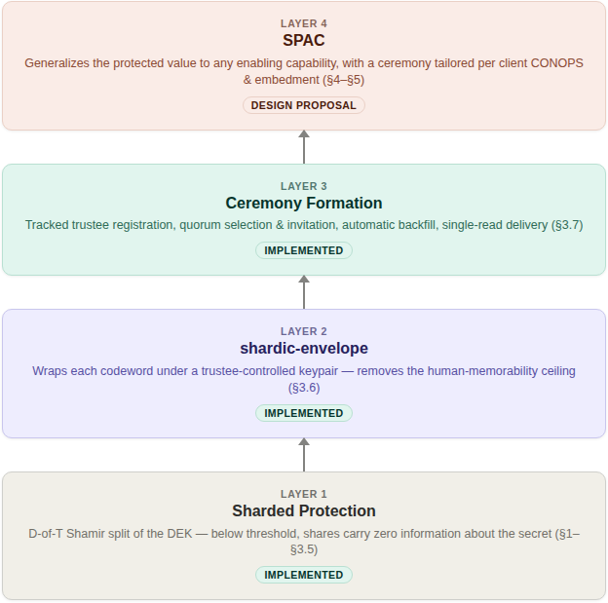
1.5 – 1.6 — FROM CONCEPT TO CAPABILITY
What shardic Provides: Components and Deployment Flexibility
A deployment can stop at any component and still have a complete, sound system — but SPAC is the most likely practical payoff.
SHARDIC
6

Slide 7
2.1 — OPERATOR WALKTHROUGH
Creating a Vault
Choose T (trustees) and D (threshold) before doing anything else.
1
Tool selects the KDF — Argon2id if available, else PBKDF2.
$ python3 vault_create.py \
--input ./secret_docs \
--trustees 5 --threshold 3 --word-count 3
[i] Shard protection KDF: pbkdf2 (400000 iters)
[i] No --word-length: defaulting to --memorable
[*] Loaded 7772 candidate words (EFF wordlist)
[*] Estimated codeword strength: ~39 bits
combinatorial per trustee (before KDF)
[*] Split DEK into 5 shards, threshold 3
[+] Wrote vault container:
vault_out/ce28by1pn9z8wib2.krypt
[+] Wrote 5 trustee codeword files.
Distribute out of band, then delete.
2
Defaults to --memorable codewords from the bundled EFF wordlist.
3
Reports a combinatorial strength estimate before anything is distributed.
4
Encrypts the archive once (AES-256-GCM) under a random 256-bit DEK, splits the DEK into T Shamir shards.
5
Writes one .krypt file, plus one codeword file per trustee.
6
The operator's remaining job is procedural, not cryptographic — distribute out of band, then delete local copies.
SHARDIC
7

Slide 8


2.2 — OPERATOR WALKTHROUGH
Recovering a Vault
Any order accepted
$ python3 vault_recover.py \
vault_out/ce28by1pn9z8wib2.krypt \
--word "broadside-repulsion-subway" \
--word "valuables-repeater-oversleep" \
--word "winking-portly-diffusion"
[i] This vault requires 3 of 5 codewords.
[+] Codeword accepted (1/3).
[+] Codeword accepted (2/3).
[+] Codeword accepted (3/3).
[*] Reconstructing DEK from recovered shards ...
[*] Success. Recovered to /recovered_out
Recovery doesn't ask “which trustee are you” — each codeword is tried against every not-yet-matched shard until one authenticates.
Fail-closed by design
If fewer than D codewords match, or any are wrong, the tool reports how many were accepted and stops — never partial or best-guess output.
No mapping required
The operator never specifies which codeword belongs to which trustee — the tool figures it out via trial matching (§3.4).
SHARDIC
8

Slide 9

2.3 — A MANDATORY-TRUSTEE VARIANT
shardic-prime
The base scheme treats every trustee identically. shardic-prime adds one essential trustee: their codeword must always be supplied, no matter how many others are gathered.
Fits situations where one specific role — an estate's executor, a security lead — must always sign off, while backups can be any qualifying subset.
RECOVERY REQUIRES
T = 4, D = 3 example
AND
Separate CLI tools
Separate container format
PRIME
always required
any 2 of 3 POOL trustees
Tagged metadata
1 prime trustee + any 2 of 3 pool trustees
All 3 pool codewords, gathered without the prime's, recover nothing — a property of the construction itself, not just the CLI.
Note: shardic-envelope (§3.5) builds directly on this construction — its live Keycloak demo uses a prime + pool ceremony under the hood.
SHARDIC
9

Slide 10


3.1 – 3.2 — TECHNICAL MECHANICS
Splitting the Key, Not Just Encrypting the Data
T shards, each at a distinct x-coordinate
Input file /
directory
AES-256-GCM
Ciphertext archive
under a random 256-bit DEK
Shamir Split — GF(2⁸)
DEK's 32 bytes each become the
constant term of a degree D−1 polynomial
Information-theoretic, not merely computational. A degree D−1 polynomial is uniquely determined by any D points — but with only D−1 points, every possible value of the secret byte remains equally consistent. An attacker holding fewer than D shards learns exactly zero bits, regardless of computing power.
SHARDIC
10

Slide 11

3.3 — TECHNICAL MECHANICS
Shardic Encryption Key: Four Pluggable Sources
A raw Shamir shard is still just data — each shard is individually encrypted under a 256-bit key held by that shard’s trustee: the shardic encryption key. What matters is only that each trustee holds one, independently.
KDF from a Memorized Secret
shardic-envelope
Today’s implemented scheme — a codeword stretched via PBKDF2 or Argon2id. The only source that asks a trustee to recall or transcribe anything.
Full-strength CSPRNG key, no KDF stretching, delivered public-key-wrapped rather than memorized (§3.6) — implemented and demoed.
External Token
Other Mainstream Mechanisms
A hardware credential the trustee already holds — PIV/FIDO2, an HSM, a shardware-token (§4.3) — rather than generated by this project’s own code.
An explicit extensibility point, not a fixed list — any standards-based 256-bit AES-GCM key source a deployment already trusts.
A deployment picks whichever source fits its trustee population and CONOPS, and can mix sources across trustees in the same vault.
SHARDIC
11

Slide 12
3.4 — FILE FORMAT
One File, Zero Metadata Leakage
Exactly one file
No assignment mapping
.krypt — nothing to accidentally separate from a companion metadata file; copy, email, or upload a single .krypt.
Shard order is randomly shuffled at creation; no record ties a shard to a trustee or a codeword.
Trial matching, not lookup
Nothing leaks at rest
Recovery tries each codeword against every unmatched shard; AES-GCM's auth tag is the correctness oracle — fails fast, never garbage output.
Raw AES-GCM bytes, no base64 (avoids ~33% size penalty). Seizing the file, or several codewords, in isolation reveals no assignment information.
SHARDIC
12

Slide 13
5.1 — SECURITY DISCUSSION
LARGELY MOOT — SEE §5.2
Two Different Guarantees, Two Different Levers
UNCONDITIONAL
COMPUTATIONAL
DEK & Shamir Split
Individual Codeword
Below threshold D, shards carry zero information about the key — regardless of computing power. Raising T or D changes how many parties must collude, not how hard one shard is to attack.
Only as strong as its own guessing space and KDF cost — the operator's responsibility. A higher D does not compensate: an attacker only ever needs D individually weak codewords.
Codeword generation modes — word count is what sets the real security margin
Memorable (default)
Dictionary
Synthetic
~12.9 bits/word
~8–11 bits/word
~3.36 bits/char
Whole real words, EFF long list. 8 words ≈ 103 bits by default.
Fixed length from a supplied wordlist — uniform shape, smaller pool.
Pronounceable syllables; --strong-words adds case + digits for density.
SHARDIC
13

Slide 14

3.6 — AN IMPLEMENTED EXTENSION
IMPLEMENTED — LIVE DEMO
shardic-envelope
Every codeword mode ultimately protects a shard with something a human can recall — the design's real computational bottleneck. shardic-envelope removes that ceiling for trustees willing to hold a keypair, wrapping each codeword under a key they already control rather than under a memory limit. Built on shardic-prime; demoed end-to-end against real Keycloak infrastructure with a live SSE dashboard.
Good fit
Poor fit
Trustee pools who already function as cryptographic identities in their day job — infra engineers, security officers, multisig cold-storage signers, PKI-backed roles. Near-arbitrary codeword strength, zero memorization burden.
The diceware-style family-estate case (§1.3): the whole premise is a relative who can recall a phrase without managing cryptographic material. Trading “remember five words” for “protect a key file forever” is plausibly a net loss for a non-technical trustee.
The two mechanisms are complementary — which trustees use envelope wrapping vs. a memorable phrase is a per-trustee decision, not vault-wide.
Trade-off: a private key becomes a new single point of failure per shard, and credential lookup introduces a new trust boundary.
SHARDIC
14

Slide 15


3.7 — OPERATOR-RUN TRUSTEE SELECTION
IMPLEMENTED — V1.0
Ceremony Formation
shardic-envelope's operator selects T primaries plus an ordered backup list from a registered candidate directory, issues per-trustee invitations, and the ceremony self-heals around declines or timeouts — without the operator ever being eligible to select themselves as a trustee.
CEREMONY STATE
FORMING
FORMED
every slot accepted → vault creation unlocked
FAILED
if backup list exhausted first
Separation of duties
Decline / TTL handling
The operator role (a dedicated Keycloak realm role) is checked against ceremony trustee selections — an operator can't invite themselves.
Each invitation is ephemeral and polled (GET /trustees/pending-invitation). A decline or timeout lapses the slot immediately.
Automatic backfill
Real routes, real state
The next-ranked candidate on the ordered backup list is promoted into a lapsed slot, inheriting its role (prime or pool) — race-safe against duplicate responses.
POST /admin/ceremony/initiate, STATE["ceremony"], and SSE events (ceremony_initiated / ceremony_formed / ceremony_failed) — not a design sketch.
SHARDIC
15

Slide 16

3.7 — THE OPERATIONAL LIFECYCLE
Register → Form → Wrap → Deliver → Recover
1. Register
2. Form
3. Wrap
4. Deliver
5. Recover
Trustees join a Keycloak candidate directory. Keypair is generated client-side only (WebCrypto / hardware token) — the private key never leaves the device.
Operator initiates a ceremony (§3.6); invitations, decline/TTL, and backfill run until every slot is accepted or the backup list is exhausted.
On vault creation, each codeword is wrapped under its trustee's ceremony-confirmed public key via shardic_envelope_crypto.wrap() — the combiner never sees a plaintext codeword.
Trustee polls GET /trustees/pending-envelope, a pull-based, single-read drop point. Working end-to-end today as an in-process store — a pluggable EnvelopeDropPoint backend is the tracked follow-on.
Trustee decrypts their own envelope locally, then supplies the shard — the base recovery flow (§2.2) is otherwise unchanged.
IMPLEMENTED
IMPLEMENTED
IMPLEMENTED
IMPLEMENTED
IMPLEMENTED
Plumbing around this flow is pluggable by design: NotificationChannel (Log/Webhook/Email, implemented v1.0, wired to ceremony invitations — envelope_ready/drop_expired await the EnvelopeDropPoint above) and VaultStore (implemented v1.0, filesystem backend) both sit behind clean protocols the core crypto path never depends on.
SHARDIC
16

Slide 17
4.1 — FROM DATA TO CAPABILITY
DESIGN PROPOSAL — §4
Shardic Protected Action Code (SPAC)
The plaintext shardic protects has never had to be a file — it is, more generally, the enabling value for a protected action: financial access, a safety interlock, a sensitive document, account access. A SPAC names that value; PT SPAC and CT SPAC name its plaintext and ciphertext forms, exactly like any other plaintext/ciphertext pair in this project.
PT SPAC
CT SPAC
The enabling value in the clear — a signing credential, a release-enable code, a safety-interlock unlock. Held only fleetingly, in memory, at the moment enough independent parties have contributed toward it.
The same value, AES-256-GCM-encrypted under a DEK reconstructed only when D-of-T trustees — and any hardware binding — genuinely agree. What a fielded system actually holds at rest, indefinitely.
Decrypting a file is the narrowest case: the protected action is simply “the codeword holder gets to read the plaintext.”
Real-world precedent: Permissive Action Links (PAL) and the Two-Person Integrity / Two-Man Rule — gating a capability, not just data.
SHARDIC
17

Slide 18
4.2 — HARDWARE-BOUND RECOVERY
The Fielded Prime Element
§2.3's prime trustee generalizes to hardware with no new mathematics: a fielded system's own PUF/secure-element-sealed secret stands in for mask in §3.5's one-time-pad construction, reused unmodified.
WHAT MAKES IT SAFE TO FIELD
RECOVERY REQUIRES
Non-extractable — generated once at emplacement, never leaves the hardware, never typed by a human, never a codeword
AND
Fielded-system binding — a copied CT SPAC plus a full legitimate trustee quorum still fails to arm a different instance
FIELDED PRIME
ELEMENT — mask
pool shards — shardware-token
or network (§3.6-3.7)
mask ⊕ pool_shares → DEK → CT_SPAC
Scoped to one specific piece of hardware — no multi-unit redundancy, no export path
Note: named after the prime-trustee role (§2.3) it embodies in hardware — a shardware-token (§4.3) is the analogous physical-carriage device for pool shards.
If the fielded hardware is replaced, mask is gone with it — re-provision, don't migrate the secret.
SHARDIC
18

Slide 19
4.3 — HARDWARE TOKEN VARIANTS
DESIGN PROPOSAL — §4.3
shardware-token
Two variants for how a physical token participates in a ceremony, differing in how much trust the token itself has to carry.
Physical Carriage
PUF-Sealed Embed/Extract
A dumb-storage USB token simply transports an already public-key-wrapped shard — replacing a network hop with a courier, hand-off, or safe-deposit retrieval for a ceremony that wants to run entirely air-gapped past registration. Nothing on the token is ever unencrypted.
The token generates its own keypair locally at “embed” time, seals the wrapped shard behind PUF/secure-element fuzzy-extractor storage, and releases it at “extract” time only against a vault-signed, token-bound, nonce-fresh extraction grant.
Open question: without a live authenticated session, “whose shard is this” needs either an attesting operator or a trustee-held signing key.
A single live operator authorizes each grant — sufficient because the operator can only approve a request a genuine physical token already originated.
SHARDIC
19

Slide 20
4.4 — SPAC ECOSYSTEM ROLES
Roles and Governance
Trustee (pool)
Fielded Prime
Element
Local
custodian
Operator
Approver
Who must jointly agree to recover? Ordinary shardic-envelope trustees, unchanged from §3.6-3.7.
What binds recovery to one piece of fielded hardware? The fielded system's own sealed secret — never a party at all.
Who is physically present to authorize the hardware's own local unseal? Whoever holds the deployment's key/token or PIN factor — a role, not an identity.
Who authorizes a given extraction request? A single, on-call role, barred from authorizing a grant naming their own token.
Who attests the protected value is correct? An authority independent of the wrap/emplacement step, holding its own signing key.
The Approver closes a gap AES-GCM alone can't: ciphertext integrity guarantees exact recovery of what was encrypted, not that what was encrypted was correct in the first place.
SHARDIC
20

Slide 21
4.5 — CONOPS & RTO TRADE-OFFS
Three Levers, One Honest Trade
Convening the Quorum
Shard Delivery
Endgame Unlock
Pre-forming a ceremony (§3.7, reused unmodified) converts “select, invite, wait for acceptance” into a one-time setup cost paid before the RTO clock starts — the single largest lever available. Cold-start: hours. Pre-formed, on-call: seconds to minutes.
A network path is near-instant; physical carriage (§4.3) is inherently minutes to days. Air-gap independence and a tight RTO are largely mutually exclusive — a deployment chooses the one it actually needs.
A single operator and custodian are each fast and cryptographically sufficient — but a lone unreachable authorizer is an availability risk, not an authorization one. An on-call backup roster protects availability without a second decision-maker.
No lever here reduces how many independent parties are cryptographically required — every latency improvement is pre-positioning of already-required inputs, never fewer of them.
SHARDIC
21

Slide 22
4.6 — NON-BYPASSABLE INVOCATION
DESIGN PROPOSAL — §4.6
Ensuring the Ceremony Can't Be Skipped
A SPAC ceremony being cryptographically sound only matters if it's actually invoked on the path to the protected action. Four patterns close that gap — a topological property, distinct from the cryptographic guarantee — ordered by how strong a guarantee they provide.
Capability
Binding
Constrained
State Machine
Secure-Element
Sequencing
Physical
Interlock
The protected value is a signing or decryption key the end state structurally requires — not a boolean checked before proceeding.
The operating sequence is modeled as a graph with no edge reaching the end state without passing through the ceremony.
The Fielded Prime Element (§4.2) performs the end-state operation internally as a side effect of completing the ceremony.
The end state's actuation circuit is physically incomplete until the ceremony asserts an unlock signal.
BYPASS RESISTANCE: MEDIUM
BYPASS RESISTANCE: MEDIUM
BYPASS RESISTANCE: HIGH
BYPASS RESISTANCE: HIGHEST
Patterns are not mutually exclusive — a fielded deployment typically layers more than one, and the composite's strength is its weakest layer's, not its strongest. §5.4 states which tiers actually reach a non-bypassable guarantee.
SHARDIC
22

Slide 23
4.7 (1 of 2) — SPAC TRUSTEE SHARDS
DESIGN PROPOSAL — §4.7
Codeword vs. shardic-envelope
A SPAC’s protected action can be materially more consequential than reading a file — arming a system, releasing funds, granting access. shardic-envelope is therefore the default for SPAC trustee shards; a memorized codeword remains a named, lower-assurance opt-out.
DEK / AES-256-GCM
Codeword / Shard Record
Holds only CT SPAC, no other angle of attack. Nothing else stands between this adversary and the plaintext — the full, unstructured 256-bit keyspace, with no known practical shortcut.
Holds one stolen or leaked shard record. The search is real but bounded — a wordlist and word count, Argon2id-stretched per guess, not a global keyspace.
The only layer that must resist a global search — regardless of computing power (§5.1).
Success yields one D-of-T point, worthless below threshold — bounded and cost-amplified, not global.
Field case: a device holding a shardic-envelope credential is a seizable, forensically-imageable artifact. A memorized codeword leaves nothing to seize, image, or subpoena, and can be relayed over any channel a trustee has available, including a single verbal exchange — the PAL precedent (§4.1).
SHARDIC
23

Slide 24
4.7 (2 of 2) — SPAC SHARD PROTECTION
DESIGN PROPOSAL — §4.7
Two Axes: Delivery vs. Entropy Source
This section’s first half settles how a SPAC trustee’s protection value reaches them; the second half asks a separate, composable question — where that value comes from. Crossing the two shows the asymmetry: a DRBG-sourced key can’t be memorized, so it forces envelope delivery, but envelope delivery doesn’t require a DRBG-sourced key.
Memorized + Codeword→KDF
Memorized + DRBG-direct
Base & prime schemes today, PBKDF2/Argon2id-stretched — SPAC’s named, deliberate opt-out too.
Not possible: a full-strength DRBG key can’t be memorized. This is the axis asymmetry — DRBG forces envelope delivery, not the reverse.
Envelope + Codeword→KDF
Envelope + DRBG-direct
Today’s actual default (demo/combiner/app.py) — envelope wraps an ordinary generated codeword for transport confidentiality only.
No KDF stretching, drawn straight from the DEK’s own CSPRNG class — proposed SPAC default, §4.7.
Delivery and entropy source compose independently — an ordinary codeword can still be envelope-wrapped today, exactly as the current implementation does. Adopting a DRBG-sourced key, however, necessarily requires envelope delivery, since there is nothing left to memorize.
SHARDIC
24

Slide 25
6.1 – 6.2 — NOTIONAL MISSIONS
ILLUSTRATIVE — NOT A REAL DEPLOYMENT
Two Ceremony Lifecycles, Illustrative Only
Vignette A — Treasury Disbursement
Vignette B — Safety-Interlock Release
PT SPAC: a high-privilege disbursement-signing credential. T=5 pool trustees (treasury officers), D=3, plus a Fielded Prime Element in the treasury appliance's own HSM. Compliance-officer operator; data-center custodian; network delivery targets an RTO of minutes.
PT SPAC: a notional release-enable value. T=5 duty-crew trustees, D=3, plus a Fielded Prime Element in secure-element hardware and dual local key-switches. On-alert standing quorum targets an RTO of seconds to low minutes.
Replaces app-logic dual control — an audit log proves which accounts clicked approve, not which people independently chose to.
Replaces a procedural two-person rule enforced by human witnessing — the same organizational problem Permissive Action Links solve.
SHARDIC
25

Slide 26
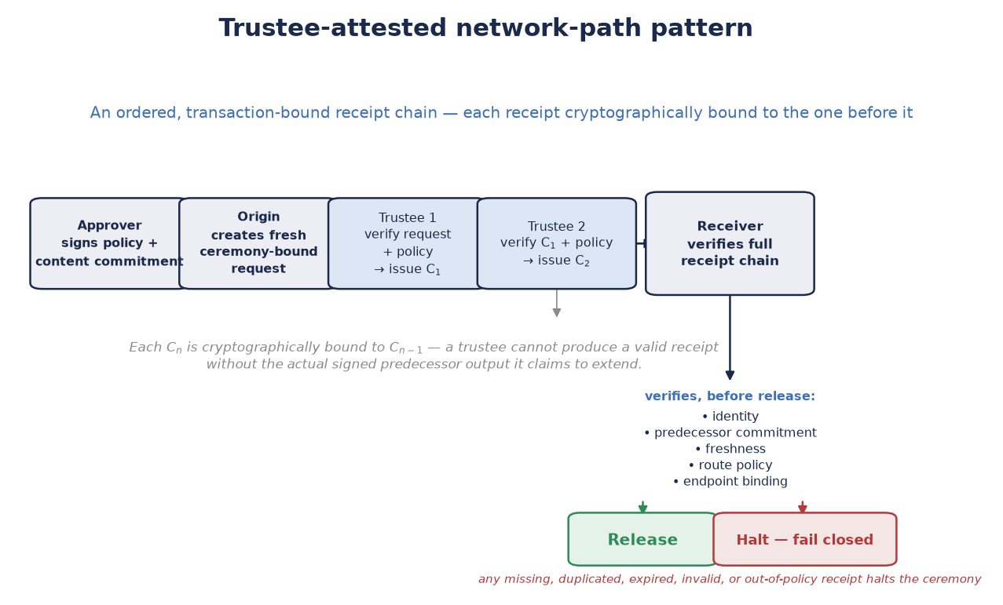
6.3 — VIGNETTE C
ILLUSTRATIVE — NOT A REAL DEPLOYMENT
Trustee-Attested Participation Along a Trusted Network Path
Mission: evidence of trustee participation and policy-controlled release — not a substitute for TLS, IPsec, or endpoint authorization. A signed receipt establishes that its signer participated; it does not by itself establish physical transit or honest behavior.
SHARDIC
26

Slide 27
6.4 — CRITICAL USE CASE
DESIGN PROPOSAL — SYNTHESIS OF §4.1–§4.7 & §6.5
Enforcing Human-AI Mutual Oversight
A trustee is, cryptographically, just a party that independently holds a shardic encryption key and chooses whether to contribute it — nothing in the math cares whether that party is a person or a policy-bound software agent.
Human-in-the-Loop Over an AI-Initiated COA
AI Validation Against a Rogue Human-Initiated COA
An AI system proposes or is positioned to initiate a consequential action. A threshold of independent human trustees means it cannot execute on the AI’s own confidence, speed, or internal state alone — the DEK simply does not exist below threshold, no matter how certain or time-pressured the system is.
A human trustee, or a colluding group below sub-threshold, attempts to authorize an action that should not proceed. An independent AI evaluator gate — attesting only against allow-listed objective criteria — supplies a check no social engineering, authority, or urgency can talk it out of: it either finds the criteria satisfied or fails closed.
Neither direction makes shardic “smarter” — no anomaly detection, no learned policy, no model in the cryptographic path. Both are the same information-theoretic guarantee: below threshold, a class of party — human or AI — carries zero information toward reconstruction on its own.
SHARDIC
27

Slide 28
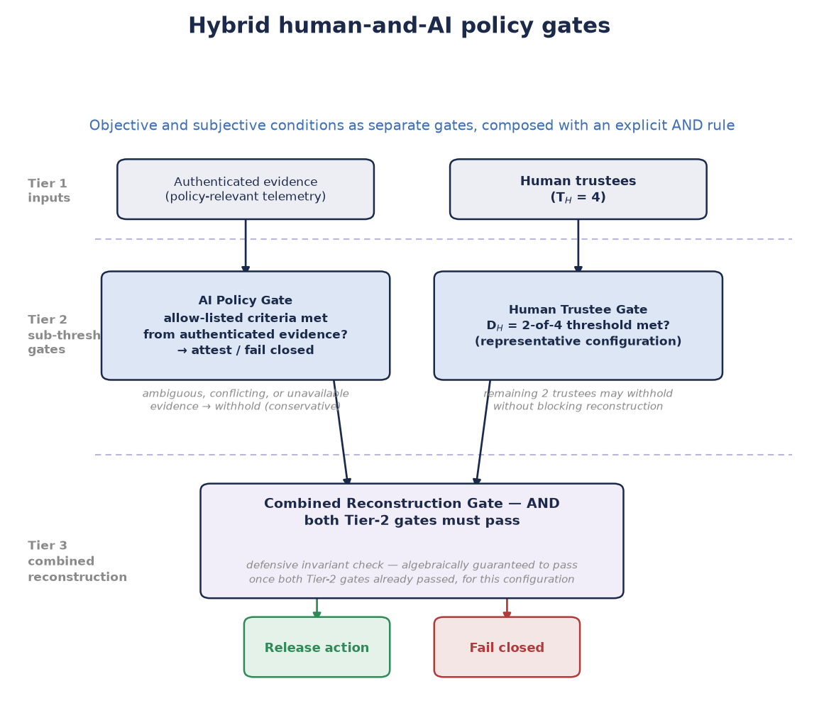
6.5 — VIGNETTE D
ILLUSTRATIVE — NOT A REAL DEPLOYMENT
Hybrid Human-and-AI Policy Gates for SPAC Authorization
Mission: objective and subjective conditions as separate, explicit gates, composed with an AND rule server-side. An AI evaluator is one evaluation gate among several server-side checks — never a substitute for the human threshold it either receives from or defends against.
SHARDIC
28

Slide 29
5.2 – 5.3 — SECURITY DISCUSSION
New Failure Modes, Each Addressed by Design
Fielded-System Binding
Content Authenticity vs. Integrity
A copied CT SPAC plus a legitimate quorum would arm the action anywhere without §4.2. Reuses §3.5's one-time-pad mathematics unmodified — an algebraic guarantee, not a policy one.
AES-GCM guarantees exact recovery of what was encrypted, not that it was correct. The Approver role (§4.4) closes this gap with an independently signed commitment.
Single-Operator / Custodian Sufficiency
RTO as a Stated Trade
Neither role being singular weakens the guarantee — neither can originate a ceremony action alone. A sufficiency argument, not an availability one.
Every latency reduction is pre-positioning of already-required inputs. A fast, networked ceremony trades away the friction a slower, dual-custodian one deliberately keeps.
SHARDIC
29

Slide 30
5.4 — SECURITY DISCUSSION
Software vs. Hardware-Anchored Enforcement
RISK-REDUCTION
TAMPER-ANCHORED
Software-Only Patterns
Hardware-Anchored Patterns
Capability binding and the constrained state machine still rest on the integrity of the code that enforces them. A sufficiently privileged insider who can modify that code can in principle modify the path around the ceremony as easily as around any other check.
Secure-element-internal sequencing and the physical interlock reach the same bar §7.2 claims for the threshold math itself — bypassing them requires compromising the tamper-resistant hardware boundary, or physically defeating a circuit, not modifying software logic that runs outside it.
Non-bypassability claims must specify which surface they cover. A deployment adopting SPAC for a genuine non-bypassability requirement should treat the software-only patterns as necessary but not sufficient, and reach a hardware-anchored tier wherever an undetected topological bypass would be unacceptable.
SHARDIC
30

Slide 31
5.5 — SECURITY DISCUSSION
NEAT: A Design Framework for Critical SPAC Deployments
Four properties a critical deployment needs beyond the shardic threshold math alone — a deployment framework, not a cryptographic one.
N — Non-bypassable
E — Evaluable
The ceremony sits on every route to the protected value — no side channel, maintenance mode, or admin override reaches the end state without it (§4.6, §5.4).
The mechanism enforcing the ceremony is small and standards-based enough to be independently verified — not a black-box system taken on faith.
A — Always-invoked
T — Tamper-proof
Every recovery or arming attempt is routed through the ceremony, with no exception path — no debug flag or maintenance procedure reaches the end state a different way.
The mechanism can’t be modified or subverted without compromising the same tamper-resistant boundary that protects the cryptographic material itself (§5.4).
NEAT is a deployment framework, not a cryptographic one — nothing about it changes the D-of-T guarantee. It’s the bar for deployments where risk-reduction alone (as in Vignettes A/B) isn’t enough.
SHARDIC
31

Slide 32
7.2 — SUMMARY
Advantages
No lone-actor risk
Graceful trustee-loss tolerance
Zero metadata leakage
Recovery is mathematically impossible below threshold, not just procedurally discouraged.
Any D of T is sufficient — survives unavailable or non-cooperating trustees.
The vault file alone reveals no trustee-to-shard mapping, even under direct inspection.
Self-describing recovery
Mandatory-signer variant available
Fail-closed throughout
KDF method and parameters travel with the vault — no external config to match.
shardic-prime, without weakening the underlying guarantees.
Insufficient or incorrect codewords stop the operation — no silent-degradation path.
Live, end-to-end verified
Generalizes past file decryption
Composable trustee classes
Ceremony formation, envelope wrap/deliver, and recovery run today against real Keycloak infra with a live dashboard — not a paper design.
The same guarantee gates an arbitrary protected action, network-path attestation, or hybrid human-AI ceremony, not only file recovery.
AI evaluators, hardware relay nodes, and human trustees can all participate in one threshold-recovery framework, math enforcing that no class acts alone.
SHARDIC
32

Slide 33
7.3 — SUMMARY (1 of 2)
Limitations — And How They're Mitigated
Codeword strength is the real bottleneck for the base scheme.
Static, split-once design — no live rotation.
Largely moot with shardic-envelope (§3.6). Otherwise: use adequate word count, review the tool's own entropy estimate, and prefer Argon2id.
Intentionally scoped to rare, offline break-glass access. Frequent/live authorization: use FROST or HSM-backed multisig instead.
The .krypt file is a single point of availability failure.
Doesn't scale limitlessly — 255-trustee GF(256) ceiling.
Back up the container durably — unlike the legacy split-file format, there is only one file to protect.
Fits double-digit trustee models by design; use it where it fits the need.
SHARDIC
33

Slide 34
7.3 — SUMMARY (2 of 2)
DESIGN-STAGE LIMITATIONS
Limitations — SPAC & Notional Missions
The SPAC extension (§4, §6) is an unimplemented design.
AI trustee data-feed integrity is an open design question.
Path-trustee chain liveness has no slack at D = T.
The cryptographic core (§3.1–§3.5) is unmodified and reused as-is; LocalUnlockFactor, PUF/secure-element choice, and the extraction-grant wire format remain open integration decisions, not open cryptographic questions.
Feed authentication and AI trustee hardening are not yet designed. Mitigation: treat AI trustee agents as shardware-token equivalents; require multi-source feed authentication.
An all-of-N path-trustee configuration tolerates zero unavailable relay nodes. Mitigation: register alternate-route trustees at ceremony formation; set D < T where the deployment can tolerate a redundant route.
SHARDIC
34

Slide 35
10 — PATH TO PROOF OF CONCEPT
What Funding Buys: A Phased Roadmap
The base scheme’s maturity isn’t in question — that risk is already retired. What remains unbuilt is everything that turns proven cryptography into a fielded, demonstrable capability.
1 — Core Hardening
2 — First SPAC Vignette (SW-only)
3 — Hardware-Anchored Variants
4 — Novel Mission Types
Automated tests for gf256_sss.py & krypt_container.py; published benchmark data across T/D profiles.
End-to-end build of the treasury-disbursement mission — a commodity HSM stands in for the not-yet-chosen secure element.
shardware-token physical carriage, then PUF-sealed embed/extract against a real secure-element target.
Path-trustee network integrity and hybrid human-AI policy gates — built and demonstrable, not just specified.
TRL 4 → 5
TRL 2 → 4
TRL 4 → 5–6
TRL 1 → 3
None of this requires inventing new cryptography — all of it is engineering, integration, and, for the hardware-anchored tiers, physical hardware to build against.
SHARDIC
35

Slide 36
“Math beats policies and permissions
for enforcement.”
Threshold recovery below D trustees is enforced by mathematics — not bypassable by any administrator, insider, or software defect in the recovery tool itself.
github.com/splashd1/shardic
SHARDIC · Sharded Encryption for Threshold-Recoverable Vaults

