Slide 1
Intro to Transistors Part 1
Orientation and Scope of this session
  Conventional current flow notations used everywhere
  Functional, functional, functional
  References to theory and “how it really works: no, really” in handouts
  A few simple device types and a few use cases
Bipolar transistor operation
  Touch on Exercises
N Channel (logic level) Field Effect transistor operation
  Exercises

Slide 2
Junction Transistors
Three terminals: Emitter, Base, Collector
Many sizes and characteristics
All share this behavior:
  In normal operation relatively small changes of current flow through the base control larger current flow through the emitter and collector
  See figure 4.51 on page 436 of Practical Electronics for Inventors, Scherz and Monk, 3rd edition, 2013. (A copy will be passed around at the session)

Slide 3
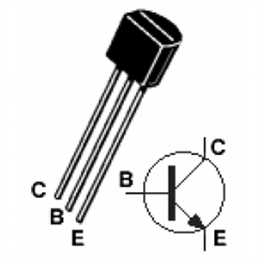
Physical vs Schematic
http://www.hobbytronics.co.za/p/607/npn-transistorp2n2222a-06a-ic-10vce

Slide 4
Operation: NPN Details
(“Simple Common Emitter” simulation with http://everycircuit.com)

Slide 5
Exercise 1: Duplicate the simulation
BOM (bill of materials):
  Solderless breadboard (aka “protoboard”)
  4.5 volt battery pack (connects to BOTTOM RAILS ONLY) and pushbutton switch
  Little blue “104” 100k ohm trimmer potentiometer (variable resistor)
  “brown black orange” 10000 ohm resistor
  2N3904 NPN transistor
  Jumpers and multimeters

Slide 6
Volts are easy: amps are harder
We’ll measure voltage in our circuits for three reasons:
  The digital meter reading voltage usually won’t interfere with the circuit. Measuring current can mess up circuit operation due to “burden voltage” (the small, but maybe relatively large voltage drop used to measure the current)
  Have to swap leads with most meters
  Forgetting to swap back can blow a fuse

Slide 7
Amps = Volts / Ohms
Measure voltage from one end to the other of the 10k (10,000 aka “brown black orange”) resistor

Slide 8
But it doesn’t DO anything!
(Getting to Blinky CE simulation 1)
Exercise in parallel:
  BOM adds an LED

Slide 9
Still not doing anything!
What could be wrong?
How much current does the LED require to light? More than 40-odd microamperes!
  Typical LEDs like this work well with 1-20 milliamperes
Fix the collector resistor
  LED drops two volts, so resistor drops three (transistor resistance ignored)
  5 milliamperes = three volts / 600 ohms (510 close enough)
  Replace 10k resistor with “green brown brown” 510 ohm resistor

