Slide 1
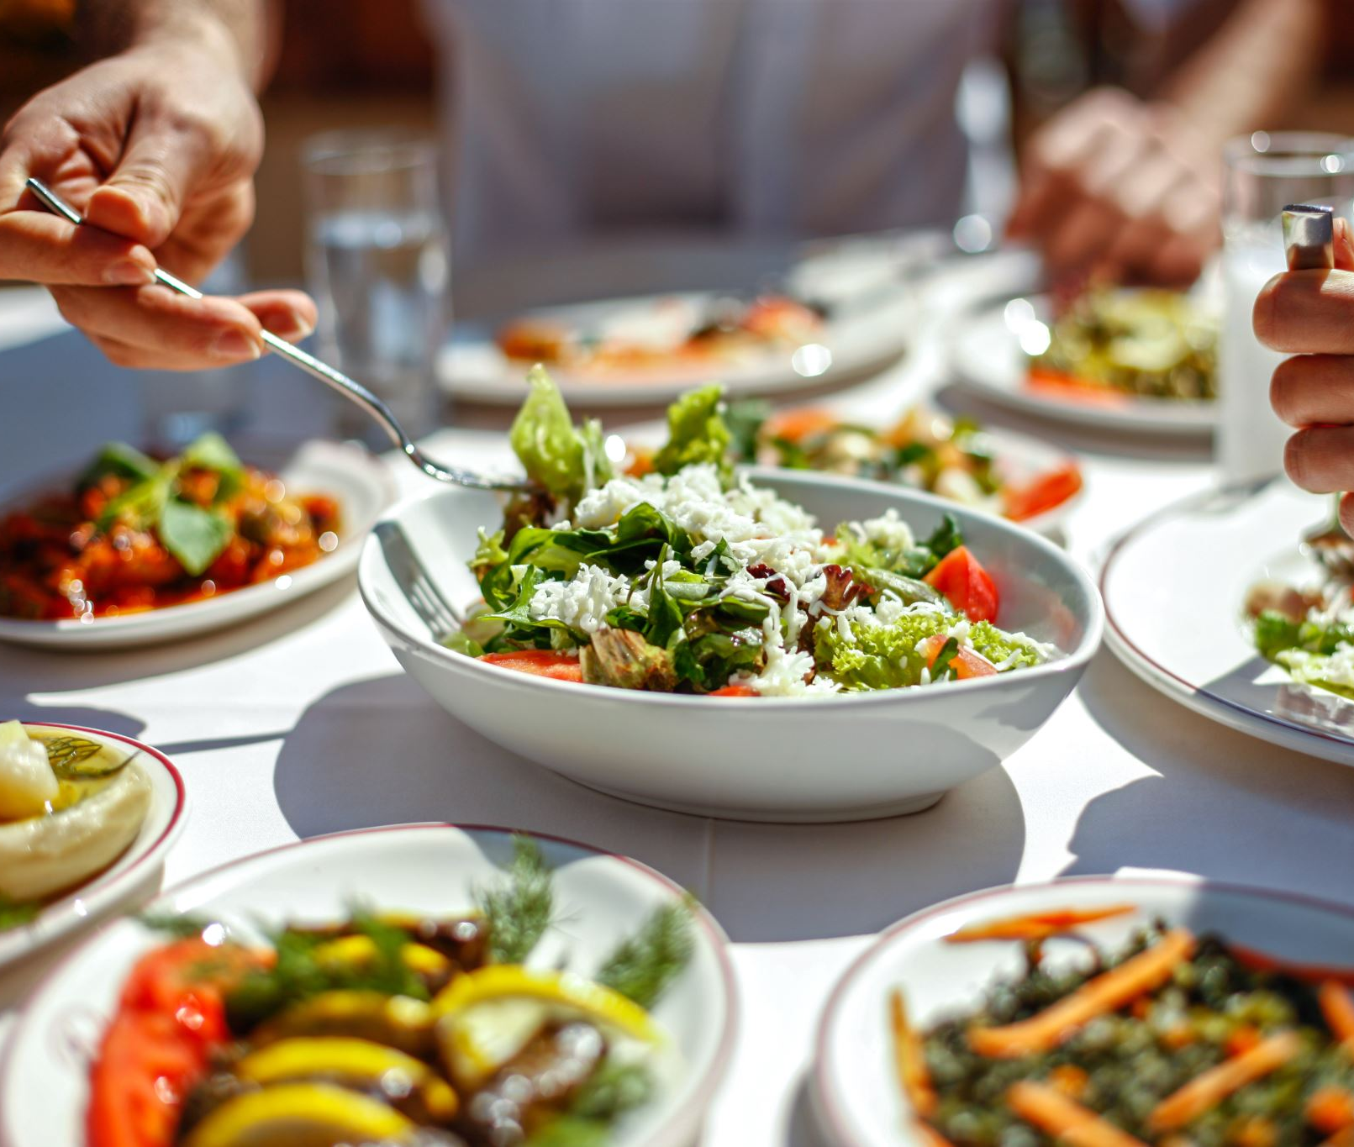
Welcome to Quantum Cuisine
An exclusive culinary experience where we pair quantum computing with wine tasting.

Slide 2

Appetizer - Quantum Terminology
Before we dive into the main course, let's familiarize ourselves with some quantum lingo.

Slide 3
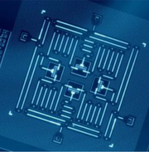
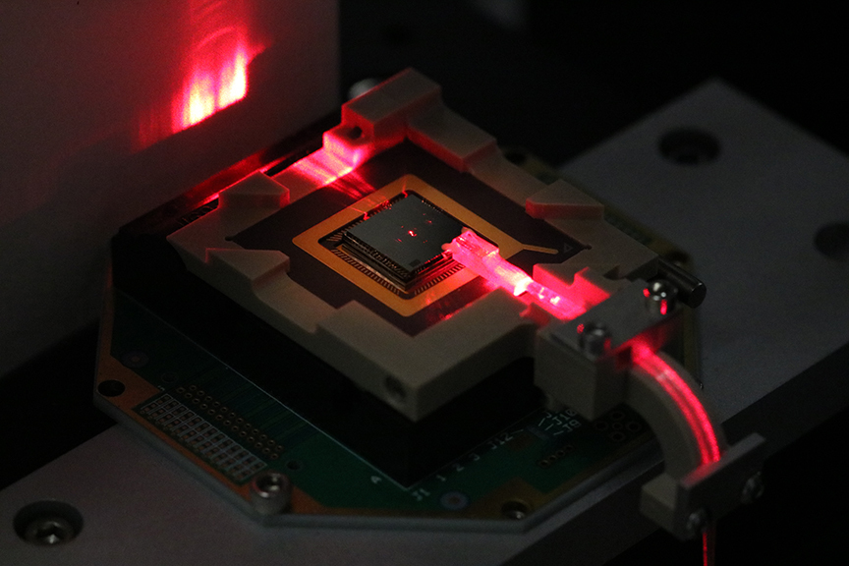
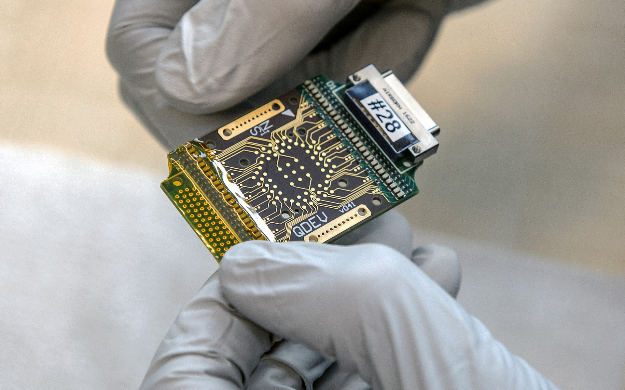
Qubits
what it is and how it’s controlled
Superconducting:
circuits that can carry an electric current without resistance
microwave pulses
Trapped Ion:
individual ions that are trapped and isolated in electromagnetic fields
lasers
Topological:
anyons or other exotic quasi-particles
“braiding” the particles around each other in a specific pattern

Slide 4
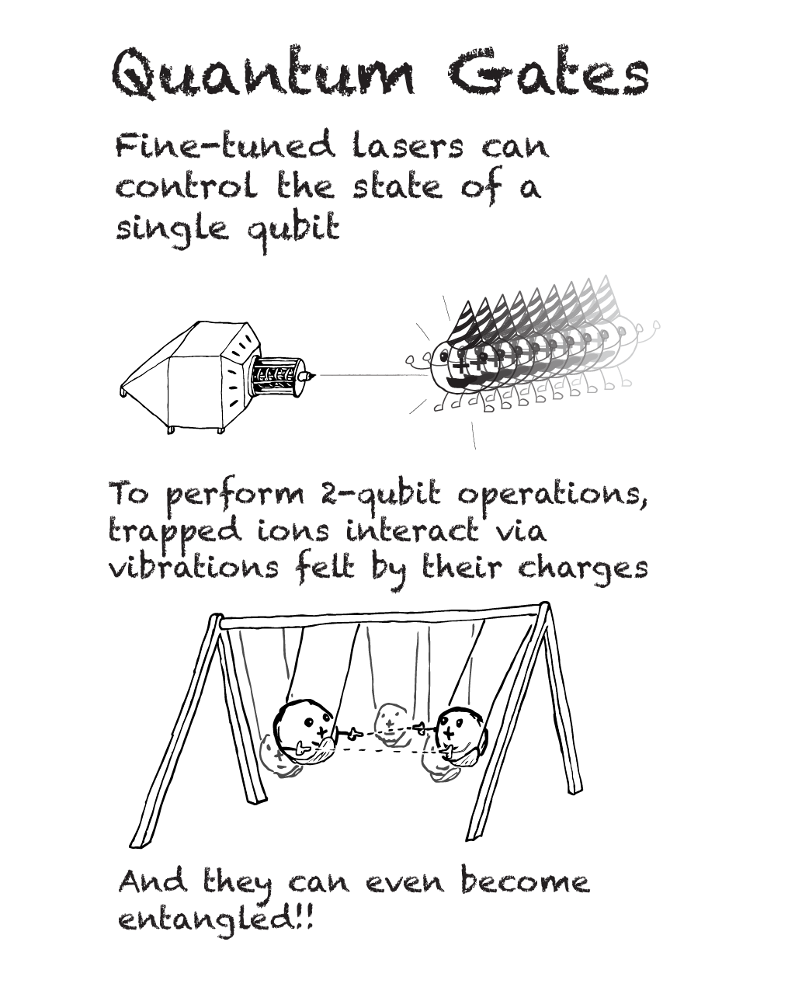
Mechanics
Superposition:
the ability of a quantum system to exist in multiple states simultaneously
a superposition of 0 and 1 is not both 0 and 1, neither 0 nor 1, not 0, and not 1
Entanglement:
a physical resource that allows qubits to be in correlated states, necessary for certain quantum algorithms and protocols

Slide 5


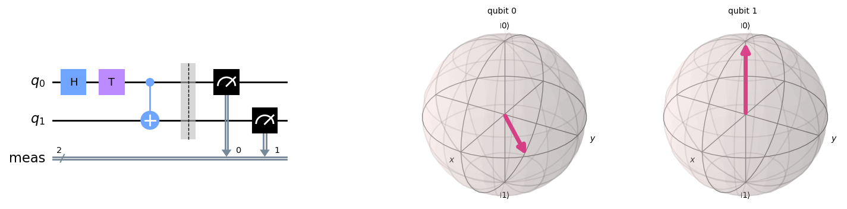

Software
Qubit
the quantum analog of a classical bit, capable of existing in a superposition of states
Quantum Gate
an operation that changes the state of a qubit or set of qubits, analogous to a logical gate in classical computing
Quantum State
the complete description of a quantum system, usually expressed as a wavefunction or density matrix
Measurement
the process of observing a quantum system, causing it to collapse into one of its basis states
Bloch Sphere
a graphical representation of the state space and state vector of a single qubit
Quantum Circuit
a sequence of quantum gates and measurements that performs a specific computation
Quantum Algorithm
a step-by-step procedure for solving a problem using quantum computing

Slide 6
Starter – A simple quantum circuit
Comes with a side of visualizations

Slide 7
Second dish – Parameterized circuits
Pair your circuits with any angle you’d like!

Slide 8

Main dish - quantum optimization
Enjoy wine while we have quantum tell us how much to enjoy it

Slide 9
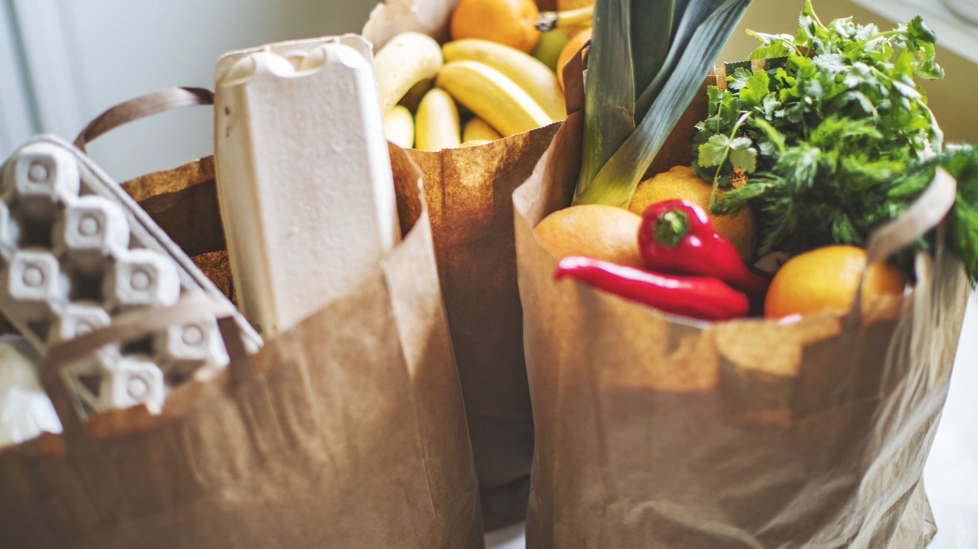
Optimizer App
Or you can order to-go and have all the food prepared and delivered

Slide 10
Dessert
Trapping Ions for Quantum Computing – Diana Prado Lopes Aude Craik
Qiskit Textbook – IBM Quantum
Quantum Computing: An Applied Approach – Jack Hidary

