Slide 1
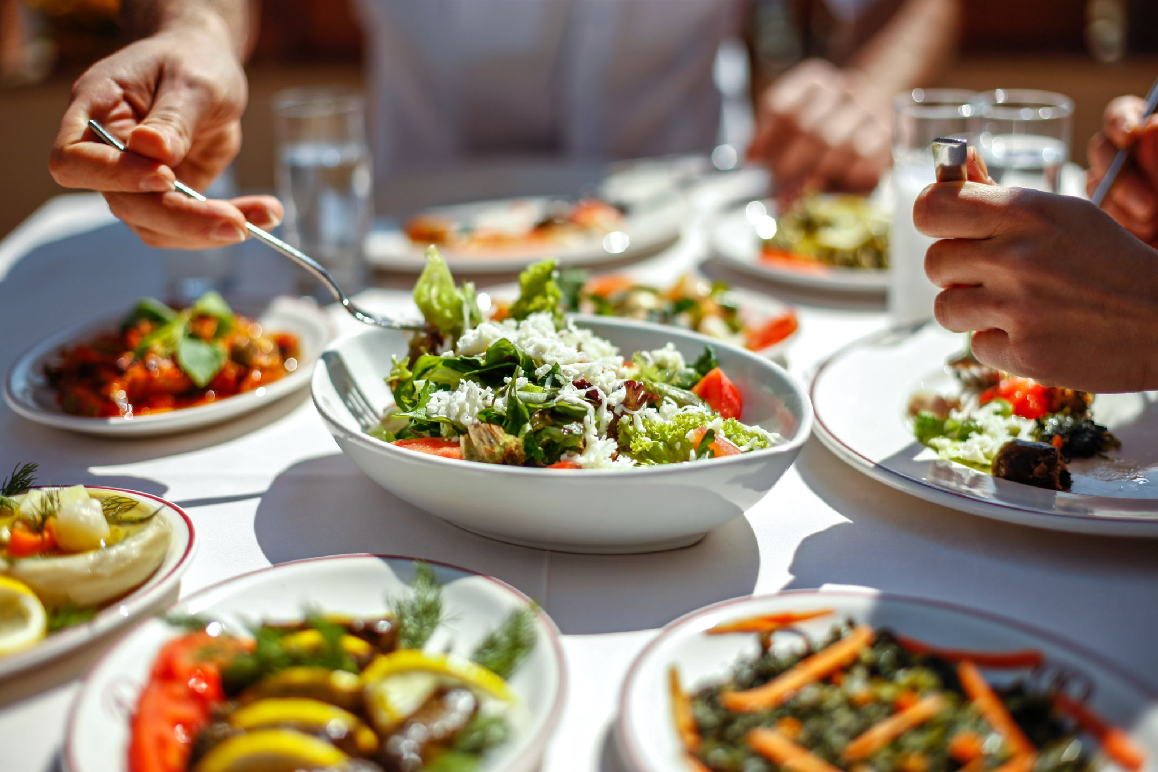
How to Use Quantum to Impress at Dinner
Cloud Team Presentation

Slide 2
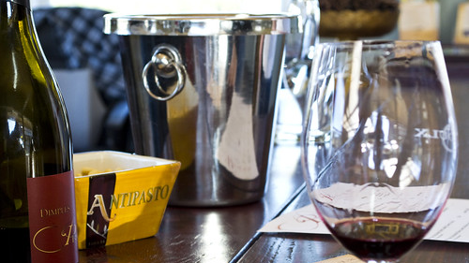
Welcome to Quantum Cuisine
Welcome to an exclusive culinary experience where we pair quantum computing with wine tasting.
This Photo by Unknown Author is licensed under CC BY-ND

Slide 3
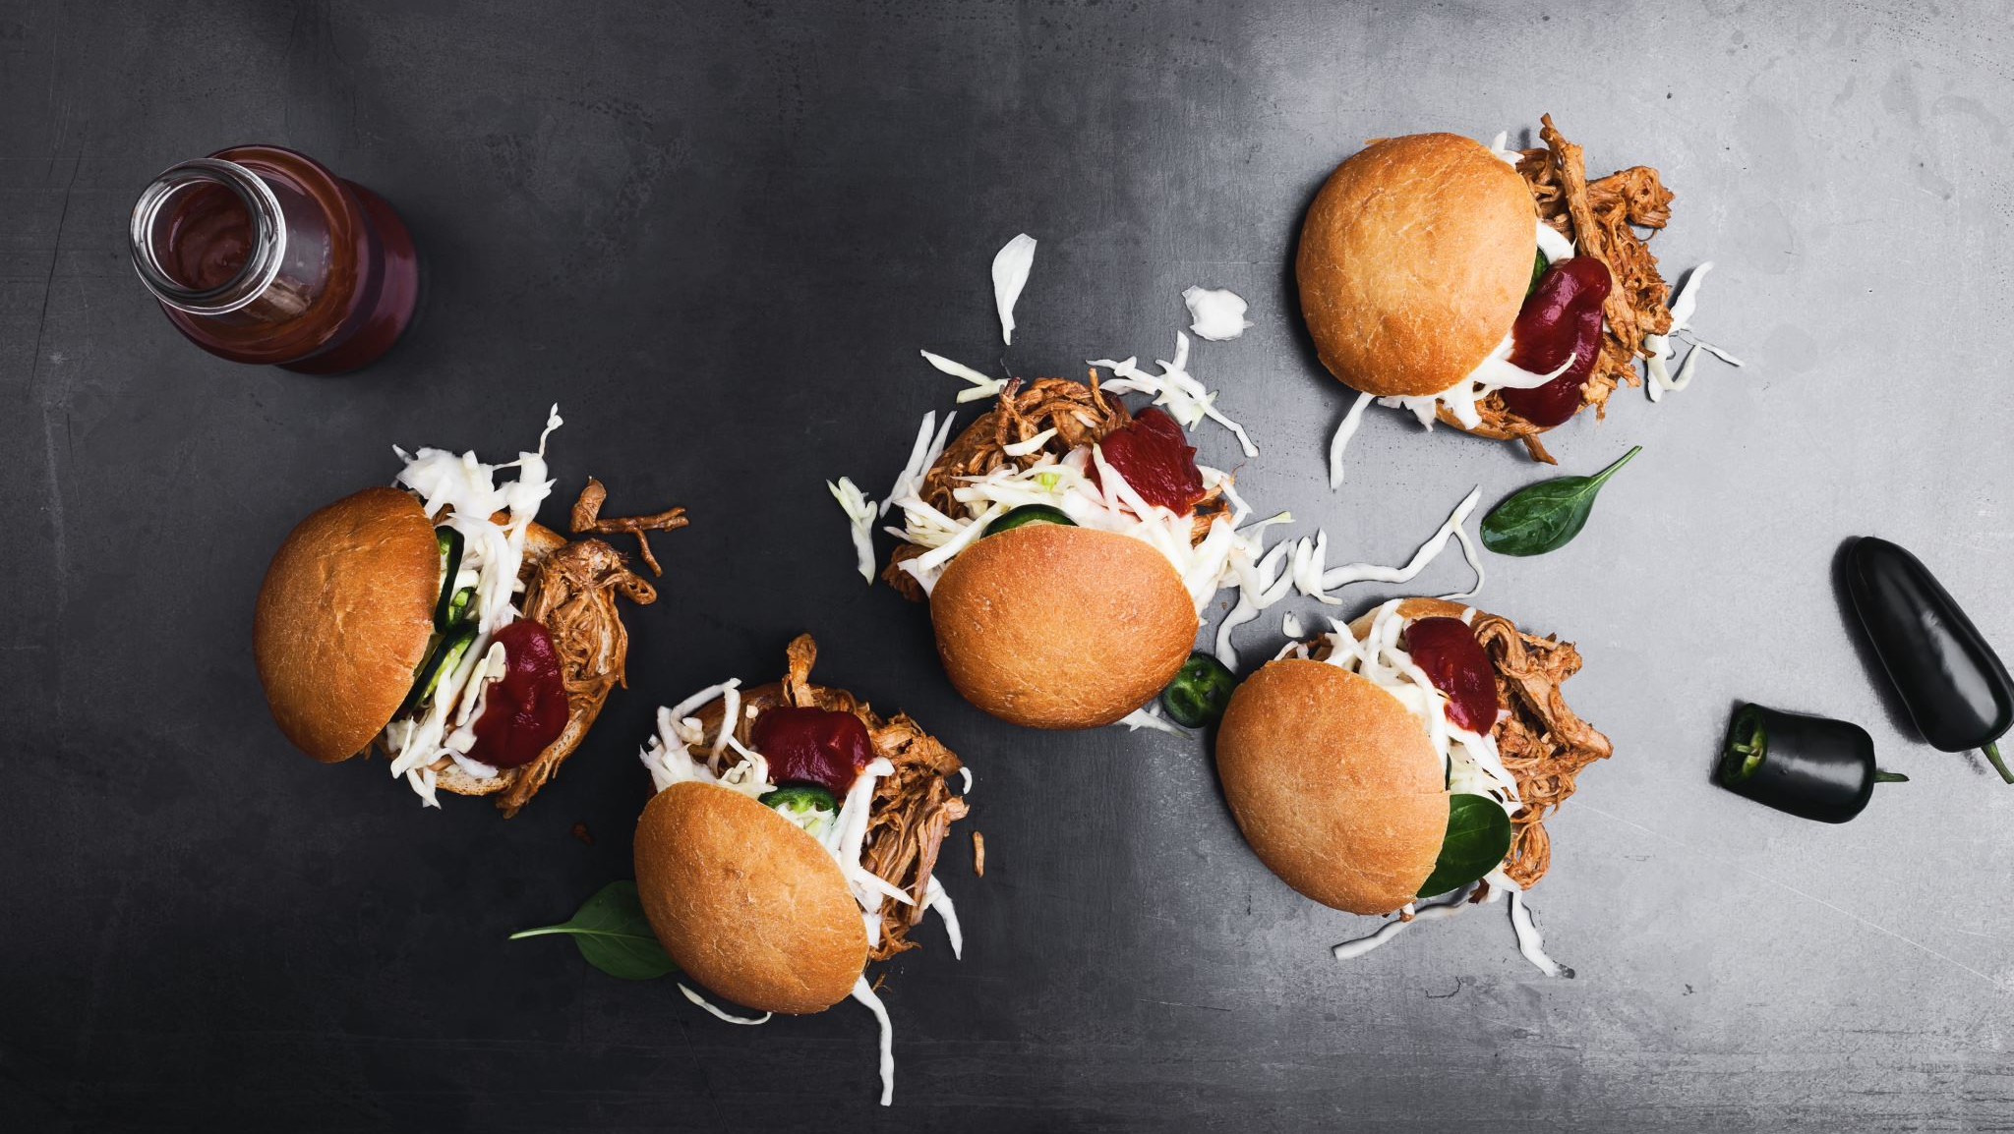
Appetizer - Quantum Terminology
Before we dive into the main course, let's familiarize ourselves with some quantum lingo.

Slide 4
Lingo
Hardware:
Qubits (what it is and how it’s controlled)
Superconducting:
circuits that can carry an electric current without resistance
microwave pulses
Trapped Ion:
individual ions that are trapped and isolated in electromagnetic fields
lasers
Topological:
anyons or other exotic quasi-particles
“braiding” the particles around each other in a specific pattern
Mechanics
Superposition:
The ability of a quantum system to exist in multiple states simultaneously
A superposition of 0 and 1 is not both 0 and 1, neither 0 nor 1, not 0, and not 1
Entanglement:
A physical resource that allows qubits to be in correlated states, necessary for certain quantum algorithms and protocols
Quantum Annealer
A specific type of quantum hardware designed to solve optimization problems
Software:
Qubit
The quantum analog of a classical bit, capable of existing in a superposition of states
Quantum Gate
An operation that changes the state of a qubit or set of qubits, analogous to a logical gate in classical computing
Quantum Circuit
A sequence of quantum gates and measurements that performs a specific computation
Quantum State
The complete description of a quantum system, usually expressed as a wavefunction or density matrix
Measurement
The process of observing a quantum system, causing it to collapse into one of its basis states
Bloch Sphere
A graphical representation of the state space and state vector of a single qubit
Quantum Algorithm
A step-by-step procedure for solving a problem using quantum computing
Notes:
Phase Shifters: These are optical devices that alter the phase of light waves passing through them, effectively changing the timing of the wave peaks and troughs without affecting their amplitude.

Slide 5

Starter – A simple quantum circuit
Comes with a side of visualizations

Slide 6
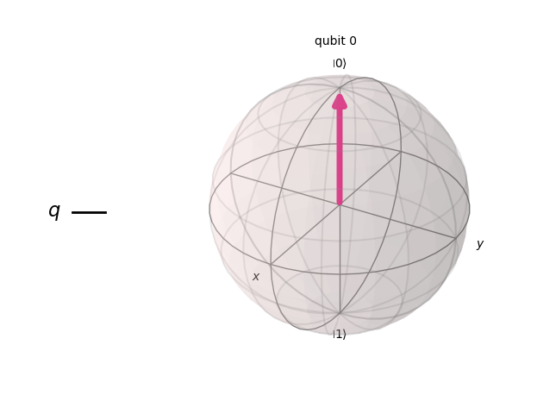
circuit = QuantumCircuit(1)
plot_circuit(circuit)
[1.0, 0​
0, 1.0​]

Slide 7
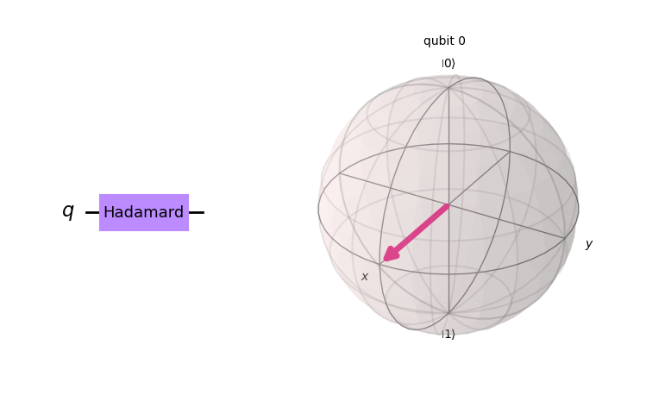
h_op = Operator(np.array(
[[1, 1],
[1, -1]]
) / np.sqrt(2))
circuit.unitary(
h_op, 0, label="Hadamard"
)
plot_circuit(circuit)
[0.707106781186547, 0.707106781186547
​0.707106781186547, −0.707106781186547​]
Notes:
Rotates state vector by π / 2 along the x-axis

Slide 8
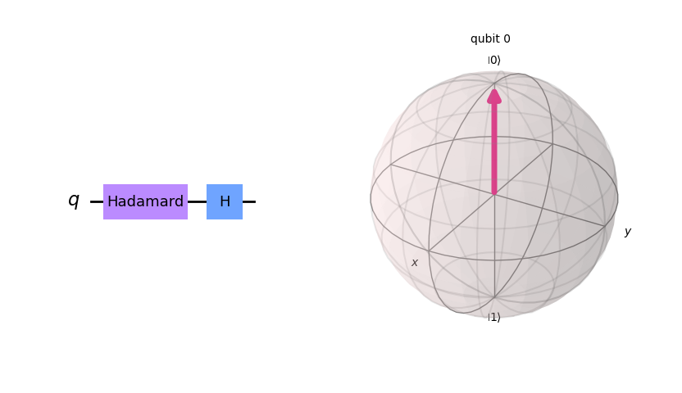
# quantum gates need to be reversible
circuit.h(0)
plot_circuit(circuit)
[1.0, 0
​0, 1.0​]

Slide 9
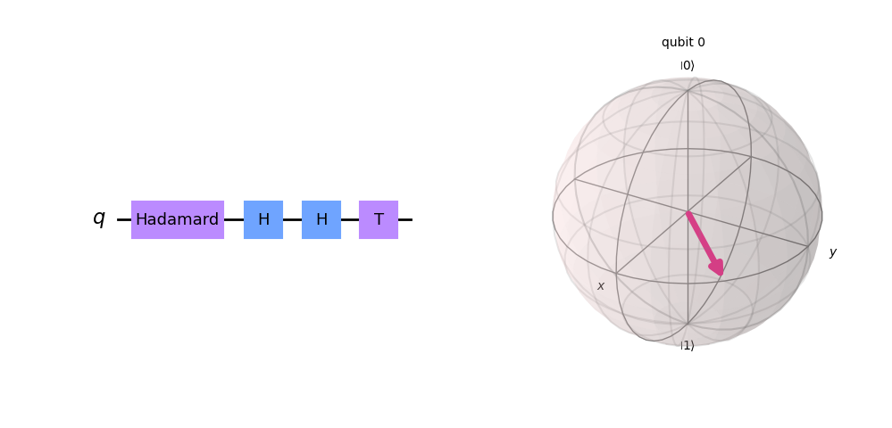
circuit.h(0)
circuit.t(0)
plot_circuit(circuit)
[0.707106781186547, 0.5+0.5i​
0.707106781186547, −0.5−0.5i​]

Slide 10
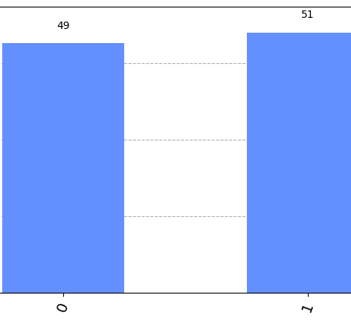
run_circuit(circuit, shots=100)

Slide 11
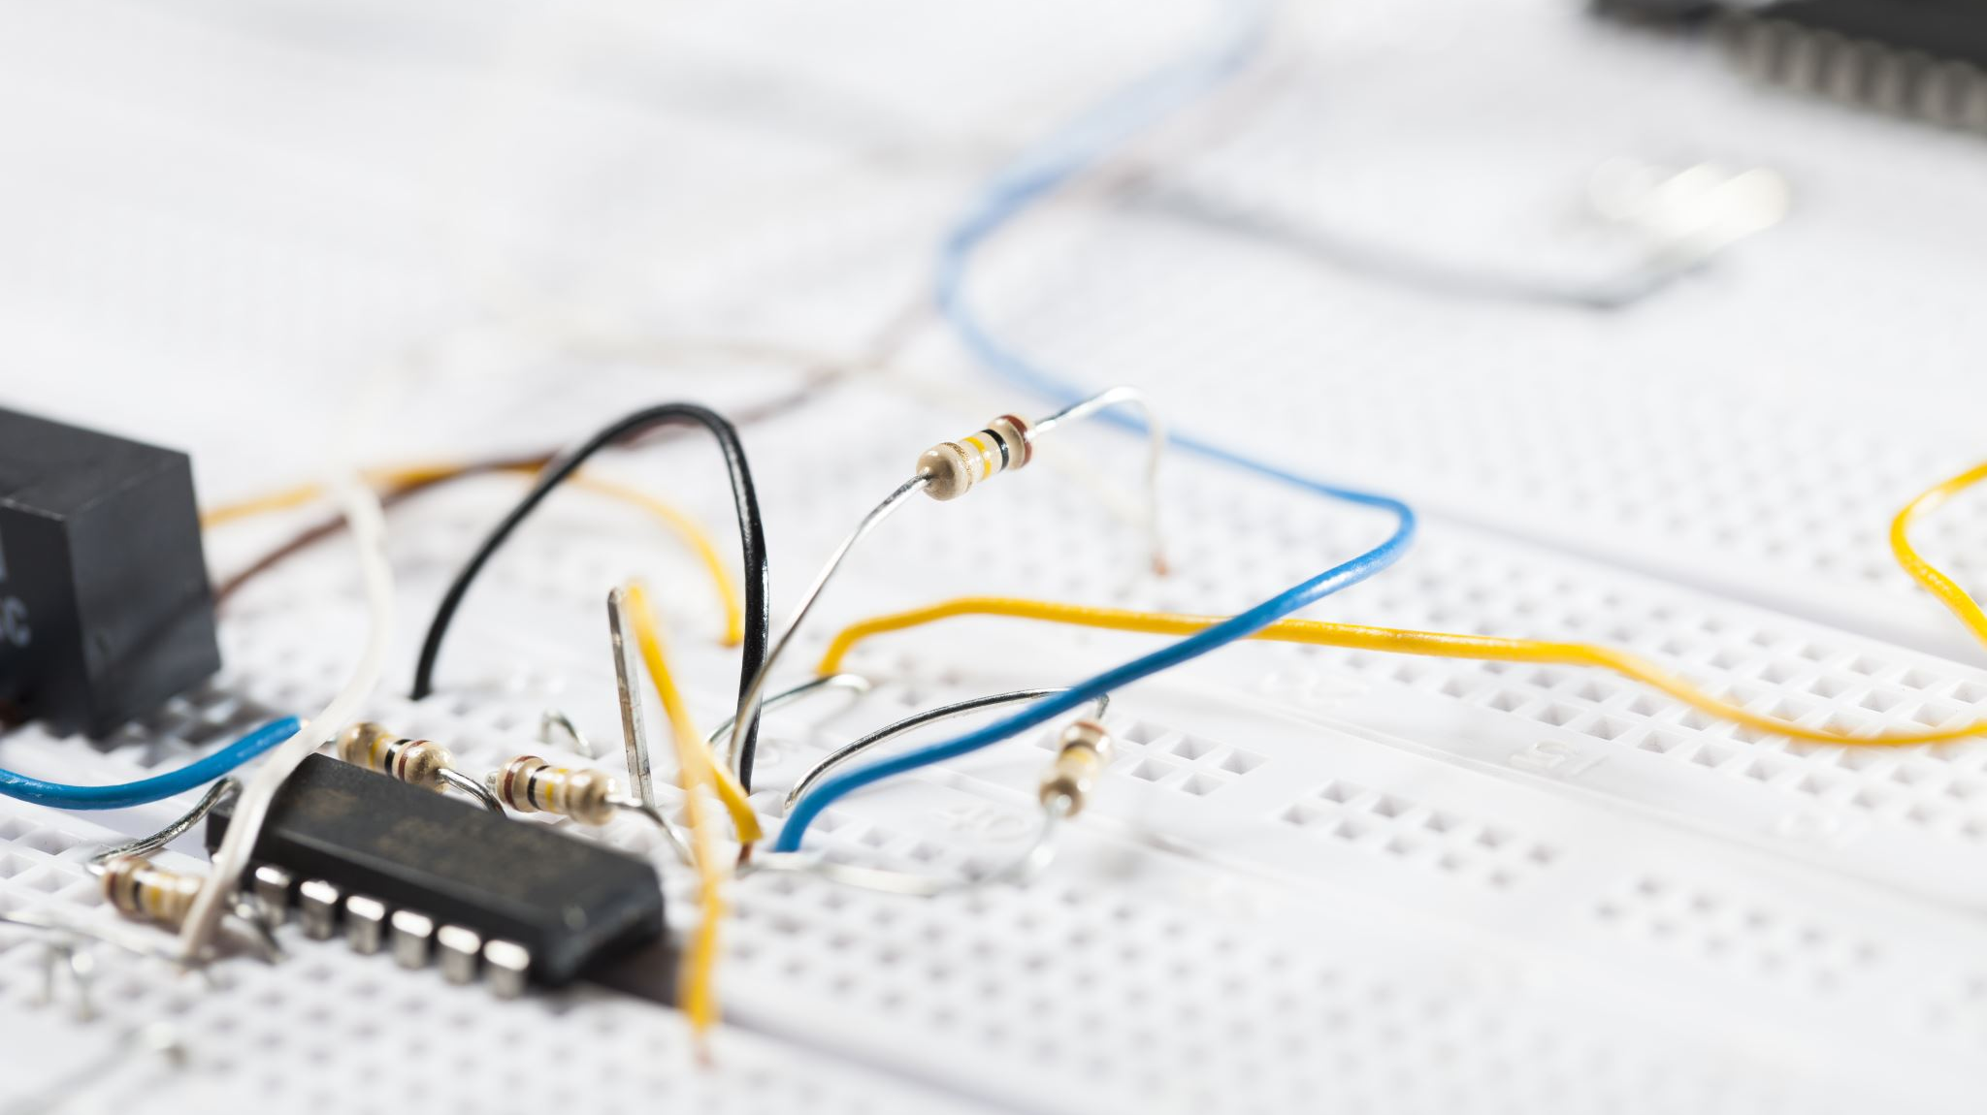
Second dish - Parameterized circuits
Pair your circuits with any angle you’d like!

Slide 12
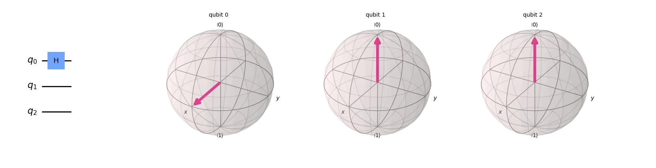
parameterized_circuit = QuantumCircuit(num_qubits)
parameterized_circuit.h(0)
plot_circuit(parameterized_circuit)

Slide 13
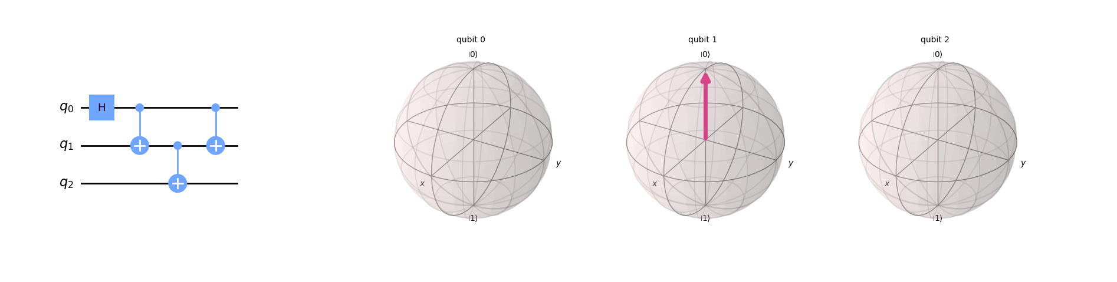
parameterized_circuit.cx(0, 1)
parameterized_circuit.cx(1, 2)
parameterized_circuit.cx(0, 1)
plot_circuit(parameterized_circuit)

Slide 14
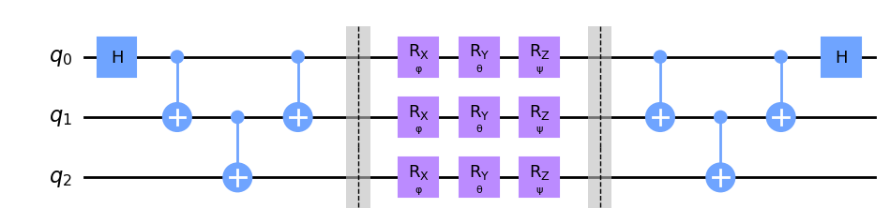
parameterized_circuit.barrier()
parameterized_circuit.rx(phi, range(num_qubits))
parameterized_circuit.ry(theta, range(num_qubits))
parameterized_circuit.rz(psi, range(num_qubits))
...
parameterized_circuit.barrier()
parameterized_circuit.cx(0, 1)
parameterized_circuit.cx(1, 2)
parameterized_circuit.cx(0, 1)
parameterized_circuit.h(0)
parameterized_circuit.draw("mpl")

Slide 15
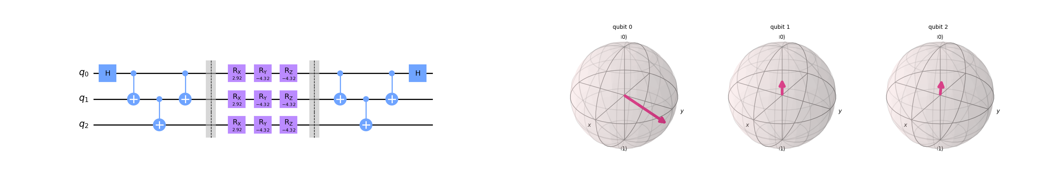
parameterized_circuit.assign_parameters(
{phi: random_angle() for _ in parameterized_circuit.parameters}, inplace=True
)
parameterized_circuit.assign_parameters(
{theta: random_angle() for _ in parameterized_circuit.parameters}, inplace=True
)
parameterized_circuit.assign_parameters(
{psi: random_angle() for _ in parameterized_circuit.parameters}, inplace=True
)
plot_circuit(parameterized_circuit)

Slide 16
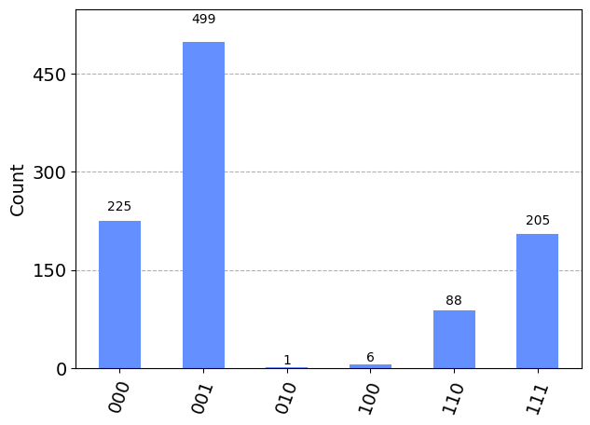
run_circuit(parameterized_circuit)

Slide 17

Main dish - quantum optimization
Enjoy wine while we have quantum tell us how much to enjoy it

Slide 18
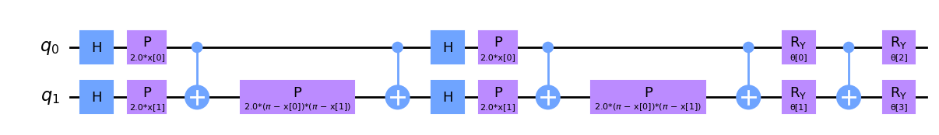
def create_qnn():
"""Create a Quantum Neural Network."""
feature_map = ZZFeatureMap(2)
ansatz = RealAmplitudes(2, reps=1)
qc = QuantumCircuit(2)
qc.compose(feature_map, inplace=True)
qc.compose(ansatz, inplace=True)
return EstimatorQNN(
circuit=qc,
input_params=feature_map.parameters,
weight_params=ansatz.parameters,
input_gradients=True,
)
class QuantumNet(nn.Module):
"""Hybrid Quantum-Classical Neural Network."""
def __init__(self, qnn):
super().__init__()
self.fc1 = nn.Linear(3, 2)
self.qnn = TorchConnector(qnn)
self.fc2 = nn.Linear(1, 2)
def forward(self, x):
x = nn.functional.relu(self.fc1(x))
x = self.qnn(x)
x = self.fc2(x)
return nn.functional.log_softmax(x, dim=1)
QuantumNet(
(fc1): Linear(in_features=3, out_features=2, bias=True)
(qnn): TorchConnector()
(fc2): Linear(in_features=1, out_features=2, bias=True)
)

Slide 19
Train and evaluate
def train_model(train_loader, model, optimizer, loss_func):
"""Train the model."""
total_samples = len(train_loader.dataset)
progress_bar = trange(EPOCHS * total_samples // BATCH_SIZE)
for _ in range(EPOCHS):
for data, target in train_loader:
optimizer.zero_grad()
output = model(data)
loss = loss_func(output, target)
loss.backward()
optimizer.step()
progress_bar.set_postfix(quality=target[0].item(), loss=loss.item())
progress_bar.update(1)
train_model(train_loader, model, optimizer, loss_func)
 | Precision | Recall | F1-Score | Support
Class 0 | 0.66 | 0.76 | 0.71 | 141
Class 1 | 0.78 | 0.69 | 0.74 | 179
Accuracy |  |  | 0.72 | 320
Macro Avg | 0.72 | 0.73 | 0.72 | 320
Weighted Avg | 0.73 | 0.72 | 0.72 | 320

Slide 20
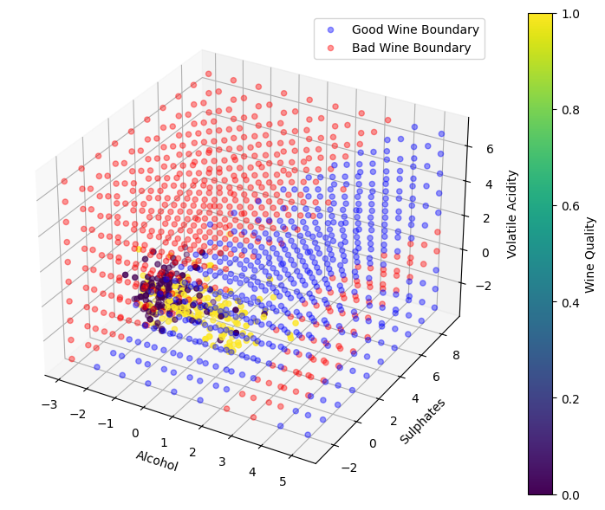
plot_3d_decision_boundary(
model,
train_loader,
test_loader
)

