Slide 1
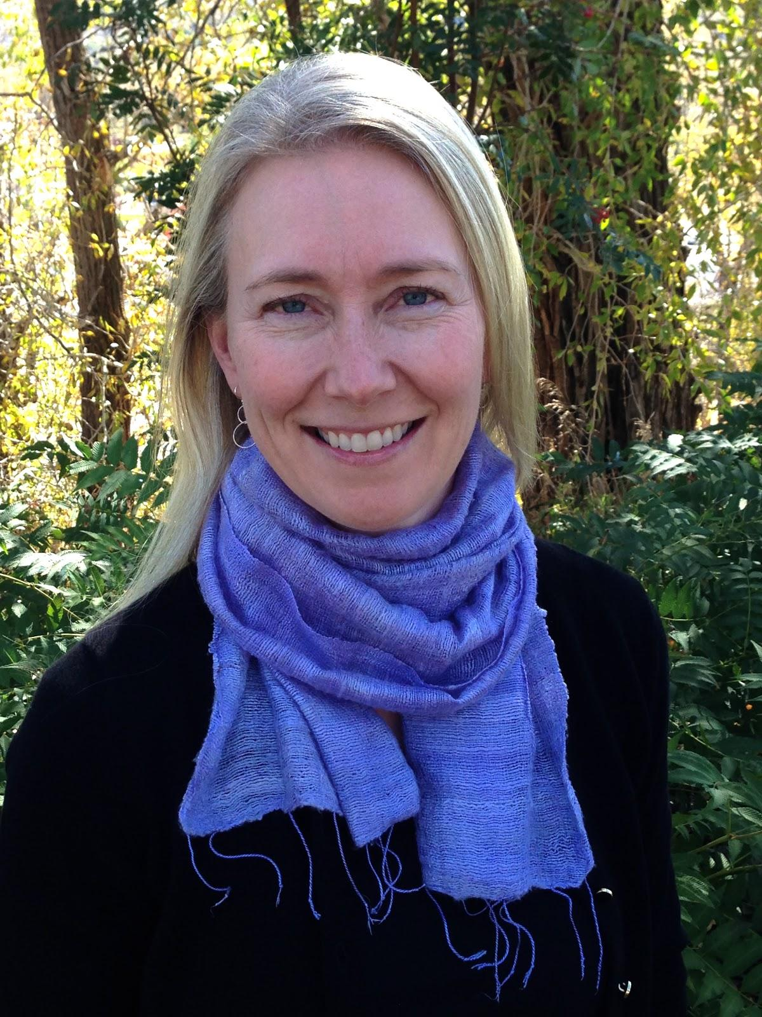
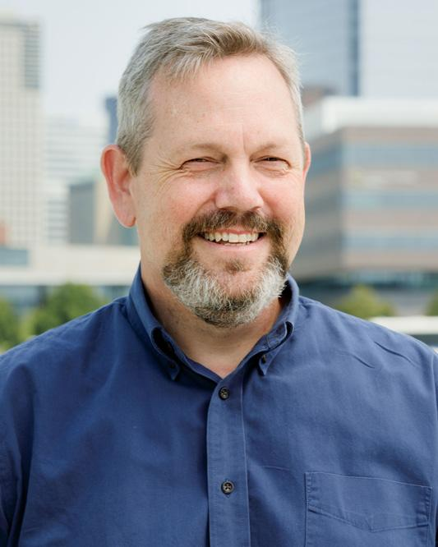
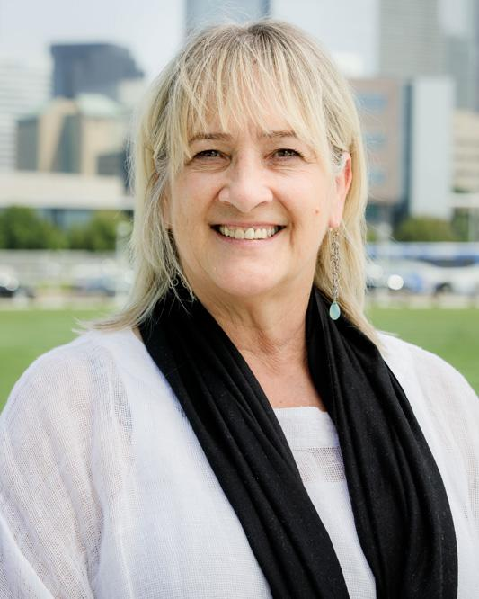
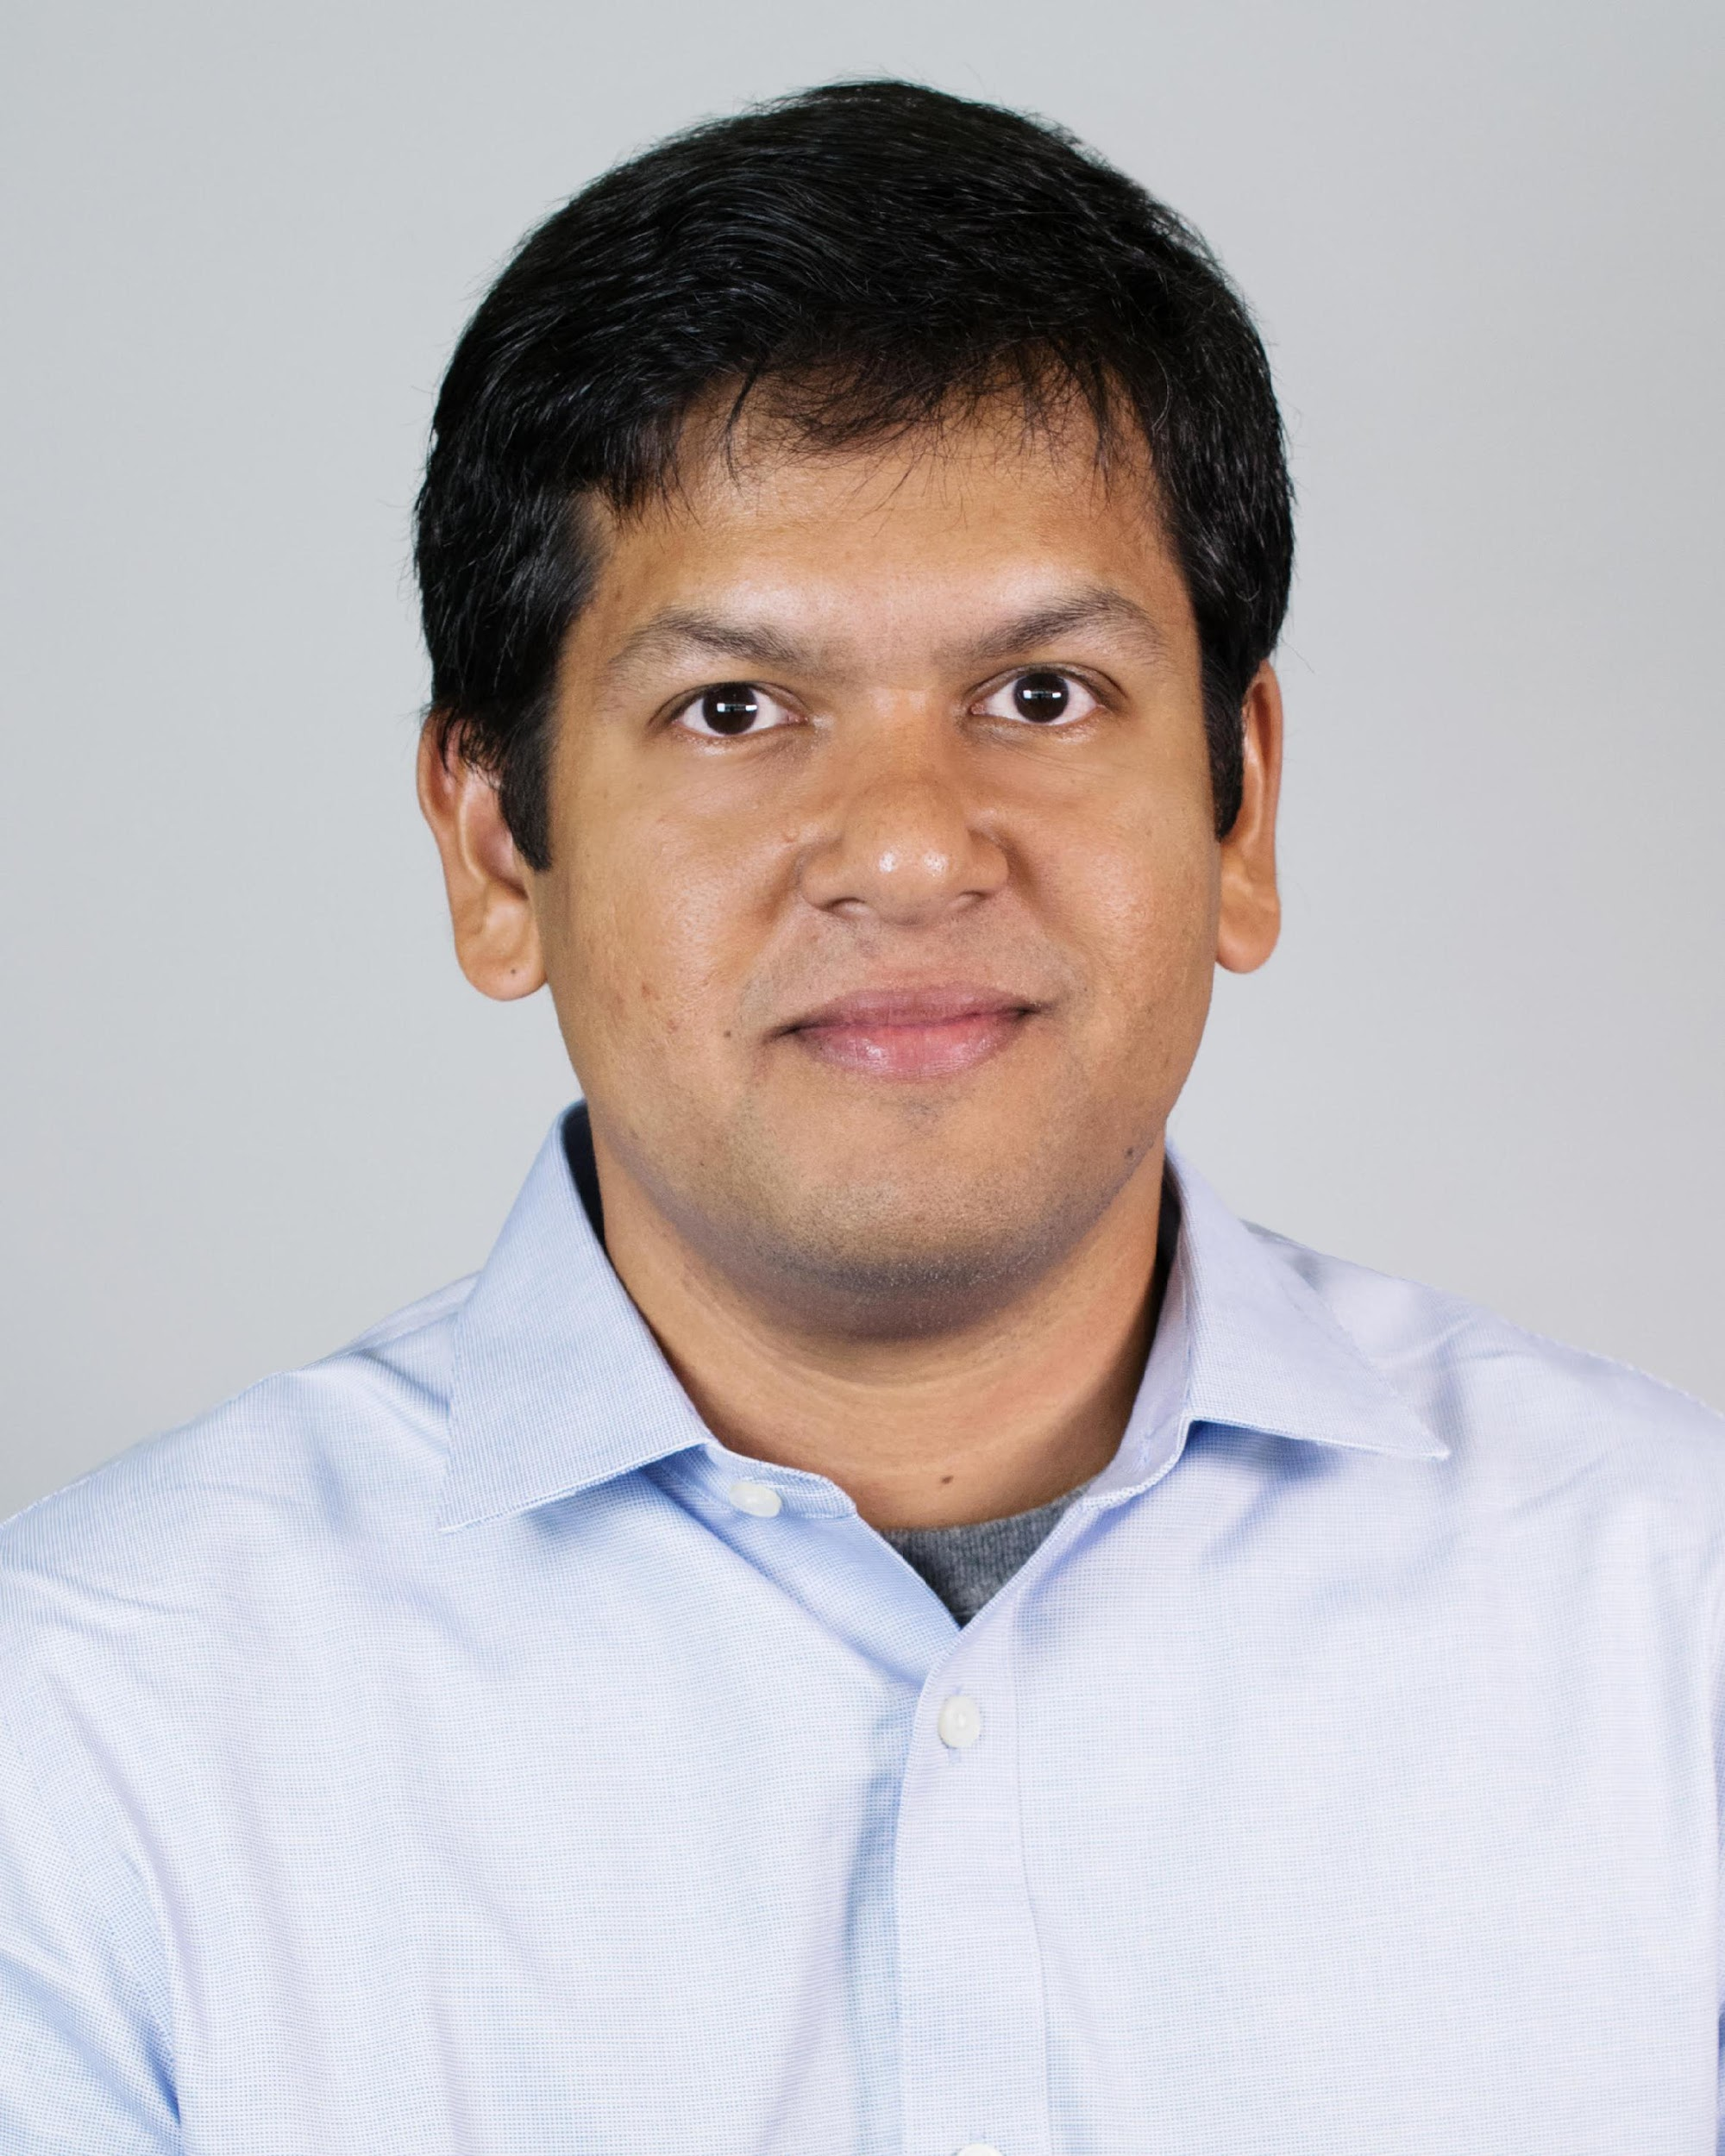
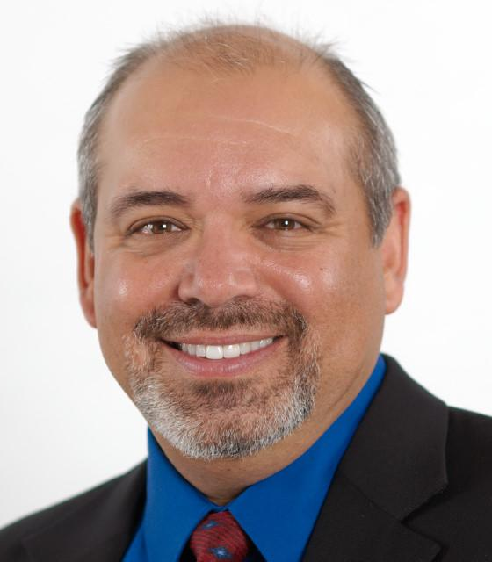
LivedX Team – Expert Advisors
Barbara Gueldner,
PhD
Social-emotional learning
Brad Hinson,
PhD
Educational Technology
Barbara Seidel,
PhD
Student Success
Ashis Biswas,
PhD
Machine Learning & Artificial Intelligence
Dan Ruparel,
BS
Business Advisor
Notes:
Add Courtney and Nancy Leech

