Slide 1
?
BRUSSELS · 16 JUNE 2026
QUIZ NIGHT
?
Permanent Representation of Lithuania to the European Union
Quiz Night · 16 June 2026 · Permanent Representation of Lithuania to the EU
Notes:
Host notes: welcome everyone and explain the team draw — slips with names of Lithuanian rivers and lakes at the door.

Slide 2




HOW TONIGHT WORKS
TEAMS
ROUNDS
Draw a slip at the door — the river or lake on it is your team.
Three rounds plus a bonus round. One point per question unless marked otherwise.
ANSWERS
FAIR PLAY
Write your answers down — we reveal and score after each round.
No phones. Diplomatic immunity does not cover googling.
Quiz Night · 16 June 2026 · Permanent Representation of Lithuania to the EU
Notes:
Team assignment: everyone draws a slip when entering — the slips carry names of Lithuanian rivers and lakes.

Slide 3



ROUND 1
EUROPE & FUN FACTS
1
Multiple choice · 6 questions · 1 point each
Quiz Night · 16 June 2026 · Permanent Representation of Lithuania to the EU

Slide 4
ROUND 1 · EUROPE & FUN FACTS
1
QUESTION 1 OF 6 · 1 POINT
Which European island changes sovereignty every six months?
Heligoland
Pheasant Island
A
B
Jersey
Bornholm
C
D
Quiz Night · 16 June 2026 · Permanent Representation of Lithuania to the EU

Slide 5
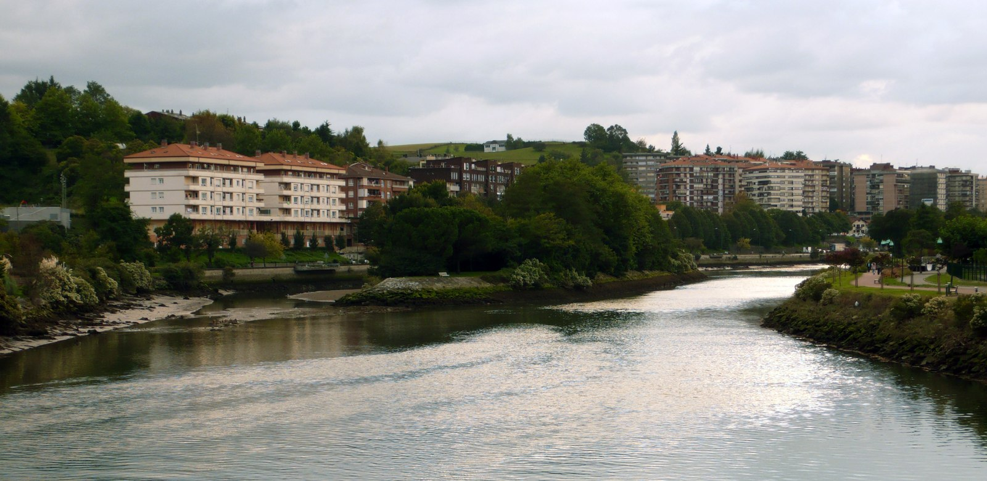
ROUND 1 · EUROPE & FUN FACTS
ANSWER · QUESTION 1
B — Pheasant Island
DID YOU KNOW?
Under the 1659 Treaty of the Pyrenees, France and Spain share this tiny uninhabited island in the Bidasoa river. Administration alternates between the two countries every six months — the world's oldest condominium.
Photo: Wikimedia Commons
Quiz Night · 16 June 2026 · Permanent Representation of Lithuania to the EU

Slide 6
ROUND 1 · EUROPE & FUN FACTS
2
QUESTION 2 OF 6 · 1 POINT
Which EU symbol was publicly unveiled about 40 years ago?
Euro coins
European flag
A
B
European anthem
Schengen passport
C
D
Quiz Night · 16 June 2026 · Permanent Representation of Lithuania to the EU

Slide 7
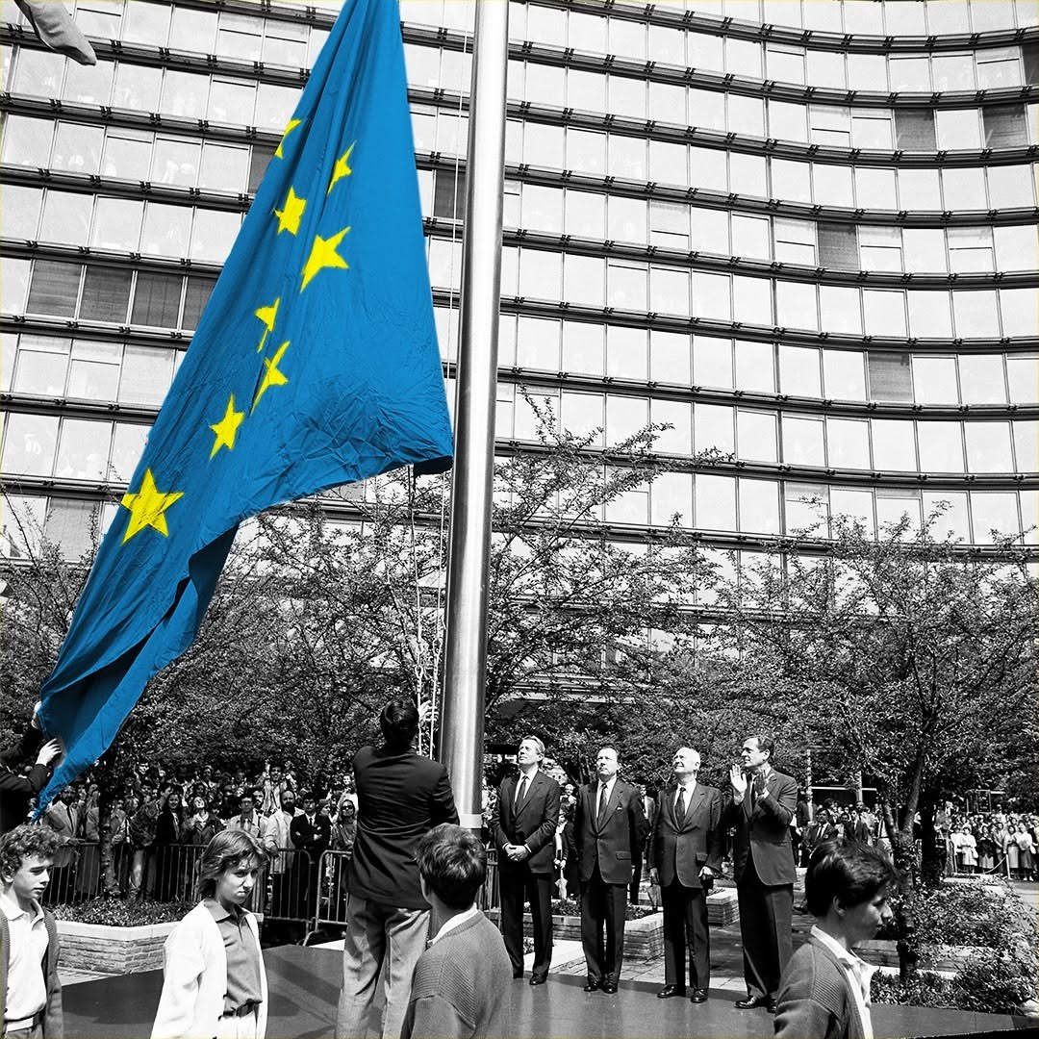
ROUND 1 · EUROPE & FUN FACTS
ANSWER · QUESTION 2
B — The European flag
DID YOU KNOW?
In May 1986 the European flag was raised for the first time outside the Berlaymont building — twelve gold stars in a circle, a symbol of unity, unchanged ever since.
Photo: © European Communities, 1986
Quiz Night · 16 June 2026 · Permanent Representation of Lithuania to the EU

Slide 8
ROUND 1 · EUROPE & FUN FACTS
3
QUESTION 3 OF 6 · 1 POINT
What major international award did the European Union receive in 2012?
Sakharov Prize
Nobel Peace Prize
A
B
Charlemagne Prize
Right Livelihood Award
C
D
Quiz Night · 16 June 2026 · Permanent Representation of Lithuania to the EU

Slide 9
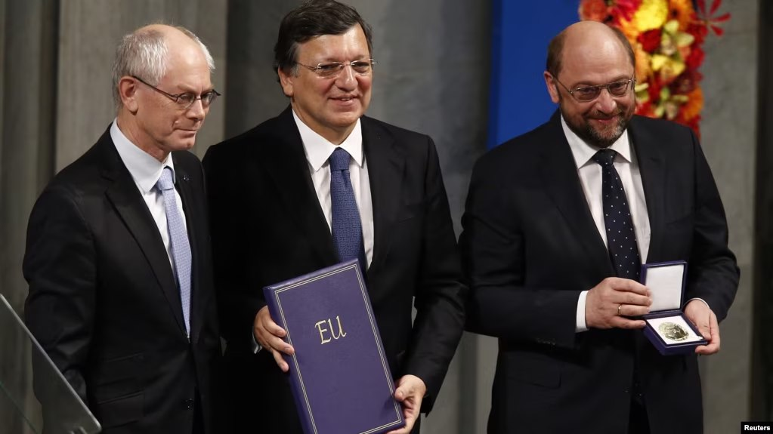
ROUND 1 · EUROPE & FUN FACTS
ANSWER · QUESTION 3
B — The Nobel Peace Prize
DID YOU KNOW?
Awarded to the EU in 2012 for over six decades of advancing peace, reconciliation, democracy and human rights in Europe.
Photo: Reuters
Quiz Night · 16 June 2026 · Permanent Representation of Lithuania to the EU

Slide 10
ROUND 1 · EUROPE & FUN FACTS
4
QUESTION 4 OF 6 · 1 POINT
Which euro banknote was nicknamed “Bin Laden”?
€50
€100
A
B
€200
€500
C
D
Quiz Night · 16 June 2026 · Permanent Representation of Lithuania to the EU
Notes:
Source: https://www.theguardian.com/business/2016/may/04/500-euro-banknote-could-be-scrapped-crime

Slide 11
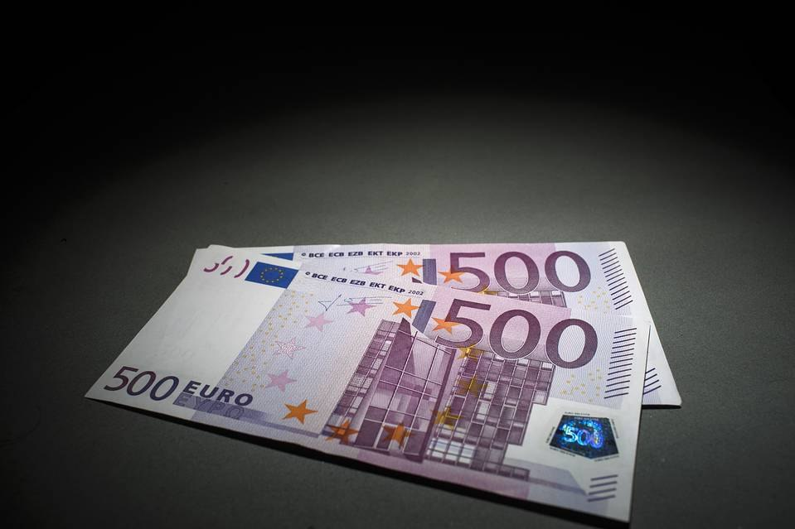
ROUND 1 · EUROPE & FUN FACTS
ANSWER · QUESTION 4
D — The €500 note
DID YOU KNOW?
The ECB stopped issuing the €500 note in 2019 over its popularity with money launderers — and because, like its namesake, everyone knew what it looked like but almost no one had ever seen one.
Quiz Night · 16 June 2026 · Permanent Representation of Lithuania to the EU

Slide 12
ROUND 1 · EUROPE & FUN FACTS
5
QUESTION 5 OF 6 · 1 POINT
In 1984, former Nigerian minister Umaru Dikko was kidnapped in London. His captors planned to smuggle him out of the UK in a diplomatic crate, relying on the Vienna Convention rule that diplomatic bags cannot be opened or detained. What went wrong?
The crate was improperly labelled as diplomatic baggage
A
Dikko did not fit inside the crate
B
The aircraft meant to transport him never arrived
C
Quiz Night · 16 June 2026 · Permanent Representation of Lithuania to the EU
Notes:
Background video: https://www.youtube.com/watch?v=N83Idy9IOmU

Slide 13
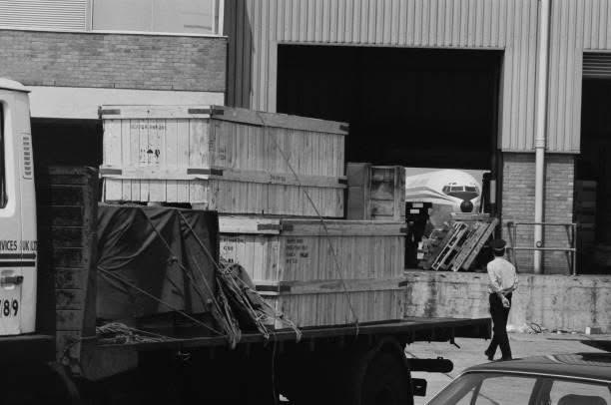
ROUND 1 · EUROPE & FUN FACTS
ANSWER · QUESTION 5
A — The crate was improperly labelled
▶ Watch the story
youtube.com/watch?v=N83Idy9IOmU
DID YOU KNOW?
With no official diplomatic markings, customs officers at Stansted were entitled to open the crate — and found Dikko unconscious, accompanied by an anaesthetist.
Press photo, Stansted 1984 — likely PA Images
Quiz Night · 16 June 2026 · Permanent Representation of Lithuania to the EU
Notes:
Video: https://www.youtube.com/watch?v=N83Idy9IOmU

Slide 14
ROUND 1 · EUROPE & FUN FACTS
6
QUESTION 6 OF 6 · 1 POINT
One of the inventors of modern blue jeans was born in present-day Latvia. He developed a way to make work trousers much more durable and partnered with Levi Strauss to patent the idea. What simple innovation made the trousers famous?
A zipper
Metal rivets
A
B
Waterproof fabric
Belt loops
C
D
Quiz Night · 16 June 2026 · Permanent Representation of Lithuania to the EU

Slide 15
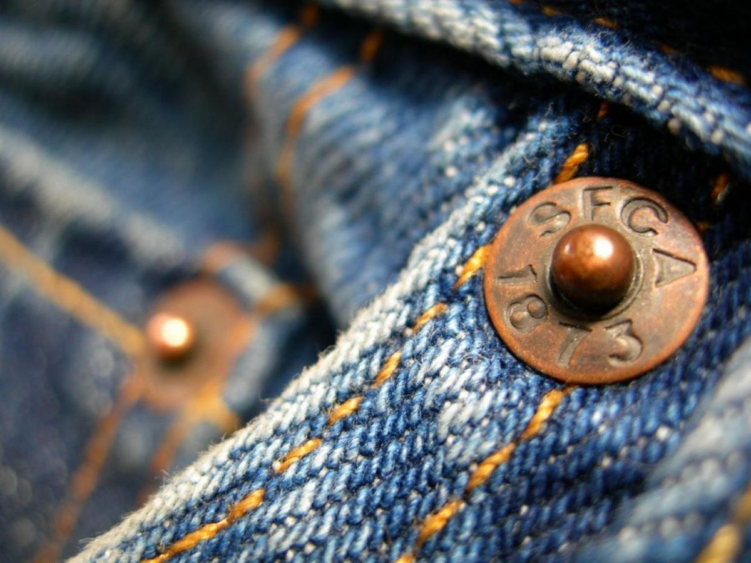
ROUND 1 · EUROPE & FUN FACTS
ANSWER · QUESTION 6
B — Metal rivets
DID YOU KNOW?
Jacob Davis, a tailor born in Riga in 1831, reinforced the stress points of work trousers with copper rivets. He and Levi Strauss patented the idea in 1873 — and blue jeans were born.
Quiz Night · 16 June 2026 · Permanent Representation of Lithuania to the EU

Slide 16



ROUND 2
LITHUANIA
2
8 questions · 1 point each
Quiz Night · 16 June 2026 · Permanent Representation of Lithuania to the EU

Slide 17

ROUND 2 · LITHUANIA
QUESTION 1 OF 8 · 1 POINT
Every year Lithuania plans to win Eurovision — although officially we never have. In 2006, however, Lithuania tried a different strategy: entering a song that simply declared victory before the contest was even over. What was the title of the song?
▶ Play the clip
youtube.com/watch?v=DBAdOlQPbwg
Quiz Night · 16 June 2026 · Permanent Representation of Lithuania to the EU
Notes:
Video: https://www.youtube.com/watch?v=DBAdOlQPbwg — decide which part of the clip to show. Option: move this question to a music/visual round.

Slide 18


ROUND 2 · LITHUANIA
ANSWER · QUESTION 1
“We Are The Winners”
DID YOU KNOW?
Honourable mention: Lithuanian-German singer Lena Valaitis took second place at Eurovision 1981 — proof that we keep looking for that victory by all possible means.
Quiz Night · 16 June 2026 · Permanent Representation of Lithuania to the EU
Photos: EBU / eurovision.tv
Notes:
Mention Lena Valaitis as a fun fact, not a question.

Slide 19
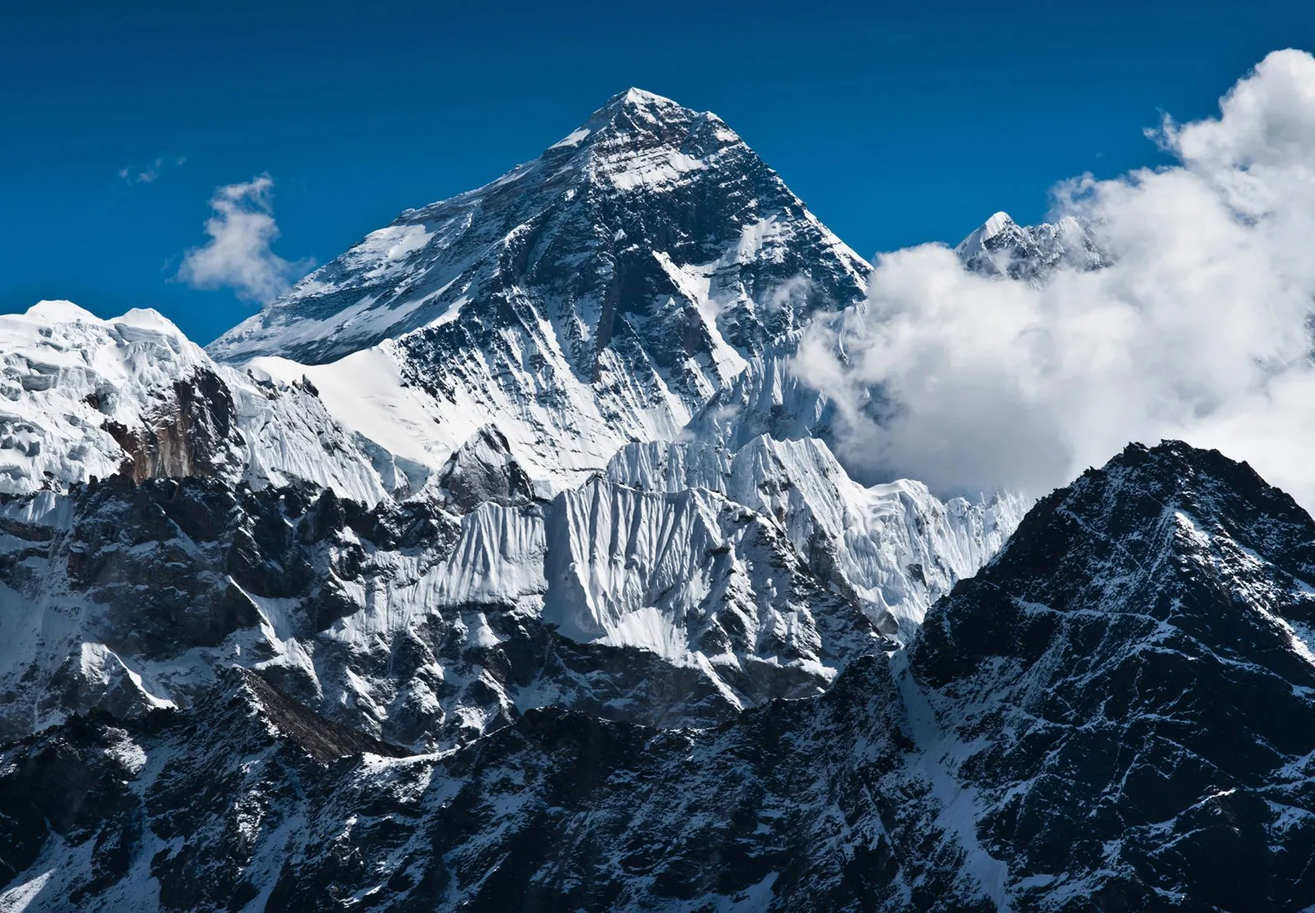
ROUND 2 · LITHUANIA
QUESTION 2 OF 8 · 1 POINT
Two Lithuanian mountaineers carried a symbolic national object to the summit of Mount Everest and scattered it from the world's highest peak. What was it?
Quiz Night · 16 June 2026 · Permanent Representation of Lithuania to the EU
Notes:
Tell the full story and the exact years out loud; keep the slide short.

Slide 20
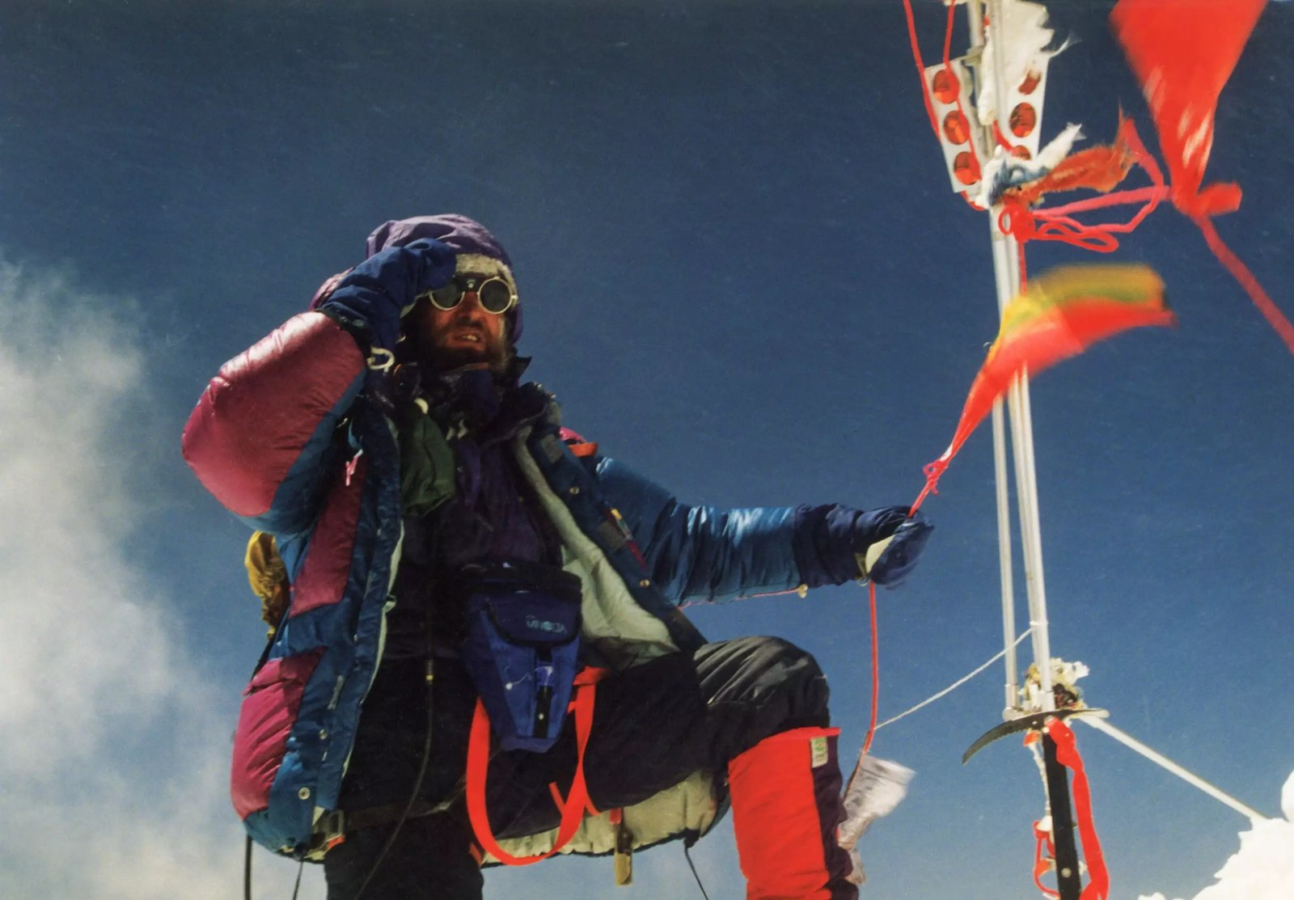
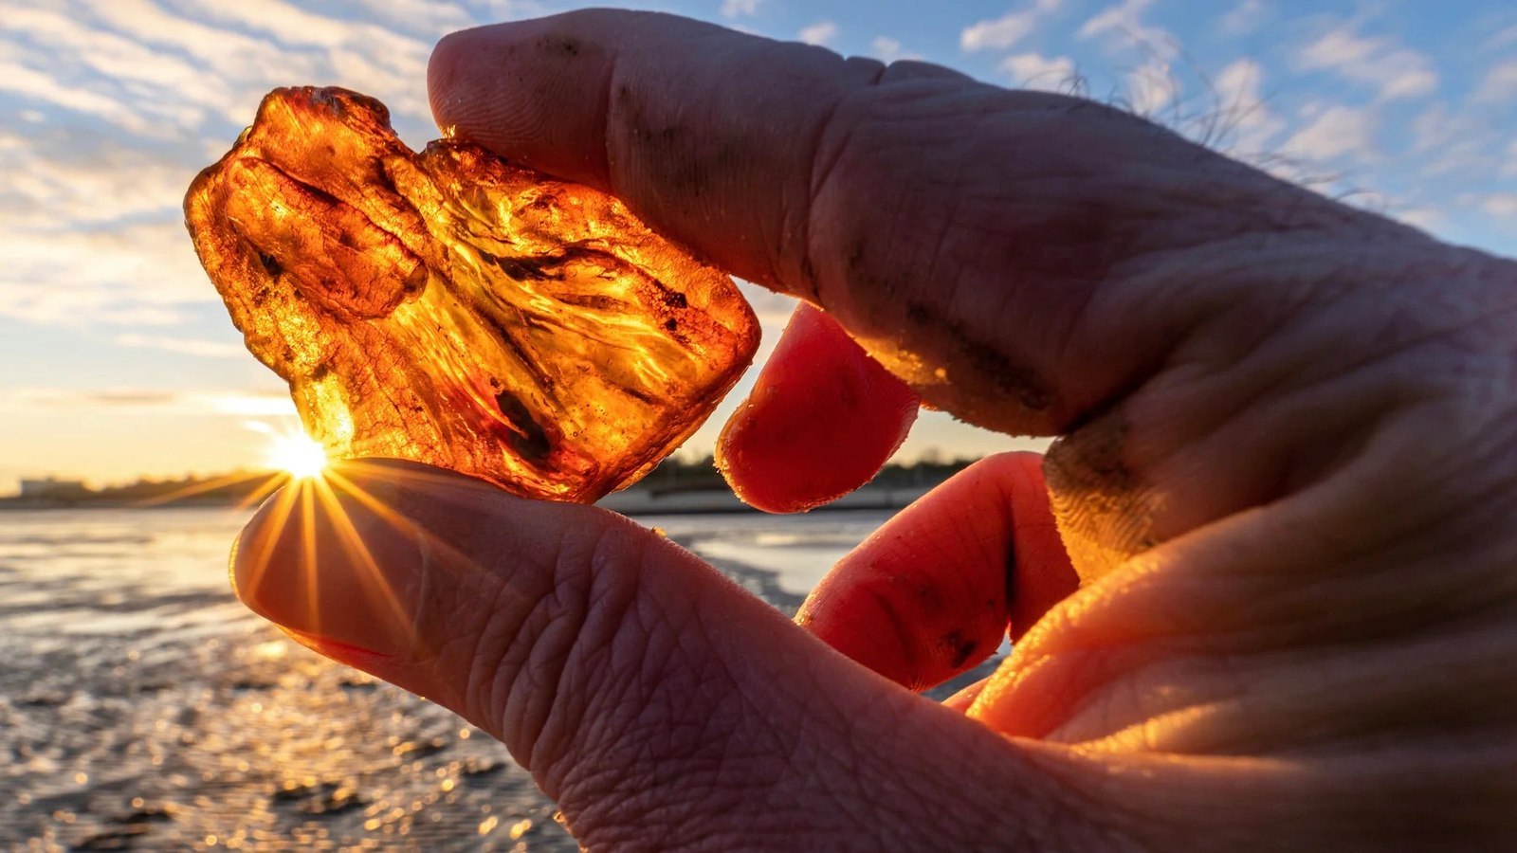
ROUND 2 · LITHUANIA
ANSWER · QUESTION 2
Amber
DID YOU KNOW?
Vladas Vitkauskas (1995) and Saulius Vilius (2003) both carried Baltic amber to the top of the world and scattered it from the summit.
Quiz Night · 16 June 2026 · Permanent Representation of Lithuania to the EU
Top photo: V. Vitkauskas archive

Slide 21
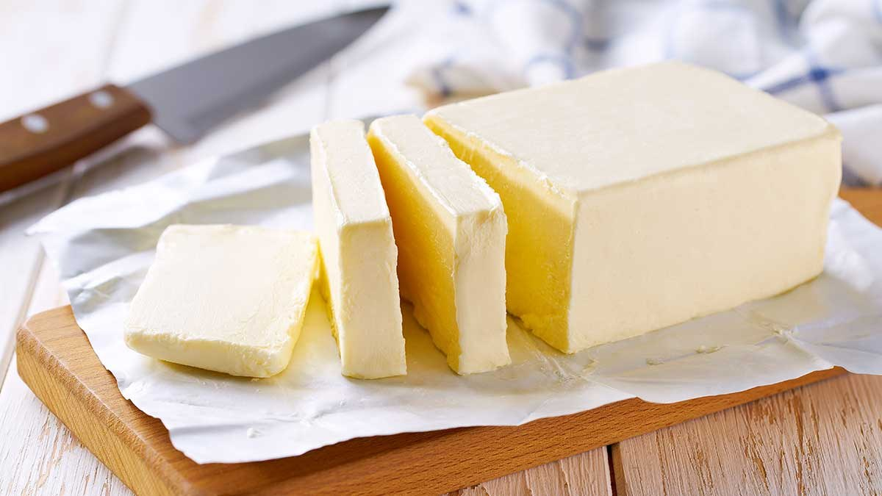
ROUND 2 · LITHUANIA
QUESTION 3 OF 8 · 1 POINT
When Lithuanians learn about the interwar period, one statistic is proudly repeated in schools: in 1938, Lithuania ranked second in Europe in butter and bacon production — despite being one of the poorest countries on the continent. Which country ranked first?
HINT Think of a recent Council Presidency.
Quiz Night · 16 June 2026 · Permanent Representation of Lithuania to the EU

Slide 22
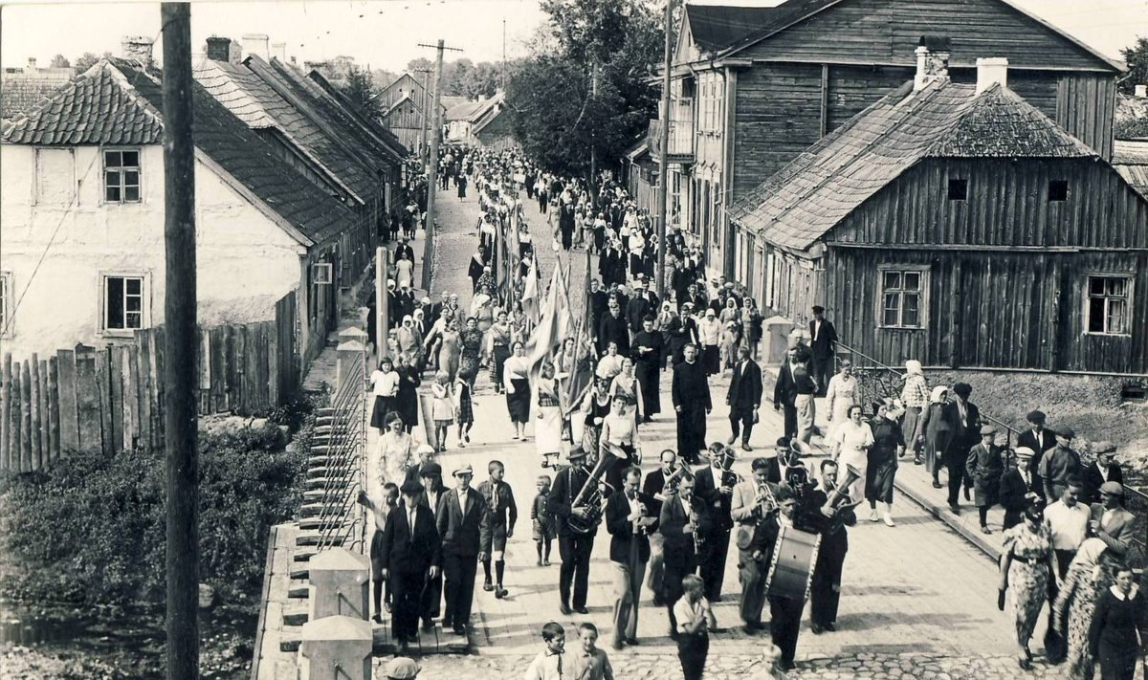
ROUND 2 · LITHUANIA
ANSWER · QUESTION 3
Denmark
DID YOU KNOW?
A statistic still celebrated in Lithuanian classrooms. Denmark, for its part, no longer wants to be the EU's bacon factory — as Politico once put it.
Quiz Night · 16 June 2026 · Permanent Representation of Lithuania to the EU
Notes:
Politico: “Denmark no longer wants to be EU bacon factory”.

Slide 23
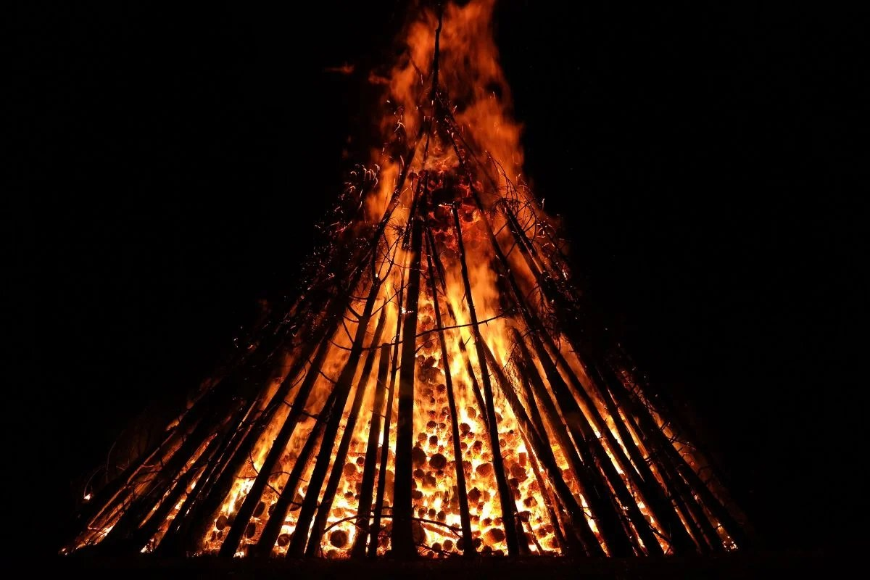
ROUND 2 · LITHUANIA
QUESTION 4 OF 8 · 1 POINT
Across Europe people celebrate Midsummer with bonfires. In Lithuania, one tradition involves searching for a mythical flower that supposedly blooms only on that night. Which flower?
Quiz Night · 16 June 2026 · Permanent Representation of Lithuania to the EU

Slide 24
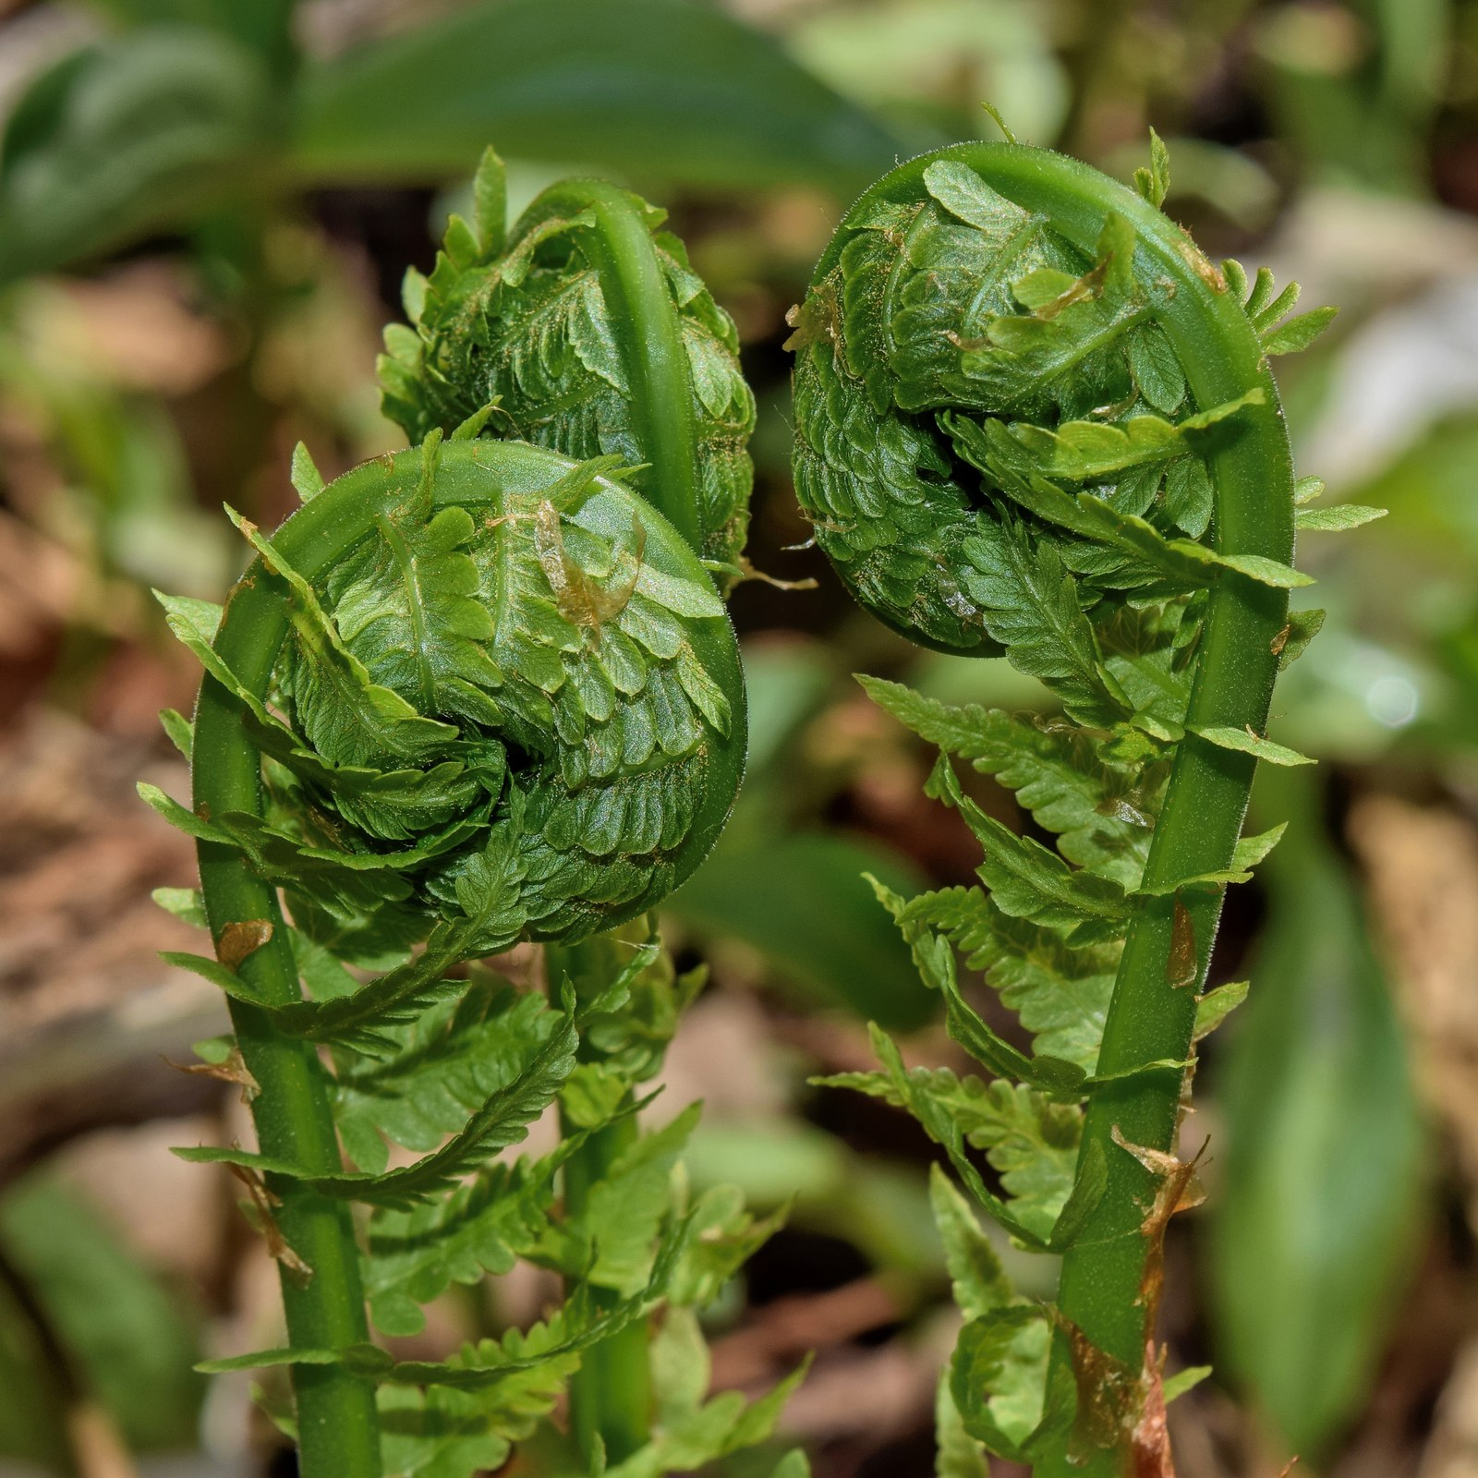
ROUND 2 · LITHUANIA
ANSWER · QUESTION 4
The fern flower
DID YOU KNOW?
According to tradition, the fern blooms only on Midsummer night — whoever finds it gains happiness and wisdom. Botanists remain unconvinced.
Photo: Wikimedia Commons
Quiz Night · 16 June 2026 · Permanent Representation of Lithuania to the EU

Slide 25
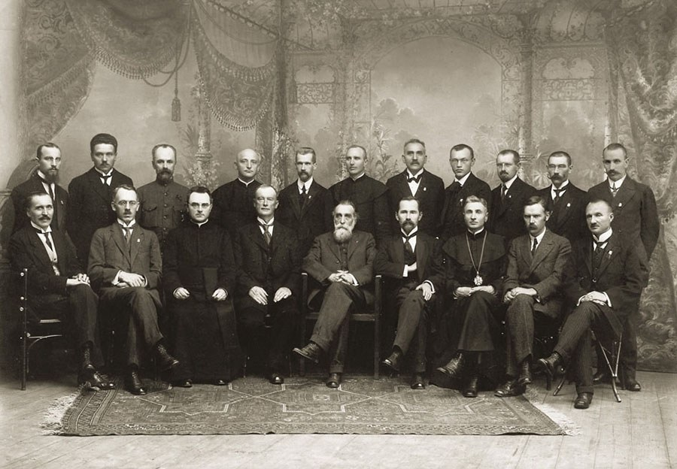
ROUND 2 · LITHUANIA
QUESTION 5 OF 8 · 1 POINT
1918 was a big year for Lithuania — also for democracy. Lithuanian women gained something that many women in Western Europe had to wait decades for. What was it?
Quiz Night · 16 June 2026 · Permanent Representation of Lithuania to the EU
Notes:
Alternative version: show the centenary stamp (with some details removed) and ask what occasion it marks. Stamp: https://manoteises.lt/straipsnis/isleidziamas-pasto-zenklas-moteru-balsavimo-simtmeciui-lietuvoje-pamineti/

Slide 26

ROUND 2 · LITHUANIA
ANSWER · QUESTION 5
Voting rights
DID YOU KNOW?
Lithuanian women gained the vote on 2 November 1918, when the provisional constitution enshrined equal suffrage — ahead of much of Western Europe. A commemorative stamp marked the centenary.
Quiz Night · 16 June 2026 · Permanent Representation of Lithuania to the EU
Stamp: Lietuvos paštas, 2018 · design J. Dadonas

Slide 27
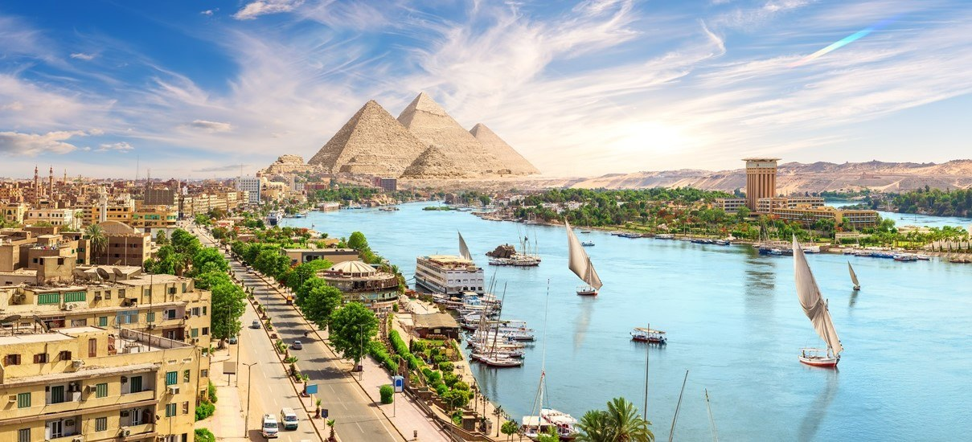
ROUND 2 · LITHUANIA
QUESTION 6 OF 8 · 1 POINT
A 16th-century Lithuanian nobleman travelled through Egypt and bought several unusual souvenirs. During a storm at sea, terrified sailors blamed the bad weather on them and threw them overboard. What were the souvenirs?
Quiz Night · 16 June 2026 · Permanent Representation of Lithuania to the EU

Slide 28
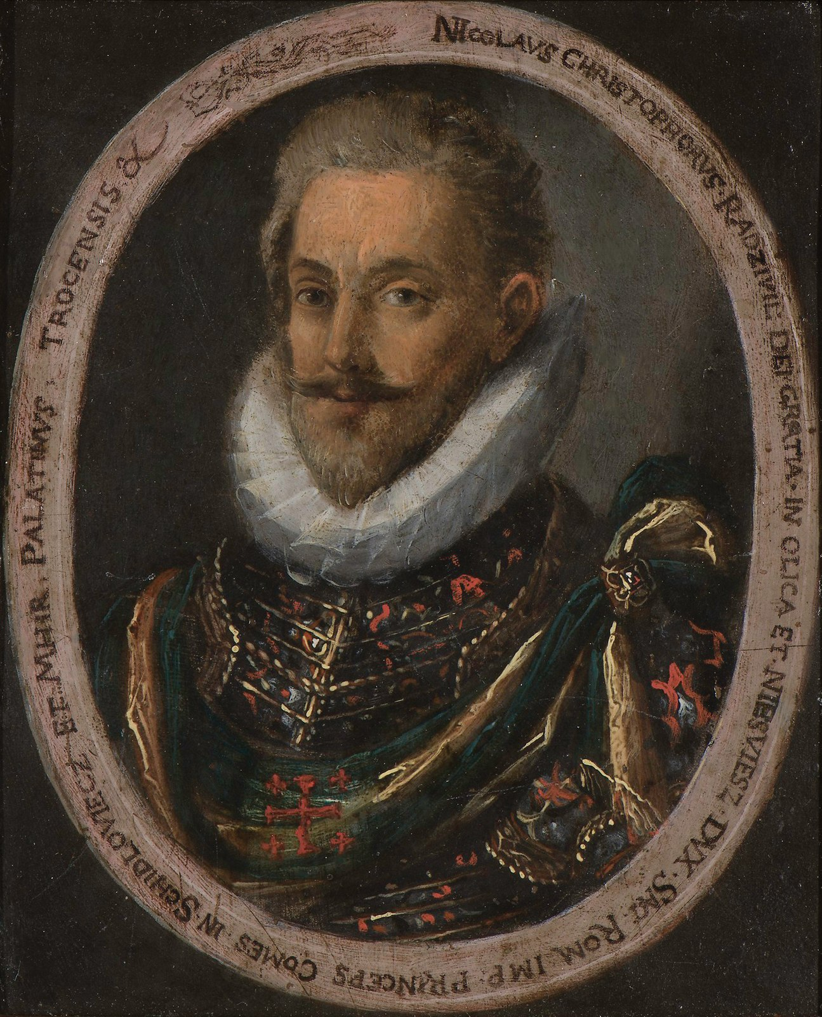
ROUND 2 · LITHUANIA
ANSWER · QUESTION 6
Egyptian mummies
DID YOU KNOW?
Mikalojus Kristupas Radvila the Orphan brought two mummies back from his pilgrimage. When storms battered the ship, the crew blamed the cargo — and overboard they went. His travel diary became a European bestseller.
Quiz Night · 16 June 2026 · Permanent Representation of Lithuania to the EU
Anonymous portrait, c. 1590 (public domain)

Slide 29
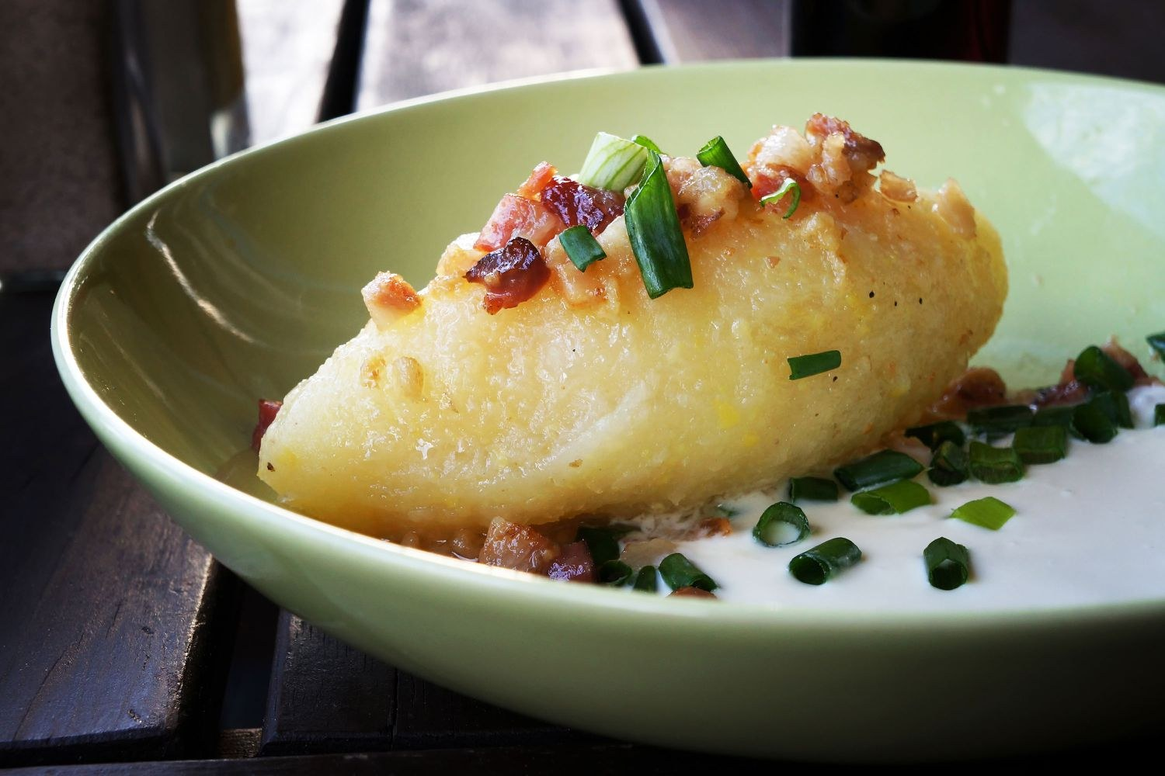
ROUND 2 · LITHUANIA
QUESTION 7 OF 8 · 1 POINT
In a humorous Lithuanian promotional video from the early 2000s, traditional dishes such as cepelinai are discussed with the idea that they might one day become popular across Europe as street food. The video reflects a moment when Lithuania was preparing for a major change. What event was approaching?
▶ Play the clip
youtube.com/watch?v=YgvHcenDYcU
Quiz Night · 16 June 2026 · Permanent Representation of Lithuania to the EU
Notes:
Video: https://www.youtube.com/watch?v=YgvHcenDYcU — add English subtitles to the clip. Consider whether to keep “early 2000s” in the wording.

Slide 30
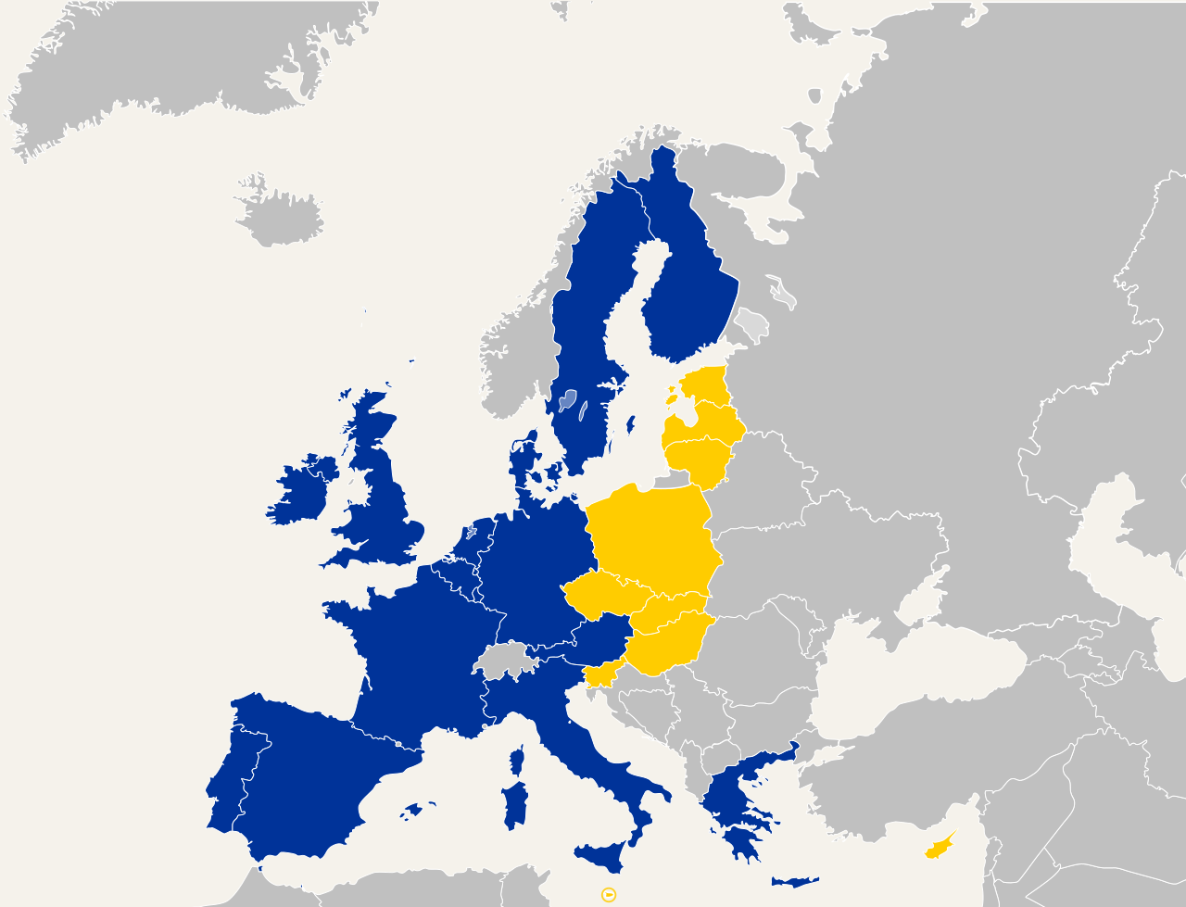
ROUND 2 · LITHUANIA
ANSWER · QUESTION 7
Joining the European Union
DID YOU KNOW?
Lithuania joined the EU on 1 May 2004, in the largest enlargement in the Union's history — ten countries at once. The cepelinai street-food revolution is still pending.
Map: Wikimedia Commons
Quiz Night · 16 June 2026 · Permanent Representation of Lithuania to the EU

Slide 31
ROUND 2 · LITHUANIA
8
QUESTION 8 OF 8 · 1 POINT
Pink is strongly associated with Lithuania because of a traditional summer dish. Which dish?
Cepelinai
Šakotis
A
B
Šaltibarščiai
Kibinai
C
D
Quiz Night · 16 June 2026 · Permanent Representation of Lithuania to the EU

Slide 32
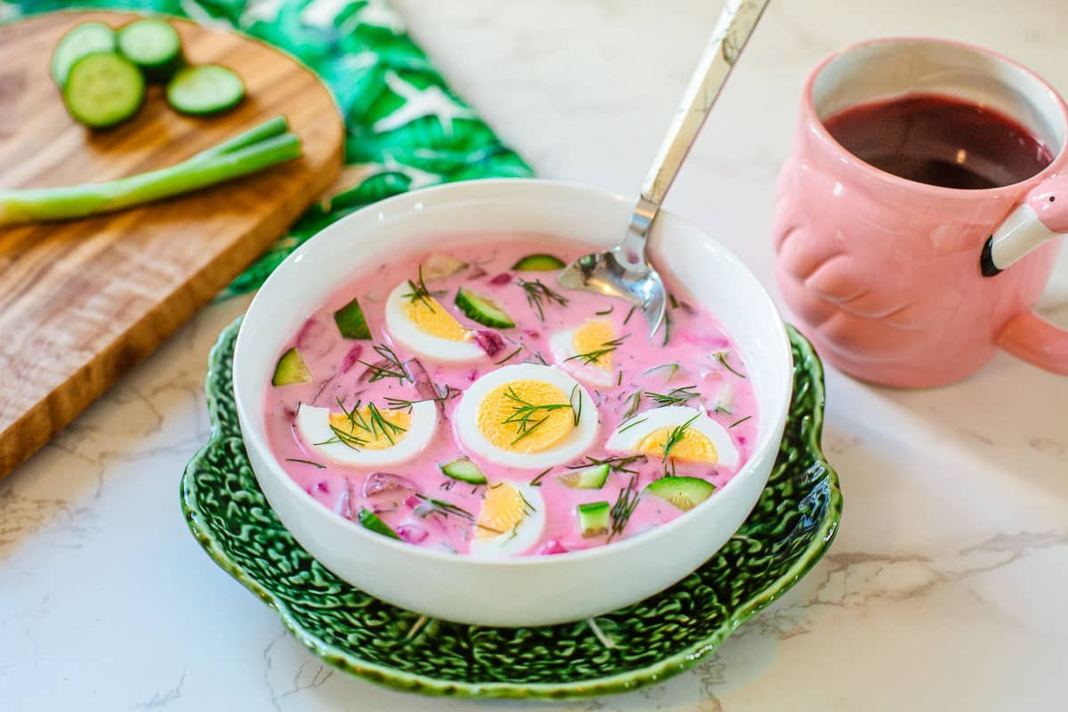
ROUND 2 · LITHUANIA
ANSWER · QUESTION 8
C — Šaltibarščiai
DID YOU KNOW?
The electric-pink cold beet soup is Lithuania's unofficial summer flag — best served with hot potatoes and a sunny terrace.
Quiz Night · 16 June 2026 · Permanent Representation of Lithuania to the EU

Slide 33



ROUND 3
ENVIRONMENT & NATURE
3
4 questions · 1 point each
Quiz Night · 16 June 2026 · Permanent Representation of Lithuania to the EU

Slide 34

ROUND 3 · ENVIRONMENT & NATURE
QUESTION 1 OF 4 · 1 POINT
In 2013 Metallica became the first band to perform on all seven continents. During their Antarctic concert, the audience used 120 of what?
Quiz Night · 16 June 2026 · Permanent Representation of Lithuania to the EU

Slide 35
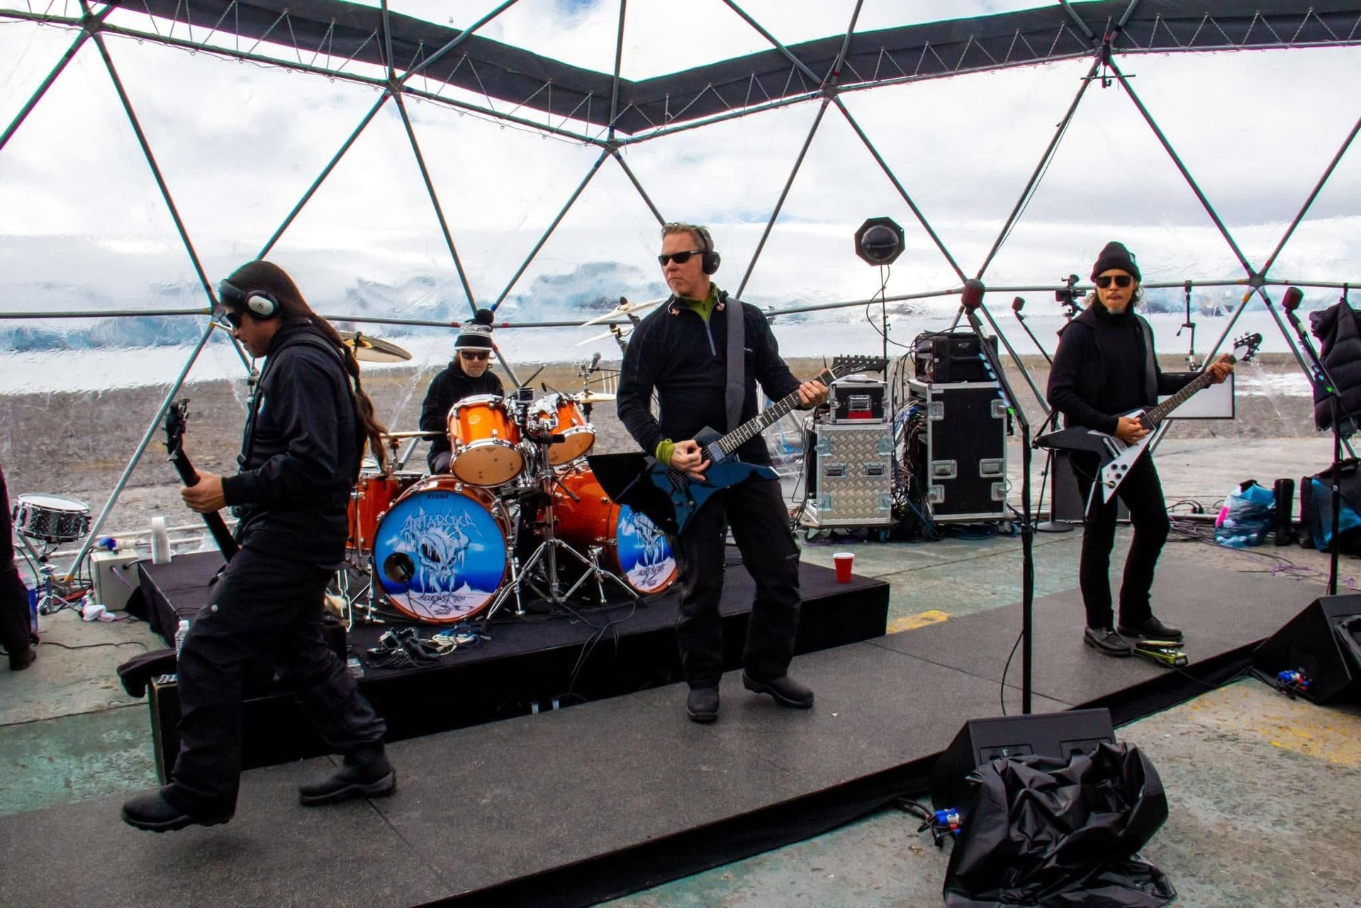
ROUND 3 · ENVIRONMENT & NATURE
ANSWER · QUESTION 1
Headphones
DID YOU KNOW?
To comply with Antarctic environmental rules, the band played without amplifiers — the audience of about 120 listened through headphones. The concert was fittingly called “Freeze 'Em All”.
Photo: Metallica (freezeemall.com)
Quiz Night · 16 June 2026 · Permanent Representation of Lithuania to the EU

Slide 36
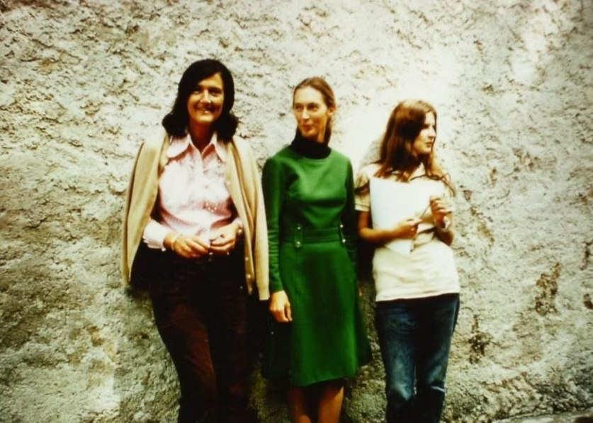
ROUND 3 · ENVIRONMENT & NATURE
QUESTION 2 OF 4 · 1 POINT
Three famous scientists — Birutė Galdikas, Dian Fossey and Jane Goodall — devoted their careers to studying these animals in the wild. Collectively, they became known as the “Trimates”. What group of animals are these?
Quiz Night · 16 June 2026 · Permanent Representation of Lithuania to the EU

Slide 37
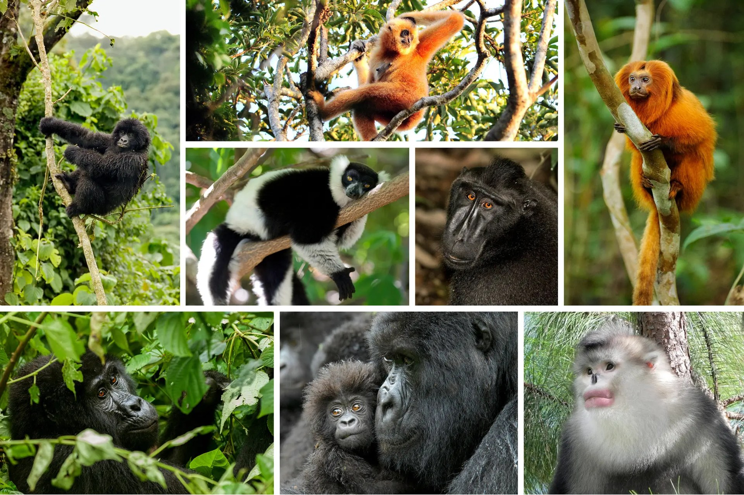
ROUND 3 · ENVIRONMENT & NATURE
ANSWER · QUESTION 2
Great apes
DID YOU KNOW?
Goodall (chimpanzees), Fossey (gorillas) and Galdikas (orangutans) were recruited by Louis Leakey — hence also “Leakey's Angels”. Galdikas, of Lithuanian descent, still works in Borneo. “Orangutan” means “person of the forest”.
Collage: The New York Times
Quiz Night · 16 June 2026 · Permanent Representation of Lithuania to the EU

Slide 38
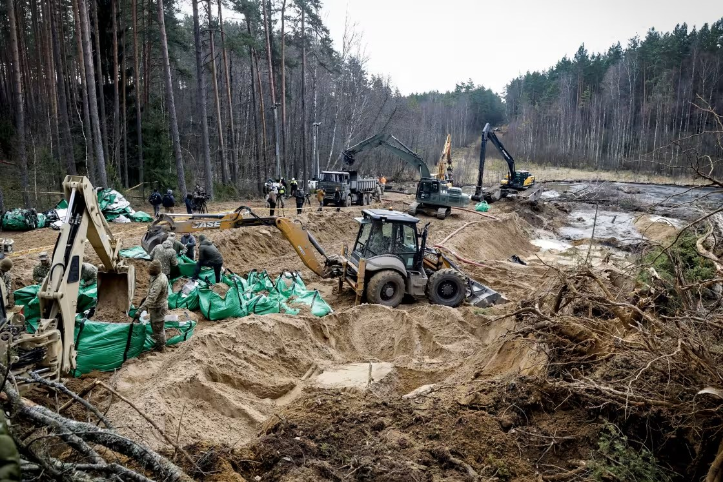
ROUND 3 · ENVIRONMENT & NATURE
QUESTION 3 OF 4 · 1 POINT
Which EU law unexpectedly entered the headlines after the deaths of four US soldiers, whose vehicle sank in a military training area near the Lithuanian–Belarusian border?
Quiz Night · 16 June 2026 · Permanent Representation of Lithuania to the EU

Slide 39
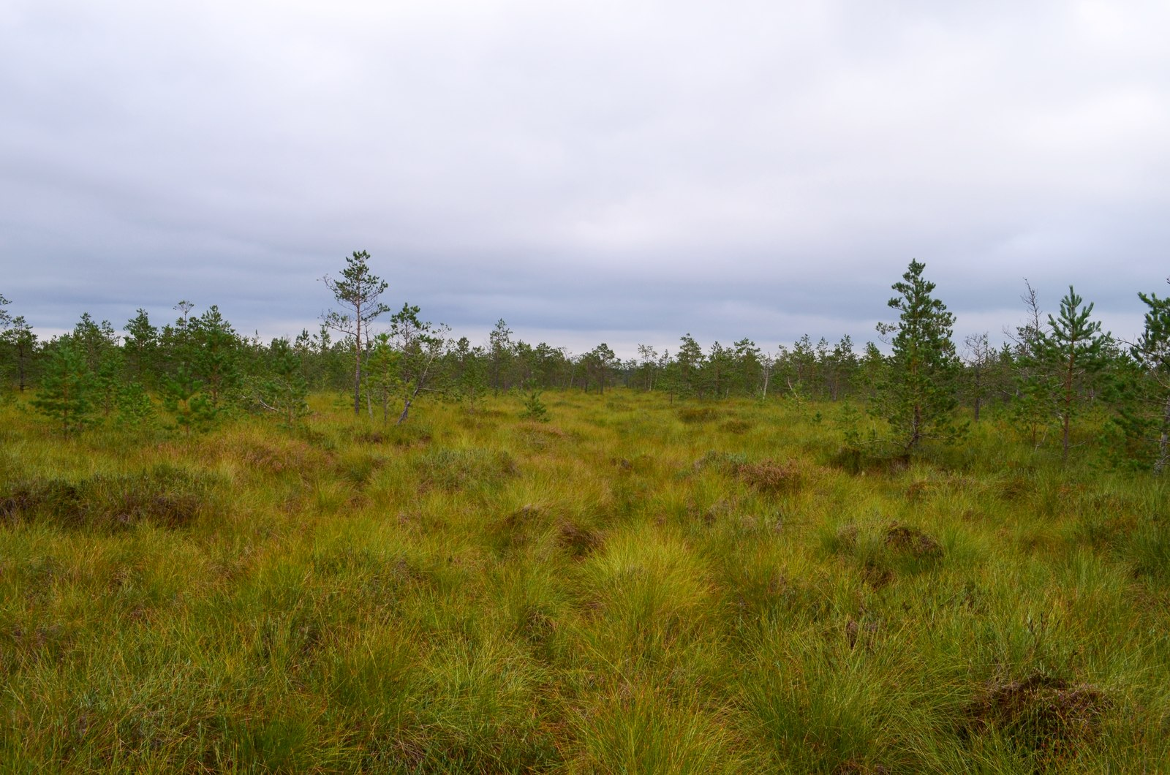
ROUND 3 · ENVIRONMENT & NATURE
ANSWER · QUESTION 3
The Nature Restoration Law
DID YOU KNOW?
Commentary on the 2025 tragedy near Pabradė linked the swampy terrain to wetlands restored under EU environmental policy — putting the Nature Restoration Law unexpectedly in the news.
Photo: Wikimedia Commons
Quiz Night · 16 June 2026 · Permanent Representation of Lithuania to the EU

Slide 40
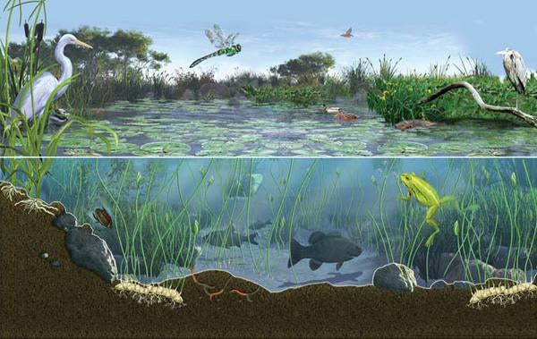
ROUND 3 · ENVIRONMENT & NATURE
QUESTION 4 OF 4 · 1 POINT
This animal is often called an “ecosystem engineer” because it creates wetlands that benefit countless other species. What animal is it?
Quiz Night · 16 June 2026 · Permanent Representation of Lithuania to the EU

Slide 41
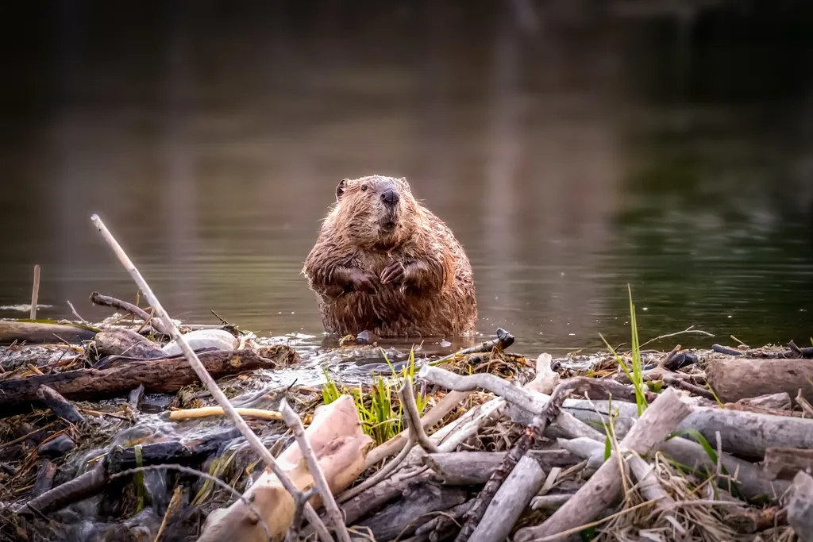
ROUND 3 · ENVIRONMENT & NATURE
ANSWER · QUESTION 4
The beaver
DID YOU KNOW?
Beaver dams create wetlands that store water, filter pollution and host countless species. Lithuania's beaver population has grown from near extinction to one of the densest in Europe.
Quiz Night · 16 June 2026 · Permanent Representation of Lithuania to the EU

Slide 42



BONUS ROUND
THE BRUSSELS BUBBLE
B
Insider questions · for those who were in the room
Quiz Night · 16 June 2026 · Permanent Representation of Lithuania to the EU
Notes:
Possible extra questions: the CBAM question about nails (still needs wording — a funny one); The Schumann Show about the institutions: https://www.youtube.com/watch?v=D0fBh-0Eiy0

Slide 43
BONUS · THE BRUSSELS BUBBLE
1
QUESTION 1 OF 3 · 1 POINT
During negotiations on which file did Violeta Dragu (Romania) say: “I have never seen Lithuania being so active during the negotiations”?
Quiz Night · 16 June 2026 · Permanent Representation of Lithuania to the EU
Notes:
Can be made multiple choice to make it easier — or harder, by also asking what the problem was.

Slide 44

BONUS · THE BRUSSELS BUBBLE
ANSWER · QUESTION 1
The Waste Framework Directive
Illustration: EPRS briefing, European Parliament
Quiz Night · 16 June 2026 · Permanent Representation of Lithuania to the EU

Slide 45

BONUS · THE BRUSSELS BUBBLE
2
QUESTION 2 OF 3 · 2 POINTS
During a Coreper I meeting, the Council was split on a legislative file, with both sides carefully counting votes. The Deputy Permanent Representative of Lithuania intervened and said… what? And which file was being discussed?
Quiz Night · 16 June 2026 · Permanent Representation of Lithuania to the EU
Notes:
Optional hint: give the exact date — the 14 June Coreper I (or the earlier one).

Slide 46
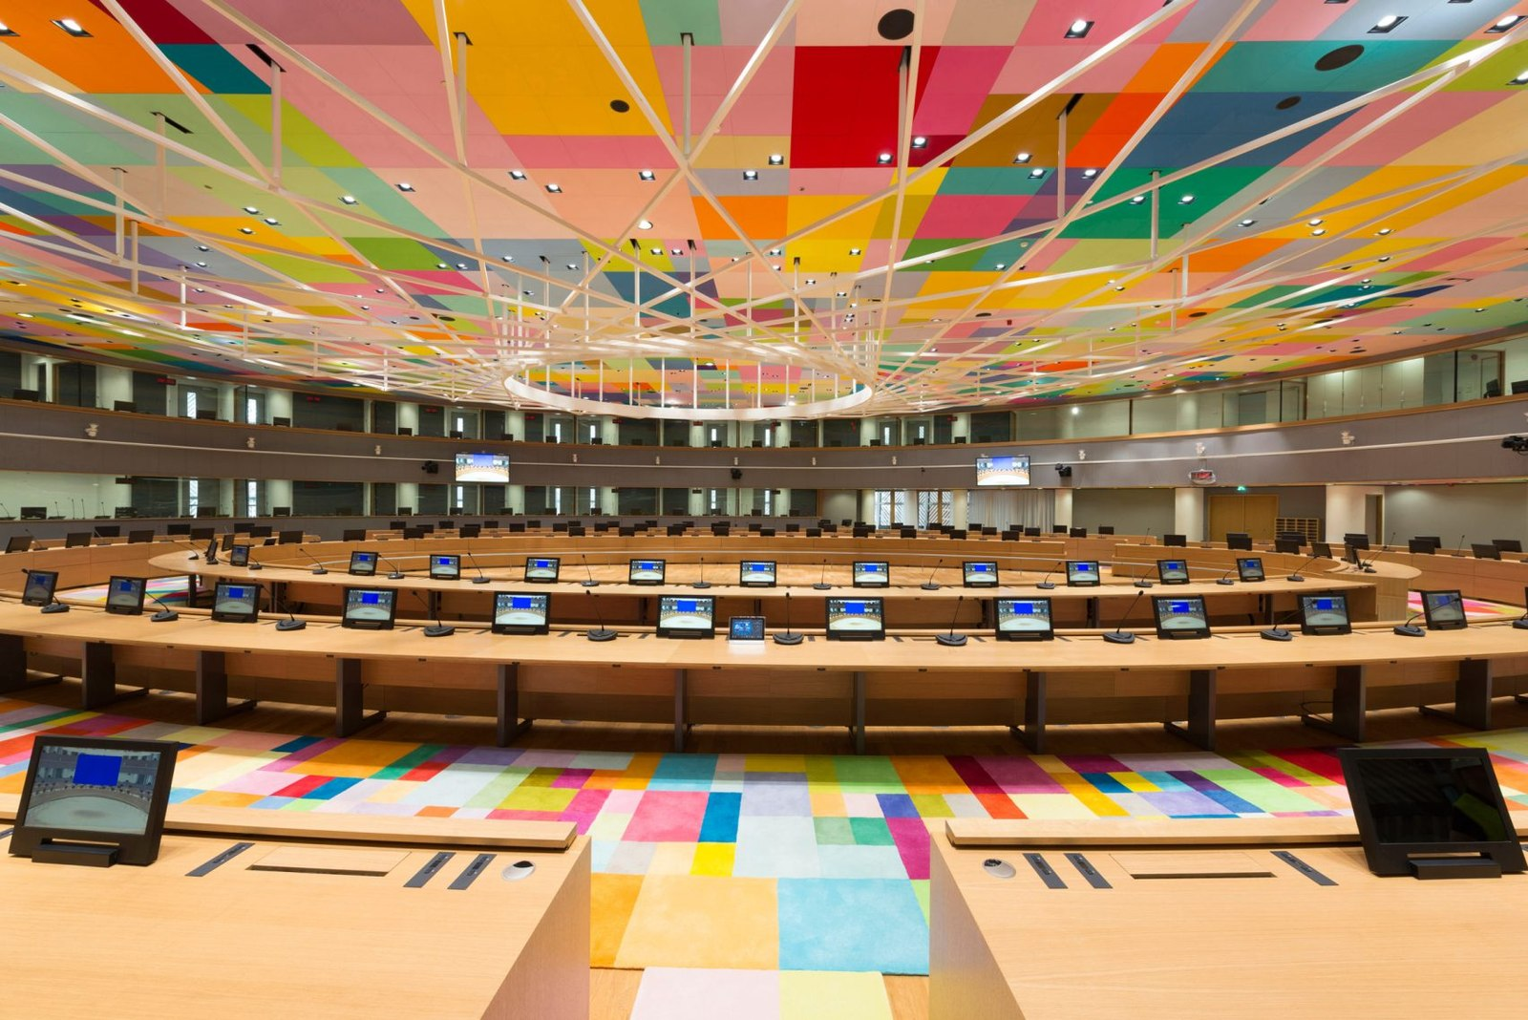
BONUS · THE BRUSSELS BUBBLE
ANSWER · QUESTION 2
“Scrutiny reservation” — on the Nature Restoration Law
DID YOU KNOW?
A scrutiny reservation lets a member state hold its position while procedures are completed back home — a small phrase that can pause a finely balanced vote. Pictured: the Europa building, where Coreper meets.
Quiz Night · 16 June 2026 · Permanent Representation of Lithuania to the EU

Slide 47
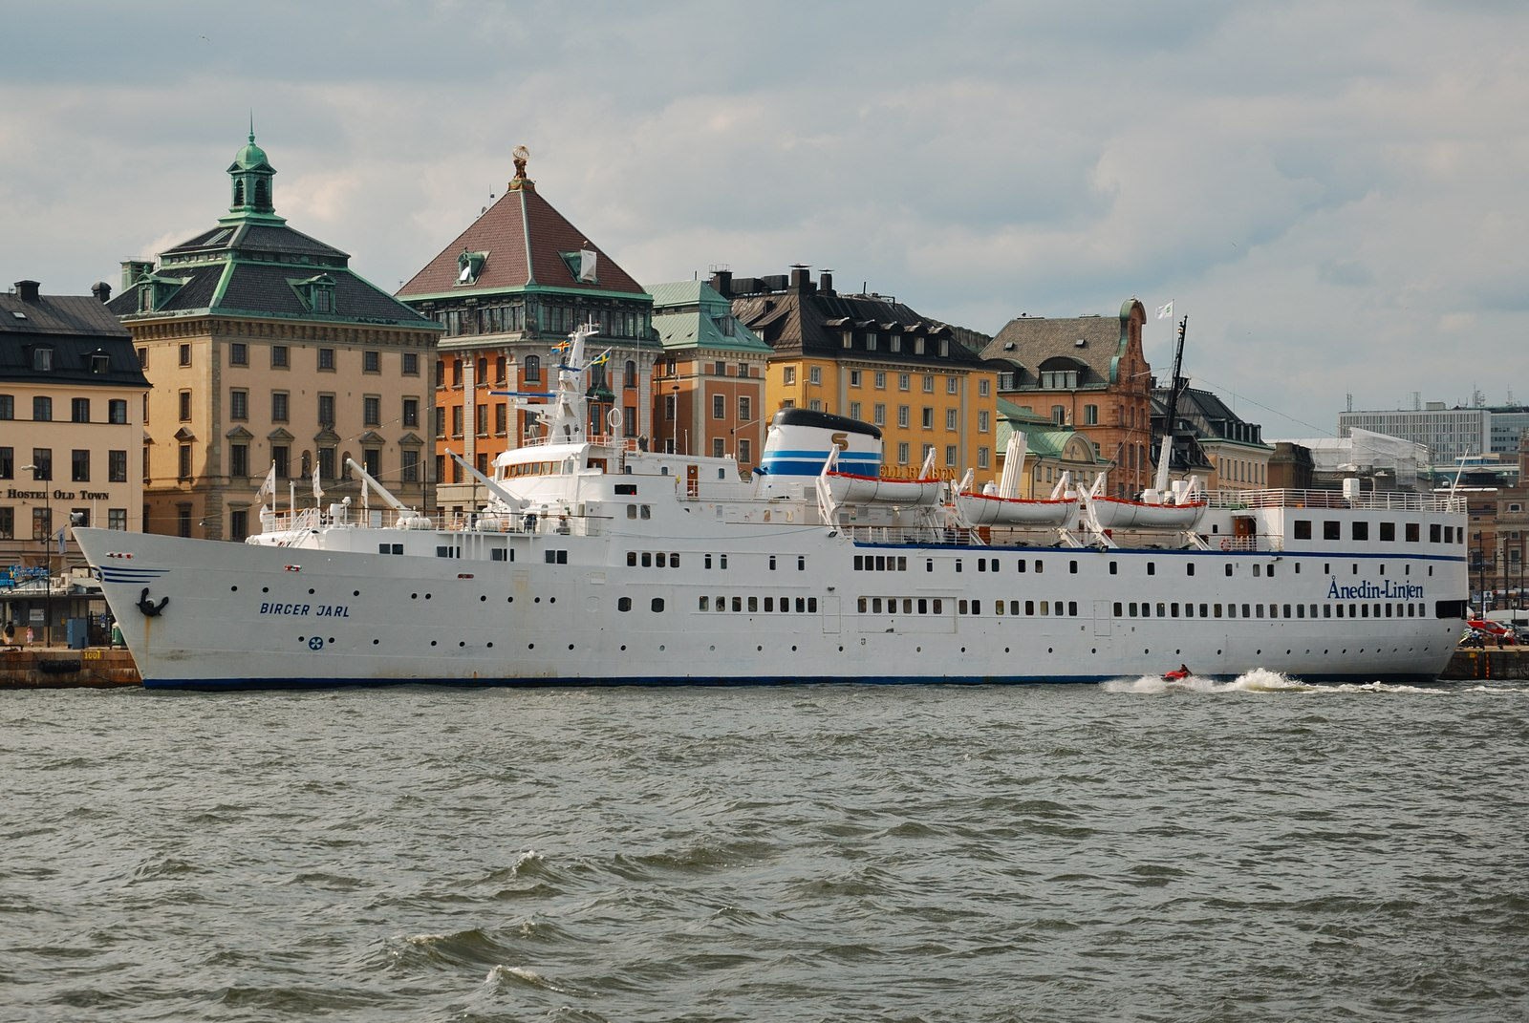
BONUS · THE BRUSSELS BUBBLE
QUESTION 3 OF 3 · 1 POINT
1985: Lithuanian, Latvian and Estonian dissidents organised the Peace and Freedom Cruise aboard the ship Baltic Star — sailing from Stockholm along the edge of Soviet territorial waters and ending with a widely reported demonstration in Helsinki. The Soviet Union tried to derail the voyage. What did it do?
Quiz Night · 16 June 2026 · Permanent Representation of Lithuania to the EU
Notes:
Background: per Tomas Venclova, Aleksandras Štromas was the cruise's spiritus movens; the Baltic Tribunal also took place in 1985. Keep names off the slide. Ship photo: Wikimedia Commons (M/S Birger Jarl, sailed as Baltic Star).

Slide 48
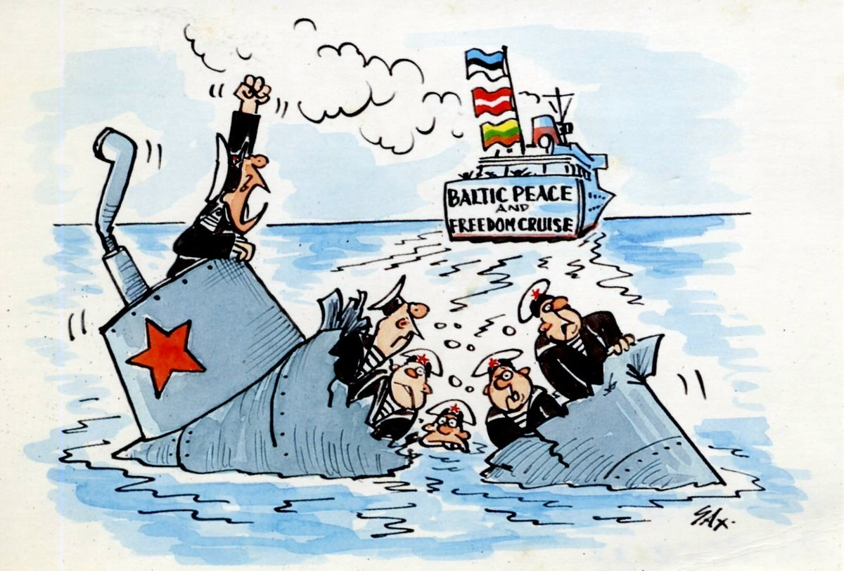
BONUS · THE BRUSSELS BUBBLE
ANSWER · QUESTION 3
A rumour that a bomb was on board
DID YOU KNOW?
The rumour failed: the cruise went ahead, and the Helsinki demonstration was reported across the Scandinavian and wider European press — a loud reminder that the Baltic states had not been forgotten.
Cartoon, 1985 — exile press, via X
Quiz Night · 16 June 2026 · Permanent Representation of Lithuania to the EU

Slide 49

THANK YOU
FOR PLAYING
Time to count the points
Quiz Night · 16 June 2026 · Permanent Representation of Lithuania to the EU
Notes:
Count the points and announce the winning team.

