Slide 1
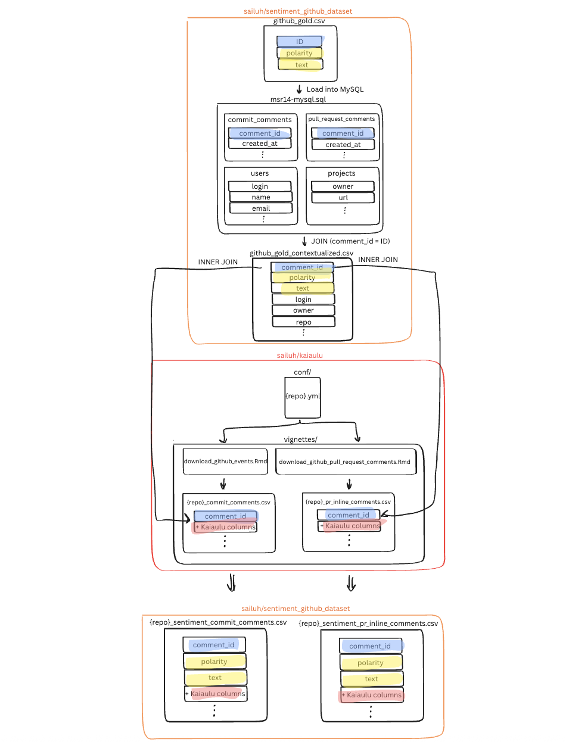
Iteration 1

Slide 2
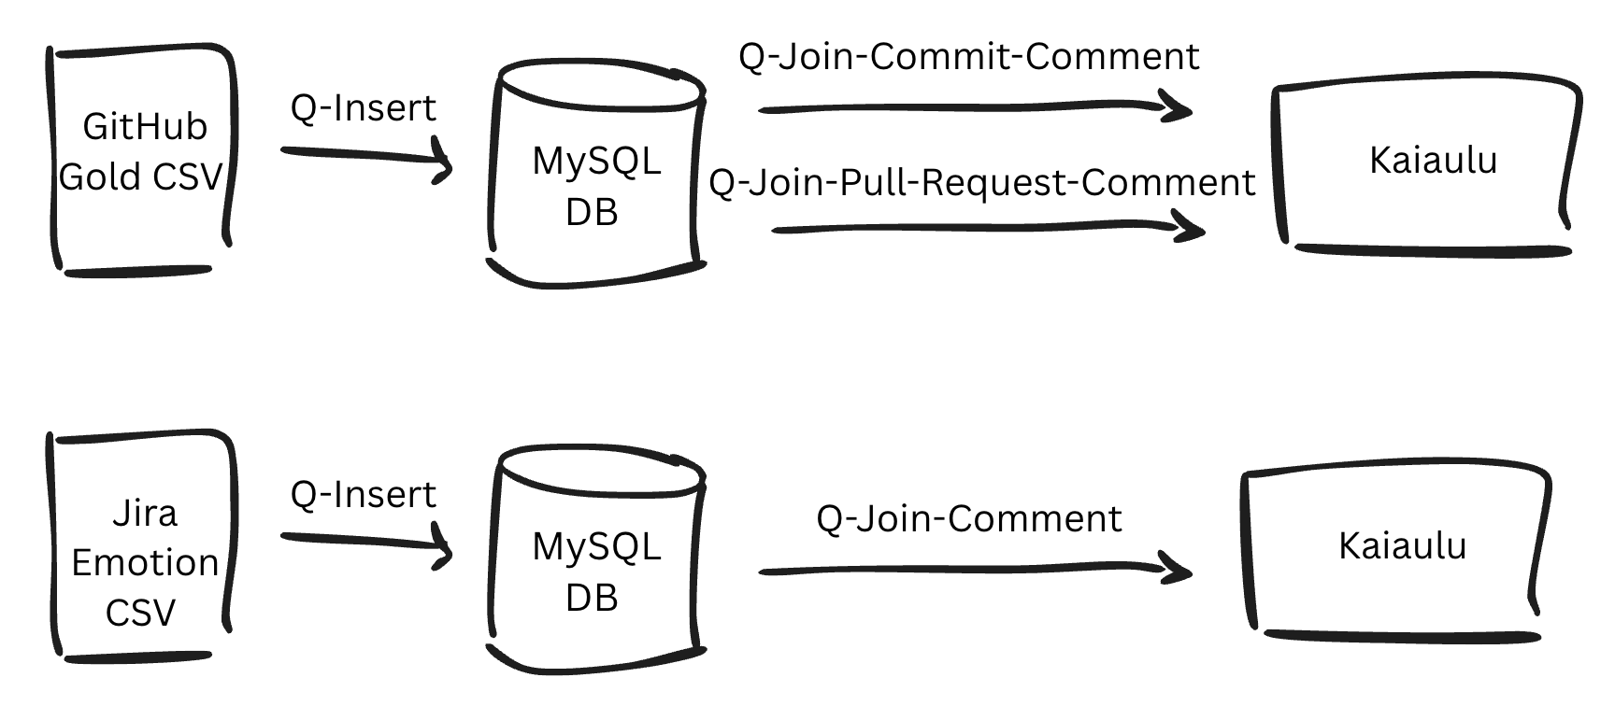
Iteration 2

Slide 3


Sentiment Dataset : : CHEAT SHEET
Iteration 3
About
Sentiment Dataset to Kaiaulu
Related Notebooks
The GitHub Gold Standard and Jira Emotion datasets contain sentiment and emotion labels for developer communication comments, but each CSV is incomplete. They have labels but no project context. Without that context, the labels cannot be connected to Kaiaulu's downloaded data. By joining each CSV to its corresponding database dump, we recover the missing context and make the labels usable in Kaiaulu.
Github Gold Standard Dataset
See supplementary notebooks in sailuh/github_sentiment_dataset that go in-depth on the documentation on making the Github Gold Standard dataset compatible with Kaiaulu.
Q-Insert
Q-Join-Commit-Comments
01_load_sentiment_csv_to_mysql.ipynb
02_explore_relevant_projects.ipynb
03_scale_config_files.ipynb
04_add_sentiment_to_kaiaulu.ipynb
Q-Join-Pull-Request-Comments
Github Gold CSV
MySQL DB
Getting Started
The following must be set up/downloaded:
1. Github Gold Standard Dataset
2. GHTorrent 2004 MySQL Dump
3. Jira Emotion Dataset
4. Jira PostgresSQL Dump
GitHub
Notebook 1: Load Gold Standard into MySQL database that contains the GHTorrent 2004 dump.
Notebook 2: Add project context columns to CSV via SQL joins.
Notebook 3: Auto-generate Kaiaulu config files for 82 repos. Download and parse comments via Kaiaulu vignettes
Notebook 4: INNER JOIN sentiment labels to Kaiaulu's downloaded comment data.
Jira
Mailing Lists
conf/*.yml
Github Gold CSV + Columns
Contextualized Dataset
Kaiaulu
Data Expansion
The original Gold Standard has only three columns. After joining to GHTorrent, we now have the project and author context needed to connect each comment to Kaiaulu.
Through this pipeline, we recover the context that is missing from the sentiment CSVs. That context enables two types of dataset expansion using Kaiaulu:
Temporal expansion: Re-download the same projects' comments from 2004 through today.
Horizontal expansion: Download additional data sources for those same projects (e.g., source code, version control history) that can be linked back to sentiment labels
Jira Emotion Dataset
Old
New
Q-Insert
ID
ID
Q-Join-Comments
polarity
polarity
Jira Emotion CSV
PostgreSQL DB
text
text
GitHub
created_at
Jira
author_login
Mailing Lists
owner
conf/*.yml
Jira Emotion CSV + Columns
repo
…
Kaiaulu
Kaiāulu
CC BY SA Samantha Limon, Carlos Paradis • Kaiaulu package version 0.0.0.9700 (in development) • Updated: 2026-04

Slide 4
Sentiment Dataset : : CHEAT SHEET
Iteration 4
About
Sentiment Dataset to Kaiaulu
Related Notebooks
Manually annotated sentiment/emotion labels can be useful to train machine learning models. The existing gold standard datasets contain sentiment and emotion labels for developer communication comments, but each CSV is incomplete. There is insufficient metadata to retrace them to the original data source. By joining each CSV to its corresponding database dump, we recover the missing data and make the labels usable in Kaiaulu.
Github Gold Standard Dataset
See supplementary notebooks that go in-depth on the documentation on making the Github Gold Standard and Jira Emotion datasets compatible with Kaiaulu.
Q-Insert
sailuh/sentiment_github_dataset
Q-Join-Commit-Comments
1_load_sentiment_csv_to_mysql.ipynb
2_explore_relevant_projects.ipynb
3_scale_config_files.ipynb
4_add_sentiment_to_kaiaulu.ipynb
Q-Join-Pull-Request-Comments
Getting Started
Github Gold CSV
GHTorrent 2014 DB
The following must be set up/downloaded:
sailuh/emotion_jira_dataset
[1]
[2]
GitHub
Jira
1_emotion_csv_inter_rater_agreement.ipynb
Github Gold CSV
Novielli et al. (2020)
GHTorrent 2014 DB
MSR Challenge 2014
+
sailuh/kaiaulu
Mailing Lists
Data Expansion
conf/*.yml
Github Gold CSV + Columns
Through this pipeline, we recover the data that is missing from the sentiment CSVs. That context enables two types of dataset expansion using Kaiaulu:
Temporal expansion: Re-download the same projects' comments from 2014 through today.
Horizontal expansion: Download additional data sources for those same projects (e.g., source code, version control history) that can be linked back to sentiment labels
The labeled comments can be used to train the sentiment classifier and for engagement analysis (refer to the Sentiment Classifier cheatsheet).
[3]
[4]
Jira Emotion CSV
Ortu et al. (2016)
Jira PostgreSQL DB
MSR Challenge 2016
Jira Emotion Dataset
Exploring Relevant Comments
Q-Insert
Sentiment labels span both main project repos and forks. However, since fork repos contain fewer labeled comments, we will only be analyzing comments from the project’s main repo.
Q-Join-Comments
sentiment_analysis.Rmd
Jira Emotion CSV
PostgreSQL DB
Comments
pysenti_train_model()
GitHub
Jira
pysenti_predict()
(2)
sailuh/sentiment_classifier
sailuh/kaiaulu
ML
(3)
ML
Main Repo
Fork Repo
GitHub
Mailing Lists
(4)
ML
ML
Jira
label
The Jira Emotion CSV contains emotion labels manually determined from multiple raters. We want to look at comments with labels that have a majority consensus inter-rate agreement.
+
sailuh/kaiaulu
engagement_sentiment()
conf/*.yml
Jira Emotion CSV + Columns
Mailing Lists
0.27
[1] N. Novielli, Fabio Calefato, Davide Dongiovanni, D. Girardi, and Filippo Lanubile, “Can We Use SE-specific Sentiment Analysis Tools in a Cross-Platform Setting?,” Jun. 2020, doi: https://doi.org/10.1145/3379597.3387446.
[2]https://web.archive.org/web/20210224080543/http://ansymore.uantwerpen.be/system/files/uploads/artefacts/alessandro/MSR16/archive3.zip
[3] M. Ortu et al., “The emotional side of software developers in JIRA,” Proceedings of the 13th International Conference on Mining Software Repositories, May 2016, doi: https://doi.org/10.1145/2901739.2903505.
[4]https://web.archive.org/web/20150206005357/http://ghtorrent.org/msr14.html
Kaiāulu
CC BY SA Samantha Limon, Carlos Paradis • Kaiaulu package version 0.0.0.9700 (in development) • Updated: 2026-04

Slide 5
Sentiment Dataset : : CHEAT SHEET
Iteration 5
About
Sentiment Dataset to Kaiaulu
Related Notebooks
Manually annotated sentiment/emotion labels can be useful for training and evaluating novel machine learning classifiers. However, these labels lack sufficient metadata to be extended with new observations for the same projects they were created. This cheatsheet demonstrates the reconstruction process used to expand labels' metadata, define reproducible project configuration files, and make them usable in Kaiaulu for new analyses.
Github Gold Standard Dataset
See supplementary notebooks that go in-depth on the documentation on making the Github Gold Standard and Jira Emotion datasets compatible with Kaiaulu.
Q-Insert
sailuh/sentiment_github_dataset
Q-Join-Commit-Comments
1_load_sentiment_csv_to_mysql.ipynb
2_explore_relevant_projects.ipynb
3_scale_config_files.ipynb
4_add_sentiment_to_kaiaulu.ipynb
Q-Join-Pull-Request-Comments
Dataset
Github Gold CSV
GHTorrent 2014 DB
The following must be set up/downloaded:
sailuh/emotion_jira_dataset
GitHub
1_emotion_csv_inter_rater_agreement.ipynb
Sentiment
Jira
Github 2020 CSV
Novielli et al. [1]
GHTorrent 2014 DB
MSR Challenge [2]
+
Mailing Lists
Data Expansion
conf/*.yml
Github Gold CSV + Columns
sailuh/kaiaulu
Through this pipeline, we recover sufficient metadata to re-obtain the data using Kaiaulu. This metadata enables two types of dataset expansion using Kaiaulu:
Temporal expansion: Re-download the same projects' comments from 2014 through today.
Horizontal expansion: Download additional data sources for those same projects (e.g., source code, version control history) that can be linked back to sentiment labels
The labeled comments can be used to train the sentiment classifier and for engagement analysis (refer to the Sentiment Classifier cheatsheet).
Emotion
Jira Emotion 2016 CSV
Ortu et al. [3]
Jira PostgreSQL 2016 DB
MSR Challenge [4]
Jira Emotion Dataset
Exploring Relevant Comments
Q-Insert
Sentiment labels span both main project repos and their forks. However, since forked repos contain a small fraction (< 10%) of labeled comments, only comments from the project’s main repo are kept.
Q-Join-Comments
sentiment_analysis.Rmd
Jira Emotion CSV
PostgreSQL DB
Comments
pysenti_train_model()
GitHub
Jira
pysenti_predict()
(2)
sailuh/sentiment_classifier
sailuh/kaiaulu
ML
(3)
ML
Main Repo
Fork Repo
GitHub
Mailing Lists
(4)
ML
ML
Jira
label
The Jira Emotion CSV contains emotion labels manually determined from multiple raters. Only comments with labels that show higher inter-rater agreement are kept.
+
engagement_sentiment()
conf/*.yml
Jira Emotion CSV + Columns
Mailing Lists
0.27
sailuh/kaiaulu
[1] N. Novielli, Fabio Calefato, Davide Dongiovanni, D. Girardi, and Filippo Lanubile, “Can We Use SE-specific Sentiment Analysis Tools in a Cross-Platform Setting?,” Jun. 2020, doi: https://doi.org/10.1145/3379597.3387446.
[2]https://web.archive.org/web/20210224080543/http://ansymore.uantwerpen.be/system/files/uploads/artefacts/alessandro/MSR16/archive3.zip
[3] M. Ortu et al., “The emotional side of software developers in JIRA,” Proceedings of the 13th International Conference on Mining Software Repositories, May 2016, doi: https://doi.org/10.1145/2901739.2903505.
[4]https://web.archive.org/web/20150206005357/http://ghtorrent.org/msr14.html
Kaiāulu
CC BY SA Samantha Limon, Carlos Paradis • Kaiaulu package version 0.0.0.9700 (in development) • Updated: 2026-04

Slide 6
Sentiment Dataset : : CHEAT SHEET
Iteration 6
About
Sentiment Dataset to Kaiaulu
Related Notebooks
Manually annotated sentiment/emotion labels can be useful for training and evaluating novel machine learning classifiers. However, these labels lack sufficient metadata to be extended with new observations for the same projects that were created. This cheatsheet demonstrates the reconstruction process used to expand labels' metadata, define reproducible project configuration files, and make them usable in Kaiaulu for new analyses.
Github Gold Standard Dataset
See supplementary notebooks that go in-depth on the documentation on making the Github Gold Standard and Jira Emotion datasets compatible with Kaiaulu.
Q-Insert
sailuh/sentiment_github_dataset
Q-Join-Commit-Comments
1_load_sentiment_csv_to_mysql.ipynb
2_explore_relevant_projects.ipynb
3_scale_config_files.ipynb
4_add_sentiment_to_kaiaulu.ipynb
Q-Join-Pull-Request-Comments
Dataset
Github Gold CSV
GHTorrent 2014 DB
The following must be set up/downloaded:
sailuh/emotion_jira_dataset
GitHub
1_emotion_csv_inter_rater_agreement.ipynb
Sentiment
Jira
Github 2020 CSV
Novielli et al. [1]
GHTorrent 2014 DB
MSR Challenge [2]
+
Mailing Lists
Data Expansion
conf/*.yml
Github Gold CSV + Columns
sailuh/kaiaulu
Through this pipeline, we recover sufficient metadata to re-obtain the data using Kaiaulu. This metadata enables two types of dataset expansion using Kaiaulu:
Temporal expansion: Re-download the same projects' comments from 2014 through today.
Horizontal expansion: Download additional data sources for those same projects (e.g., source code, version control history) that can be linked back to sentiment labels
The labeled comments can be used to train the sentiment classifier and for engagement analysis (refer to sailuh/sentiment-classifier).
Emotion
Jira Emotion 2016 CSV
Ortu et al. [3]
Jira PostgreSQL 2016 DB
MSR Challenge [4]
Jira Emotion Dataset
Exploring Relevant Comments
Q-Insert
Sentiment labels span both main project repos and their forks. However, since forked repos contain a small fraction (< 10%) of labeled comments, only comments from the project’s main repo are kept.
Q-Join-Comments
sentiment_analysis.Rmd
(1)
Jira Emotion CSV
PostgreSQL 2016 DB
Comments
pysenti_train_model()
GitHub
Jira
pysenti_predict()
(2)
sailuh/sentiment_classifier
sailuh/kaiaulu
ML
(3)
ML
Main Repo
Fork Repo
GitHub
Mailing Lists
(4)
ML
ML
Jira
label
The Jira Emotion CSV contains emotion labels manually determined from multiple raters. Only comments with labels that show higher inter-rater agreement are kept.
+
engagement_sentiment()
conf/*.yml
Jira Emotion CSV + Columns
Mailing Lists
0.25
sailuh/kaiaulu
[1] N. Novielli, Fabio Calefato, Davide Dongiovanni, D. Girardi, and Filippo Lanubile, “Can We Use SE-specific Sentiment Analysis Tools in a Cross-Platform Setting?,” Jun. 2020, doi: https://doi.org/10.1145/3379597.3387446.
[2]https://web.archive.org/web/20210224080543/http://ansymore.uantwerpen.be/system/files/uploads/artefacts/alessandro/MSR16/archive3.zip
[3] M. Ortu et al., “The emotional side of software developers in JIRA,” Proceedings of the 13th International Conference on Mining Software Repositories, May 2016, doi: https://doi.org/10.1145/2901739.2903505.
[4]https://web.archive.org/web/20150206005357/http://ghtorrent.org/msr14.html
Kaiāulu
CC BY SA Samantha Limon, Carlos Paradis • Kaiaulu package version 0.0.0.9700 (in development) • Updated: 2026-04

Slide 7
Sentiment and Emotion Datasets : : CHEAT SHEET
Iteration 7
About
Datasets to Kaiaulu
Related Notebooks
Manually annotated sentiment/emotion labels can be useful for training and evaluating novel machine learning classifiers. However, these labels lack sufficient metadata to be extended with new observations for the same projects that were created. This cheatsheet demonstrates the reconstruction process used to expand labels' metadata, define reproducible project configuration files, and make them usable in Kaiaulu for new analyses.
Github Gold Standard Dataset
See supplementary notebooks that go in-depth on the documentation on making the Github Gold Standard and Jira Emotion datasets compatible with Kaiaulu.
Q-Insert
sailuh/sentiment_github_dataset
Q-Join-Commit-Comments
1_load_sentiment_csv_to_mysql.ipynb
2_explore_relevant_projects.ipynb
3_scale_config_files.ipynb
4_add_sentiment_to_kaiaulu.ipynb
Q-Join-Pull-Request-Comments
Dataset
Github Gold CSV
GHTorrent 2014 DB
The following must be set up/downloaded:
sailuh/emotion_jira_dataset
GitHub
1_emotion_csv_inter_rater_agreement.ipynb
Sentiment
Jira
Github 2020 CSV
Novielli et al. [1]
GHTorrent 2014 DB
MSR Challenge [2]
+
Mailing Lists
Data Expansion
conf/*.yml
Github Gold CSV + Columns
sailuh/kaiaulu
Through this pipeline, we recover sufficient metadata to re-obtain the data using Kaiaulu. This metadata enables two types of dataset expansion using Kaiaulu:
Temporal expansion: Re-download the same projects' comments from 2014 through today.
Horizontal expansion: Download additional data sources for those same projects (e.g., source code, version control history) that can be linked back to sentiment labels
The labeled comments can be used to train the sentiment classifier and for engagement analysis (refer to sailuh/sentiment-classifier).
Emotion
Jira Emotion 2016 CSV
Ortu et al. [3]
Jira PostgreSQL 2016 DB
MSR Challenge [4]
Jira Emotion Dataset
Exploring Relevant Comments
Q-Insert
Sentiment labels span both main project repos and their forks. However, since forked repos contain a small fraction (< 10%) of labeled comments, only comments from the project’s main repo are kept.
Q-Join-Comments
sentiment_analysis.Rmd
(1)
Jira Emotion CSV
PostgreSQL 2016 DB
Comments
pysenti_train_model()
GitHub
Jira
pysenti_predict()
(2)
sailuh/sentiment_classifier
sailuh/kaiaulu
ML
(3)
ML
Main Repo
Fork Repo
GitHub
Mailing Lists
(4)
ML
ML
The Jira Emotion CSV contains emotion labels manually determined from multiple raters. Only comments with labels that show higher inter-rater agreement are kept.
Jira
label
+
engagement_sentiment()
conf/*.yml
Jira Emotion CSV + Columns
Mailing Lists
0.25
sailuh/kaiaulu
[1] N. Novielli, Fabio Calefato, Davide Dongiovanni, D. Girardi, and Filippo Lanubile, “Can We Use SE-specific Sentiment Analysis Tools in a Cross-Platform Setting?,” Jun. 2020, doi: https://doi.org/10.1145/3379597.3387446.
[2]https://web.archive.org/web/20210224080543/http://ansymore.uantwerpen.be/system/files/uploads/artefacts/alessandro/MSR16/archive3.zip
[3] M. Ortu et al., “The emotional side of software developers in JIRA,” Proceedings of the 13th International Conference on Mining Software Repositories, May 2016, doi: https://doi.org/10.1145/2901739.2903505.
[4]https://web.archive.org/web/20150206005357/http://ghtorrent.org/msr14.html
Kaiāulu
CC BY SA Samantha Limon, Carlos Paradis • Kaiaulu package version 0.0.0.9700 (in development) • Updated: 2026-04

Slide 8
Sentiment and Emotion Datasets : : CHEAT SHEET
Iteration 8
About
Reproducing Datasets with Kaiaulu
Related Notebooks
Manually annotated sentiment/emotion labels can be useful for training and evaluating novel machine learning classifiers. However, these labels lack sufficient metadata to be extended with new observations for the same projects that were created. This cheatsheet demonstrates the reconstruction process used to expand labels' metadata, define reproducible project configuration files, and make them usable in Kaiaulu for new analyses.
GitHub Sentiment Dataset
See supplementary notebooks that go in-depth on the documentation on making the Gold Standard and Jira Emotion datasets compatible with Kaiaulu.
Q-Insert
sailuh/sentiment_github_dataset
Q-Join-Commit-Comments
1_load_sentiment_csv_to_mysql.ipynb
2_explore_relevant_projects.ipynb
3_scale_config_files.ipynb
4_add_sentiment_to_kaiaulu.ipynb
Q-Join-Pull-Request-Comments
Raw Dataset
GitHub 2020 CSV
GHTorrent 2014 DB
The following must be set up/downloaded:
sailuh/emotion_jira_dataset
GitHub
1_emotion_csv_inter_rater_agreement.ipynb
Sentiment
Jira
GitHub 2020 CSV
Novielli et al. [1]
GHTorrent 2014 DB
MSR Challenge [2]
+
Mailing Lists
Data Expansion
conf/*.yml
GitHub Gold CSV + Columns
sailuh/kaiaulu
Through this pipeline, we recover sufficient metadata to re-obtain the data using Kaiaulu. This metadata enables two types of dataset expansion using Kaiaulu:
Temporal expansion: Re-download the same projects' comments from 2014 through today.
Horizontal expansion: Download additional data sources for those same projects (e.g., source code, version control history) that can be linked back to sentiment labels.
The labeled comments can be used to train the sentiment classifier and for engagement analysis (refer to sailuh/sentiment-classifier).
Emotion
Jira Emotion 2016 CSV
Ortu et al. [3]
Jira PostgreSQL 2016 DB
MSR Challenge [4]
Jira Emotion Dataset
Label Selection Criteria
Q-Insert
Sentiment labels span both main project repos and their forks. However, since forked repos contain a small fraction (< 10%) of labeled comments, only comments from the project’s main repo are kept.
Q-Join-Comments
sentiment_analysis.Rmd
(1)
Jira Emotion 2016 CSV
Jira PostgreSQL 2016 DB
Comments
pysenti_train_model()
GitHub
Jira
pysenti_predict()
sailuh/kaiaulu
(2)
sailuh/sentiment_classifier
ML
(3)
ML
Main Repo
Fork Repo
GitHub
Mailing Lists
(4)
ML
ML
The Jira Emotion CSV contains emotion labels manually determined from multiple raters. Only comments with labels that show higher inter-rater agreement are kept.
Jira
label
+
engagement_sentiment()
conf/*.yml
Jira Emotion CSV + Columns
Mailing Lists
0.25
sailuh/kaiaulu
[1] N. Novielli, Fabio Calefato, Davide Dongiovanni, D. Girardi, and Filippo Lanubile, “Can We Use SE-specific Sentiment Analysis Tools in a Cross-Platform Setting?,” Jun. 2020, doi: https://doi.org/10.1145/3379597.3387446.
[2]https://web.archive.org/web/20210224080543/http://ansymore.uantwerpen.be/system/files/uploads/artefacts/alessandro/MSR16/archive3.zip
[3] M. Ortu et al., “The emotional side of software developers in JIRA,” Proceedings of the 13th International Conference on Mining Software Repositories, May 2016, doi: https://doi.org/10.1145/2901739.2903505.
[4]https://web.archive.org/web/20150206005357/http://ghtorrent.org/msr14.html
Kaiāulu
CC BY SA Samantha Limon, Carlos Paradis • Kaiaulu package version 0.0.0.9700 (in development) • Updated: 2026-04

Slide 9
Sentiment and Emotion Datasets : : CHEAT SHEET
Iteration 9
About
Reproducing Datasets with Kaiaulu
Related Notebooks
Manually annotated sentiment/emotion labels can be useful for training and evaluating novel machine learning classifiers. However, these labels lack sufficient metadata to be extended with new observations for the same projects that were created. This cheatsheet demonstrates the reconstruction process used to expand labels' metadata, define reproducible project configuration files, and make them usable in Kaiaulu for new analyses.
GitHub Sentiment Dataset
See supplementary notebooks that go in-depth on the documentation on making the Gold Standard and Jira Emotion datasets compatible with Kaiaulu.
Q-Insert
sailuh/sentiment_github_dataset
Q-Join-Commit-Comments
1_load_sentiment_csv_to_mysql.ipynb
2_explore_relevant_projects.ipynb
3_scale_config_files.ipynb
4_add_sentiment_to_kaiaulu.ipynb
Q-Join-Pull-Request-Comments
Raw Dataset
GitHub 2020 CSV
GHTorrent 2014 DB
The following must be set up/downloaded:
sailuh/emotion_jira_dataset
GitHub
1_emotion_csv_inter_rater_agreement.ipynb
Sentiment
Jira
GitHub 2020 CSV
Novielli et al. [1]
GHTorrent 2014 DB
MSR Challenge [2]
+
Mailing Lists
Data Expansion
conf/*.yml
GitHub 2020 CSV + Columns
sailuh/kaiaulu
Through this pipeline, we recover sufficient metadata to re-obtain the data using Kaiaulu. This metadata enables two types of dataset expansion using Kaiaulu:
Temporal expansion: Re-download the same projects' comments from 2014 through today.
Horizontal expansion: Download additional data sources for those same projects (e.g., source code, version control history) that can be linked back to sentiment labels.
The labeled comments can be used to train the sentiment classifier and for engagement analysis (refer to sailuh/sentiment-classifier).
Emotion
Jira Emotion 2016 CSV
Ortu et al. [3]
Jira PostgreSQL 2016 DB
MSR Challenge [4]
Jira Emotion Dataset
Label Selection Criteria
Q-Insert
Sentiment labels span both main project repos and their forks. However, since forked repos contain a small fraction (< 10%) of labeled comments, only comments from the project’s main repo are kept.
Q-Join-Comments
sentiment_analysis.Rmd
(1)
Jira Emotion 2016 CSV
Jira PostgreSQL 2016 DB
Comments
pysenti_train_model()
GitHub
Jira
pysenti_predict()
sailuh/kaiaulu
(2)
sailuh/sentiment_classifier
ML
(3)
ML
Main Repo
Fork Repo
GitHub
Mailing Lists
(4)
ML
ML
The Jira Emotion CSV contains emotion labels manually determined from multiple raters. Only comments with labels that show higher inter-rater agreement are kept.
Jira
label
+
engagement_sentiment()
conf/*.yml
Jira Emotion 2016 CSV + Columns
Mailing Lists
0.25
sailuh/kaiaulu
[1] N. Novielli, Fabio Calefato, Davide Dongiovanni, D. Girardi, and Filippo Lanubile, “Can We Use SE-specific Sentiment Analysis Tools in a Cross-Platform Setting?,” Jun. 2020, doi: https://doi.org/10.1145/3379597.3387446.
[2]https://web.archive.org/web/20210224080543/http://ansymore.uantwerpen.be/system/files/uploads/artefacts/alessandro/MSR16/archive3.zip
[3] M. Ortu et al., “The emotional side of software developers in JIRA,” Proceedings of the 13th International Conference on Mining Software Repositories, May 2016, doi: https://doi.org/10.1145/2901739.2903505.
[4]https://web.archive.org/web/20150206005357/http://ghtorrent.org/msr14.html
Kaiāulu
CC BY SA Samantha Limon, Carlos Paradis • Kaiaulu package version 0.0.0.9700 (in development) • Updated: 2026-04

Slide 10
Sentiment and Emotion Datasets : : CHEAT SHEET
Iteration 10
About
Reproducing Datasets with Kaiaulu
Related Notebooks
Manually annotated sentiment/emotion labels can be useful for training and evaluating novel machine learning classifiers. However, these labels lack sufficient metadata to be extended with new observations for the same projects that were created. This cheatsheet demonstrates the reconstruction process used to expand labels' metadata, define reproducible project configuration files, and make them usable in Kaiaulu for new analyses.
GitHub Sentiment Dataset
See supplementary notebooks that go in-depth on the documentation on making the Github dataset and Jira Emotion dataset compatible with Kaiaulu.
Q-Insert
sailuh/sentiment_github_dataset
Q-Join-Commit-Comments
1_load_sentiment_csv_to_mysql.ipynb
2_explore_relevant_projects.ipynb
3_scale_config_files.ipynb
4_add_sentiment_to_kaiaulu.ipynb
Q-Join-Pull-Request-Comments
Raw Dataset
GitHub 2020 CSV
GHTorrent 2014 DB
The following must be set up/downloaded:
sailuh/emotion_jira_dataset
GitHub
1_emotion_csv_inter_rater_agreement.ipynb
Sentiment
Jira
GitHub 2020 CSV
Novielli et al. [1]
GHTorrent 2014 DB
MSR Challenge [2]
+
Mailing Lists
Data Expansion
conf/*.yml
GitHub 2020 CSV + Columns
sailuh/kaiaulu
Through this pipeline, we recover sufficient metadata to re-obtain the data using Kaiaulu. This metadata enables two types of dataset expansion using Kaiaulu:
Temporal expansion: Re-download the same projects' comments from 2014 through today.
Horizontal expansion: Download additional data sources for those same projects (e.g., source code, version control history) that can be linked back to sentiment labels.
The labeled comments can be used to train the sentiment classifier and for developer engagement (refer to sailuh/sentiment-classifier).
Emotion
Jira Emotion 2016 CSV
Ortu et al. [3]
Jira PostgreSQL 2016 DB
MSR Challenge [4]
Jira Emotion Dataset
Label Selection Criteria
Q-Insert
Sentiment labels span both main project repos and their forks. However, since forked repos contain a small fraction (< 10%) of labeled comments, only comments from the project’s main repo are kept.
Q-Join-Comments
sentiment_analysis.Rmd
(1)
Jira Emotion 2016 CSV
Jira PostgreSQL 2016 DB
Comments
pysenti_train_model()
GitHub
Jira
pysenti_predict()
sailuh/kaiaulu
(2)
sailuh/sentiment_classifier
ML
(3)
ML
Main Repo
Fork Repo
GitHub
Mailing Lists
(4)
ML
ML
The Jira Emotion CSV contains emotion labels manually determined from multiple raters. Only comments with labels that show higher inter-rater agreement are kept.
Jira
label
+
engagement_sentiment()
conf/*.yml
Jira Emotion 2016 CSV + Columns
Mailing Lists
0.25
sailuh/kaiaulu
[1] N. Novielli, Fabio Calefato, Davide Dongiovanni, D. Girardi, and Filippo Lanubile, “Can We Use SE-specific Sentiment Analysis Tools in a Cross-Platform Setting?,” Jun. 2020, doi: https://doi.org/10.1145/3379597.3387446.
[2]https://web.archive.org/web/20210224080543/http://ansymore.uantwerpen.be/system/files/uploads/artefacts/alessandro/MSR16/archive3.zip
[3] M. Ortu et al., “The emotional side of software developers in JIRA,” Proceedings of the 13th International Conference on Mining Software Repositories, May 2016, doi: https://doi.org/10.1145/2901739.2903505.
[4]https://web.archive.org/web/20150206005357/http://ghtorrent.org/msr14.html
Kaiāulu
CC BY SA Samantha Limon, Carlos Paradis • Kaiaulu package version 0.0.0.9700 (in development) • Updated: 2026-04

Slide 11
Sentiment and Emotion Datasets : : CHEAT SHEET
Iteration 11
About
Reproducing Datasets with Kaiaulu
Related Notebooks
Manually annotated sentiment/emotion labels can be useful for training and evaluating novel machine learning classifiers. However, these labels lack sufficient metadata to be extended with new observations for the same projects that were created. This cheatsheet demonstrates the reconstruction process used to expand labels' metadata, define reproducible project configuration files, and make them usable in Kaiaulu for new analyses.
GitHub Sentiment Dataset
See supplementary notebooks that go in-depth on the documentation on making the Github dataset and Jira Emotion dataset compatible with Kaiaulu.
Q-Insert
sailuh/sentiment_github_dataset
Q-Join-Commit-Comments
1_load_sentiment_csv_to_mysql.ipynb
2_explore_relevant_projects.ipynb
3_scale_config_files.ipynb
4_add_sentiment_to_kaiaulu.ipynb
Q-Join-Pull-Request-Comments
Raw Dataset
GitHub 2020 CSV
GHTorrent 2014 DB
The following must be set up/downloaded:
sailuh/emotion_jira_dataset
GitHub
1_emotion_csv_inter_rater_agreement.ipynb
Sentiment
Jira
GitHub 2020 CSV
Novielli et al. [1]
GHTorrent 2014 DB
MSR Challenge [2]
+
Mailing Lists
Data Expansion
conf/*.yml
GitHub 2020 CSV + Columns
sailuh/kaiaulu
Through this pipeline, we recover sufficient metadata to re-obtain the data using Kaiaulu. This metadata enables two types of dataset expansion using Kaiaulu:
Temporal expansion: Re-download the same projects' comments from 2014 through today.
Horizontal expansion: Download additional data sources for those same projects (e.g., source code, version control history) that can be linked back to sentiment labels.
The labeled comments can be used to train the sentiment classifier and for developer engagement (refer to sailuh/sentiment-classifier).
Emotion
Jira Emotion 2016 CSV
Ortu et al. [3]
Jira PostgreSQL 2016 DB
MSR Challenge [4]
Jira Emotion Dataset
Label Selection Criteria
Q-Insert
Sentiment labels span both main project repos and their forks. However, since forked repos contain a small fraction (< 10%) of labeled comments, only comments from the project’s main repo are kept.
Q-Join-Comments
sentiment_analysis.Rmd
(1)
Jira Emotion 2016 CSV
Jira PostgreSQL 2016 DB
Comments
pysenti_train_model()
GitHub
Jira
pysenti_predict()
sailuh/kaiaulu
(2)
sailuh/sentiment_classifier
ML
(3)
ML
Main Repo
Fork Repo
GitHub
Mailing Lists
(4)
ML
ML
The Jira Emotion CSV contains emotion labels manually determined from multiple raters. Only comments with labels that show higher inter-rater agreement are kept.
Jira
label
+
engagement_sentiment()
conf/*.yml
Jira Emotion 2016 CSV + Columns
Mailing Lists
0.25
sailuh/kaiaulu
[1] N. Novielli, Fabio Calefato, Davide Dongiovanni, D. Girardi, and Filippo Lanubile, “Can We Use SE-specific Sentiment Analysis Tools in a Cross-Platform Setting?,” Jun. 2020, doi: https://doi.org/10.1145/3379597.3387446.
[2]https://web.archive.org/web/20210224080543/http://ansymore.uantwerpen.be/system/files/uploads/artefacts/alessandro/MSR16/archive3.zip
[3] M. Ortu et al., “The emotional side of software developers in JIRA,” Proceedings of the 13th International Conference on Mining Software Repositories, May 2016, doi: https://doi.org/10.1145/2901739.2903505.
[4]https://web.archive.org/web/20150206005357/http://ghtorrent.org/msr14.html
Kaiāulu
CC BY SA Samantha Limon, Carlos Paradis • Kaiaulu package version 0.0.0.9700 (in development) • Updated: 2026-04

