Slide 1
Eclipse: simulating election manipulation in multi-agent networks
Simulator, configuration, studies, results and certified equilibria · state at commit 86de48b, 9 November 2026
splittersplatter/Multi_Agent_System
Notes:
Eclipse is a single cumulative research simulator for repeated plurality elections under manipulation. Every result in this deck was re-run from the repository for this presentation.

Slide 2
At a glance: one engine, seven mechanisms, every run reproducible
343
26
7
5
0
tests passing (re-run, 35 s)
built-in voting rules + plugins
manipulation mechanisms + 17-arm matrix
certified convergence domains (F1–F5)
failed runs across all re-run studies
1
What works
2
What doesn't
3
What is next
Restricted strategic play converges to provable equilibria (F1–F5). Budgeted coalition sight and eavesdropping, campaign edges and alignment attacks each flip small elections in 5 of 5 seeds.
There is no universal convergence guarantee: a two-voter conformity cycle refutes it. Distorted polls with a budget of 2 and hidden leader adaptation change no winners in the example electorates.
Stage 11 needs a frozen protocol: balanced electorates, at least 30 held-out seeds per scenario and run-level uncertainty. Example-scale results validate the controls; they are not effect sizes.
Notes:
Headline numbers come from re-running every study command on the current commit.

Slide 3
Research question: how far can bounded manipulators move an election?
Voters see only local, possibly corrupted information. Every manipulator spends from an explicit, logged budget.
1
Dynamic proximity
2
Coalitions
3
Campaign edges
4
Public-poll distortion
Contacts change as voters move; compared against frozen and static graphs
Preference sight, deceptive reports, private-channel eavesdropping
Buy directed influence edges from supporters to non-supporters
Bounded L1 shifts of a broadcast poll toward a target
5
Spatial nomination
6
Alignment attacks
7
Leader adaptation
Combined system
Leaders nominated from issue-space proximity
Push voter ideals toward a target, with an aggregate-only detector
Hidden platform moves revealed only through noisy signals
All seven together, with isolated and leave-one-out ablations
Notes:
Literature basis: 31 papers reviewed in full text, including Meir et al. on convergence, Wilczynski on poll manipulation, Sina et al. on edge control, and Tsang and Larson on network expected-utility voting.

Slide 4
Roadmap: twelve cumulative stages on one simulator
00
01
02
03
04
05
Baseline & research contract
Simulator, CLI, browser, replay
Epistemic voting
Dynamic proximity
Coalitions
Campaign edges
Verified
Implemented
Implemented
Implemented
Implemented
Implemented
06
07
08
09
10
11
Public-poll distortion
Nomination & alignment
Alignment attacks & detector
Adapting leaders
Combined system
Frozen experiments & report
Implemented
Implemented
Implemented
Implemented
Implemented
Pending
Built 5–9 November 2026 across 7 commits. The regression suite grew from 130 to 343 tests as stages landed.
“Implemented” means the code runs and is tested. The formal stage acceptance gates (manual browser checks, rejected-action audit) are still open.

Slide 5
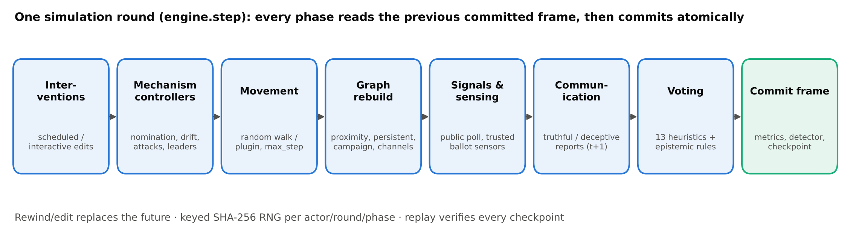
One round, eight phases, one atomic commit
Separated state
Delayed information
Paired randomness
Private preferences, cast ballots, reports and perceptions are never merged.
A report generated at round t describes round t−1 and is delivered at t+1.
SHA-256-keyed RNG per actor, round and phase keeps treatment and control arms matched.

Slide 6
Architecture: one engine behind every interface
Configuration model.py · canonical TOML parsing, immutable schemas
CLI
18 commands: run, resume, batch, compare-*, export, knowledge
Coordinator engine.py · phase order, atomic frames, rewind/resume
Browser
Observations observations · coalitions · policies (scoped inputs)
Play, step, rewind, edit, inspect; network and statistics views
Decisions voting · epistemic · network · campaign · signals · detector · majority
Exports
CSV, SVG, PNG and GIF from recorded frames
Replay records · provenance: SHA-256 of core, pipeline, web, plugins
Checkpoints
Evaluation metrics · *_experiments · combined · majority_experiments
v21/v22, verified by full replay; tampering rejected
6.0k lines of engine Python, 0.5k of web UI, 6.9k of tests. Core uses only the standard library; Pillow is optional for images.

Slide 7
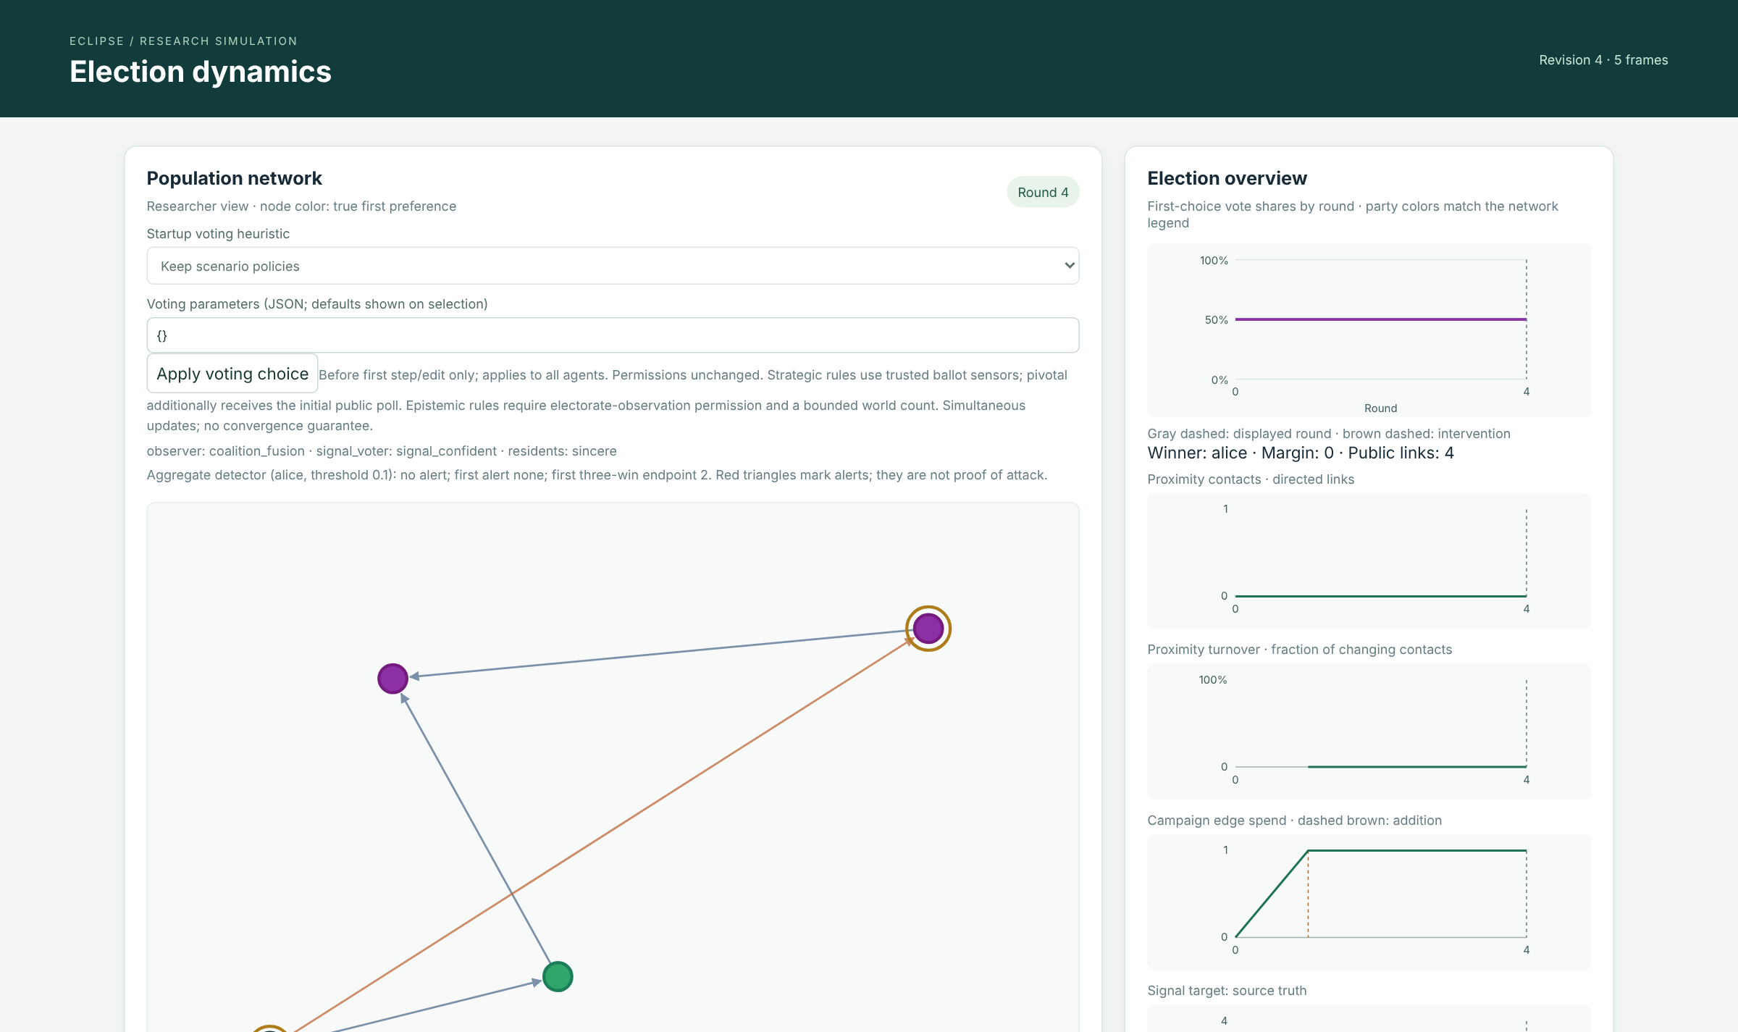
Interactive browser: watch, rewind and edit an election
Population network: persistent (blue), proximity (grey) and purchased campaign (orange) edges
Charts: vote shares, contacts, turnover, campaign spend, signals, detector
Inspector: each agent's permissions, trusted observations, reports and policy memory
Edits: editing a past round replaces the future; drafts are per agent and round; stale revisions are rejected
Startup heuristic selector switches all 13 voting rules before round 1

Slide 8
Configuration I: a scenario is one TOML file
Key / table | Definition and bounds
parties, k | Candidate IDs (also the tie order); global ballot length 1 ≤ k ≤ |C|, exactly k distinct parties
seed, rounds | Master seed for keyed RNG streams; default CLI horizon
[groups.<name>] | voting, movement (stationary | random_walk | plugin), max_step ∈ [0,1], communication (none | truthful | target_report), graph, proximity_radius ∈ [0,√2], parameters
capabilities | 15 permissions. Sensing, sight, interception, signal and roster default to false; send, receive, move and modify default to true
[[people]] | id, group, strict preference (or ideal ∈ [0,1]^d), position ∈ [0,1]², per-person overrides
[network] | radius; proximity_mode dynamic | frozen | static; directed persistent and campaign edges; private_channels
[[interventions]] | Scheduled per round and person: preference, position, group, one-round ballot, edge and channel edits
[convergence] | case = direct_best_response | source_local_dominance | certified_conformity (guard-checked)
Validation is canonical: every Scenario, including programmatic replacements, is re-parsed. Invalid input raises ElectionError before any state exists.

Slide 9
Configuration II: one table per mechanism, each with a budget
Table | Key fields
[[coalitions]] | members, target, report / sight / eavesdrop budgets per round and in total
[campaign_controller] | target, policy none | random | target_heuristic, lifetime and per-round budgets (1 per edge)
[signal_controller] | target, policy truthful | bounded_random | target_biased, schedule; cost = L1/2
[nomination] | m, eligible, mode endogenous | fixed | random
[alignment.attack] | target, targets, policy, per_person_round, total_budget (L2 path)
[detector] | target, threshold: alert if Δ target share > threshold
[leaders] | policy fixed | feedback, step, budget, signal_noise, perception_weight
[majority_estimation] | poll_counts, memory_rounds = 10, poll_weight = 0.5
# examples/all-enabled.toml
k = 2
seed = 2026
[campaign_controller]
target = "alice"
policy = "target_heuristic"
lifetime_budget = 1
[signal_controller]
target = "alice"
policy = "target_biased"
schedule = "repeated"
[alignment.attack]
target = "alice"
targets = ["bob"]
total_budget = 0.3
[detector]
target = "alice"
threshold = 0.1

Slide 10
26 built-in voting rules, from sincere to certified
Controls (3)
sincere · local_plurality · sensed_plurality
Strategic (10)
pivotal · expected_utility · top_k · max_m · tie_u · tie_h · tie_r · poisson · local_dominance · maximin
Epistemic (6)
de re · dominant · pessimistic, each with a bounded-signal variant
Coalition & signal (4)
sight_plurality · overheard_plurality · coalition_fusion · signal_confident
Certified (3)
direct_best_response · source_local_dominance · certified_conformity
Strategic defaults: top_k = 2, samples = 200, uncertainty_radius = 2, max_states = 200,000, information_source native | poll. Plugins: python:module:function, hashed for replay but not sandboxed.

Slide 11
Study A: conformity churns; strategic rules mostly hold the sincere winner
9 voters, 3 parties, random walk, 100 rounds, seeds 101/202/303. Mean ballot switches per run.
sensed_plurality: 95 switches on seed 101, hitting the horizon on 2 of 3 seeds
28 of 30 strategic runs keep sincere winner C; TieR and maximin each end one run on B
With a common poll, all 30 strategic runs stabilise at 0–4 switches, so the information source drives the differences
69 runs, 0 failures. Policies without a common-poll arm show 0.

Slide 12
Study A at 500 voters: cost and churn diverge sharply
Notes:
Top-2's exact-tie model cannot fire at N=500, because 499 other ballots cannot split evenly. Its switches come from consideration-set churn. No heuristic is ranked best.

Slide 13
No universal convergence guarantee, so five domains are certified
Case | Behaviour | Guarantee | Change bound
F1 | Direct best response to truthful aggregate | Pure Nash equilibrium | ≤ m²N² (≤ mN truthful)
F2 | Homogeneous local dominance, L1 radius r | Voting equilibrium | ≤ N(m−1)
F3 | Conformity on fixed undirected graph | Local fixed point | ≤ m|E| + N(m−1)
F4 | Finite attacks, then F1 relaxation | Equilibrium of final election | F1 bound after last event
F5 | Finite attacks, then F3 on same graph | Local fixed point | F3 bound after last event
Counterexample
Two voters, u: A≻B and v: B≻A, both copy their only neighbour (sensed_plurality) on edges u⇄v.
t | u | v | winner
0 | A | B | A
1 | B | A | A
2 | A | B | A
… | … | … | A
Ballots flip forever while the winner never changes. A stable winner is not convergence.
F3 potential: Φ = m·A(b) + Σ qᵢ(bᵢ) rises by at least 1 on every change. Sequential cyclic scheduler; unsupported settings fail certification explicitly.

Slide 14
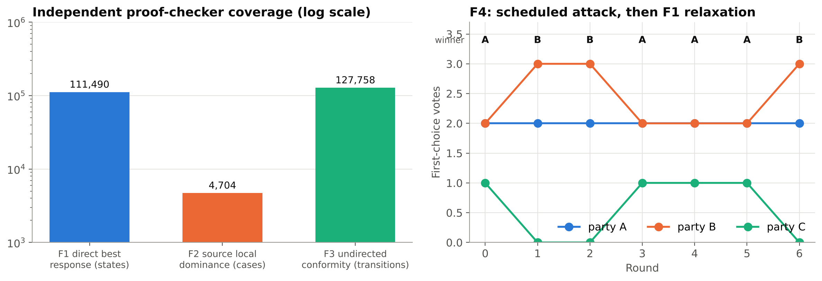
Certified runs reach equilibrium, and the proofs are checked exhaustively
F1: certified-direct
F3: certified-conformity
F4: attack, then relax
C,B,A,A,B → voter 1 moves C→B. Nash equilibrium, B wins 3–2, 1 change (bound 15).
(A,B) → (B,B): a fixed point after 1 change. The simultaneous version would cycle.
An attack at round 3 resets C and A wins; F1 restores the B equilibrium at round 6.

Slide 15
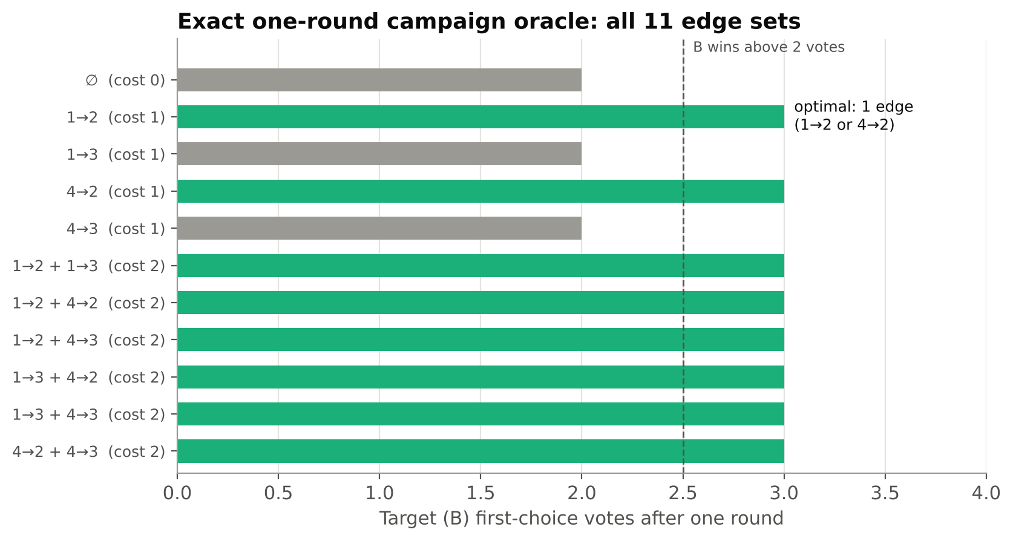
Optimal solutions: exact oracles return the cheapest winning manipulation
Campaign optimum (budget 2)
All 11 eligible edge sets were enumerated. One edge, 1→2 or 4→2, is the cheapest win (B: 2 → 3 votes). The edges 1→3 and 4→3 alone are wasted.
Conditional epistemic equilibria
9 profiles and 72 evaluations give exactly two equilibria, {A,B} and {B,B}, reproducing the source paper's §5.2.
F1 / F2 equilibrium
The compromise C→B is the best and dominance response, and it is reached in 1 step.

Slide 16
Seven paired mechanism studies: 5 seeds each, zero failures
The arms share scenario, seed and movement draws, and positions are verified equal. The examples have 3–4 voters, so these runs validate controls rather than estimate effect sizes.
Study | Arms | Outcome on example electorate | Verdict
B Proximity | dynamic vs frozen | Exposure L1 = 0 at 3 voters; ≈5k contact-rounds at 200 voters | Null
C Coalition | 6 capability arms | Sight and eavesdrop flip to target in 5/5 (+0.25 share) | Effect
D Campaign | none / random / heuristic | Heuristic wins from round 1 in 5/5; random catches up later | Effect
E Public signal | 3 responses × 3 polls | Budget spent, final share unchanged in all 45 runs | Null
F Nomination | endogenous / fixed / random | Fixed control is frame-identical; random adds bob in 4/5 | Control OK
G Alignment | 4 drift / attack arms | Targeted attack wins 5/5, random 3/5; detector recall 100% / 60% | Effect
H Leaders | fixed/adaptive × signal | Perception error ≤ 0.10, no winner change; invariant holds | Null

Slide 17
Coalitions and campaign edges: information and links flip the result
Deception alone and coordination alone do nothing here; “all” equals the best single capability. Both campaign controllers spend the full budget.

Slide 18
Public polls and nomination: bounded distortion is too weak here
Response \ poll | truthful | bounded_random | target_biased
sincere | 0 switches spend 0 | 0 switches spend 2 | 0 switches spend 2
signal_confident | 0 switches spend 0 | 0 switches spend 2 | 5 switches spend 2
epistemic_signal_dominant | 0 switches spend 0 | 2 switches spend 2 | 0 switches spend 2
3×3 factorial, 5 seeds per cell; switches are totals over the 5 seeds. Distorted polls spend their full budget of 2 and trusting or dominant voters occasionally switch, but target B's final share changes by 0.00 in every cell.

Slide 19
Alignment attacks win, and the aggregate-only detector catches them
The threshold is calibrated on disjoint no-attack seeds 100–104 (0.0). Every alert comes at onset (0-round delay), before the third consecutive win. Attack spend is 0.35 of L2 budget.

Slide 20
Hidden leader adaptation moves platforms, not outcomes
Feedback leader alice repeats a move after support rises and reverses after it falls. She spends her full 0.5 budget.
Without signals, perceptions freeze, so error peaks at 0.10. Noisy broadcasts (±0.05) cut it to about 0.06.
Winner unchanged in every round of all 20 runs. The no-signal invariant (all non-leader fields identical) holds 5/5.

Slide 21
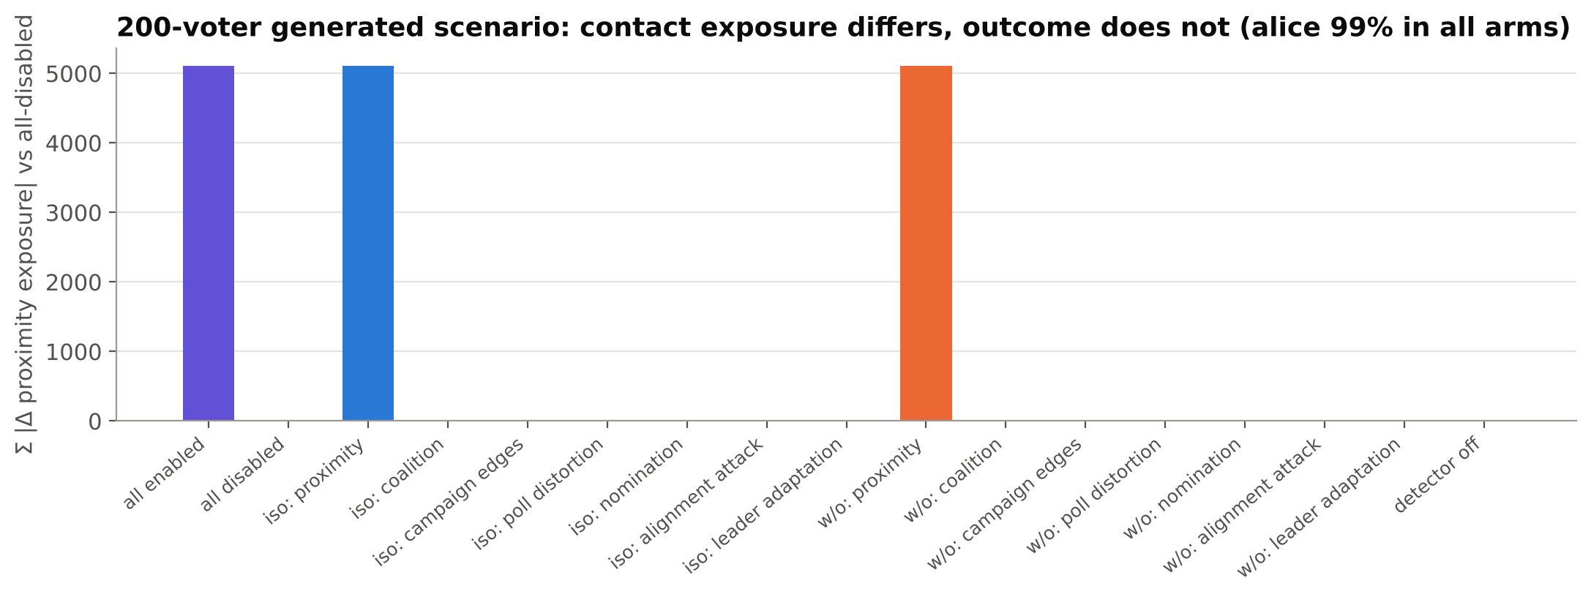
Combined 17-arm matrix: valid infrastructure, but a ceiling effect
4-voter all-enabled
5 seeds × 17 arms, 0 failures. Alice wins all 6 rounds in every arm; nomination already gives her a majority.
200-voter generated
3 seeds × 17 arms, 0 failures. Alice holds 99% in every arm, and proximity changes exposure by ≈5k contact-rounds.
Arms: all enabled · all disabled · 7 isolated · 7 leave-one-out · detector-off, which checks that every non-detector field is identical. Next step: a balanced, contested electorate.

Slide 22
Majority estimation: local memory helps most when the poll goes stale
Passive belief: w·poll + (1−w)·recent neighbour share. It never changes ballots.
30 trajectories, 240 arms, 0 failures; the numbers match the repo's documented report exactly
Support shift: after the round-50 shift the blend leaves 12.8% unrecovered, against 100% for the stale poll
Sensitivity: K=20 (error 0.078) and w=0.75 (0.046) each beat the defaults (0.085). Defaults unchanged.

Slide 23
Engineering quality: tests grew with every stage; scale is measured
Independent oracles: 80 randomised exact-EU cases, brute-force graphs, and exhaustive F1–F3 checks. All 31 examples replay. Benchmarks are single runs (i7-12700H), not guarantees.

Slide 24
Conclusions and next steps
Built
A reproducible, permission-scoped simulator with 7 mechanisms, 26 voting rules, replayable checkpoints and a browser UI. 343 tests pass.
1
Proved
Full-model convergence is refuted, but F1–F5 give certified equilibria. The exact oracles find the cheapest winning manipulations.
2
Observed
Information capabilities (sight, eavesdropping), campaign edges and alignment attacks flip small elections. Bounded poll distortion and leader adaptation do not.
3
Next
Freeze the Stage 11 protocol: balanced electorates, ≥30 held-out seeds, run-level uncertainty, a Top-2 parity fix, a rejected-action ledger and browser acceptance.
4
Report: docs/presentation_docs/Eclipse_Project_Report.pdf · commands to reproduce every figure: docs/presentation_docs/README.md

