Slide 1
Date A Scientist – Analysis
Machine Learning Fundamentals
Philip Mannion
Course start date: Nov 13 2018

Slide 2
Table of contents
Data Exploration
My Questions
New Columns
Q1 Analysis
Q1 Conclusions
Q2 Analysis
Q2 Conclusions

Slide 3
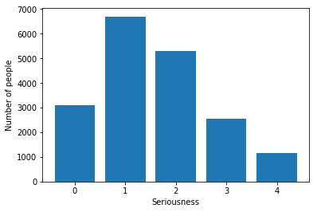
Data Exploration - Religion
I was interested in how serious users were about their religion.
This chart shows the numbers for that for each actual relgion (i.e. excluding atheism and agnosticism).
0 is the least serious, 4 the most.
The chart shows there’s a good amount of data for each level, so attmepting to predict that should be feasible.

Slide 4
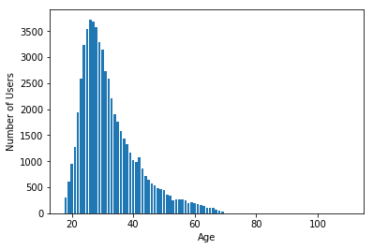
Data Exploration - Age
I was also interested in age as it was a continuous variable in the data.
This chart shows the numbers for each age in the data.
Whilst there is some data for almost all ages up to 70, the numbers tail off and there are a few outliers.
Whilst predicting age could be possible, it may be that restricting predictions to where we have the most data (20 – 42) might yield better results.

Slide 5
My Questions
I formulated questions by choosing features that seemed:
  broadly prima facie relevant to what I wanted to predict
  had data that could be used on a numerical scale
Q1 - Can we predict the seriousness of someone’s religious belief based on their stand on vices (drink, drugs and tobacco)?
Q2 – Can we predict age based on when someone was last online, their number of children, the number of languages they speak and their indulgence of drink and drugs?

Slide 6
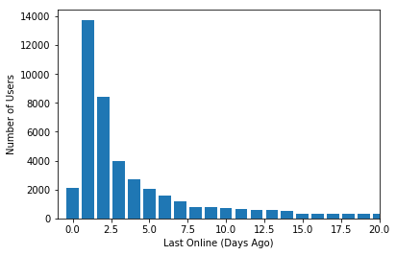
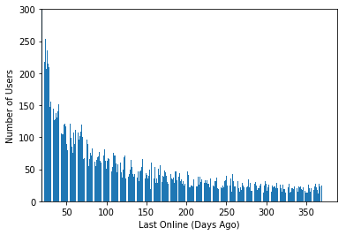
New Columns – Last Online
Assuming that the latest date in the data was the date the data was created, I used the last online datetime to work out how many days ago each user was last online.
The charts on the right show the results.
As expected most people were online recently, the top chart shows the counts for the ‘last’ 20 days – peaking at over 13,000 online ‘yesterday’.
The bottom chart shows more than 20 ‘ago’, with a long tail up to 365 days ‘ago’ most below 100 people.

Slide 7
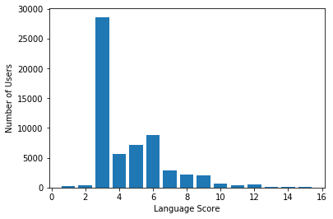
New Columns - Languages
The language data showed not only which languages people spoke, but how well. I used that to give each person a score for how good at languages they were.
I awarded 3 points for fluency, 2 for being ‘okay’ and 1 for being ‘poor’.
When the level of language was not given I assumed fluency as the largest single value was simply ‘English’, and I assumed the data was from an English speaking country.
Some people mentioned coding languages, given I like to code I did not discriminate against them.
The table on the right shows the scores for the data. Scoring less than 3 seems strange, but some users had indeed mentioned only one language at a level of ‘okay’ or ‘poor’ and who am I to judge.

Slide 8
New Columns - Misc
I also added columns:
  Drinks from 0 – ‘not at all’ to 5 - ‘Desperately’
  Drugs from 0 - ‘Never’ to 2 - ‘Often’
  Smokes from 0 - ‘No’ to 4 - ‘Yes’
    I scored ‘Sometimes’ more highly than ‘Trying to Quit’, which seemed a close call but I gave ‘credit’ for effort.
  Number of Kids 0, 1 or 2
    2 includes everyone with more than one

Slide 9
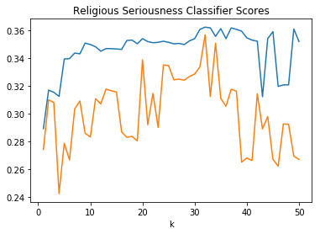
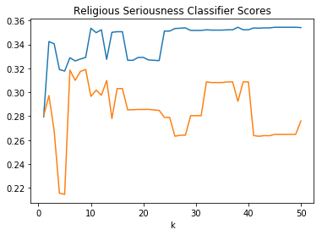
Q1 Analysis - KNeighbours
The charts on the right show the accuracy (blue) and precision (orange) of KNeighbours classifiers trying to predict religious seriousness on:
  Top – Drinks, Drugs and Smokes
  Bottom - Drinks and Drugs
I tried without Smokes as I was still slightly unsure about my rating scale (see above), and wondered if eliminating the controversy would help.
The best in both cases are about 1 in 3 accuracy and precision. This isn’t great, but given a random guess is 1 in 5 it suggests some usefullness

Slide 10
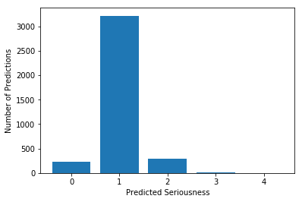
Q1 Analysis - KNeighbours
However I was suspicious as simply predicting 1 every time would get those scores as it was the most likely answer and roughly 1 in 3 of users (see above).
Sure enough the chart on the right shows the predictions for the best K (32) for the drinks, drugs and smokes classifier. It chooses 1 the vast majority of the time.

Slide 11

Q1 Analysis – SV Classifier
I then tried a Support Vector Classifier on the same data.
It was much more intensive for my machine to run, with one trial taking not much shorter than the whole look of 50 trials of the Kneighbours charted above.
It also performed similarly to the best Kneighbours, with ~36% accuracy and ~28.8% precision. The choice of Gamma and C value did not affect the scores, except for very small C which reduced precision greatly.
As the chart on the right shows it suffered from the same problem as the K Neighbours, it’s success was from almost always predicting 1.

Slide 12
Q1 - Conclusion
It’s tempting to conclude that seriousness of religion cannot be predicted from the features I chose. This would not be that surprising.
However it may be worth investigating individual religions separately – they have different attitudes and teachings on ‘vices’
Also the data on seriousness of belief is not that ‘serious’ itself and is self reporting. It may be that an objective measure of religious attitude yields better results.

Slide 13
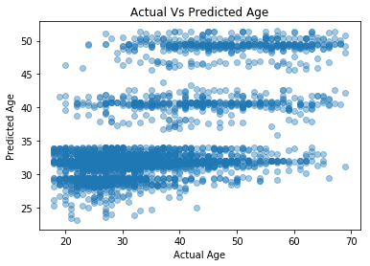
Q2 Analysis - LinearRegressor
The top chart shows the actual age against the age predicted by a linear regressor using the features in the table below.
It’s R2 score for the test data was 0.33 which is pretty modest (possibly a weak effect), and the chart shows that it is clustering its guesses in 3 groupings - ~28-35, ~40 and ~50.
The chart below shows the Co-Efficients. The data was scaled beforehand, so I wondered if eliminating Kids might be worth a try. Although it was the strongest feature it only had 3 possible values and it seemed worth testing if that was responsible for the clustering of guesses.
Last Online | -0.15
Kids | 5.79
Drinks | -0.73
Drugs | -1.08
Languages | -0.21

Slide 14
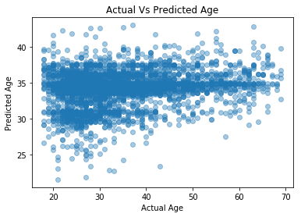
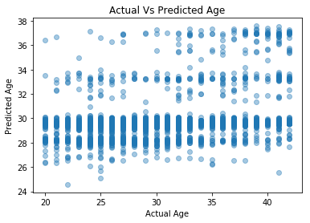
Q2 Analysis – Linear Regressor
The charts on the right show failed attempts to improve the Linear Regessor.
Above is removing the Kids feature, it ended up with all predictions clustered around 35 and an R2 of 0.04.
Below is using all the features from the previous slide but concentrating on the ages 20 to 42, where we had the most data and which eliminated age outliers.
It also seemed to perform more poorly, once again the guesses clustered and gave a R2 score of 0.1.

Slide 15
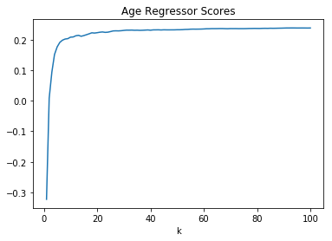
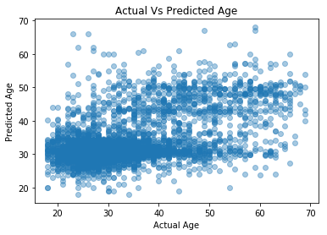
Q2 Analysis – K Regressor
I then tried a KNeighbours Regressor on the same features to try and predict age.
The chart above on the right shows the R2 scores for different K values, the regressor tended towards a value ~0.2 pretty quickly.
It ran about as fast as the Linear Regressor, but 0.2 is very weak suggesting no real efficacy.
The chart below shows the guesses for a K of 20, they seem to be clustered in a similar way to the Linear Regressor.

Slide 16
Q2 - Conclusion
As before it’s tempting to conclude that age cannot be predicted from the features I chose. However whilst it’s true these models don’t do a good job, it seems clear that no. of kids and possibly Drugs are well correlated and could be part of a decent model
For the data on kids it seems obvious that we’d need more granularity, how many exactly, even when they were born.
Similarly the options for drugs were very constrained, so investigating a more detailed survey of attitudes to drugs against age could be interesting.

