Slide 1



Channabasaveshwara Institute of Technology
(Affiliated to VTU, Belgaum & Approved by AICTE, New Delhi)
(NAAC Accredited & ISO 9001:2015 Certified Institution)
NH 206 (B.H. Road), Gubbi, Tumkur – 572216. Karnataka.
PROJECT PRESENTATION
ON
INGENIOUS BRAIN TRACKER
Guide: Mr. RAJENDRA C J, Assistant Professor, Dept. of ECE, C.I.T, Gubbi. | Team members: MANASA M (1CG14EC056) NAYANA C P (1CG14EC072) MANOHAR N (1CG14EC058) LOKESH S P (1CG14EC052)

Slide 2
Contents
Introduction
Literature Survey
Methodology
Hardware requirements
Software requirements
Experimental setup and result
Future scope
Conclusion
References

Slide 3
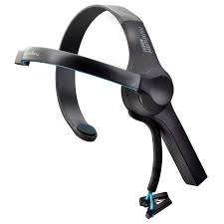
INTRODUCTION
Ingenious brain tracker is a device which uses the concept of BCI(Brain Computer Interfacing). It translate brain activities into a set of commands for the computer to understand to control any computer application .
It is designed for mental disorder patients like Autism, Stroke, Paralyzed and other mental disorder people who cannot express their feelings. The device captures the EEG signal like Alpha, Beta, Gamma, Delta, Theta.
Autism patients suffer from behavioral changes issue and sometimes get too furious and its difficult to control them. This is a low cost device and keeps continuous monitoring on the patient.

Slide 4
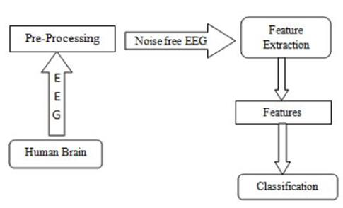
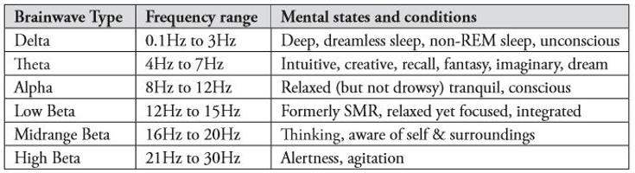
Figure.1: Basic BCI block diagram
Table 1: Commonly recognized frequencies

Slide 5
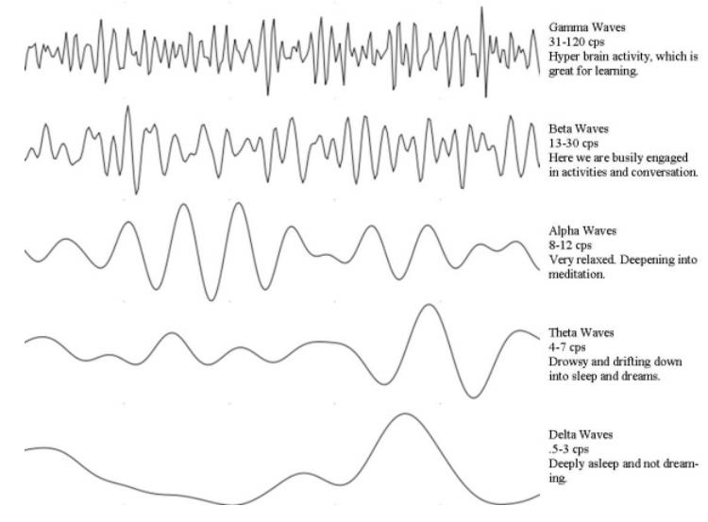
Figure 2: Brain Wave Graph
Several methods are existing to detect brain activity such as magneto encephalography (MEG), Functional Magnetic Resonance Imaging (FMRI) and Electroencephalogram (EEG).

Slide 6
LITERATURE SURVEY
The recognition of emotion can also be an asset for disabled people who have difficulties with communication. Thus with the help of EEG based emotion recognition; the computer can actually take a look inside the users head to observe their mental state emotions was prominent over the right posterior regions in the alpha signal.
Emotions are a great asset in communication and a key element in social interactions. They can be used as mechanisms for signaling, directing attention, motivating and controlling interactions.
Here we discuss about autism and Cognitive-behavioral interventions.

Slide 7
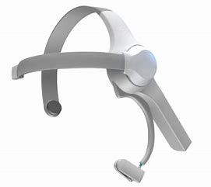
METHODOLOGY
ThinkGear Driver (Thinkgear.dll)
ThinkGear Connector
Personal Computer
Further Processing
Figure 3: Flow chart

Slide 8
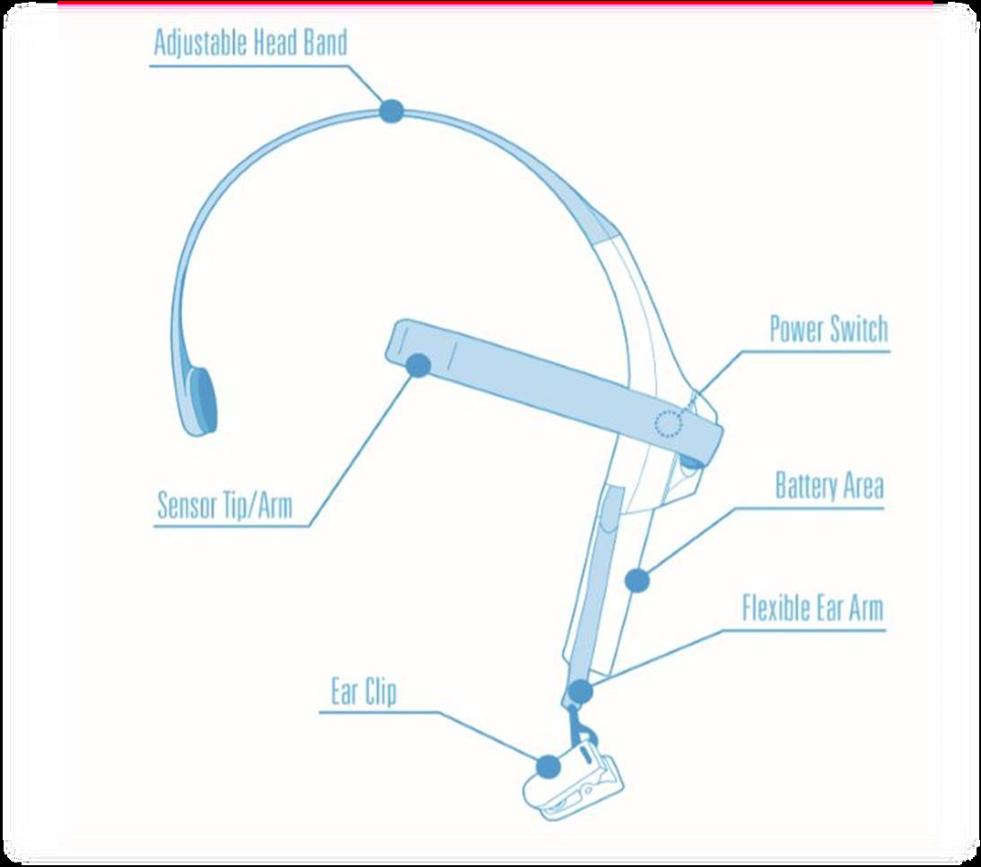
HARDWARE REQUIREMENTS
NEUROSKY MINDWAVE BAND
The Mindwave Mobile reports the wearer’s mental state in the form of NeuroSky’s proprietary Attention and Meditation Sense algorithms, along with raw wave and information about the brain wave frequency bands.
Figure 4: Mindwave mobile Headset

Slide 9
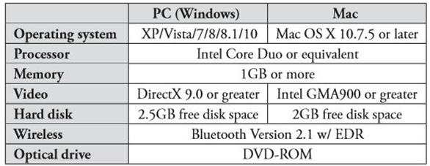
2.Minimum System Requirements for PC/Mac
The table below shows the system requirements that are needed for the Mindwave Mobile Handset to be interfaced with the PC or MAC.
Table 2: Minimum System Requirements for PC/Mac

Slide 10
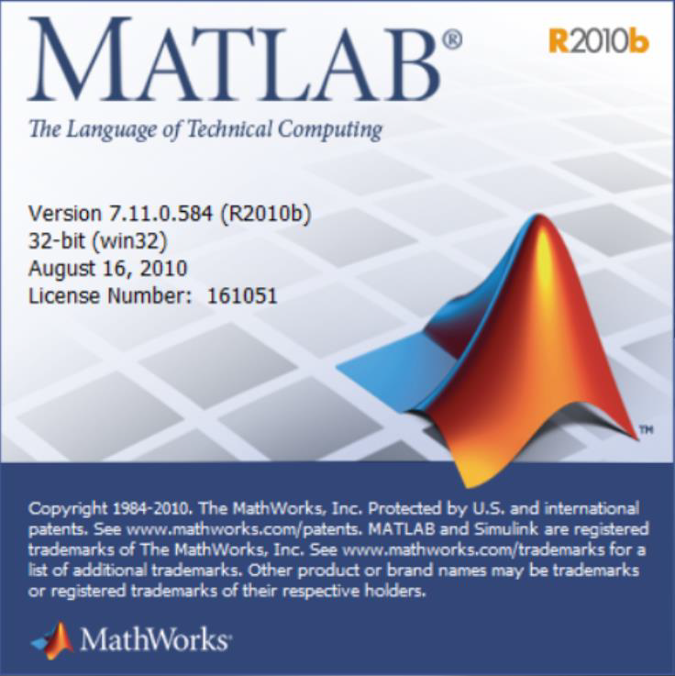
SOFTWARE REQUIREMENTS
MATLAB (R2010b)
Version 7.11.0.584
1.MATLAB Software
MATLAB is used for data acquisition and visualization of data format. MATLAB is widely used as a computational tool in science and engineering encompassing the fields of physics, chemistry, math and all engineering streams.
FEATURES
MATLAB's programming interface gives development tools for improving code quality maintainability and maximizing performance.
It is a high-level language for numerical computation, visualization and application development.
Figure 5: Matlab Software

Slide 11
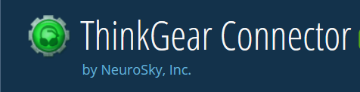
USES OF MATLAB
Signal Processing and Communications, Image and Video Processing, Control Systems, Test and Measurement
Computational Finance, Computational Biology.
ThinkGear Connector
The ThinkGear Connector (TGC) runs as a background process on computer and is responsible for directing headset data from the serial port to an open network socket.
ThinkGear Communications Driver(ThinkGear.dll)
The ThinkGear Communications Driver (TGCD) is a native Windows and OS X library that handles all the “heavy-lifting” of interacting with a NeuroSky headset.
Figure 6: ThinkGear Connector

Slide 12
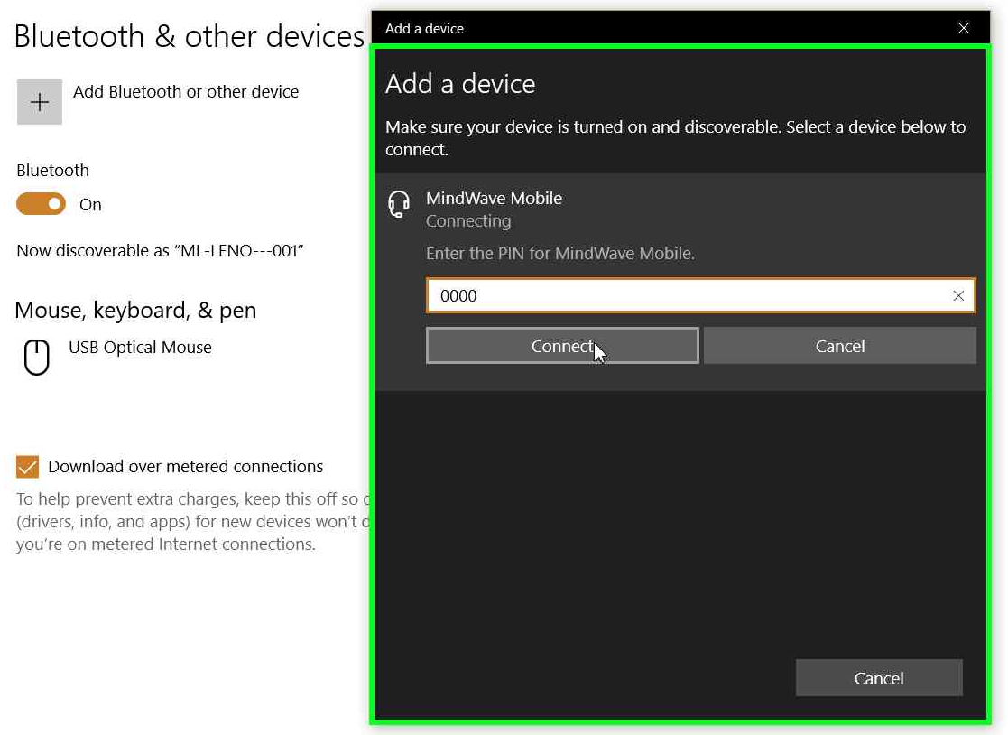
EXPERIMENTAL SETUP AND RESULT
Step 1
Turn on the Bluetooth in the System which is being connected to NeuroSky Mindwave Mobile and pair them each other by entering the pin as “0000”.
Figure 7: Pairing of MindWave Mobile to PC

Slide 13
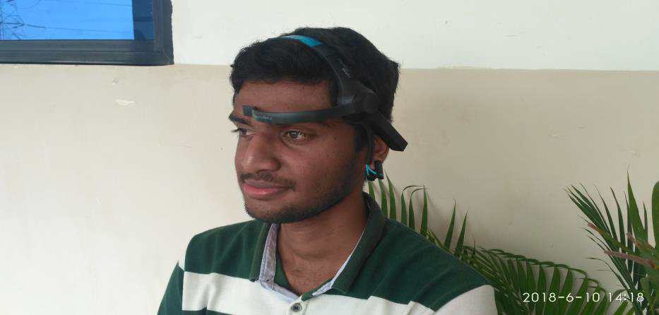
Step 2
Wear MindWave Mobile and make the electrode rests on the forehead, above the eyebrow, and the reference clips onto the ear.
Figure 8: A person wearing MindWave Mobile

Slide 14
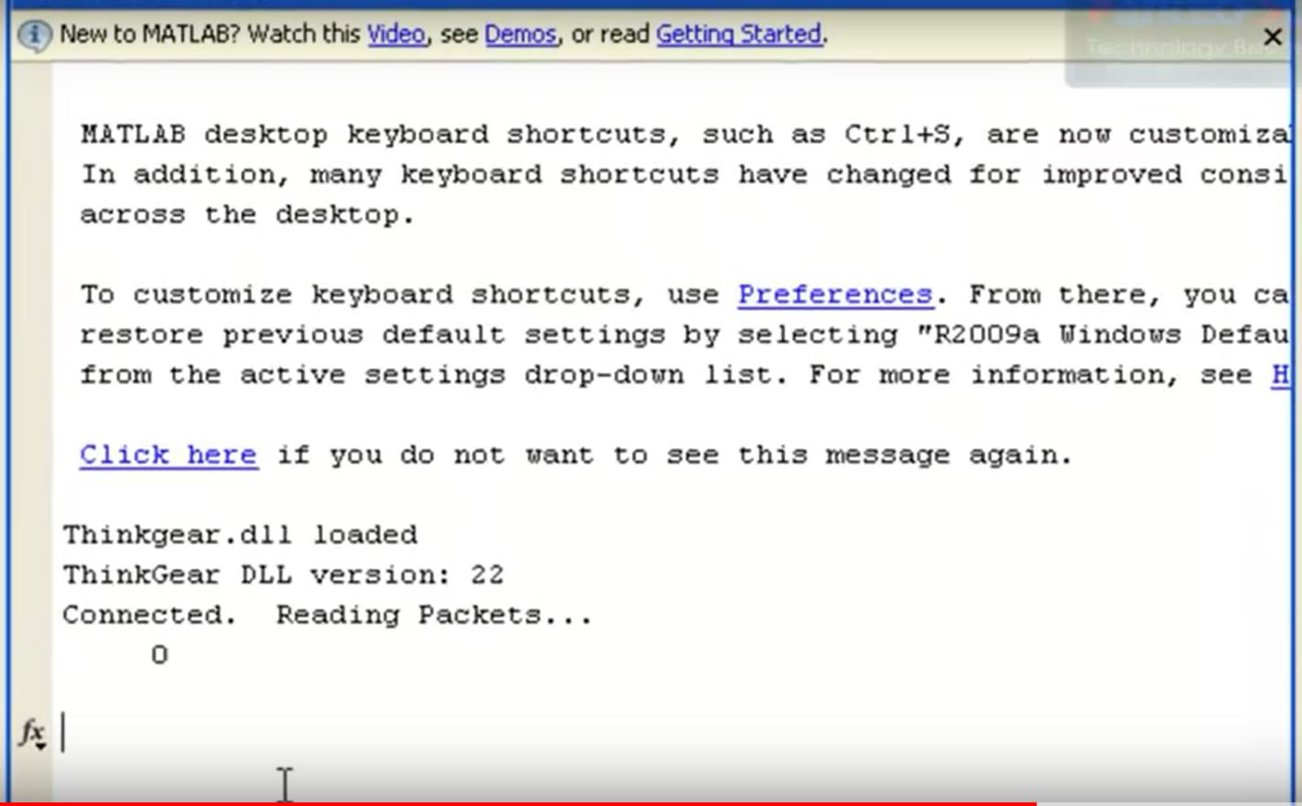
EXPERIMENTAL RESULT
Figure 9: ThinkGear Connecting to Matlab

Slide 15
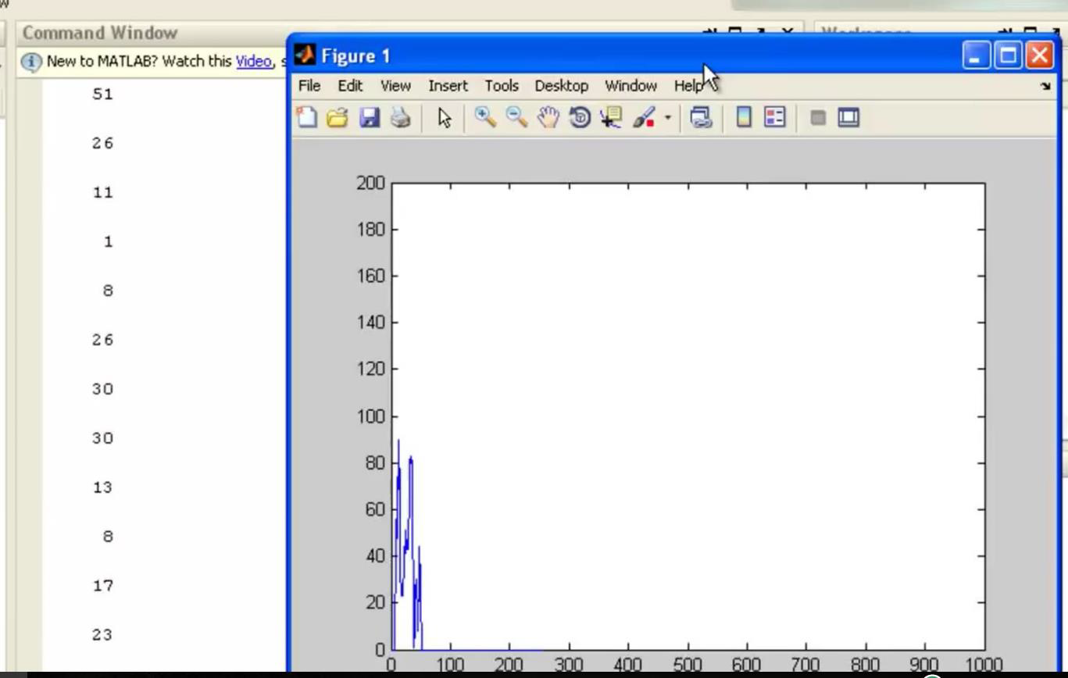
Fig 10: Graph of the obtained raw data
CIT, Gubbi

Slide 16
FUTURE SCOPE
BEHAVIOURAL ANALYSIS The data obtained in the process can be used to analyze the behaviour of the autism patients by using data analytics. And this could help in predicting upcoming behaviour within a prescribed time.
RESEARCH ON MENTAL DISORDER The data we are getting is in semi-structured form which can be stored in databases. And these data can be used to get in depth understanding of the particular disorders.
PREVENTING ABNORMAL BEHAVIOURS Preventing the patients to enter into abnormal conditions. For example, if a mental disorder patient has detected that he gets furious. Doctors could sedate him before he reach that level.
CIT, Gubbi

Slide 17
CONCLUSION
In this project, we have used attention mode and meditation mode signals which were received from the NeuroSky Mindwave Mobile. And this attention mode contains more beta waves which indicates conscious and alertness of an individual. This is very useful in predicting the behaviours of the individual. Here we are successfully obtaining attention mode data.
Meditation mode is due to the calmness of an individual, which is not useful in treatment of mentally disordered patients.
And by using matlab we have achieved both Data Acquisition and Data Visualization.
CIT, Gubbi

Slide 18
REFERENCES
[1] Mangala Gowri S G, Cyril Prasanna Raj P, Badarinarayan K S, “Novel Algorithm for feature extraction and classification of EEG signals,” IJERT, ISSN: 2278-0181, Vol. 4 Issue 12, December-2015
[2] Betty P.V. Ho, Jennifer Stephenson, Mark Carter,” Cognitive-behavioral approaches for children with autism spectrum disorder: A trend analysis”, Faculty of Human Sciences, Macquarie University, NSW, Australia
[3] Sravanth Kumar, Vivek Kumar and Bharat Gupta,” Feature Extraction from EEG Signal through One Electrode Device for Medical Application”, 2015 1st International Conference on Next Generation Computing Technologies (NGCT-2015) Dehradun, India, 4-5 September 2015
[4] Niels Birbaumer, William J. Heetderks, Dennis J. McFarland, P. Hunter Peckham, Gerwin Schalk, Emanuel Donchin, Louis A. Quatrano, Charles J. Robinson,” Brain–Computer Interface Technology: A Review of the First International Meeting”, IEEE Transactions On Rehabilitation Engineering, VOL. 8, NO. 2, JUNE 2000
[5] Kamlesh H. Solanki, Hemangi Pujara,” Brainwave Controlled Robot”, IRJET, p-ISSN: 2395-0072, Volume: 02 Issue: 04 | July-2015.
CIT, Gubbi

Slide 19
BOOK REFERED
Erik Andreas Larsen, “Classification of EEG Signals in a BrainComputer Interface System”, Norwegian University of Science and Technology.
WEBSITE LINK
http://neurosky.com
CIT, Gubbi

Slide 20


