Slide 1



Channabasaveshwara Institute of Technology
(Affiliated to VTU, Belgaum & Approved by AICTE, New Delhi)
(NAAC Accredited & ISO 9001:2015 Certified Institution)
NH 206 (B.H. Road), Gubbi, Tumkur – 572216. Karnataka.
PROJECT REVIEW
INGENIOUS BRAIN TRACKER
Guide: Mr. RAJENDRA C J, Assistant Professor, Dept. of ECE, C.I.T, Gubbi. | Team members: MANASA M (1CG14EC056) NAYANA C P (1CG14EC072) MANOHAR N (1CG14EC058) LOKESH S P (1CG14EC052)

Slide 2
Content
Introduction
Literature Survey
Objective
Methodology
Hardware Details
Software Details
Status of the project
References

Slide 3
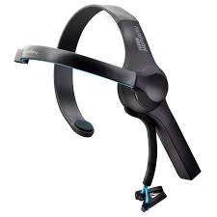
INTRODUCTION
Ingenious brain tracker is an aiding device which captures the EEG signals from the people who are suffering from mental disorders like paralysis, stroke, neural disorders and particularly for Autism patients.
The device is to increase the possibility for the treatment of mental disabilities related to neural system and it also helps as an analysis device.
This system generates the ready prescriptions, for critical cases, which could be used immediately.
As an analysis device, the data got from the sensors where being monitored as well as stored in the databases where it will help the specialists, researchers for the better understanding of the disorders.

Slide 4
LITERATURE SURVEY
Autism spectrum disorder (ASD): Autism spectrum disorder (ASD) is a complex developmental disorder that can cause problems with thinking, feeling, language and the ability to relate to others. It is a neurological disorder, which means it affects the functioning of the brain[1].
In Autism disorder, the patients shows rapid changes in their behaviors like anxiety, hyper activeness, etc., Which causes heart attacks, chest pain...[1]
Not only Autism, some other disorders where patients can’t move the body or/and who can’t express how they feel.[2]
Here we are using a part of Brain control Interface(BCI). Where we can get the EEG signals directly from the brain. The wireless transmission of raw data to the discreet system where all the processing has been done. [3]

Slide 5
OBJECTIVES:
To suggest the preliminary treatment.
To develop a continuous behavioral monitoring system, and provide prescriptions for abnormal cases.
To develop a cost effective diagnosis system.

Slide 6


METHODOLOGY
Display
SENSOR (Mindwave Band)
Bluetooth module
Microcontroller (Arduino UNO)
Database

Slide 7
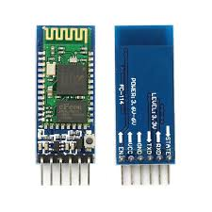
HARDWARE DETAILS:
NeuroSky Mindwave Band * Outputs 12 bit Raw-Brainwaves (3 - 100Hz) with Sampling rate at 512Hz * Outputs EEG power spectrums (Alpha, Beta, Gamma, Delta, Theta) * BT/BLE dual mode module (10 maters range) * Static Headset ID (headsets have a unique ID for pairing purposes) * Supported platforms: Windows (XP/7/8/10), Mac (OSX 10.8 or later), iOS (iOS 8 or later) and Android (Android 2.3 or later)
Bluetooth SPP (Serial Port Protocol) module - - HC-05 * Low Power 1.8V Operation, 3.3 to 5 V I/O * Bluetooth V2.0+EDR (Enhanced Data Rate) * UART interface with programmable baud rate * With integrated antenna

Slide 8
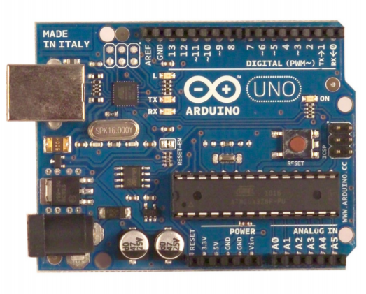
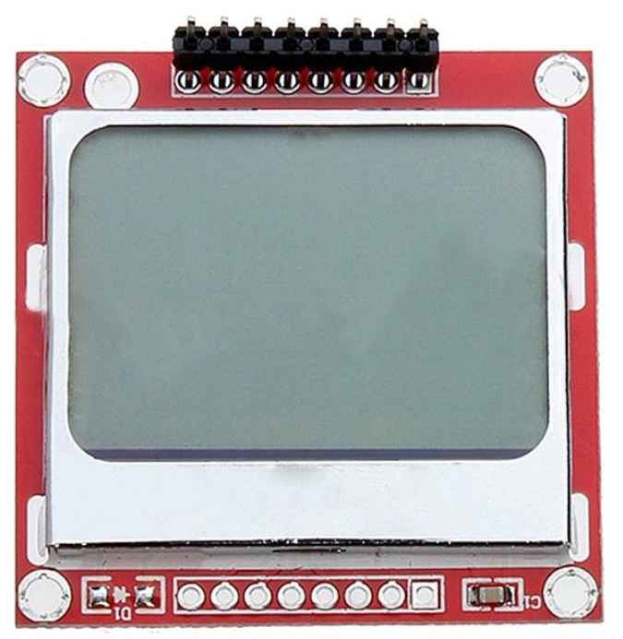
HARDWARE DETAILS: (Cont…)
Arduino Uno * Microcontroller---- ATmega328 * DC Current per I/O Pin 40 mA * DC Current for 3.3V Pin 50 mA * SRAM-- 2 KB, EEPROM--1 KB * Clock Speed 16 MHz
Nokia 5110 LCD Module, Arduino Compatible * Low power supply, requires less than 200μA,and has power-down mode. * 84 x 84 dot matrix LCD,can show 4 lines of characters, 12 Characters Per Line * Uses Serial Peripheral Interface (SPI) to communicate with the minicontroller, only 8 signal lines including power and GND.

Slide 9



SOFTWARE DETAILS:
Arduino IDE (64 bit) * Language - - C/C++
Platform * Window 10, Ubuntu 14.0

Slide 10
Current status
At present, the project is at CODING phase.
Hardware and Software Integration, Testing is pending.

Slide 11
REFERENCES:
Betty P.V. Ho, Jennifer Stephenson, Mark Carter,” Cognitive-behavioral approaches for children with autism spectrum disorder: A trend analysis ”, Faculty of Human Sciences, Macquarie University, NSW, Australia, 27 November 2016.
Sravanth Kumar , Vivek Kumar , Bharat Gupta,"Feature extraction from EEG signal through one electrode device for medical application", Next Generation Computing Technologies (NGCT), 2015 1st International Conference, 4-5 Sept. 2015.
Jonathan R Wolpaw, Niels Birbaumer, William J Heetderks, Dennis J McFarland, P Hunter Peckham, Gerwin Schalk, Emanuel Donchin, Louis A Quatrano, Charles J Robinson, Theresa M Vaughan, et al. Brain-computer interface technology: a review of the ﬁrst international meeting. IEEE transactions on rehabilitation engineering, 8(2):164–173, 2000.
Cooley J. W., J. W. Tukey, An Algorithm for the Machine Computation of the Complex Fourier Series, Mathematics of Computation, 19, pp. 297-301, 1965.

Slide 12


