Slide 1
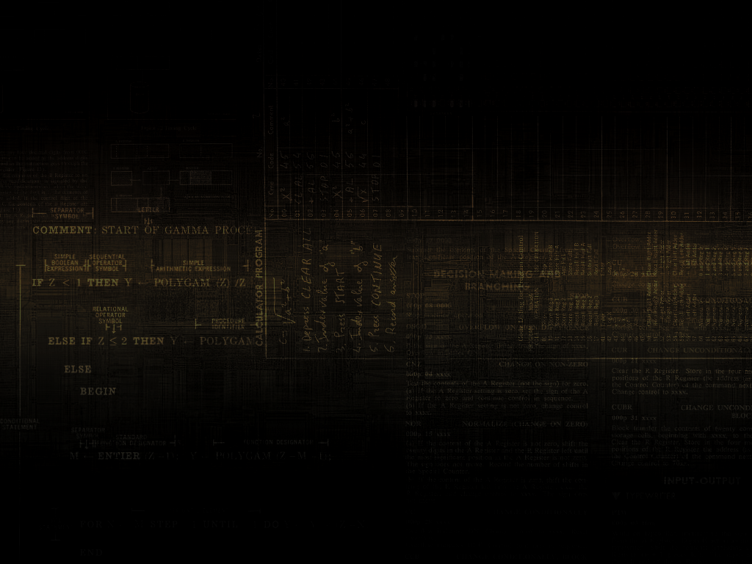
20093 Crash Course #1
Python/Qt4 Bindings
Presented By
Sean Madden

Slide 2
What's a Qt?
Graphics Toolkit
Called Qt because the 'Q' looked cool in the creator's Emacs font
Added 't' for 'Toolkit'
  (Also inspired by Xt, another toolkit of the time)

Slide 3
Toolkits? Huh?
Toolkits are used to abstract away complex and painful OS-Specific graphics APIs.
  X11
  Windows API
Others include
  GTK
  wxWidgets
  Tcl/Tk

Slide 4
Fun Qt Applications
Google Earth
KDE
Opera
Skype
VLC
VirtualBox

Slide 5
What's a Python?
Seriously?

Slide 6
Into the meat of it

Slide 7
Two main classes of Objects
Widgets
  Displayable on screen
  Swing := JComponent
Non-Widgets
  Other utility objects
  Think layouters

Slide 8
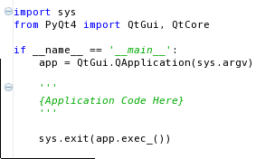
Anatomy of a PyQt Application

Slide 9
QApplication
Manages the GUI application's control flow and main settings.
Only ever ONE instance in any running application
  Regardless of how many Widgets are shown

Slide 10
Things you will use
QWidget
QLabel
QAbstractButton
QTextEdit
QMenuBar
QLayout

Slide 11
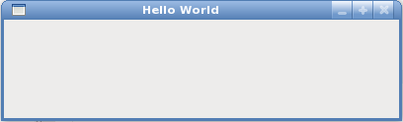
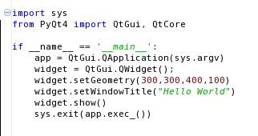
QWidget

Slide 12
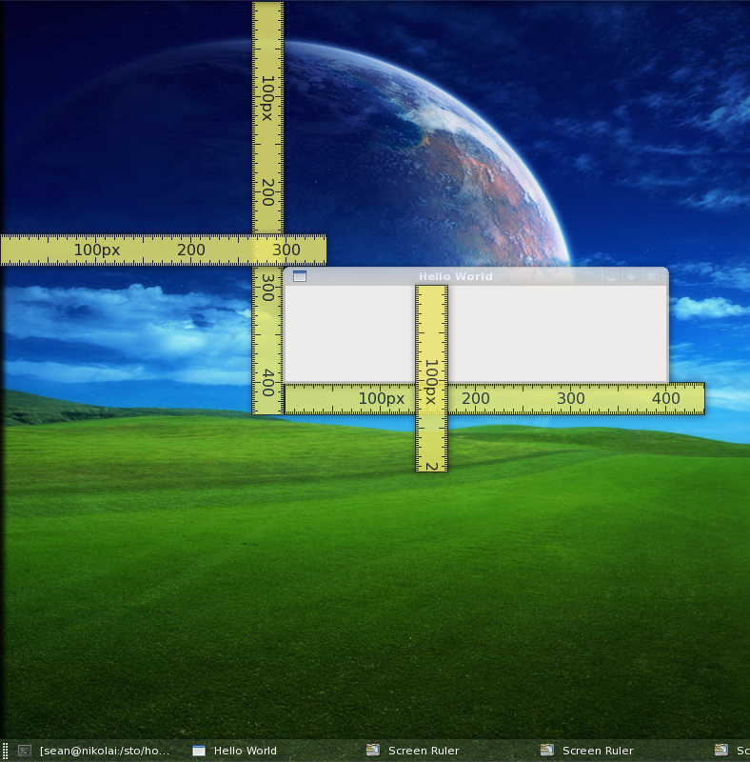

Slide 13
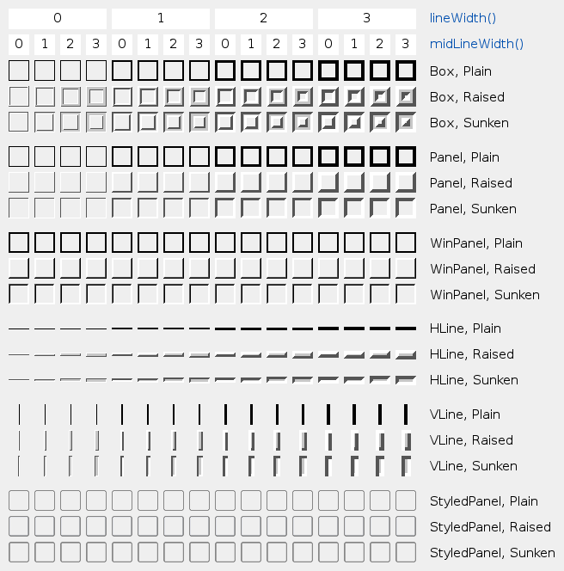
QFrame

Slide 14
QLabel!
QObject
QWidget
QFrame
QLabel

Slide 15
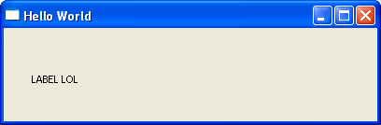
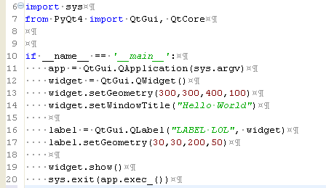
QLabels!

Slide 16
QAbstractButton
QObject
QWidget
QAbstractButton
QPushButton
QRadioButton
QCheckBox
QToolButton

Slide 17
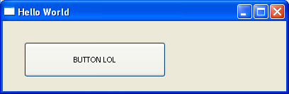
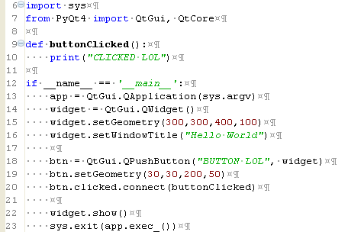
QPushButton

Slide 18
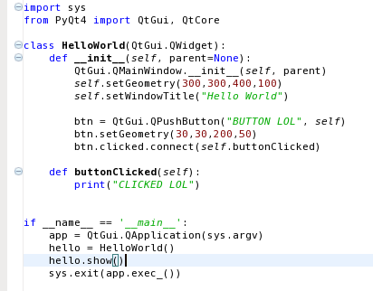
QPushButton (OO)

Slide 19
Signals
PyQt Has Signals and Slots
  Slots accept Signals (Giggity)
Signals are dispatched by events
  Buttons clicked
  Text typed
  Etc
Swing :
  Signal => ActionEvent
  Slot => ActionListener

Slide 20
QPushButton Signals
Clicked
Pressed
Released
Toggled

Slide 21
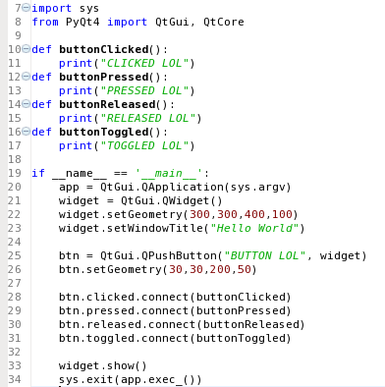
Signals In Use

