Slide 1


Testing
Gonzalo Martínez
gonzalo.martinez@uc.cl

Slide 2
Esta clase asume que ya saben algo de Testing a partir de otros cursos

Slide 3
A partir de Entrega 3, el código realizado debe tener tests asociados
Su planificación en el proyecto debe considerar tests

Slide 4
El contenido de estas clases es para guiar lo que es la materia de diseño de software y arquitecturas.
El enfoque es desarrollo basado en pruebas.

Slide 5
¿Why write test? (Literature says)
Helps to catch bugs earlier.
  Code is more reliable, so less headache for developers (no more whack-a-mole).
  Better user experience which helps the brand.
  Helps new features to be shipped faster.
Allows developers to safely refactor code.
Provides self-documentation for the developers.
Enforces code splitting and single responsibility.
Found a bug?
  Create a test for it and solve it
  Make sure that this bug never happens agains.

Slide 6
Usuarios
Su objetivo es
Retorno a la inversión de su tiempo/dinero
Una vez alcanzado genera
Es usado por
Software
3 roles
Clientes
Su objetivo es
Proteger y aumentar sus ganancias
Valor
Su objetivo es
Mantener la entrega de valor continua para clientes y usuarios
Developers
Cuando los developers no logran su objetivo generan
Valor
Negativo
Se manifiesta en
Bugs, Regressions, Defects
Requerimientos e implementaciones incompletas
Features toman demasiado tiempo en construcción

Slide 7
Una vez alcanzado genera
Para
Es usado por
Hipótesis
Resolver problema
Software
3 roles
Valor
Con el objetivo de
Utilizan
Su objetivo es
Mantener la entrega de valor continua para clientes y usuarios
Developers
Cuando los developers no logran su objetivo generan
Valor
Negativo
Se manifiesta en
Bugs, Regressions, Defects
Requerimientos e implementaciones incompletas
Features toman demasiado tiempo en construcción

Slide 8
¿Cómo sabemos que efectivamente nuestra hipótesis resuelve el problema?
Una vez resuelto
Para
Solución
Hipótesis
Resolver problema
Validación
Mismo
software en construcción
Realizadas por
Realizadas por
Implementan
Developers
Manual
Automática
Tradeoffs (Inversión vs Ganancia):
Fáciles de realizar, pero toman demasiado tiempo (costo).
Inversión de costo aumenta a medida que el software crece.
Costo oportunidad: podría estar realizado otra cosa.
Tradeoffs (Inversión vs Ganancia):
La inversión inicial es costosa pero una vez que ya se realiza un test automatizado, el resto sigue el mismo patrón (costo disminuye en el tiempo).

Slide 9

Why do we need to test?
.
Because we all make mistakes and mistakes can be expensive.

Slide 10

Importancia de los tests
Página Scotiabank (Semana 6 Mayo/2024) -Producción-

Slide 11
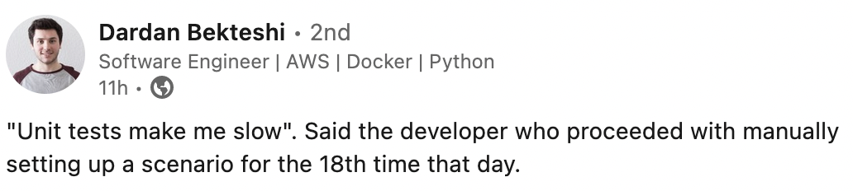
Testing Myths

Slide 12
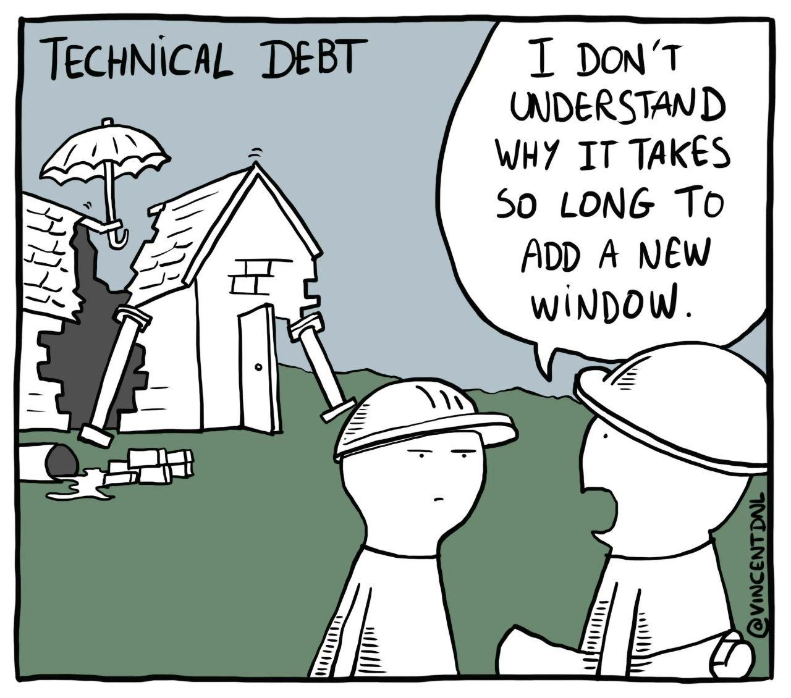

Slide 13
Los tests no deben verificar unidades de código.
Los tests verifican el comportamiento.

Slide 14
Anatomía de un test automatizado
Precondiciones necesarias
Ejecución de código
Verificación del resultado

Slide 15
A test should tell a story about the problem your code helps to solve, and this story should be cohesive and meaningful to a non-programmer.

Slide 16

When I call my dog, he comes right to me.

Slide 17
When I call my dog, he moves his front left leg first, then the front right
leg, his head turns, the tail start wagging...

Slide 18
Don’t do:
Over Specification...

Slide 19
Básico: AAA Pattern
public class CalculatorTests
{
[Fact]
public void Sum_of_two_numbers()
{
// Arrange
double first = 10;
double second = 20;
var calculator = new Calculator();
// Act
double result = calculator.Sum(first, second);
// Assert
Assert.Equal(30, result);
}
}
public class Calculator
{
public double Sum(double first, double second)
{
return 30;
}
}

Slide 20
Given-When-Then Pattern
public class CalculatorTests
{
[Fact]
public void Sum_of_two_numbers()
{
// Given
double first = 10;
double second = 20;
var calculator = new Calculator();
// When
double result = calculator.Sum(first, second);
// Then
Assert.Equal(30, result);
}
}
public class Calculator
{
public double Sum(double first, double second)
{
return first + second;
}
}

Slide 21
Test Code
SUT: System under Testing
public class CalculatorTests
{
[Fact]
public void Sum_of_two_numbers()
{
// Given
double first = 10;
double second = 20;
var sut = new Calculator();
// When
double result = sut.Sum(first, second);
// Then
Assert.Equal(30, result);
}
}
public class Calculator
{
public double Sum(double first, double second)
{
return first + second;
}
}

Slide 22
Test Code
MUT: Method under Testing
public class CalculatorTests
{
[Fact]
public void Sum_of_two_numbers()
{
// Given
double first = 10;
double second = 20;
var mut = new Calculator().Sum;
// When
double result = mut(first, second);
// Then
Assert.Equal(30, result);
}
}
public class Calculator
{
public double Sum(double first, double second)
{
return first + second;
}
}

Slide 23
Unit Testing

Slide 24
Unit Test
Verifies a small piece of code (also known as unit)
Does it quickly
Does isolated manner

Slide 25
Unit Test
Verifies a small piece of code (also known as unit)
Does it quickly.
Does isolated manner.

Slide 26
Unit Test - Frameworks (xUnit frameworks)
Python: pytest
JS: Jest, Mocha, Chai
Ruby

Slide 27
Los ejemplos que revisaremos son agnósticos al lenguaje

Slide 28
Unit Test
Unit Test
When unit testing class A, our focus is on testing A, as isolated as possible from the rest!
If A depends on other classes, we have to decide whether to simulate them or to make our unit test a bit bigger.
Class
B
DB
ATest
Class
A
Class
C

Slide 29
Unit Test
Unit Test
For test Class A we can test all the behaviour of the class A in a isolated way.
Class
B
DB
ATest
Class
A
Class
C

Slide 30

Classical School
(Detroit Style)
Set all the real dependencies for the unit testing

Slide 31
import { Store, Product, Customer } from './pathToYourModels';
describe('Customer Purchases', () => {
test('Purchase succeeds when enough inventory', () => {
// Arrange
const store = new Store();
store.addInventory(Product.Shampoo, 10);
const customer = new Customer();
// Act
const success = customer.purchase(store, Product.Shampoo, 5);
// Assert
expect(success).toBe(true);
expect(store.getInventory(Product.Shampoo)).toBe(5);
});
CLASSICAL/DETROIT STYLE:
Se realiza la llamada real a las dependencias.

Slide 32
No sólo se prueba que funcione
También se prueba cuando NO debe funcionar junto con casos bordes

Slide 33
import { Store, Product, Customer } from './pathToYourModels';
describe('Customer Purchases', () => {
test('Purchase succeeds when no enough inventory', () => {
// Arrange
const store = new Store();
store.addInventory(Product.Shampoo, 10);
const customer = new Customer();
// Act
const success = customer.purchase(store, Product.Shampoo, 15);
// Assert
expect(success).toBe(false);
expect(store.getInventory(Product.Shampoo)).toBe(10);
});
Se debe escribir tests automatizados para todos los casos posibles de éxito y de fallo

Slide 34
Mismo ejemplo en C#
[Fact]
public void Purchase_succeeds_when_enough_inventory()
{
// Arrange
var store = new Store();
store.AddInventory(Product.Shampoo, 10);
var customer = new Customer();
// Act
bool success = customer.Purchase(store, Product.Shampoo, 5);
// Assert
Assert.True(success);
Assert.Equal(5, store.GetInventory(Product.Shampoo));
}
[Fact]
public void Purchase_fails_when_not_enough_inventory()
{
// Arrange
var store = new Store();
store.AddInventory(Product.Shampoo, 10);
var customer = new Customer();
// Act
bool success = customer.Purchase(store, Product.Shampoo, 15);
// Assert
Assert.False(success);
Assert.Equal(10, store.GetInventory(Product.Shampoo));
}

Slide 35
Unit Test
Unit Test
How do we write tests for A without depending on B, C, and all their transitive dependencies?
Class
B
DB
ATest
Class
A
Class
C

Slide 36
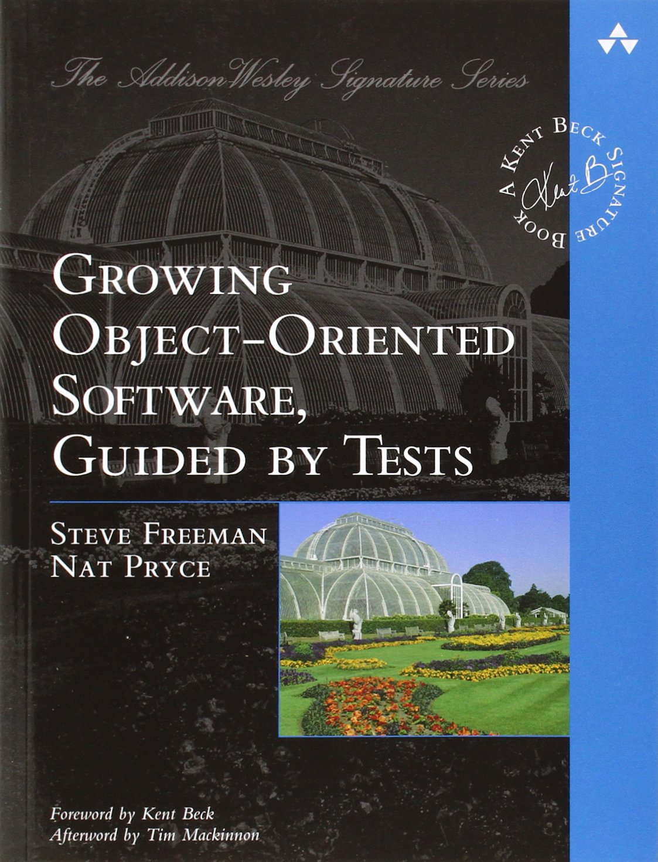
London School
(Mockists)
Isolate all dependencies with a Double or Mock

Slide 37
Mock Style
MOCK
B
ATest
MOCK DB
Class
A
MOCK
C

Slide 38
const { Product, Customer } = require('./pathToYourModels');
describe('Customer Purchases', () => {
test('Purchase succeeds when enough inventory', () => {
// Arrange
const storeMock = {
hasEnoughInventory: jest.fn(),
removeInventory: jest.fn(),
};
storeMock.hasEnoughInventory.mockReturnValue(true);
const customer = new Customer();
// Act
const success = customer.purchase(storeMock, Product.Shampoo, 5);
// Assert
expect(success).toBe(true);
expect(storeMock.removeInventory).toHaveBeenCalledWith(Product.Shampoo, 5);
expect(storeMock.removeInventory).toHaveBeenCalledTimes(1);
});
});
London School (Mocks):
Configuro un objeto Mock con comportamientos predefinidos. No hago la llamada real a la dependencia
Llamo al mock

Slide 39
const { Product, Customer } = require('./pathToYourModels');
describe('Customer Purchases', () => {
test('Purchase fails when not enough inventory', () => {
// Arrange
const storeMock = {
hasEnoughInventory: jest.fn(),
removeInventory: jest.fn(),
};
storeMock.hasEnoughInventory.mockReturnValue(false);
const customer = new Customer();
// Act
const success = customer.purchase(storeMock, Product.Shampoo, 5);
// Assert
expect(success).toBe(false);
expect(storeMock.removeInventory).not.toHaveBeenCalledWith(Product.Shampoo, 5);
expect(storeMock.removeInventory).toHaveBeenCalledTimes(0);
});
});
London School (Mocks):
Configuro un objeto Mock con comportamientos predefinidos. No hago la llamada real a la dependencia
Llamo al mock

Slide 40
Mismo ejemplo en C#
[Fact]
public void Purchase_succeeds_when_enough_inventory()
{
// Arrange
var storeMock = new Mock<IStore>();
storeMock
.Setup(x => x.HasEnoughInventory(Product.Shampoo, 5))
.Returns(true);
var customer = new Customer();
// Act
bool success = customer.Purchase(storeMock.Object,
Product.Shampoo, 5);
// Assert
Assert.True(success);
storeMock.Verify(
x => x.RemoveInventory(Product.Shampoo, 5),
Times.Once);
}
[Fact]
public void Purchase_fails_when_not_enough_inventory()
{
// Arrange
var storeMock = new Mock<IStore>();
storeMock
.Setup(x => x.HasEnoughInventory(Product.Shampoo, 5))
.Returns(false);
var customer = new Customer();
// Act
bool success = customer.Purchase(
storeMock.Object, Product.Shampoo, 5);
// Assert
Assert.False(success);
storeMock.Verify(
x => x.RemoveInventory(Product.Shampoo, 5),
Times.Never);
}

Slide 41
const { Product, Customer } = require('./pathToYourModels');
describe('Customer Purchases', () => {
test('Purchase succeeds when enough inventory', () => {
// Arrange
const storeMock = {
hasEnoughInventory: jest.fn(),
removeInventory: jest.fn(),
};
storeMock.hasEnoughInventory.mockReturnValue(true);
const customer = new Customer();
// Act
const success = customer.purchase(storeMock, Product.Shampoo, 5);
// Assert
expect(success).toBe(true);
expect(storeMock.removeInventory).toHaveBeenCalledWith(Product.Shampoo, 5);
expect(storeMock.removeInventory).toHaveBeenCalledTimes(1);
});
});
const { Store, Product, Customer } = require('./pathToYourModels');
describe('Customer Purchases', () => {
test('Purchase succeeds when enough inventory', () => {
// Arrange
const store = new Store();
store.addInventory(Product.Shampoo, 10);
const customer = new Customer();
// Act
const success = customer.purchase(store, Product.Shampoo, 5);
// Assert
expect(success).toBe(true);
expect(store.getInventory(Product.Shampoo)).toBe(5);
});
});
Classical School
(Detroit Style)
London School
(Mock)

Slide 42
Técnica: Test Fixture
A test fixture is an object the test run against.
This object can be a regular dependency - a argument passed to the SUT -
  It can also be data in the database or a file on the hard disk.
  This object needs to remain in a known state (fixed state) before each test run, so produce the same results each time that the test is executed.
  This is why called Fixture.

Slide 43
Fixture: preconfigurar respuestas
describe('Customer Purchases', () => {
const tests = new CustomerTests();
test('Purchase succeeds when enough inventory', () => {
const store = tests.createStoreWithInventory(Product.Shampoo, 10);
const sut = CustomerTests.createCustomer();
const success = sut.purchase(store, Product.Shampoo, 5);
expect(success).toBe(true);
expect(store.getInventory(Product.Shampoo)).toBe(5);
});
test('Purchase fails when not enough inventory', () => {
const store = tests.createStoreWithInventory(Product.Shampoo, 10);
const sut = CustomerTests.createCustomer();
const success = sut.purchase(store, Product.Shampoo, 15);
expect(success).toBe(false);
expect(store.getInventory(Product.Shampoo)).toBe(10);
}); });
class CustomerTests {
createStoreWithInventory(product, quantity) {
const store = new Store();
store.addInventory(product, quantity);
return store;
}
static createCustomer() {
return new Customer();
}
}

Slide 44
Test Fixture Pattern: Object Mother
import { AccountObjectMother } from './AccountObjectMother';
test('should create an account using the builder', function () {
const account = AccountObjectMother.validAccountWithEmptyTransactions();
expect(account.getBalance()).toBe(0);
});
export class AccountObjectMother {
static validAccountWithEmptyTransactions(): Account {
return new AccountBuilder('11.111.11-1')
.setBank('Banco de Chile')
.setBranch('Providencia')
.setAccount('123456-7')
.build();
}
}

Slide 45
Test Doubles and Mocks

Slide 46


Slide 47
Doubles
A test double is an object that can stand in for a real object in a test, similar to how a stunt double stands in for an actor in a movie.
Double
Dummy
Fake
Stub
Mock

Slide 48
Dummies
Dummy objects are passed to the class under test but never used.
This is common in business applications where you need to fill a long list of parameters.
  The test exercises only a few of them
Think of a unit test for a Customer class.
  Maybe this class depends on several other classes like Address, Email, and so on.
  Maybe a specific test case A wants to exercise a behaviour, and this behaviour does not care which Address this Customer has.
  In this case, a tester can set up a dummy Address object and pass it to the Customer class.

Slide 49
Fake
Fake objects have real working implementations of the class they simulate.
  However, they usually do the same task in a much simpler way.
Imagine a fake database class that uses an arraylist instead of a real database
  For example, instead of PostgreSQL you can use a in-memory db for testing.

Slide 50
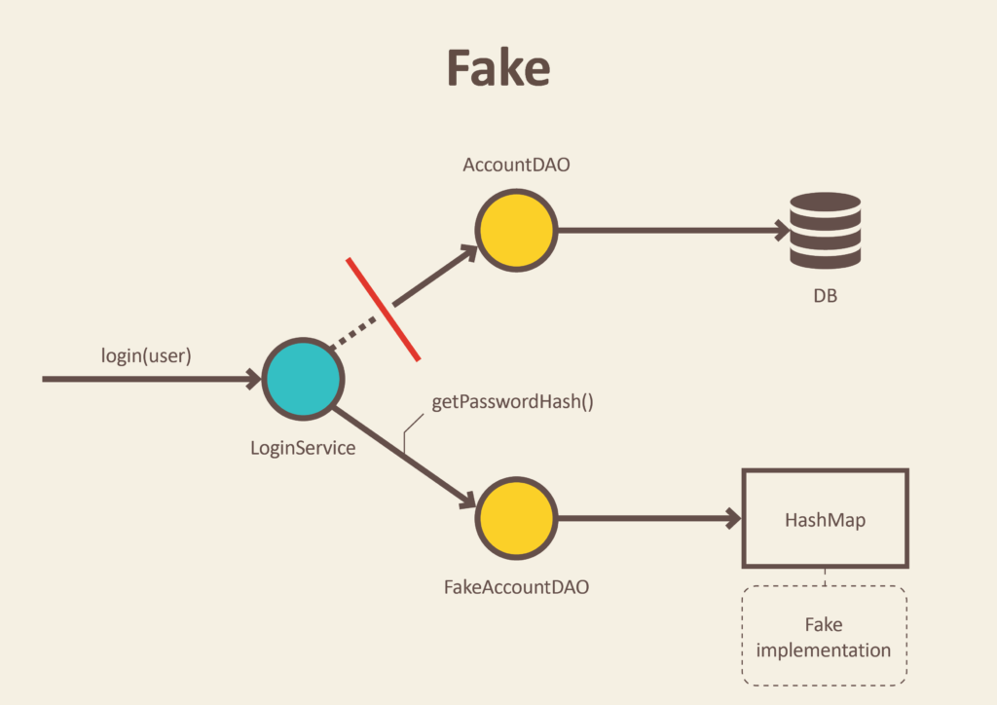
Fake
Fake objects have real working implementations of the class they simulate.
  However, they usually do the same task in a much simpler way.

Slide 51
Fake
Fake objects have real working implementations of the class they simulate.
  However, they usually do the same task in a much simpler way.
public class FakeAccountRepository implements AccountRepository {
Map<User, Account> accounts = new HashMap<>();
public FakeAccountRepository() {
this.accounts.put(new User("john@email.com"), new UserAccount());
this.accounts.put(new User("boby@email.com"), new AdminAccount());
}
String getPasswordHash(User user) {
return accounts.get(user).getPasswordHash();
}
}

Slide 52
Stubs
Stubs provide hard-coded answers to the calls performed during the test.
Unlike fake objects, stubs do not have a working implementation.
  If the code calls a stubbed method getAllInvoices, the stub will return a hard-coded list of invoices.

Slide 53
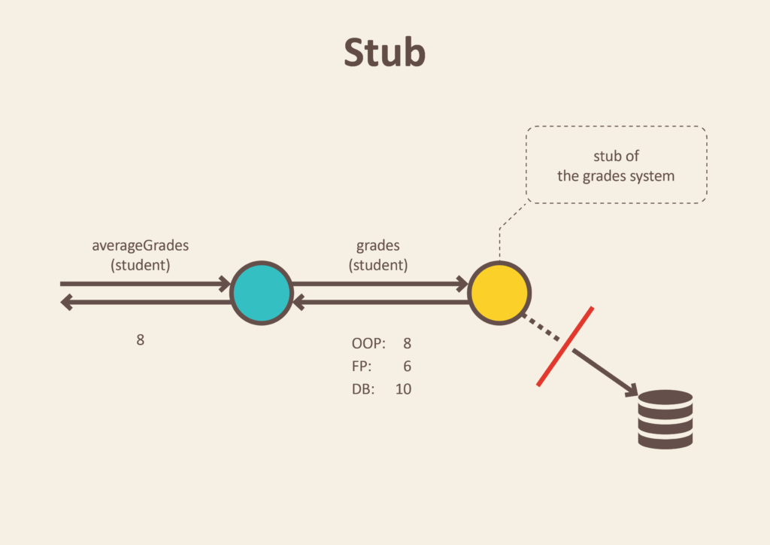
Stubs
Stubs provide hard-coded answers to the calls performed during the test.
public class GradesService {
private final Gradebook gradebook;
public GradesService(Gradebook gradebook) {
this.gradebook = gradebook;
}
Double averageGrades(Student student) {
return average(gradebook.gradesFor(student));
}
}

Slide 54
Stubs
public class GradesServiceTest {
private Student student;
private Gradebook gradebook;
@Before
public void setUp() throws Exception {
gradebook = mock(Gradebook.class);
student = new Student();
}
@Test
public void calculates_grades_average_for_student() {
when(gradebook.gradesFor(student)).thenReturn(grades(8, 6, 10)); //stubbing gradebook
double averageGrades = new GradesService(gradebook).averageGrades(student);
assertThat(averageGrades).isEqualTo(8.0);
}
}

Slide 55
Mocks
Mock objects act like stubs in the sense that you can configure how they reply if a method is called.
For example, to return a list of invoices when getAllInvoices is called. However, mocks go beyond that.
  They save all the interactions and allow you to make assertions afterward.
  For example, maybe we only want the getAllInvoices method to be called once.
  If the method is called twice by the class under test, this is a bug, and the test should fail.
  At the end of our test, we can write an assertion along the lines of “verify that getAllInvoices was called just once.”
Mocking frameworks let you assert all sorts of interactions, such as “the method was never called with this specific parameter” or “the method was called twice with parameter A and once with parameter B.” Mocks are also popular in industry since they can provide insight into how classes interact.

Slide 56
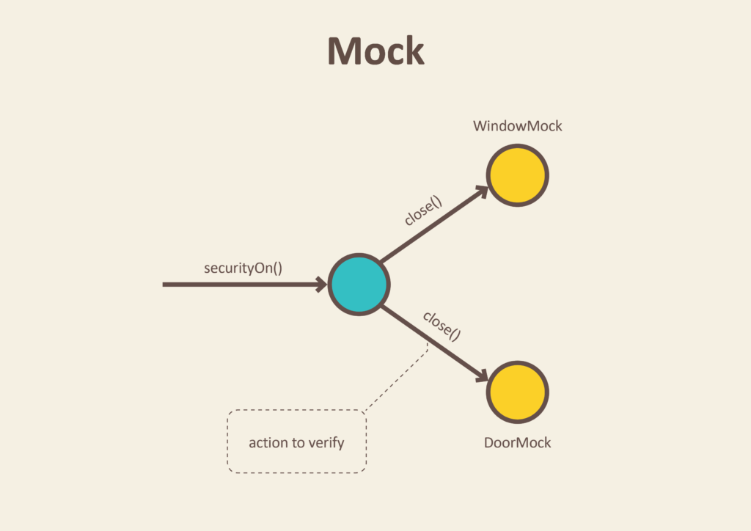
Mocks
Mock objects act like stubs in the sense that you can configure how they reply if a method is called.
public class SecurityCentral {
private final Window window;
private final Door door;
public SecurityCentral(Window window, Door door) {
this.window = window;
this.door = door;
}
void securityOn() {
window.close();
door.close();
}
}

Slide 57
Mocks
public class SecurityCentralTest {
Window windowMock = mock(Window.class);
Door doorMock = mock(Door.class);
@Test
public void enabling_security_locks_windows_and_doors() {
SecurityCentral securityCentral = new SecurityCentral(windowMock, doorMock);
securityCentral.securityOn();
verify(doorMock).close();
verify(windowMock).close();
}
}

Slide 58
Integration Testing

Slide 59
Integration Test
Test the integration of your system with a external component (e.g database)
Integration Test
Class
B
DB
Class
A
Class
C
Integration Test

Slide 60
Integration Test
Test the integration of the internal components
Integration Test
Class
B
DB
Integration Test
Class
A
Class
C

Slide 61
Integration Test
Test the integration of the internal components
Integration Test
Class
B
DB
Integration Test
Class
A
Class
C

Slide 62
Observable Behaviour(Contract)
Implementation Details
Third Party Service
(external client)
Application Database
(managed dependency)
Class
B
Class
A
Class
C
SMTP Service
(unmanaged dependency)

Slide 63
Observable Behaviour(Contract)
Implementation Details
Third Party Service
(external client)
Application Database
(managed dependency)
Class
B
Maybe you can Replace with mocks or test directly
Replace with mocks
Class
A
Verify final state not interactions with it
Class
C
SMTP Service
(unmanaged dependency)
Replace with mocks

Slide 64
Integration Testing
Cada interacción entre las capas puede ser Detroit School (llamadas reales) o Mocks (London School)
Changing User Mail
Order Checkout
Resetting Password
Application Layer
Domain Layer
Infrastructure Layer
Integration Test

Slide 65
Integration Testing
GetUserById
CanChangeEmail
GetCompany
ChangeEmail
SaveCompany
SaveUser
Database
Application Service (Controller)
Business Logic
(Domain Model)

Slide 66
Integration Testing
Cada interacción entre las capas puede ser Detroit School (llamadas reales) o Mocks (London School)
getUserById
Application Layer
Domain Layer
Infrastructure Layer
Integration Test

Slide 67
app.js
app.test.js
Integration test with mocks (London School)
const request = require('supertest');
const { app, getUserFromDb } = require('./app');
jest.mock('./app');
describe('User Route Integration Test', () => {
beforeEach(() => {
// Mock la función para este test
getUserFromDb.mockImplementation((id) => {
return { id: id, name: 'Jane Smith' };
});
});
test('should get user details', async () => {
const response = await request(app).get('/user/123');
expect(response.statusCode).toBe(200);
expect(response.body).toEqual({ id: '123', name: 'Jane Smith' });
});
afterEach(() => {
// Limpiamos los mocks después de cada test
jest.clearAllMocks();
});
});
const express = require('express');
const app = express();
let getUserFromDb = (id) => {
// doSomething
};
app.get('/user/:id', (req, res) => {
const user = getUserFromDb(req.params.id);
res.json(user);
});
module.exports = { app, getUserFromDb };

Slide 68
app.js
app.test.js
Integration test without mocks (Detroit School)
const request = require('supertest');
const app = require('./app');
describe('User Route Integration Test', () => {
test('should get user details', async () => {
const response = await request(app).get('/user/123');
expect(response.statusCode).toBe(200);
expect(response.body).toEqual({ id: '123', name: 'John Doe' });
});
});
const express = require('express');
const app = express();
let getUserFromDb = (id) => {
// doSomething
};
app.get('/user/:id', (req, res) => {
const user = getUserFromDb(req.params.id);
res.json(user);
});
module.exports = { app, getUserFromDb };

Slide 69
Integration Testing
Cada interacción entre las capas puede ser Detroit School (llamadas reales) o Mocks (London School)
getUserById
Application Layer
Domain Layer
Infrastructure Layer
Integration Test

Slide 70
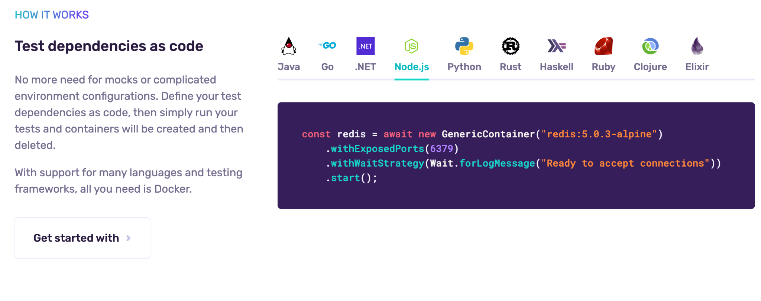
Integration Testing (Testcontainers)

Slide 71
Integration Test
Controller - Nodejs Supertest
También puede ser un test e2e del backend
it('/my-endpoint (GET)', () => {
return request(app.getHttpServer())
.get('/my-endpoint')
.expect(HttpStatus.OK)
.expect('Content-Type', /json/)
.expect({
data: [/* expected data */],
});
});

Slide 72
System Test
Request
Response
Test all the system together
E2E Test
Class
B
Web Service
DB
System(E2E) Test
Controller
Class
A
Class
C

Slide 73
E2E Testing
Changing User Mail
Order Checkout
Resetting Password
Presentation Layer
Application Layer
Domain Layer
Infrastructure Layer
E2E Test

Slide 74
Parameterized Testing
(Property Testing)

Slide 75
Property Testing
Application
Test the method/SUT with a fixture of scenarios
Behaviour 1
Behaviour 2
Behaviour N
Fact 1
Fact 2

Slide 76
Property Testing - Jest
test.each<{ input: string; expected: boolean }>([
{ input: 'hello', expected: false },
{ input: 'bob', expected: true },
{ input: '101', expected: true },
{ input: '102', expected: false },
])('Test a lot of inputs', ({ input, expected }) => {
expect(palindromeChecker.isAPalindrome(input)).toBe(expected);
});

Slide 77
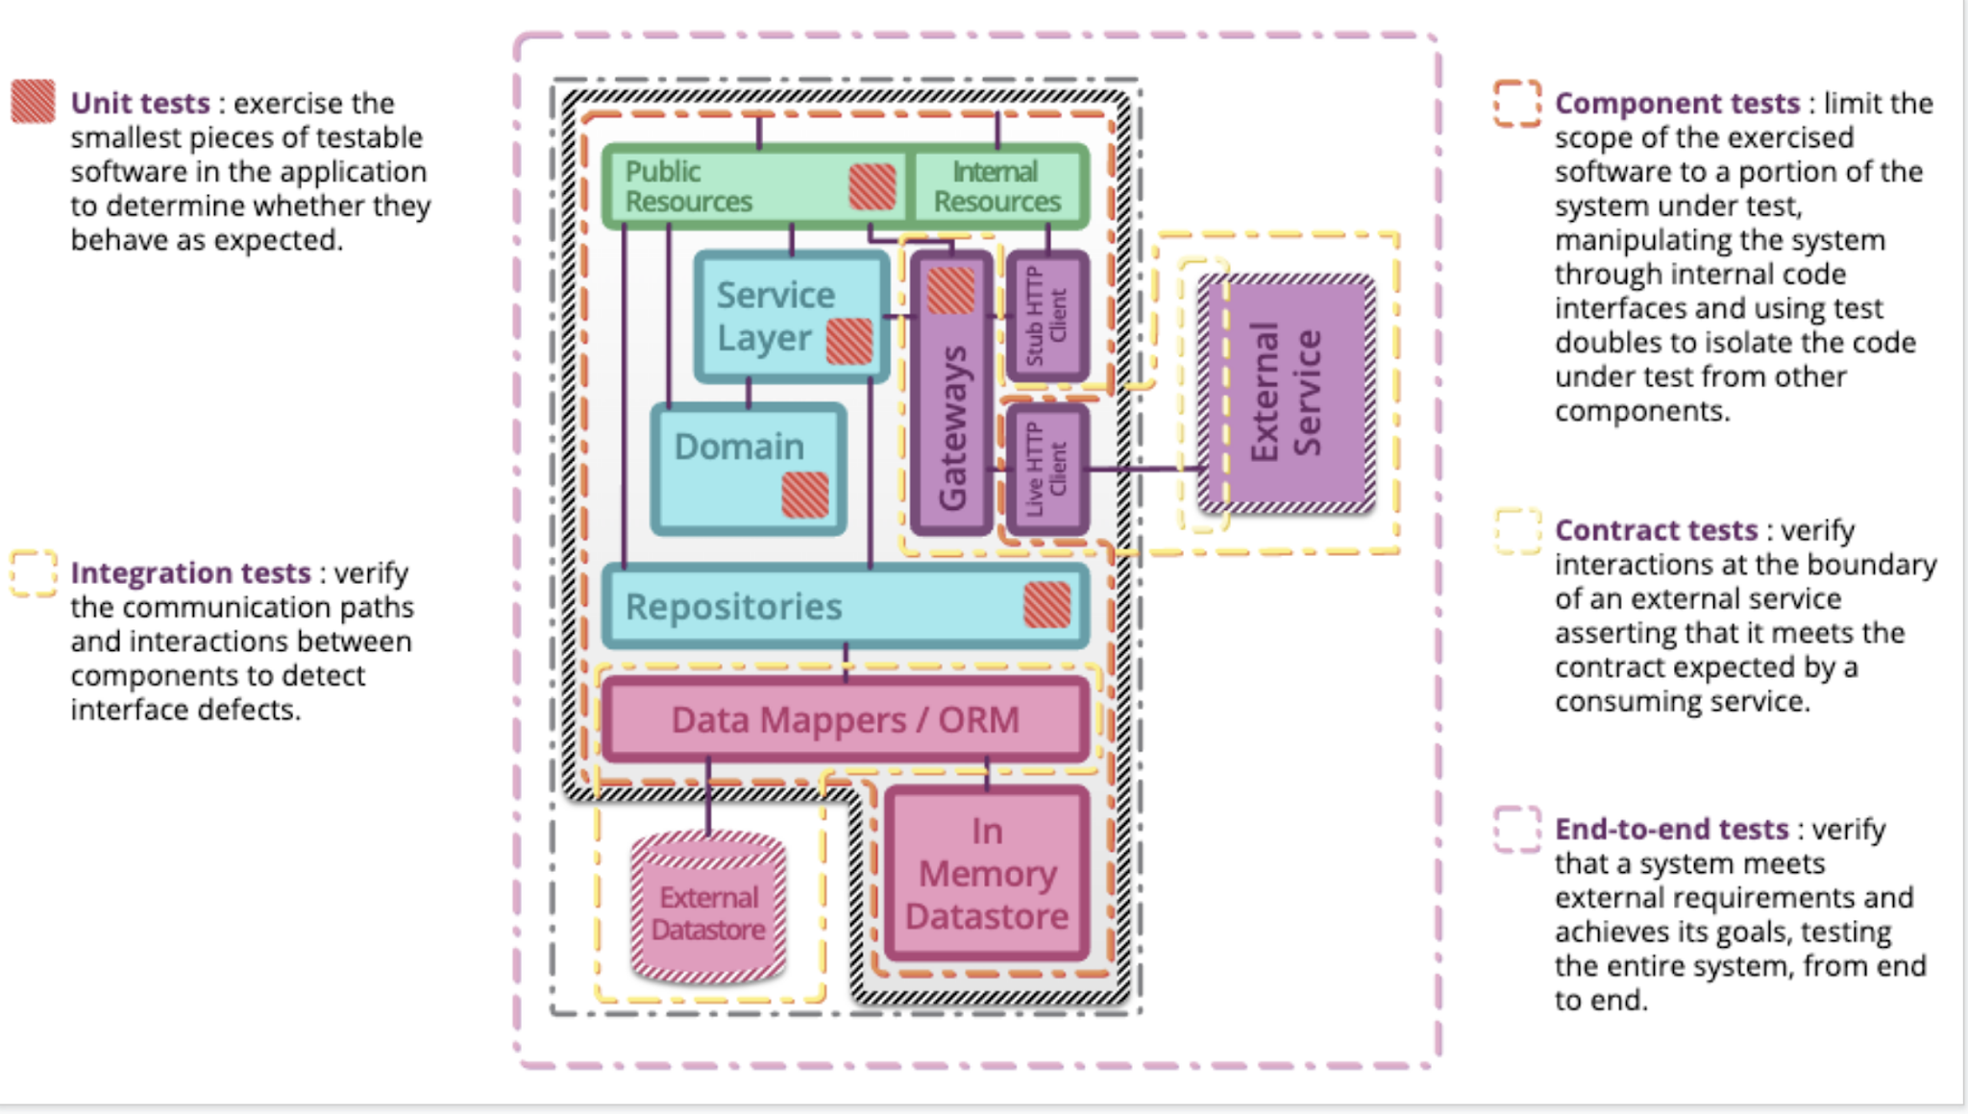
Test stack driven
‹#›

Slide 78
¿Cuándo implementar testing?
Test Last Development
código funcional
prueba unitaria
Tiempo
Test First Development
prueba unitaria
código funcional
Tiempo

Slide 79
Unit Testing: Best practices
How Google Tests
Focussed: One behaviour at a time, not one function at a time.
Tests should focus on public APIs.
Tests names should summarize the behavior and outcome.
Follow this flow in your tests: setup -> act -> assert.
Create class constants if some values are referred in more than one test.
Assume your dependencies are tested!
Fast: No one run slow tests.

Slide 80
Integration Testing
How Google Tests
It is not focussed: can touch multiple behaviors.
It is not hermetic: Needs to bring up other dependencies (other services).
not focussed
not hermetic

Slide 81
Integration Testing: SUT (System Under Test)
How Google Tests
Dependency 1
DB1
DB1
Client
SUT
Dependency 2
DB1
DB2

Slide 82
Integration Testing: Challenges
How Google Tests
Flaky tests. Slower.
Who owns the test?
Test Data: Seeding.
Backends dependencies.
How to scale it.
Requires knowledge of how the SUT AND dependencies work.

Slide 83
No tenemos recursos ilimitados, nuestro trabajo como ingenieros requiere implementar una estrategia de testing

Slide 84
Automate most of the Ideal Test Pyramid
Exploratory
(manual)
End-to-end user journeys
Tests from a User Point of View
Expensive to Maintain
Business value
E2E via GUI
Maintenance costs
Integration between APIs
Regressive end-to-end tests
Quick feedback on interactions among APIs
E2E subcutaneous
Backward compatibility
Regressive data validation tests
May have dB interactions
Contract tests
Quick service-level feedback on functionality
Integration with platform
Unit tests for both functional and UI classes
Boundary values and edge cases
Immediate feedback
Safety net
Lowest cost of implementation
Other integration categories
Unit tests
Pyramid tuning

Slide 85
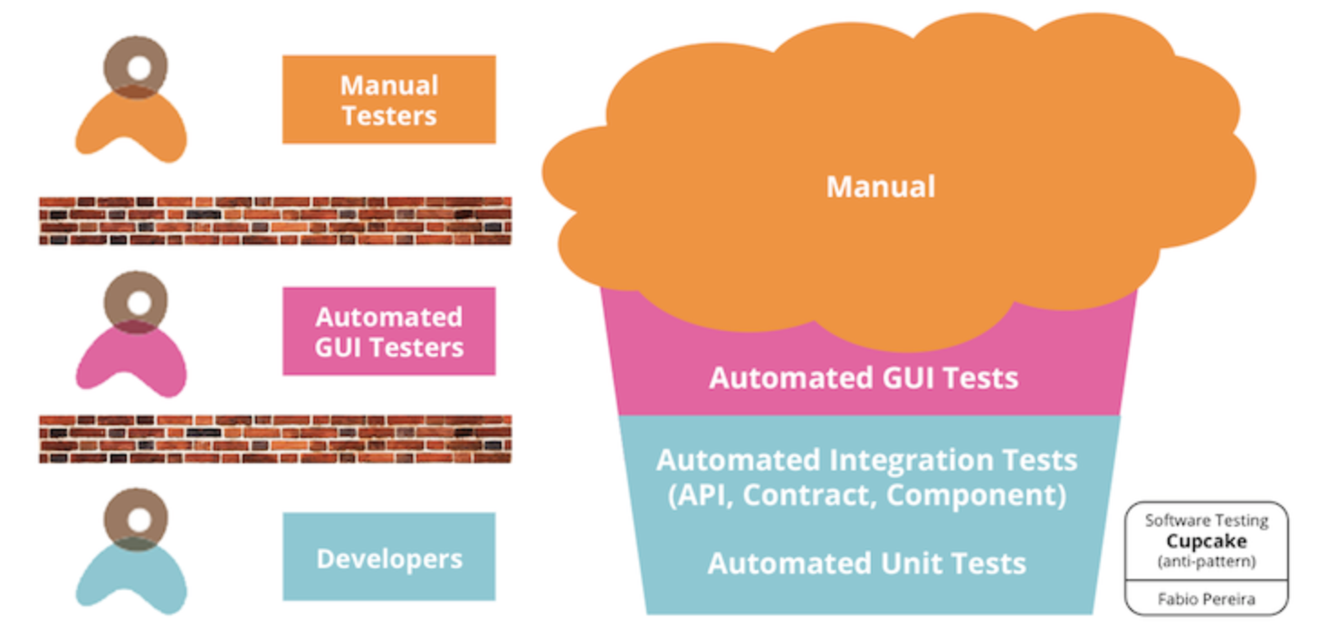
Antipatrones:
Ice Cream Cone y Cupcake
Manual tests
Automated
GUI tests
Software testing ice-cream cone
anti-pattern
Automated integration tests
Integration
Unit
test
Automated unit tests

Slide 86
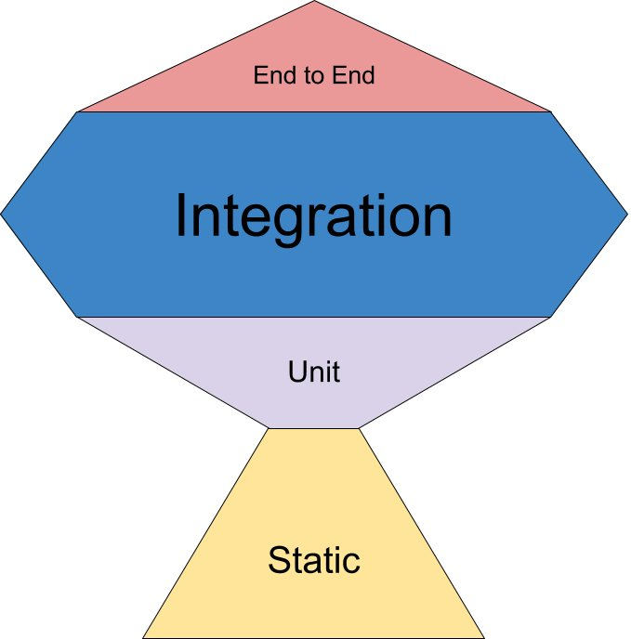
Otro patrón:
The Testing Trophy
The Testing Trophy (Kent C. Dodds blog)
Write tests but no so many tests
Se privilegia las integraciones entre componentes.
Automated integration tests
Automated unit tests

Slide 87
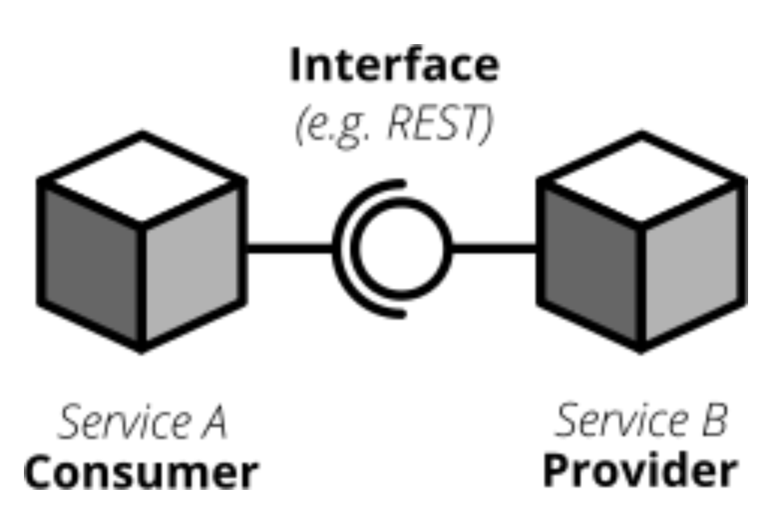
Contract Test (Pruebas de Contrato)
Verifica si el servicio externo funciona y entrega lo que se necesita.
Se ejecuta de forma periódica.

Slide 88
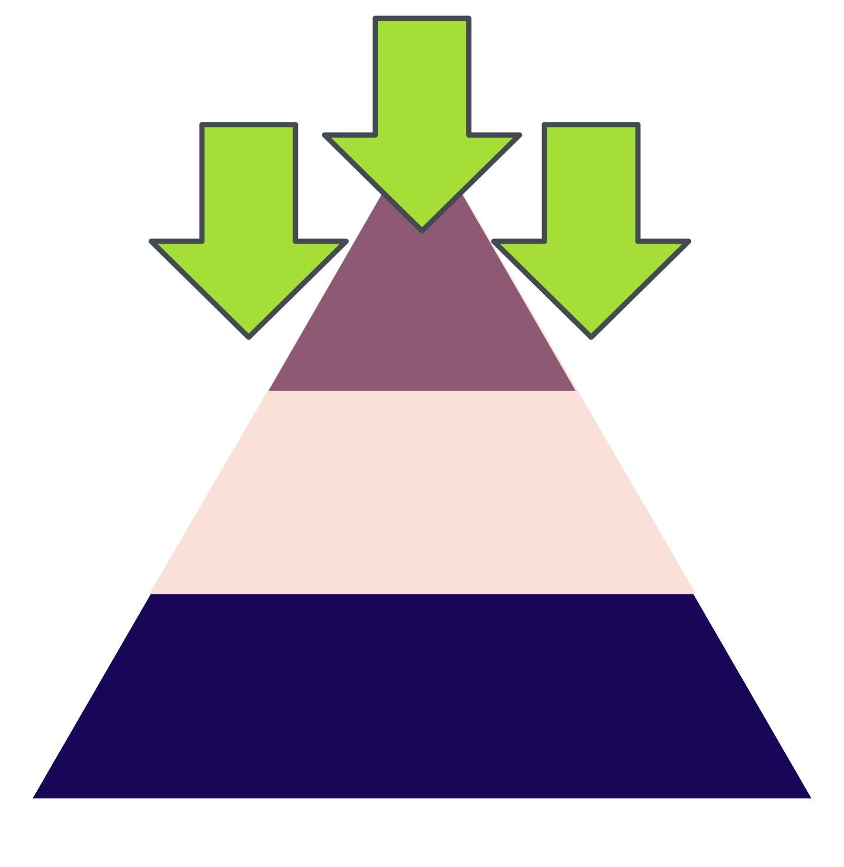

Modificar el código puede ser: crear algo nuevo o modificar lo que ya existe
Create
Modify
Notes:
Modify ocurre usualmente en sistemas legados sin cobertura de pruebas

Slide 89
Intelligent Testing:
Testing the tests

Slide 90
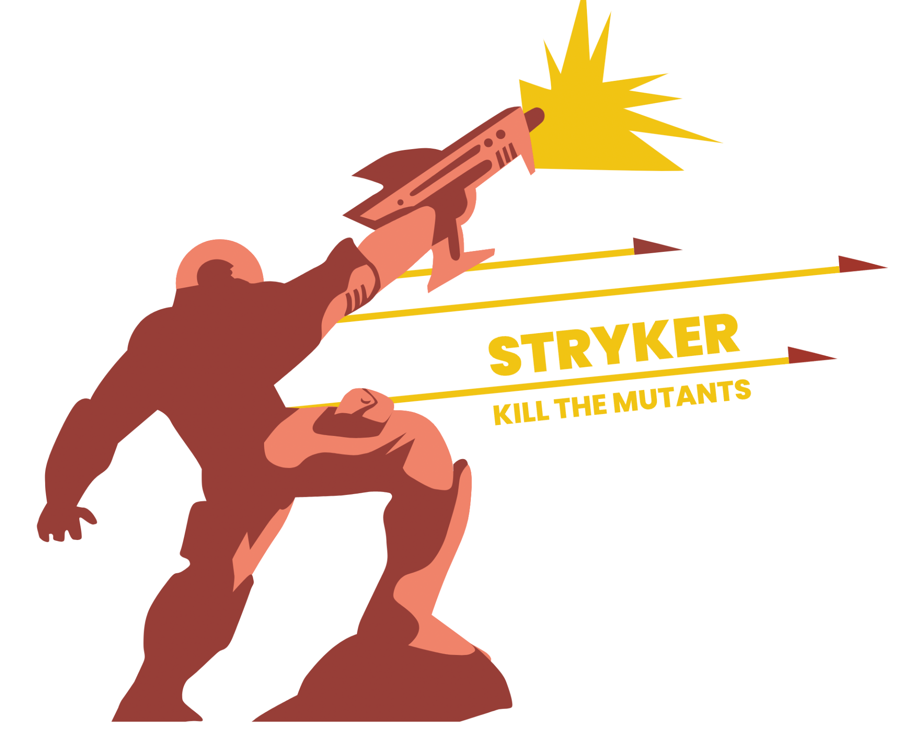
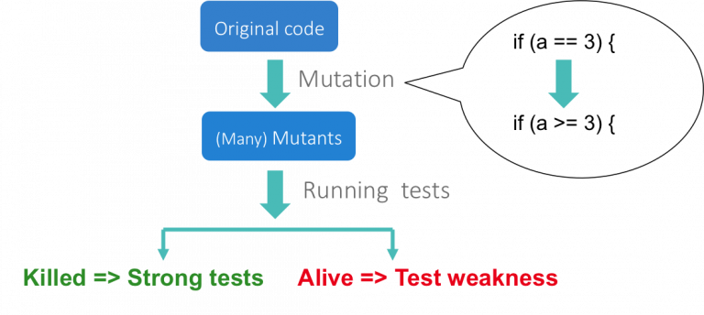
Mutation Testing
Reference:
https://csl.ucd.ie/index.php/mutation-testing/
https://stryker-mutator.io/

Slide 91
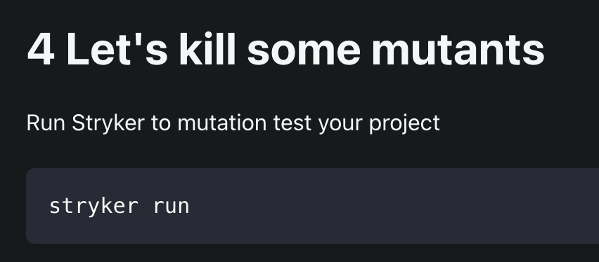
Stryker
https://stryker-mutator.io/

Slide 92
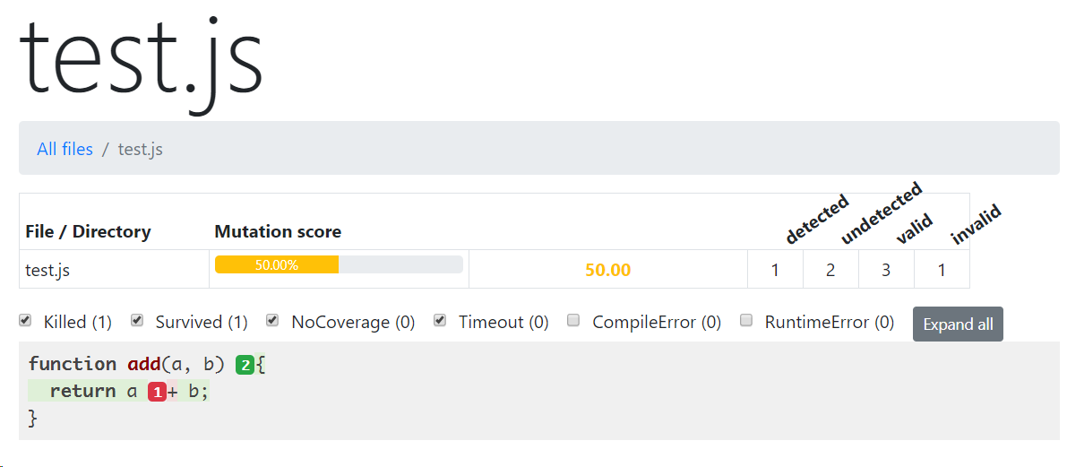
Stryker

Slide 93
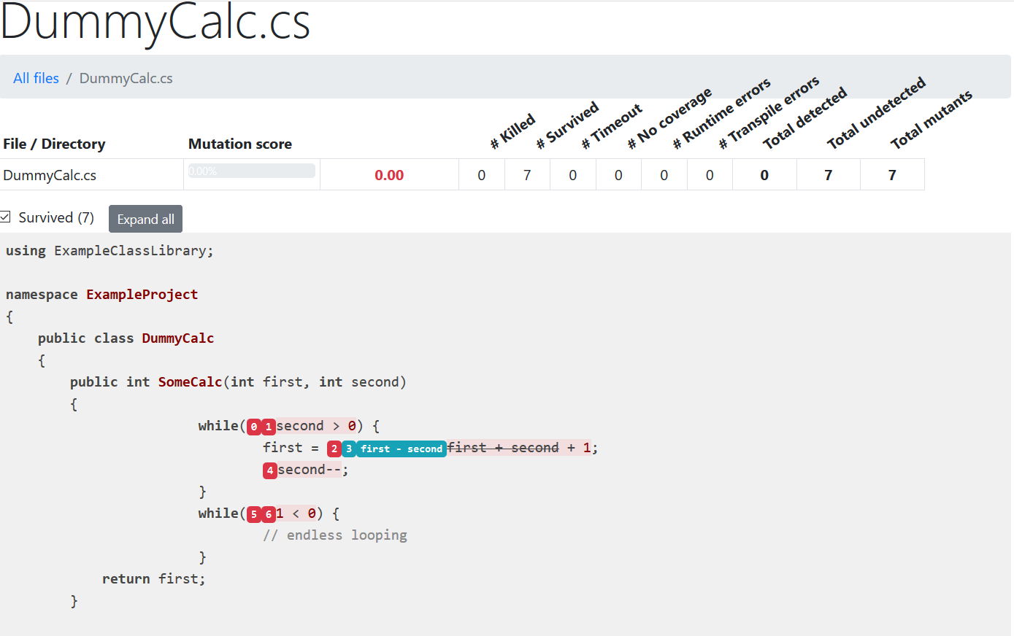
Stryker

Slide 94
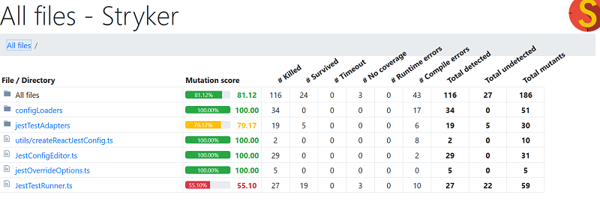
Stryker

Slide 95
Testing on Frontend
You want your tests to avoid including implementation details of your components and rather focus on making your tests give you the confidence for which they are intended.
  Referencia:
    React Testing Library documentation

Slide 96
Frontend
Reactivo
Espera input del usuario y reacciona
Cada acción tiene su reacción inmediata
Backend
Flujo Lineal

Slide 97
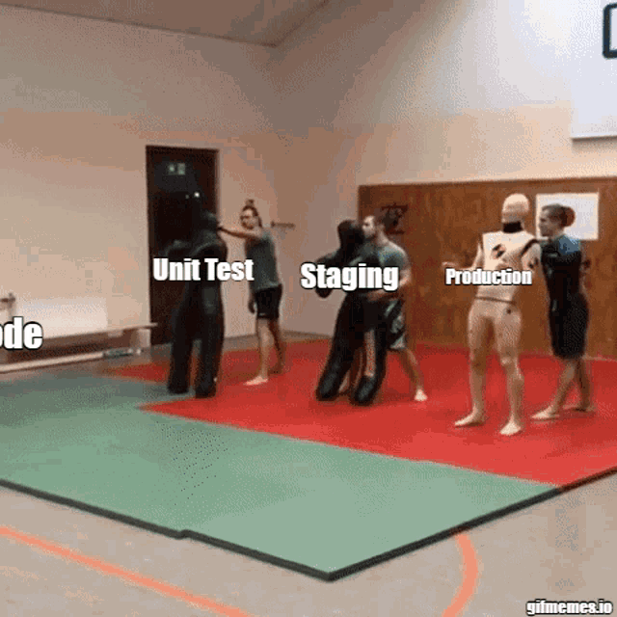

Slide 98
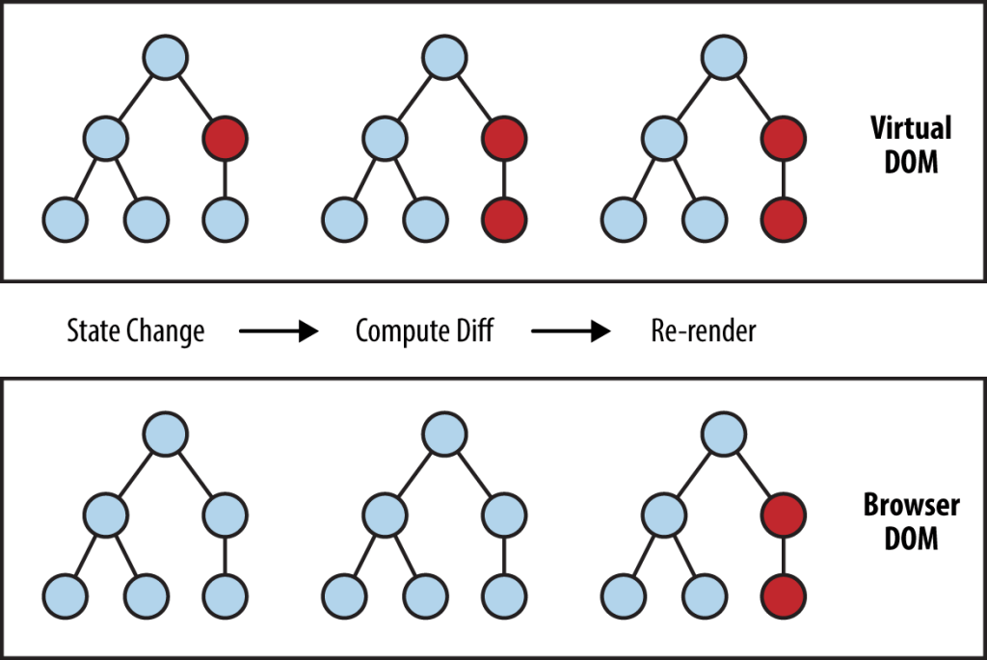

Slide 99
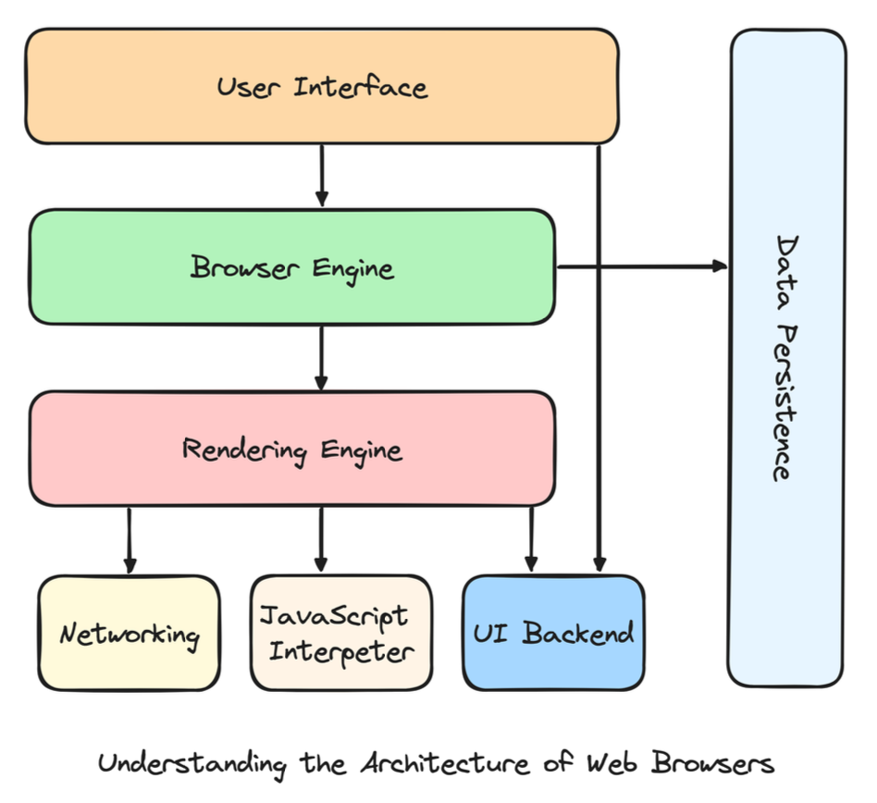
Browser Architecture

Slide 100
Unit Test
Unit Test
When unit testing class A, our focus is on testing A, as isolated as possible from the rest!
If A depends on other classes, we have to decide whether to simulate them or to make our unit test a bit bigger.
Class
B
DB
ATest
Class
A
Class
C

Slide 101
Frontend
Interact with
Function
User
Component
Function
Un componente contiene funciones
funciones cuyo output es tipo string

Slide 102
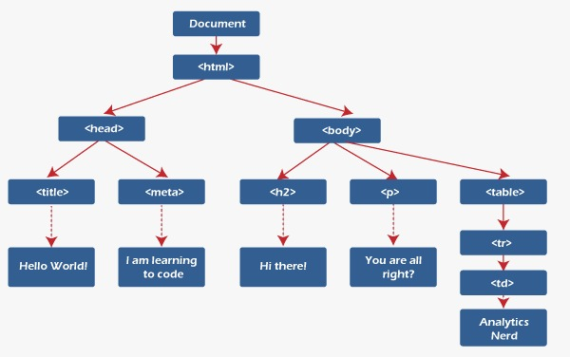
Frontend - DOM
Notes:
Reference: https://www.javatpoint.com/what-is-dom-in-react

Slide 103
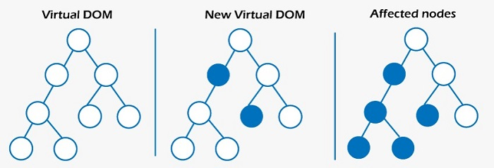
React DOM
Cada nodo contiene labels y textos.
Lo que hace React es cambiar el texto de cada uno de estos nodos.
Por lo que para verificar si todo es correcto debemos comprobar el texto de cada uno de estos nodos.
Notes:
Reference: https://www.javatpoint.com/what-is-dom-in-react

Slide 104
Frontend - DOM
Un React component viene a ser un conjunto de nodos a través del árbol
Notes:
Reference: https://www.javatpoint.com/what-is-dom-in-react

Slide 105
Client side testing
Interact with
Clicking
Typing
Scrolling
Open something
Function
Component
User
Page
Component
Una página puede interactuar con un componente

Slide 106
Client side testing
Interact with
Clicking
Typing
Scrolling
Open something
Function
Component
User
Page
Component
Un componente puede interactuar con un componente

Slide 107
Behaviour testing
(Test de comportamiento)

Slide 108
En frontend probamos las interacciones que tiene el usuario con la web app

Slide 109
No probamos la interacción con backend. Eso se puede simular.

Slide 110
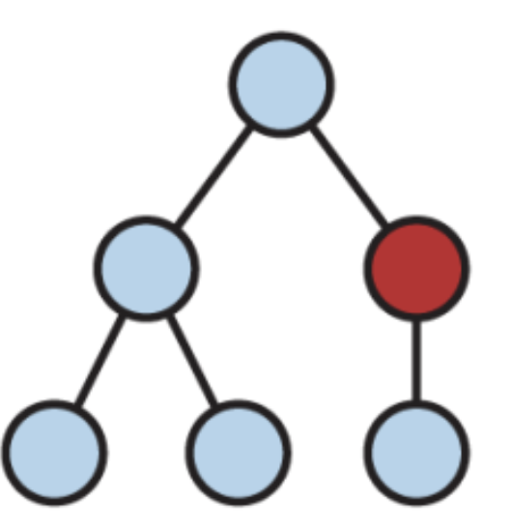
Frontend
Reactivo
Espera input del usuario y reacciona
Cada acción tiene su reacción inmediata
Cada input del usuario cambia el DOM
DOM: Document Object Model
Estructura Árbol

Slide 111
Frontend
Dado que el frontend es reactivo debemos verificar todas las interacciones del usuario con las vistas

Slide 113
Frontend - DOM
Deberíamos verificar el estado de cada nodo por cada interacción
Recursión
Tree Traversal:
inorder - preorder - postorder
BST (binary search tree)
Notes:
Reference: https://www.javatpoint.com/what-is-dom-in-react

Slide 114
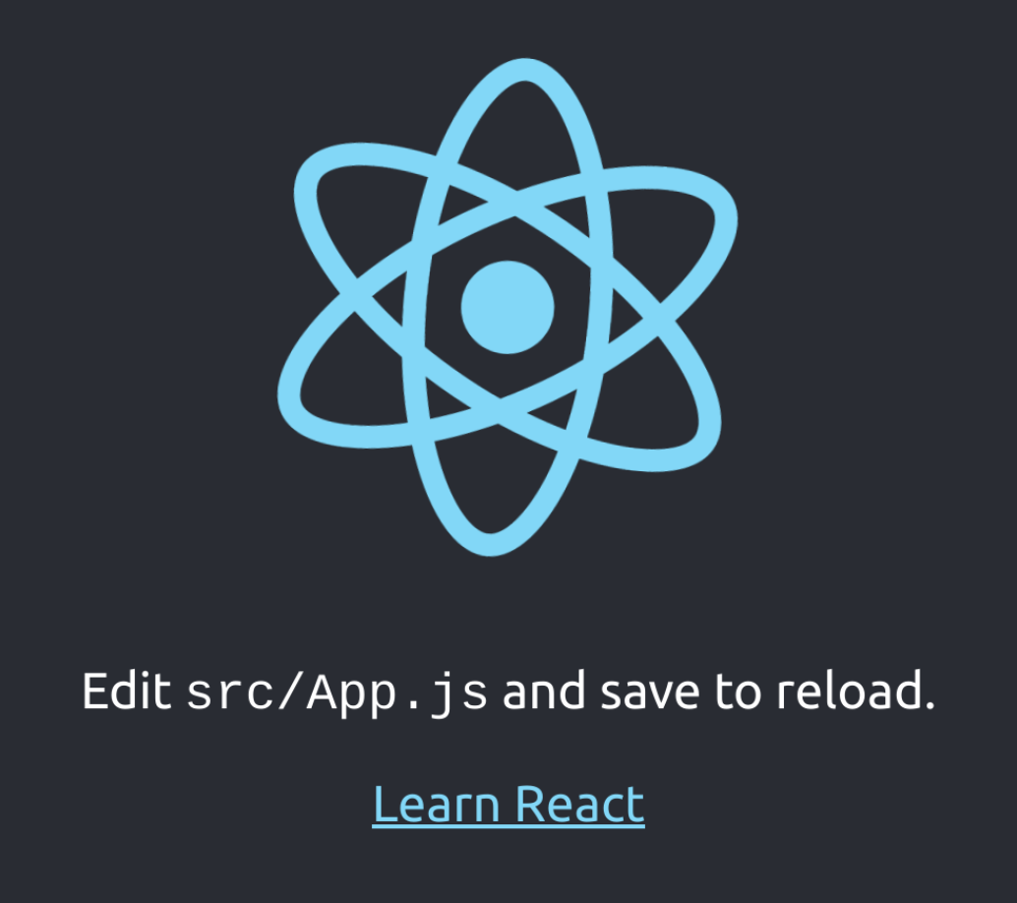
<body>
<div>
<div class="App">
<header class="App-header">
<img alt="logo" class="App-logo" src="logo.svg" />
<p>
Edit<code> src/App.js </code>and save to reload.
</p>
<a
class="App-link"
href="https://reactjs.org"
rel="noopener noreferrer"
target="_blank"
>
Learn React
</a>
</header>
</div>
</div>
</body>

Slide 115
Testing Library
screen
render
render
screen
fireEvent
Component1
Component2
Component3

Slide 116
Testing Library
screen
screen
render
render
fireEvent
render recibe un componente y sólo recrea su DOM almacenandolo en memoria
Component1
Component2
Component3

Slide 117
Testing Library - render
<body>
<div>
<div class="App">
<header class="App-header">
<img />
<p>
</p>
<a> Learn React </a>
</header>
</div>
</div>
</body>
test('renders learn react', () => {
render(<MyComponent />);
});
Crea y almacena en memoria el DOM del componente

Slide 118
Testing Library
screen
render
render
screen
fireEvent
screen recupera un elemento de la página
Component1
Component2
Component3

Slide 119
Testing Library - screen
<body>
<div>
<div class="App">
<header class="App-header">
<img />
<p>
</p>
<a> Learn React </a>
</header>
</div>
</div>
</body>
import { render, screen } from '@testing-library/react';
import App from './App';
test('renders learn react link', () => {
render(<App />);
const linkElement = screen.getByText(/learn react/i);
expect(linkElement).toBeInTheDocument();
});

Slide 120
Testing Library - screen
<body>
<div>
<div class="App">
<header class="App-header">
<img />
<p>
</p>
<a> Learn React </a>
</header>
</div>
</div>
</body>
import { render, screen } from '@testing-library/react';
import App from './App';
test('renders learn react link', () => {
render(<App />);
const linkElement = screen.getByText(/learn react/i);
expect(linkElement).toBeInTheDocument();
});
Obtiene todos los textos que contengan “learn react”, /i indica caseInsensitive

Slide 121
Testing Library - screen
test('renders a button', () => {
render(<MyComponent />);
const buttonElement = getByRole('button');
expect(buttonElement).toBeInTheDocument();
});

Slide 122
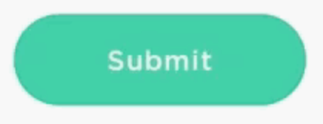
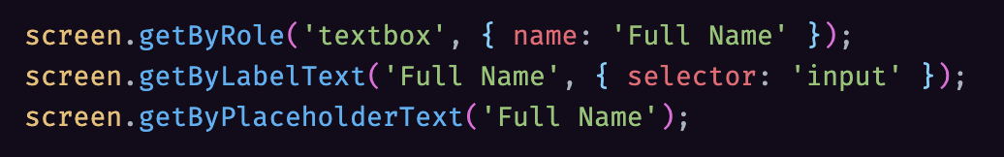
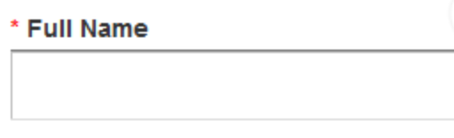
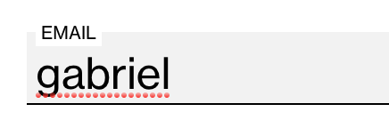





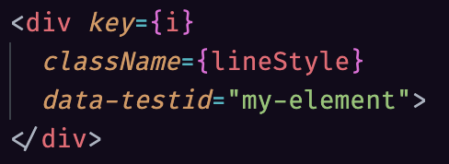



React Testing Library: Which query should I use?
https://testing-library.com/docs/guide-which-query
ByRole: top preference for accessible elements (button, checkbox, option, radio, etc.)
ByLabelText: will NOT find the input node for label text broken up by elements. You can use ByRole.
If you really can’t put a label in your UI, only then use ByPlaceholderText
ByDisplayValue: when you want to test when user fills data in an input
ByText: number 1 method for non-interactive elements like divs and spans
ByTestId: for cases where you can't use previous
matchers
querySelector: should be avoided most of the times, query by class or id is a bad practice

Slide 123
Testing Library - screen
<body>
<div>
<div class="App">
<header class="App-header">
<img />
<p>
</p>
<a> Learn React </a>
</header>
</div>
</div>
</body>
import { render, screen } from '@testing-library/react';
import App from './App';
test('renders learn react link', () => {
render(<App />);
const linkElement = screen.getByText(/learn react/i);
expect(linkElement).toBeInTheDocument();
});
jestMatcher verifica si se encuentra dentro del DOM

Slide 124
Testing Library
screen
render
render
screen
fireEvent
fireEvent simula interacciones del usuario
Component1
Component2
Component3

Slide 125
Testing Library - fireEvent
import { render, fireEvent } from '@testing-library/react';
import MyComponent from './MyComponent';
test('clicking the button triggers event', () => {
const { getByRole } = render(<MyComponent />);
const buttonElement = getByRole('button');
fireEvent.click(buttonElement);
// assertions here that check the result of the button being clicked
});

Slide 126
Testing Library - fireEvent
import { render, fireEvent } from '@testing-library/react';
import MyComponent from './MyComponent';
test('clicking the button triggers event', () => {
const { getByRole } = render(<MyComponent />);
const buttonElement = getByRole('button');
fireEvent.click(buttonElement);
// assertions here that check the result of the button being clicked
});

Slide 127
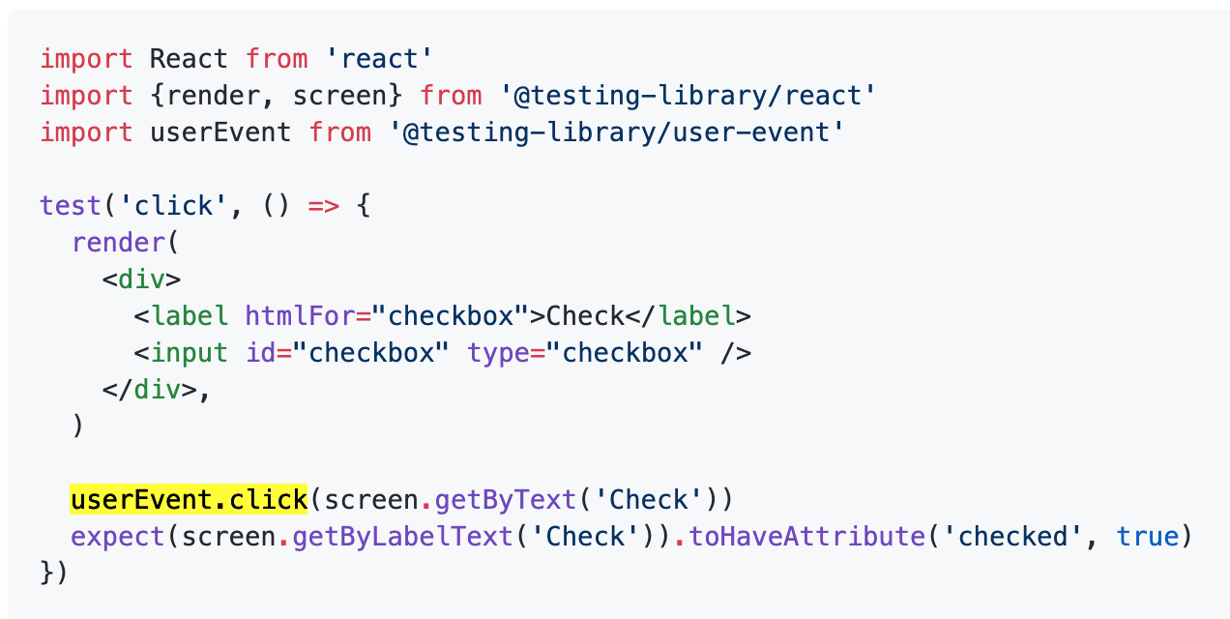
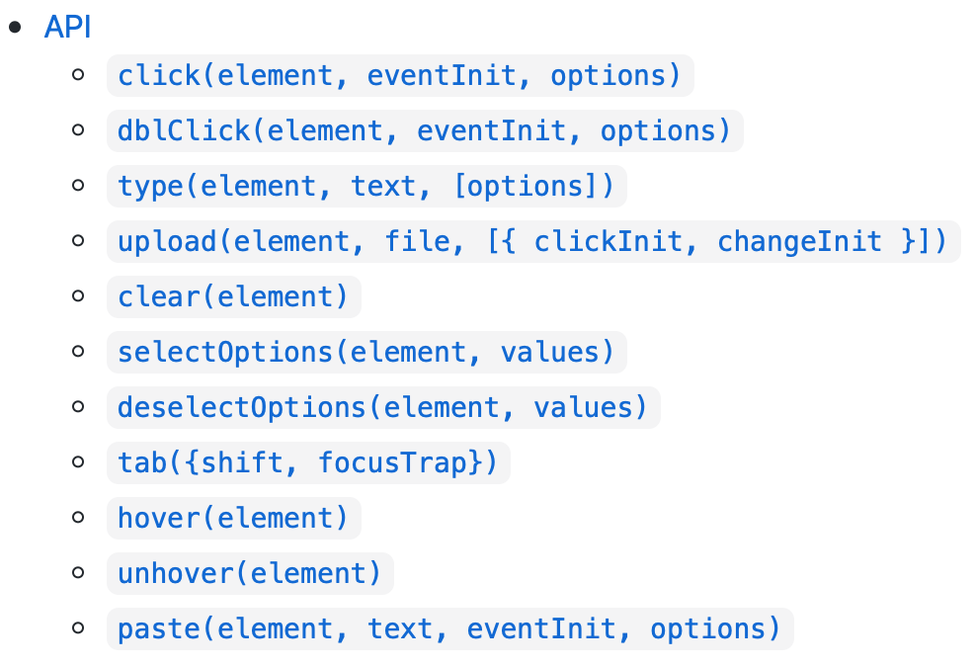
Testing user events with @testing-library/user-event
https://github.com/testing-library/user-event
user-event tries to simulate the real events that would happen in the browser as the user interacts with it
fireEvent antes se llamaba userEvent

Slide 128
Real World Examples

Slide 129



Not all is test pyramid
Prefers unit testing
Prefers integration testing

Slide 130
Testing
Gonzalo Martínez
gonzalo.martinez@uc.cl

