Slide 1
Uber Supply-Demand Gap Insights
S P Mithun | LabmentixInternship | 2025

Slide 2
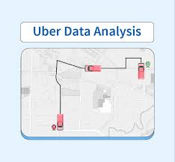
Introduction
Uber faces demand-supply imbalance during key hours
Unfulfilled requests impact customer experience
Aim: Analyze failure patterns and suggest operational improvements
Dataset includes ride request logs with timestamps and status

Slide 3

Project Goals
Identify when and where requests fail
Understand cancellation and no-car availability trends
Analyze driver behavior and trip patterns
Provide data-backed solutions for operational efficiency

Slide 4
Dataset Overview
Total Records: 6745 ride requests
Key Columns: Request ID, Timestamp, Status, Driver ID, Pickup Point
Locations: City and Airport
Trip outcomes: Completed, Cancelled, No Cars Available

Slide 5

Tools Used
Excel: Initial cleaning and dashboard
SQL: Status queries and pattern mining
Python: EDA, time-slot analysis, visualizations
Used: Pandas, Matplotlib, Seaborn

Slide 6

Data Cleaning - Excel
Fixed timestamp formats and missing values
Derived Time of Day and Trip Duration fields
Removed duplicates and corrupt records
Cleaned categorical values (City, Status)

Slide 7
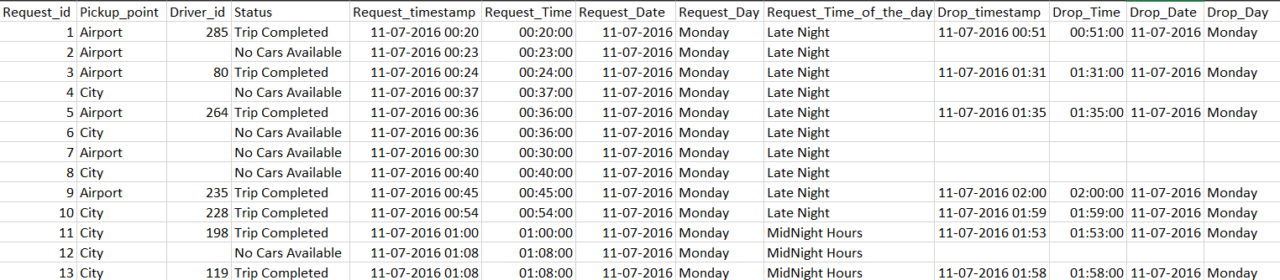
Data Cleaning - Excel

Slide 8
Excel Dashboard Insights
Pivot tables show peak demand slots
City: High cancellations in Morning/Evening
Airport: High 'No Cars Available' at Night
3D Pie shows only 42% trips completed

Slide 9
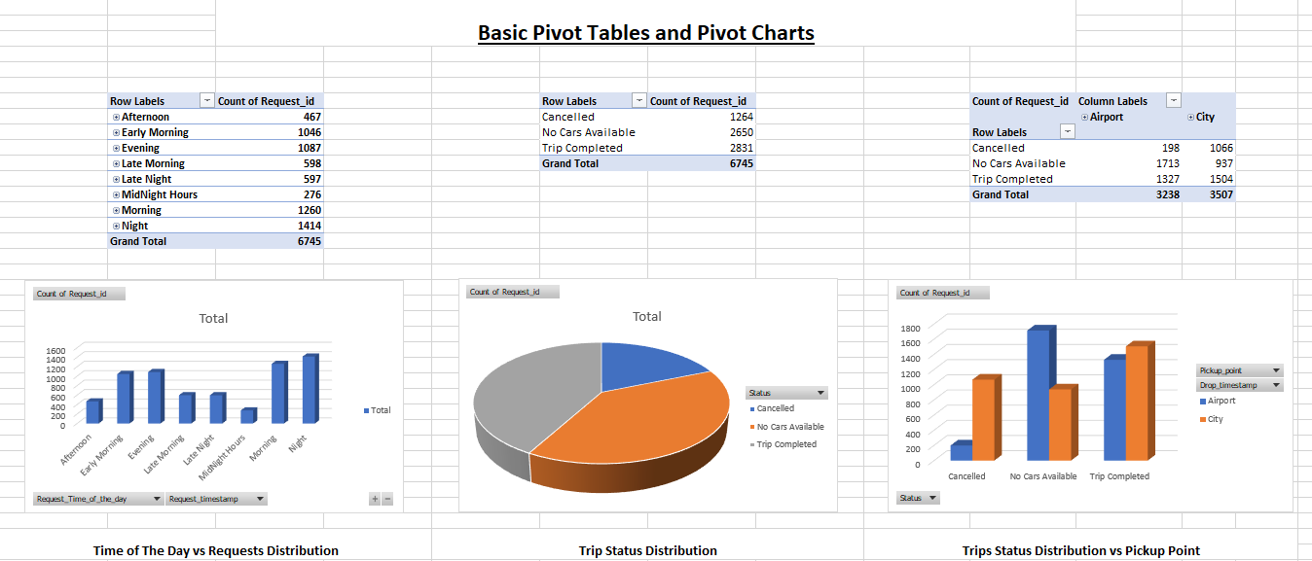
Excel Dashboard Insights

Slide 10
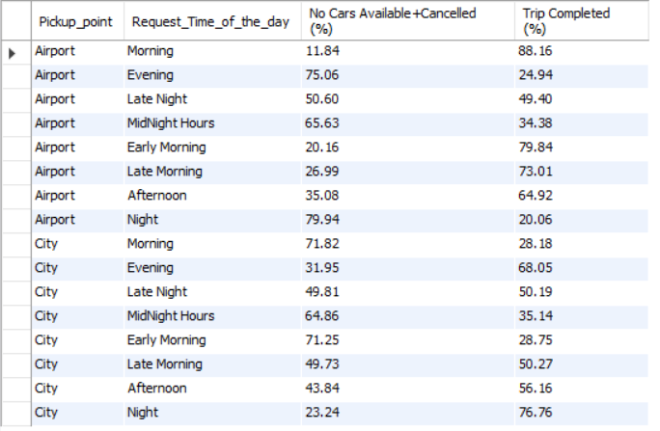
SQL Insights

Slide 11
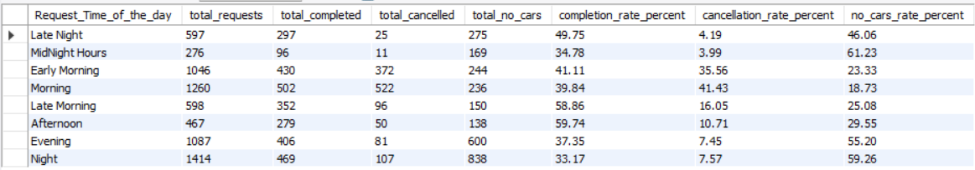
SQL Insights

Slide 12
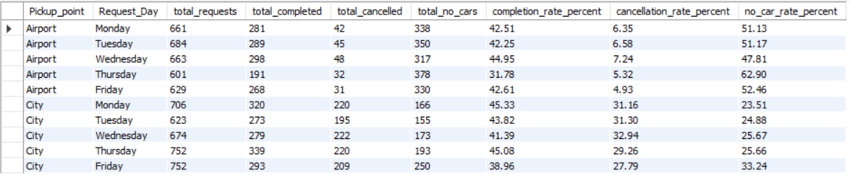
SQL Insights

Slide 13
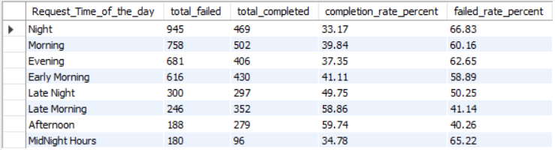
SQL Insights

Slide 14
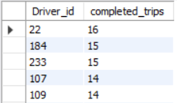
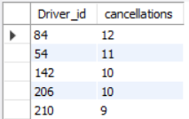
SQL Insights

Slide 15
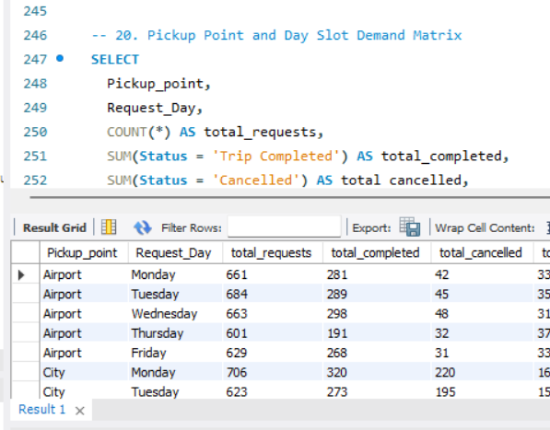
Key SQL Insights
Grouped by pickup point and status
Time-slot wise failure patterns identified
Cancellations higher in City; unavailability in Airport
Identified top failing time slots
Identified top failing and top performing drivers

Slide 16
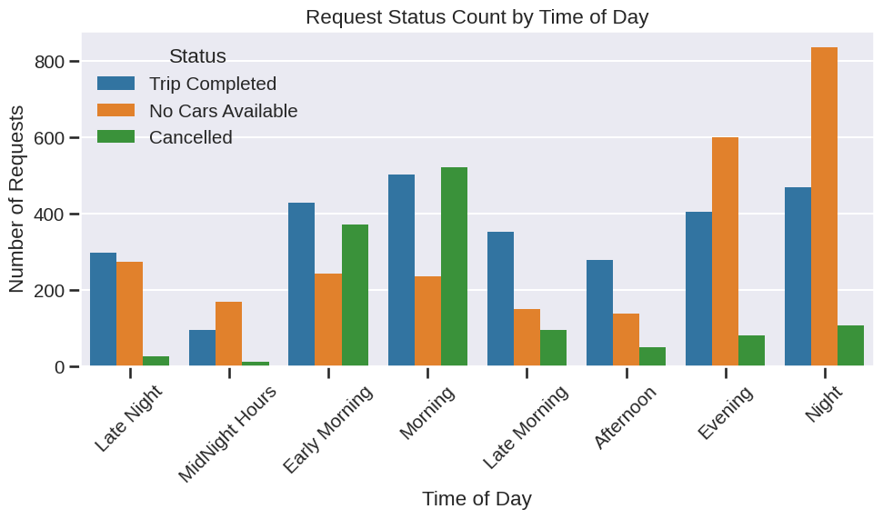
Python Insights

Slide 17
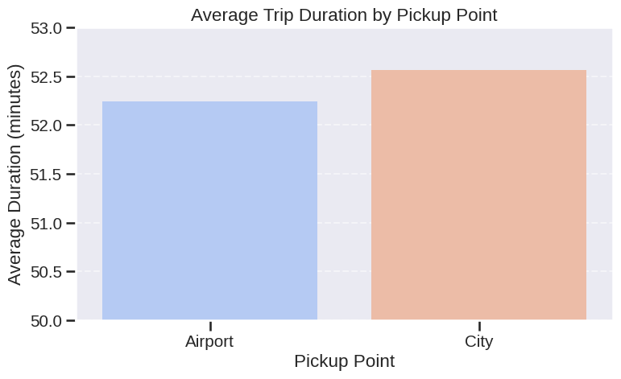
Python Insights

Slide 18
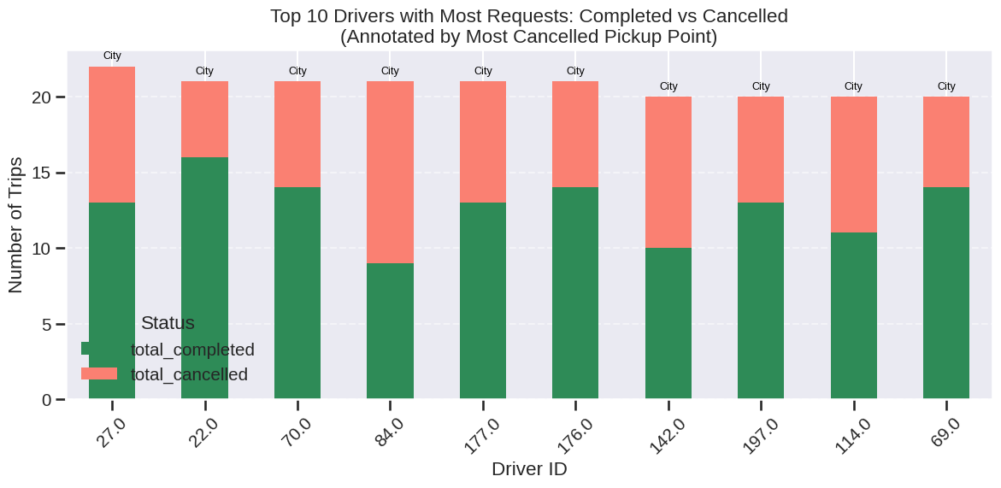
Python Insights

Slide 19
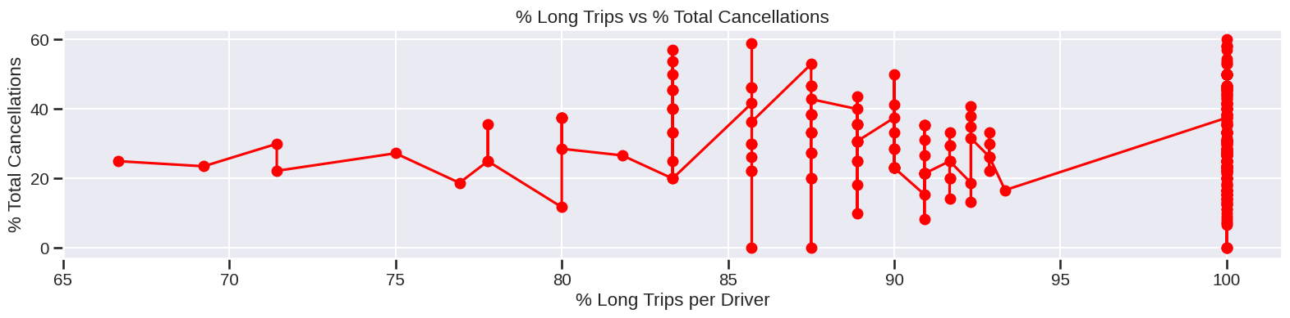
Python Insights
Long trip frequency does not affect cancellation

Slide 20
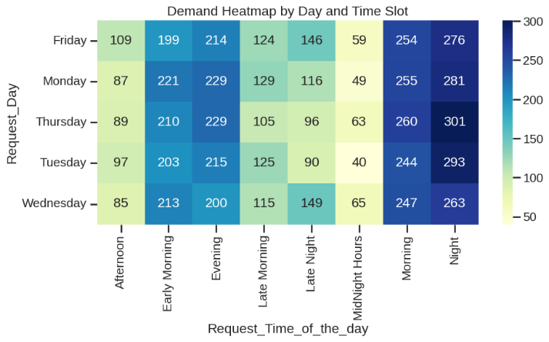
Python Insights

Slide 21
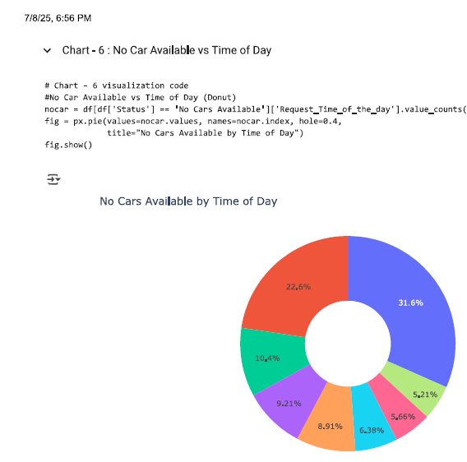
Key Python Insights
Morning/Night have the highest unfulfilled ride requests
Trips from the City are slightly longer on average
Some top drivers have high cancellation counts
Long trip frequency does not affect cancellation
Morning and evenings are facing higher surge in requests

Slide 22

Key Overall Insights
58% of requests failed (Cancelled or No Cars)
City: Cancellation hotspot in peak morning hours
Airport: Night-time supply shortfall
Long trips more likely to be dropped post-evening
Towards the weekend a greater number of unmet demands are seen

Slide 23

Driver Behavior
Few drivers cancel frequently—mostly City-based
Top performers complete 95%+ trips
Shift-end time overlaps with long-trip cancellations

Slide 24

Recommendations
Reallocate drivers during Morning & Night slots
Boost Airport coverage in Evening & Night
Time-slot based incentives for long-trip completions
Monitor and retrain high-cancellation drivers

Slide 25

Business Impact
Improved trip fulfillment and customer trust
Reduced cancellations and driver drop-offs
Optimized operational cost and fleet utilization
Data-backed decisions for long-term growth

Slide 26

Conclusion
Supply-demand gaps are time and location specific
Failures can be reduced through smart allocation
Data analysis offers clear, actionable solutions
Supports Uber’s mission of reliable urban mobility

Slide 27
ThankYou

