Slide 1
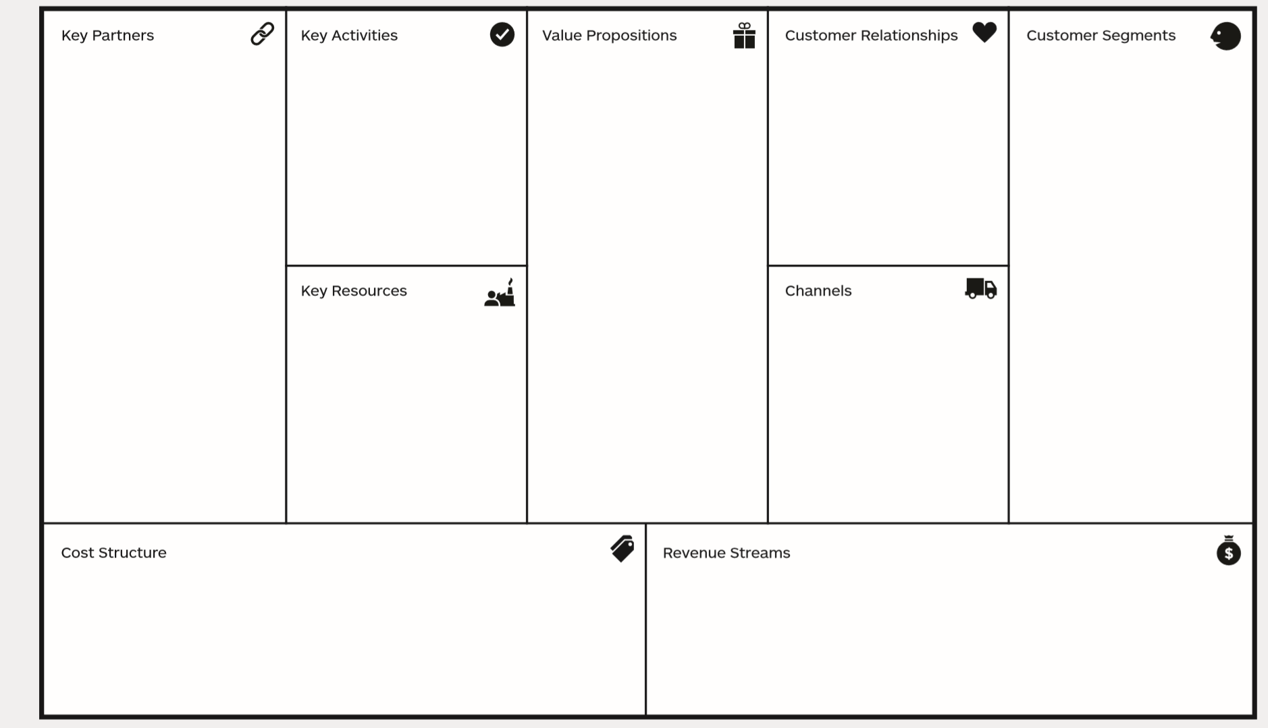
Universities (RWTH)
Hospitals
Investors/Sponsors
Supplier/Manu-facturers
Chipdesign
Making Lemonade
Research
Cooperation with doctors and patients
Better control of treatment with Vancomycin
Affordable monitoring of Vancomycin concentration
Less undesirable side effects
Close Cooperation with future Customers
Patient needs/feedback are main design focus
Creating value for patients
Broader usage possibilities for Vancomycin.
Good risk management for hospitals and doctor‘s offices
Less stress for patients
Lab access via University
Blood samples
Insight on newest technologies
Personal (at first)
Logistic service
Website
Industry events
Developing costs
Manufacturing costs
Marketing costs
Sponsoring

