Slide 1
Photo Hunt
Turn any gathering into a themed photo contest
www.familyphotohunt.com

Slide 2
What is Photo Hunt?
A web app for group photo contests — no download required.
Organizer creates a contest with themed categories (Food, Best View, Silly Moment…).
Participants join with a 4-character code from their phone browser.
Everyone uploads photos, votes on favorites, and celebrates winners together.
Perfect for family trips, reunions, retreats, and team events.
familyphotohunt.com

Slide 3
Four stages, one smooth flow
The organizer controls timing; participants always know what to do.
1 Setup
Add categories. Join code hidden until ready.
2 Photo Collection
Share join code. Participants upload & submit photos.
3 Voting
Collection closes. One vote per category (not your own).
4 Results
Winners, scoreboard, TV reveal, and downloads.
familyphotohunt.com

Slide 4
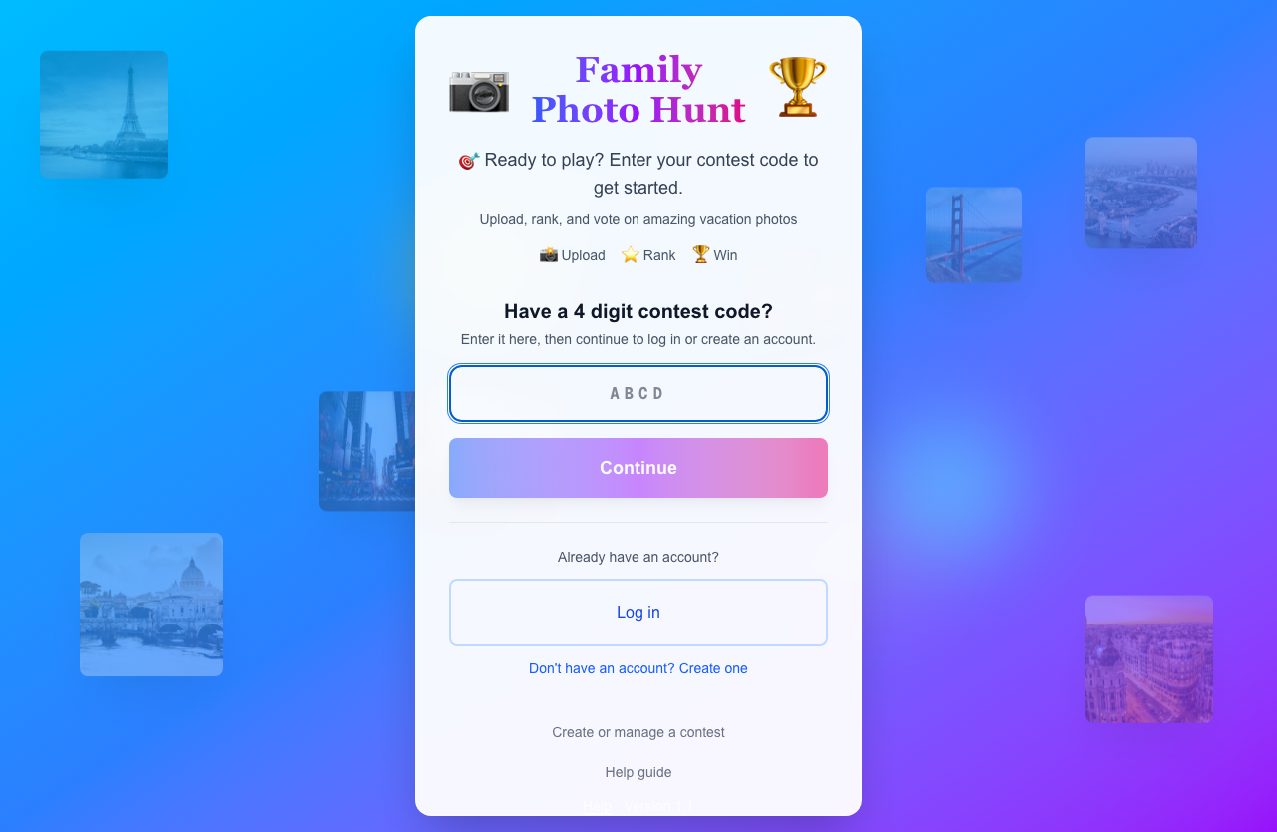
Joining is simple
Enter a code on the home page — or follow a link from your organizer.
4-character join codes — easy to text to a group.
Create an account once; stay signed in on the same device.
Contest cards show location, date, and current stage.
familyphotohunt.com

Slide 5
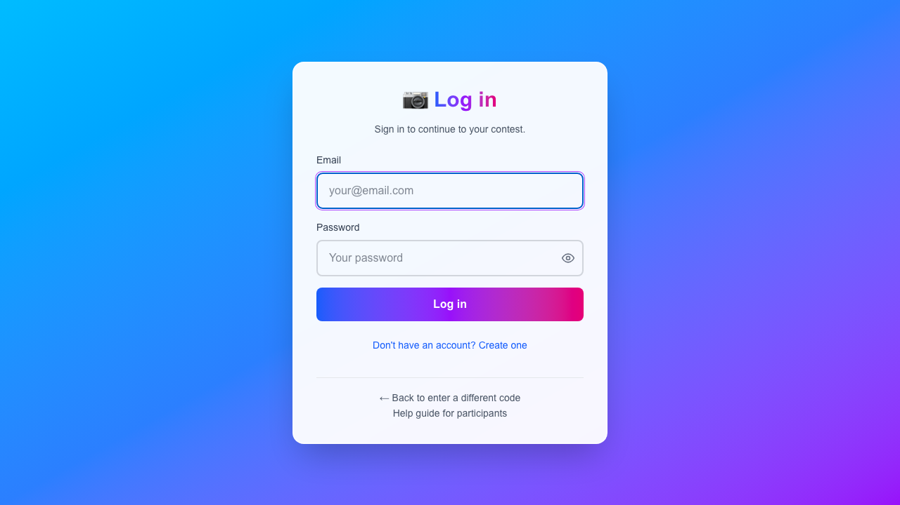
Sign in or register in seconds
Name, email, and password — then you're in the contest.
Works on phone and desktop browsers.
Join code can be pre-filled from an invite link.
Password show/hide for easier mobile entry.
familyphotohunt.com

Slide 6
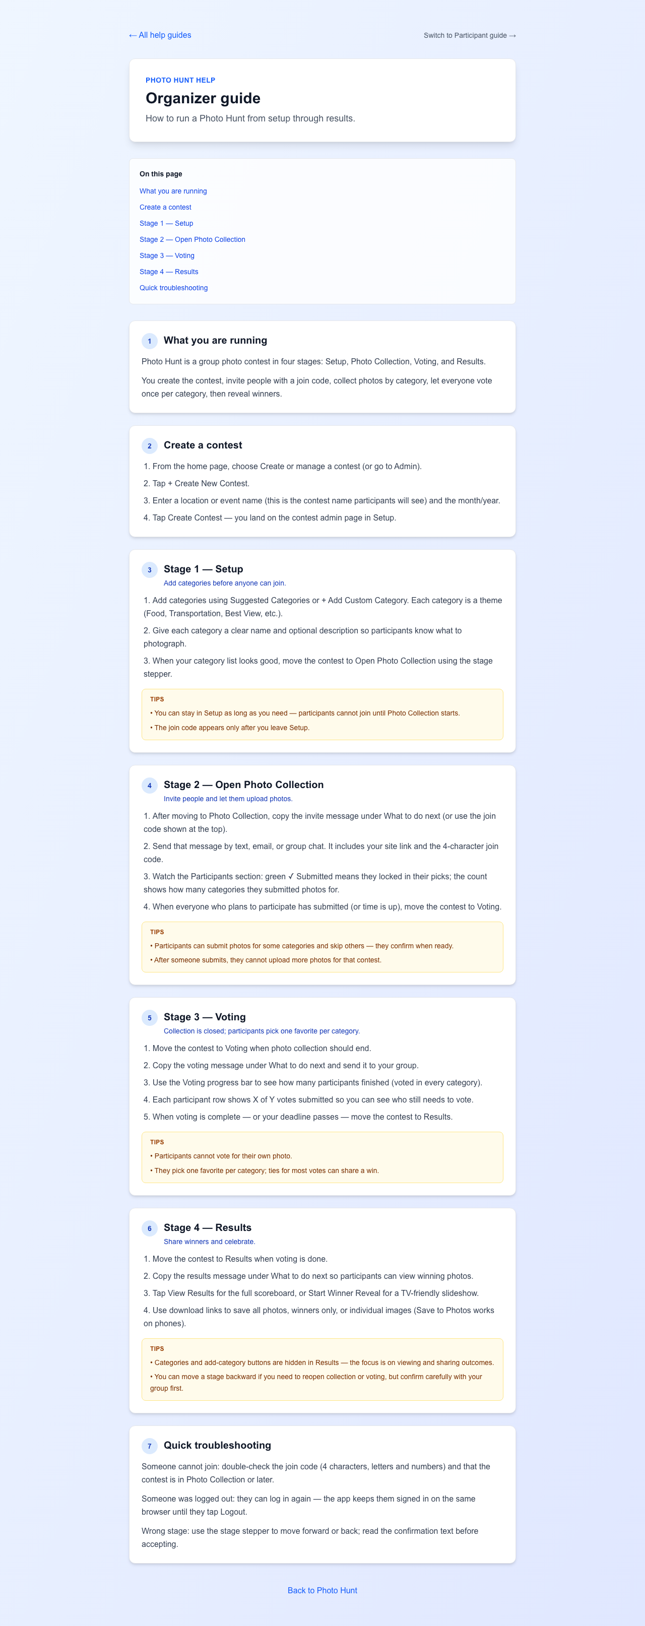
Stage 1 — Setup
Build your category list before anyone joins.
Create contest with location/event name + month/year.
Add suggested categories or custom themes with descriptions.
Advance to Photo Collection when categories are ready.
Join code appears only after leaving Setup.
familyphotohunt.com

Slide 7
Stage 2 — Open Photo Collection
Invite the group and collect photos by category.
Copy a ready-made invite message (link + join code).
Participants upload from camera or photo library.
Rank multiple photos — top photo is submitted per category.
Organizer tracks who submitted and category progress.
familyphotohunt.com

Slide 8
Stage 3 — Voting
Fair, simple, one favorite per category.
Gallery view per category — browse all submitted photos.
One vote per person per category.
Cannot vote for your own photo.
Organizer sees voting progress bar and per-participant status.
Ties for most votes can share a win.
familyphotohunt.com

Slide 9
Stage 4 — Results
Celebrate winners and keep the memories.
Full scoreboard with vote counts per category.
Start Winner Reveal — TV-friendly slideshow for the room.
Download all photos or winners-only ZIP.
Participants: Save to Photos on mobile from results.
familyphotohunt.com

Slide 10
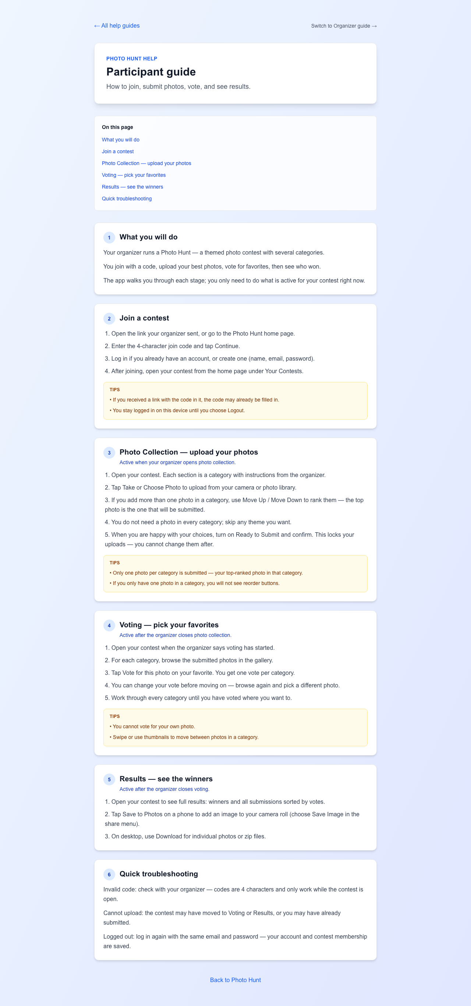
Participant experience
Built-in guide walks users through every step.
Join → Upload → Submit → Vote → Results
Skip categories you don't have photos for.
Ready to Submit locks uploads — plan before confirming.
Help at /help/participants anytime.
familyphotohunt.com

Slide 11
Organizer tools
Everything you need to run the contest from your phone or laptop.
Visual stage stepper — move forward or back with confirmation.
Copyable announcement snippets for each stage.
Participant panel with submission & voting status.
Suggested category library (Animal, Architecture, Food…).
Admin dashboard lists all your contests with current stage.
familyphotohunt.com

Slide 12
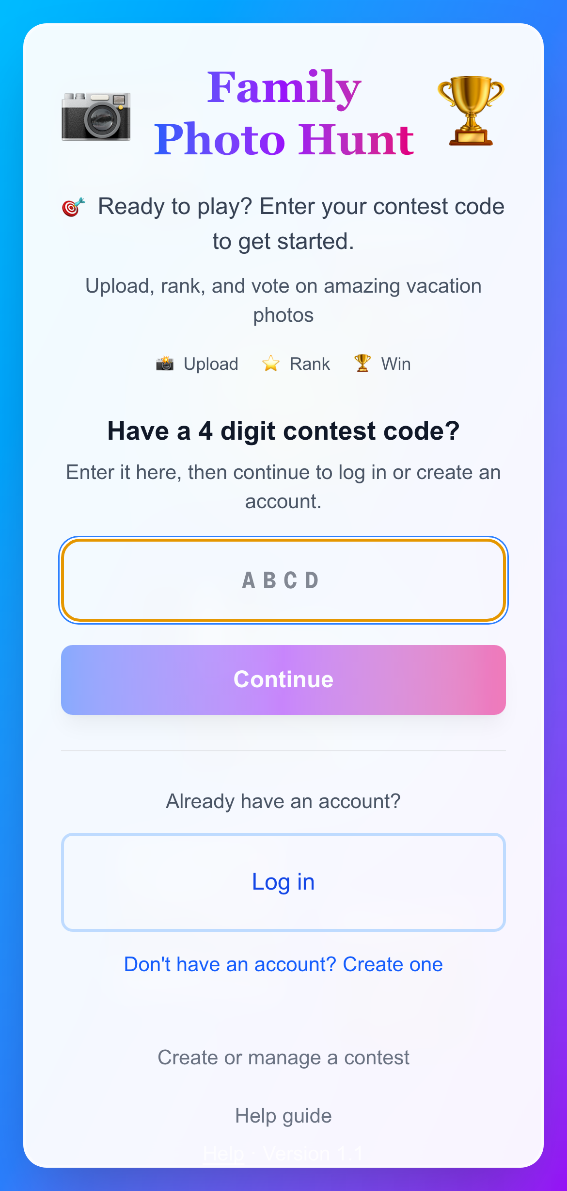
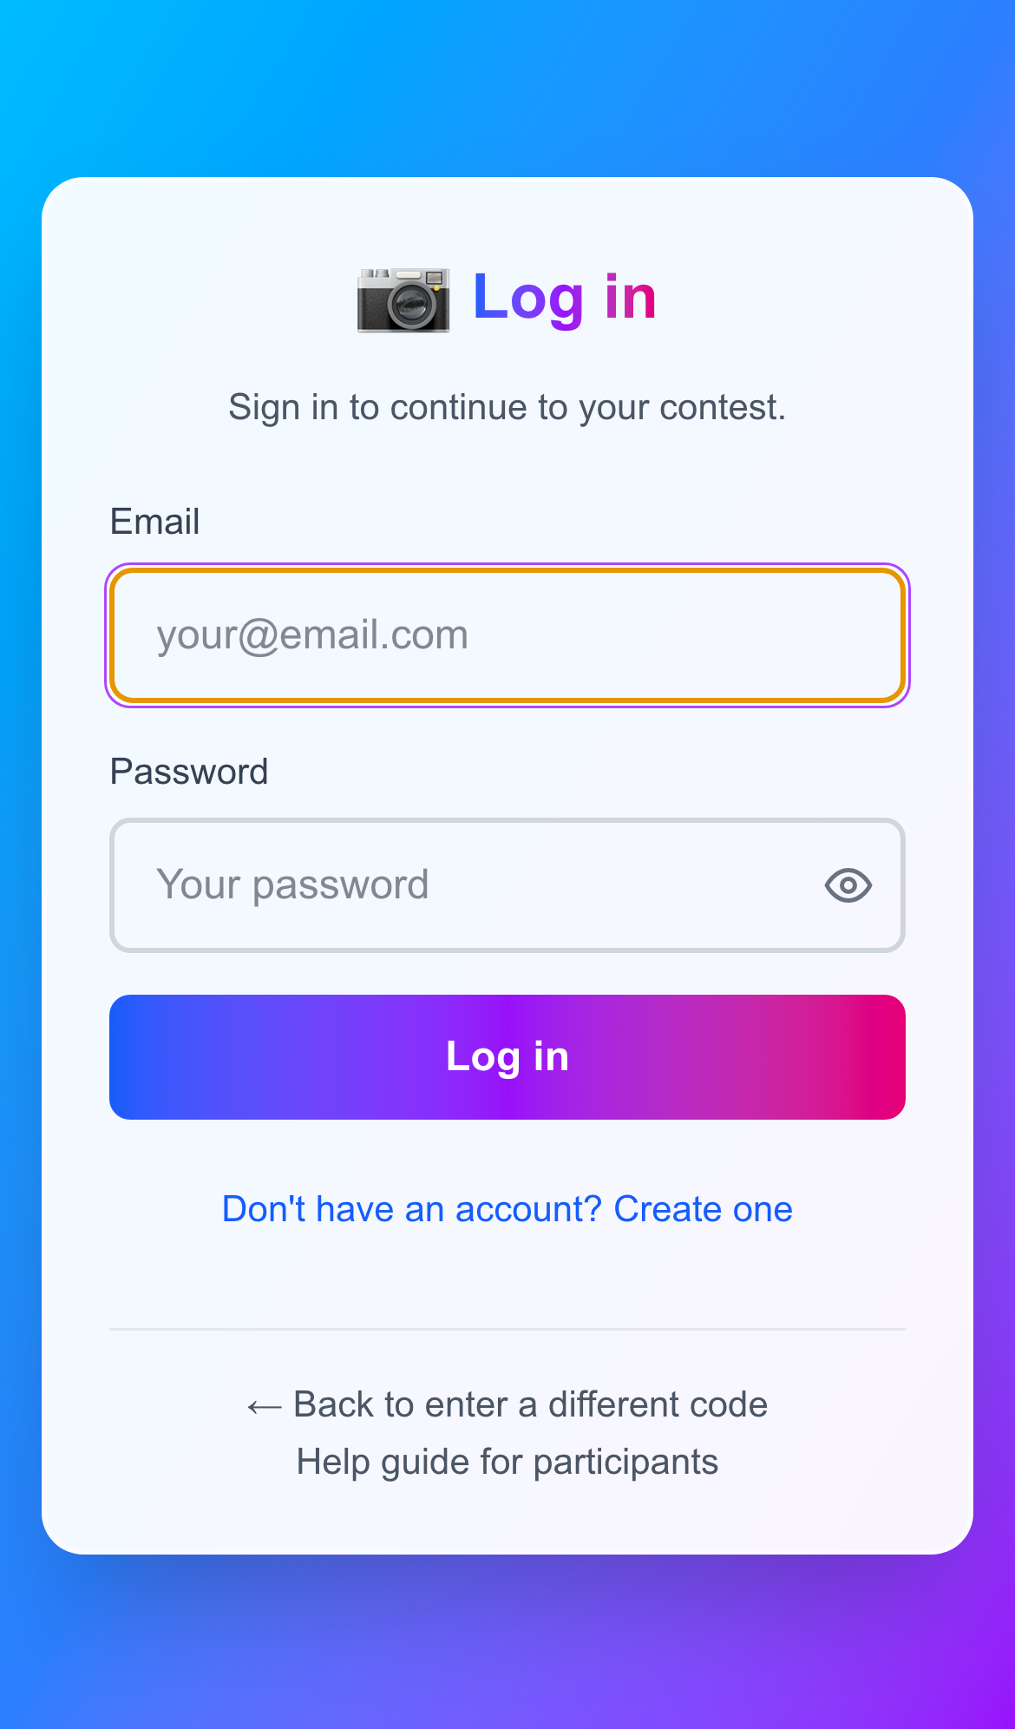
Built for phones
Upload, vote, and save winners from the mobile browser.
Touch-friendly buttons and galleries.
Camera roll upload — no separate app.
Save winning photos to camera roll on iOS/Android.
Desktop great for admin + projector winner reveal.
familyphotohunt.com

Slide 13
Feature highlights
Join codes
4 characters — text to your group
Categories
Custom themes + optional descriptions
Submissions
One photo per person per category
Voting
One vote per category; no self-voting
Reveal
Fullscreen winner presentation
Downloads
ZIP all photos or winners only
familyphotohunt.com

Slide 14
Get started
Free to try — create your first contest in minutes.
1. Visit www.familyphotohunt.com
2. Sign in and tap Create or manage a contest
3. Add categories and invite your group with the join code
4. Move through stages as your event unfolds
Questions? Share this deck and the Photo-Hunt-Prospect-Guide.md companion doc.
familyphotohunt.com

