Slide 1
CASSINI A SDN BASED NETWORK AUOTOMATION TOOL
Aashi Gupta, Manish Singh Kushwaha , Pamunugundla Vamshi Sai
Turbo Summer Interns

Slide 2
SDN CONTRIVANCE:- EXPLAINATION OF CASSINI

Slide 3
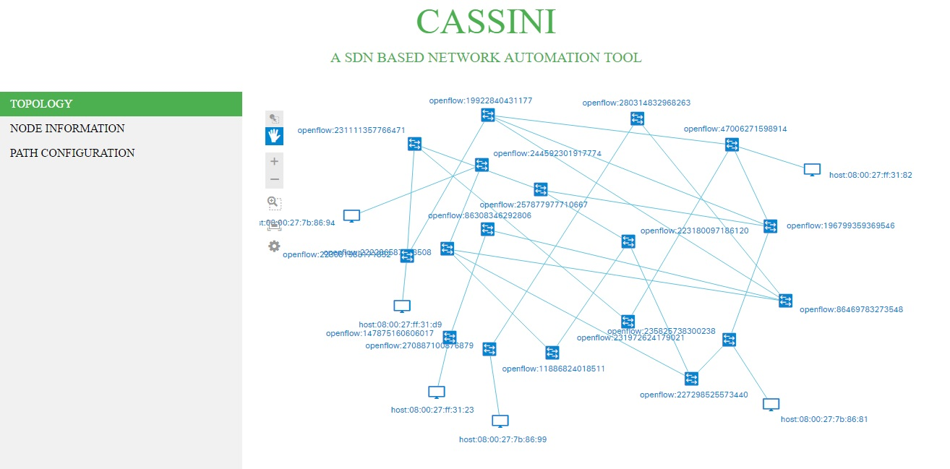
PROBLEM STATEMENT:
WE ARE PROVIDED WITH A NETWORK AND OUR TASK IS TO AUTOMATIZE THAT NETWORK USING SDN IN TERMS OF-:
CONNECTIVITY
RE-ROUTING
QUALITY OF EXPERIENCE(QoE)

Slide 4
Access provisioning tool(NA)
FRONT-END
MONGO-
CLIENT
MONGO-DB
PHP
FUNCTION CALLS
JAVASCRIPT
AJAX
TCP
SOCKET
CONNECTING
THE
DOTS
BACK-END(JAVA)
MONGOCLIENT
REST API
ODL
REST LIBRARY
OPENFLOW
NETWORK

Slide 5
PHYSICAL SETUP:
CASSINI
172.16.52.74
OPENDAYLIGHT CONTROLLER
172.16.52.9
TEST ENVIRONMENT
172.16.52.140
172
NETWORK
DATABASE
172.16.52.73

Slide 6
COMPUTATIONS AND WORKING:
The Application will retrieve the topology information from SDN Controller and the topology based on this data will be displayed in the web page along with the information regarding hosts and nodes.
The application detects hosts whenever they connect to or disconnect from the agglomeration of nodes.
The network access application can ask Cassini to configure a path between a host and a server. The application will configure the path that is the shortest by default.
The shortest path between edge nodes in the network will be calculated and stored in the database for path configuration.
If a node is added or deleted from the network, all the paths will be reconfigured accordingly and stored in database. The topology is checked every 30 seconds for any changes.
If a host moves in a network from one position to other, we remove the old path and ask the access provisioning application for a path configuring trigger.

Slide 7
Contd.:
If an intermediary switch in the path fails, reconfiguration is done for all the hosts’ path going through that switch. This reconfiguration is done within the interval of 30 seconds.
The application also assigns weight to each link between nodes. And based on the traffic between the nodes the weight of the link is modified to reflect the bandwidth consumed.
These weights which will be used for the best path calculation.
We have a predefined threshold for making a decision to switch the user to a best path from the shortest path.
This comparison between sum of the weight along the path to the threshold is done every 30 sec. .
If there is an increase in traffic then the user is shifted from the shortest path to the immediate best path available. If the traffic increases on selected best path too, then we move to the second best path available. This path analysis is made every 2 minutes by the application.

Slide 8
Contd-:
Cassini is performing a trend analysis on the traffic data to make the decision to shift to a best path.
T denotes a sample space of 5 path sums where each sample is collected every 30 seconds.
T is categorized in to the following,
Increasing Trend Ex: T = (35, 40, 45, 50, 60)
Decreasing Trend Ex: T = (65, 60, 55, 45, 40)
Normal Trend Ex: T = (60, 57, 55, 58, 55)
Sudden Decrease Ex: T = (60, 55, 30, 25,10)
Sudden Increase Ex: T = (30, 50, 55, 60,85)
If sum of the differences of the samples is greater than 50 we make a decision to change the path.
With Cassini we can also retrieve statistics related to ports, nodes and flows.

Slide 9
TECHNOLOGY HOARD:
1
MONGO DB
Mongo DB is a NoSQL , document database with Scalability and Flexibility .It stores data in flexible , JSON like documents and is container of collections . Document is set of key value pairs .Fields can be varied from document to document and data structure be changed over time
2
NETBEANS IDE 8.0.2
A software development platform written in java . But it also supports other languages like C++. It provides integrated support for scripting languages like PHP and Javascript.It has Extensible Platform
3
LUBUNTU 17.04
Lubuntu is fast and lightweight operating system. The core of the system is based on linux. It has low hardware (RAM) requirements
4
OPENDAYLIGHT
The Open Daylight Controller is a pure software and as a JVM it can be run on any OS and Metal as long as it supports Java
5
MOBAXTERM
It provides important remote network tools and unix commands to windows desktop in single exe file.It supports multi tab environment and multi execution mode we can create and manage sessions
6
APACHE HTTP SERVER
Web server with good reliability and performance.

Slide 10
FRONT-END:

Slide 11
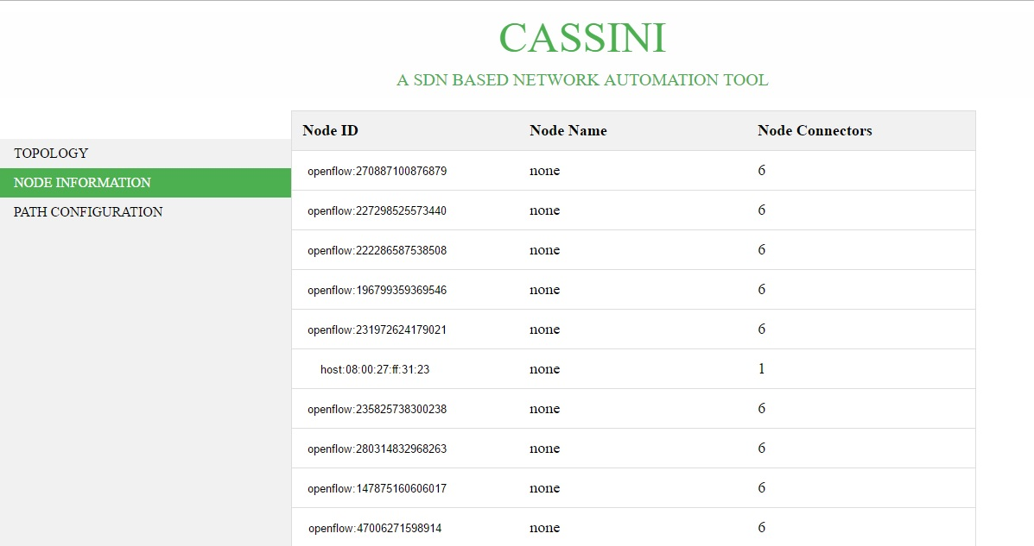
Contd.:

Slide 12
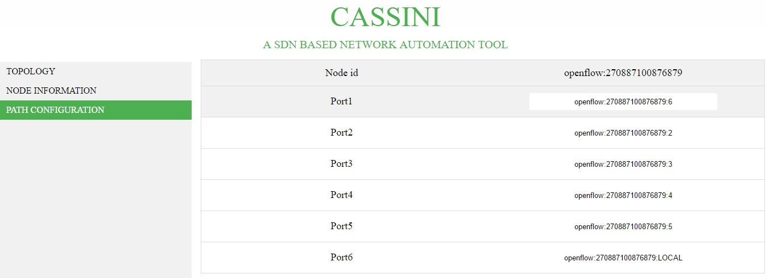
Contd.:

Slide 13
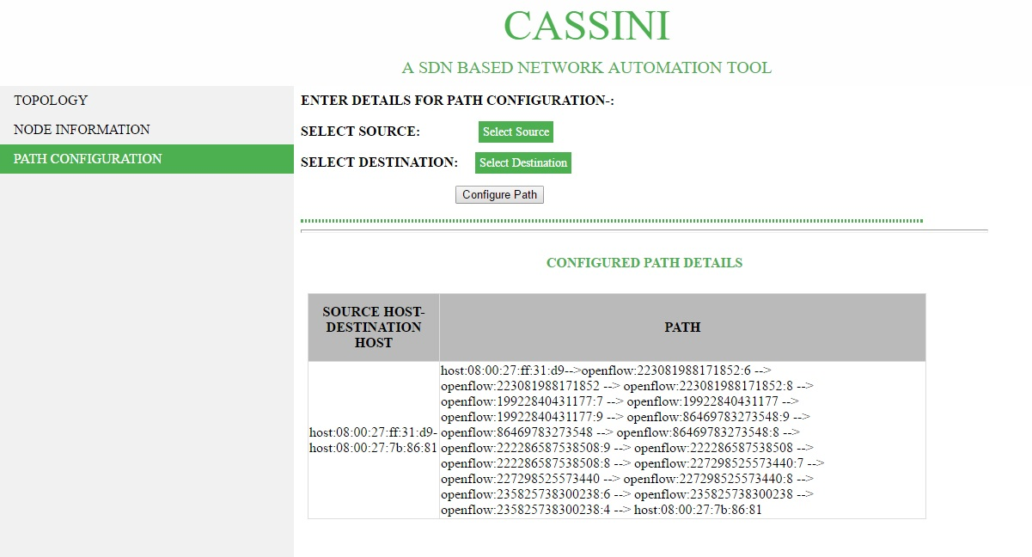
Contd.:

Slide 14
Thank you
Team MAV
Turbo Summer Interns

