Slide 1
Microservices
DevOps

Slide 2
Content
//WEEK 1 - Tobias
DevOps Introduction
Pipeline (continuous integration / continuous delivery / continuous deployment)
Real World Examples
//WEEK 2 - Peter
Infrastructure as Code (Puppet?, Chef?)
Cloud Foundry
tbd.

Slide 3
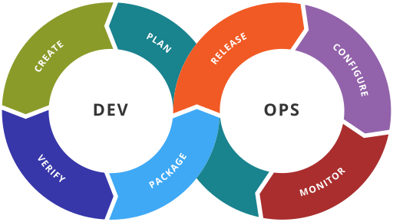
DevOps - Introduction
DevOps is a software engineering practice that aims at unifying software development (Dev) and software operation (Ops)
People, processes and tools
working together
to enable continuous delivery of value
to the end users
fast(er)
➔ Cultural change required
➔ We just focus on the software delivery process process!
https://upload.wikimedia.org/wikipedia/commons/thumb/0/05/Devops-toolchain.svg/512px-Devops-toolchain.svg.png

Slide 4
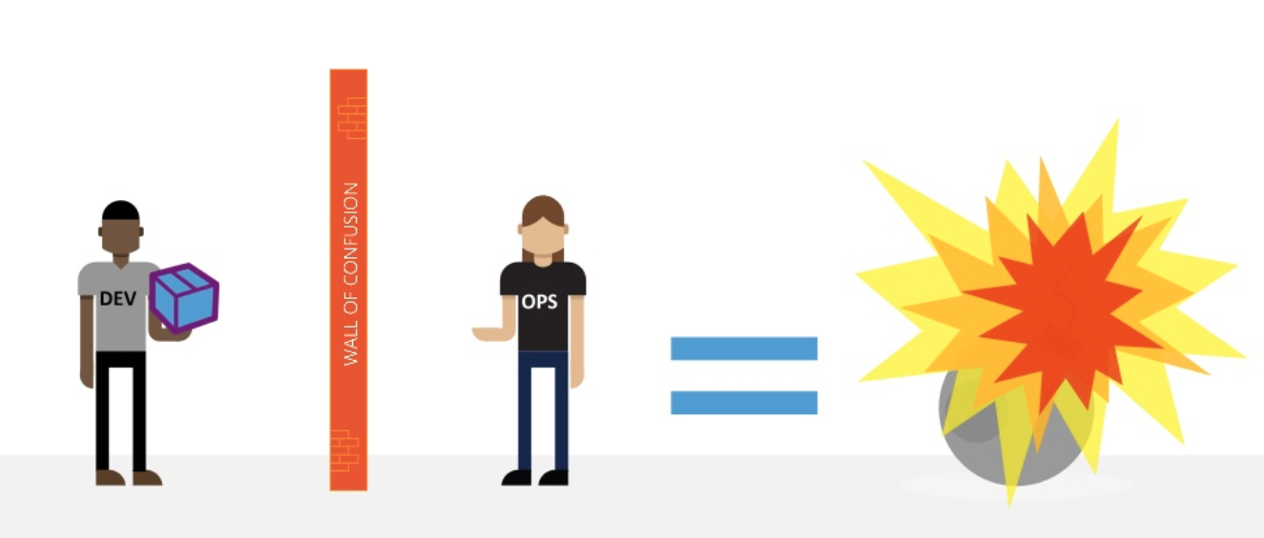
DevOps - Challenges
development vs. operation
agile vs. stability
a lot iterations
a lot of releases
monitoring of all services
code quality
https://www.slideshare.net/MaxYermakhanov/devops-in-the-real-world?qid=4059c0ff-d1ba-462e-83e4-4b4e79b404c9&v=&b=&from_search=1

Slide 5
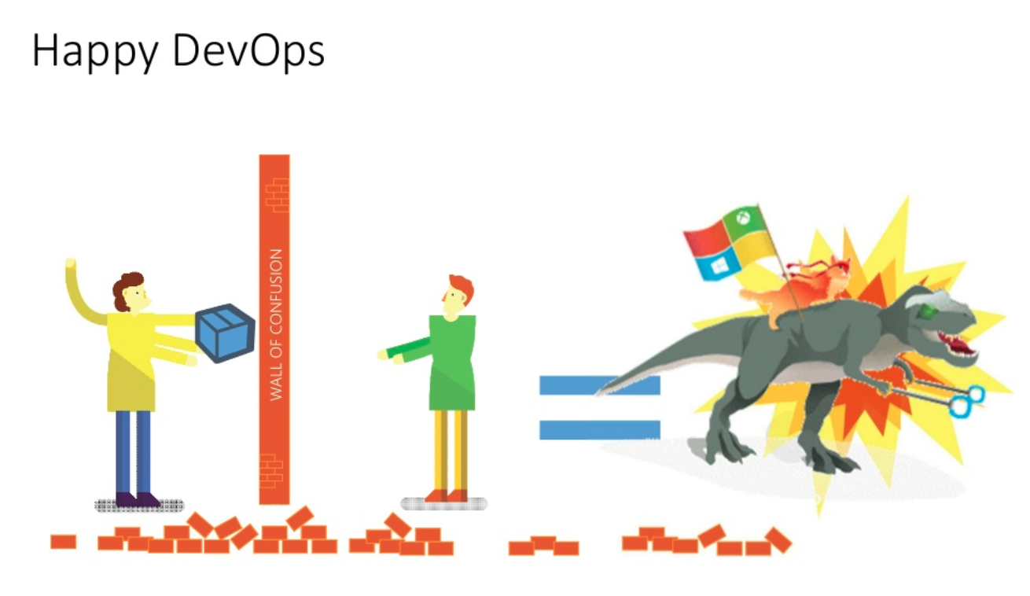
Goals
The goals of DevOps span the entire delivery pipeline.
Improved deployment frequency
Faster time to market
Lower failure rate of new releases
Shortened lead time between fixes
Faster mean time to recovery
Easier onboarding for new developers
Dev ➔ Create Change, Add or modify features
Ops ➔ Create stability, Create or enhance services
https://www.slideshare.net/MaxYermakhanov/devops-in-the-real-world?qid=4059c0ff-d1ba-462e-83e4-4b4e79b404c9&v=&b=&from_search=1

Slide 6
DevOps
plan
general project management tasks
backlog
documentation
scrum planning
Retrospectives
use mvp's – don't develop the hole software without test! (from lean startup)
Tools: JIRA, Trello, Confluence, Wiki, github readme, Planning poker, Whiteboard /w Post-it, User Story Mapping, Business Model Canvas, …

Slide 7
DevOps
plan
code
coding with git (hopefully not with svn anymore)
code reviews
Tools: github, codacy, bitbucket, …

Slide 8
DevOps
plan
code
build
Continuous Integration
different build tools for your project
Automatic unit tests
Tools: sbt, maven, gradle, docker build, …
➔ CI: Jenkins, Travis CI, Circle CI, AWS CodeBuild

Slide 9
DevOps
plan
code
test
build
Continuous Integration
Code coverage report
automatic test
acceptance testing
Integration testing
➔ CI: Jenkins, Travis CI, Circle CI, AWS CodeBuild

Slide 10
DevOps
plan
code
release
build
test
Packaging like building a jar or a docker container
Pre-Deployment-Staging
Release automation
➔ CD: Jenkins, Travis CI, Circle CI, AWS CodeDeploy, heroku, CloudFormation, Docker

Slide 11
DevOps
plan
code
release
deploy
build
test
configuration
production staging
Infrastructure as a Code (IaaC)
Tools: Chef, Ansible, Cloud Formation, Elastic Beanstalk, Reactive Platform, ...
➔ CD: Jenkins, Travis CI, Circle CI, AWS CodeDeploy, heroku

Slide 12
DevOps
plan
code
release
deploy
build
test
operate
logging
exception handling
performance monitoring
support / service desk
feature toggles
Metrics / measure success / …
Tools: Jira Service Desk, CloudWatch, ELK Stack, Reactive Platform, ECS, EC2, Kubernetes, …

Slide 13
DevOps Pipeline
plan
code
build
operate
test
release
deploy
Agile development
Continuous Integration
Continuous Delivery
Continuous Deployment
Continuous Configuration Automation
MORE INFO: https://www.scrum.de/unterschiede-zwischen-continuous-integration-continuous-delivery-und-continuous-deployment/

Slide 14
DevOps: Automate Almost Everything for Microservice
The build
database change (flyway)
Deployment to test/staging/production environments
Tests
Remediation plans
Monitoring
Infrastructure as code
Service discovery, DNS, Load Balancing, Auto Scaling, …
Your continuous deployment pipeline should be a model of your process for getting software from version control into the hands of your users.
A visualization (in real-time) of the status of software codebase after every change, for all stages from chek-in to release
@SPOTIFY: https://labs.spotify.com/2014/03/27/spotify-engineering-culture-part-1/ !!!

Slide 15
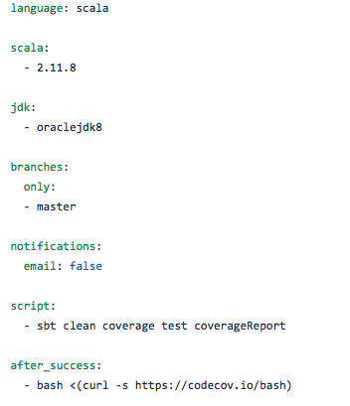
Travis CI Sample
You can try this travis ci sample.
Just fork innfactory/bootstrap-akka-graphql and activate travis ci (its free for open source!)

