Slide 1
Docker Clustering
Docker cluster systems (Swarm, Kubernetes,…)

Slide 2


Slide 3
Agenda
Why clustering
Problems of clustering
Available products
Components of Docker cluster systems
Persistence
Networking
Configuration
Docker Swarm Setup
The „Ingress“ network

Slide 4
Why clustering
High availability
Scalability
“Scale out” instead of “scale up”
Simplifying the maintenance of cluster nodes (updating, replacement, hardware maintenance,…)

Slide 5
Problems of clustering
Networking
Load balancing
On which IP/hostname is a service reachable?
Where are my depandant services reachable
Scaling
How is the load balanced on all available instances
When should a service scale up or down?
Configuration
Secrets
Persistence: where’s the data?
NFS
vSphere Volumes
SAN storage
(we talk about cloud solutions later)

Slide 6
Available products
Kubernetes
OpenShift (based on Kubernetes)
DC/OS (Mesosphere)
Docker Swarm
Rancher
Nomad
Mantl
…

Slide 7
Components – Persistence
There are plenty of plugins available:
Azure File Storage
NFS
GCE Volumes
GlusterFS
SAN systems (NetApp, Nimble, Virtuozzo)
VMWare vSphere Storage
Most of them are trying to solve the problem that a container may run on any host so the data has to be available on any host!
A few are also able to control concurrent R/W access by multiple containers (e.g. GlusterFS, VMWare)

Slide 8
Components – Persistence
Which persistence driver you want to use depends on your environment
Is very fast access required (databases, caches,…)?
Do multiple instances have to share the same data (file storages like NextCloud)?
Is there any infrastructure available (cloud native like AWS, Azure, GCE, on promise like SAN systems or a NFS server)?
How fast do you have to setup the cluster? (the setup of a NFS is much easier than a GlusterFS cluster)

Slide 9
Components – Networking
Port publishing (on which cluster-node is an application reachable?)
Ingress network in Docker Swarm
Communication between containers across multiple container hosts
Overlay networks in Docker Swarm
Isolation of applications against each other (multiple applications may need the same services but would interfere with each other)
Stacks and Services in Docker Swarm
Service Discovery (method to access other services in an application)
Realized with DNS in Docker Swarm

Slide 10
Components – Configuration
Mounting configuration files into container
Securing sensible data like credentials, API keys, …
Share configuration files across multiple containers and hosts
Docker Swarm has special CMDlets for storing secrets (docker secret) and configuration files/values (docker config)

Slide 11
Components - Scaling
Dynamically scale services up and down
Optionally: scale services when load is getting higher or lower (Kubernetes)
Docker Swarm is able to start new containers on demand (docker service scale helloworld=5) but it does not detect if the load is getting worse so this is up to you

Slide 12
Docker Swarm concepts
Based on Raft (consensus protocol, will be discussed later)
Nodes are manager or worker
Managers are taking actively part in the Raft consensus
One manager is the leader, the others are in stand-by and are forwarding requests to the master
Interactions (like starting a service) are only possible with a master node

Slide 13
Docker Swarm – Setup
To create a new Docker Swarm you need at least 2 nodes (for high availability 4 nodes)
On machine 1 (let‘s call it master) you’re initializing the swarm by running docker swarm init –advertise-addr <MASTER IP>
To get a join token you’ve to run on the master docker swarm join-token worker. As result Docker should print the complete command to join a worker node
On machine 2 (let’s call it worker) you executed the printed command (e.g. docker swarm join –token SWMTKN-1-49nj1cmql0jkz5s954yi3oex3nedyz0fb0xx14ie39trti4wxv-8vxv8rssmk743ojnwacrr2e7c <MASTER IP:PORT>
A join token may be used multiple times but it has a lifetime so you will have to generate new ones from time to time

Slide 14

Docker Swarm – Routing Mesh

Slide 15
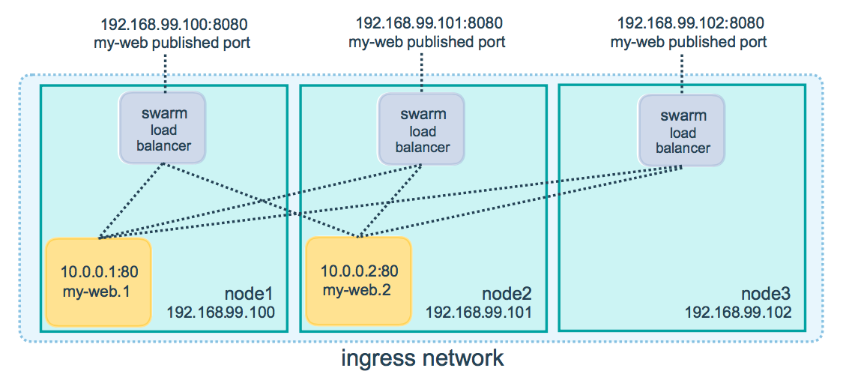
Docker Swarm – Routing mesh
Source: https://docs.docker.com/engine/swarm/ingress/

Slide 16
Docker Swarm – Accessing services
Like with any local Docker container a Swarm Container publishes a port – ports which should be available from outside the swarm are published through the so called “Ingress” network
A port published by the ingress network is available at every node (even on worker nodes)
Communication between services is always possible (if they’re in the same network)
To resolve other services Docker Swarm uses internal DNS entries for every service, all calls are balanced over all available instances of a specific service (load balancing)

Slide 17
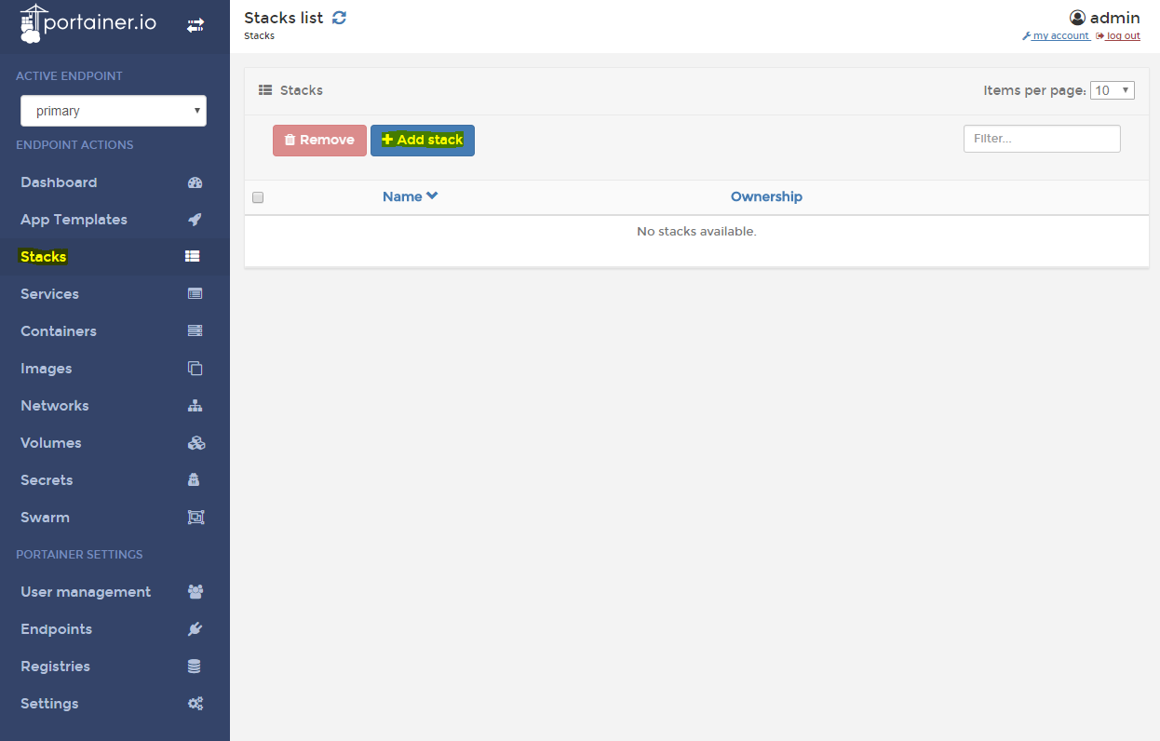
Docker Swarm – Deployment

Slide 18
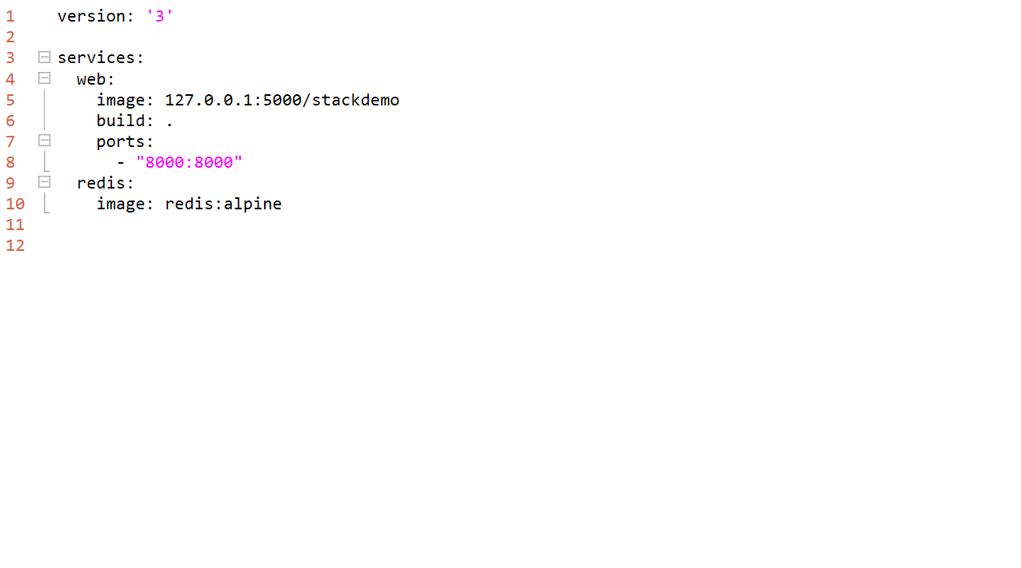
Docker Swarm – Deployment

