Slide 1
Microservices
API-Gateways

Slide 2
Content
Load Balancing basics
Load Balancing strategies
Round Robin
Least Connection
Chained Failover
…
Failover techniques
Common address redundancy protocol (CARP)
Gateway Load Balancing Protocol (GLBP)
API gateways
Products
Traefik
HAProxy
…

Slide 3
Basics
Load Balancers are needed to avoid single point of failures
Load Balancers distribute calls sent to them to one or more instances
Load Balancers keep track of their known backends to avoid errors when a services is no longer healthy
Optionally they have additional features like SSL termination
Only one or a few servers where certificates have to be exchanged when a new certificate is created
No special handling required in the services behind the load balancer
Admins have to take care that communication between load balancer(s) and nodes is safe (e.g. VLANs)
In Microservice environments it’s essential that the load balancer(s) can be reconfigured dynamically (e.g. in combination with etcd or Consul)
When you’re able to scale your microservice instances but not the persistence layer of them you’re just moving the single point of failure one layer backwards!

Slide 4
SSL termination

Slide 5
Load Balancing strategies
Round-robin
Weighted round-robin
Least connection
Weighted least connection
Agent Based Adaptive Load Balancing
Chained Failover (Fixed Weighted)
Weighted Response Time
Source IP Hash
…

Slide 6
(Weighted) Round-robin
There are many Round-robin algorithms
The simplest one is to use a FIFO queue to keep track of all available backens
Dequeue
Relay request
Enqueue
Results in max-min-fairness (the longest waiting requests gets the highest priority)
The weighted round robin algorithm gives every backend a weight and the scheduler takes the weights into account to prefer servers with a higher weight before servers with a lower weight (e.g. used for quality of service (QoS))

Slide 7
(Weighted) Least connection
In contrast to round-robin the least connection algorithm takes the load of every node in account.
The least connection algorithm relays an incoming request always to the node which has the lowest count of active connections.
This way nodes with a higher performance handle more requests than nodes with lower performance without the need to configure weights.
The weighted least connection variant enables the administrator the give nodes a weight. These weights are considered when two nodes serve the same count of active connections and the node with the higher weight is considered first.

Slide 8
Agent Based Adaptive Load Balancing
Every node has an local agent installed which reports real time data to the load balancer (e.g. CPU usage, memory allocation,…)
Load balancers takes load of every node into to account when a new request has to be relayed
Can be combined with weighted round-robin or weighted least connection algorithms
Used e.g. in Windows Terminal Server (RDS role after Server 2003)

Slide 9
Chained Failover
All backend nodes are in a predefined chain
Whenever the first node can’t handle/accept another request the next node in the chain is taken into account and so on
Not a real load balancing protocol!

Slide 10
Weighted Response Time
Kind of health check done by the load balancer(s)
Uses the response time of the health check to determine the fastest server currently available
Whenever a node is under heavy load the response times will be longer than the response times of a node with least load.
Avoid overload of nodes.

Slide 11
Source IP Hash
Algorithm creates a hash of source and destination IP (unique hash key)
Hash key is used to determine to which node the request should be forwarded
When the same client sends another request the hash key can be regenerated and the client gets forwarded to the same node
Useful for stateful services (don’t do that in microservices!) when nodes aren’t able to sync session information because a client always gets relayed to the same node (as long as its source IP does not change)

Slide 12
Network failover
But wait! If I have 1 load balancer what happens if this load balancer fails?
Possible solution: multiple load balancers with multiple DNS A/AAAA records to balance the load of the load balancers -> but DNS does not check for availability and there are the caches…
Better solution: configure network based failover:
Common address redundancy protocol (CARP)
Gateway Load Balancing Protocol (GLBP) (just for routers)

Slide 13
Common address redundancy protocol (CARP)
Enables multiple hosts in the same LAN to share a set of IP addresses
Available on BSD and Linux based hosts
Master-slave (or more polite active-passive) based
One master per group of redundancy
Each group of redundancy shares one virtual IP
A server maybe member of multiple groups of redundancy
Every server needs a second unique IP address for communication (best practice is to configure two unique IP addresses: one for LAN communication and one for the communication between all members of the group of redundancy e.g. heartbeats)
Whenever the master fails a slave takes over and answers all incoming requests
Can be combined with DNS round robin e.g. two groups of redundancy with two members each to ensure that always two load balancers are available

Slide 14
Gateway Load Balancing Protocol (GLBP)
Proprietary protocol created by Cisco for redundant routers
Allows weighting parameter to be set
Based on the weights (in a virtual router group) ARP requests will be answered with MAC addresses pointing to different routes
Balances in round-robin fashion by default
Elects one Active Virtual Gateway (AVG) for each group
AVG assigns every listener (and itself) virtual MAC addresses which enables Active Virtual Forwarders (AVF)
Each AVF is responsible to forward packages sent to its virtual MAC address

Slide 15
API Gateways
API Gateways are a crucial part of every microservices environment
API Gateways enable a microservices environment to scale by implement load balancing (e.g. round-robin based)
API Gateways are the single entry point for your whole application
Access to specific services is managed by:
DNS-Host per Service (A/AAAA/CName e.g. ServiceA.my-domain.com)
Virtual Routes (e.g. gateway.my-domain.com/ServiceA )
API Gateways are a kind of server-side service discovery (usually just for client apps but it’s possible to use it also for cross service calls)
They also hide implementation details by optionally aggregating all internal APIs to one (or more in case of Backends for frontends) in the point of view of the client app(s)
In the case of custom API Gateways the gateway may also execute calls to multiple services and aggregate the responses answering to the client request

Slide 16
API Gateways

Slide 17
Variation: Backends for frontends
Configure a API Gateway per kind of frontend e.g.
One for your web app
One for your mobile app
One for all 3rd party applications (public API)
The backends for frontends-pattern ensures the optimal API for every kind of application (e.g. gRPC gateway for desktop apps but RESTful API for web apps)

Slide 18
Backends for frontends

Slide 19




Products
General load balancers
HAProxy
Nginx
Created for microservices
Traefik
Fabio

Slide 20
HAProxy
Open source (GPLv2) high availability load balancer and proxy written by Willy Tarreau (core contributor of the Linux kernel)
Initial release 2001
Can be configured dynamically e.g. with consul-template
Can be used for SSL termination
Very good performance (dual-core servers are able to serve up to 40k requests/s and are able to saturate 2Gbit/s)
Used by GitHub, Bitbucket, Stack Overflow, Reddit,…
StackOverflow architecture

Slide 21
Nginx
Open source (BSD-like) web server which can also be used as reverse proxy, load balancer and HTTP cache
Developed by Igor Sysoev (company founded 2011)
Initial release 2004
Can be dynamically reconfigured e.g. with consul-template
According to w³Techs 35.9% off all websites in the internet are hosted by Nginx (according to Netcraft 19%)
Performance compared to HAProxy is a little lower (~33.5k requests/s) but still 4 times better than Apache

Slide 22
Fabio
Open source (MIT) zero-conf load balancer
Developed by ebay.nl
1st GitHub release in 2015
Written in Go
Built to deploy microservices managed by Consul
Performance is a little bit lower than Nginx (~23k requests/s) but still a young project
Powers already some large websites (markplaats.nl, gumtree.com.au, www.kijiji.it)

Slide 23
Traefik
Open source (MIT) reverse proxy and load balancer developed with microservices and containers in mind
1st GitHub release in 2015
Written in Go
Built-in dynamic configuration with many supported Backend (Docker, Swarm mode, Kubernetes, Marathon, Consul,…)
Performance compared to HAProxy and Nginx is a little bit lower (~28.4k requests per second) but it’s still a young project
Part of the Mantl stack

Slide 24
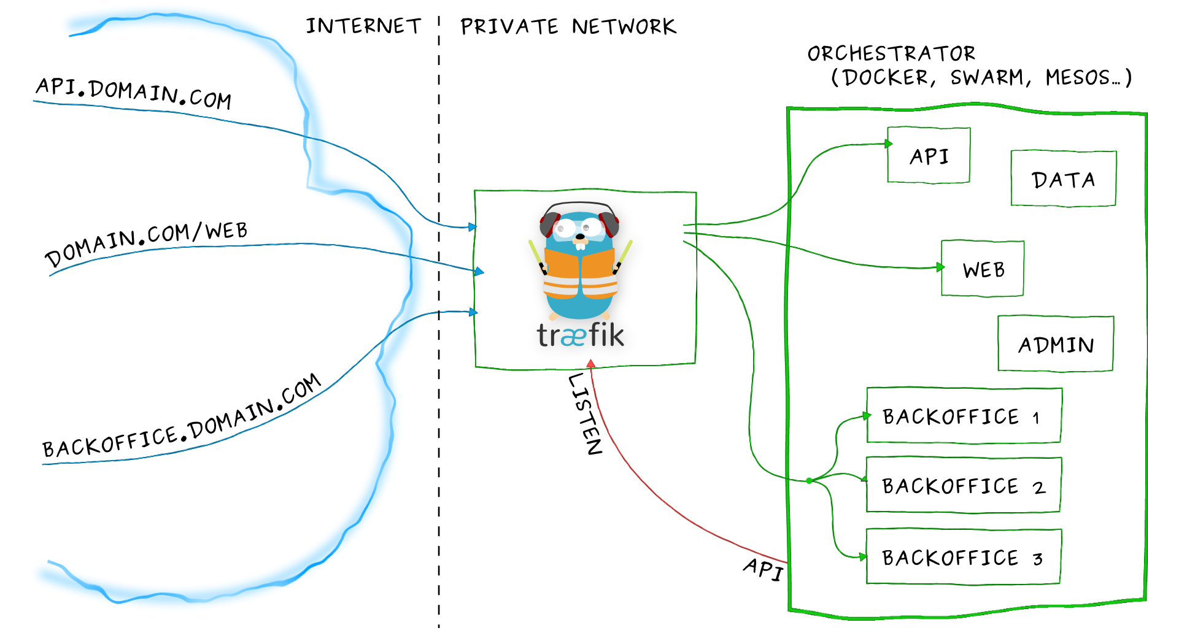
Traefik
Source: https://docs.traefik.io/basics/

Slide 25
Supported strategies
Product | Round robin | WRR | Least connection | Sticky session
Traefik | X | X |  | X
HAProxy | X |  | X | X
Nginx | X |  | X | X
Fabio | X | X

