Slide 1
Microservices
Infrastructure as Code

Slide 2
Content
//WEEK 1 - Tobias
DevOps Introduction
Pipeline (continuous integration / continuous delivery / continuous deployment)
Real World Examples
//WEEK 2 - Peter
Infrastructure as Code
Puppet, Chef, Ansible, Salt, …
DNS as Code

Slide 3
History
In the past, administrators have taken care of each server for its entire lifecycle
Every server was kind a „piece of art“
Every server hosted a large number of services
To be able to restore a server, administrators created full backups of every server (e.g. the /etc directory of Linux servers)
Purchase
Initial install
Maintenance
Removal from service
Final Disposal

Slide 4
Introduction
Define the configuration of your whole infrastructure as code
Whenever you don’t need a server any more delete it and restore it if needed (only data backup and code is required)
It’s easy (and required) to put all your infrastructure code into a version control system
Test your infrastructure code as you test your program code!
New servers can be bootstrapped full-/ or semi-automatic
It doesn’t matter if you’re building a Docker container or if you’re installing a virtual or physical server – infrastructure code may be applied to all of them
Focused on managing a large number of servers (instead of building a container farm)

Slide 5
Workflow
Code
Test
Provision
Deploy
Monitor/Alert
Problem resolution

Slide 6
Architecture
Server only
Client – Server

Slide 7
Fundamentals
Server or agent collects facts about target system
Configuration may be applied multiple times leading to the same result (means no change if not necessary)
Process of applying configuration may be forced
Configuration describes a desired state of a machine (configuration files, installed packages, existence of users, running services, … )
Most of the systems abstract the concrete operating system (e.g. the concrete package manager)
Most of the systems are resource orientated to describe:
Packages
Files
Users/Groups
Services

Slide 8

Ansible
Open-source and commercial editions available
Available for Linux/Unix systems with Python 2.7 environment
Server oriented – no agent available, changes are executed through SSH commands
Configuration (called Playbooks) are written in YAML files
Modules can be created in every language which can create JSON
Information about the target system are collected by the setup module (or Facter or Ohai)
Ansible Galaxy as central module registry
Modules are created by the Ansible company and the community
https://www.ansible.com/

Slide 9
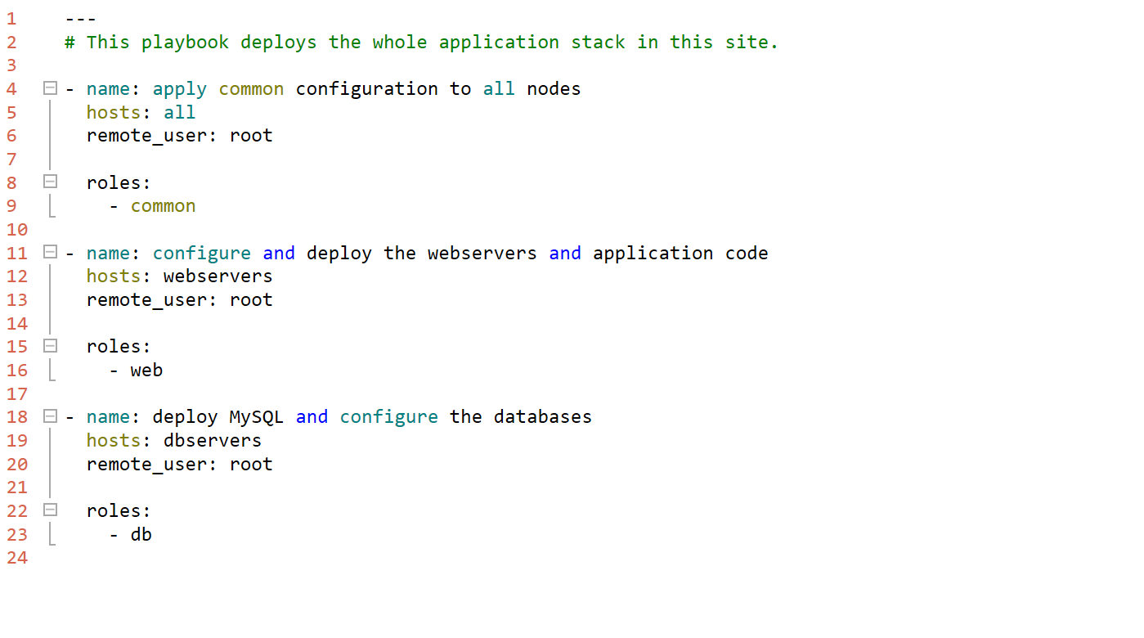
Ansible Sample

Slide 10
Ansible – known customers
Atlassian
Cisco
EA Sports
Evernote
Gartner
GoPro
Juniper
NASA
NEC
Twitter

Slide 11

Chef
Open-source and commercial editions available
Available for most common Linux Systems, OS X, AIX and Windows
Server oriented – standalone mode available
Configurations are written in Ruby
Recipes are written in Ruby
Central Chef Supermarket for recipes
https://www.chef.io/chef/

Slide 12
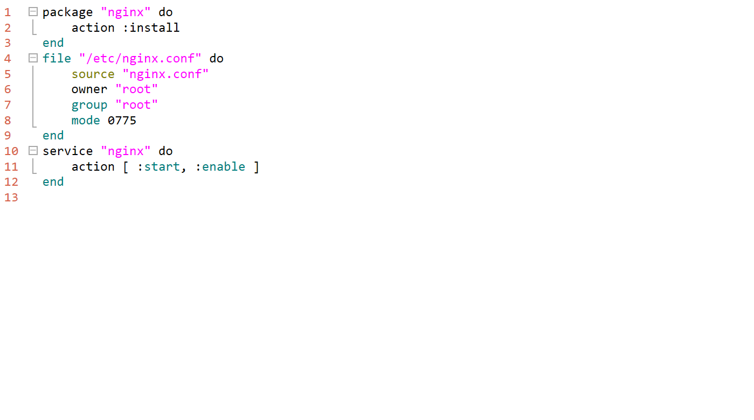
Chef Sample

Slide 13
Chef – known customers
Bloomberg
Facebook
HP Enterprise
IBM
Microsoft
Prezi
Yahoo
…

Slide 14

Puppet
Open-source and commercial editions available
Available for most Linux systems, few Unix systems and Windows Server
Client – Server oriented, standalone mode available
Configuration (called Manifests) are written in custom DSL
Modules are written in Ruby
Information about systems are collected by a component called “Facter”
Central module registry maintained by vendor Puppet Labs
Modules are created by Puppet Labs and the community
…
https://puppet.com

Slide 15
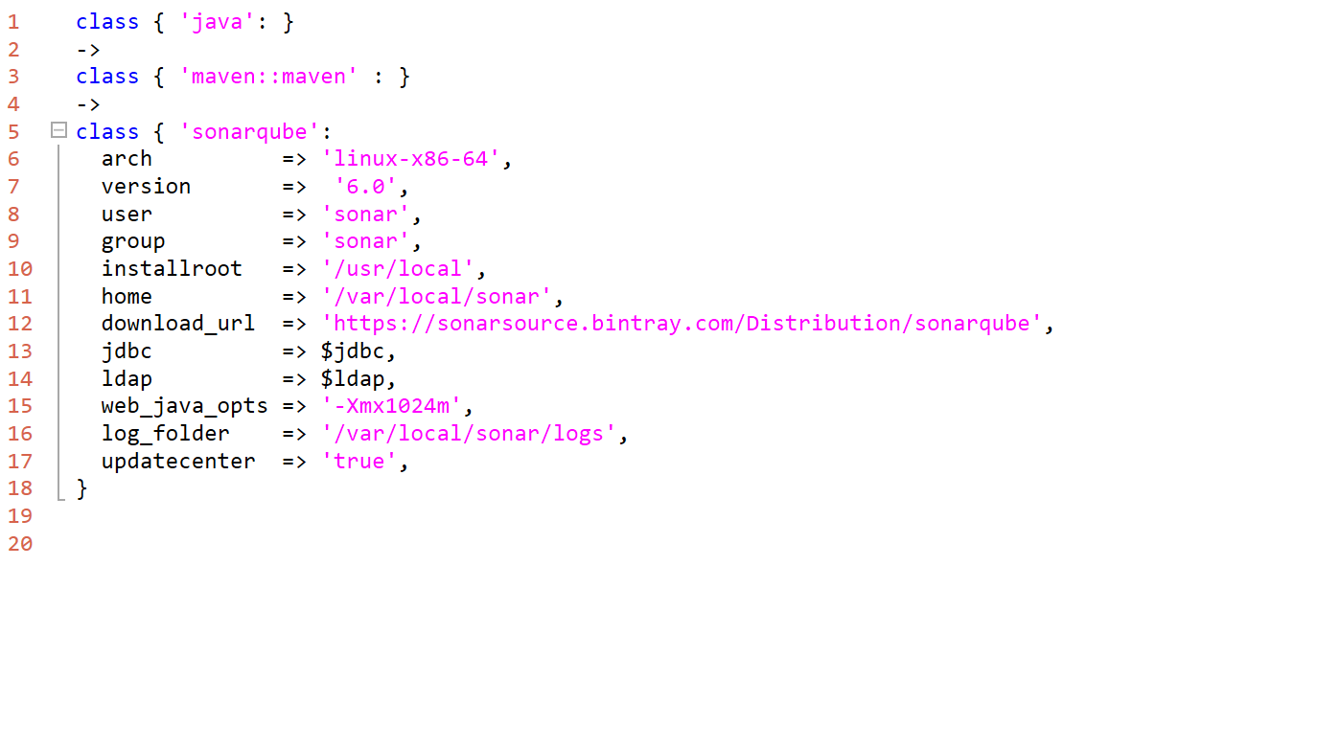
Puppet Samples

Slide 16
Puppet – known customers
at&t
Citrix
EMC
GitHub
HP
Jenkins
NetApp
Sun
…

Slide 17
Product overview
Name | Ansible | CFEngine | Chef | Machinery | Puppet | Salt
Vendor | Ansible HQ | CFEngine | Chef | SUSE | Puppet Labs | SaltStack
Release year | 2012 | 1993 | 2008 | 2014 | 2005 | 2011
Operating system | Unix/Linux Python 2.7 | SLES, Debian, CentOS, Windows | Debian, RHEL, Ubuntu, OSX | openSUSE, SLES, Fedora, CentOS, Ubuntu, Debian | Debian, Fedora, Ubuntu, CentOS, OSX, RHEL,… | Unix/Linux Python 2.6
Architecture | Server only | Client – server | Chef server, Chef local | CLI | Client – server, standalone | Client – server
Data model | Hosts, Playbooks, Roles, Modules, Attribute | Bundles, Policies, Promises | Environments, Nodes, Roles, Cookbooks, Attributes | - | Variables, Parameter, Manifests, Classes, Hiera | Pillars, States, Formulas, Modules
Inventory | Local only | Server | Local | Server | Local | Local

Slide 18
DNS as Code
Solution to manage DNS entries in an independant format
Enables administrators (or so called devops) to test the DNS settings and entries through continuous integration
Adapters available for:
Active Directory
BIND
CloudFlare
Google
…
https://github.com/StackExchange/dnscontrol

Slide 19
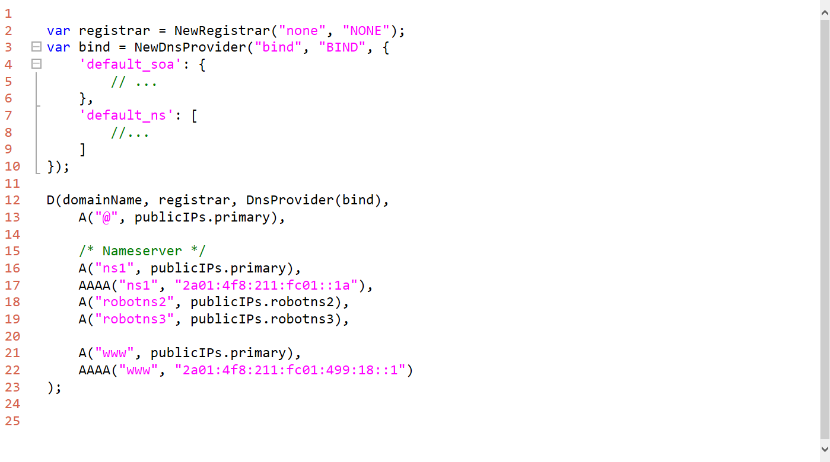
DNSControl – Sample

Slide 20
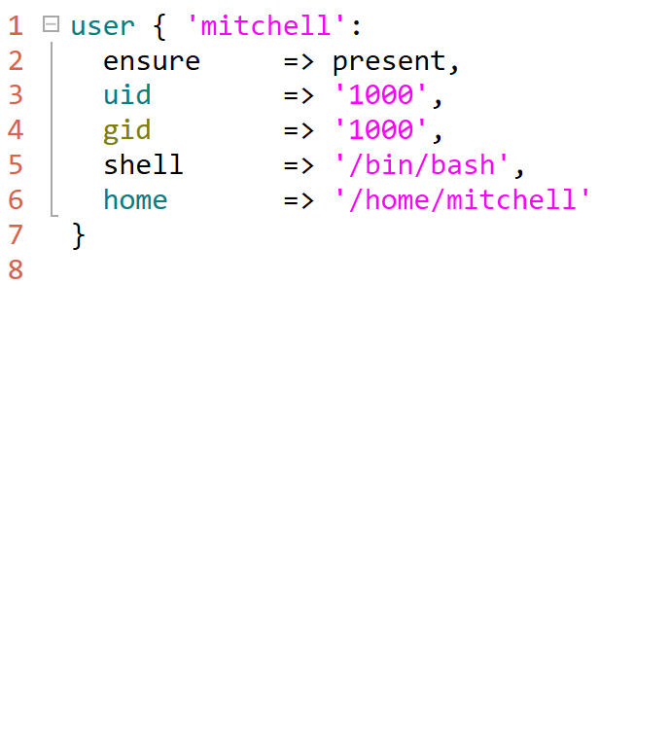
Puppet – Resources
Puppet is pure declarative
Everything is a resource
Resources may have parameters

Slide 21
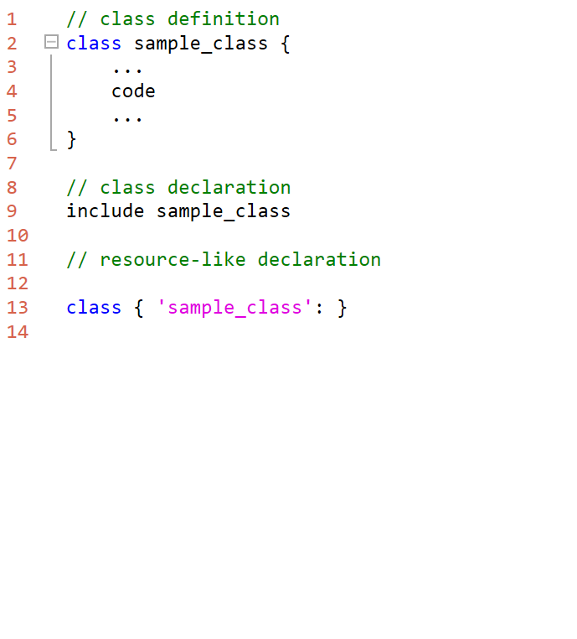
Puppet – Classes
Classes encapsulate code like in any other programming language
Classes are a construct to model reusable code
Classes are used in manifests
When a class is included, Puppet evaluates the code in the class
Classes may be used as resources to create “new” resources like an Apache web server or anything else

Slide 22
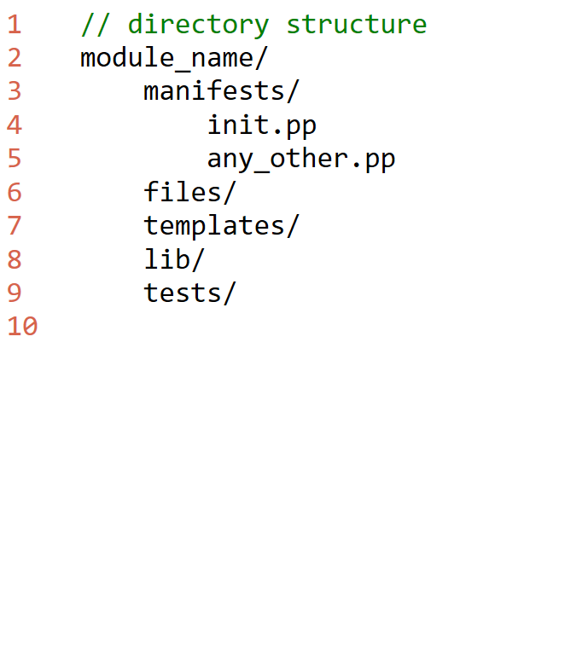
Puppet – Modules
Modules aggregate manifests
Contains:
Files
Templates
Classes
Ruby code for processing
Encapsulates management of a special resource or application (like SonarQube)

Slide 23
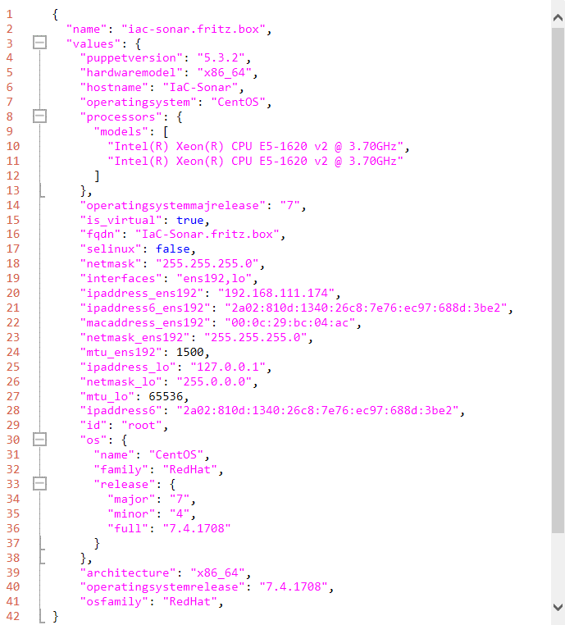
Puppet – Facts
Facter collects information about the local system
Collected information is used by modules, classes and manifests
Facter is very thoroughly!

Slide 24
Puppet – CLI
CMDlet | Explanation
puppet apply <path/to/file> | Applies given manifest to local host system
puppet module install <module name> | Installs a module to the local system
puppet module list | List all local installed modules
puppet facts | List local
puppet help | Displays the help of the Puppet CLI

