Slide 1
Microservices
Service Discovery

Slide 2
Content
Underlying concepts
Client-side discovery
Server-side discovery
Service registration
DNS
Key value stores
Specialized products (consul)

Slide 3
Introduction
Service discovery can be used for many tasks:
Service resolution for cross service communication
Dynamic load balancing configuration
Dynamic monitoring configuration
…
Approaches:
Static configuration files (forget about this…)
DNS
Dynamic solutions
Patterns:
Client-side discovery
Server-side discovery
Additionally a few products also include:
Configuration stores
Health checks (basically a kind of monitoring)
Events on changes (e.g. new services, changes in the configuration store…)
Notes:
~ is like dependency injection for network applications

Slide 4
Server-side service discovery

Slide 5
Server-side service discovery
Context:
Services are registered at a central service registry
Problem:
Service A wants to contact service B
Solution:
Service A contacts router
If router is not a service registry itself it contacts the service registry to get an address and port of service B
Router redirects request to instance of service B
Router redirects response to service A
We‘ll have a look at server-side service discovery next week in combination with API gateways.

Slide 6
Client-side service discovery
Notes:
B.1 and B.2 are two instances of the same service
Service A wants to talk to an instance of service B
Service A resolves one or all healthy instances of service B
Service A can contact service B (if it’s aware of the API)

Slide 7
Client-side service discovery
Context:
Services are registered at a central service registry
Problem:
Service A wants to contact service B
Solution:
Service A asks the service registry for one or all known instances of service B (depends on the kind of service registry)
Service A uses response of the service registry to contact service B directly (assuming service A is aware of the API of service B)

Slide 8
Service registration
Self registration
Every client/service registers himself at the service registry
Every client has to deregister himself on failures or when quitting
Every client has to deal with the API of the service registry himself
E.g. Netflix Eureka
3rd party registration
Clients/services are registered by a external instance
Whenever a client exits the external component deregisters him
The external component has to monitor every known service to ensure that it’s still available
E.g. registrator (Docker), Nomad

Slide 9
DNS – record types (selection)
Record name | Explanation
A or AAAA | Host entries (e.g. www.google.de – IPv4: 172.217.21.35 and IPv6: 2a00:1450:4016:80d::2003)
CNAME | Alias of a host entry (e.g. www.fh-rosenheim.de and fh-rosenheim.de)
SRV | Service location record (includes port of the service)
TXT | Often carries machine-readable data (often used e.g. for domain validation in Azure, C&C servers,…)
NAPTR | Name Authority Pointer – allows regular-expression-based rewriting of domain names (e.g. to form URIs)
https://en.wikipedia.org/wiki/List_of_DNS_record_types

Slide 10
DNS as service registry
A (or AAAA) can be used to locate services (a single A record may contain multiple IP addresses e.g. amazon.com )
SRV records are even better because SRV records also store the port of service
Every instance has to register itself at a DNS server or a 3rd party service has to look for new instances and register them within a DNS server
Developers and administrators are required to create a common schema for service naming

Slide 11
DNS – naming schemas
Schema example | Use case
<servicename>-<env>.domain.tld | All environments share the same domain/DNS server
<servicename>.<env>.domain.tld | Subdomain per environment (e.g. test.domain.tld and staging.domain.tld, keep prod on domain.tld)
<servicename>.env-domain.tld | Separate domains and DNS servers per environment

Slide 12
DNS as service registry
Pros:
Very easy to implement
No special software required
Most stacks already support DNS queries
Cons:
TTL of entries (stale entries)
Many points where DNS caching happens, difficult to invalidate if services are ephemeral
Dynamic registration difficult in self hosted environments (most DNS servers don’t have REST APIs)

Slide 13

ZooKeeper
One of the oldest tools which can be used for service discovery
Developed as part of the Hadoop project
Open-source – part of the Apache foundation
Hierarchical key-value store
Relies on running multiple nodes (recommended at least 3 nodes)
Can also be used as configuration store
Clients may subscribe to one or multiple keys to get notified when:
A new key was created
A key was deleted
A value was changed
…
Also used for Kafka, Cassandra,…
REST interface, client libraries available for many languages/ frameworks
https://zookeeper.apache.org/

Slide 14

Eureka
Developed by Netflix for their own microservice architecture/platform as open-source project (Apache 2.0 license)
Very targeted (in opposite to ZooKeeper and Consul)
Provides basic load balancing capabilities (round-robin lookup for services)
Java and REST API available
Clients have to register themselves (Netflix uses Eureka in every component so this isn’t a big deal for them); problematic in polyglot environments
https://github.com/Netflix/eureka

Slide 15

Consul
Developed by Hashicorp (in Go) as open-source project (Mozilla open-source license)
Can be used as configuration store
Developed to serve as service discovery (unlike etcd or ZooKeeper)
HTTP (RESTful) and DNS API (can be used as drop in replacement for an already existing DNS based solution)
Built-in functionality for health checks (HTTP checks, TCP checks, check for running Docker containers or custom scripts) to detect unhealthy services and exclude them from the discovery
Highly fault tolerant
Based on a Gossip protocol (Serf)

Slide 16
Gossip protocol
In Consul used to manage membership and broadcast messages
In Consul (Serf) based on Scalable Weakly-consistent Infection-style Process Group Membership Protocol (SWIM)
A gossip protocol satisfies the following conditions:
Periodic, pairwise, inter-process (or network) interactions
The information exchanged during these interactions is of bounded size
Agents are synchronizing their state when they interact with each other
Reliable communication is not assumed
The frequency of the interactions is low compared to typical message latencies so that the protocol costs are negligible.
There is some form of randomness in the peer selection. Peers might be selected from the full set of nodes or from a smaller set of neighbors.
Due to the replication there is an implicit redundancy of the delivered information.
Source: https://en.wikipedia.org/wiki/Gossip_protocol
SWIM

Slide 17
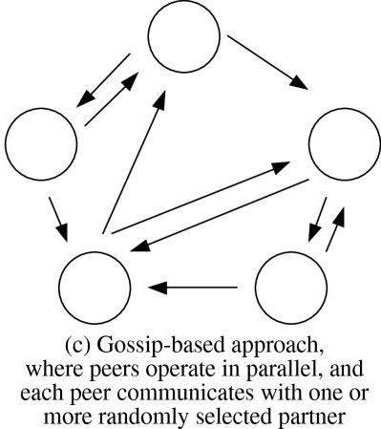
Gossip protocol – schema
https://jisajournal.springeropen.com/articles/10.1186/1869-0238-4-14

Slide 18
Gossip example – document search

Slide 19
Gossip example – document search

Slide 20
Gossip example – document search

Slide 21
Gossip example – document search

Slide 22
Gossip example – document search

Slide 23
Gossip example – document search

Slide 24
Gossip example – document search remarks
A search query should “age out” after a given time to reduce traffic
If there are many search queries a maximum of data that may be exchanged during one “gossip” has to be defined
Given a frequency of 10 gossips per second, a maximum of 30 rounds of gossip per search query and a network of 25.000 machines a query would take just about 3 seconds!

Slide 25
Raft consensus
Designed as an easier alternative to Paxos
Uses leader election to achieve consensus
Models a distributed state machine
Every node is a state machine
All nodes have to apply the same commands in the same order to stay in sync (same resulting state/transition)
Just one leader in a Raft cluster, all other nodes are followers
Leader is responsible for the log replication to all followers
Followers are expecting a heartbeat within a given timeout otherwise they suspect the leader failing
If a leader fails a new leader is elected
Visualization: https://raft.github.io/

Slide 26
Raft leader election
Leader election is started by a candidate server (a server that wasn’t contacted by the leader within the timeout period)
Candidate increments the term number (serial for periods where a leader was elected) and proposes itself as the new leader and sends a message to all other servers requesting their vote
If candidate gets a response with a term number at least as large as his current term number the election is defeated and the candidate is switching in follower mode
If the candidate server gets a majority of votes he’s getting the new leader
If neither happens (split vote) a new term is getting started (resulting in a new election)

Slide 27
Log replication
Leader replicates received requests (commands for the state machine) to all followers
Leader appends the command to his log as a new entry and sends a AppendEntry to the followers
When the leader receives confirmation of a majority of his followers he applies the entry to his state machine (request is considered committed )
When a follower learns that an entry was applied by the leader he applies the entry to his local state machine
In case of a leader crash the new leader enforces a replication of his log to all followers. To get a consistent state the leader compares his log with every log of the followers, takes the latest where they agree and replaces all following entries with his own

Slide 28
Raft – safety rules
Election safety (at most one leader can be elected in a given term)
Leader Append-Only (a leader can only append new entries to its logs - it can neither overwrite nor delete entries)
Log Matching (if two logs contain an entry with the same index and term, then the logs are identical in all entries up through the given index)
Leader Completeness (if a log entry is committed in a given term then it will be present in the logs of the leaders since this term)
State Machine Safety ( if a server has applied a particular log entry to its state machine, then no other server may apply a different command for the same log)
https://en.wikipedia.org/wiki/Raft_(computer_science)

Slide 29
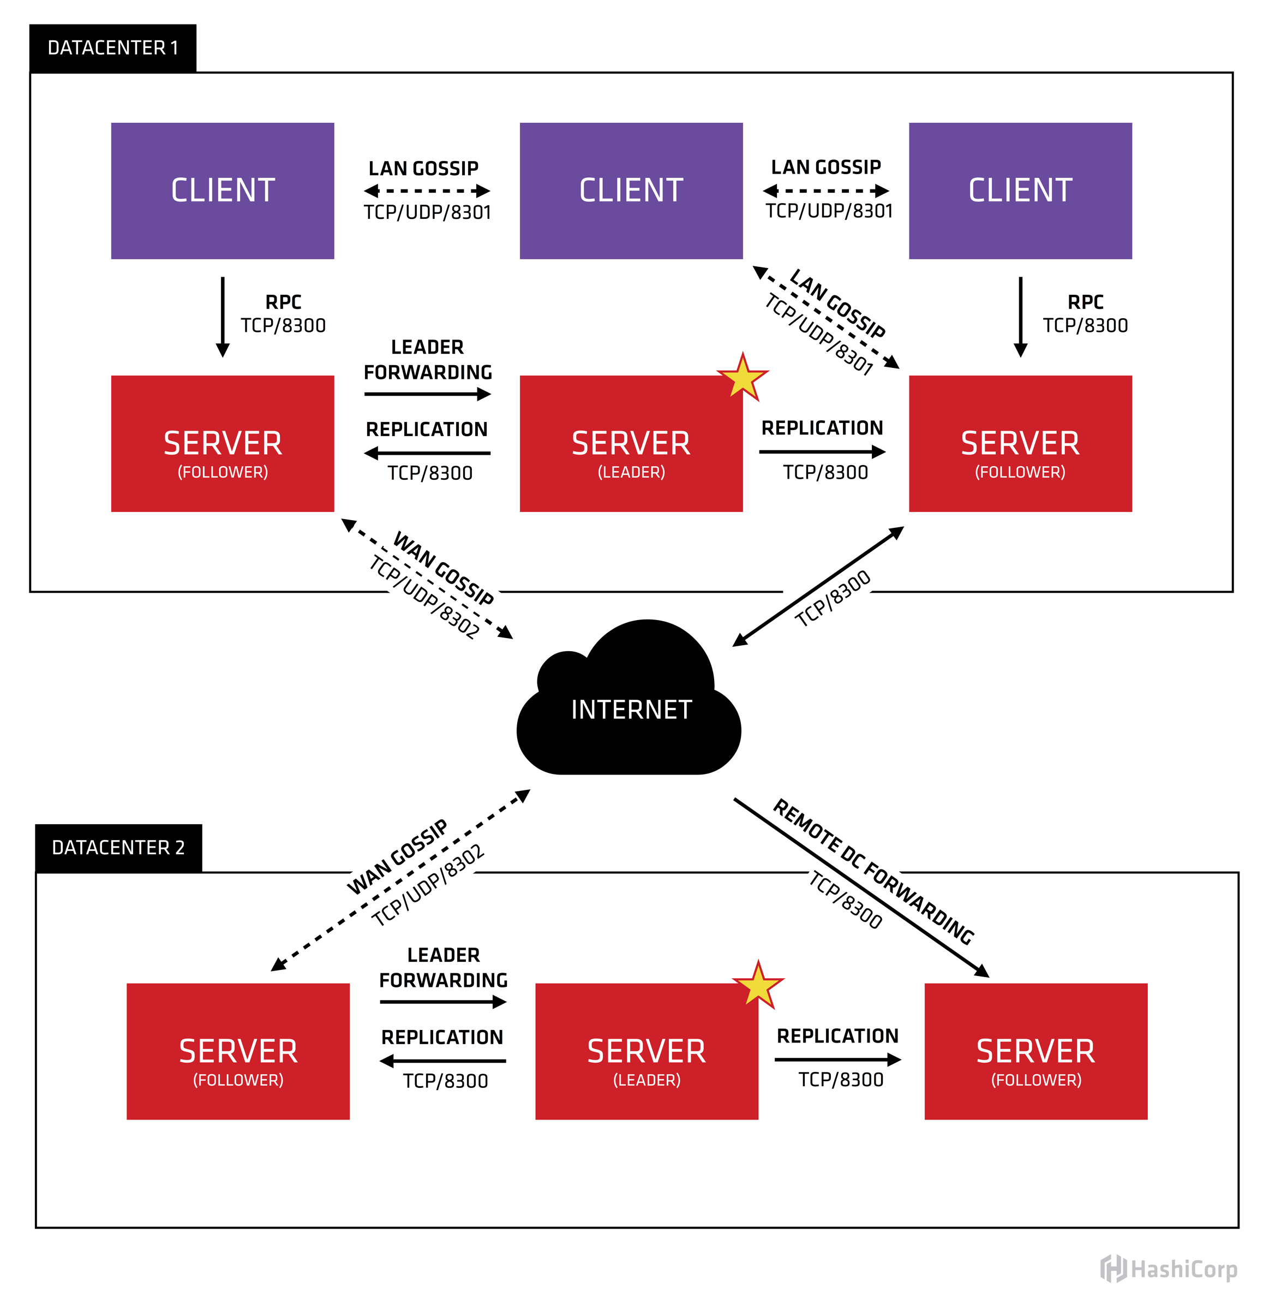
Consul architecture

Slide 30
Consul architecture – glossary
Term | Explanation
Agent | An agent is the long running daemon on every member of the Consul cluster. May be a client or server node (differences in WAN gossip)
Client | Forwards all RPC calls to a server. Only participates in LAN gossip.
Server | Expanded set of responsibilities compared to the client (Raft quorum, maintaining cluster state, …)
Datacenter | Defines a private, low latency, high bandwith areal

Slide 31
Consul architecture
Expected to be 3 to 5 server instances per datacenter
All nodes of a datacenter participate in the LAN gossip to determine which nodes are servers, doing heartbeats,…
All nodes in the server mode are part of a single Raft peer set to elect a single leader per datacenter. The leader is responsible for all queries and transactions in the datacenter
Server nodes are also participating in the WAN gossip pool. The WAN gossip pool exists to allow the datacenters to discover each other and is optimized for high-latency. Furthermore it’s required for cross-datacenter queries.
There’s no data replication between data centers. Queries are always forwarded to the leader of the remote datacenter!
https://www.consul.io/docs/internals/architecture.html

Slide 32
Consul advantages and disadvantages
Pro
Specialized for service discovery (has an understanding for services and instances)
Many tools available which intergrate well with Consul (registrator, Nomad, Vault, Fabio)
Integrated health checks
DNS interface
Con
Weak consistent
Client has balance traffic himself – Consul only tells him which instances are healthy or not
Training required – developers may train themselves but they have to understand the concept to avoid pitfalls

