Slide 1
Microservices
Monitoring and Logging

Slide 2


Slide 3
Content
Monitoring
Classical vs. „the new shit“
Active monitoring
Passive monitoring
Application metrics
Caveats in Microservice applications
Logging

Slide 4
Monitoring
Monitoring has 2 objectives:
detect errors as soon as possible
Avoid occurring errors (that‘s even better!)
You‘ve to distinguish between classical monitoring systems (targeting „classical“ infrastructure like physical and virtual servers) and „the new shit“
Depending on your environment you might need both
Classical systems:
Nagios/Icinga
Zabbix
PandoraFMS
„new shit“:
Prometheus & Grafana
Graphite & Grafana
ELK

Slide 5
Monitoring principles
Almost all classical systems are supporting polling of metrics
A few of them also support pushing of metrics e.g. with a local agent on every server
Both have advantages and disadvantages (discussed later on)
None of them is a perfect solution. You’ll want to achieve a “hybrid” solution by combining both principles to get all the information you need to determine if your system is healthy

Slide 6
Active monitoring
Active monitoring (polling) has an extrinsic view of the system to monitoring (good for availability and service integrity checks e.g. is the DNS server or web server running correctly)
It can detect if a server or a service is available and is behaving correctly
It can’t monitor resources like CPU usage, RAM usage, disk usage, disk I/O and so on (actually a few active systems do this by connecting via WMI or SSH but that’s more a hybrid solution)
Active monitoring is agentless so you don’t have to deploy and configure any additional component to your servers

Slide 7
Passive Monitoring
Passive monitoring (pushing) has an intrinsic view of the system to be monitored
It can detect if the actual service (in terms of systemd or Windows services) is running (e.g. Nginx, bind, IIS,…)
It can detect if the service is behaving correctly
It is able to monitor CPU usage, RAM usage, disk usage, disk I/O…
Passive monitoring requires a component on every system you want to observe
If the whole server fails the central system has to recognize that the system was lost (kind of active monitoring if you like)

Slide 8
Application metrics
Beside the classical monitoring metrics mentioned earlier we are required to collect metrics of our application/services
These metrics might include:
Success/error response rate
Response time statistics (max, min, median, average)
memory usage
CPU times
Message bus throughput
…
Nor active neither passive monitoring is by default able to collect these metrics, you have to implement custom endpoints to serve these metrics, custom middleware to collect these metrics, …
In addition you might want to add domain specific metrics (e.g. how often is a user viewing his profile page, how long does it take to execute a search and so on) as this can help you to decide which features are more important than others and which features are never used

Slide 9
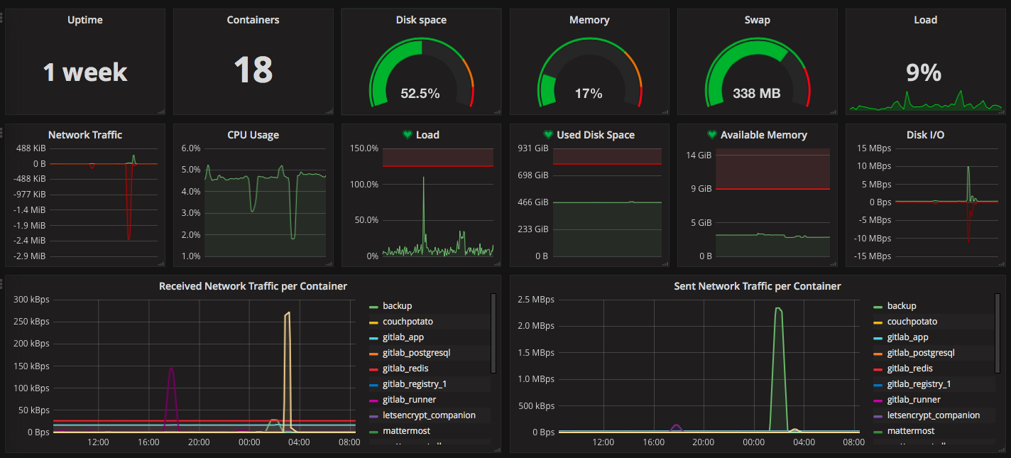
Application metrics

Slide 10
Caveats in Microservice applications
Equivalent to load balancers (see chapter 4) systems have to picked up by the monitoring when they’re started
Depending on the scale of your application the monitoring system has to keep track of many more systems
To get a high perspective, your system has to aggregate the collected information to determine if a service is healthy (in term of a component of your application architecture) as it might not matter if a single instance has a high load or is unavailable for a moment if there are other instances to keep your application up and running
To be able to analyze a certain error it’s also necessary to be able to go down the rabbit hole and inspect a single node
As you might have many servers and services the amount of collected could be huge. Your system has to be able to handle this amount of data or aggregate it to meaningful snapshots

Slide 11
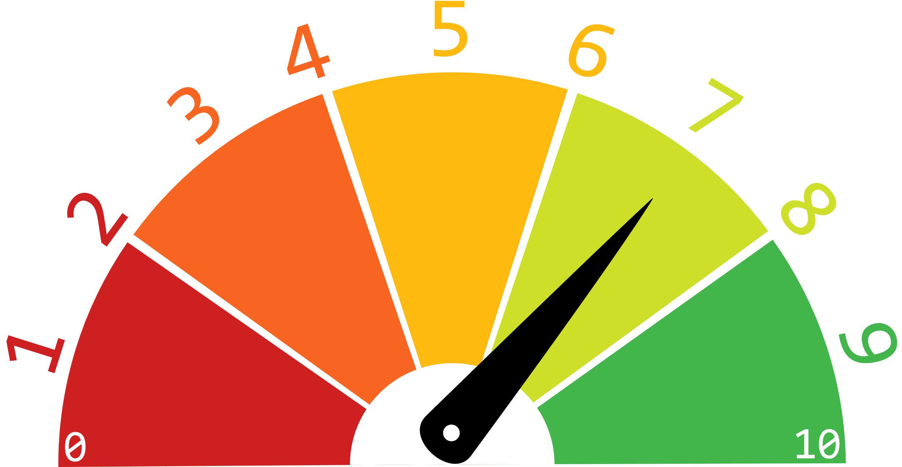
Valuation

Slide 12
Valuation
To decide if the current value of a metric is good, bad or just okay you have to have data to compare it to
Single datapoints might not be representative. It might be a better choice to trigger an alert only after several values.

Slide 13
Synthetic Monitoring
Synthetic monitoring is about is the system working
The advantage of synthetic monitoring is that it tests the whole system at once by executing regular tasks a regular users also executes
This sounds a lot like behavior driven development and E2E tests, doesn’t it? Well, if it sounds like a duck, and smells like a duck and behaves like a duck…it is a duck! Actually you could re-use (more or less) your already existing E2E tests (you implemented E2E tests, right?) for synthetic monitoring!
When it comes to implementing synthetic monitoring and you want to re-use your E2E tests you have to pay attention that you don’t trigger any side-effects by manipulating real user accounts, orders or anything else.
To avoid these side effects you could have test accounts, data, … in your production environment. This way you also have a discrete set of data you know when you implement the tests. This is also helpful when it comes to response validation.

Slide 14
Correlation IDs

Slide 15
Correlation IDs
From the moment when you have more than one service in your microservice application it might be the case that an interaction of a user might result in a cascade of events in multiple services (even if you avoided direct coupling)
When it comes to an error and you have to analyze how this error occurred you have to dig through your logs and trace the request from the beginning to the error site (think of a distributed stack trace)
If you don’t have any indicator which entries belong to the initial request you have to analyze all logs of a certain timespan and guess which entries are belonging together

Slide 16

Correlation IDs

Slide 17
Correlation IDs

Slide 18
Correlation IDs
A correlation id helps to aggregate logs belonging together
Whenever a service triggers an action of another service (directly or indirectly e.g. by enqueuing a message to a bus) it has to include the correlation id
Tools like Kong are providing plugins or mechanisms to add correlation ids
To avoid that a team mate forgets to include the correlation id it might be a good idea to handle the inclusion in a middleware component, a custom HTTP client wrapper, a custom event bus wrapper,…
Tools like ZipKin help to trace requests in distributed systems (but with extra costs!)

