Slide 1
Microservices
Monitoring and Logging

Slide 2
Content
Basics
Considerations
Service-to-Service Authentication and Authorization

Slide 3
Basics
Authentication the application confirms that a party is who she is e.g. by typing in a username and a password in classical applications but there are also other options like smartcards, 2FA and many more
Authorization Is an already authenticated user allowed this or not.
RBAC Role-based access control – determines what a user is allowed to do based on his assigned roles e.g. AUTOMOTIVE_TEAM_LEADER
ACL Access control list – captures a list of principals (maybe a single person or a group) with their access level e.g. Administrators – Full access Helpdesk – Read-Write access Any – Read access

Slide 4
Considerations
Does the API gateway handle all the authentication and authorization stuff?
If it does, how do you enable your developers to test their services in a production-like environment?
How fine-grained are your roles? (Organization structure!)
How many roles do you define?
Do you need an ACL approach (better you don’t!)
What about other security layers? Firewalls, encryption, message authentication codes(MAC),…
Never, never, never, never,… implement your own encryption algorithm!

Slide 5
Service-to-Service Authentication and Authorization
When you think of authentication and authorization most people think of people consuming your service(s) but that’s just half the truth. If you’re building a microservice application your services also have authenticate and authorize to be able to call other services!
First idea: well my services are protected by the firewall (internal perimeter) so…why should I care about authentication and authorization between them? What about man-in-the-middle attacks in the internal network?

Slide 6

Service-to-Service Authentication and Authorization

Slide 7
Service-to-Service Authentication and Authorization – HTTP(S) Basic Auth
Client sends username and password in an HTTP header (typically the Authorization header) in the format <username>:<password> e.g. YWhtZWQudGhlVGVycm9yaXN0OlNpbGVuY2UhMUsxbGxZMHU=
Seems cryptographic, doesn’t it? No! It’s just a Base64 encoded string…
You’ll need HTTPS for your cross services calls to ensure that the credentials are not getting stolen
Public certificates are expensive (depending on the security level), the management of local PKI seems easier as it is (revocation of certs, …)
How do you validate the username and the password? Local credentials store, LDAP, Single-Sign On (SSO) provider?
Solution 1: Use a SSO if possible (we’ll have at how to do this later on)
Solution 2: Client certificates (we won’t go into this, ask if you would like to know how this works)

Slide 8
A few word about service accounts
Any service should have his own service account
The password of a service account can be as complex as you can think as no one ever has to type or remember it (you got me right? never!)
Change the passwords of the service accounts frequently (frequently does not mean every 5 years)
A service account is always as limited as possible e.g. if the account does not have to log on to a machine it should not be able to do it!
There are tools available to handle the creation, deletion and management of service accounts for different systems like Hashicorp Vault

Slide 9
HMAC over HTTP
Repetition: a message authentication code is based on hashing operation. It takes the body, creates a hash of it based on a public key as kind of signature procedure and add the signature to the request. The server takes the signature validates it with his private key and drops the request if the validation failed.
Advantages:
By checking the signature man-in-the-middle attacks are (mostly) impossible
May be faster that HTTPS
Traffic is cacheable as no HTTPS is required
Disadvantes:
No default implementation
PKI needed to provide certificates (revocation problem)
Certificates have to be distributed over a secure connection
No encryption, just source validation!
Alternative: JWT (JWS/JWE)

Slide 10
„API Keys”
Everyone has heard about “API keys”
There’s no default mechanism to create an API key
There may be just one hard coded API key, one API key per user or multiple API keys per user (with different access rights/roles/claims)
You could use public-private keys to generate APIs or so many other procedures…
We won’t look any further as it depends on your use case, technical infrastructure any more how you could implement an API key and there are other ways to solve this which are standardized (Oauth/Oauth2, OpenID Connect)

Slide 11
Confused deputy problem

Slide 12
Confused deputy problem
So you have authenticated a user by its username and password
The username interacts with your online shop service – till now all is fine
but now you online shop service has to contact the shipping service and the order service to get some additional information (you’re right, that’s evil! But let’s assume it for a moment.)
How should the shipping service or order service authenticate themselves the user when the information about the principal is gone in the SSO gateway or the scope of the token (we’ll have a look at scopes later on) does not include the shipping service and the order service?
There’s no easy solution for this! You might choose to trust the online shop service, you might pass the access token through the SSO gateway or do a kind of cross service call

Slide 13
A few advisories
If you have to do password hashing and validation on your own, do it right. Use algorithms that are meant to be used for that:
PBKDF2: is designed to be slow on CPUs, unfortunately not on GPUs
BCrypt is not just optimized to be slow on CPUs but also to be memory-intensive so it should be harder to be implemented on GPUs and ASICs
If you have to do encryption use the currently recommended encryption algorithms (AES256) and don’t implement on your own! If you are not sure what is recommended have a look here
If you have to do cryptographic signing (you also got it, don’t it on your own) if possible use elliptic-curve cryptography! Otherwise RSA4096 is told to be safe for the next years (but not post-quantum)
If you have to store certificates, have a look what your platform is offering you (e.g. Windows cert store, TPM,…)

Slide 14
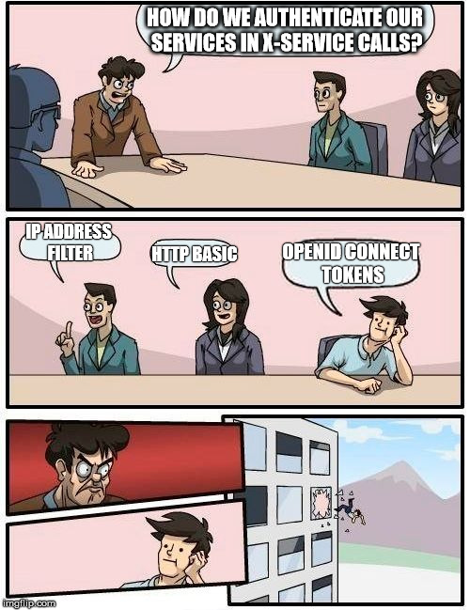
Service-to-Service Authentication and Authorization

Slide 15
Single-Sign On (SSO)
SSO is great!...but what is it?
Most of the time you’re speaking about SSO you’re meaning ticket based SSO (there’s a second variant called local SSO but that’s more like a password safe than a real protocol)
SSO means that you’re proving that you are who you are to one central party and that party hands you over a token
Whenever you’re accessing another resource and you’re required to authenticate you’re doing it with the help of the SSO token to avoid passing your credentials to another resource than the central party
There are a few of SSO protocols which are well known (and some not so well known):
OAuth
OAuth2
OpenID Connect
Security Assertion Markup Language (SAML)
Kerberos

Slide 16
OAuth2
As OAuth has a few design flaws it was abandoned and replaced by OAuth2
OAuth2 was developed as an authorization protocol (not for authentication!)
OAuth2 is based on JSON (in the opposite to SAML which is based on XML and SOAP – is anyone remembering SOAP?)
OAuth2 was originally developed by Twitter (2006) to delegate access rights to other applications
Since 2012 it is standardized in the RFC 6749

Slide 17
OAuth2 – Roles
There are 4 roles in OAuth2:
Resource owner
Resource server
Client
Authorization server

Slide 18
Resource owner
Definition of the spec: An entity capable of granting access to a protected resource. When the resource owner is a person, it is referred to as an end-user.
So the resource owner is the one who’s authorizing an application to access his data – you’re well aware of this grant process as you all did it already multiple times!
Note that there may be edge-cases where a resource owner isn’t asked to grant any access. E.g in enterprise environments where the data is not owned by a single user but by an company and the company decides to share the data.

Slide 19
Resource server
Definition of the spec: The server hosting the protected resources, capable of accepting and responding to protected resource requests using access tokens.
Every application which stores data of you is a resource server. E.g. the internal GitLab instance stores your students contact data, your activity, your repositories and many more. If you’re installing the LabCoat app on your mobile the app needs access to your GitLab account to be able to display your repositories and so on, so the GitLab server is the resource server. But when you’re importing a GitHub repository to GitLab, GitLab needs access to your GitHub account so a resource server may also be a client at the same.

Slide 20
Client
Definition of the spec: An application making protected resource requests on behalf of the resource owner and with its authorization. The term „client“ does not imply any particular implementation characteristics (e.g., whether the application executes on a server, a desktop, or other devices).
According to the spec a client may be any application that requests data.
As already mentioned a resource server may also be a client at the same time.

Slide 21
Authorization server
Definition of the spec: The server issuing access tokens to the client after successfully authenticating the resource owner and obtaining authorization.
The authorization server is the central party handing you over an access token (the term access token is special in OAuth2)
The authentication process is not specified so it may be with username and password, username, password and OTP, smartcard,…

Slide 22
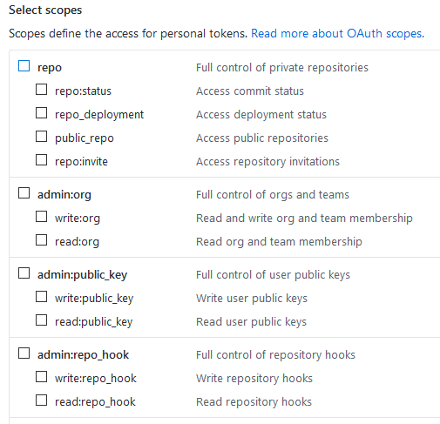
OAuth2 – Scopes
Scopes are defining a kind of roles on APIs
A client has to require scopes to be able to access the APIs grouped in the scope
On the right is a screenshot from GitHub which show a few of the available scopes GitHub offers when you create access tokens
Multiple resource servers may share one scope but it’s also possible to have multiple scopes on one resource server

Slide 23
OAuth2 – Tokens
OAuth2 differs between the following two types of tokens:
Access tokens
Refresh tokens

Slide 24
OAuth2 – Access tokens
Access tokens are short living (between a few minutes and a few hours)
Access tokens are required by the client to access resources served by resource servers
The access token contains the granted scopes
The OAuth2 spec nor does specify how a access token should look like (JWT, Bearer,…) neither does it specify what exactly should be contained in it. So it depends on the provider of the token
But when this token exceeds within a few minutes, why isn’t the client repeatedly asking for my credentials you ask?

Slide 25


Slide 26
OAuth2 – Refresh tokens
Depending on the flow a client receives with the access a second token called refresh token
In contrast to the access token the refresh token a very long lifetime (can be over a year)
The refresh token also contains the information which scopes where granted and for which client the access was granted
The refresh token has to be stored secured in the client
When the access token exceeds the client is able to fetch a new one by passing the refresh token to the authorization server
On the one hand that’s pretty nice because whenever a token is lost an attacker can’t do much with it because of the short lifetime but on the other hand if the refresh token is stolen you have real problem!

Slide 27
OAuth2 – Client registration
To be able to interact with an authorization server it’s not enough to just know its address but the client has to be registered within the authorization server
The registration at an authorization server typically requires two parts:
The client type (confidential or public)
A redirect URI
OAuth2 providers are allowed to require more information for the registration, e.g.:
Name of the application
Description
Logo
License terms
…
When the registration is completed you’re getting a client id and a client secret where the client id is kind of a username and the client secret is kind of a password (and they should be handled equivalently)

Slide 28
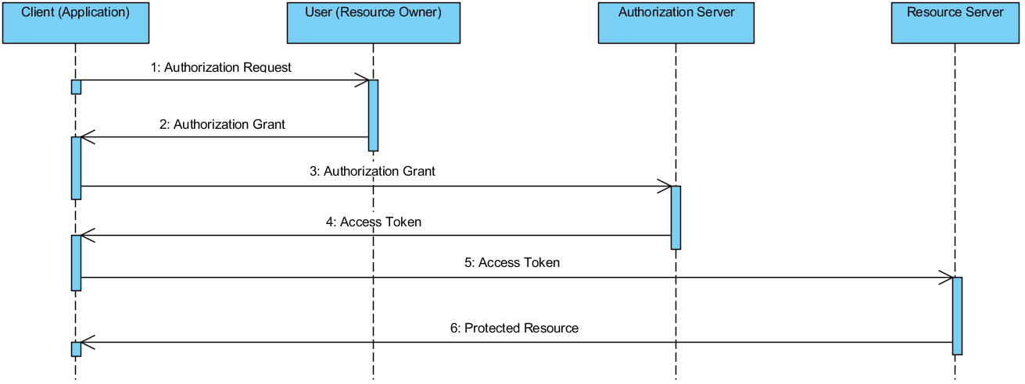
OAuth2 – the abstract flow

Slide 29
OAuth2 – Flows
Flows are describing the interaction between the different roles specified in OAuth2
The abstract flow is meant as an orientation and can be interpreted likes this:
The application (or client) asks for access to resources/scopes of the user
User grants access (application gets an so called authorization grant)
The application claims for an access token by sending the authorization grant and its identity (client id and client secret) to the authorization server
If client id, client secret and authorization grant are valid the application get’s an access token
The application can now access resources of the user at the resource server
OAuth2 is aware of the following Flows:
Authorization Code
Implicit
Resource Owner Password Credentials
Client Credentials

Slide 30
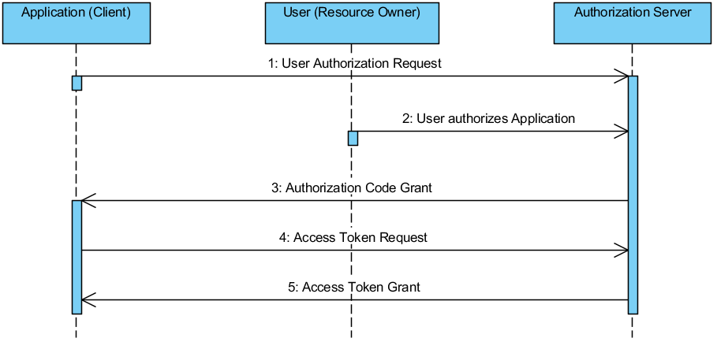
OAuth2 – Authorization Code flow

Slide 31
OAuth2 – Authorization Code flow
The Authorization Code flow requires the client to include its client secret when it claims for an access token. Because of that this flow is mostly used within classical web applications like JSP/JSF or ASP.NET MVC where the backend can store the client secret securely
A prerequisite for this flow is that the application can force the user agent to follow redirects to route the user agent at first to the authorization server and afterwards back to the client application including the authorization grant included as query param
The flow is proceeded like this:
The client claims for access to user resources by routing the user to the authorization server
User (resource owner) grants access
Authorization grant gets redirected to a previously registered callback URL
Client can acquire an access token by sending the authorization grant, the client id and the client secret to the authorization server
If all params were valid the client gets an access token (and a refresh token)

Slide 32
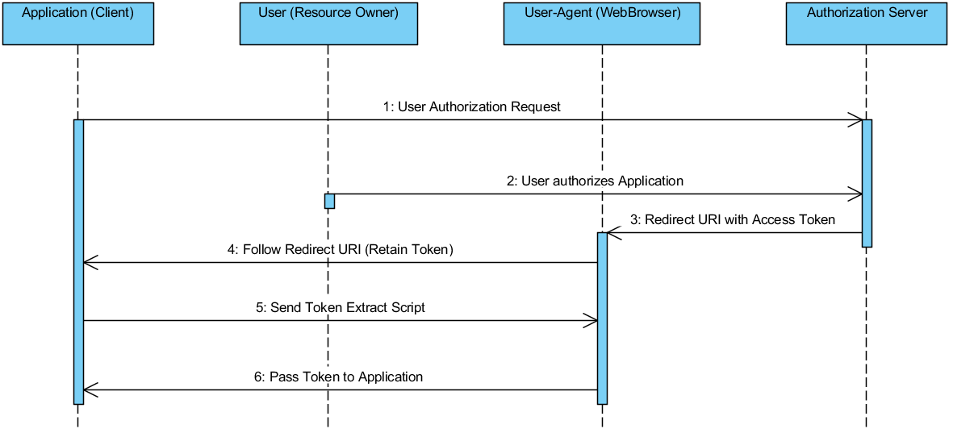
OAuth2 – Implicit flow

Slide 33
OAuth2 – Implicit flow
The Implicit flow is designed for mobile and browser apps where confidentiality can not be guaranteed
Within the Implicit flow the access token is directly handed over to the user agent of the user
Because of the missing confidentiality there’s no refresh token when the Implicit flow is used
The flow works like this:
The client redirects the user agent to the authorization server for claiming access
User has to grant the access
User agent is redirected to an previously registered callback URL including the access token (no authorization grant!)
User agent follows the redirect
Script in the browser is triggered by the URL and extracts the access token
Script passes token to the application

Slide 34
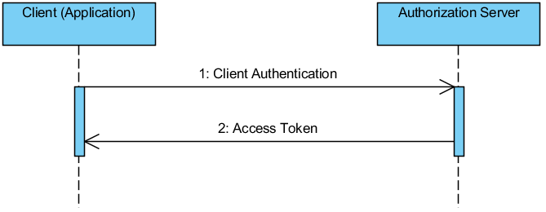
OAuth2 – Client credentials flow

Slide 35
OAuth2 – Client credentials flow
The client credentials flow is designed for cross service calls
Furthermore this workflow can be used if the service is updating its metadata stored at the authorization server
Within this flow service A creates an access token with his own client credentials (client id and client secret)
The flow works like this:
Client sends his own client id and client secret to the authorization server
Client receives access token and can access his own API

Slide 36
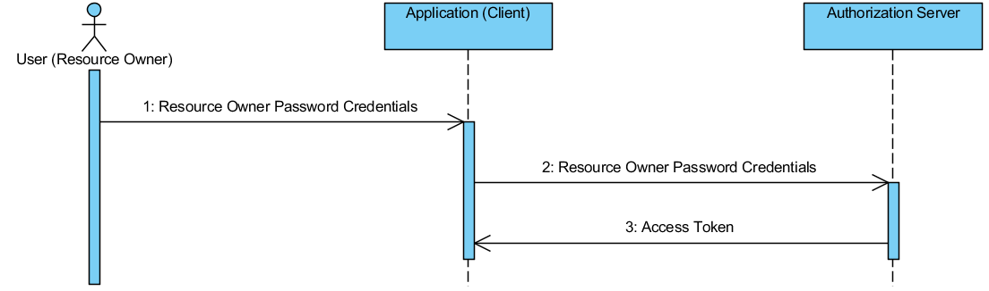
OAuth2 – Resource owner password credentials flow

Slide 37
OAuth2 – Resource owner password credentials flow
The resource owner password credentials flow is based on letting the user pass his credentials to the client and the client sending his credentials to the authorization server.
Because most OAuth2 providers don’t want their users to expose their credentials to 3rd party apps this flow is often not implemented
The flow works like this:
User passes his credentials to the client
Client passes the credentials to the authorization server and applies for a access token
If the credentials were valid the client receives an access token

Slide 38
OAuth2 – Conclusion
Scopes are a nice abstraction to tell the user which permissions he’s granting the client
The predefined flows are containing everything you need for a microservice application
OAuth2 is no identity framework but an authorization framework
It can be used as an identity framework too but a developer doing this has to know what he’s doing as there may occur security leaks if he doesn’t

Slide 39
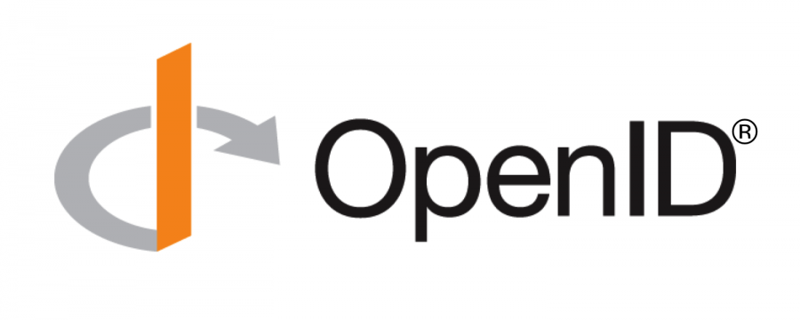
OpenID Connect
OpenID Connect was designed a an identity framework
It is based on OAuth2
OpenID connect is much more restrictive than OAuth2 as it specifies a token format, some default claims a token has to contain, API endpoints with special routes that have to exist and much more
Special attention was paid on interoperability within different providers

Slide 40
OpenID Connect
OpenID Connect consists of the following three parts:
Core (token specs, flows, endpoints, claims, implementation advises and security remarks)
Discovery (assists users to log on to an application with an account of a provider completely unknown prior to the first log on of the user, relies on WebFinger, exposes the endpoints /.well-known/webfinger and /.well-known/openid-configuration for dynamic configuration of a new application)
Dynamic client registration (without this concept a discovery of a new OpenID Connect provider would be useless. Enables applications to register themselves on the fly if required)

Slide 41
OpenID Connect – Tokens
As already mentioned OpenID Connect is much more restrictive than OAuth2 and defines the concrete format and even the content of all tokens
OpenID Connect uses JWT (but you can choose between JWE and JWS) for all tokens
OpenID Connect is aware of the following tokens:
Identity token
Access token
Refresh token

Slide 42
OpenID Connect – Tokens – Identity token
The identity token is kind of a passport of a user
It has to contain 20 claims e.g.:
Sub
Name
Nickname
Prefered_username
Profile
Email
…
The identity token can be used for many use cases, e.g.:
Stateless sessions
Identification at 3rd party apps
Key exchange (to get an access token)

Slide 43
OpenID Connect – Tokens – Access Token
Like OAuth2 OpenID Connect specifies an access token
The functionality is equivalent to OAuth2
If the app only claims for the scope “openid” the response will only contain an identity token but no access token

Slide 44
OpenID Connect – Flows
OpenID Connect specifies just 3 flows:
Authorization Code (is like in OAuth2)
Implicit (is like in OAuth2)
Hybrid (this one is a little bit tricky)

Slide 45
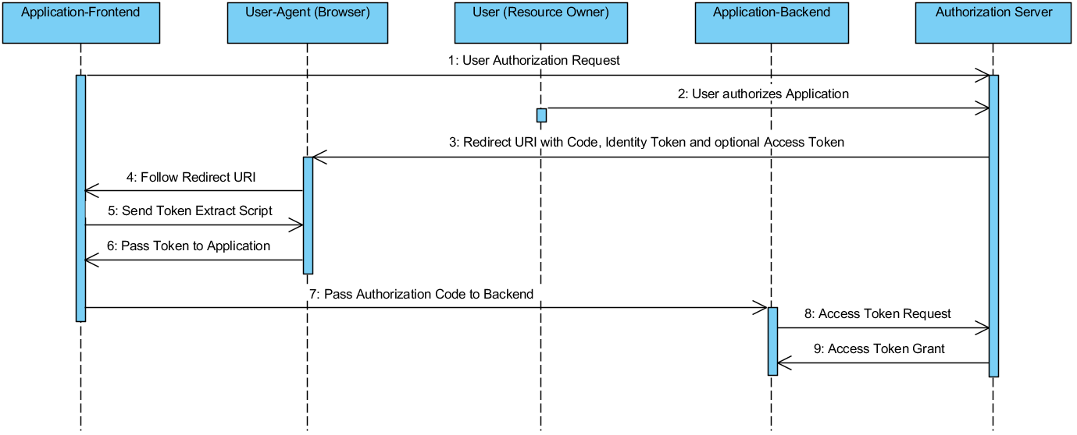
OpenID Connect – Hybrid flow

Slide 46
OpenID Connect – Hybrid flow
The Hybrid flow is mixture of Authorization Code and Implicit flow
It’s try to compensate the disadvantages of the Implicit flow by added a refresh token which is only available in the backend of an application but not in the (unsecure) frontend
The flow works like this:
Frontend applies for access to resources of the resource owner
User grants access
Authorization server redirects user agent to previously registered callback URI
User agent follows redirect including the encoded identity token and optionally encoded access token and authorization code
Frontend extracts identity token and optionally the access token and authorization code
Script passes extracted token(s) to frontend application
Optionally: backend retrieves refresh token with with the authorization code
If params are valid backend retrieves refresh token

Slide 47
OpenID Connect – overflow
Property | Authorization Code Flow | Implicit Flow | Hybrid flow
All tokens from authorization endpoint | Yes | Yes | No
All tokens from token endpoint | Yes | No | No
Tokens exposed to user agent | Yes | No | No
Client can be authenticated | Yes | No | Yes
Refresh token possible | Yes | No | Yes
Communication in one roundtrip | No | Yes | No
Communication mostly server to server | Yes | No | Varies

