Slide 1
ENGI 301 Frameless Laser Harp Proposal
9/26/2022
Angus Jelinek

Slide 2
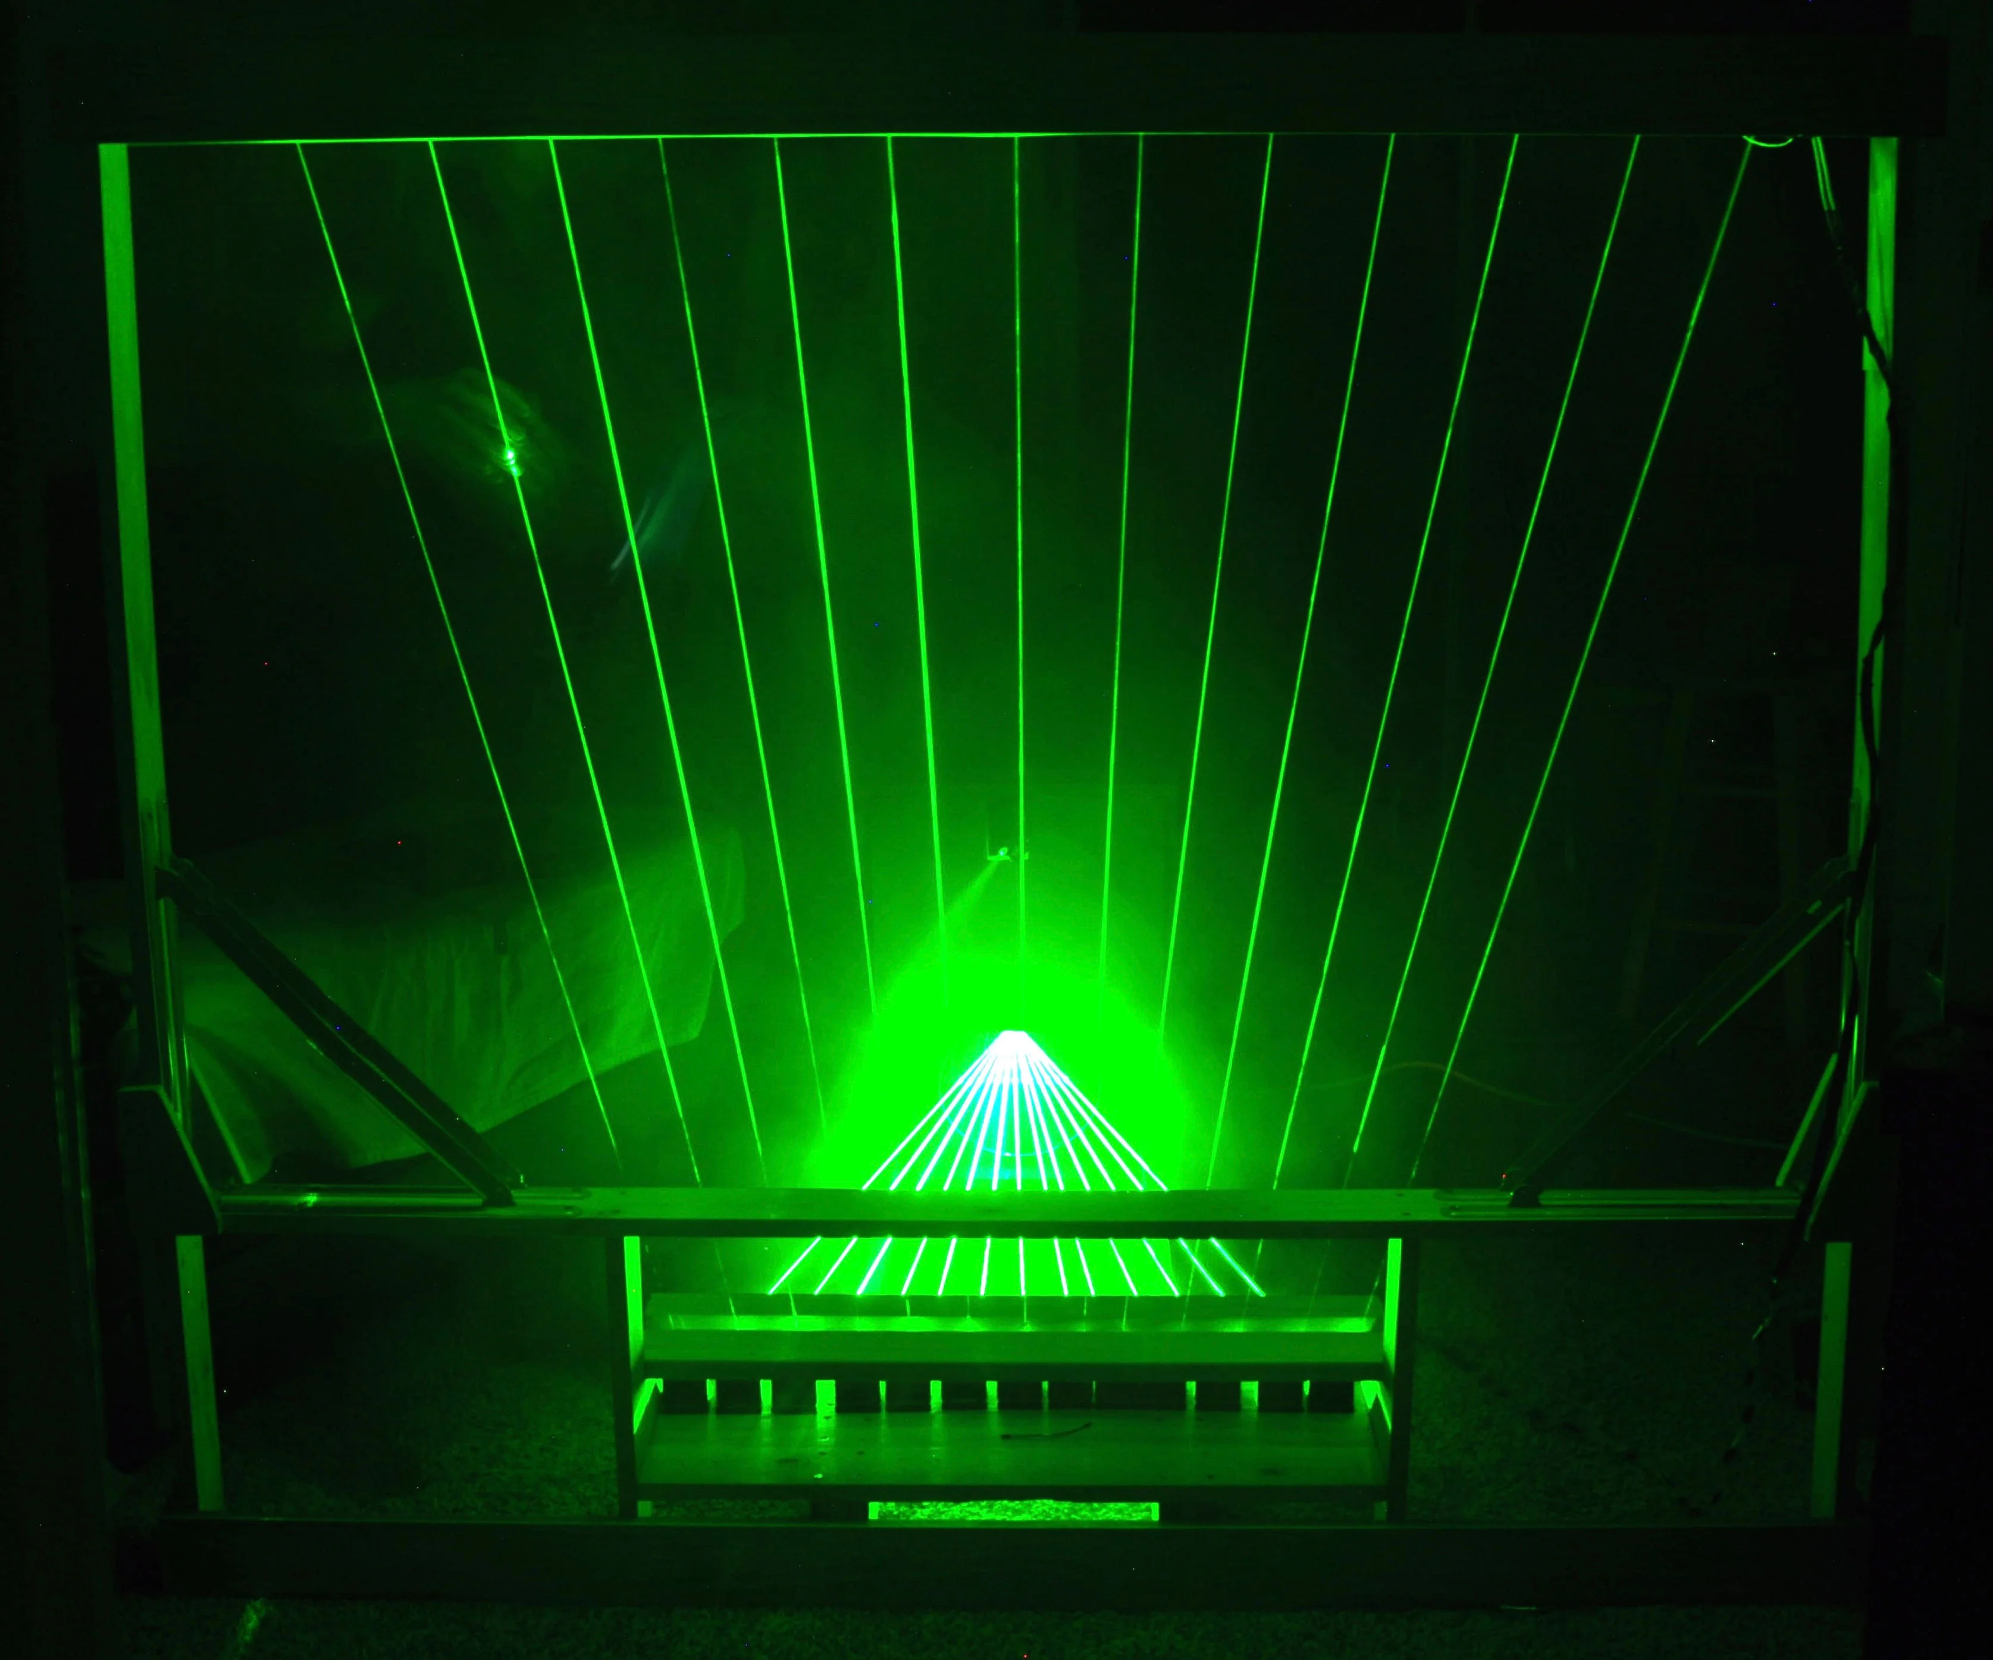
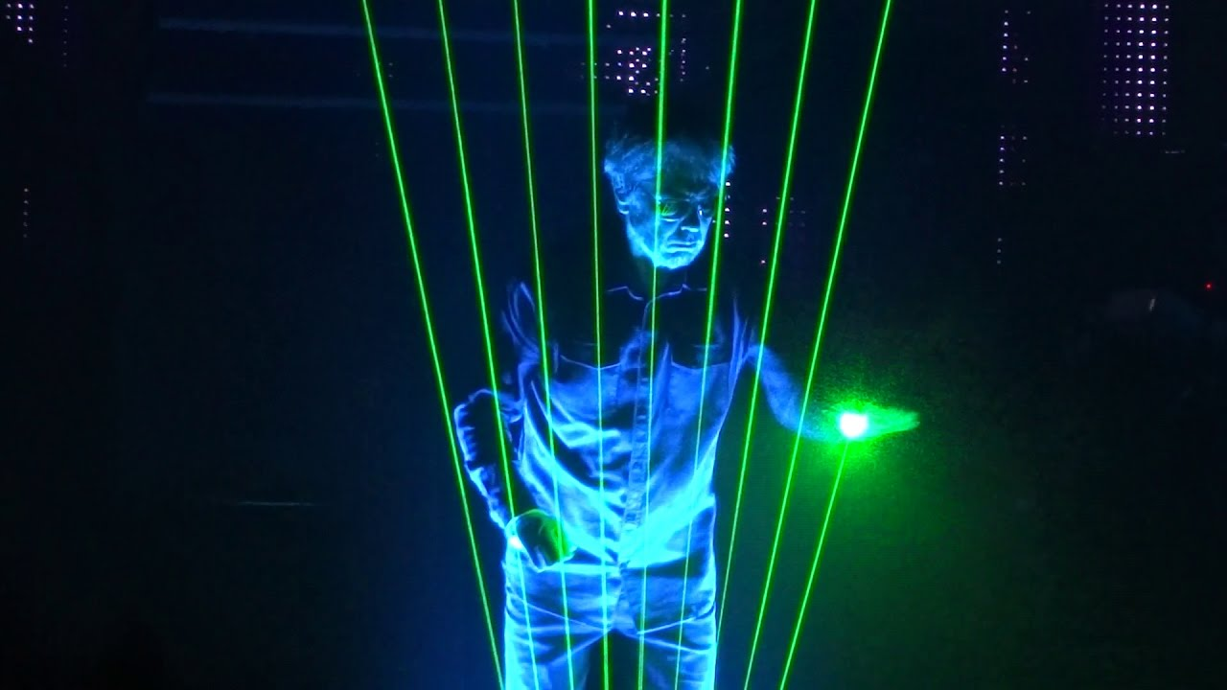
Background Information
I’ve always been interested in the intersection of electronics and instruments. In 2012 I went to the New York Maker Faire by Make Magazine. They had a laser harp on display; after playing it, I knew I wanted to build one.
There are two main variations of laser harps. Framed harps and unframed harps. The framed style uses an array of photoresistors inside the upper or lower part of the frame to detect the blocking of the laser beams. This is the more simple design.
I am interested in the unframed style. This style of laser harp is generally built using a single laser, splitting its beam into an array of beams in parallel or fan arrangement, relying on reflecting the light to a single photoresistor to determine which beam the player is blocking.

Slide 3
Background Information
I plan to make an unframed laser harp but improve on the current standard design. Instead of just sensing if the beam is broken, I want to estimate where the beam is broken to express how loud a note should be played. I believe that from here, I can iterate on this design with other features, such as adding special effect pedals.
There are currently many laser harp tutorials online, so getting a working design should be relatively straightforward.
https://www.instructables.com/13-Note-MIDI-Laser-Harp-Controlled-by-Arduino/
https://www.instructables.com/Frameless-Laser-Harp/
https://www.instructables.com/Easy-and-cheap-Laser-Harp/

Slide 4
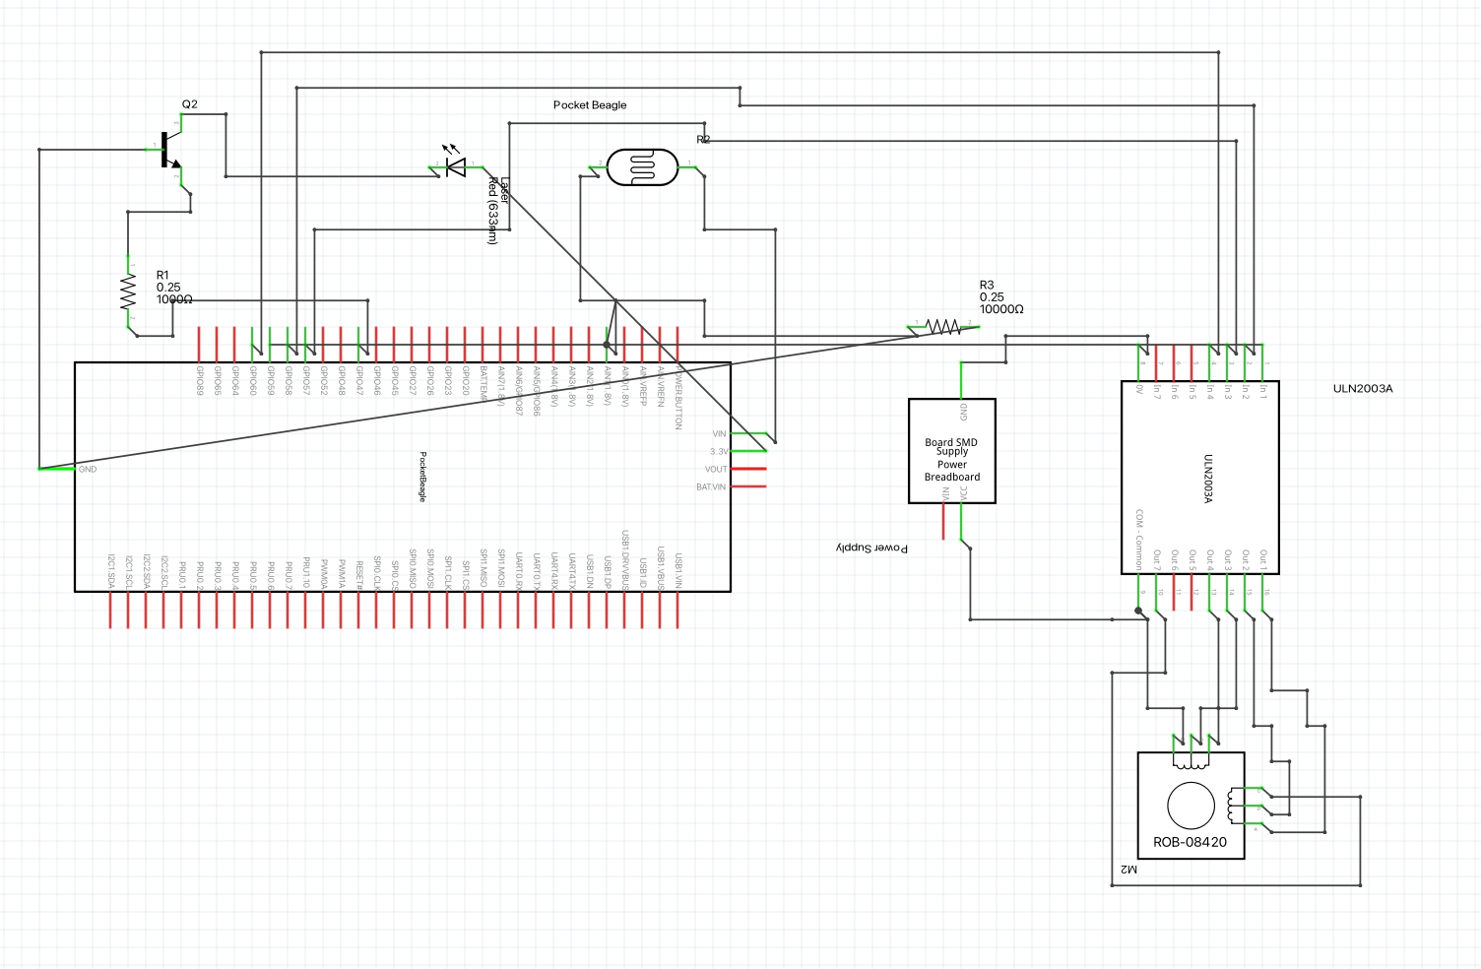
System Block Diagram
Need Moderate Level of Detail

Slide 5
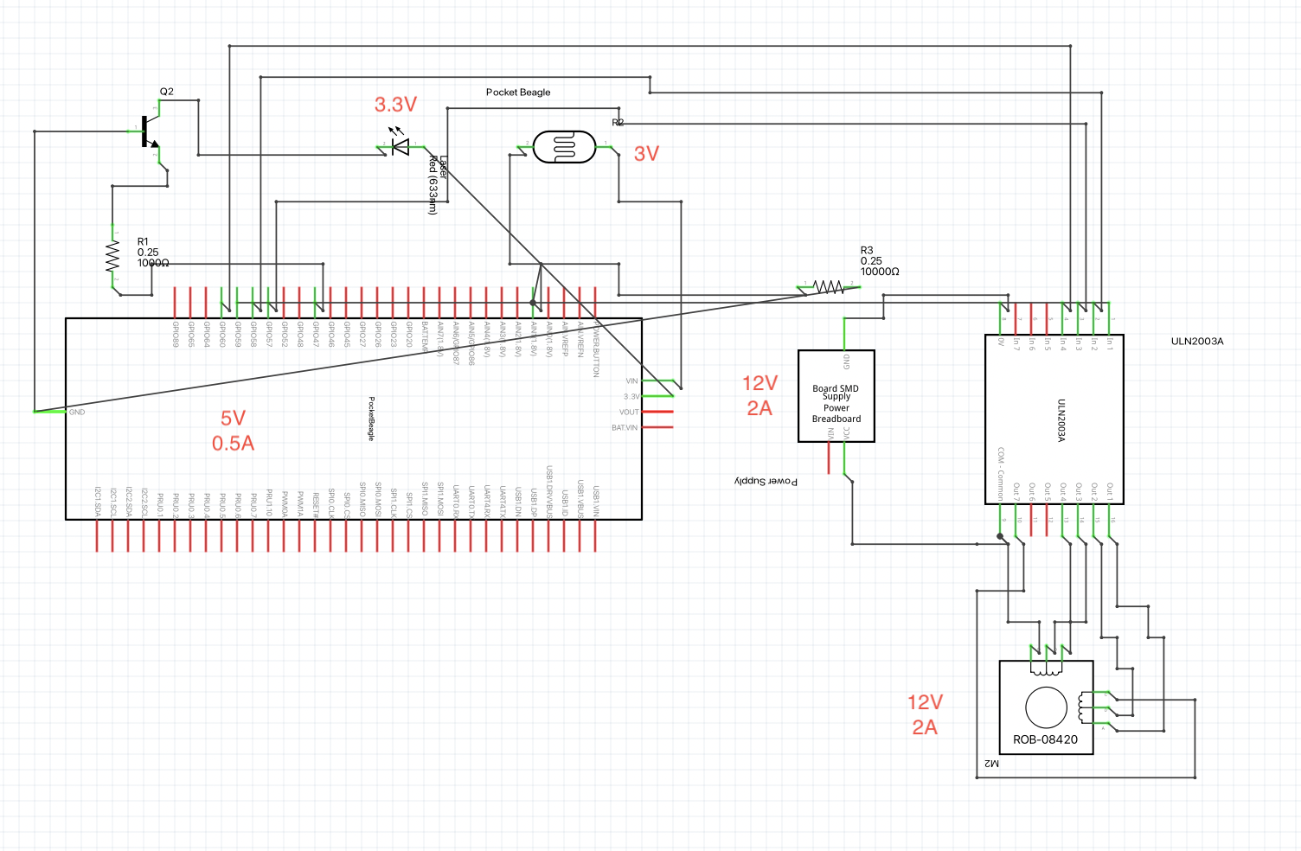
Power Block Diagram
Create a Power Block Diagram
Label voltages / currents of components
Need All Power Inputs and Outputs

Slide 6
Components / Budget
Component | Need to Buy | Cost
Laser Diode | Yes | ~15
12V DC Power Supply | Yes | 12
Stepper Motor | Yes | 20
ULN2003a | Yes | 0.80
3cm mirror | Yes | 7
LDR, Resistors. 1kΩ and 20kΩ | No | 0
Transistor 2N3904 or 2N22 | No | 0
modelling clay | Yes | 5
Wires | No | 0
Pocket Beagle | No | 0
Total |  | ~$60
Need all components to be purchased by instructor listed; additional components may be purchased by student

