Slide 1
Business expansion suggestion report
Sarthak Pokharel

Slide 2
Story
Mr. Jim, who is a successful Starbucks owner in California, USA wants to expand his business outside United States preferably in Asia.
For this purpose, he hires a single data scientist to provide him insights on where he should expand his Starbucks.
As a data scientist, we'll be suggesting Mr. Jim the country and as per the other insights, we'll suggest his manager and his team to have a good benefit of their expanded business.

Slide 3
Dataset
For this purpose, as a data scientist we select Zomato Restaurant dataset from kaggle. The dataset can be found in this link: https://www.kaggle.com/shrutimehta/zomato-restaurants-data#zomato.csv

Slide 4
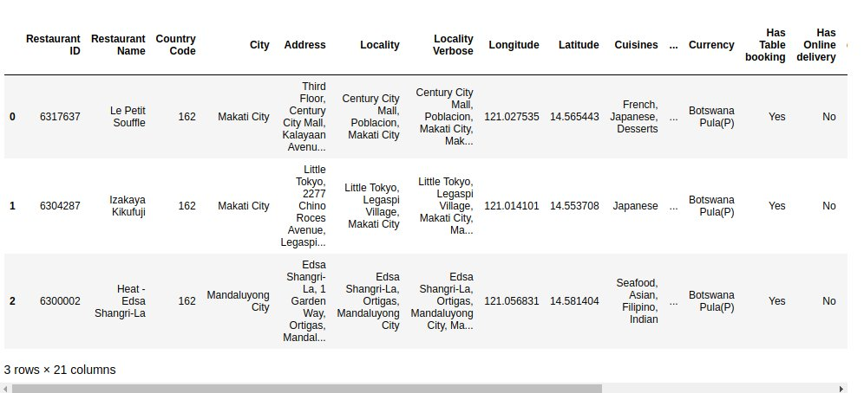
Insights into the data
We can see that the dataset has 21 columns.
We only use those columns which will be important for us to produce a valuable insights to the CEO, manager and the team.

Slide 5
Data Cleaning
We view the dataset in depth with the standard deviation and percentile insights and find out that there are some outliers in the dataset.
We remove those rows where there are no votes as it would not be helpful for us to generate insights without any votes and feedback.

Slide 6
Visualization to the CEO
We suggest the CEO to expand the starbucks to those places where there are no cafes already established.
For this, we plot the restaurants number in the city .

Slide 7
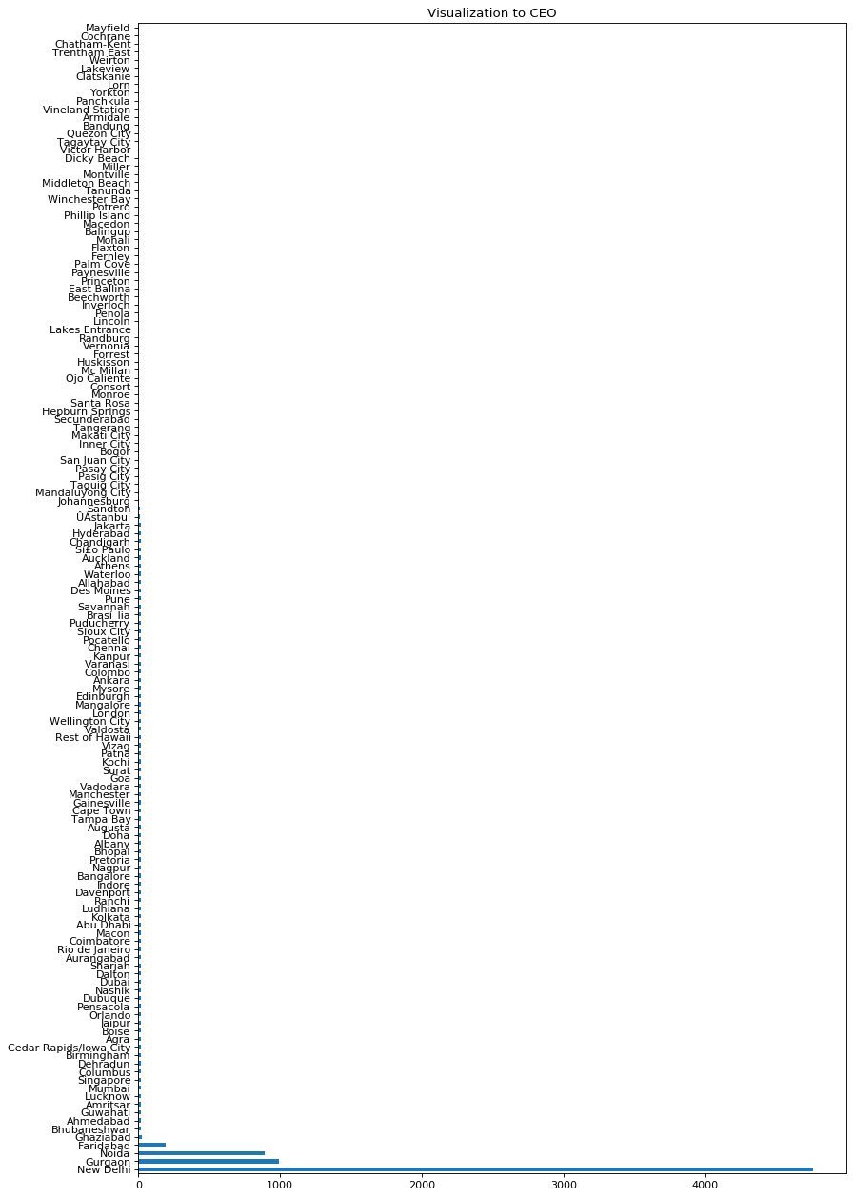
In the plot, we can see that there are already many restaurants in New Delhi and such cities in India.
Likewise, there are few restaurants in other cities but there are very less restaurants in some cities and we suggest the CEO to expand the restaurant to such places.

Slide 8
Suggestion to Manager
The CEO assigns the manager to shortlist the cities by looking at the further features.
For this purpose, we select those cities where the number of restaurants are below 5.
And among the cities below 5 restaurants, we see if there are any cafes already established or not.
As we find some places where there are already established cafes and many places where there are no cafes, we try to use other feature I.e., number of votes given by people which will give us the outside eating habit of people in that place.

Slide 9
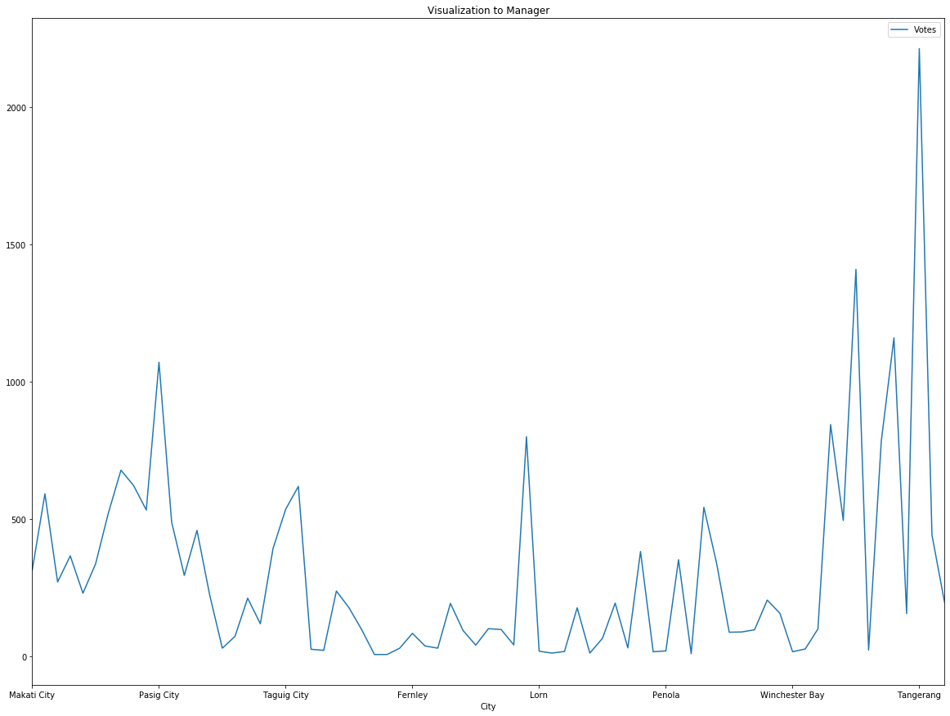
In the figure aside, we can see that the maximum number of votes are in Tangerang, which is the city in Indonesia, whose country code is 94.
We now look at the other cities with the country code 94 and then find out the features of restaurants where the people have given "Excellent" and "Very Good" rating.

Slide 10
Suggestion to the team
Since, there is another restaurant which also serves coffee in Indonesia with "Very Good" rating, we shortlist the city name to "Tangerang" in order to open new Starbucks.
Seeing at the features of the city with preferred ratings, we advice the team to focus on medium price range rather than online delivery, online table booking, delivering at any time and Switching to order menu.
We plot the price range of those places where people have given nice ratings.

Slide 11
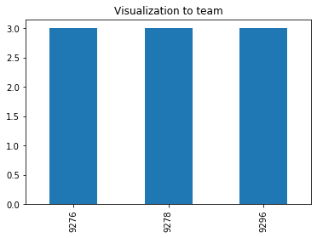
We can see that all the restaurants with nice ratings have a price range of 3, which is moderate price.
So, we suggest the team to focus on price rather than other features.

Slide 12
Conclusion
The suitable country to open a new chain of Starbucks in Asia will be Indonesia where there are very few cafes. (Suggestion to CEO)
The suitable city in Indonesia would be Tangerang where more people have a habit of eating outside. (Suggestion to Manager)
In order to be desired by the customers, the team should focus on keeping the price range to moderate rather than focusing on different new and advanced features.

