Slide 1

Advanced Algorithms Summer Session Project Retiming of a Graph
Samuel David Polo Peña - 10670388

Slide 2
Retiming Problem
Problem
Optimize the frequency of a circuit
Solutions
Move register(s) so that
clock cycle decreases, or number of registers decreases and
input-output behavior is preserved
Taken from Course Slides

Slide 3


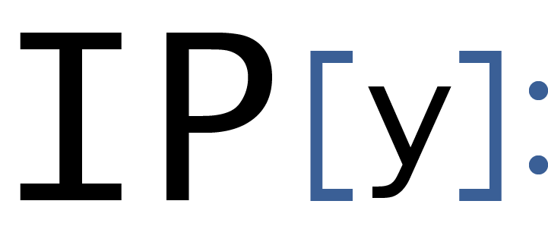

Implementation Details
-Program Used: Python in Jupyter Notebook with Graph Tool Module [2].
-Why Use Python-Graph-Tool?
The power of C++ and easiness of Python combined into one!
It’s heavily based on Boost Graph Library for C++
Efficient Network Analysis
Everything can be tested via step by step for extensive algorithms
Powerful Visualization techniques with different features

Slide 4

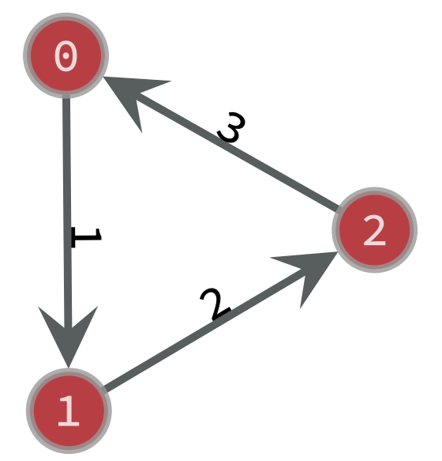
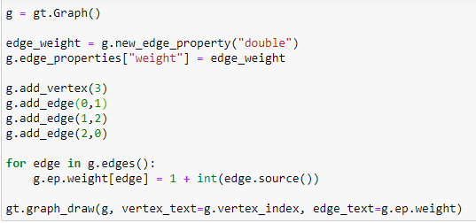
Python Graph-Tool – The Basics
Creation of a graph of 3 nodes with 3 edges and one property.
Graph created
Notes:
Way 1 of creating a Graph. (Scratch)

Slide 5
Python Graph-Tool – Circuit Representation
Restrictions on Graph Generation
In order that a graph G = (V, E, d, w) have well-defined physical meaning as a circuit, we place nonnegativity restrictions on the propagation delays d(v) and the register counts w(e):
D1. The propagation delay d(v) is nonnegative for each vertex v belonging to V.
W1. The register count w(e) is a nonnegative integer for each edge e belonging to E. We also impose the restriction that there be no directed cycles of zero weight:
W2. In any directed cycle of G, there is some edge with (strictly) positive register count.

Slide 6

Python Graph-Tool – Circuit Representation
Each Graph G is formed by G = (V, E, d(v), w(e) )
Where:
V: Vertices of the Graph.
E: Edges of the Graph.
d(v): Propagation delay of each vertex.
w(e): Register count or weight of the Edge.
Comments:
nodeCapacity can be replaced with any value, the reason for the name was like this representation is very similar to a Network Flow Graph, where each node has a capacity.
This is one of various ways of creating a graph.
Notes:
Way 2 of creating a Graph. (Hard coding)

Slide 7
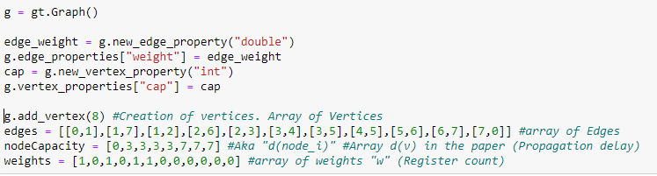
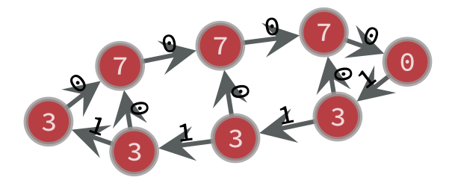
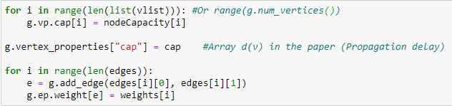
Python Graph-Tool – Circuit Representation
In order for the algorithms to work properly, a “weight” property must be added to each edge and a “cap” property to each node.
Representation from scratch

Slide 8
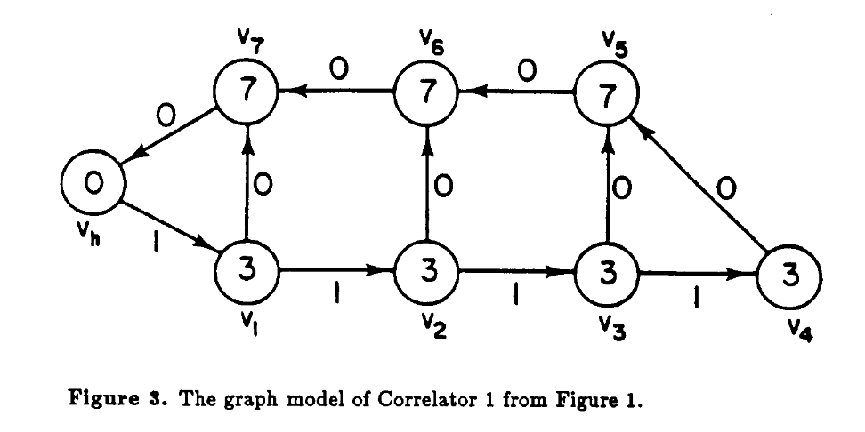
Python Graph-Tool – Circuit Representation
Correlator example from Paper [1]
Correlator example from Paper [1] represented in Graph-Tool.

Slide 9
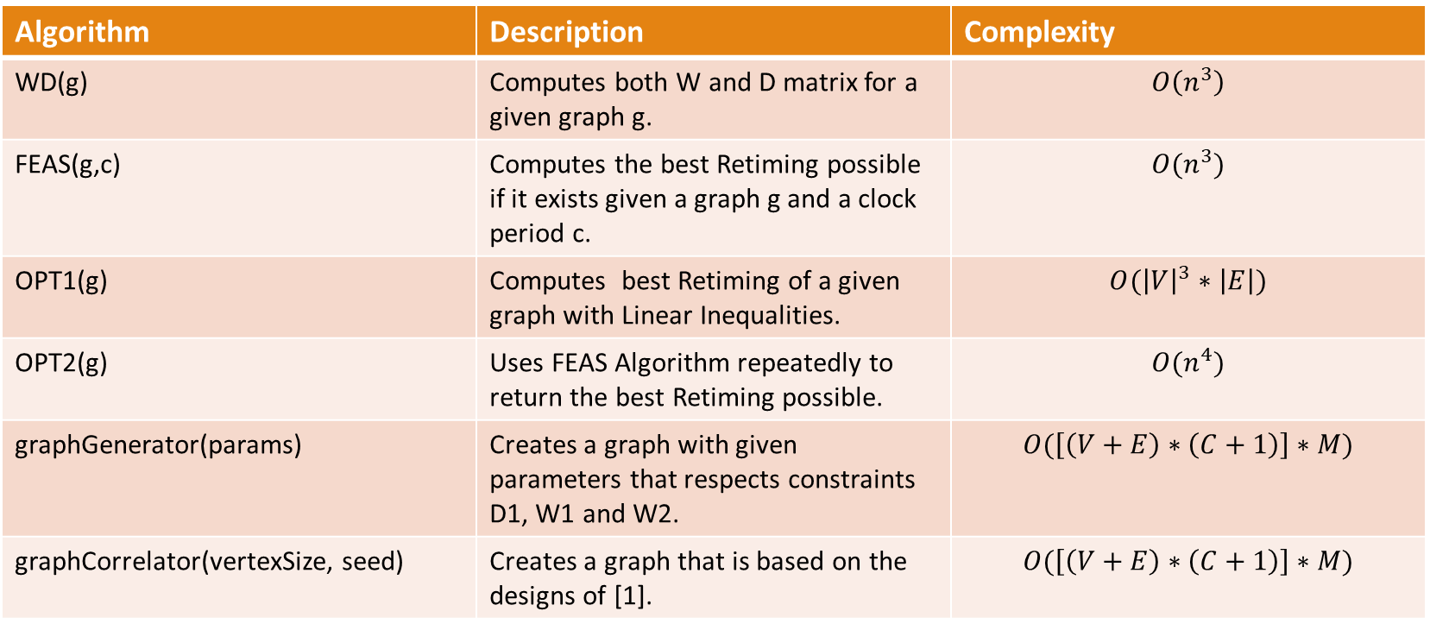
Implemented Algorithms (Summary)
Every algorithm has it’s own Python file and Notebook with documentation.
Algorithm | Description | Complexity
WD(g) | Computes both W and D matrix for a given graph g. | $$O\left(n^{3}\right)$$
FEAS(g,c) | Computes the best Retiming possible if it exists given a graph g and a clock period c. | $$O(n^{3})$$
OPT1(g) | Computes best Retiming of a given graph with Linear Inequalities. | $$O({\left|V\right|}^{3}∗\left|E\right|)$$
OPT2(g) | Uses FEAS Algorithm repeatedly to return the best Retiming possible. | $$O(n^{4})$$
graphGenerator(params) | Creates a graph with given parameters that respects constraints D1, W1 and W2. | $$O(\left[\left(V+E\right)∗\left(C+1\right)\right]∗M)$$
graphCorrelator(vertexSize, seed) | Creates a graph that is based on the designs of [1]. | $$O(\left[\left(V+E\right)∗\left(C+1\right)\right]∗M)$$
Notes:
O([(V+E)(C+1)]*M)

Slide 10
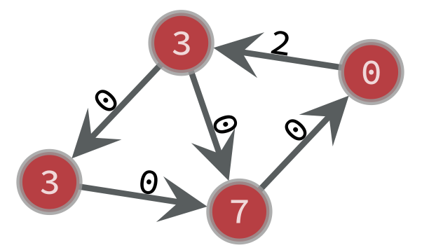
Test Cases
Example from [1]
Example 2
-Random Retiming Graph: graphs that respect the graph generation constraint.
-Random Correlator Graph: graphs based on the designs of [1] that resemble a classic digital circuit.

Slide 11

Command Line Tool
A standard command line program was created with the implemented algorithms for the user’s manipulation.
First, the user must load the main project into python virtual environment in order to work with it:
An example graph is automatically created after the previous statement
Then we can already apply any implemented algorithms with the following line command:
Separate Algorithms can also be imported in case the user wants to modify it without changing the main one:

Slide 12
Command Line Tool
We can manually create a graph for later use, but it needs to have the following requirements:
Edge with «Weight» property
Node with «Cap» property
We first create the nodes, edges, node capacities and weights of our graph.
And then we assign the values to the graph.

Slide 13
Profiling
Two scripts were made in order to automatically check the performance and the memory usage of the implemented algorithms. Each script calculates the time/memory used by each OPT1 and OPT2 algorithms by varying the number of nodes and edges by a fixed increasing size.
After each script is run, a graph image will be generated showing the performance of both algorithms depending of the profiling.
To run the memory profiler, we just simply need to write the following command:
Same with the time profiler:

Slide 14
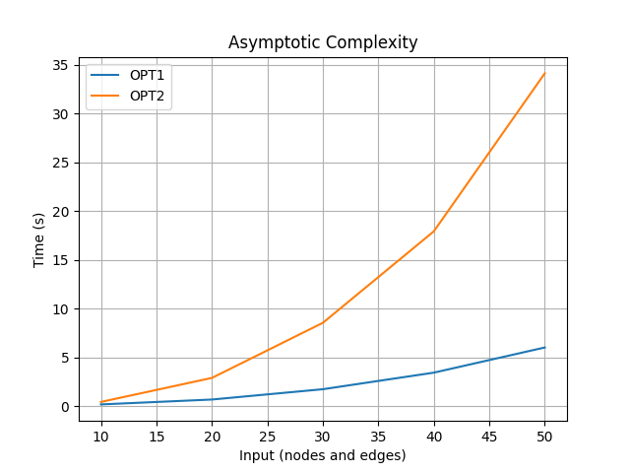

Time Profiling
Since the complexity of OPT1 is $O\left(n^{3}\right)$ it will outperform OPT2 $O\left(n^{4}\right)$ completely.

Slide 15
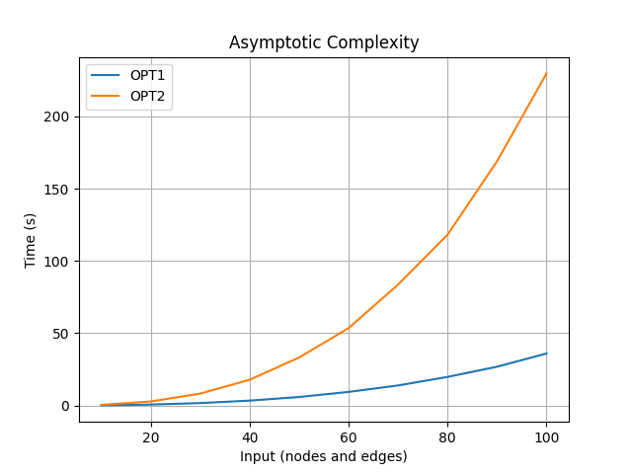

Slide 16
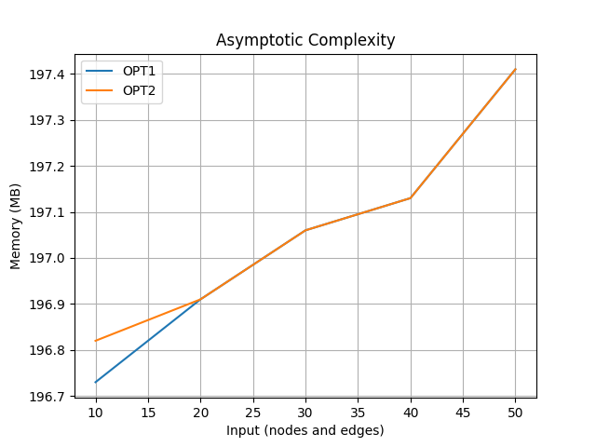
Memory Profiling
For nodes fewer or equal than 20, OPT1 is better than OP2 but after 20 nodes, both algorithms will use more or less the same memory.

Slide 17
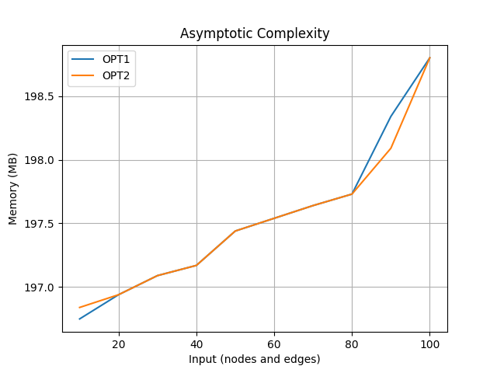
Memory Profiling
However, after a certain number of nodes, OPT2 will perform better than OPT1.

Slide 18
Manual Profiling
In order to manually check the performance and the memory usage of the algorithms, IPython[3] was used because it provides access to a wide array of functionality for this kind of timing and profiling of code. The following IPython magic commands were used:
%time: Time the execution of a single statement
%timeit: Time repeated execution of a single statement for more accuracy
%prun: Run code with the profiler
%lprun: Run code with the line-by-line profiler
%memit: Measure the memory use of a single statement
%mprun: Run code with the line-by-line memory profiler

Slide 19
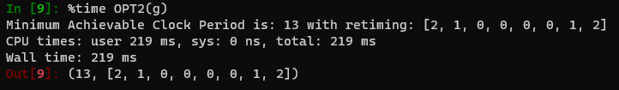
Manual Profiling
For example, %memit can be used to check how much memory a statement uses:
%time can be used for the time execution (duration) of a statement:

Slide 20
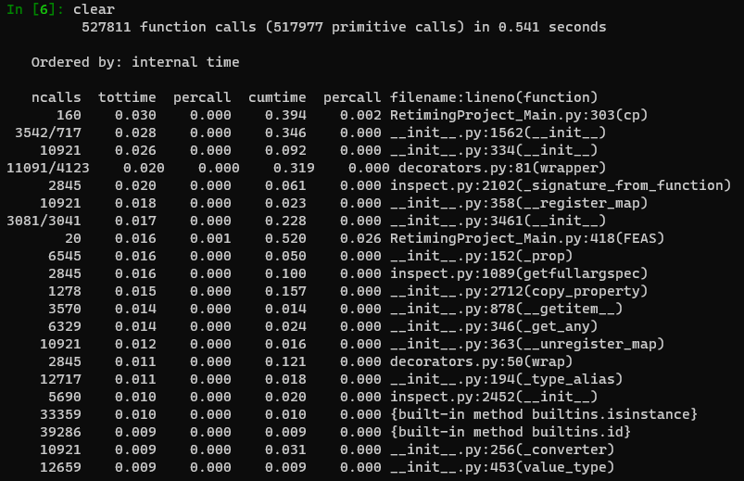
Manual Profiling
%prun can be used to create a table that indicates, in order of total time on each function call, where the execution is spending the most time.

Slide 21
References
[1]. C. E. Leiserson and J. B. Saxe, "Retiming Synchronous Circuitry", Digital Systems Research Center, Report 18, August 20, 1986.
[2]. Graph Tool Official Documentation: https://graph-tool.skewed.de/
[3]. Profiling and Timing Code: https://jakevdp.github.io/PythonDataScienceHandbook/01.07-timing-and-profiling.html
[4]. SnakeViz: https://jiffyclub.github.io/snakeviz/

