Slide 1
CS101 Introduction to Computing
Lecture 26
Arrays
(Web Development Lecture 9)

Slide 2
During the last lecture we had a discussion on Flow Control & Loops
We discussed the concept of flow control using the “if” and “switch” structures
And also the concept behind the “while” and “for” looping structures
We also solved simple problems using flow control and loop structures

Slide 3
if…else --?-- switch
If the action to be taken of the value of a single variable (or a single expression), use ‘switch’
When the action depends on the values of multiple variables (or expressions), use the ‘if...else’ structure

Slide 4
Compound Statements
At times, we need to put multiple statements at places where JavaScript expects only one
For those situations, JavaScript provides a way of grouping a number of statements into a single statement, called a “statement block”
This is done simply by enclosing any number of statements within curly braces, { }
NOTE: Although the statements within the block end in semicolons, the block itself doesn’t

Slide 5
for: Example 1
x = 1 ;
while ( x < 6000 ) {
document.write ( x ) ;
x = x + 1 ;
}
Initial count
Condition
Operation
for ( x = 1 ; x < 6000 ; x = x + 1 ) {
document.write ( x ) ;
}

Slide 6
for --?-- while
When the exact number of iterations is known, use the ‘for’ loop
When the number of iterations depend upon a condition being met, use the ‘while’ loop

Slide 7
‘for’ loops become especially useful when used in conjunction with arrays
We’ll find out about arrays today, and we’ll probe their usefulness as part of ‘for’ loop structures

Slide 8
Today’s Topic:
Arrays
We will find out why we need arrays
We will become able to use arrays for solving simple problems

Slide 9
Array?

Slide 10
Array
An indexed list of elements
We said that a variable is a container that holds a value.
Similarly, an Array can be considered a container as well, but this one can hold multiple values

Slide 11




Array
An indexed list of elements
Example: There are many ways of assigning identifiers to the following fruit
strawberry
fruit1
fruit[ 0 ]
orange
fruit2
fruit[ 1 ]
apple
fruit3
fruit[ 2 ]
watermelon
fruit4
fruit[ 3 ]

Slide 12
Array
An indexed list of elements
fruit[ 0 ], fruit[ 1 ], fruit[ 2 ], and fruit[ 3 ] are the elements of an array
‘fruit’ is the identifier for that array
The length of the ‘fruit’ array is 4, i.e. ‘fruit’ has four elements

Slide 13
Array
fruit[ 0 ]
Identifier
Square bracket
Index

Slide 14
Let’s now take look at one of the advantages of using arrays

Slide 15
var student1, student2, student3, student4 ;
student1 = “Waseem” ;
student2 = “Waqar” ;
student3 = “Saqlain” ;
student4 = “Daanish” ;
document.write( student1 ) ;
document.write( student2 ) ;
document.write( student3 ) ;
document.write( student4 ) ;

Slide 16
student = new Array( 4 ) ; //array declaration
student[ 0 ] = “Waseem” ;
student[ 1 ] = “Waqar” ;
student[ 2 ] = “Saqlain” ;
student[ 3 ] = “Daanish” ;
for ( x = 0 ; x < 4 ; x = x + 1 ) {
document.write( student[ x ] ) ;
}
Can you see the advantage of using arrays along with the ‘for’ loop?

Slide 17
Arrays in JavaScript
In JavaScript, arrays are implemented in the form of the ‘Array’ object
The key property of the ‘Array’ object is ‘length’, i.e the number of elements in an array
Two of the key ‘Array’ methods are:
  reverse( )
  sort( )
Elements of an array can be of any type; you can even have an array containing other arrays

Slide 18
Declaring a New Instance of the Array Object
‘student’ is an instance of the ‘Array’ object
‘student’ was declared such that it is of length ‘4’
That is, student is an array having 4 elements
The four elements of the array are: ‘student[ 0 ]’, ‘student[ 1 ]’, ‘student[ 2 ]’, and ‘student[ 3 ]’

Slide 19
student = new Array( 4 )
The ‘new’ operator creates an instance
This is the identifier of the new instance
Pair of paren-theses
The ‘assignment’ operator
Length of the new instance of ‘Array’
This is the parent object (or class) of the new instance

Slide 20

An Object

Slide 21
‘Instances’ of an Object

Slide 22
All instances of an object are objects themselves!

Slide 23

‘Property’ Values of the Instances May Differ

Slide 24
student = new Array( 4 )

Slide 25
Array Identifiers
The naming rules for Array identifiers are the same as were discussed for variable identifiers

Slide 26
Assigning Values to Array Elements
a[ 1 ] = 5 ; //the second element
name[ 5 ] = “bhola” ;
number = 5 ;
name[ number ] = name[ 5 ] ;
for ( x = 0 ; x < 10 ; x = x + 1 ) {
y[ x ] = x * x ;
}

Slide 27
Remember: just like C, C++ and Java, the first element of an array has an index number equal to zero

Slide 28
JavaScript Arrays are Heterogeneous
Unlike many other popular languages, a JavaScript Array can hold elements of multiple data types, simultaneously
  a = new Array( 9 ) ;
  b = new Array( 13 ) ;
  b[ 0 ] = 23.7 ;
  b[ 1 ] = “Bhola Continental Hotel” ;
  b[ 2 ] = a ;

Slide 29
The ‘length’ Property of Arrays
‘d’ is an instance of the ‘Array’ object
‘length’ is a property of the object ‘d’
d = new Array ( 5 ) ;
document.write( d.length ) ;

Slide 30
The ‘length’ Property of Arrays
What is advantage of using ‘x.length’ here instead of using the literal ‘10’?
x = new Array ( 10 ) ;
for ( x = 0 ; x < 10 ; x = x + 1 ) {
y[ x ] = x * x ;
}
x = new Array ( 10 ) ;
for ( x = 0 ; x < x.length ; x = x + 1 ) {
y[ x ] = x * x ;
}

Slide 31
Array Methods: sort( )
Sorts the elements in alphabetical order
x = new Array ( 4 ) ;
x[ 0 ] = “Waseem” ;
x[ 1 ] = “Waqar” ;
x[ 2 ] = “Saqlain” ;
x[ 3 ] = “Shoaib” ;
x.sort( ) ;
for ( k = 0 ; k < x.length; k = k + 1 ) { document.write( x[ k ] + “<BR>” ) ;
}
Saqlain
Shoaib
Waqar
Waseem

Slide 32
Were the elements sorted in ascending or descending order?
What if you wanted to arrange them in the reverse order?

Slide 33
Array Methods: reverse( )
Reverses the order of the elements
x = new Array ( 4 ) ;
x[ 0 ] = “Waseem” ;
x[ 1 ] = “Waqar” ;
x[ 2 ] = “Saqlain” ;
x[ 3 ] = “Shoaib” ;
x.reverse( ) ;
x.sort( ) ;
for ( k = 0 ; k < x.length; k = k + 1 ) { document.write( x[ k ] + “<BR>”) ;
}
Saqlain
Shoaib
Waqar
Waseem
Is this the
required
result?

Slide 34
Array Methods: reverse( )
Reverses the order of the elements
x = new Array ( 4 ) ;
x[ 0 ] = “Waseem” ;
x[ 1 ] = “Waqar” ;
x[ 2 ] = “Saqlain” ;
x[ 3 ] = “Shoaib” ;
x.sort( ) ;
x.reverse( ) ;
for ( k = 0 ; k < x.length; k = k + 1 ) { document.write( x[ k ] + “<BR>”) ;
}
Waseem
Waqar
Shoaib
Saqlain

Slide 35
Let’s Now Do a More Substantial Example
Develop a Web page that prompts the user for 10 words, and then displays them in form of a list in two different ways:
  In the order in which the words were entered
  In a sorted order
We will try to show you the complete code - the JavaScript part as well as the HTML part - for this example

Slide 36
Before looking at code, let’s first understand what is that code supposed to do

Slide 37
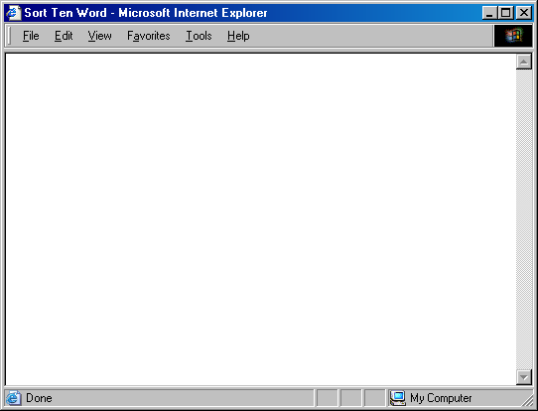
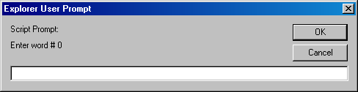

Slide 38
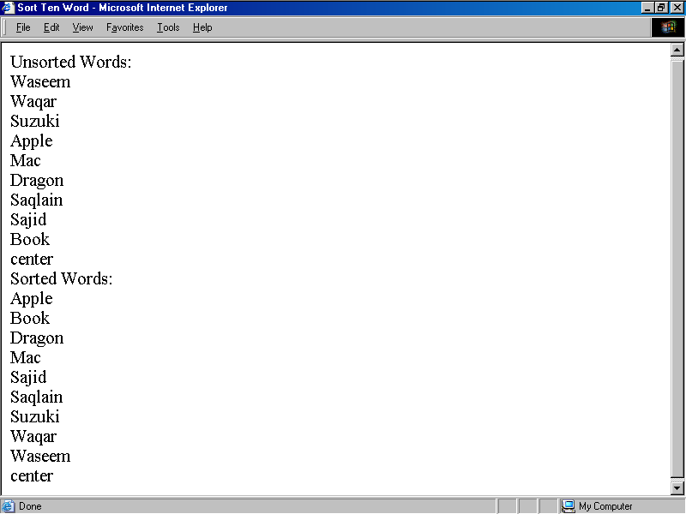

Slide 39
Pseudo Code
Declare the array that will be used for storing the words
Prompt the user and read the user input into the elements of the array
Now write the array to the document
Sort the array
Write the sorted array to the document

Slide 40
<HTML>
<HEAD>
<TITLE>Sort Ten Words</TITLE>
<SCRIPT>
words = new Array ( 10 ) ;
for ( k = 0 ; k < words.length ; k = k + 1 ) {
words[ k ] = window.prompt( "Enter word # " + k, "" ) ;
}
document.write( "UNSORTED WORDS:" + "<BR>" ) ;
for ( k = 0 ; k < words.length ; k = k + 1 ) {
document.write( words[ k ] + "<BR>" ) ;
}
words.sort( ) ;
document.write( "SORTED WORDS:" + "<BR>" ) ;
for ( k = 0 ; k < words.length ; k = k + 1 ) {
document.write( words[ k ] + "<BR>" ) ;
}
</SCRIPT>
</HEAD>
<BODY>
</BODY>
</HTML>

Slide 41
<HTML>
<HEAD>
<TITLE>Sort Ten Words</TITLE>
<SCRIPT>
//JavaScript Code
</SCRIPT>
</HEAD>
<BODY>
</BODY>
</HTML>

Slide 42
The next three slides show the JavaScript code that goes between the <SCRIPT>, </SCRIPT> tags

Slide 43
Pseudo Code
Declare the array that will be used for storing the words
Prompt the user and read the user input into the elements of the array
Now write the array to the document
Sort the array
Write the sorted array to the document

Slide 44
words = new Array ( 10 ) ;
for ( k = 0 ; k < words.length ; k = k + 1 ) {
words[ k ] = window.prompt(
"Enter word # " + k, "" ) ;
}
This method is used for collecting data from the user. It can display a message and provides a field in which the user can enter data

Slide 45
Pseudo Code
Declare the array that will be used for storing the words
Prompt the user and read the user input into the elements of the array
Now write the array to the document
Sort the array
Write the sorted array to the document

Slide 46
document.write( "Unsorted Words:" + "<BR>" ) ;
for ( k = 0 ; k < words.length ; k = k + 1 ) { document.write( words[ k ] + "<BR>" ) ;
}

Slide 47
Pseudo Code
Declare the array that will be used for storing the words
Prompt the user and read the user input into the elements of the array
Now write the array to the document
Sort the array
Write the sorted array to the document

Slide 48
words.sort( ) ;
document.write( "Sorted Words:" + "<BR>" ) ;
for ( k = 0 ; k < words.length ; k = k + 1 ) { document.write( words[ k ] + "<BR>" ) ;
}

Slide 49
Assignment #9
Build a Web page that implements the Bubble Sort algorithm discussed during the 17th lecture (Algorithms II)
The numbers to be sorted will be provided to you and should be hard coded in the JavaScript code.
Your page should display a button labeled “Run Bubble Sort”. When that button is clicked, the page should display the sorted list of numbers
Further information on this assignment will be provide on the CS101 Web site

Slide 50
During Today’s Lecture …
We found out why we need arrays
We became able to use arrays for solving simple problems

Slide 51
Next (the 10th) Web Dev Lecture:
Functions & Variable Scope
To become familiar with some of JavaScript’s built-in functions
To be able to understand the concept of user-defined functions and their use for solving simple problems
To become familiar with the concept of local and global variables

