Slide 1
Project Phase 2
Team18
105062206蔡哲維
105062306胡世昕

Slide 2
Goal
Reduce the I/O frequency.
Allow more Concurrency.

Slide 3
Method
1 Locktable => allow more thread to run concurrently
2.ChacheMgr => Public Cache
3.Hashcode => Reduce Calculation

Slide 4
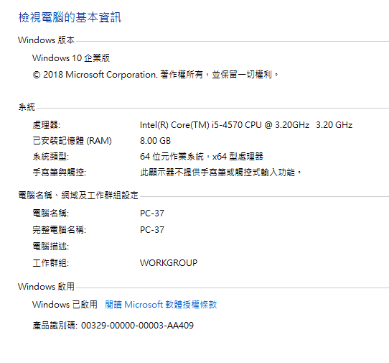
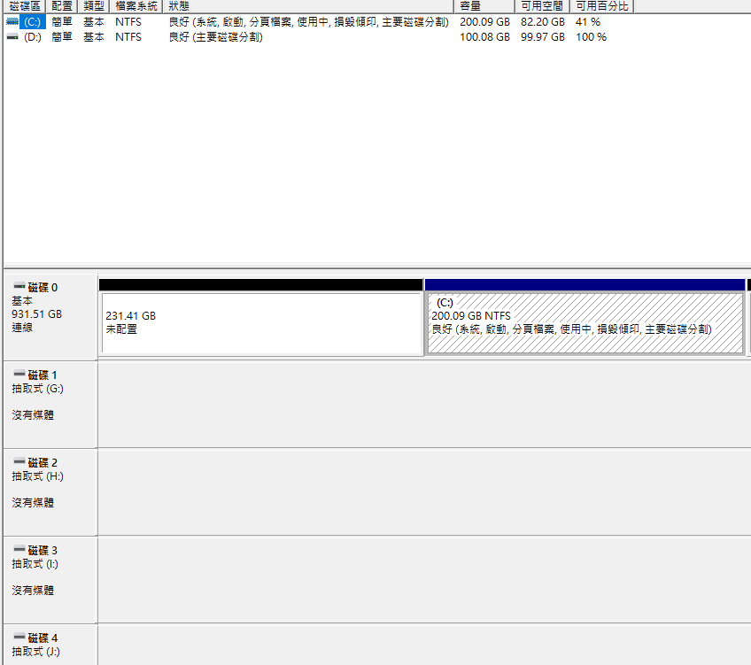
Experiment Environment

Slide 5
Experiment Parameters
TPC-C Benchmark
RTE:150
Warehouse number: 2 per partition
3 partitions, each runs on one machine

Slide 6
Experiment Results

Slide 7
Experiment Results
Name | Throughput | Percentage
origin | 19599 | 100%
anchor | 33189 | 169%
anchor+hash | 31223 | 159%
anchor+hash+cache | 27767 | 141%

