Slide 1
Fundamentals of Data Analytics HW3-1

Slide 2
Python Practice
Please implement 3 classifiers to predict the stock movement.
Logistic Regression
Neural Network
One other classifier
Due: 5/21 Thu. 9am !!!

Slide 3
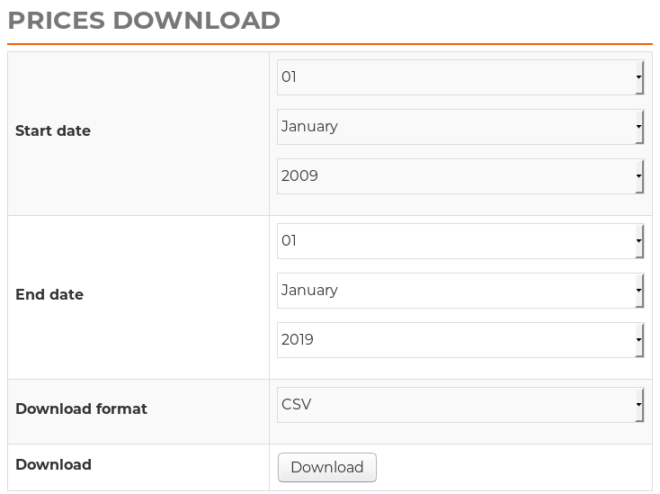
Dataset - S&P 500
https://www.sharecast.com/index/SP_500/prices/download
Training set
02-Jan-2009 to 29-Dec-2017
Test set
02-Jan-2018 to 31-Dec-2018

Slide 4
Discussion
How did you preprocess this dataset ?
Which classifier reaches the highest classification accuracy in this dataset ?
Why ?
Can this result remain if the dataset is different ?
How did you improve your classifiers ?

Slide 5
Requirement
You should use jupyter / ipython notebook to implement this homework.
Please upload your code and report to your github.

