Slide 1

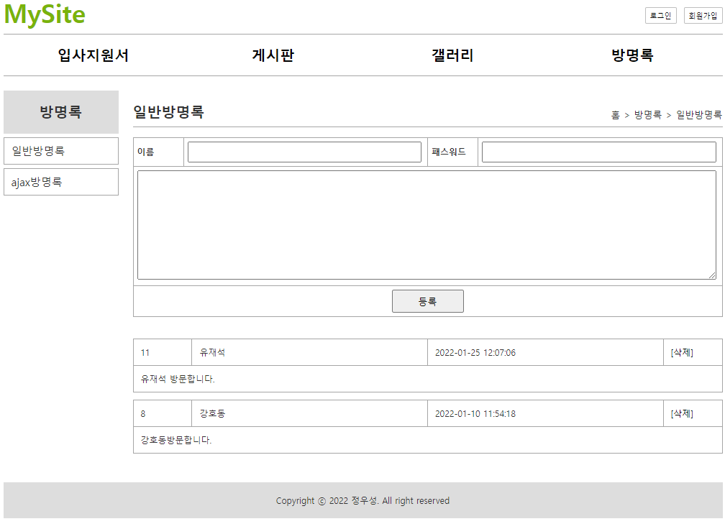
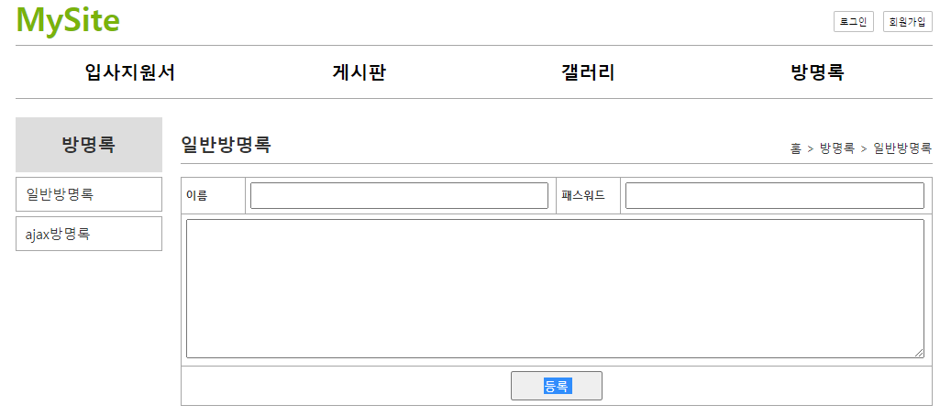
*방명록
jsp
Controller
Service
Dao
(SqlSession)
xml
/mysite4/guestbook/addList
입력폼+리스트
/addList
list()
getGuestbookList()
selectList()
selectList()
guestbook.selectList
addList.jsp
guestbookList
guestbookList
guestbookList
guestbookList
guestbookList
@ResponseBody
/mysite4/api/guestbook/addList
입력폼+리스트
/addList
addList()
addList.jsp
*ajax요청(데이타만 주세요)
/list
list()
ajax요청
getGuestbookList()
selectList()
selectList()
guestbook.selectList
data만 받는다
data만 받는다
guestbookList
guestbookList
guestbookList
guestbookList
guestbookList
자바스크립트로 화면을 그린다
@ResponseBody 리턴: guestbookList

Slide 2
*방명록
jsp
Controller
Service
Dao
(SqlSession)
xml
파라미터
name=유재석
password=1234
content=방명록글
guestbookVo
name=유재석
password=1234
content=방명록글
/mysite4/guestbook/write
등록
guestbookVo
guestbookVo
guestbookVo
guestbookVo
/write
write()
addGuest()
insert()
insert()
guestbook.insert
addList.jsp
파라미터
name=유재석
password=1234
content=방명록글
/mysite4/api/guestbook/write
0x333
0x333
0x333
0x333
등록
*파라미터 전달
guestbookVo
guestbookVo
guestbookVo
guestbookVo
/write
write()
*ajax요청(데이타만 주세요)
addGuestResultVo()
insertSelectKey()
insert()
guestbook.insertSelectKey
guestbookVo JS
name=유재석
password=1234
content=방명록글
0x999
no=34
no=34
no=34
json
selectGuset()
selectOne()
guestbook. selectByNo
0x999
0x999
0x999
DS
JS
no=13
name=유재석
password=1234
content=방명록글
regDate= 2022-01-01
0x333
0x999
마이바티스
Vo
name=유재석
password=1234
content=방명록글
Vo
no=34
name=유재석
password=1234
content=방명록글
regDate=
Vo
no=13
name=유재석
password=1234
content=방명록글
regDate= 2022-01-01
0x333

