Slide 1
Core Hadoop: HDFS, MapReduce & YARN
Julien Heck
Hadoop and Managing Big Data
UCLA Extension

Slide 2
Agenda
HDFS
Lab with HDFS
MapReduce
Lab with MapReduce
YARN

Slide 3
Distributed Filesystems
Big Data usually outgrows the storage capacity of a single physical machine.
It becomes necessary to partition the data across a network of machines, or cluster.
Hence we need a filesystem that manage the storage across a network of machines. Such filesystems are called distributed filesystems.
Distributed filesystems are more complex than regular disk filesystems, since they are network based.
One of the biggest challenges is to tolerate node failure without suffering data loss.
Hadoop comes with a distributed filesystem called HDFS, which stands for Hadoop Distributed Filesystem.

Slide 4
Design of HDFS
HDFS was inspired by the GoogleFS whitepaper released in 2003.
Google outlined how they were storing the large amount of data captured by their web crawlers.
There are several key design principles which require that the filesystem
is scalable.
is fault tolerant.
uses commodity hardware.
supports high concurrency.
HDFS is a virtual filesystem, meaning that it appears to a client as if it is one system, but the underlying data is located in multiple different locations.
HDFS is immutable, meaning it has the inability to update data after it is committed to the filesystem. HDFS is often referred to as a WORM (write once, read many) filesystem.

Slide 5
Design of HDFS
HDFS does not work well for some applications, including:
Low-latency data access: Applications that require low-latency access to data, in the tens of milliseconds range, will not work well with HDFS.
Lots of small files: Because filesystem metadata is hold in memory, the limit to the number of files in a filesystem is governed by the amount of memory available.
Each file, directory, and block takes about 150 bytes metadata in memory, e.g. one million files, each taking one block, would need at least 300 MB of memory.
Multiple writers: There is no support for multiple writers or for modifications at arbitrary offsets in the file.

Slide 6
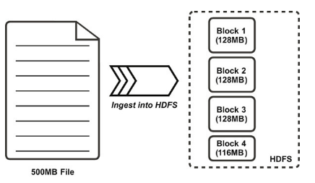
HDFS Blocks
Like in a filesystem for a single disk, files in HDFS are broken into block-sized chunks, which are stored as independent units.
Unlike a filesystem for a single disk, a file in HDFS that is smaller than a single block does not occupy a full block’s worth of underlying storage.
A 1 MB file stored with a block size of 128 MB uses 1 MB of disk space, not 128 MB.

Slide 7
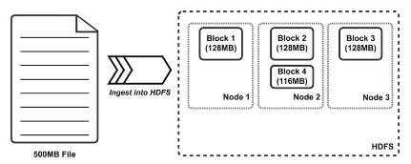
HDFS Blocks
HDFS blocks are larger (128 MB by default) than single disk blocks to minimize the cost of seeks.
Example : if the seek time is around 10 ms and the transfer rate is 100 MB/s, to make the seek time 1% of the transfer time, we need to make the block size around 100 MB.
MapReduce jobs operate one block at a time, so blocks cannot be too big otherwise too few jobs (fewer than nodes in the cluster) would run.
If a cluster contains more than one node, blocks are distributed among slave nodes.

Slide 8
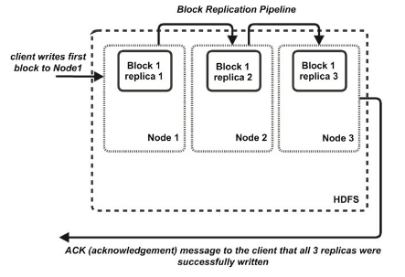
HDFS Blocks
Having a block abstraction for a distributed filesystem brings several benefits.
There is nothing that requires the blocks from a file to be stored on the same disk, so a file can be larger than any single disk in the network.
Blocks fit well with replication for providing fault tolerance and availability. Each block is replicated to a small number of physically separate machines.

Slide 9
NameNode and DataNodes
An HDFS cluster has two types of nodes operating in a master − worker pattern: a NameNode (the master) and a number of DataNodes (workers).
The NameNode is the HDFS master node process, which manage the distributed filesystem namespace.
The DataNodes are the nodes of the cluster on which HDFS blocks are stored and managed.

Slide 10
NameNode
The NameNode’s most important function is management of the filesystem’s metadata.
HDFS metadata is the filesystem catalog, which contains all of the directory and file objects and their related properties and attributes.
NameNode’s in-memory representation of the metadata includes the locations of the blocks which comprise files in HDFS.
This is the only stateful representation of the relationship between files and blocks in HDFS.
If the machine hosting the NameNode fails all the files on the filesystem would be lost.
The NameNode must be resilient to failure.
Notes:
The combination of replicating NameNode metadata on multiple filesystems and using the secondary NameNode to create checkpoints protects against data loss, but it does not provide high availability of the filesystem.
High availability refers to a system or component that is continuously operational for a desirably long length of time
The NameNode is still a single point of failure (SPOF).
If the NameNode would go down, the whole system would be out of service until a new NameNode could be brought online.
Hadoop 2 remedied this situation by implementing a pair of NameNodes in an active-standby configuration (this is different from the SecondaryNameNode).
The main change is that when a standby NameNode comes up, it reads up to the end of the shared edit log to synchronize its state with the active NameNode, and then continues to read new entries as they are written by the active NameNode.
Datanodes must send block reports to both NameNodes.

Slide 11

NameNode Metadata
The NameNode’s metadata is perhaps the single most critical component in the HDFS architecture.
The metadata persists in resident memory on the NameNode to facilitate fast lookup operations for clients.
Common misconception: data does not flow through the NameNode.
The NameNode simply uses its metadata to direct clients where to read and write data.
Think of the metadata as a giant lookup table, which includes HDFS blocks, the HDFS object (file or directory) they are associated with, and their sequence in the file.

Slide 12
DataNodes
DataNodes are responsible for:
storing and retrieving blocks when they are told to (by clients or the nameNode).
participating in the block replication pipeline.
managing local volumes and storage.
providing block reports to the NameNode.
DataNodes store and manage physical HDFS blocks only, without having any knowledge of how these blocks are related to files and directories in the HDFS filesystem.

Slide 13
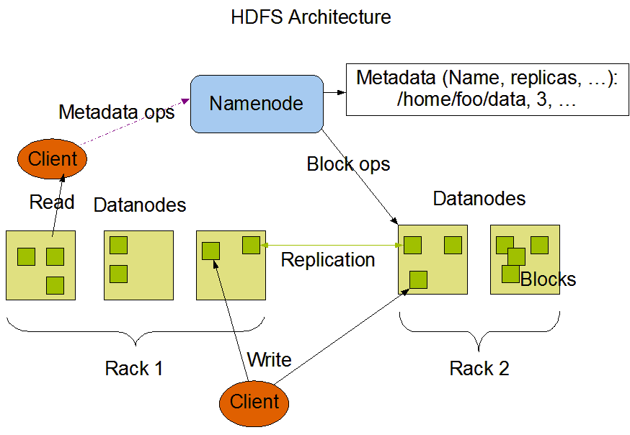
HDFS Architecture

Slide 14
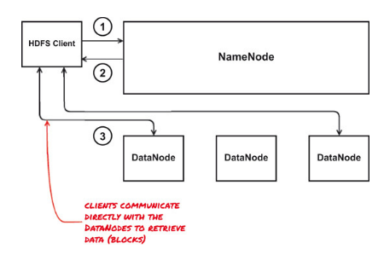
File read
The HDFS Client requests to read a file.
The NameNode responds to the request with a list of DataNodes containing the blocks that comprise the file.
The Client communicates directly with the DataNodes to retrieve blocks for the file.

Slide 15
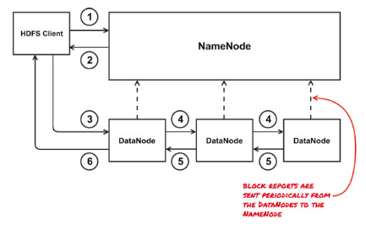
File write
The HDFS Client requests to write a file block.
The NameNode responds to the Client with the DataNode to which to write the block.
The Client requests to write the block to the specified DataNode.
The DataNode opens a block replication pipeline with another DataNode in the cluster, and this process continues until all configured replicas are written.
A write acknowledgment is sent back through the replication pipeline.
The Client is informed that the write operation was successful.

Slide 16
HDFS Filesystem - Exercise
Login to Canvas for the exercise instruction.
Download the MovieLens dataset and move it to HDFS.

Slide 17
MapReduce
Hadoop MapReduce is a software framework for easily writing applications which process vast amounts of data (multi-terabyte data-sets) in-parallel on large clusters (thousands of nodes) of commodity hardware in a reliable, fault-tolerant manner – The Apache Software Foundation
MapReduce distributes the processing of data on the cluster.
MapReduce works by breaking the processing into two phases: the map phase (transforming) and the reduce phase (aggregating).
Each phase has key-value pairs as input and output, the types of which may be chosen by the programmer.

Slide 18
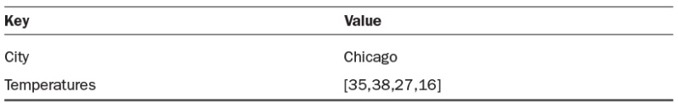
Key-Value Pairs
Input, output, and intermediate records in MapReduce are represented in the form of key-value pairs.
The key is an identifier; for instance, the name of the attribute.
In MapReduce programming in Hadoop, the key is not required to be unique.
The value is the data that corresponds to the key.
This value can be a simple, scalar value such as an integer, or a complex object such as a list of other objects.
Complex problems in Hadoop are often decompose into a series of operations against key-value pairs.

Slide 19
Map phase
The Map phase is the initial phase of processing in which we will use an input dataset as a data source for processing.
The Map phase uses input format and record reader functions in its specific implementation to derive records in the form of key-value pairs for the input data.
The Map phase then applies one or several functions to each key-value pair over a portion of the dataset.

Slide 20
Reduce phase
Each Reduce task (or Reducer) executes a reduce() function for each intermediate key and its list of associated intermediate values.
The output from each reduce() function is zero or more key-value pairs considered to be part of the final output.
This output may be the input to another Map phase in a complex multistage computational workflow.

Slide 21
Shuffle and Sort
Between the Map phase and the Reduce phase, there is the Shuffle and Sort phase.
Intermediate data from completed Map tasks (keys and lists of values) is sent to the appropriate Reducer, depending upon the partitioning function specified.
The keys and their lists of values are then merged into one list of keys and their associated values per Reducer, with the keys stored in key-sorted order according the key datatype.
The Shuffle-and-Sort phase is the entire process of transferring intermediate data from Mappers to Reducers and merging the lists of key-value pairs into lists in key-sorted order on each Reducer.

Slide 22
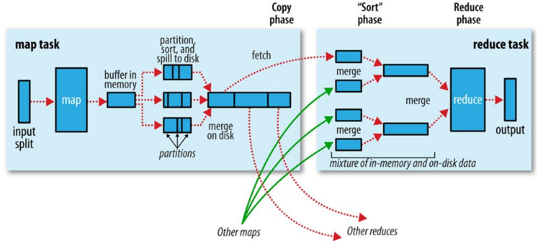
Shuffle and Sort

Slide 23

MapReduce - Example
Let’s use the MovieLens dataset as an example and find out how many movies did each user rated.

Slide 24
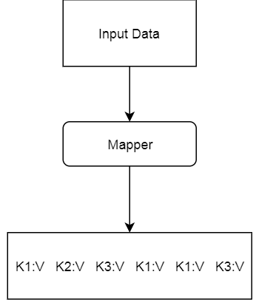
How MapReduce works
The MAPPER converts raw source data into key/value pairs

Slide 25
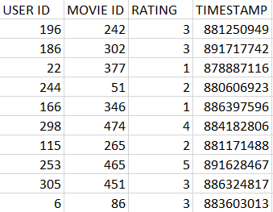
How MapReduce works
This is how the MovieLens u.data looks like:

Slide 26
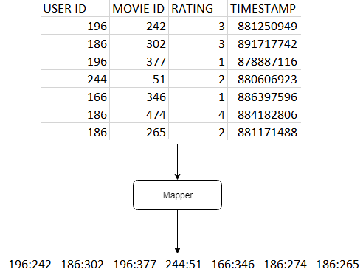
How MapReduce works
Map users to movies they watched:

Slide 27
How MapReduce works
Extract and organize data we care about.
The less data we put on the cluster, the better.

Slide 28
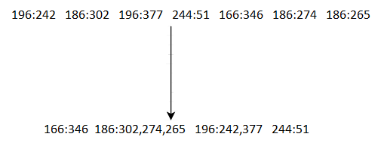
How MapReduce works
MapReduce sorts and groups the mapped data (“Shuffle and Sort”)

Slide 29
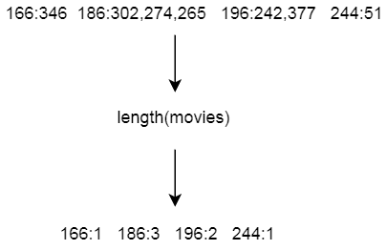
How MapReduce works
The REDUCER Processes each key’s values

Slide 30
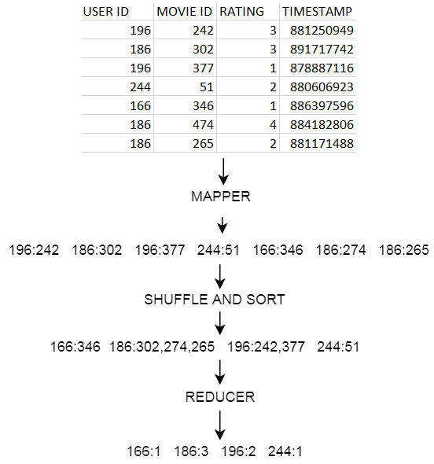
How MapReduce works

Slide 31
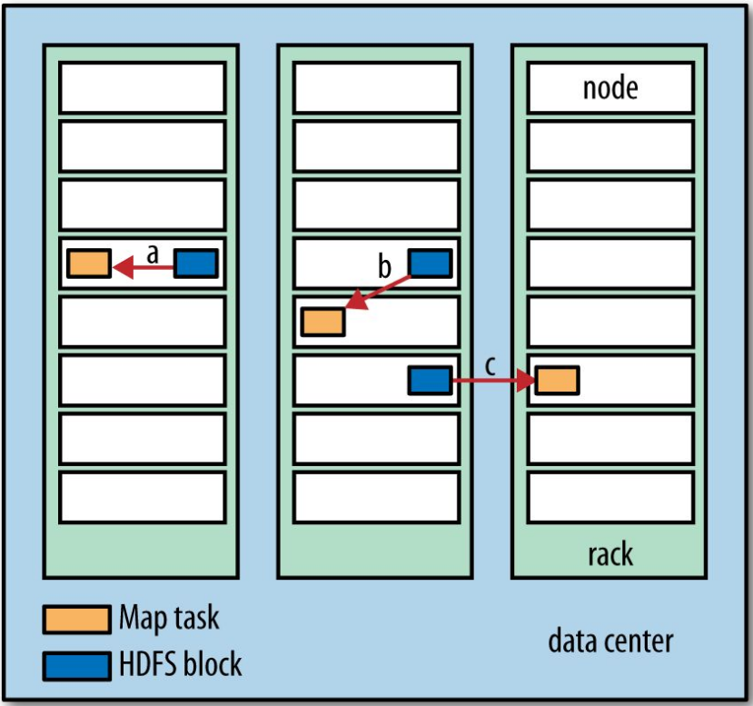
Data Locality Optimization
Hadoop does its best to run the map task on a node where the input data resides in HDFS. This is called the data locality optimization.
This is not always the case, sometimes Hadoop has to look for a free slot on another node in the same rack
Sometimes it even has to look for a free node in another rack.

Slide 32
Reduce Tasks
Reduce tasks don’t have the advantage of data locality.
The input to a single reduce task is normally the output from all mappers.
The sorted map outputs have to be transferred across the network to the node where the reduce task is running, where they are merged and then passed to the user-defined reduce function.
The output of the reduce is normally stored in HDFS for reliability.
For each HDFS block of the reduce output, the first replica is stored on the local node, with other replicas being stored on off-rack nodes for reliability (remember HDFS block replication).
Writing the reduce output does consume network bandwidth, but only as much as a normal HDFS write pipeline consumes.

Slide 33
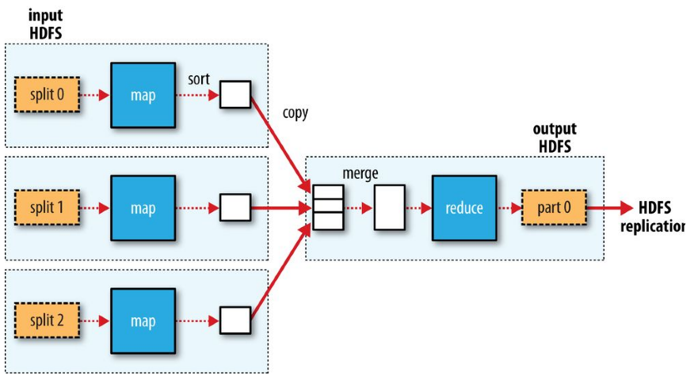
Reduce Tasks
Data flow with a single reduce task

Slide 34
Reduce Tasks
When there are multiple reducers, the map tasks partition their output, each creating one partition for each reduce task.
There can be many keys (and their associated values) in each partition, but the records for any given key are all in a single partition.
The partitioning can be controlled by a user-defined partitioning function.
Each reduce task is fed by many map tasks (“Shuffle” from the “Shuffle and Sort”).

Slide 35
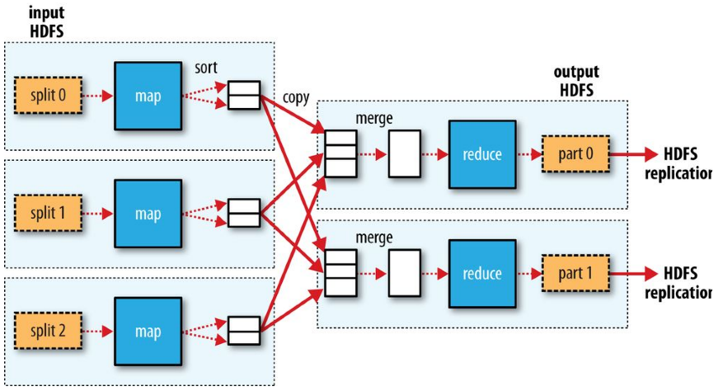
Reduce Tasks
Data flow with multiple reduce tasks

Slide 36
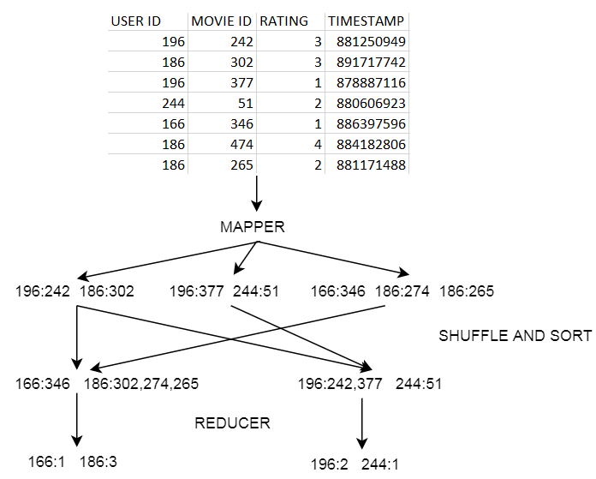
MapReduce Example on a cluster

Slide 37
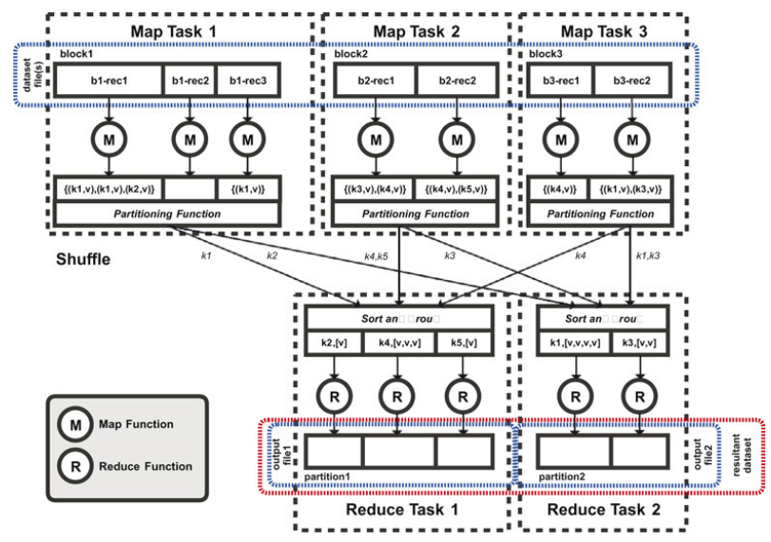
MapReduce Overview

Slide 38
MapReduce Exercise
Login to Canvas for the exercise instruction.
Run your first MapReduce job!

Slide 39
MapReduce Demo
MapReduce is not efficient for small Datasets!
Try a simple python script to do the same job.

Slide 40
YARN
Apache YARN (Yet Another Resource Negotiator) is Hadoop’s cluster resource management system. YARN was introduced in Hadoop 2 to improve the MapReduce implementation,
YARN provides APIs for requesting and working with cluster resources, but these APIs are not typically used directly by user code.
Instead, users write to higher-level APIs provided by distributed computing frameworks, which themselves are built on YARN and hide the resource management details from the user.
Pig, and Hive are examples of processing frameworks that run on MapReduce, Spark, or Tez (or on all three), and don’t interact with YARN directly.
The YARN cluster architecture is a master-slave cluster framework like HDFS, with a master node daemon called the ResourceManager and one or more slave node daemons called NodeManagers running on worker or slave nodes in the cluster.

Slide 41
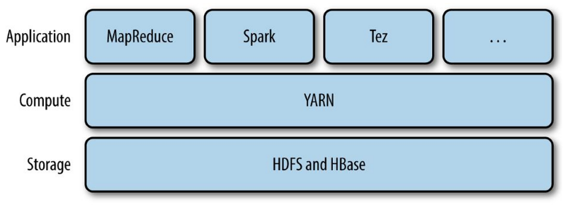
YARN

Slide 42
ResourceManager
The ResourceManager is responsible for granting cluster compute resources to applications running on the cluster.
Resources are granted in units called containers, which are predefined combinations of CPU cores and memory.
The ResourceManager also tracks available capacity on the cluster as applications finish and release their reserved resources as well as the status of applications running on the cluster.
Clients submit applications to the ResourceManager, the ResourceManager then allocates the first container on an available NodeManager in the cluster as a delegate process for the application called the ApplicationMaster, and the ApplicationMaster then negotiates all of the further containers required to run the application.

Slide 43
NodeManager Daemons
The NodeManager is the slave node YARN daemon that manages containers on the slave node host.
Containers execute the tasks involved in an application.
As Hadoop’s approach to solving large problems is to “divide and conquer,” a large problem is decomposed into a set of tasks, many of which can be run in parallel.
These tasks are run in containers on hosts running the NodeManager process.

Slide 44
The ApplicationMaster
The ApplicationMaster is the first container allocated by the ResourceManager to run on a NodeManager for an application.
Its job is to plan the application, including determining what resources are required—often based upon how much data is being processed—and to work out resourcing for application stages.
The ApplicationMaster requests these resources from the ResourceManager on behalf of the application.
The ResourceManager grants resources on the same or other NodeManagers to the ApplicationMaster, to use within the lifetime of the specific application.
The ApplicationMaster also monitors progress of tasks, stages (groups of tasks that can be performed in parallel), and dependencies.
The summary information is provided to the ResourceManager.

Slide 45
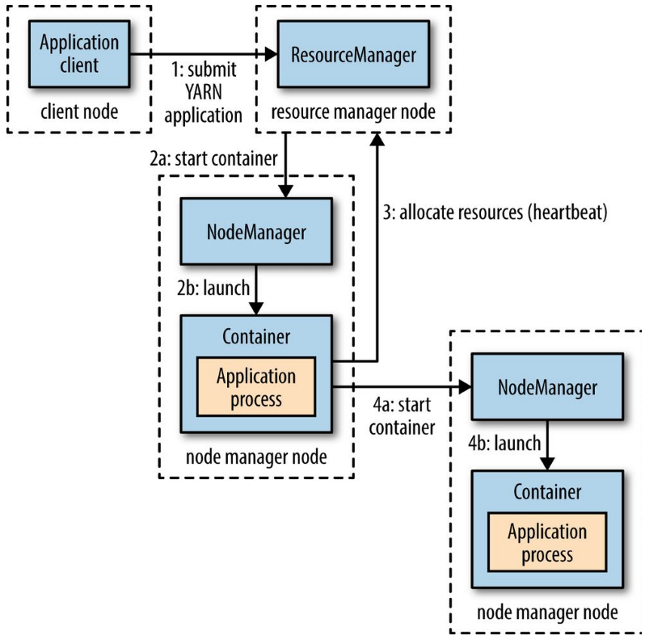
How YARN runs an application
A client contacts the resource manager and asks it to run an application master process.
The resource manager then finds a node manager that can launch the application master in a container.
The application master could simply run a computation in the container it is running in and return the result to the client.
Or the application master could request more containers from the resource managers.
And use them to run a distributed computation.

Slide 46
References
White, Tom. Hadoop: The Definitive Guide: Storage and Analysis at Internet Scale, O'Reilly Media.
Aven, Jeffrey. Hadoop in 24 Hours, Sams Teach Yourself, Pearson Education.
Sundog Education by Frank Kane, The Ultimate Hands-On Hadoop - Tame your Big Data!
https://blog.cloudera.com/blog/2014/03/a-guide-to-checkpointing-in-hadoop/
https://hortonworks.com/apache/hdfs/
https://hadoop.apache.org/docs/stable/hadoop-mapreduce-client/hadoop-mapreduce-client-core/MapReduceTutorial.html
https://hadoop.apache.org/docs/r2.4.1/hadoop-project-dist/hadoop-common/FileSystemShell.html

