Slide 1
WS8212B
RGB LED with serial data interface

Slide 2

Access to every single RGB LED

Slide 3
Complex Scenario

Slide 4
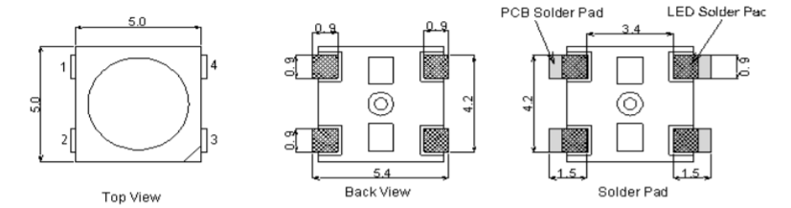
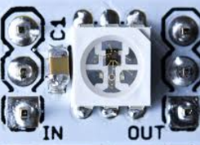
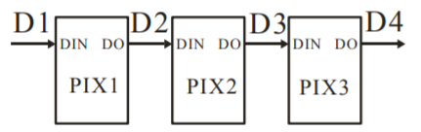
WS8212B
Datasheet

Slide 5
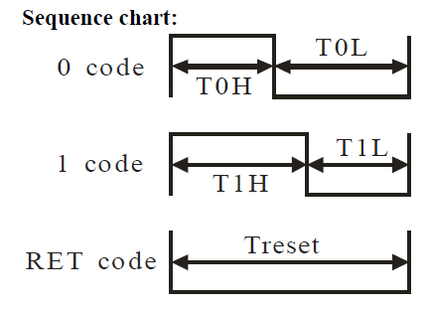
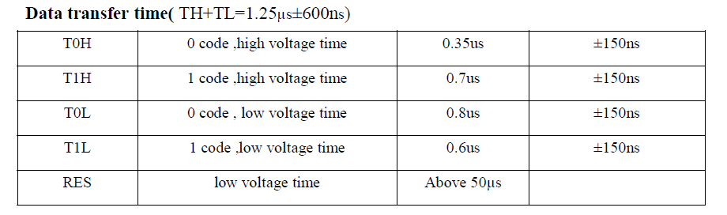
Easy to use
TH+TL: 650 … 1850
T0H: 200 … 500 -> ~25% / 1250
T0L: 650 … 950
T1H: 550 … 850 -> ~50% / 1250
T1L: 450 … 750
All Numbers in Nano Seconds

Slide 6
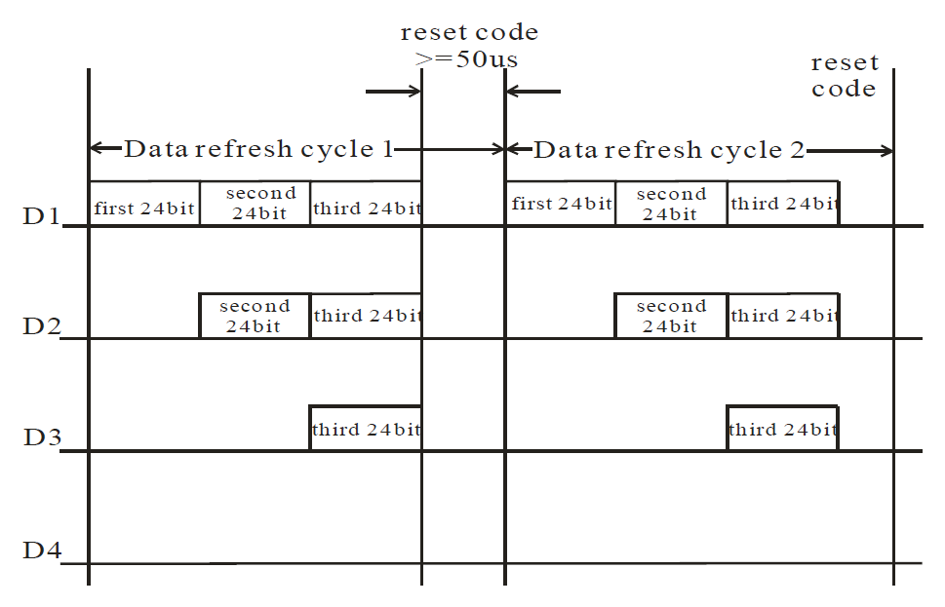
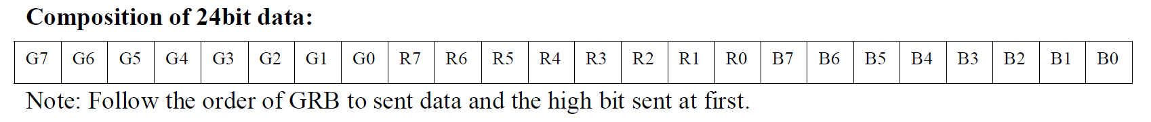
Timing
MSB First (SPI Allows MSB first)

Slide 7
Approach with PIC18F25K42
DMA transports complete RGB LED data array to SPI in one shot
SPI invert automatically every byte to MSB->LSB
SPI Data out is connected with PWM and Serial Clock to achive neccessary 25%...50% timing with simple CLC boolean equation: D = SCK*(SDO+PWM)
SPI of K42 do have transmit FIFO, this allows with DMA a continous stream

Slide 8
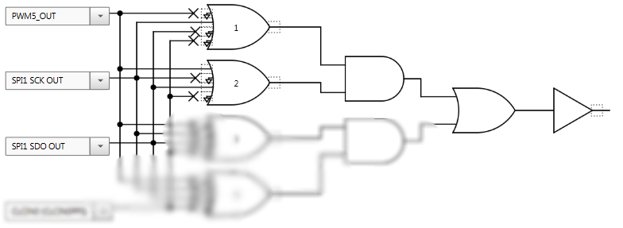

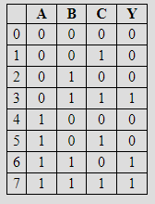
Solution
TMR2 runs with
  OSC/4
  Pre and Post scale 1/1
  Period 625ns
PWM5 triggerd by TMR2
  50% Duty Cylce
  1,6 MHz @ 5 Bits
SPI1
  Clock TMR2
  8 Bit / MSB First
DMA Channel 1
  Source: Data Array
  Destination: SPI1TXB
  Count: Number of LED‘S
  Mode: One Shot
C = PWM3 0,8 MHz
B = SCK 1,6 MHz
A = SDO 0/1
Y = DIN (WS2812B)
25%
50%
www-32x8.com

Slide 9
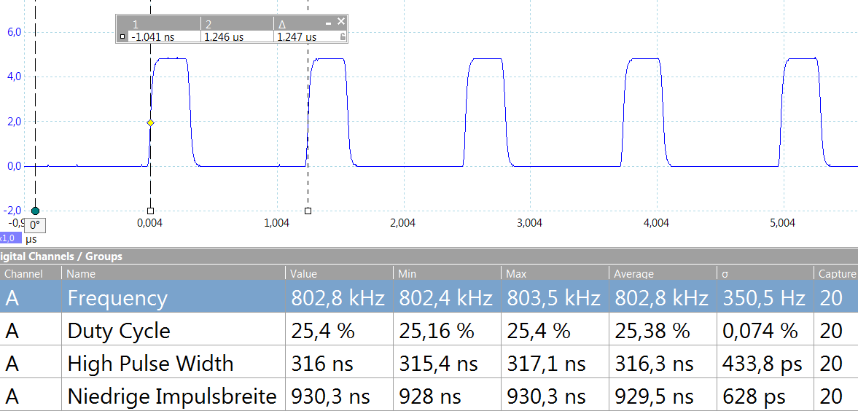
Logic „0“
TH+TL: 650 … 1850 Tolerance ok
T0H: 200 … 500 Tolerance ok
T0L: 650 … 950 Tolerance ok
T1H: 550 … 850
T1L: 450 … 750

Slide 10
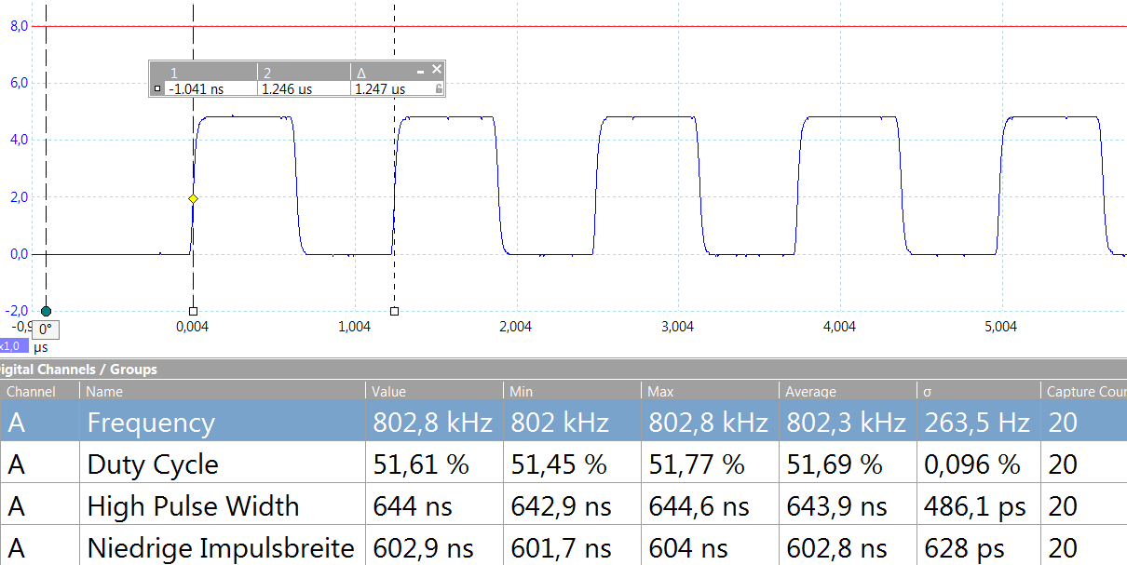
Reduced Logic „1“
TH+TL: 650 … 1850 Tolerance ok
T0H: 200 … 500
T0L: 650 … 950
T1H: 550 … 850 Tolerance ok
T1L: 450 … 750 Tolerance ok

Slide 11
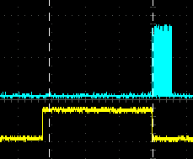
The Graphic Idea
Three virtual moving dots on a higher resolution grid
Every LED do have a virtual distance to a dot
The brightness is the reversed distance
The calculation of 16x3 the = 48 LED brightness is done with pythagoras
Sqaring is done in fixpoint
Square Root is implemented with a fixpoint iteration
The advantage of the DMA is that calculation can be done continuoes and separate. If ready, just fire the DMA
2.50 ms for calculation
0.48 ms for transport

Slide 12
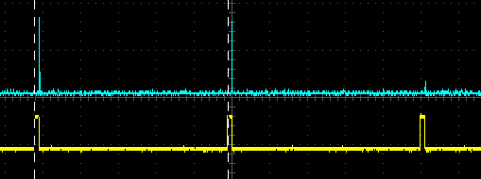
Computing Power
To „move“ 3 virtual dots on a RGB LED Matrix, it is neccesary to calculate the color for every LED in relation to the position of the virtual dots.
16x3 = 48 LED‘s, need 2.5ms. When I assume a LED martix update every 100ms, there would time for 100ms/2.5ms = 40 of this 4x4x3 = 487 RGB Led‘s.
In theory this would be 40x4x4 = 640 RGB LED‘s
One Bit time is 1.25us , for 8 bit we have 10us, for all 3 Bytes of one RGB LED it is 30us.
640 x 30us = 19,2ms
The calculation and the
data transport can be done
simultaneously, thanks
to the DMA, SPI and the CLC
of the PIC28F25K42

Slide 13
Project
Source Code on Github
https://github.com/sponkytoo/Moving-Colors.git
All 16 RGB LED colors are calculated and put into the array
uint8_t MyPxelArray[16][3];
Then the DMA Transfer of the array is started with
DMA1CON0bits.DMA1SIRQEN = 1;
With a delay, the screen play is slowed down
__delay_ms(100);

Slide 14
Video Links
Single LED access
https://vimeo.com/224312490
Screen Play Moving Colors
https://vimeo.com/224312522
Moving Colors in the Dark https://vimeo.com/224312470

Slide 15
Appendix
PIC18F25K42 DMA
Pin Diagram

Slide 16
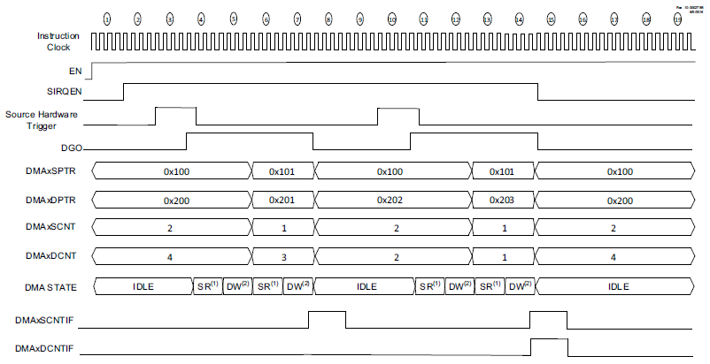
DMA
Two Direct Memory Access (DMA) Controllers
  Data transfers to SFR/GPR spaces from either Program Flash Memory, Data EEPROM or SFR/GPR spaces
  User-programmable source and destination sizes
  Hardware and software-triggered data transfers
The DMA module is
designed to move data by using the existing Instruction
Bus<16> and Data Bus<8> without the need for any
dual-porting of memory or peripheral systems

Slide 17
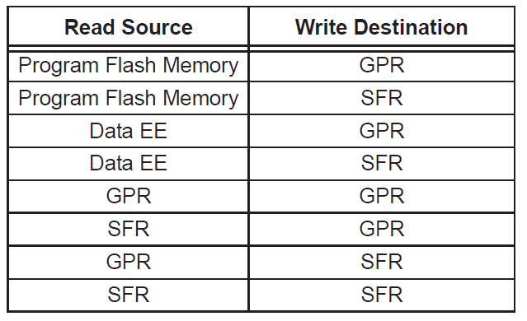
Key Features
Support access to the following memory regions:
  GPR and SFR space (R/W)
  Program Flash Memory (R only)
  Data EEPROM Memory (R only)
Programmable priority between the DMA and
CPU Operations.
Programmable Source and Destination address
modes
  Fixed address
  Post-increment address
  Post-decrement address
Programmable Source and Destination sizes
Source and destination pointer register, dynamically updated and reloadable
Source and destination count register, dynamically updated and reloadable
Programmable auto-stop based on Source or Destination counter
Software triggered transfers
Multiple user selectable sources for hardware triggered transfers
Multiple user selectable sources for aborting DMA transfers

Slide 18
DMA Registers
Control registers DMAxCON0 DMAxCON1
Data buffer register DMAxBUF
Source Start Address Register DMAxSSAU:H:L
Source Pointer Register DMAxSPTRU:H:L
Source Message Size Register DMAxSSZH:L
Source Count Register DMAxSCNTH:L
Destination Start Address Register DMAxDSAH:L
Destination Pointer Register DMAxDPTRH:L
Destination Message Size Register DMAxDSZH:L
Destination Count Register DMAxDCNTH:L
Start Interrupt Request Source Register DMAxSIRQ
Abort Interrupt Request Source Register DMAxAIRQ

Slide 19
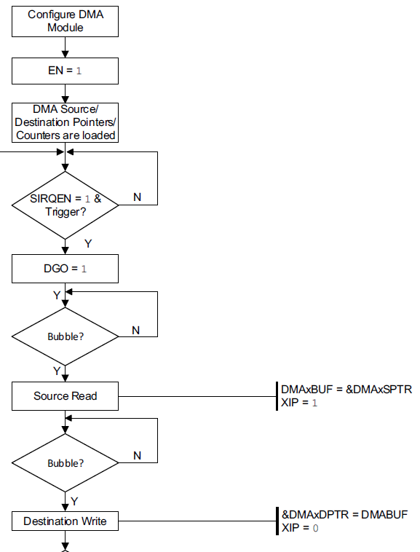
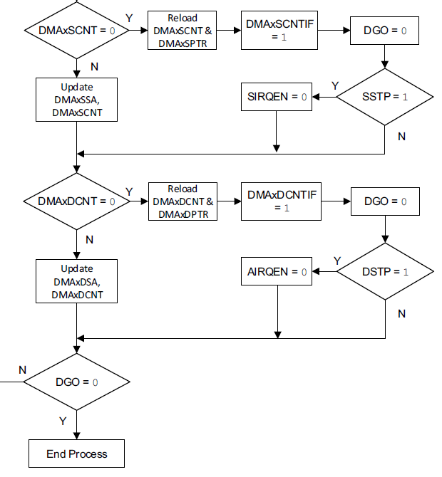
Functional Block Diagram
The DMA module transfers data from the source to the destination one byte at a time
DMA data movement is a two-cycle operation

Slide 20
Two Methods to Move Data
Depending on the priority of the DMA with respect to CPU execution the DMA Controller can move data through two methods
  Stalling the CPU execution until it has completed its transfers (DMA has higher priority over the CPU in this mode of operation)
  Utilizing unused CPU cycles for DMA transfers (CPU has higher priority over the DMA in this mode of operation).
  Unused CPU cycles are referred to as bubbles which are instruction cycles available for use by the DMA to perform read and write operations.

Slide 21
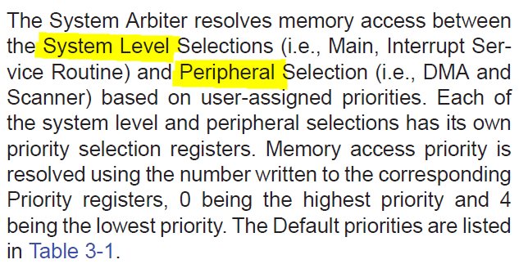
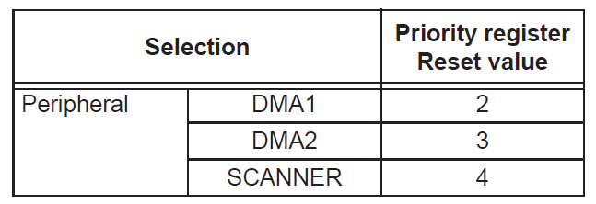
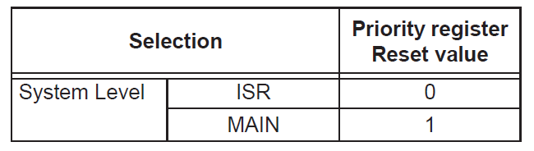
System Arbiter
Memory Access Priorization

Slide 22
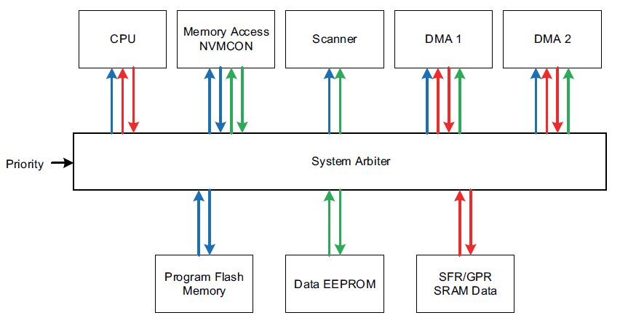

Arbiter

Slide 23
Message Size
A transaction is the transfer of one byte
A message consists of one or more transactions
A complete DMA process consists of one or more messages
The size registers determine how many transactions are in a message
Process
Message
Message
Message
Byte
Byte
Byte
Byte
Byte
Byte
Byte
Byte
Byte
Byte
Byte
Byte

Slide 24
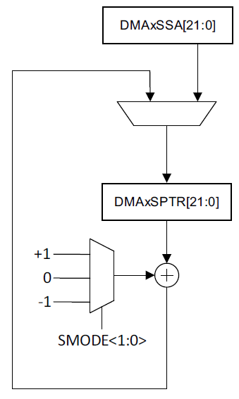
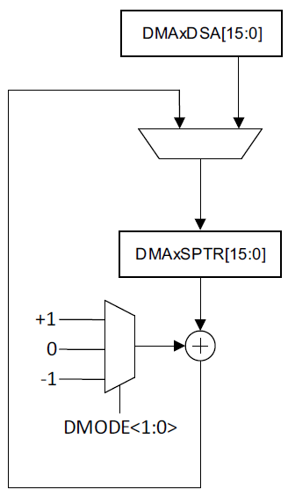
DMA Addressing
Each address can be separately configured to:
• Remain unchanged
• Increment by 1
• Decrement by 1

Slide 25
Pointer and Counter Reload
When either counter reaches zero the DGO bit is cleared and the counter and pointer registers are immediately reloaded with the corresponding size and address data.
If the other counter did not reach zero then the next message will continue with the count and address corresponding to that register
When the source and destination size registers are not equal then the ratio of the largest to the smallest size determines how many messages are in the DMA process

Slide 26
DMA Interrupts
Each DMA has its own set of four interrupt flags, used to indicate a range of conditions during data transfers
The DMAxSCNTIF source count interrupt flag is set every time the DMAxSCNT<11:0> reaches zero and is reloaded to its starting value
The DMAxDCNTIF destination count interrupt flag is set every time the DMAxDCNT<11:0> reaches zero and is reloaded to its starting value.
The DMAxAIF abort interrupt flag is used to signal that the DMA has halted
the DMAxORIF Overrun interrupt flag is set when the DMA is started before the current message is completed

Slide 27
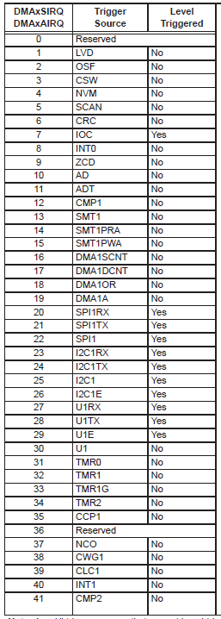
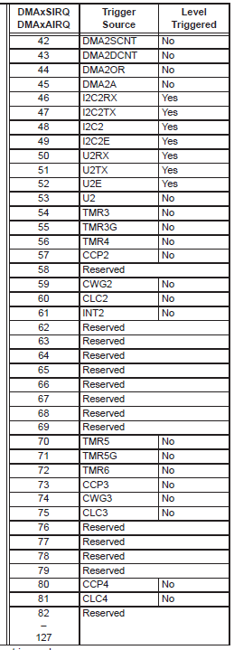
Hardware Trigger Source

Slide 28
DMA Setup
Program the appropriate Source and Destination addresses for the transaction into the DMAxSSA and DMAxDSA registers
Select the source memory region that is being addressed by DMAxSSA register, using the SMR<1:0> bits.
Program the SMODE and DMODE bits to select the addressing mode.
Program the Source size DMAxSSZ and Destination size DMAxDSZ registers with the number of bytes to be transferred. It is recommended for proper operation that the sizeregisters be a multiple of each other.
If the user desires to disable data transfers once the message has completed, then the SSTP and DSTP bits in DMAxCON0 register need to be set.
If using hardware triggers for data transfer, setup the hardware trigger interrupt sources for the starting and aborting DMA transfers (DMAxSIRQ and DMAxAIRQ), and set the corresponding interrupt request enable bits (SIRQEN and AIRQEN).
Select the priority level for the DMA (see Section 3.1 “System Arbitration”) and lock the priorities (see Section 3.1.1 “Priority Lock”)
Enable the DMA (DMAxCON1bits. EN = 1)
If using software control for data transfer, set the DGO bit, else this bit will be set by the hardware trigger.

Slide 29
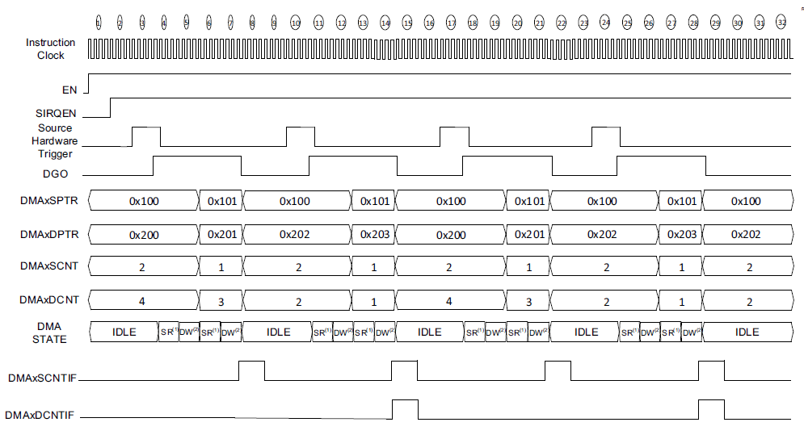
GPR-GPR TRANSACTIONS WITH HARDWARE TRIGGERS, SSTP, DSTP = 0

Slide 30
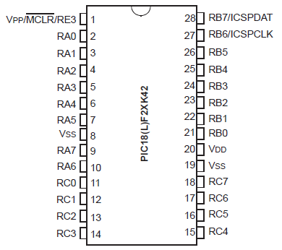
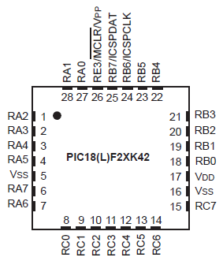
Pin Diagram

