Slide 1


VISVESVARAYA TECHNOLOGICAL UNIVERSITY BELAGAVI – 590018
GOVERNMENT ENGINEERING COLLEGE, KUSHALNAGARA- 571234
Department of Electronics and Communication Engineering
Project Presentation on
“FIRE FIGHTING ROBOT”
Presented By,
BHAVANI SHANKAR G S 4GL21EC007
CHANDANA B G 4GL21EC011
MINCHU B C 4GL21EC030
SPOORTHI L S 4GL21EC048
Under the Guidance of,
Prof. SANDHYA P B.E., MTech.
Assistant Professor
Department of E&C Engineering,
Government Engineering college,Kushalnagar

Slide 2
Table of contents
Introduction
Motivation
Objectives of the work
Literature Review
Hardware & Software Requirements
Methodology
Advantages and Limitations
Applications
Result
Conclusion
Future work
Reference

Slide 3
Introduction
This project introduces a smart FIRE FIGHTING ROBOT.
It is designed specifically to detect and extinguish fires.
This system integrates both autonomous & remote-controlled features.
The robot employs a WIFI module for communication through a mobile phone.
The robot is equipped with multiple sensors, which may include flame, smoke sensors to detect fire conditions.
GSM is used to receive SMS.
ESPCAM32 used to monitor the environment continuously.

Slide 4
Motivation
This project is motivated by the need to improve fire detection and response times.
It reduce human exposure to fire hazards especially in high-risk environments.
By developing a smart firefighter robot, this project aims to provide a solution that can rapidly detect and suppress fires.
Motivation lies in the potential for enhancing safety and efficiency in emergency situations.

Slide 5
Objectives of the work
Current fire detection and response systems largely rely on Fire alarms, sprinklers and manual firefighting efforts.
Flame detectors and alarms are designed to alert occupants to the presence of fire and alerting local authorities.
Autonomous fire fighting solutions that can rapidly detect, navigate, and extinguish fires and enhancing overall safety.

Slide 6
Literature Review
Sl.no | Author | Title | Year | Functions | Results | Scope
1 | Monica P Suresh, V R Veda Rhythesh, J Dinesh, K Deepak, J Manikandan | Arduino Uno Controlled Fire Fighting Robot for Fires in Enclosed Spaces | 2022 | This firefighting robotic system is capable of detecting and extinguishing fire. It can be made to roll into places where it is not safe for humans to enter. | By using such robots ,fire identification and rescue activities can be done with greater accuracy and securely without exposing the fire fighters to dangerous conditions. | The main function of this robot is to become an unmanned support vehicle, developed to search and extinguish fire vehicle, developed to search and extinguish fire.

Slide 7
2 | Md. Aowrongajab Uaday, Md. Nazmul Islam Shuzan,Saffan Shanewaze ,Rakibol Islam Rakib Hasan | The Design of a Novel Multi-Purpose Fire Fighting Robot with Video Streaming Capability | 2019 | In this work we introduce a novel design of a multi-purpose fire-fighting robot which, with the help of a streaming video camera attached to it, transmits live video from its surroundings to a remote location from where the robot can be controlled. | The robot can be mobilized and directed to the spot of the fire and throw water at the fire. It uses RF signal for communication. | It can effectively reduce the human risk of fire-fighting operation. The design of the robot is cost effective, which makes it especially attractive for deployment in developing countries.

Slide 8
3 | P Anantha Raj, M Srivani | Internet of Robotic Things Based Autonomous Fire Fighting Mobile Robot. | 2018 | This paper proposes the idea of including the autonomous firefighting mobile robot in the traditional fire safety Internet of Things (IoT) system to perform early firefighting action. If the fire is detected, IOT system sends alerting message to fire safety department and initiates mobile robot to perform action. | Firefighting robot reaches fire location by using path planning algorithm and performs firefighting action and sends the video stream of fire location to the control room. | In the meantime, fire safety officers can do better plan to handle the fire accident by watching the video sent by the firefighting robot. Industries which has lot of possibility of fire accident may use firefighting mobile robot with their existing fire alerting system.

Slide 9
Hardware & Software Requirements
HARDWARE COMPONEMTS
ESP8266 NODE MCU
GSM
ESP32 CAM
IR SENSOR
BUCK CONVERTER
BUZZER
MOTOR DRIVER
WATER PUMP
RELAY MODULE
BATTERY
JUMPER WIRES
SOFTWARE REQUIREMENTS
Arduino software (IDE)
Embedded C

Slide 10
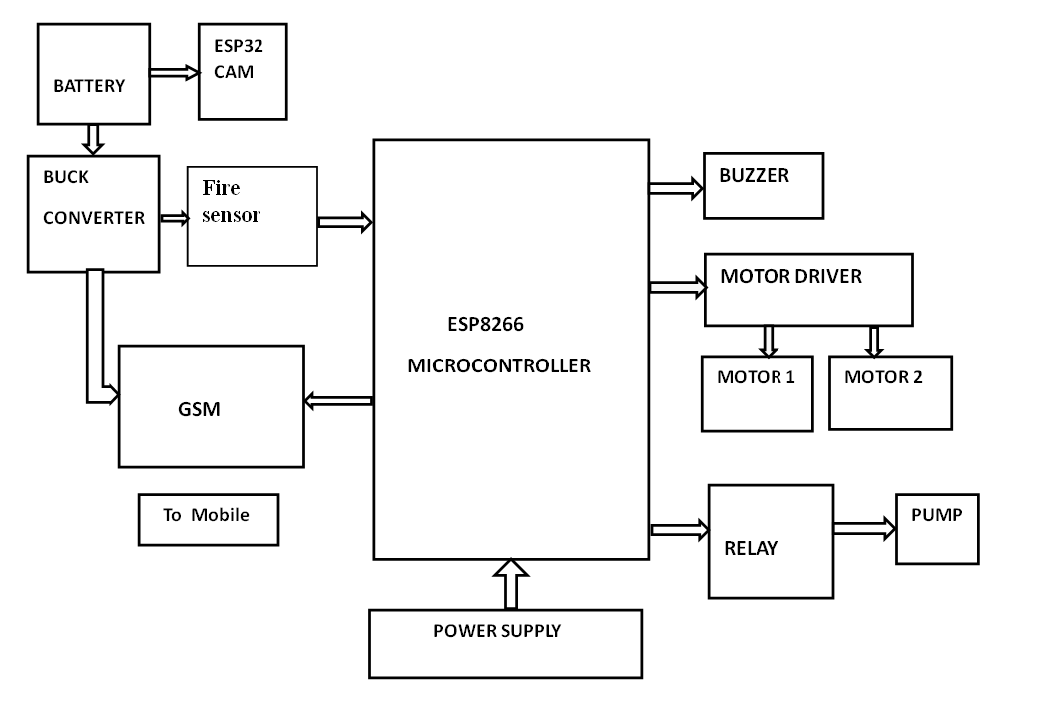
Block Diagram

Slide 11
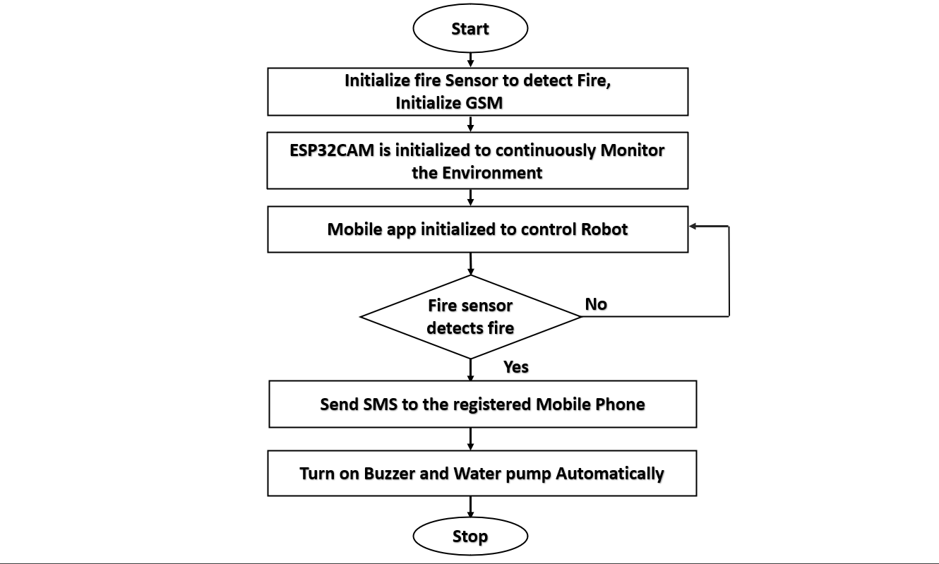
Flow Chart

Slide 12
Advantages
Remote Operation
Enhanced Safety
Early Detection
Real-time Monitoring
24/7 Operation

Slide 13
Limitations
Limited Extinguishing Capacity
Power Dependency
Sensor Limitations
High Maintenance Cost
Control Range

Slide 14
Applications
Residential Fire Safety
Healthcare Facilities
Educational Institutions
Museums and Art Galleries
Laboratories and Research Centers

Slide 15
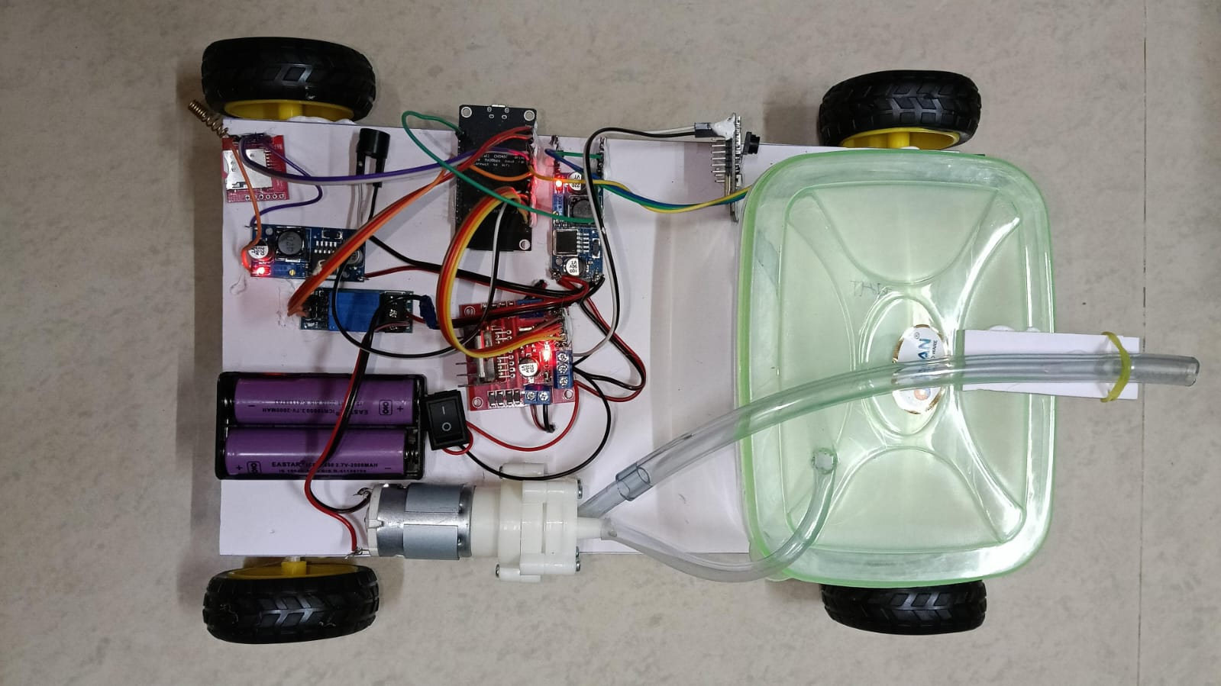
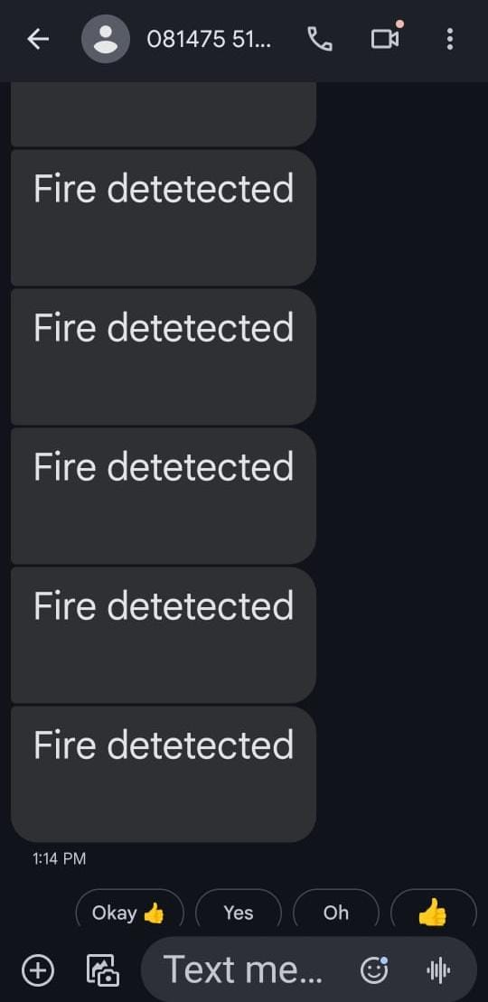
RESULT

Slide 16
Conclusion
Smart fire-fighting robot has achieved its aim and objective successfully.
The robot developed to help firefighters in their duty.
It has advantageous features such as the ability to detect the source of fire and extinguish it .
This robot will reduce the risk of injury for firefighters .

Slide 17
Future work
Enhanced Autonomy and AI Integration.
Improved sensor Capabilities.
Collaboration with Human Firefighters.
Swarm robotics(Multiple robots)

Slide 18
Reference
[1] Boo SiewKhoo, SiewWen Chin, Leong Yee Soo, Edwin Chuah, “ FireDroid- An Automated Fire Extinguishing Robot", 2013 IEEE International Conference on Control System, Computing and Engineering, 29 Nov. - 1 Dec. 2013, pp: 356 – 360.
[2] Su, K.L et al., “Automatic Fire Detection System Using Adaptive Fusion Algorithm for Fire Fighting Robot”, Systems Man and Cybernetics, 2006.SMC '06.IEEE International Conference Publications, vol.2, no.7, Oct.2006, pp: 966-971.
[3] Tong feng et al., “An ultrasonic obstacle avoidance system for fire fighting robot", Intelligent Control and Automation, IEEE International Conference Publications, vol.2, 2002, pp: 1219-1222.
[4] Avanzato et al., “Fire-fighting mobile robotics and interdisciplinary design-comparative perspectives Pack", IEEE Trans. Education., vol. 47, no. 3, Aug. 2004, pp. 369-376.
[5] Md. Hazrat Ali* , Sultan Shamishev and Aidos Aitmaganbayev “Development of a Network-based Autonomous Firefighting Robot ”School of Engineering, Nazarbayev University, 010000 Astana, Kazakhstan.

Slide 19




TEAM MEMBERS
Name: BHAVANI SHANKAR G S
USN:4GL21EC007
Address:D/O Shankaregowda, Gowdayyanadoddi, Maddur taluk,Mandya District -571422
Email Id : bhavanishankargs22@gmail.com
Mob no : 8105294914
Name: CHANDANA B G
USN:4GL21EC011
Address:D/O Gangadharaiah B C, Bheemasandra, C N Halli taluk,Tumkur District -572119
Email Id : chandanac641@gmail.com Mob no : 9535599391
Name: MINCHU B C
USN:4GL21EC030
Address:D/O Channappa, Halebudanur, Mandya taluk,Mandya District -571401
Email Id : minchubc15@gmail.com
Mob no : 8970665998
Name: SPOORTHI L S
USN:4GL21EC048
Address:D/O Shivappa T H, Kabburu,Davanagere taluk, Davanagere District -577514
Email Id : spoorthishivakumar26@gmail.com
Mob no : 7676007709

Slide 20


