Slide 1

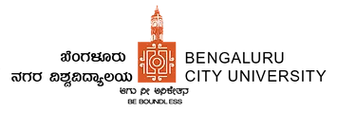
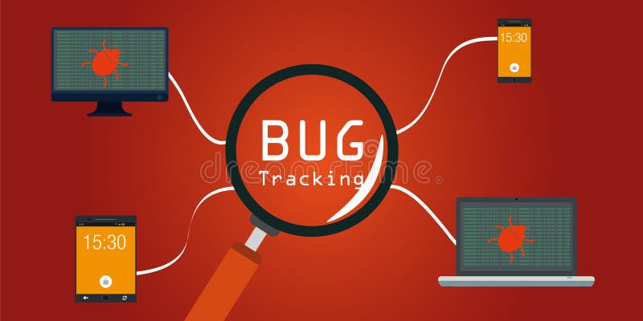
Presented by : Spoorthi K R [P18BRS10016] Guide name : Prof. Subhash K S

Slide 2

Company details :
TechCiti, since 2013, pioneers end-to-end IT solutions across 12+ PAN India cities, boasting 56+ satisfied corporate clients. Our technical prowess ensures tailored solutions, from consultation to seamless installation.

Slide 3

Abstract:
• This project is aimed at developing a tracking system useful for application developed in an organization.
• The BugTrackingSystem (BTS) is a application that can be accessed throughout the organization.
• This system can be used for logging bug against an application/module, assigning bug to individuals and tracking the bug to resolution.
• There are features like user maintenance, user access control, report generators etc. in this system.
• Bug are managing, evaluating and prioritizing.
Bug tracking systems are computer database systems that store
bug and help people to mange them.

Slide 4

Existing System:
• The client has a system which is controlled only through manual or they are using it in the excel file for solving the problems.
• The existing system does not be controlled and cannot be customized for allocation of problems to the users.
• Manual entries in the excel and the reports generation is not possible as if they like.

Slide 5
Proposed System :
• They need to computerized the system and to be shared to all the system they want to be local use only not in web based.
• The application will look and feel and GUI based friendly usage of the system.
• Allocation of problems to the users can be assigned easily, reports generation of fixed bugs etc. can be taken.
• Efficient ways of testing through this project is very easy and quiet easy handling of errors and fixing bugs made easy.

Slide 6
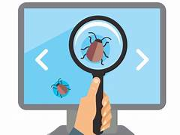
HARDWARE REQUIRMENTS: ➢ Processor: Pentium-III (or) Higher ➢ Ram: 64MB (or) Higher ➢ Hard disk: 80GB (or) Higher
SOFTWARE REQUIREMENTS: ➢ Technology: Python Django ➢ IDE : PyCharm ➢ Client Side Technologies: HTML, CSS, JavaScript ➢ Server Side Technologies: Python ➢ Data Base Server: SQLite ➢ Operating System: Microsoft Windows

Slide 7

Modules :
• User Registration
• Login
• Search
• Bug Addition
• Update
• Reports
• Allocation

Slide 8
User Registration:- A new user who wants to login has to be registered by entering all the details like username, password, email, phone etc.
Login:- Every user who wants to view or edit should login into the system by entering the username, password and will be validated from the database
Search:- In this module, we can search the particular bug id, bug particulars, bug description and displays all the details of the bug in grid format.
bug Addition:- In this module, the user can add bug by entering bug description and what type of bug will be recorded in this module.
Module Description :

Slide 9

Update:- in this module, the user can update the previous bug by modifying the details of the bug, fix the bug and close the bug if he wish.
Reports:- In this module, various reports can be generated what all the bug are pending, what are the defects are to be fixed can be viewed by the user.
Allocation:- all the bug will be allocated to the different user by the administrator.

Slide 10
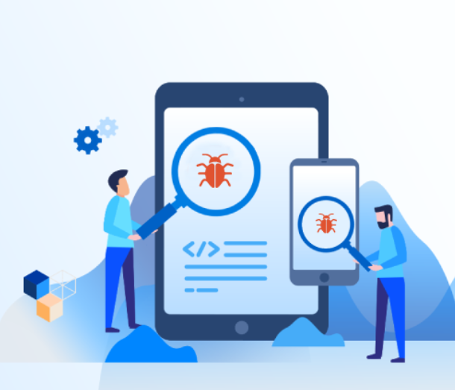
Scope of the Project :
The project has a wide scope, as it is not intended to a particular organization.
This project is going to develop generic software, which can be applied by any businesses organization.
More over it provides facility to its users.
The software is going to provide a huge
amount of summary data.

Slide 11
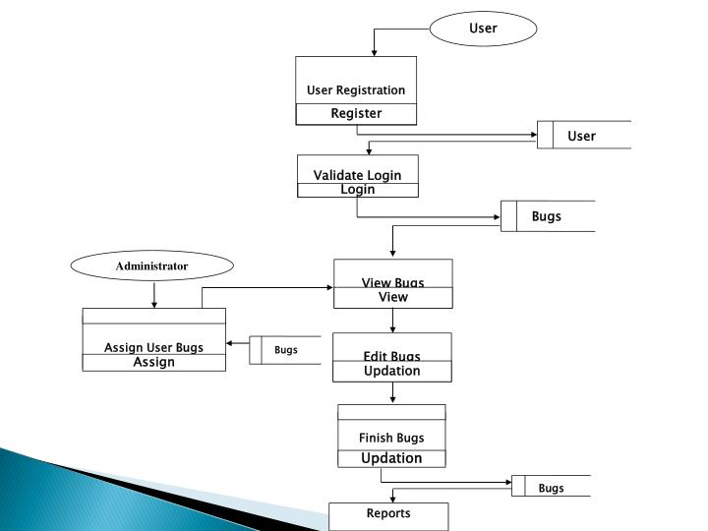
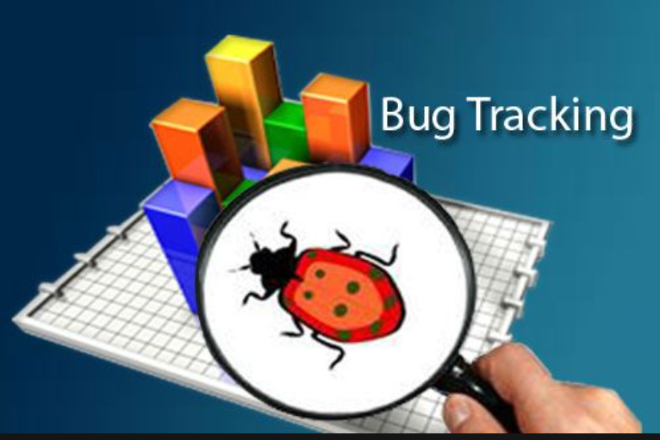



ARCHITECTURAL REPRESENTATION :

Slide 12
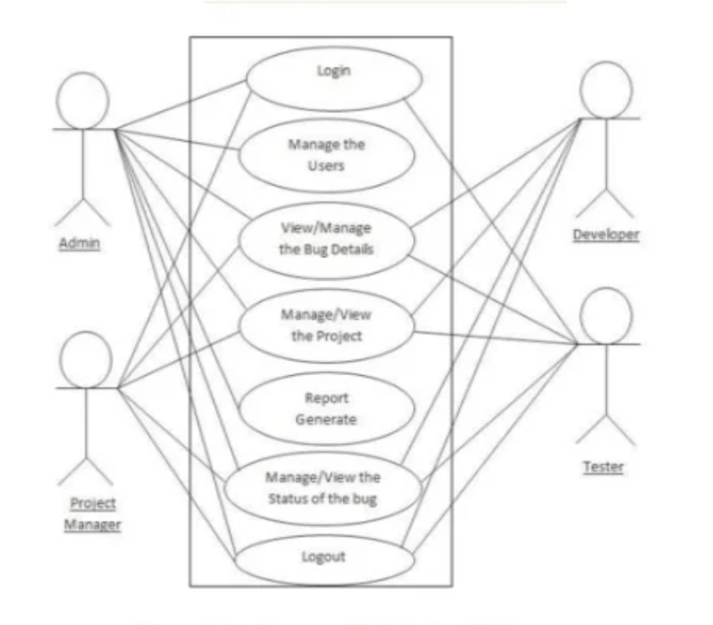
USE CASE DIAGRAMS :

Slide 13
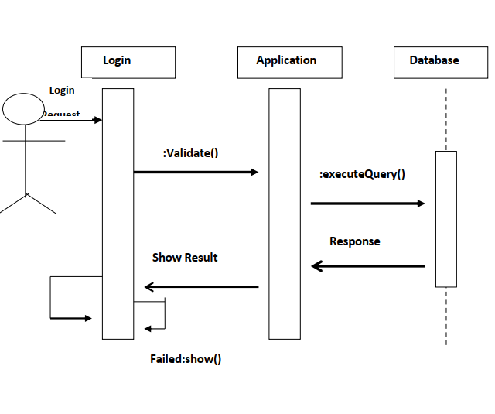
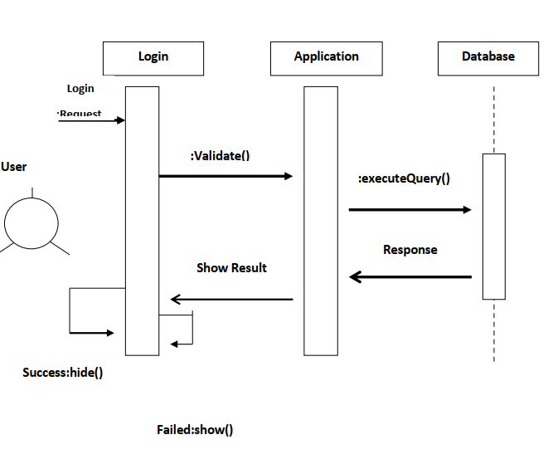
SEQUENCE DIAGRAM:
Sequence Diagram For Administrator :-
Sequence Diagram For User :-

Slide 14
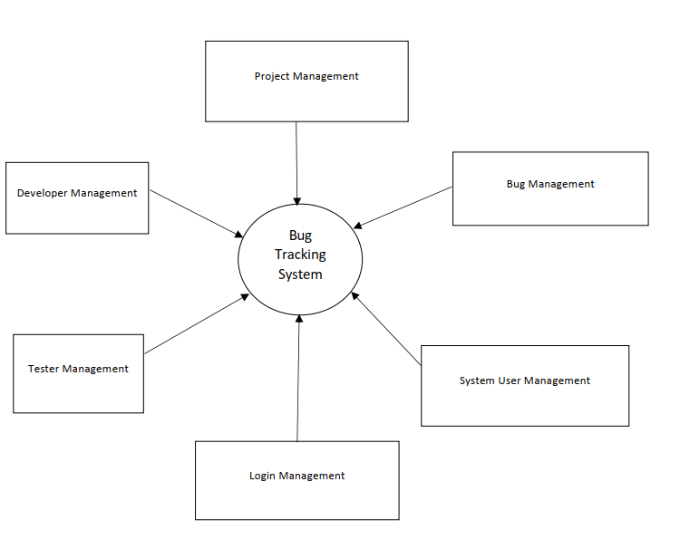
DATA FLOW DIAGRAMS

Slide 15
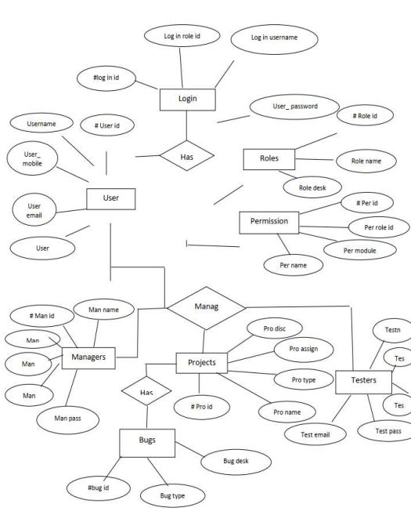
ER DIAGRAM :

Slide 16
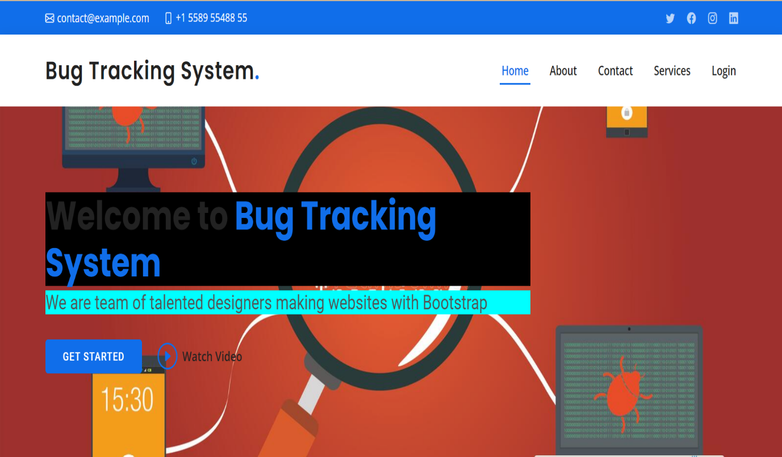
Screen Shorts :
Home page:

Slide 17
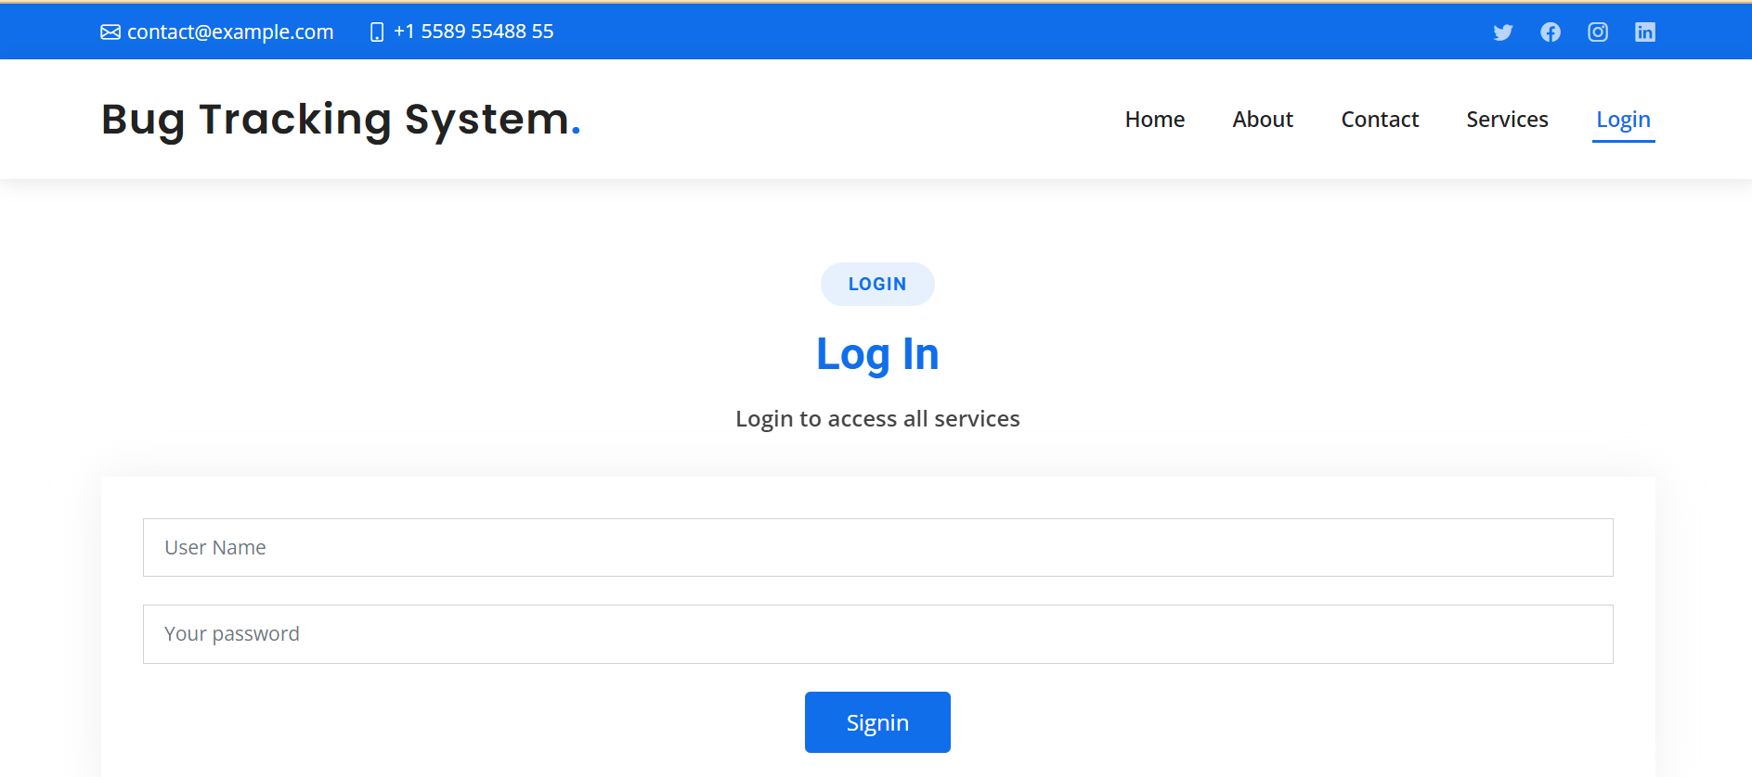
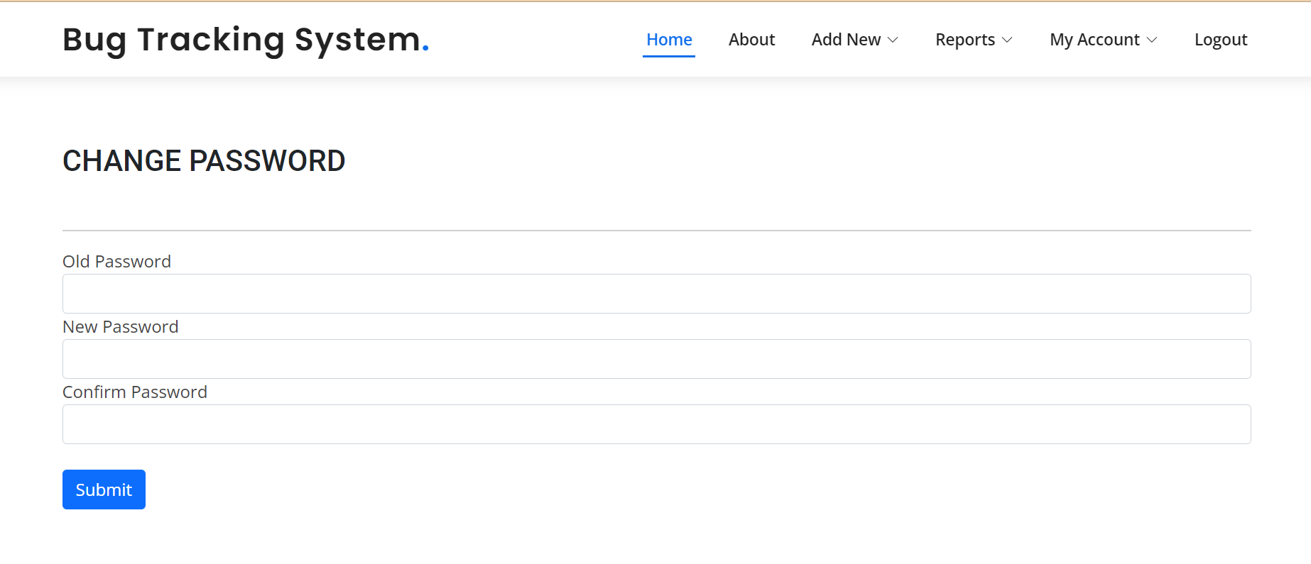
Login Page :
Change password page

Slide 18
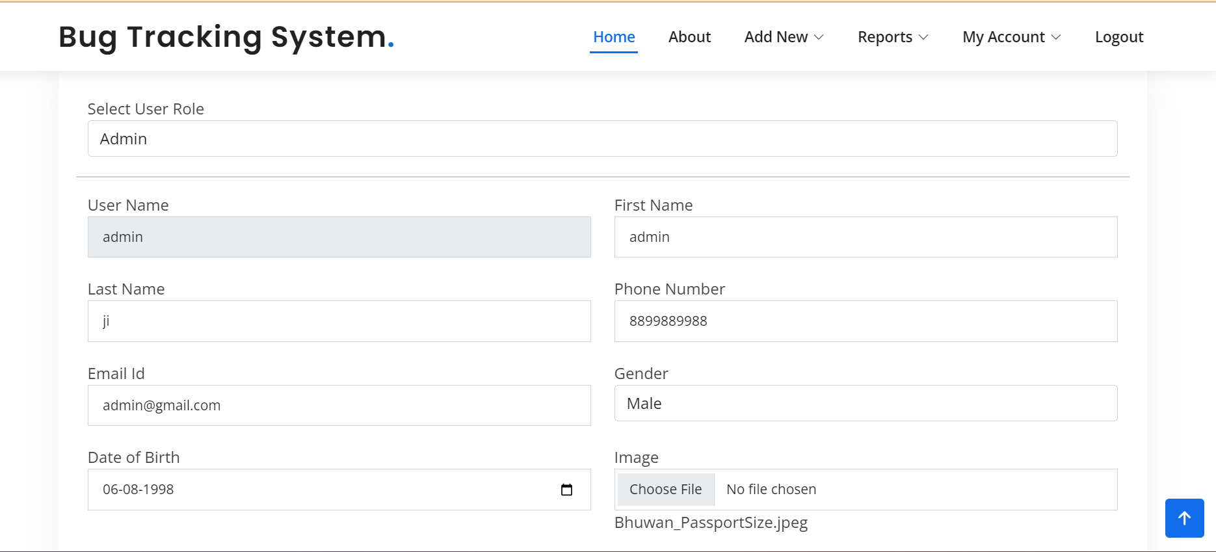
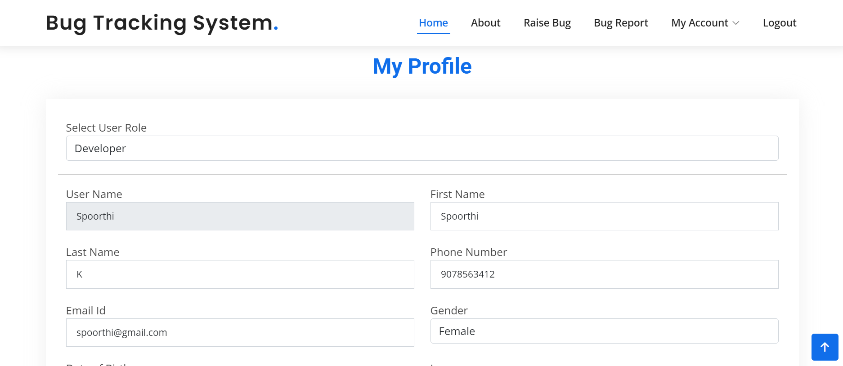
Admin login profile :
User login profile :

Slide 19
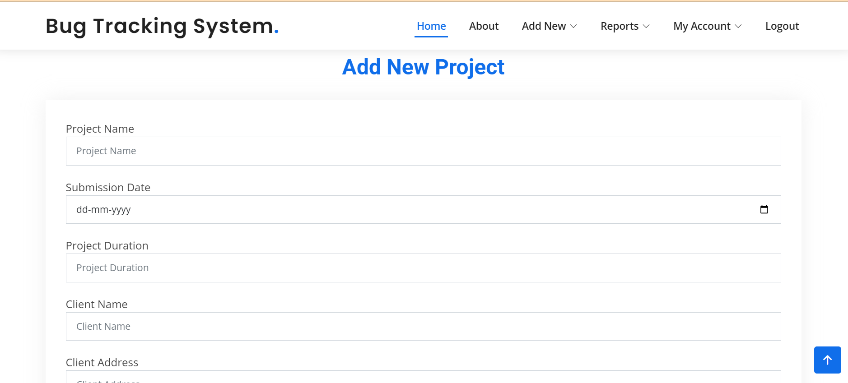
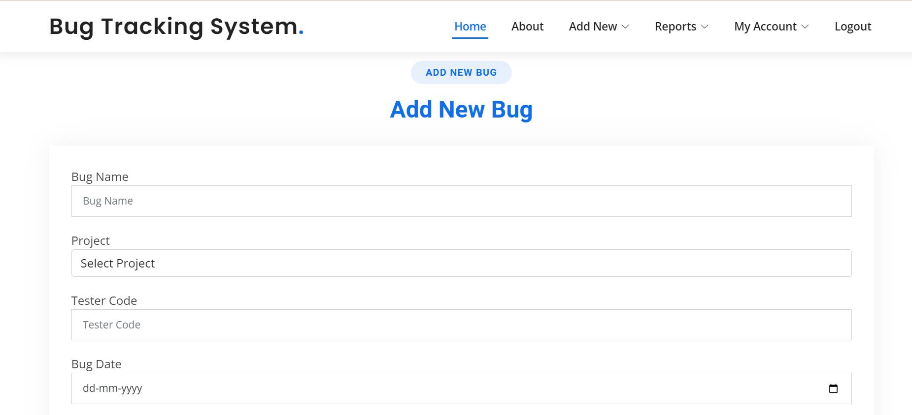
Adding new project
Adding new bug

Slide 20
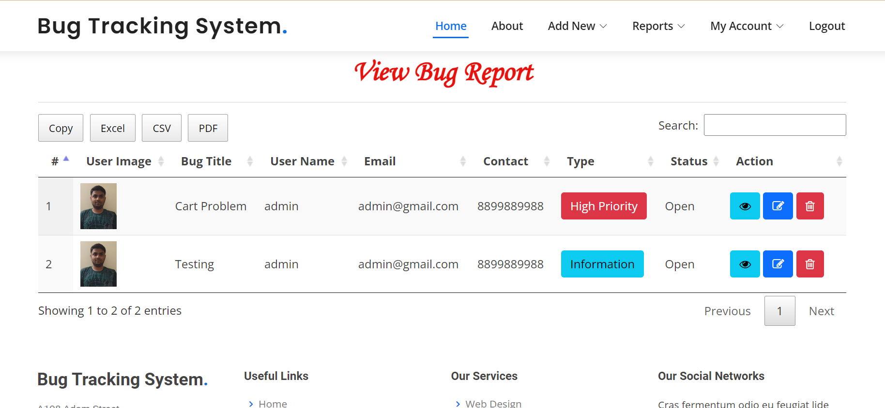
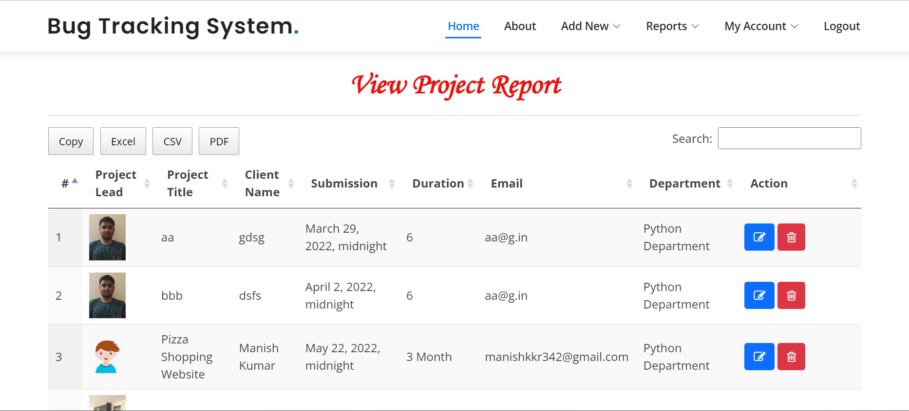
View new report
View project report

Slide 21
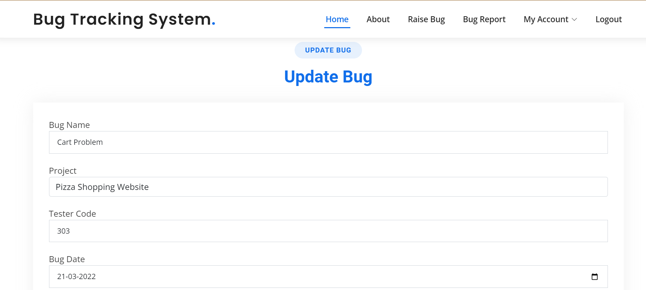
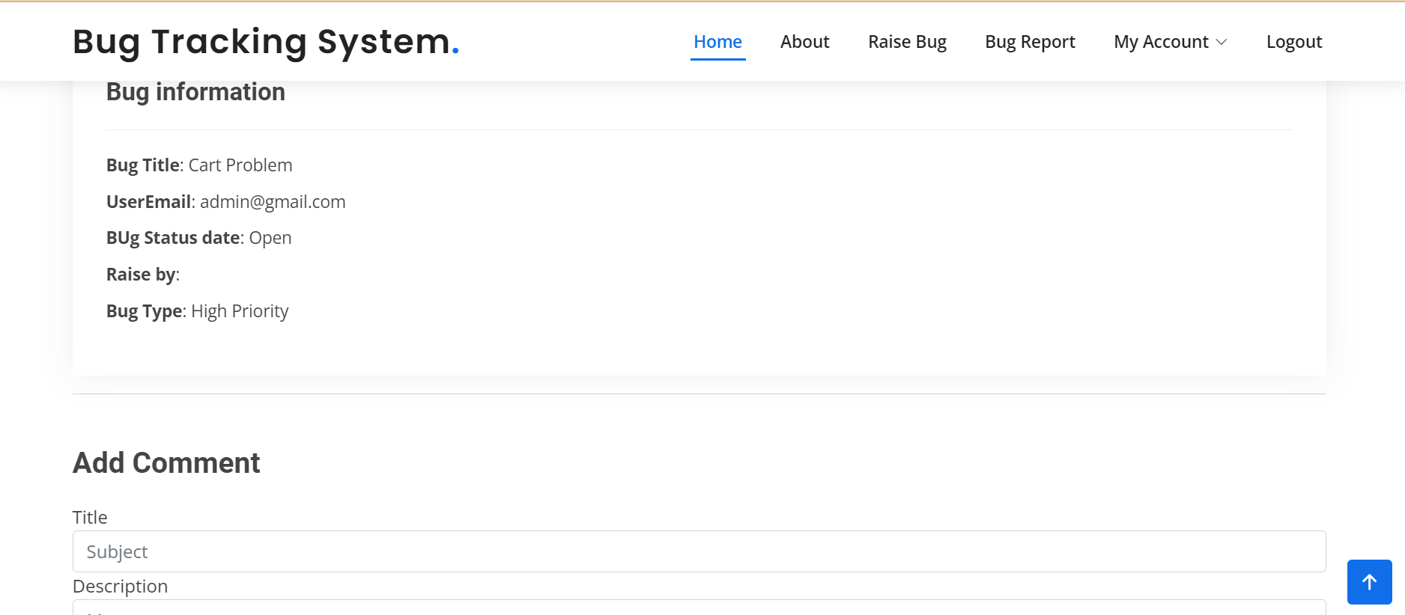
Update Bug
Bug Details

Slide 22
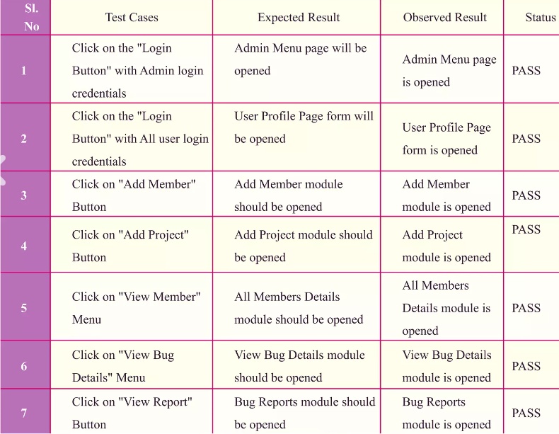
Test cases:

Slide 23
FUTURE ENHANCEMENT :
The development of this project surely helps to solve and address all the problems faced by software testers and developers. It can be implemented in almost any software development firms even Freelance developers can make use of this system on being upgraded in the future. The bugs can be fixed with ease using this system.
Generate reports on the overall performance of the system.
Developing mobile app.
Email/SMS notification to User/Admin.
We will host the platform on online servers to make it accessible worldwide.
Integrate multiple load balancers to distribute the loads of the system.
Implement the backup mechanism for taking backup of codebase and database on regular basis on different servers.

Slide 24
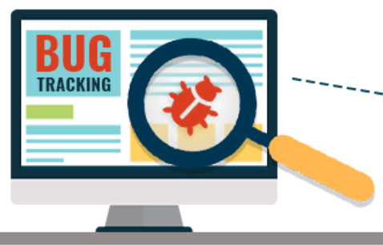
CONCLUSION :
A bug tracking system aids in the effective detection and management of bug in software products.
This project BTS can be used to track bug in project modules and help with error debugging during testing and development processes.
This project eliminates all potential sources of delay in problem reporting levels inside project modules in the software industry.
It is substantially more when the application is installed on a company server.

Slide 25
REFERENCE :
Wikipedia
https://www.geeksforgeeks.org/python-django/
https://www.javatpoint.com
https://www.python.org/
https://www.tutorialspoint/

