Slide 1
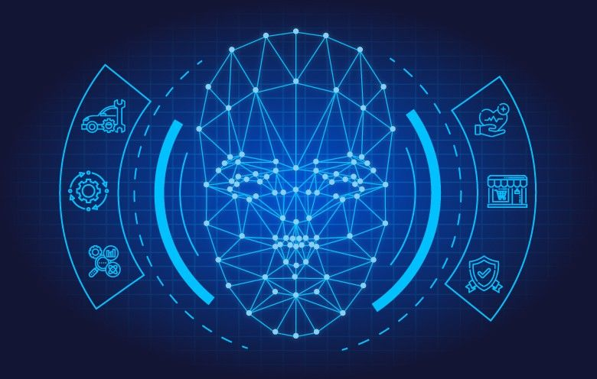
ONLINE ATTENDANCE SYSTEM USING FACE RECOGNITION

Slide 2
INTRODUCTION
Face is the most common biometric used by humans. Recognize the face from a general view point under different illumination conditions, facial expressions. A face recognition system is a technology capable of matching a human face from digital image or a video frame against a database of faces, typically employed to authenticate users through ID verification services, works by pinpointing and measuring facial features from a given image.
Face detection and Face recognition are often employed in various real-world application fields. The purpose of the examination monitoring system using face recognition is to ease the attendance process which consumes lot of time and efforts, it is a convenient and easy way for students and examiner.

Slide 3
Modules
Python: Python is a popular programming language known for its simplicity and versatility. It provides a wide range of libraries and frameworks that facilitate various aspects of web development and machine learning, making it a suitable choice for implementing the system.
OpenCV: OpenCV (Open Source Computer Vision Library) is a powerful computer vision library that offers various functions for image and video processing, including face detection and recognition. It provides pre-trained models and algorithms for face-related tasks.
HTML, CSS, JavaScript: These web technologies are used for designing and developing the user interface of the online examination system. HTML defines the structure, CSS handles the styling, and JavaScript provides interactivity and dynamic functionality.

Slide 4
Tkinter: This library provides a graphical user interface (GUI) toolkit for Python.
OS: This module provides a way to interact with the operating system, including file and directory operations.
csv: This module provides classes for reading and writing CSV files.
PIL (Python Imaging Library): This library provides image processing capabilities, including reading, manipulating, and saving images.
pandas as pd: This library provides data manipulation and analysis tools.

Slide 5
LBPH Algorithm:The LBPH algorithm is a combination of Local Binary Pattern (LBP) and Histogram Oriented Gradients (HOG), which is used to change the performance of face recognition results to be more accurate [7][8]. LBPH is famous for its performance and accuracy, which can recognize a person's face from both the front and the side.
detectMultiScale: This function is used to detect the faces. This function will return a rectangle with coordinates(x,y,w,h) around the detected face. It takes 3 common arguments — the input image, scaleFactor, and minNeighbours. scaleFactor specifies how much the image size is reduced with each scale.

Slide 6
HARDWARE AND SOFTWARE REQUIREMENTS
HARDWARE:
Minimum 5 GB HDD space
Intel core 2 duo or above processor
4 GB RAM required or above
X86 64-bit CPU (Intel/AMD architecture)
Power supply for backup
SOFTWARE:
1. Microsoft Windows 11
2. PyCharm 10.1

Slide 7
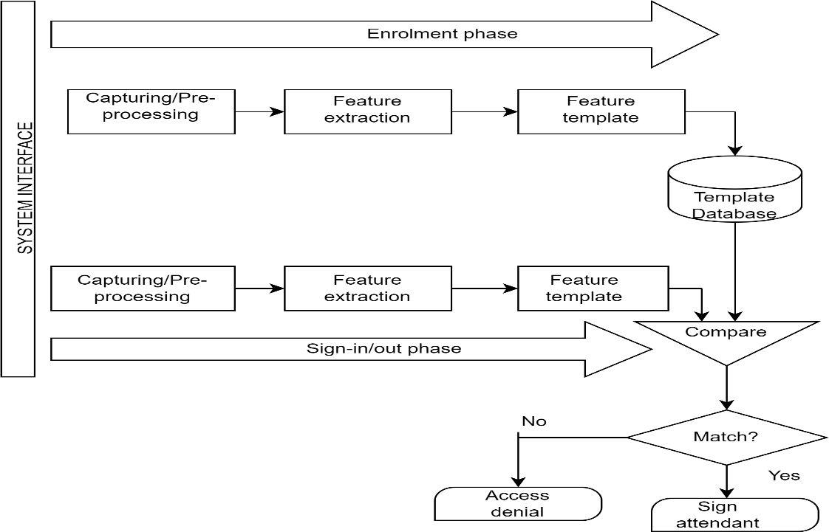
SYSTEM ARCHITECTURE

Slide 8
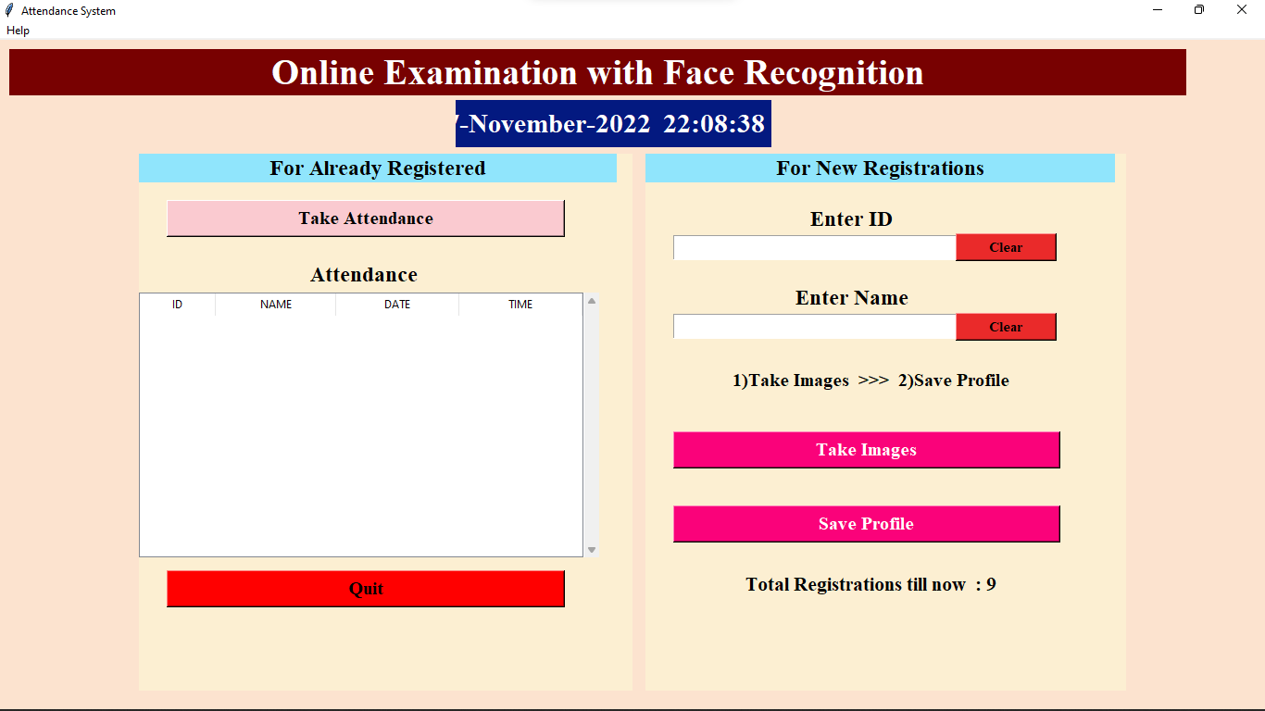
RESULTS

Slide 9
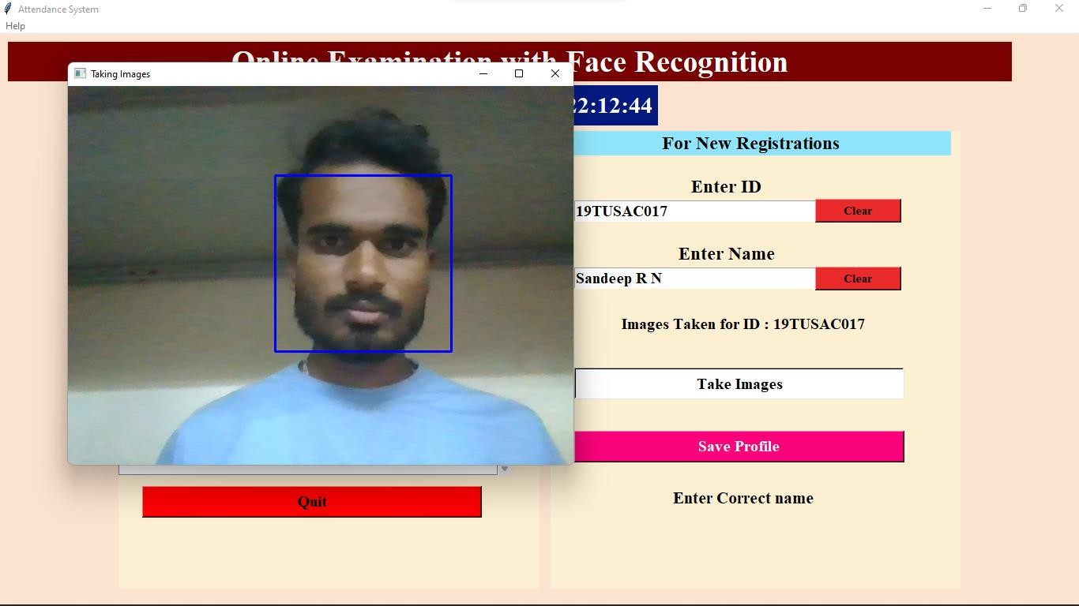

Slide 10
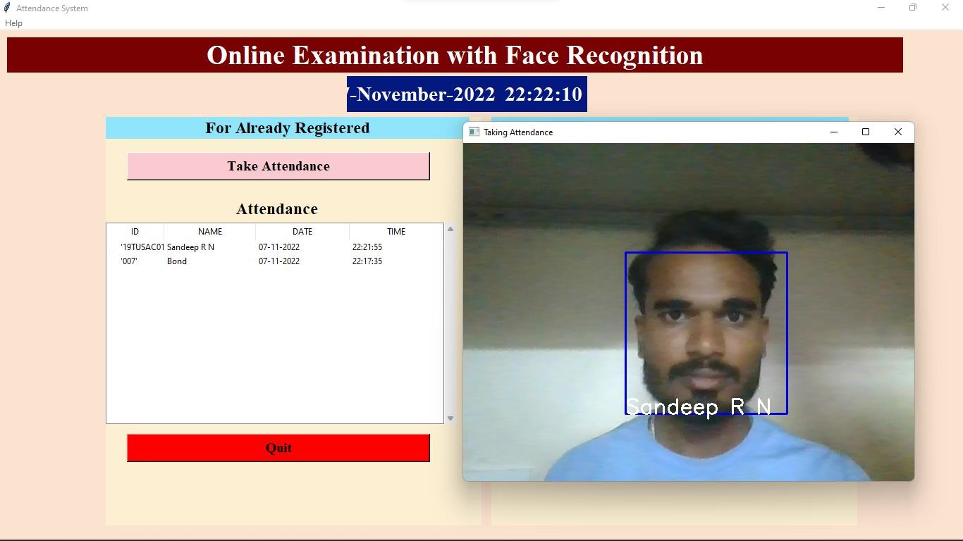

Slide 11
CONCLUSION
Face recognition technologies have been associated generally with very costly top secure applications. Certain applications of face recognition technology are now cost effective, reliable and highly accurate. As a result there are no technological or financial barriers for stepping from the pilot project to widespread deployment.
Face recognition is a difficult problem.
Pre-processing is very important.
It is not enough to use only global features.
Better results can be obtained with different classifications(eigen features).
A good face detection system may need to use more than one method.
Face recognition has many potential applications

Slide 12
FUTURE ENHANCEMENT
The system can be modified to detect and recognize a broader class of faces. Gender classification, happiness index and emotion analysis may be obtained.
We also need to discuss the approach of camera planning based on the result of the position estimation in order to improve face detection effectiveness. In further work, we intend to improve face detection effectiveness by using the interaction among our system, the students and the teacher on the other hand, our system can be improved by integrating viedo-streaming service and lecture archiving system, to provide more profound applications in the field of distance education, Course Management System, Support for Faculty Development(FD).

Slide 13


