Slide 1
GeoFlink
An Efficient and Scalable Spatial Data Stream Management System

Slide 2
INTRODUCTION
We live in an era with increasing use of GPS enabled devices, and hence spatial data is omnipresent. Many applications require real time processing of spatial data.
Geoflink is an efficient and scalable spatial data stream management system capable of handling such huge data and huge throughput, unlike the current system which include GIS and QGIS which cannot do so.
Geoflink is an extension of Apache flink rather than a separate software.

Slide 3
CONTENTS
What is spatial data? Spatial data analysis, Vectors and rasters, spatial data science.
Importance of spatial data.
Spatial data processing
Apache Flink
Geoflink
Architecture of Geoflink
Conclusion

Slide 4
What is Spatial Data?
Any type of data directly or indirectly referencing to a specific geographical area or location is called spatial data.
These are also called geospatial or geographic data.
If a non-spatial data or additional information exists, then it is called the attribute of the spatial data.
There are 2 key types of spatial data:
Geometric – mapped on a two dimensional flat surface.
Geographic – mapped on around a sphere.
Notes:
Spatial data is represented as coordinates of a physical object in a geographic coordinate system.

Slide 5
Spatial Data Analysis
Geospatial analysis is the gathering, display and manipulation of images, GPS or any location data described explicitly in terms of geographic coordinates and implicitly in terms of address or postal code etc.
Geospatial analysis has two important aspects:
Georeferencing
Geocoding
While both are used to fit data into the real world using coordinates, however georeferencing uses vectors and rasters whereas geocoding uses address and location depicters.
Notes:
Explicitly – in a clear and detailed manner.
Implicitly – in a way not directly expressed.

Slide 6
Vectors And Rasters
There are 2 common formats used to store geospatial data:
Vectors
Vectors are the graphical representation of real world.
The vector model uses points and line segments to identify locations on the earth.
Rasters
Raster represent information in pixel grid.
The raster model uses a series of cells to represent locations on the earth.

Slide 7
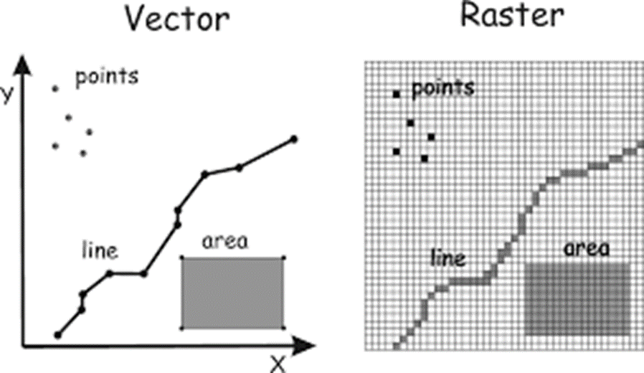

Slide 8
Spatial Data Science
It is subset of data science that focuses on special characteristics of spatial data using modelling to know where and why things happen.
Spatial data science is a growing field in data science used by many industries to evaluate, study and analyze how their product of company will make a profit in that area.
Many companies are investing in SDS as it proves to be an important factor for the future of their company.
Notes:
If focuses on unique characteristics that moves beyond simply looking at where things happened to understand why things happen there.

Slide 9
Importance of spatial data
Web applications use spatial data to provide contextualized results to their users, allowing for more accurate and personalized suggestions to be made. Some common examples include finding the nearest gas station, auto-selecting your nearest store, and providing news and events that are local to you.
Mobile ordering apps can dynamically track you to ensure your order is started and finished at the optimal time.
During the pandemic authorities used the spatial data of patients(the routes they travelled and the relationship between where the lived).

Slide 10
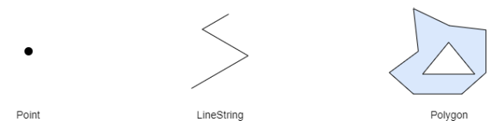
Spatial Data Processing
The most common way that spatial data is processed and analyzed is using a GIS, or, geographic information system.
A system for capturing, storing, checking, integrating, manipulating, analysing and displaying data which are spatially referenced to the earth.
GIS technology was developed from :
Digital cartography and CAD
Database Management Systems
Data structures used by GIS:
Point
LineString
Polygon
Notes:
Digital cartography – is the process by which a data is compiled and formatted into a virtual image.
CAD – Computer aided design.

Slide 11
Components of GIS
A working GIS integrates 5 key components:
Hardware-
Hardware is the computer on which a GIS operates
Software-
GIS software provides the functions and tools needed to store, analyze, and display geographic information
Data-
Geographic data and related tabular data can be collected in-house or purchased from a commercial data provider.
People-
GIS technology is of limited value without the people who manage the system and develop plans for applying it to real world problems.
Methods-
A successful GIS operates according to a well-designed plan and business rules, which are the models and operating practices unique to each organization.

Slide 12



Examples of GIS software
Esri ArcGIS
BatchGeo

Slide 13

Apache Flink
Apache Flink is an open-source, unified stream-processing and batch-processing framework developed by the Apache Software Foundation.
Flink is a distributed stream data flow engine capable of executing tasks in a data-parallel and pipelined manner.
It can perform stateful computations over bounded and unbounded data stream.

Slide 14
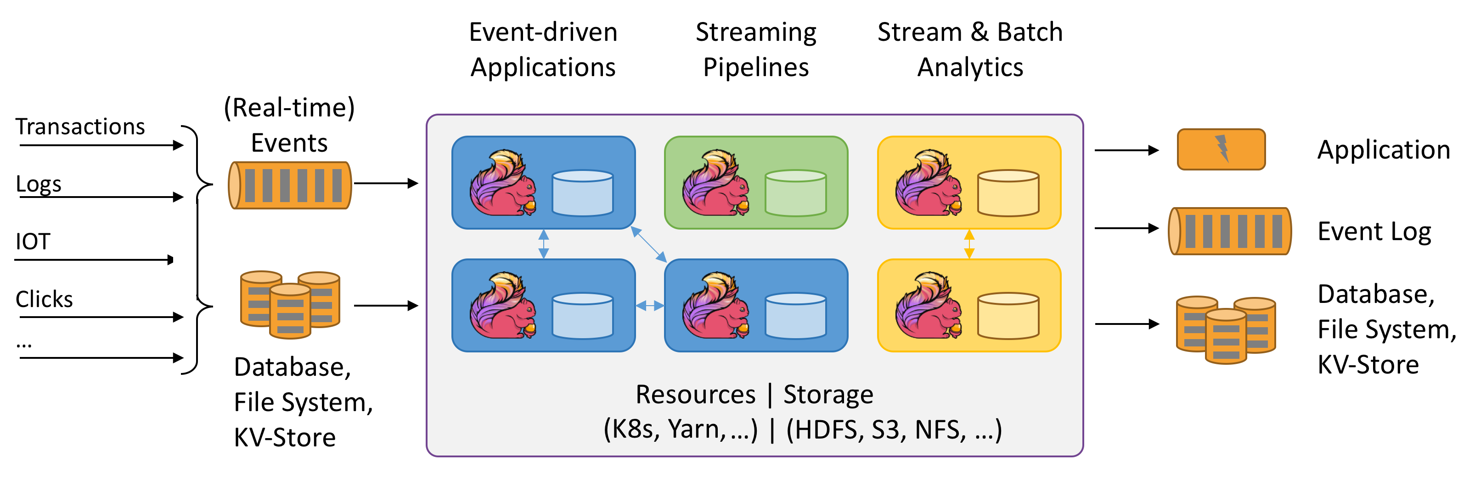
Stateful Computations Over Data Streams
Notes:
K8-Kubernetes
S3-simple storage service

Slide 15
Flink Use Cases
Event-Driven Applications
An event-driven application is a stateful application that ingest events from one or more event streams and reacts to incoming events by triggering computations, state updates, or external actions.
Data Analytics Applications
With a sophisticated stream processing engine, analytics can also be performed in a real-time fashion. Instead of reading finite data sets, streaming queries or applications ingest real-time event streams and continuously produce and update results as events are consumed.
Data Pipeline Applications
Data pipelines serve a similar purpose as ETL jobs. They transform and enrich data and can move it from one storage system to another. However, they operate in a continuous streaming mode instead of being periodically triggered.
Notes:
ETL – Extract Transform Load

Slide 16
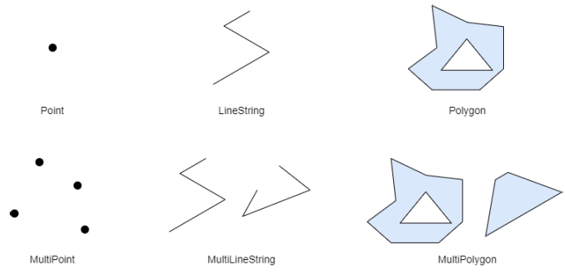
Geoflink
Geoflink is an efficient and scalable spatial data stream management system developed to handle real-time spatial stream.
Geoflink support spatial objects, indexes and continuous queries over spatial data streams.
GeoFlink supports the following types of spatial objects in 2D space:
Point
LineString
Polygon
MultiPoint
MultiLineString
MultiPolygon

Slide 17
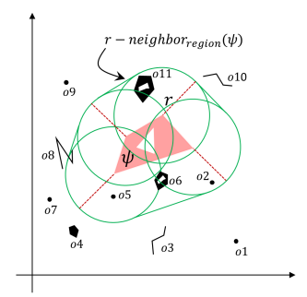
Some Important Concepts
r – Neighbors
All of the GeoFlink’s spatial queries require neighborhood computation.
We define r-neighborregion and r-neighbors(ψ) given a spatial object ψ and distance r.
Any object which lies within or overlaps the r distance of ψ is r-neighbors(ψ).

Slide 18
SPATIAL STREAM INDEXING
Spatial data index structures can be classified into two broad categories:
Tree-based
Tree based spatial indexes can significantly speed-up the spatial query processing.
However their maintenance and restructuring cost is high especially during continuous updates (insertions and deletions).
Grid-based
Grid based indexes enable fast updates but cannot answer queries as efficiently as tree based indexes.

Slide 19
Geoflink Grid Index
Geoflink is a distributed spatial data stream management system, hence an index which can work efficiently in distributed environment in the presence of heavy updates is needed.
And the obvious choice is grid index which is not fast but can handle these heavy updates.
The grid index is used in GeoFlink for filtering and pruning objects during spatial queries execution.
Notes:
Pruning- removal of unwanted data

Slide 20
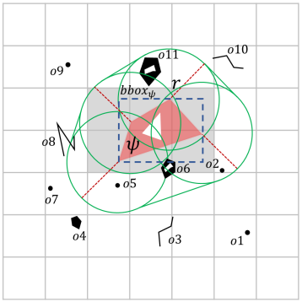
Grid Index of Spatial object (ψ) and its nearest neighbor

Slide 21
Spatial Continuous Queries
There are 3 basic spatial continuous queries in GeoFlink:
Spatial Range-
This query comes in handy when a user wants to fetch spatial objects within certain distance of query objects.
Spatial kNN-
This query is useful in fetching k nearest spatial objects of a query object.
Spatial Join-
Spatial join is a useful operator where one stream is joined with another based on some query distance. Join is an expensive operator as it involves Cartesian product between the two streams.
Notes:
Cartesian product -

Slide 22
Each Geoflink query has 2 variants:
Real-time:
Real-time query is triggered with the arrival of new stream tuples. Precisely, as a new tuple is received by GeoFlink, it is processed by real-time query and a corresponding output is generated.
Window-based:
Triggering of window-based query is based on window size and window slide step. The window-based query performs computation on all the spatial objects in the window and generates output corresponding to all the window contents. The query output is generated every slide step (Ws) in case of sliding window or every window size (Wn) in case of tumbling window.
Notes:
tumbling window-When a windowed query processes each window in a non-overlapping manner
sliding window -Sliding windows can be overlapping

Slide 23
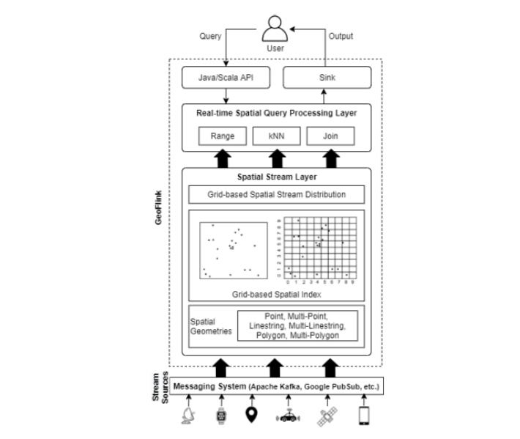
Geoflink Architecture
Geoflink architecture has 2 important layers:
Spatial Stream Layer
This layer is responsible for converting incoming data streams into spatial data stream.
Apache flink treats spatial data stream as ordinary data stream which leads to insufficient processing. Geoflink convers it into spatial data stream of spatial objects.
Real-Time spatial query processing layer
This layer provides support for a number of basic spatial operators required by most of the spatial data processing and analysis applications.
Users can use Java or Scala to write the spatial queries or custom applications.
This layer makes extensive use of the grid index for efficient queries’ execution.
Notes:
Sink writes partitioned files to filesystems supported by the Flink File System.
User can register queries to GeoFlink through java/Scala API and its output is available via a variety of sinks provided by Apache flink.

Slide 24
Conclusion
Geoflink is an efficient and scalable spatial data stream management system.
Geoflink supports spatial datatypes, indexes and continuous queries.
Geoflink supports spatial grid index for efficient query processing.
GeoFlink supports incoming data streams in GeoJSON, CSV and WKT formats.
Notes:
CSV-Comma Separated Values
WKT-Well-known text

Slide 25
Thank You

