Slide 1
CHINOOK MUSIC STORE
Sales & Customer Analytics — Findings and Recommendations
Spoorthi H R | 30-09-2026

Slide 2
AGENDA
What We'll Cover
01
Problem Statement
Why Chinook needs this analysis
02
Data Overview
Schema, scope, and data quality
03
Key Metrics & Visualizations
Revenue, customers, genres, churn
04
Insights & Recommendations
What the data means for the business
Chinook Music Store — Sales & Customer Analytics
2

Slide 3
PROBLEM STATEMENT
The Business Question
As Data Analyst at Chinook, the objective is to analyze music record sales data to uncover actionable insights and recommend a data-backed strategy for the company's performance in the physical & digital music market.
Who are our customers and where are they?
What sells, and where should we invest next?
Who is at risk of churning — and why?
Chinook Music Store — Sales & Customer Analytics
3

Slide 4
DATA OVERVIEW
Dataset at a Glance
11
59
3,503
Tables
Customers
Tracks
614
25
24
Invoices
Genres
Countries
11 relational tables covering customers, invoices, tracks, albums, artists and genres — spanning 24 countries.
Chinook Music Store — Sales & Customer Analytics
4

Slide 5
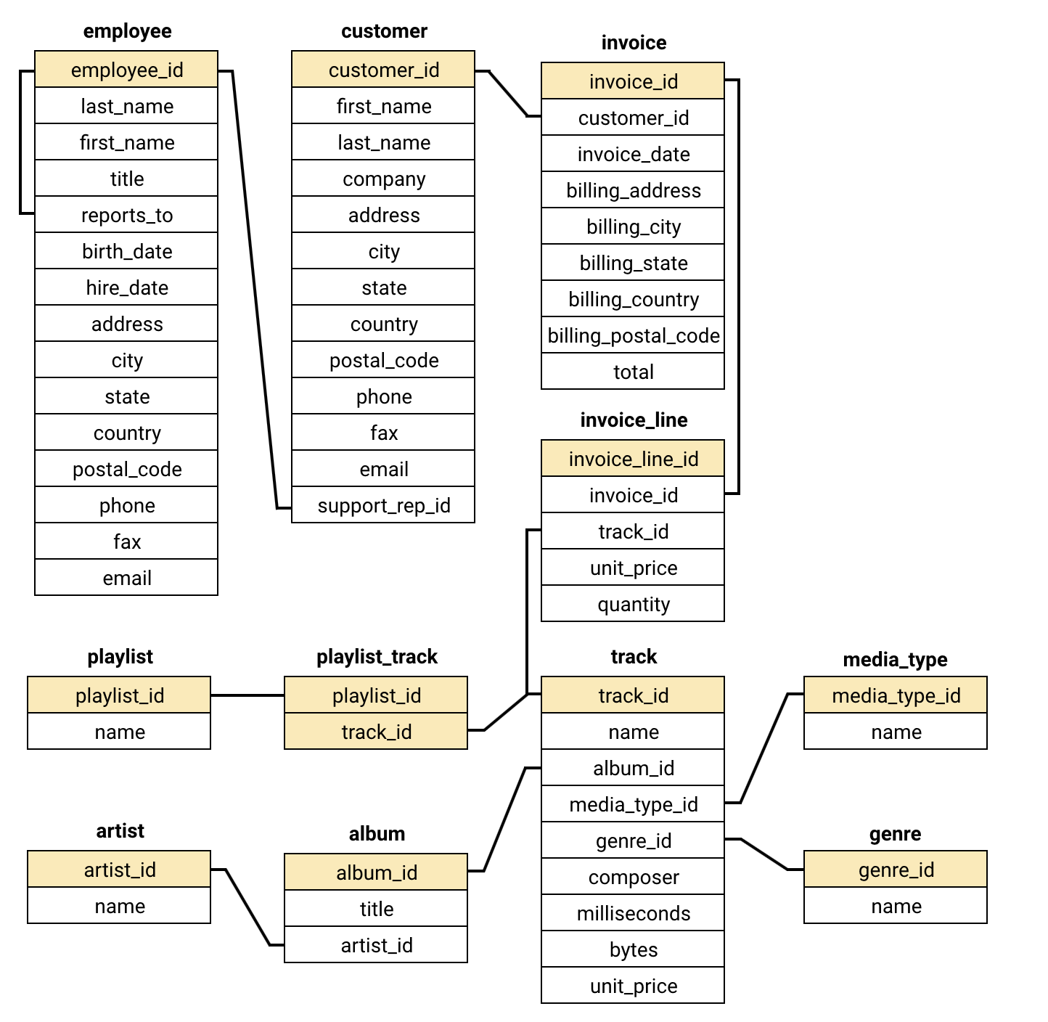
DATA OVERVIEW
Database Schema
Chinook Music Store — Sales & Customer Analytics
5

Slide 6
KEY METRICS — DATA QUALITY
Data Quality: No Duplicates, Expected NULLs
0 duplicate primary keys found across the dataset.
NULLs are optional fields (company, fax, state, postal code) — not data defects.
Left as NULL rather than imputed, to avoid misrepresenting the data.
Chinook Music Store — Sales & Customer Analytics
6

Slide 7
KEY METRICS — PRODUCT PERFORMANCE
Top-Selling Tracks in the USA
"War Pigs" by Cake
leads USA revenue among individual tracks.
Rock and Alternative-leaning tracks dominate the top 5 — consistent with genre-level trends.
Chinook Music Store — Sales & Customer Analytics
7

Slide 8
KEY METRICS — GENRE PERFORMANCE
Rock Dominates USA Sales
53.4%
of all USA revenue comes from Rock alone
Rock, Alternative & Punk and Metal together = ~78% of USA revenue.
This same pattern holds in 22 of 23 non-USA countries — Rock leads almost everywhere.
Recommendation: prioritize Rock / Alt-Punk / Metal titles for promotion and new-label advertising spend.
Chinook Music Store — Sales & Customer Analytics
8

Slide 9
KEY METRICS — CUSTOMER GEOGRAPHY
Where Our Customers & Revenue Come From
Chinook Music Store — Sales & Customer Analytics
9

Slide 10
KEY METRICS — PURCHASE BEHAVIOR
How Customers Buy
$7.67
10.41
7.75
Average order value
Average invoices per customer
Average tracks per invoice
Every customer in the dataset has purchased across 3 or more distinct genres — engagement is broad, not narrow.
Chinook Music Store — Sales & Customer Analytics
10

Slide 11
KEY METRICS — RETENTION
Retention & Churn
37.3%
22 / 59
Overall churn rate
(no purchase in 3+ months)
customers have not purchased in the last 3 months and need re-engagement outreach
Chinook Music Store — Sales & Customer Analytics
11

Slide 12
INSIGHTS — CUSTOMER LOYALTY
Tenure Drives Volume, Not Basket Size
Order value stays flat between the two groups (~$7.70) — loyalty programs should target purchase frequency, not basket size.
Chinook Music Store — Sales & Customer Analytics
12

Slide 13
INSIGHTS — RISK PROFILING
1 in 3 Customers Is High-Risk
No age/gender data exists, so risk is scored on purchase recency instead — days since a customer's last order.
Recency beats spend as a signal:
several High-risk customers have solid historical spend but have gone quiet — a spend-only view would miss them.
Chinook Music Store — Sales & Customer Analytics
13

Slide 14
INSIGHTS — LIFETIME VALUE
Projected Annual Value: Top Customers
CLV proxy = (total spend / tenure days) × 365 — a run-rate projection, since there's no subscription structure to model.
Checked churned customers for a pre-drop-off pattern:
none found — most simply stop without a gradual decline, favoring a time-based re-engagement trigger over behavior-based detection.
Chinook Music Store — Sales & Customer Analytics
14

Slide 15
INSIGHTS — CROSS-SELL
Rock, Metal & Alt-Punk Sell Together
Genre pairs bought in the same invoice cluster tightly around Rock.
Recommendation:
Build "customers who bought this also bought" prompts and bundle promotions around the Rock / Metal / Alt-Punk cluster.
Chinook Music Store — Sales & Customer Analytics
15

Slide 16
INSIGHTS — REGIONAL RISK
Churn Varies Sharply by Country
Smaller markets (Germany, Brazil) show much higher churn than the USA/UK.
Caveat:
these are small samples (2-5 customers) — a couple of inactive customers swings the % a lot. Treat as a watch-list, not a confirmed trend.
Chinook Music Store — Sales & Customer Analytics
16

Slide 17
RECOMMENDATIONS
What Chinook Should Do Next
1
Prioritize Rock / Alt-Punk / Metal for new-label advertising — these 3 genres drive ~78% of USA revenue.
2
Launch a 60-day inactivity trigger email/offer once a customer passes 60 days of silence — 37% churn shows re-engagement can't wait.
3
Bundle cross-genre promotions around the Rock–Metal–Alt-Punk cluster, the strongest co-purchase pattern in the data.
4
Build frequency-based loyalty perks (not spend-based) — order value is flat across tenure, frequency is what grows.
Chinook Music Store — Sales & Customer Analytics
17

Slide 18
Thank You
Questions & discussion welcome
Spoorthi H R

