Slide 1

AGILEGRAPH
Graph-Based Cryptographic Risk Analysis for Post-Quantum Migration
PHASE 2 | 2026–2027
Project Team:
• Spoorthi — NNM23CB058
• Sindhoora R — NNM23CB057
• Nivedita V Shetty — NNM23CB033
• Sujan S — NNM23CB062
Project Guide:
Ms. Madhushree
Assistant Professor
Dept. of Computer Science (Cyber Security)
NMAM Institute of Technology, Nitte
Department of Cyber Security | NMAMIT, Nitte
Page 1

Slide 2

PRESENTATION OUTLINE
1
Introduction
6
Proposed Methodology
2
Research Gap
7
System Architecture
3
Review of Phase 1
8
Tools & Technologies
4
Problem Statement
9
Results & Performance
5
Objectives
10
Conclusion & Future Scope
Page 2

Slide 3
INTRODUCTION
Background
• Modern applications use encryption such as RSA and ECC to protect data.
• Future quantum computers may break many widely used encryption methods.
• Attackers may store encrypted data today and try to decrypt it later (Harvest Now, Decrypt Later).
• Existing tools may miss risks spread across connected software components.
Why AgileGraph?
• Scans software for cryptographic components across multiple languages.
• Connects components through a property graph to reveal exposure paths.
• Scores and prioritizes migration risks using deterministic metrics.
• Prepares actionable CBOM reports for post-quantum cryptographic agility.
Department of Cyber Security | NMAMIT, Nitte
Page 3

Slide 4
RESEARCH GAP
Existing Tools
• Dependency scanners focus mainly on third-party software packages.
• Traditional tools may miss relationships between cryptographic components.
• Risk prioritization is often subjective rather than mathematically grounded.
• Code components are often analyzed separately without call context.
What AgileGraph Adds
• Scans multiple programming languages (Python, Java, Go).
• Builds a graph of connected software components and endpoints.
• Calculates deterministic cryptographic risk scores and Mosca urgency.
• Uses GATv2 to analyze graph relationships and connected patterns.
• Supports CycloneDX CBOM reporting and immutable audit logs.
Department of Cyber Security | NMAMIT, Nitte
Page 4

Slide 5
REVIEW OF PHASE 1
Work Completed in Phase 1
• Reviewed research on cryptographic misuse and post-quantum migration.
• Developed an initial single-language static-analysis prototype.
• Explored graph-based representation of software dependencies.
• Identified evaluator feedback on the need for multi-language automated risk prioritization.
Progress in Phase 2
• Expanded scanning across 3 major enterprise programming languages.
• Implemented 7-factor linear risk scoring and the Mosca Readiness Index.
• Developed the 6-node property graph and evaluated the GATv2 model.
• Tested and verified the system across an 8-repository corpus with 451 passing tests.
Department of Cyber Security | NMAMIT, Nitte
Page 5

Slide 6
PROBLEM STATEMENT
Problem
Existing tools do not provide a complete graph-based assessment of cryptographic risks across software projects, making post-quantum migration priorities difficult to determine.
Who Is Affected?
• Enterprise software development teams.
• Banking and financial transaction systems.
• Organizations managing long-term confidential data.
Project Scope
• Analyze source code and configuration files.
• Identify cryptographic risks and vulnerabilities.
• Recommend clear, sprint-level migration priorities.
Department of Cyber Security | NMAMIT, Nitte
Page 6

Slide 7
OBJECTIVES
1
Cryptographic Discovery: Identify cryptographic algorithms and components across supported languages.
2
Graph Construction: Represent software components and relationships using a property graph.
3
Risk Prioritization: Calculate risk scores and migration urgency using the heuristic model and Mosca Index.
4
Graph Learning: Evaluate GATv2 for identifying risk patterns across connected components.
5
Migration Support: Generate CBOM reports and maintain auditable cryptographic records.
Department of Cyber Security | NMAMIT, Nitte
Page 7

Slide 8
PROPOSED METHODOLOGY
1
2
3
4
Cryptographic
Discovery
Scan code and identify algorithms, keys, and configurations.
Graph
Construction
Connect files, functions, crypto assets, and dependencies.
Risk
Assessment
Calculate risk scores and Mosca-based urgency.
Graph Learning
& Reporting
Use GATv2 and generate prioritized results and CBOM.
Output: Risk scores • Migration priorities • Cryptographic Bill of Materials (CBOM)
Department of Cyber Security | NMAMIT, Nitte
Page 8

Slide 9
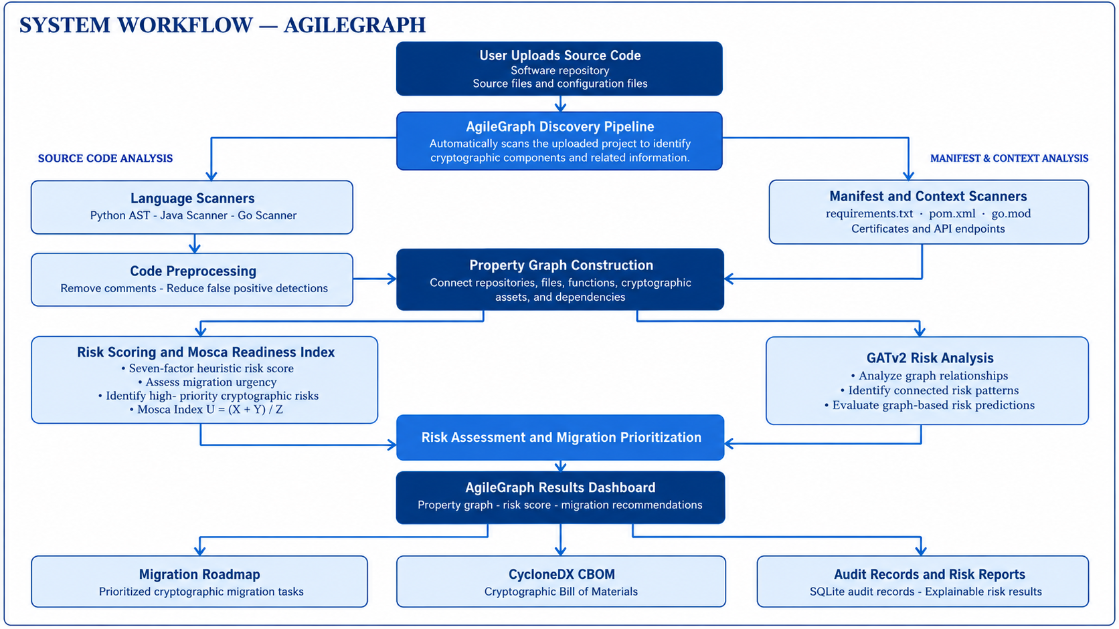
Department of Cyber Security | NMAMIT, Nitte
Page 9

Slide 10
TOOLS & TECHNOLOGIES
CODE ANALYSIS
• Python AST + Regex Parsers
• Scan code and identify crypto components.
GRAPH MODELING
• NetworkX
• Build and analyze dependency graphs.
MACHINE LEARNING
• PyTorch Geometric + GATv2
• Learn patterns from graph relationships.
BACKEND
• FastAPI + Pydantic
• Build backend APIs and validate data.
FRONTEND
• React + TypeScript
• Display interactive graphs and risk results.
REPORTING
• SQLite + CycloneDX v1.6
• Store audit records and generate CBOMs.
Department of Cyber Security | NMAMIT, Nitte
Page 10

Slide 11
DATASETS & BENCHMARK CORPUS
Reported Risk Distribution
• 251 Low Risk • 166 Medium Risk • 103 High Risk
Benchmark Overview
• Eight open-source software repositories.
• 4,558 source files analyzed across projects.
• 520 structural evaluation nodes extracted.
• Projects include multiple programming languages (Python, Java, Go).
• Covers diverse software architectures: cryptography libraries, JWT tokens, and network servers.
Low Risk
251
Medium Risk
166
High Risk
103
Evaluation
Leave-One-Project-Out (LOPO) and stratified 5-fold validation
Page 11

Slide 12
DISCOVERY & PROPERTY GRAPH ENGINE
LAYER 1 | 7 MULTI- MODEL SCANNERS
Language Scanners: Python AST, Java Scanner, Go Scanner
Manifest & Dependency Scanner: requirements.txt, pom.xml, go.mod
Contextual Scanners: X.509 Certificates, API Endpoints, and Sensitive Data
LAYER 2 | PREPROCESSING
Removes comments before analysis to reduce false-positive detections.
LAYER 3 | PROPERTY GRAPH
Represents repositories, files, functions, crypto assets, dependencies, and infrastructure.
Why a property graph? It helps trace how risks may connect across software components.
Page 12

Slide 13
RISK SCORING & MOSCA INDEX
2. Mosca Index
• Compares data-protection time and migration time with expected quantum-threat timeline.
• Formula: U = (X + Y) / Z
• X = Data Shelf Life, Y = Migration Timeline, Z =Quantum Threat Horizon.
• Helps assess whether migration should begin sooner.
3. Migration Priority
• Immediate Action
• Strategic Migration
• Monitored Retention
• Routine Maintenance
1. Risk Scoring
• Algorithm vulnerability
• Key weakness and exposure
• Dependency importance
• Known vulnerabilities
• Migration difficulty
• Data confidentiality period
Risk score + urgency → clearer migration priorities
Page 13

Slide 14
RESULTS AND PERFORMANCE
Model | Accuracy | F1-Score
Static Heuristic Rules | 52.12% | 0.3567
Feature-Only MLP | 98.08% | 0.9802
Randomized-Edge GATv2 | 74.81% | 0.6629
Canonical GATv2 | 83.08% | 0.7176
Stratified 5-Fold GATv2 | 84.81% | 0.8005
Key Observation: Stratified 5-fold GATv2 reported 84.81% accuracy, outperforming the randomized-edge control by +10.00%.
Department of Cyber Security | NMAMIT, Nitte
Page 14

Slide 15
GATV2 EVALUATION RESULTS
89.38%
Reported unweighted mean accuracy
+8.27%
Reported gain over randomized-edge control
96.55%
Reported high-risk precision
p < 0.001
Reported statistical significance
Graph relationships may provide useful signals for identifying connected cryptographic risks.
Department of Cyber Security | NMAMIT, Nitte
Page 15

Slide 16
SENSITIVITY & PLATFORM VERIFICATION
ρ > 0.94
Reported rank correlation under parameter changes
84.17% ± 1.28%
Reported multi-seed performance
100% Pass
Reported backend and frontend tests (451 tests)
CycloneDX v1.6
CBOM export and audit logging
Prioritization rankings remain stable and robust across sensitivity tests and 451 automated test cases.
Page 16

Slide 17
CONCLUSION
1
Discovery: Identifies cryptographic components across supported programming languages.
2
Graph Modeling: Connects software components and dependencies in a property graph.
3
Risk Prioritization: Combines risk scoring with Mosca-based urgency.
4
Graph Learning: Evaluates GATv2 for learning risk patterns from graph structure.
5
Reporting: Supports CBOM generation and audit logging.
AgileGraph supports evidence-based planning for post-quantum migration.
Page 17

Slide 18
FUTURE SCOPE
Runtime Analysis
Monitor cryptographic operations while applications run.
Automated Migration
Explore assisted replacement of vulnerable algorithms.
Security Verification
Test migrated systems for protocol weaknesses.
CI/CD Integration
Add cryptographic checks to development pipelines.
Performance Testing
Evaluate post-quantum methods on different hardware.
Improved Reporting
Extend CBOM and software-supply-chain audit support.
Page 18

Slide 19
REFERENCES
Key References
[1] National Institute of Standards and Technology (NIST), “Module-Lattice-Based Key-Encapsulation Mechanism Standard,” Federal Information Processing Standards Publication (FIPS PUB) 203, Aug. 2024
[2] National Institute of Standards and Technology (NIST), “Module-Lattice-Based Digital Signature Standard,” Federal Information Processing Standards Publication (FIPS PUB) 204, Aug. 2024.
[3] National Institute of Standards and Technology (NIST), “Stateless Hash-Based Digital Signature Standard,” Federal Information Processing Standards Publication (FIPS PUB) 205, Aug. 2024.
[4] M. Mosca, “Cybersecurity in an Era with Quantum Computers: Will We Be Ready?,” IEEE Security & Privacy, vol. 16, no. 5, pp. 38–41, Sep./Oct. 2018, doi: 10.1109/MSP.2018.3761723. (Also: IACR Cryptology ePrint Archive, Report 2015/1075, 2015).
[5] P. W. Shor, “Polynomial-Time Algorithms for Prime Factorization and Discrete Logarithms on a Quantum Computer,” SIAM Journal on Computing, vol. 26, no. 5, pp. 1484–1509, Oct. 1997, doi: 10.1137/S0097539795293172.
[6] S. Brody, U. Alon, and E. Yahav, “How Attentive Are Graph Attention Networks?,” in Proc. 10th Int. Conf. Learn. Represent. (ICLR), Virtual Event, Apr. 2022, pp. 1–18.
[7] P. Veli kovi , G. Cucurull, A. Casanova, A. Romero, P. Liò, and Y. Bengio, “Graph Attention Networks,” in Proc. 6th Int. Conf. Learn. Represent. (ICLR), Vancouver, Canada, Apr. 2018, pp. 1–12.
[8] National Institute of Standards and Technology (NIST), “Migration to Post-Quantum Cryptography: Quantum Readiness: Cryptographic Discovery,” NIST Special Publication (SP) 1800-38B (Preliminary Draft), NCCoE, Dec. 2023.
[9] OWASP Foundation, “CycloneDX v1.6 Released, Advances Software Supply Chain Security with Cryptographic Bill of Materials and Attestations,” OWASP CycloneDX News, Apr. 2024. [Online]. Available: https://cyclonedx.org/news/cyclonedx-v1.6-released/
[10] M. Egele, D. Brumley, Y. Fratantonio, and C. Kruegel, “An Empirical Study of Cryptographic Misuse in Android Applications,” in Proc. 2013 ACM SIGSAC Conf. Comput. Commun. Secur. (CCS), Berlin, Germany, Nov. 2013, pp. 73–84, doi: 10.1145/2508859.2516693.
Page 19

Slide 20
THANK YOU
Department of Cyber Security | NMAMIT, Nitte
Page 20

Slide 21
Q & A
Questions, Technical Discussion & Evaluation
AGILEGRAPH
Department of Cyber Security | NMAMIT, Nitte
Department of Cyber Security | NMAMIT, Nitte
Page 21

