Slide 1
TRANSLINGUA
AI POWERED MULTI LANGUAGE TRANSLATOR

Slide 2
Introduction
AI-powered multi-language translators utilize advanced algorithms to facilitate real-time language conversion.
They are increasingly vital in our globalized world, breaking down language barriers in communication and commerce.

Slide 3
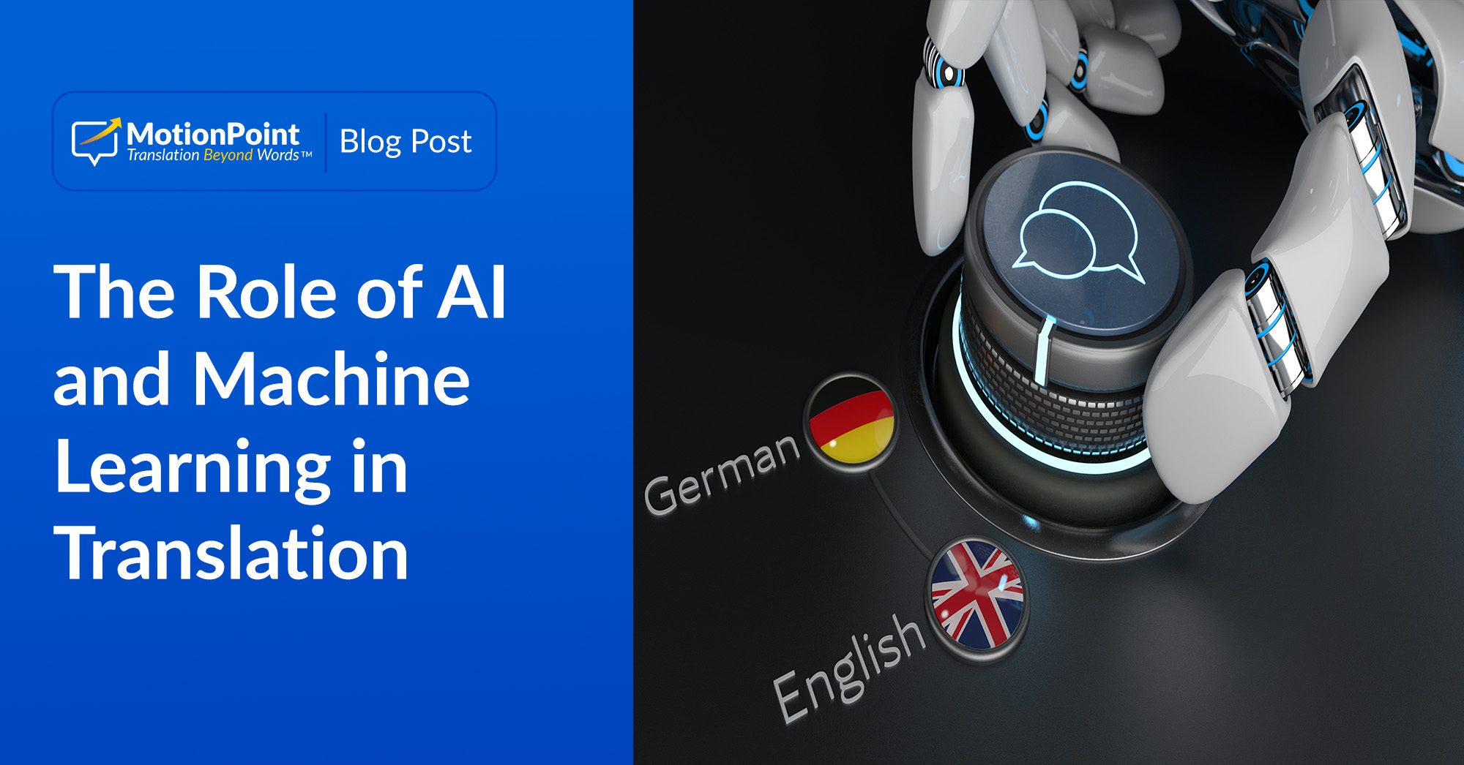
How AI Translation Works
AI translation systems analyze and learn from vast datasets of multilingual text to improve their performance.
They employ techniques like natural language processing (NLP) to understand the nuances of different languages.
The use of deep learning models allows for more fluent and contextually relevant translations than traditional methods.

Slide 4
Key Features of AI Translators
Multi-language support enables users to translate texts in dozens, if not hundreds, of languages.
Real-time translation capabilities allow for instantaneous communication in dynamic environments.
Integration with other applications, such as messaging and document editors, enhances user convenience and accessibility.

Slide 5
Advantages of AI-Powered Translators
They provide cost-effective solutions for businesses and individuals needing translation services.
AI translators offer improved speed and efficiency, significantly reducing translation turnaround times.
Their ability to learn from user interactions leads to continuous improvement in translation quality.

Slide 6
Challenges in AI Translation
Despite advancements, AI translators still struggle with idiomatic expressions and cultural nuances.
Language ambiguity can lead to mistranslations, especially in complex sentences or specialized terminology.
Ensuring data privacy and security remains a critical concern when using online translation services.

Slide 7
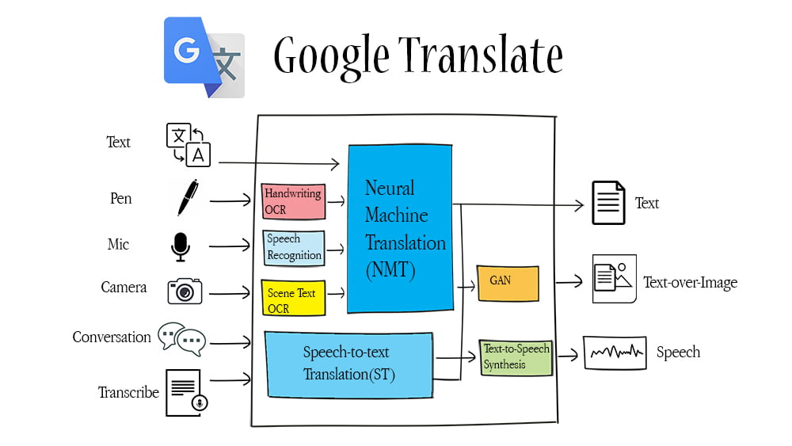
Popular AI Translation Tools
Google Translate is one of the most widely used AI-powered translation tools with extensive language support.

Slide 8
Conclusion
AI-powered multi-language translators are transforming communication in an increasingly interconnected world.
As technology advances, these tools will become more sophisticated, reliable, and user-friendly.
Their impact on global interaction and commerce highlights the essential role of language translation in the digital age.

