Slide 1
IPL Data Analysis & Statistical Validation ApexPlanet Data Analytics Internship
Prepared by: Chelimela Spoorthi
Task 4: Data Storytelling & Statistical validation

Slide 2
Project Overview
Objectives
Analyse IPL data from 2008–2016.
Identify important trends and patterns.
Validate findings using statistical observations.
Present insights through storytelling.
Tools used
Python
Pandas
Matplotlib
SQL
Microsoft Excel

Slide 3
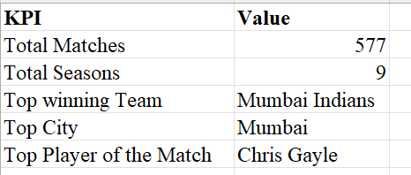
Dataset Overview
Dataset Information
Metric Value
Total 577
Total Seasons 9
Years Covered 2008-2016
Cities Multiple
Teams Multiple

Slide 4
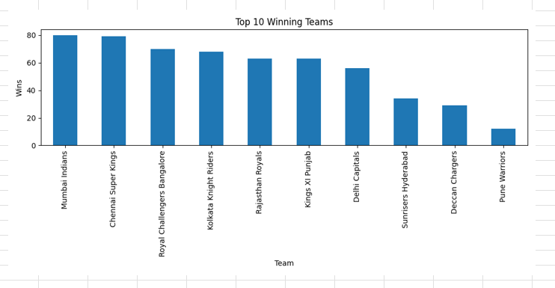
Top Winning Teams
Insights
Mumbai Indians achieved the highest wins.
Chennai Super Kings closely followed.
Consistent teams dominate IPL

Slide 5
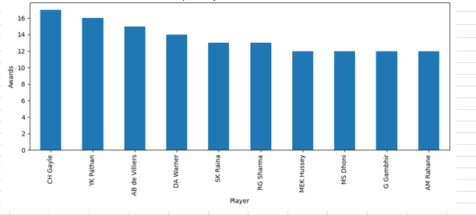
Top Players Analysis
Insights
Chris Gayle won the most awards.
Individual player performance impacts team success.

Slide 6
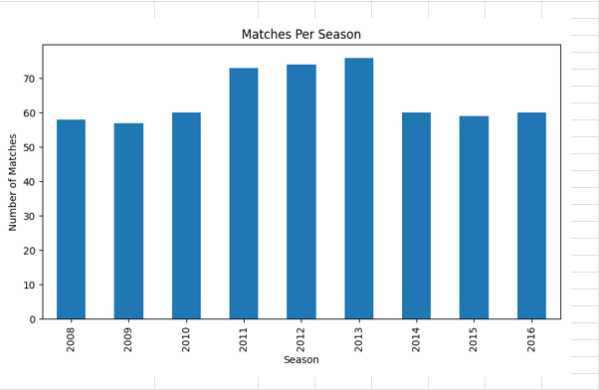
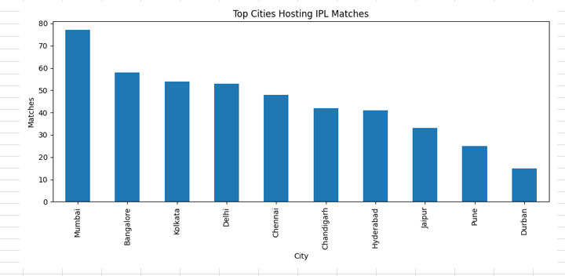
City & Season Analysis
Insights
Mumbai hosted the maximum matches.
IPL expanded significantly between 2011–2013.
Major cities played an important role.

Slide 7
Business Story
The IPL evolved into a highly competitive tournament between 2008 and 2016. Teams such as Mumbai Indians established long-term dominance, while players like Chris Gayle delivered exceptional performances. Major metropolitan cities became the center of IPL activities, contributing significantly to the league's growth.

Slide 8
Statistical Validation
Hypothesis
H₀: No team performs significantly better.
H₁: Some teams perform significantly better.
Observation
Mumbai Indians recorded 80 wins.
Several teams had substantially fewer wins.
Conclusion
The analysis suggests that certain teams consistently outperform others.

Slide 9
Key Findings
Mumbai Indians are the most successful team.
Chris Gayle received the highest Player of the Match awards.
Mumbai hosted the most IPL matches.
IPL experienced major growth from 2011–2013.

Slide 10
Conclusion
Project Outcomes
Performed EDA analysis.
Created dashboards.
Conducted deep-dive analysis.
Developed data storytelling skills.
Derived business insights.

Slide 11
THANK YOU

