Slide 1

AI Student Stress Detector
An Artificial Intelligence-Based Student Stress Detection System
Presented by: C. Spoorthi | AIML - B

Slide 2

Introduction
Growing Concern
Student stress is a growing concern in academic environments.
Multiple Pressures
Academic pressure, exams, assignments, deadlines, and personal issues can affect students' mental well-being.
Early Identification
Early identification of stress can help students take appropriate action.
AI-Powered Solution
Our project uses Artificial Intelligence (AI) to identify the stress level of students through a simple and accessible assessment system.

Slide 3

Problem Statement
Students may experience stress without recognizing its severity.
Traditional methods of identifying stress can be time-consuming.
Students may hesitate to discuss their mental health with others.
There is a need for a quick and user-friendly stress assessment system.
The project aims to use AI to analyze student responses and predict their stress level.

Slide 4
Objectives
Develop the System
Identify Stress Levels
To develop an AI-based student stress detection system.
To identify whether a student is experiencing different levels of stress.
Web-Based Access
Ease of Use
To provide quick results through a web-based application.
To make the system simple and easy to use.
Raise Awareness
Encourage Support
To encourage students to become more aware of their mental well-being.
To provide an initial indication that can encourage appropriate support when needed.

Slide 5

Proposed System
How the system works:
Answer Questions
Open App
Process Input
AI Analysis
Predict Stress
Platform: Streamlit Web Application

Slide 6




Technologies Used
System Flow
Python
Machine Learning / AI
Programming language
Stress prediction
Student Input
Streamlit
Pandas
Data Processing
Web application interface
Data processing
NumPy
Scikit-learn
AI/ML Model
Numerical operations
Machine learning and model development
Stress Prediction
Result displayed to the student via the web application.

Slide 7
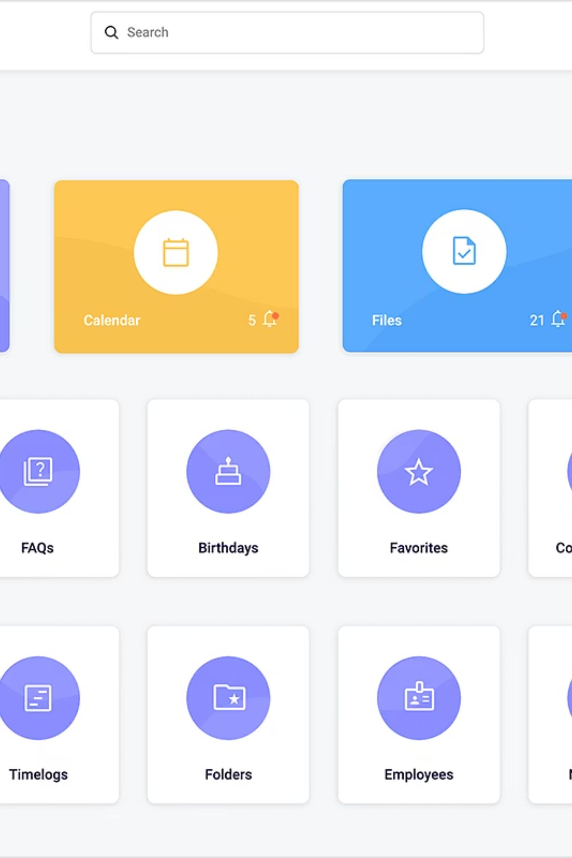



Features of the Application
Simple & User-Friendly Interface
Web-based application accessible through any web browser.
AI/ML-Based Prediction
Student stress assessment powered by machine learning for fast result generation.
Easy-to-Understand Output
Clear results that help create awareness about student stress levels.

Slide 8
Advantages & Future Scope
Advantages
Future Scope
Quick and convenient assessment
Reduces the time required for initial screening
Easy to access through a web browser
Helps students become aware of their stress levels
Supports early identification of potential stress
Improve prediction accuracy with larger datasets.
Add personalized recommendations.
Integrate additional student well-being factors.
Develop a mobile application.
Add dashboards for authorized counselors or institutions.
Continuously improve the model using validated data.

Slide 9
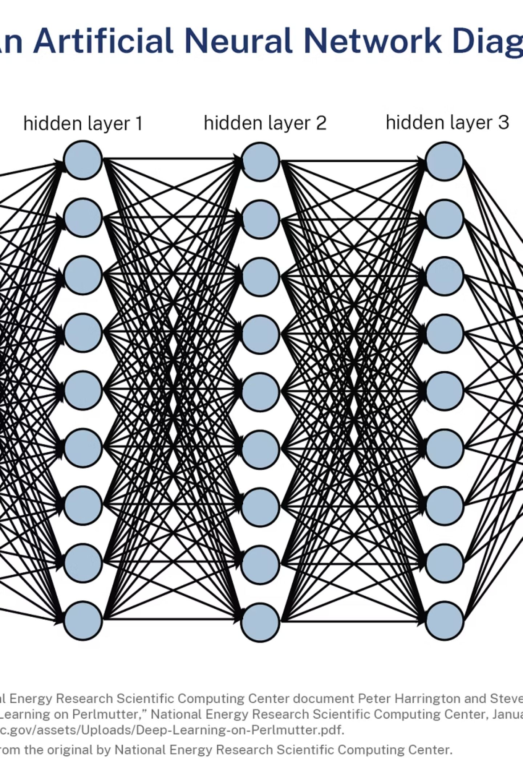
Conclusion
The AI Student Stress Detector demonstrates how Artificial Intelligence can be applied to student well-being.
The system provides a simple way to assess and identify potential stress levels.
It can help promote awareness and encourage students to seek appropriate support.
AI-based tools can complement, but should not replace, professional mental-health assessment.
With further development, the system can become more accurate, personalized, and useful for educational institutions.
AI can help identify the problem early — awareness is the first step toward support.

Slide 10
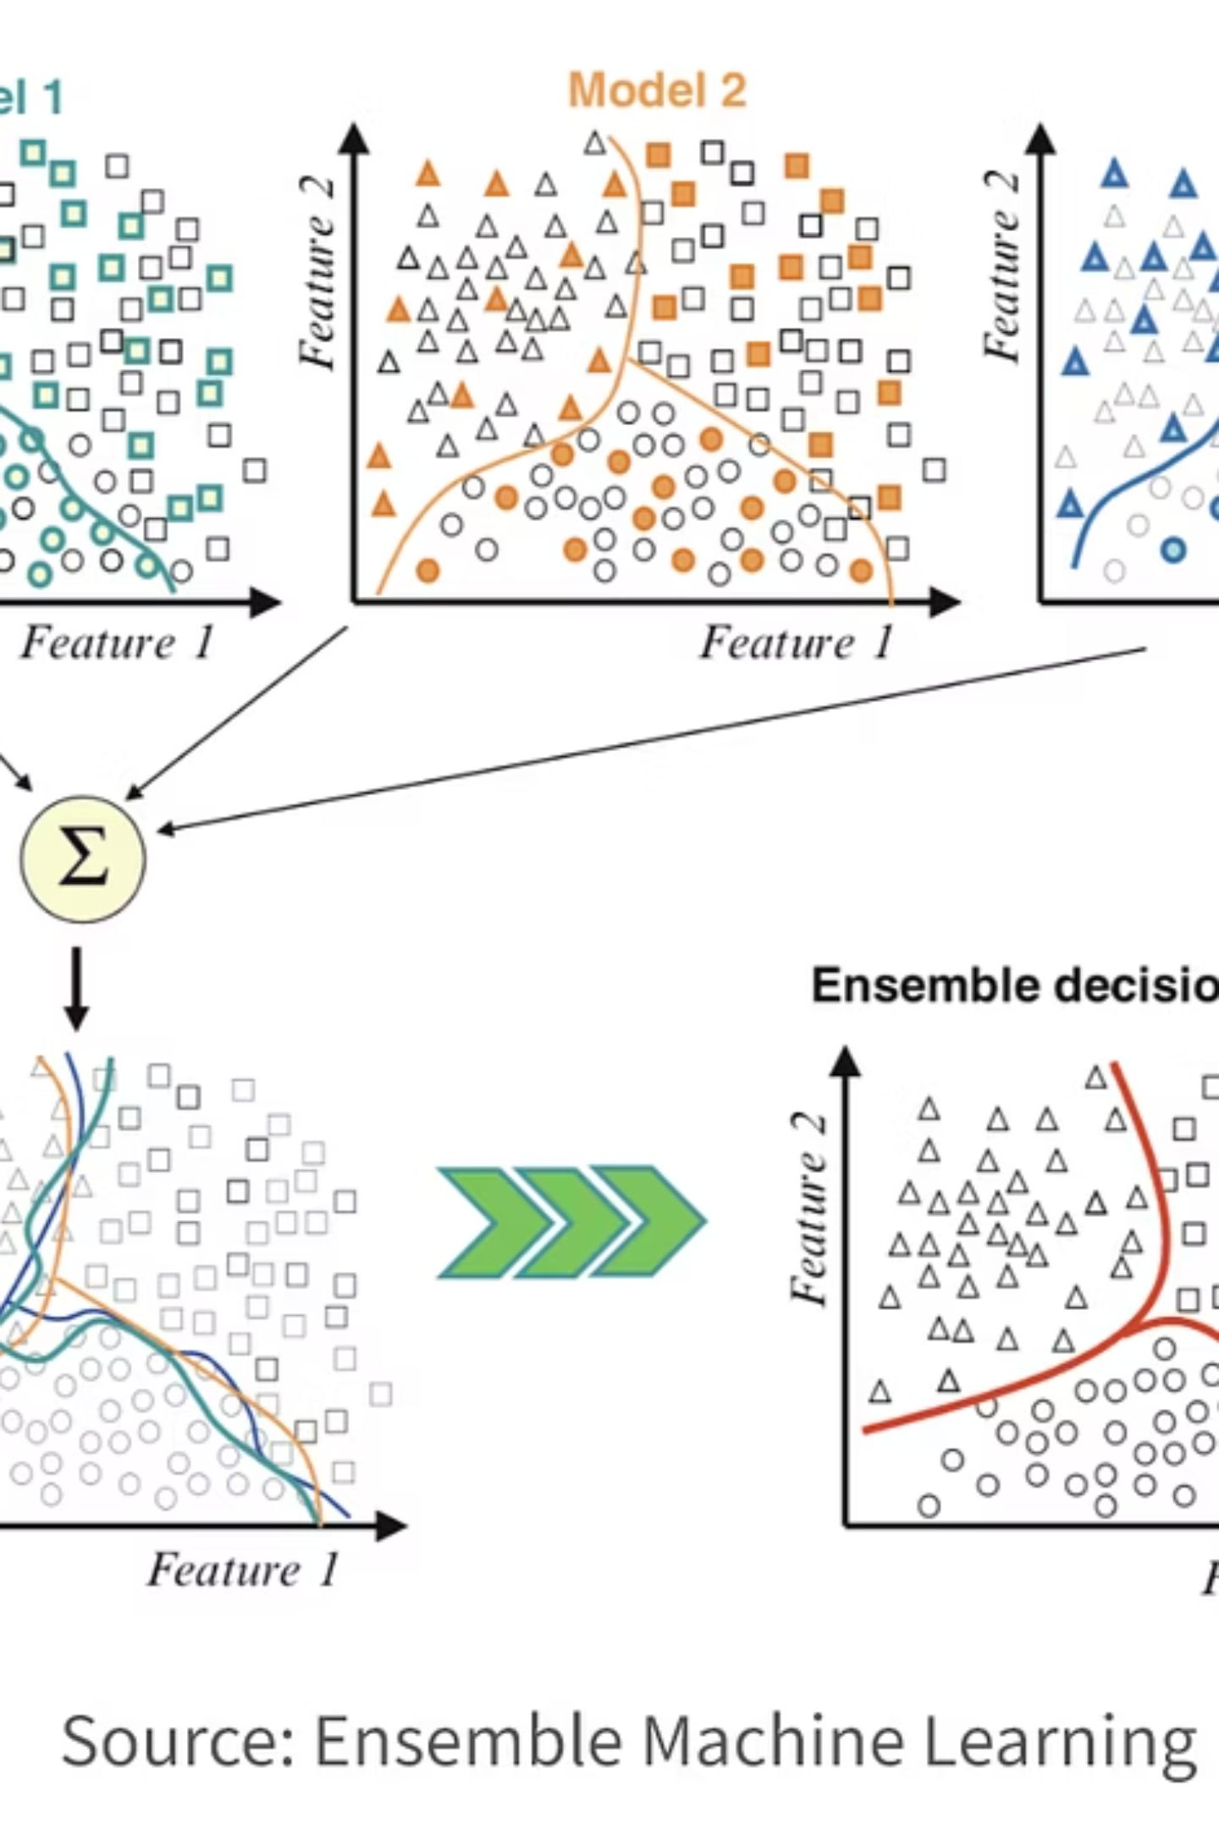
Thank You
Questions & Answers
AI Student Stress Detector
Presented by: C. Spoorthi | AIML - B

